Slide 1
“Weather and Climate” module Textbook Powerpoints
Selected slides from Chapter 6, 7, and 16

Slide 2
Weather vs. Climate
Weather – conditions of atmosphere at particular time and place
Climate – long-term average of weather
Ocean influences Earth’s weather and climate patterns.

Slide 3
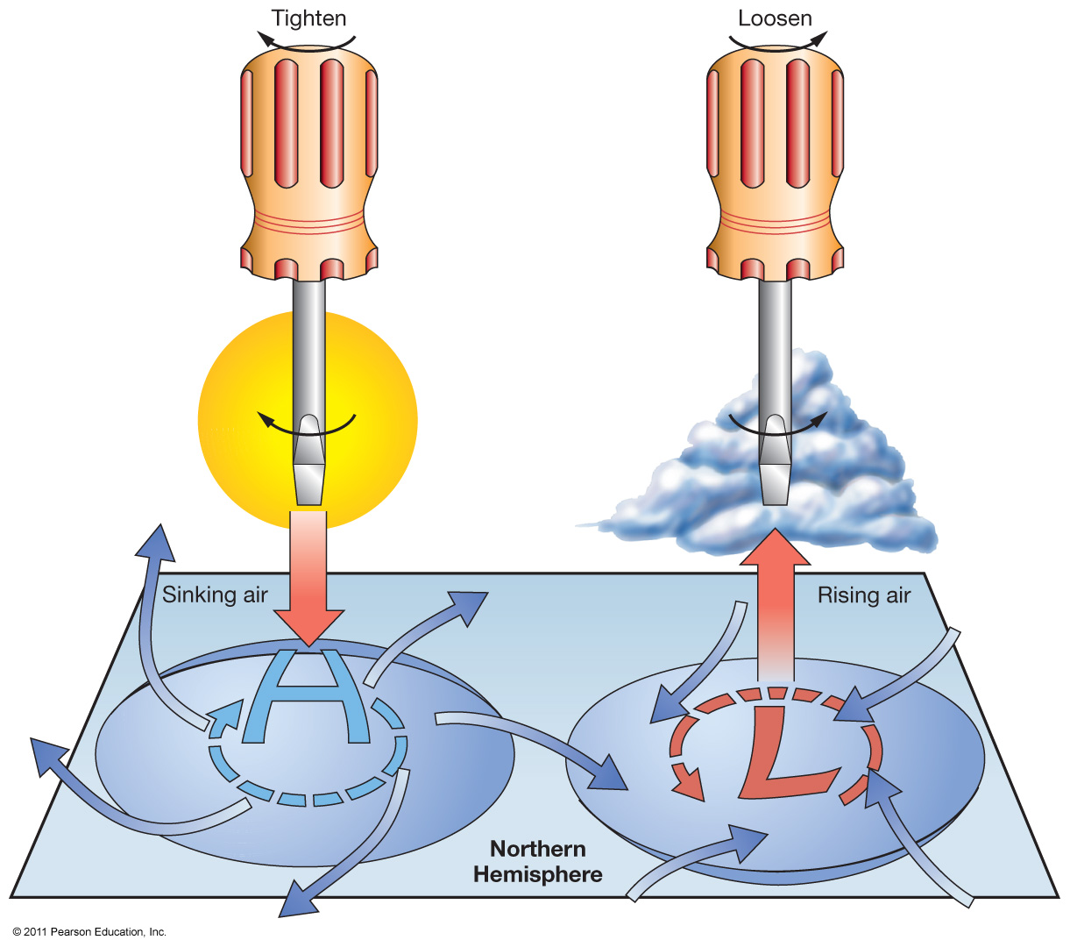
Winds
Cyclonic flow
  Counterclockwise around a low in Northern Hemisphere
  Clockwise around a low in Southern Hemisphere
Anticyclonic flow
  Clockwise around a low in Northern Hemisphere
  Counterclockwise around a low in Southern Hemisphere

Slide 4
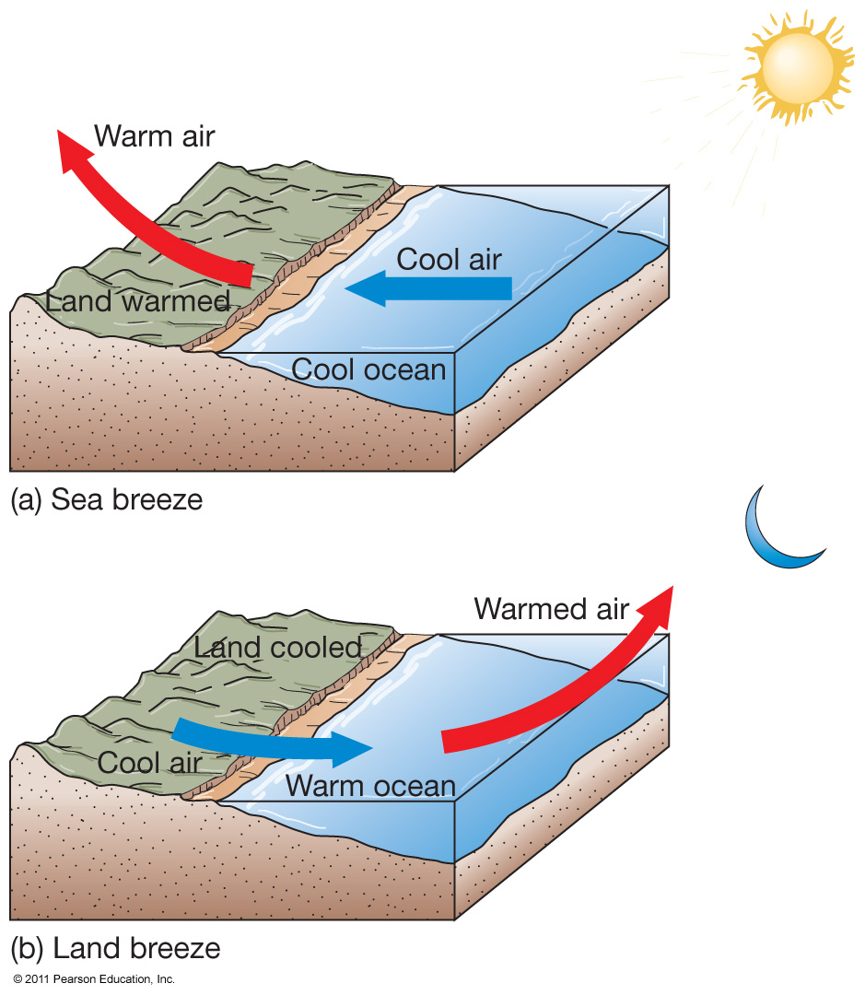
Sea and Land Breezes
Differential solar heating is due to different heat capacities of land
and water.
Sea breeze
  From ocean to land
Land breeze
  From land to ocean

Slide 5
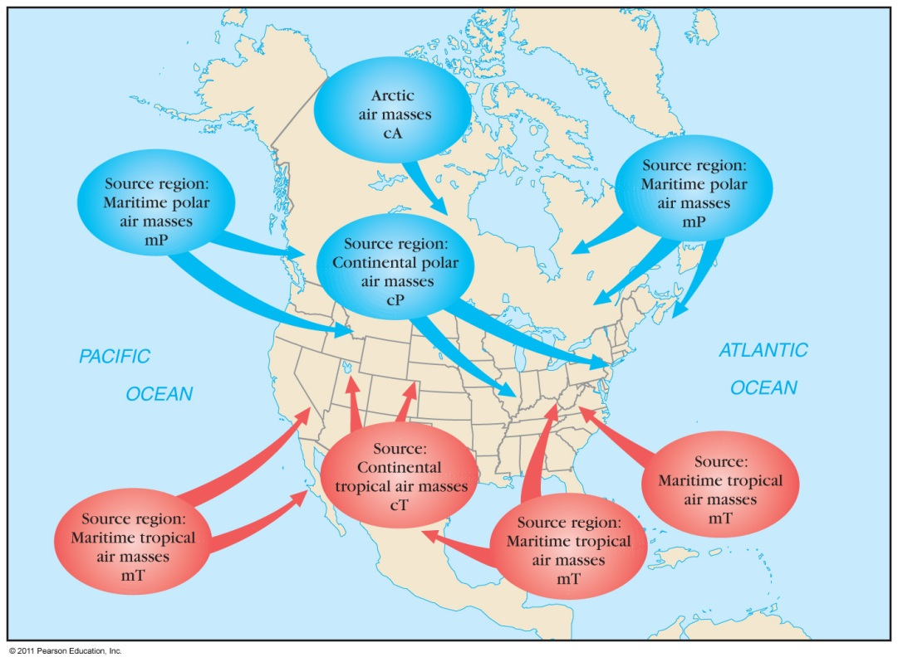
Storms and Air Masses
Storms – disturbances with strong winds and precipitation
Air masses – large volumes of air with distinct properties

Slide 6
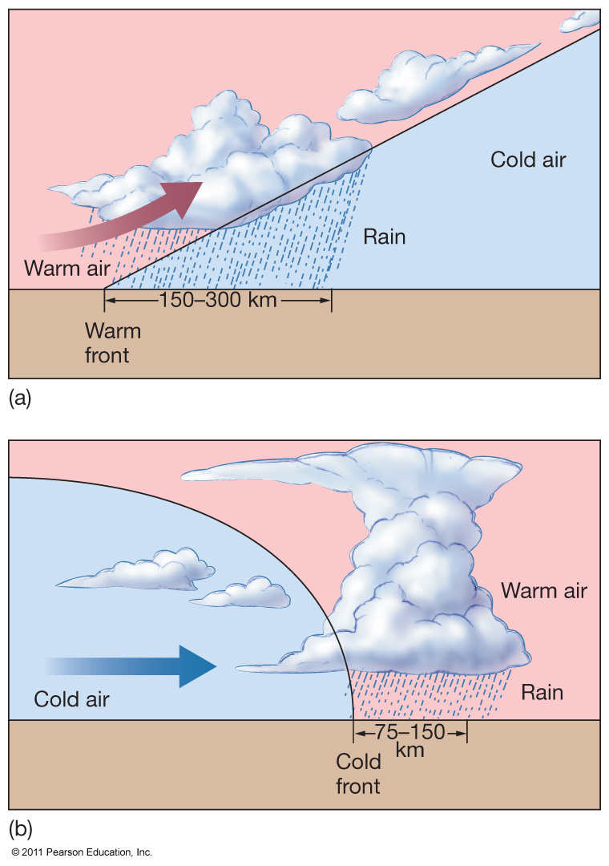
Fronts
Fronts – boundaries between air masses
  Warm front
  Cold front
Storms typically develop at fronts.
Jet Stream – may cause unusual weather by steering air masses.

Slide 7
Tropical Cyclones (Hurricanes)
Large rotating masses of low pressure
Strong winds, torrential rain
Classified by maximum sustained wind speed
Typhoons
Cyclones

Slide 8
Hurricane Origins
Low pressure cell
Winds feed water vapor – latent heat of condensation
Air rises, low pressure deepens
Storm develops
  Winds less than 61 km/hour (38 miles/hour) – tropical depression
  Winds 61–120 km/hour (38–74 miles/hour) – tropical storm
  Winds above 120 km/hour (74 miles/hour) – tropical cyclone or hurricane

Slide 9
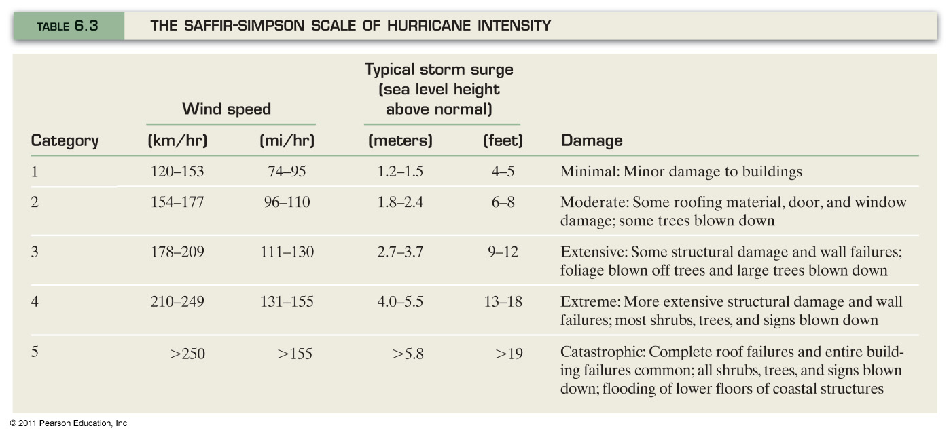
Hurricane Intensity

Slide 10
Hurricanes
About 100 worldwide per year
Require
  Ocean water warmer than° 25°C (77°F)
  Warm, moist air
  The Coriolis Effect
Hurricane season is June 1 – November 30

Slide 11
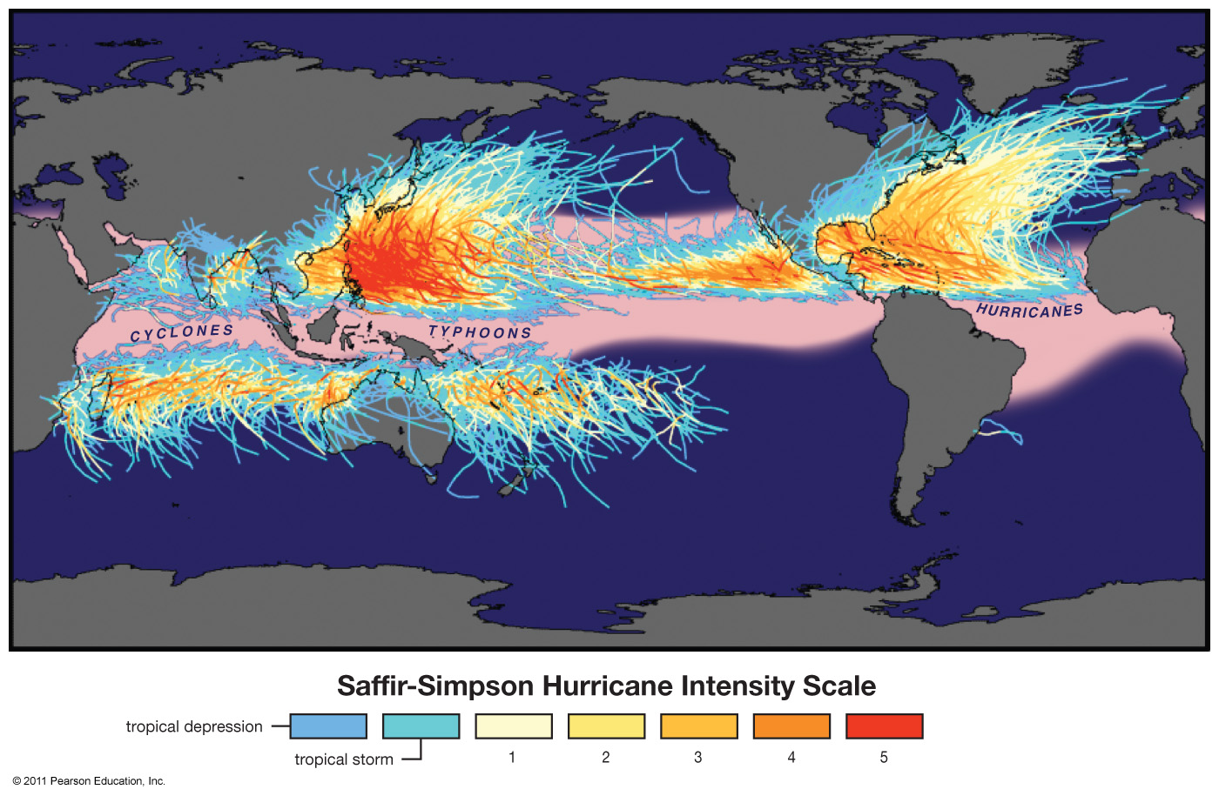
Historical Storm Tracks

Slide 12
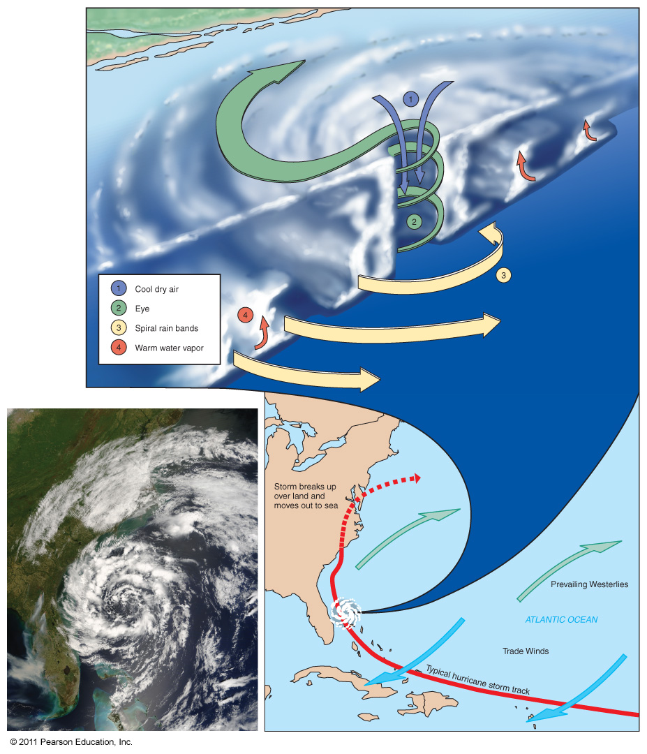
Hurricane Anatomy and Movement

Slide 13
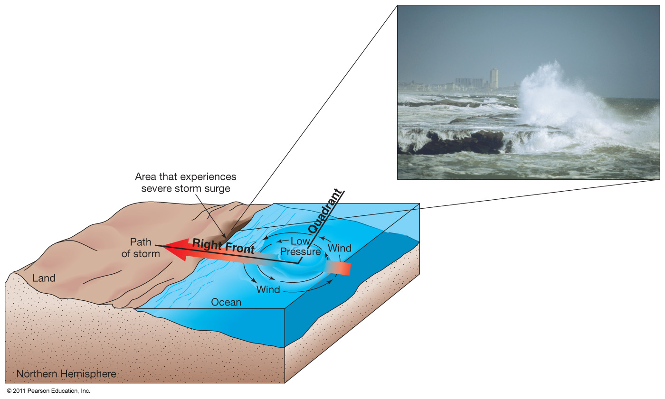
Hurricane Destruction
High winds
Intense rainfall
Storm surge – increase in shoreline sea level

Slide 14
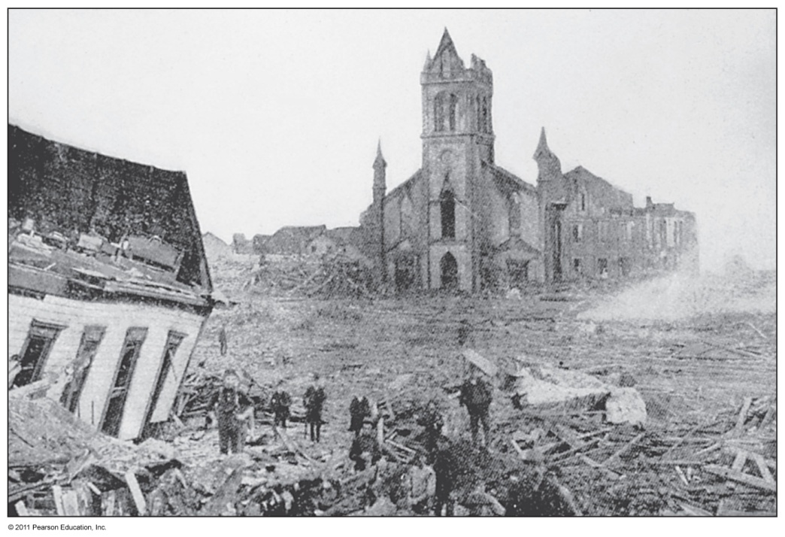
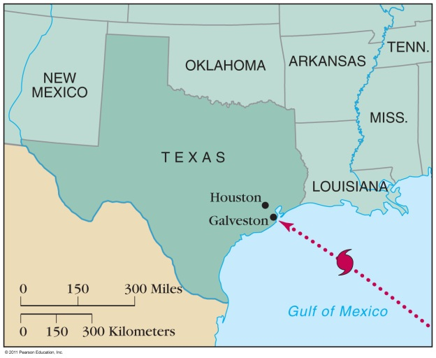
Storm Destruction
Historically destructive storms
  Galveston, TX, 1900
  Andrew, 1992
  Mitch, 1998
  Katrina, 2005
  Ike, 2008

Slide 15
Ocean’s Climate Patterns
Open ocean’s climate regions are parallel to latitude lines.
These regions may be modified by surface ocean currents.

Slide 16
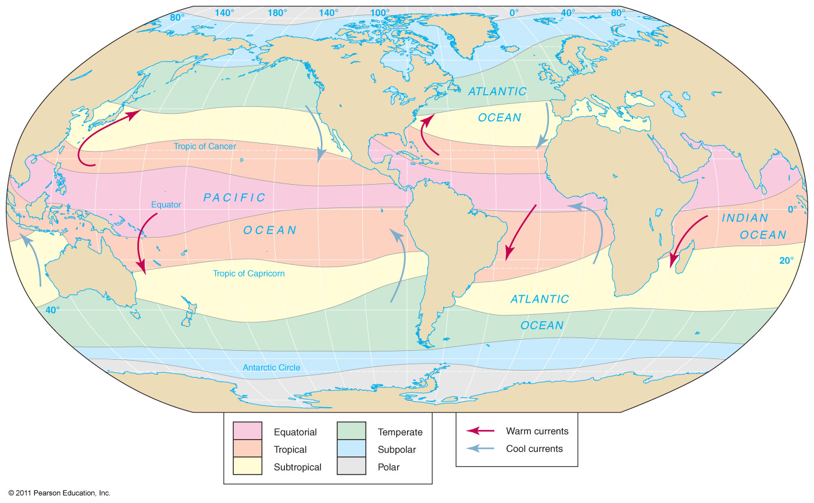
Ocean’s Climate Patterns

Slide 17
Ocean’s Climate Zones
Equatorial
  Rising air
  Weak winds
  Doldrums
Tropical
  North and south of equatorial zone
  Extend to Tropics of Cancer and Capricorn
  Strong winds, little precipitation, rough seas
Subtropical
  High pressure, descending air
  Weak winds, sluggish currents

Slide 18
Ocean’s Climate Zones
Temperate
  Strong westerly winds
  Severe storms common
Subpolar
  Extensive precipitation
  Summer sea ice
Polar
  High pressure
  Sea ice most of the year

Slide 19
Atmospheric-Ocean Connections in the Pacific Ocean
Walker Circulation Cell – normal conditions
  Air pressure across equatorial Pacific is higher in eastern Pacific
  Strong southeast trade winds
  Pacific warm pool on western side of ocean
  Thermocline deeper on western side
  Upwelling off the coast of Peru

Slide 20
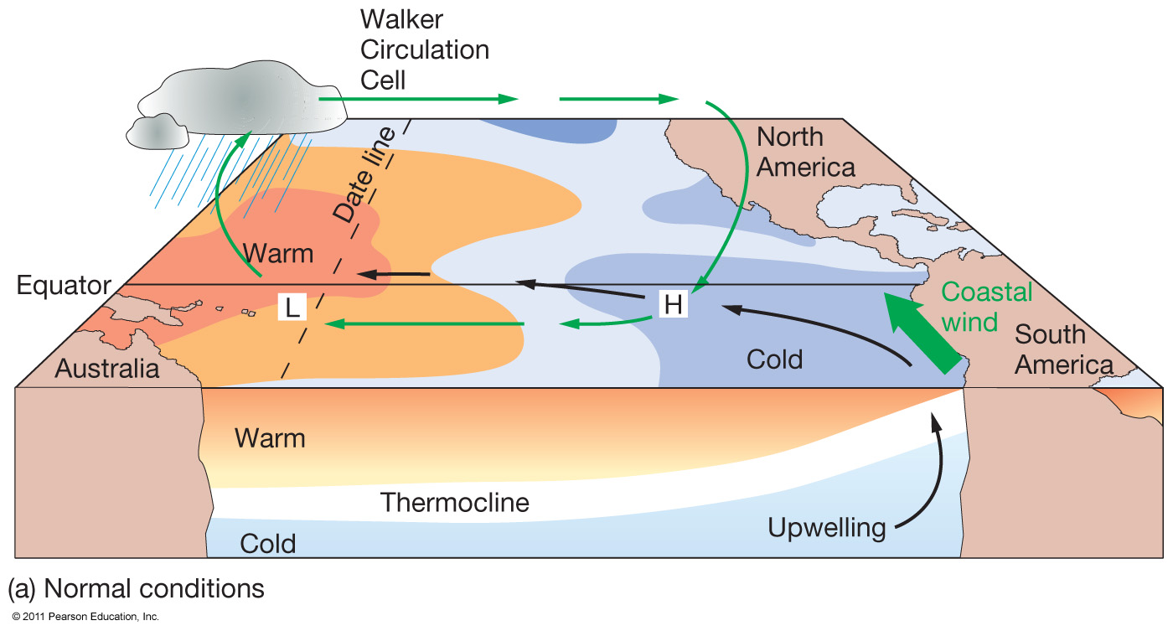
Normal Conditions, Walker Circulation

Slide 21
El Niño – Southern Oscillation (ENSO)
Walker Cell Circulation disrupted
High pressure in eastern Pacific weakens
Weaker trade winds
Warm pool migrates eastward
Thermocline deeper in eastern Pacific
Downwelling
Lower biological productivity
  Peruvian fishing suffers

Slide 22
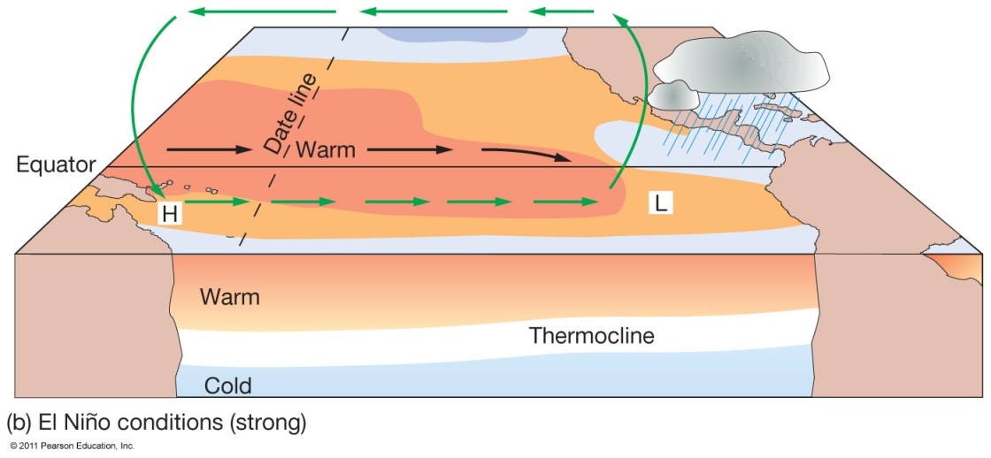
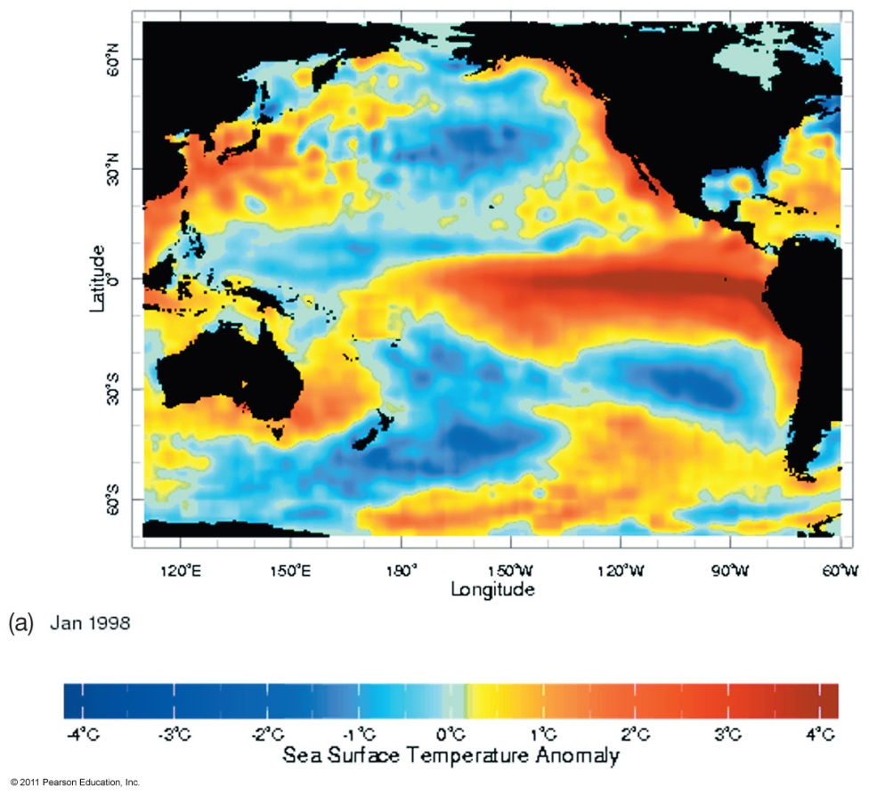
ENSO Conditions in the Pacific Ocean

Slide 23
La Niña – ENSO Cool Phase
Increased pressure difference across equatorial Pacific
Stronger trade winds
Stronger upwelling in eastern Pacific
Shallower thermocline
Cooler than normal seawater
Higher biological productivity

Slide 24
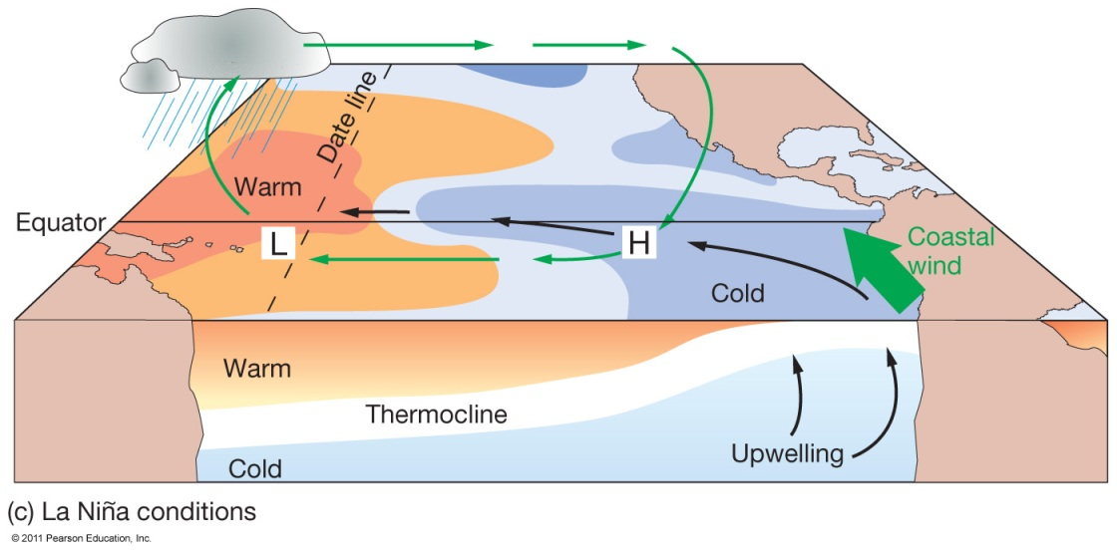
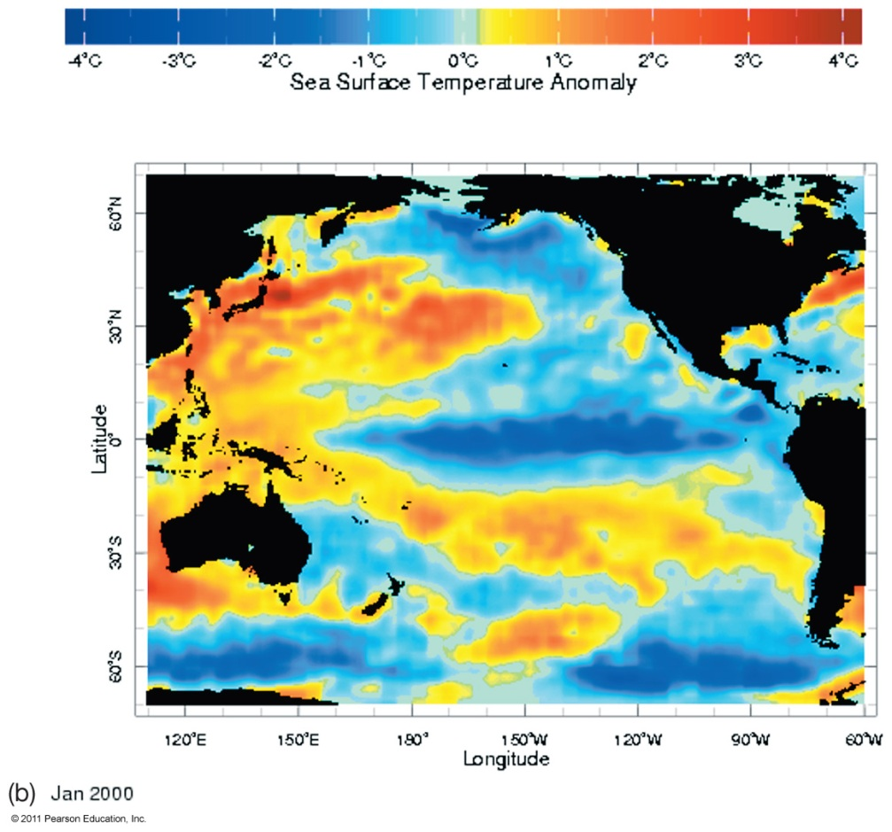
La Niña Conditions

Slide 25
Occurrence of ENSO Events
El Niño warm phase about every
2–10 years
Highly irregular
Phases usually last 12–18 months
10,000-year sediment record of events
ENSO may be part of Pacific Decadal Oscillation (PDO)
  Long-term natural climate cycle
  Lasts 20–30 years

Slide 26
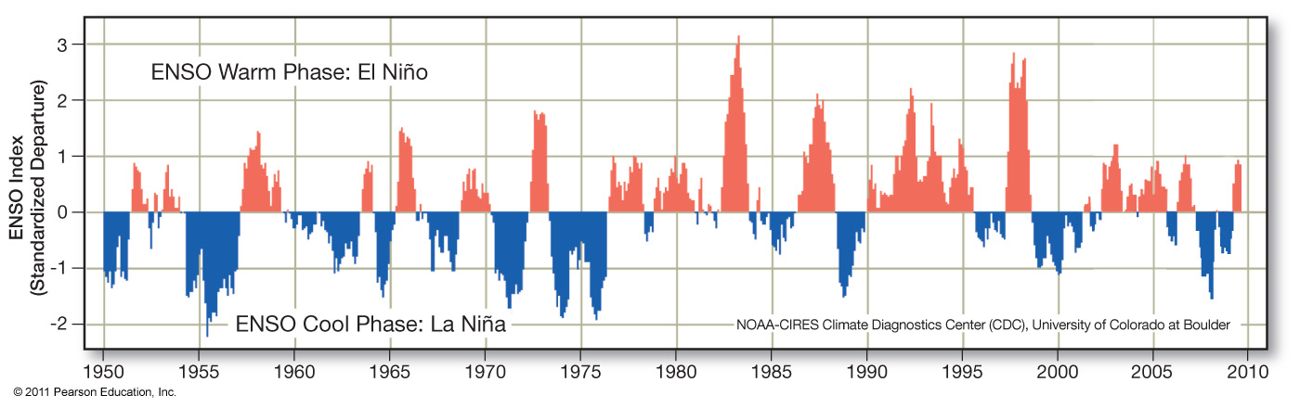
ENSO Occurrences

Slide 27
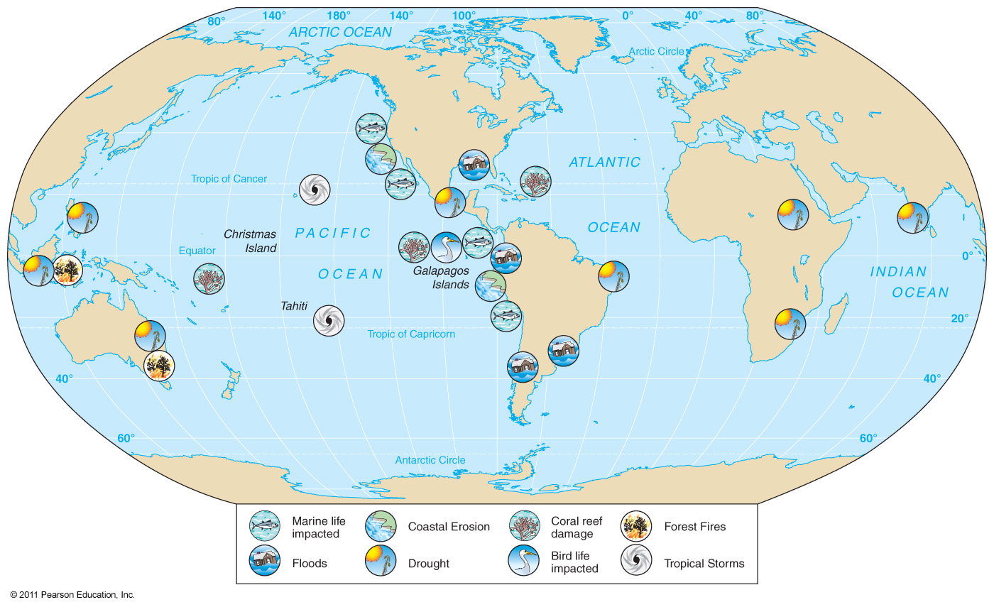
ENSO has Global Impacts

Slide 28
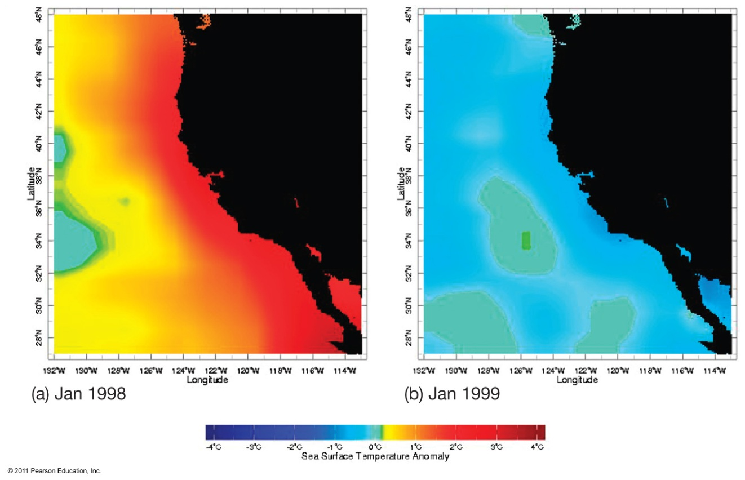
Notable ENSO Events
1982 – 1983
1997 – 1998
Flooding,
drought,
erosion, fires,
tropical storms, harmful effects
on marine life
Unpredictable

Slide 29
Predicting El Niño Events
Tropical Ocean−Global Atmosphere (TOGA) program
  1985
  Monitors equatorial South Pacific
  System of buoys
Tropical Atmosphere and Ocean (TOA) project
  Continues monitoring
ENSO still not fully understood

Slide 30
Earth’s Climate System
Climate – long term atmospheric conditions in a region
Earth’s climate includes interactions of:
  Atmosphere
  Hydrosphere
  Geosphere
  Biosphere
  Cryosphere
Climate system – exchanges of energy and moisture between these spheres

Slide 31
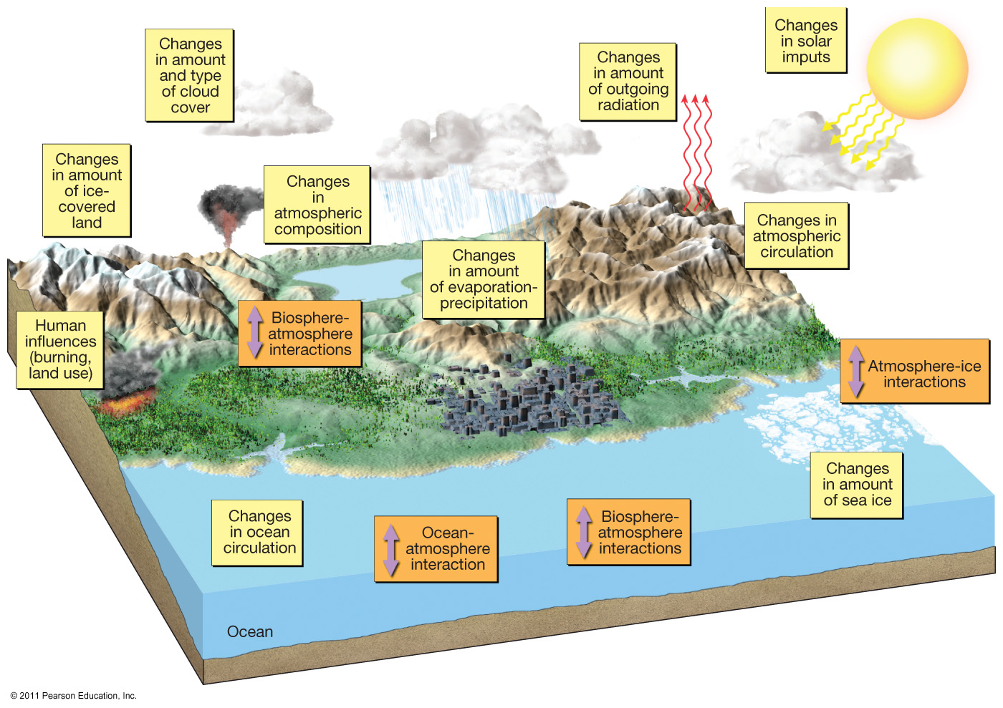
Earth’s Climate System

Slide 32
Earth’s Climate System
Feedback loops – modify atmospheric processes
  Positive feedback loops – enhance initial change
  Negative feedback loops – counteract initial change

Slide 33
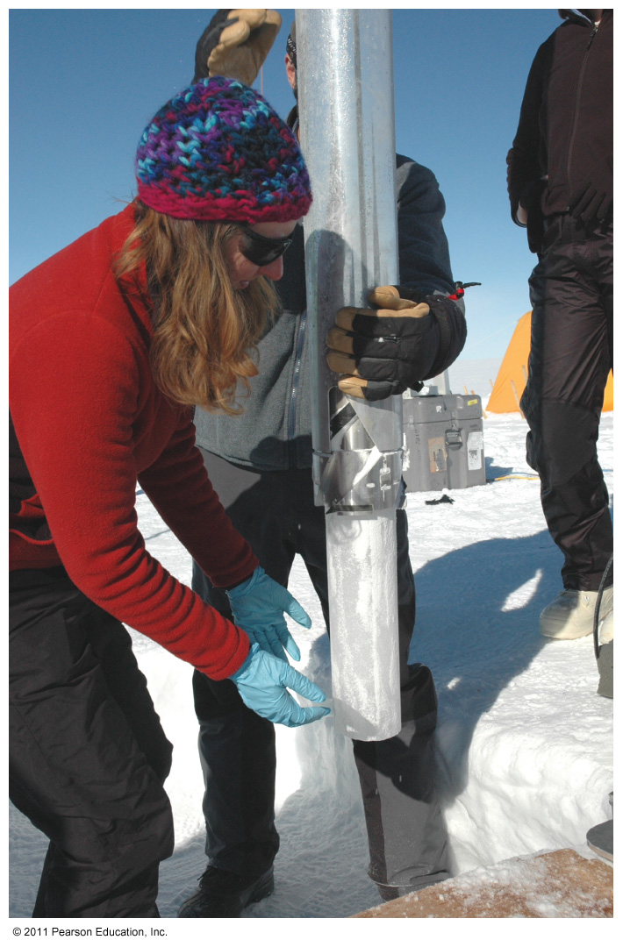
Determining Causes of Earth’s Climate Change
Paleoclimatology
Proxy data – indirect evidence using natural recorders of climate variability
  Sea floor sediments
  Coral deposits
  Glacial ice rings
  Tree rings
  Pollen
  Historical documents

Slide 34
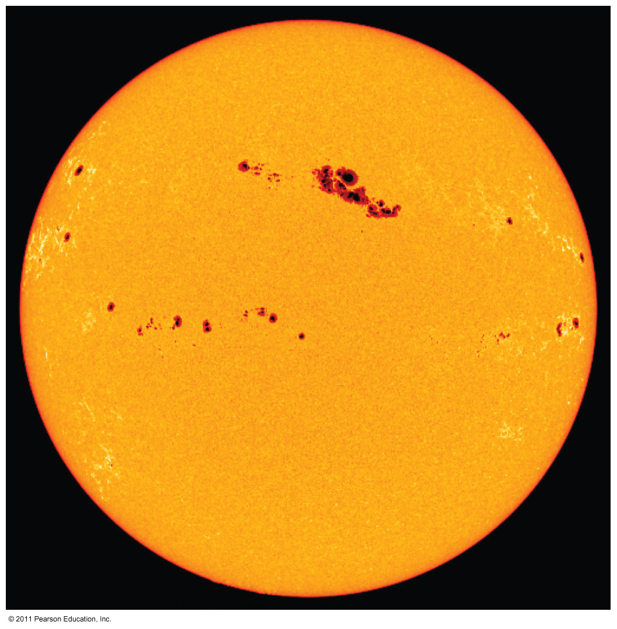
Natural Causes of Climate Change
Solar energy changes
  Variable energy from the Sun over time
  Luminosity
  Sunspots
Little evidence to link solar activity with climate change

Slide 35
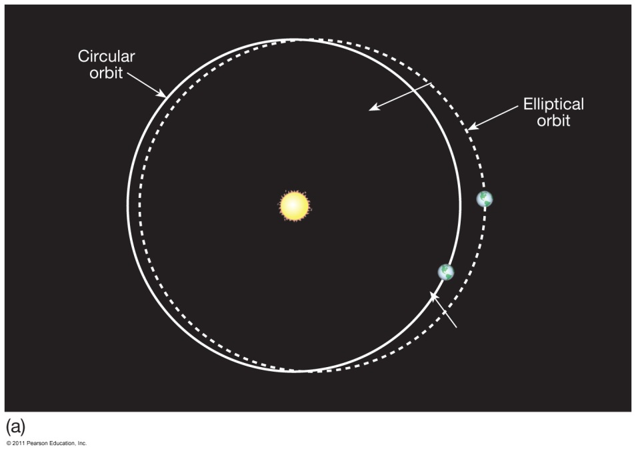
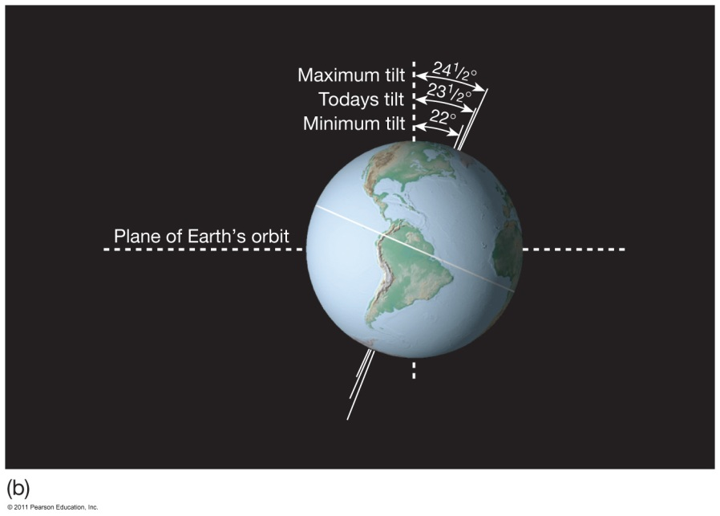
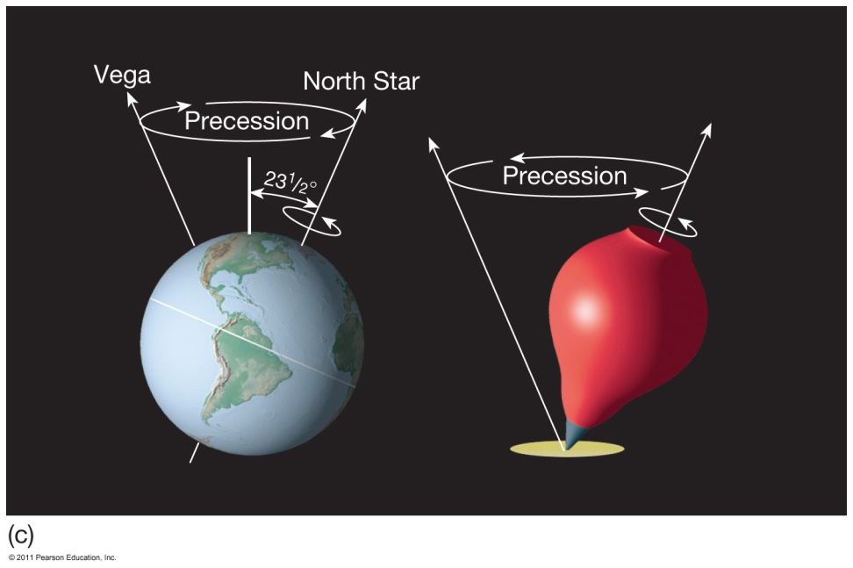
Natural Causes of Climate Change
Variations in Earth’s Orbit
Milankovitch Theories
  Eccentricity of Earth’s orbit
  Obliquity of Earth’s axis
  Precession of Earth’s axis

Slide 36
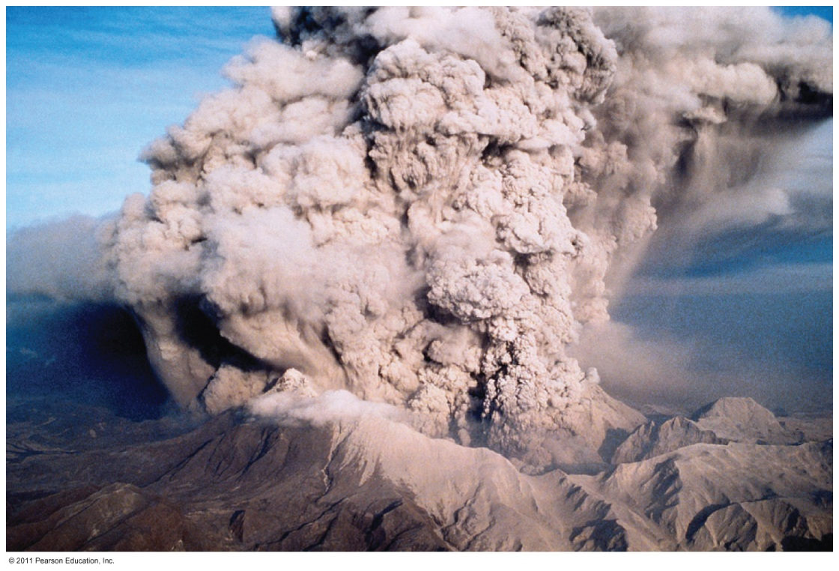
Natural Causes of Climate Change
Volcanic eruptions
Volcanic ejecta may block sunlight
Need many eruptions in short time period
Not observed in recent history

Slide 37
Natural Causes of Climate Change
Movement of Earth’s Plates
  Change ocean circulation
  Extremely slow process
  Climate change would be very gradual over millions of years

Slide 38
Natural Causes of Climate Change
Linked to Pleistocene Ice Age, Little Ice Age, Medieval Warm Period
Recent change unprecedented
  More likely result of human activity than natural causes

Slide 39
Documenting Human-Caused Climate Change
Intergovernmental Panel on Climate Change (IPCC)
  Global group of scientists
  Published assessments since 1990
  Predict global temperature changes of
  1.4–5.8°C (2.5–10.4°F)
Climate change models can mimic modern conditions only if human emissions are taken into account.

Slide 40
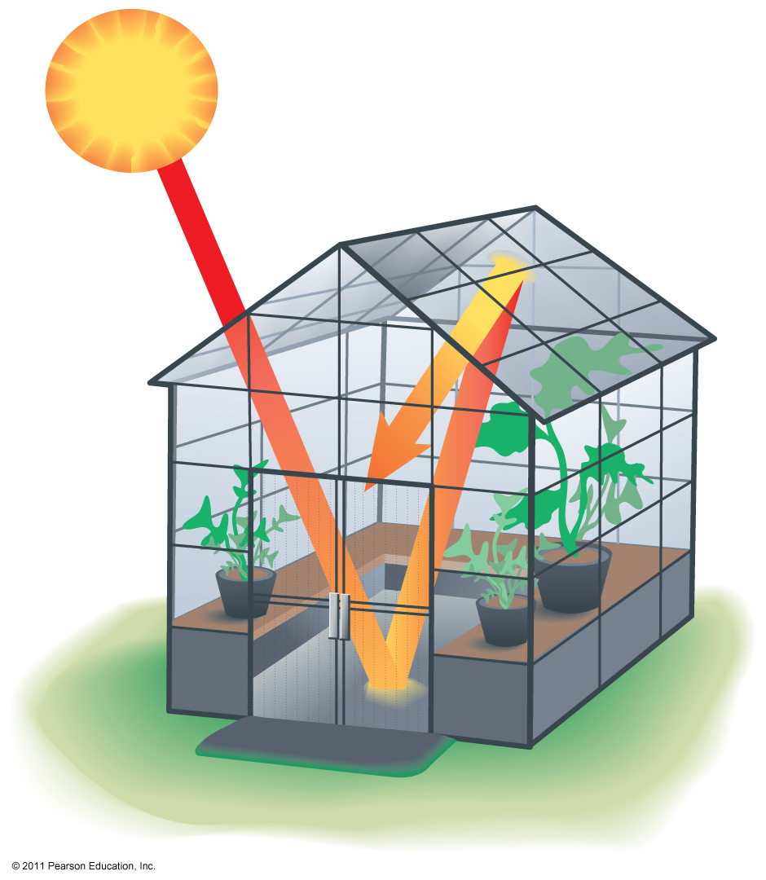
Atmosphere’s Greenhouse Effect
Global warming – increase in Earth’s global temperatures
Greenhouse effect – keeps Earth’s surface habitable
  Incoming heat energy is shorter wavelengths
  Longer wavelengths – some trapped, some escape, net warming effect

Slide 41
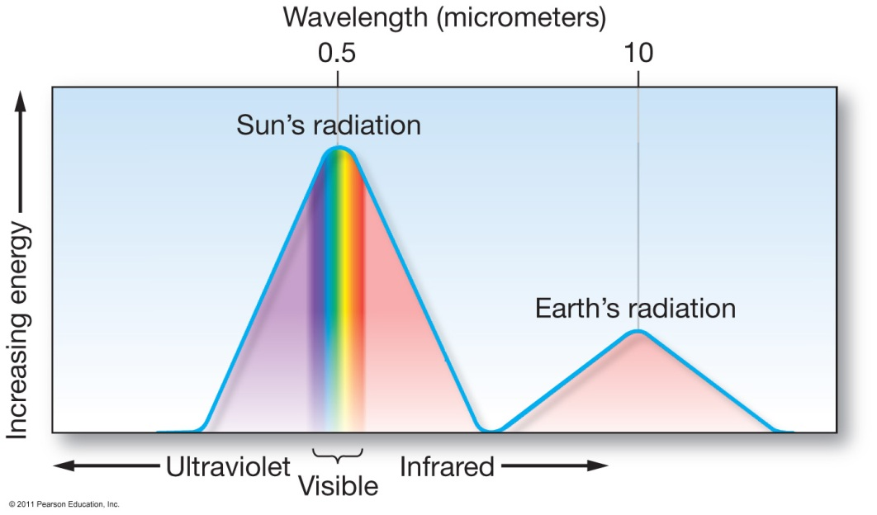
Earth’s Heat Budget
Addition to or subtraction from heat on Earth
Incoming radiation from Sun shorter wavelengths
Outgoing radiation from Earth longer wavelengths
Rates of energy absorption and reradiation must be equal

Slide 42
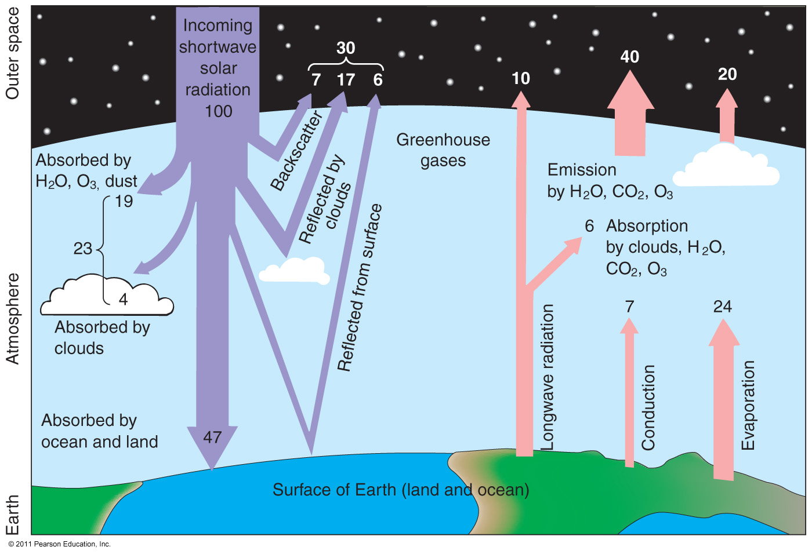
Earth’s Heat Budget

Slide 43
Greenhouse Gases
Water vapor
  Most important
  66–85% of greenhouse effect
Carbon dioxide
  Natural part of atmosphere
  Greatest relative contribution from human activities
  Burning of fossil fuels

Slide 44
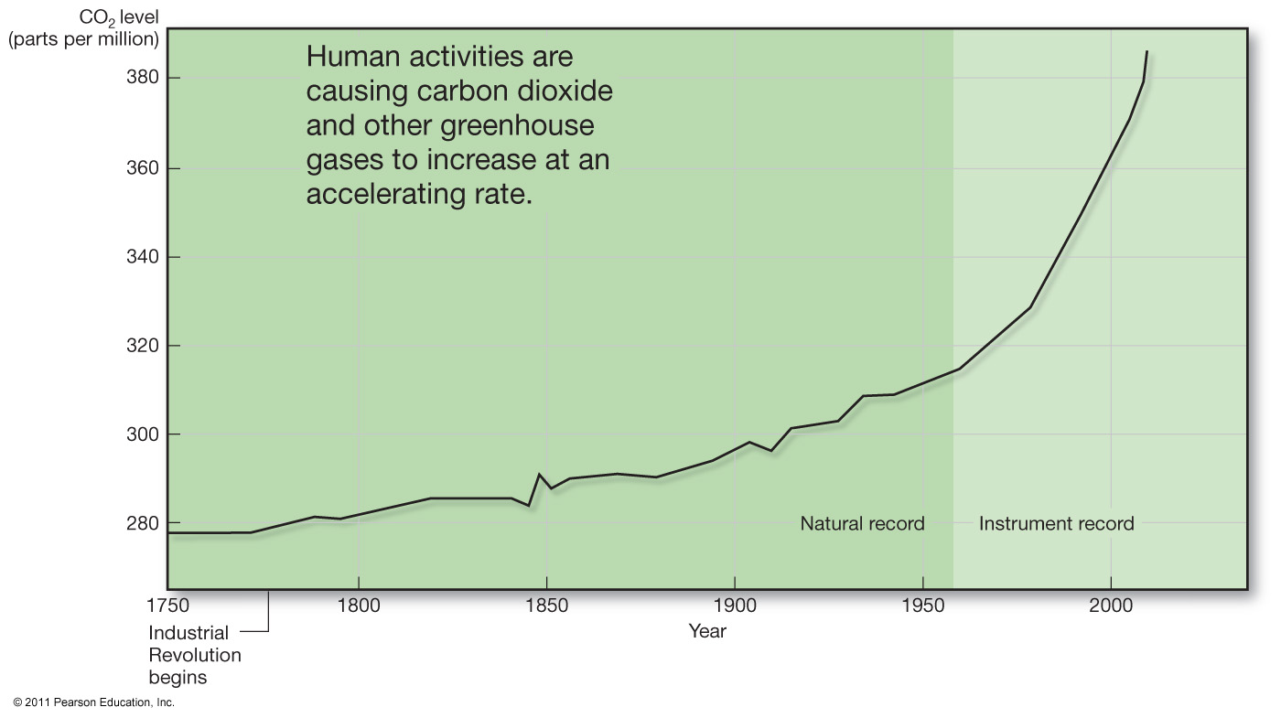
Atmospheric Carbon Dioxide

Slide 45
Greenhouse Gases
Methane
  Second most abundant human-caused greenhouse gas
  Great warming power per molecule
  Landfill decomposition
  Cattle
Other trace gases
  Nitrous oxide, CFCs, ozone

Slide 46
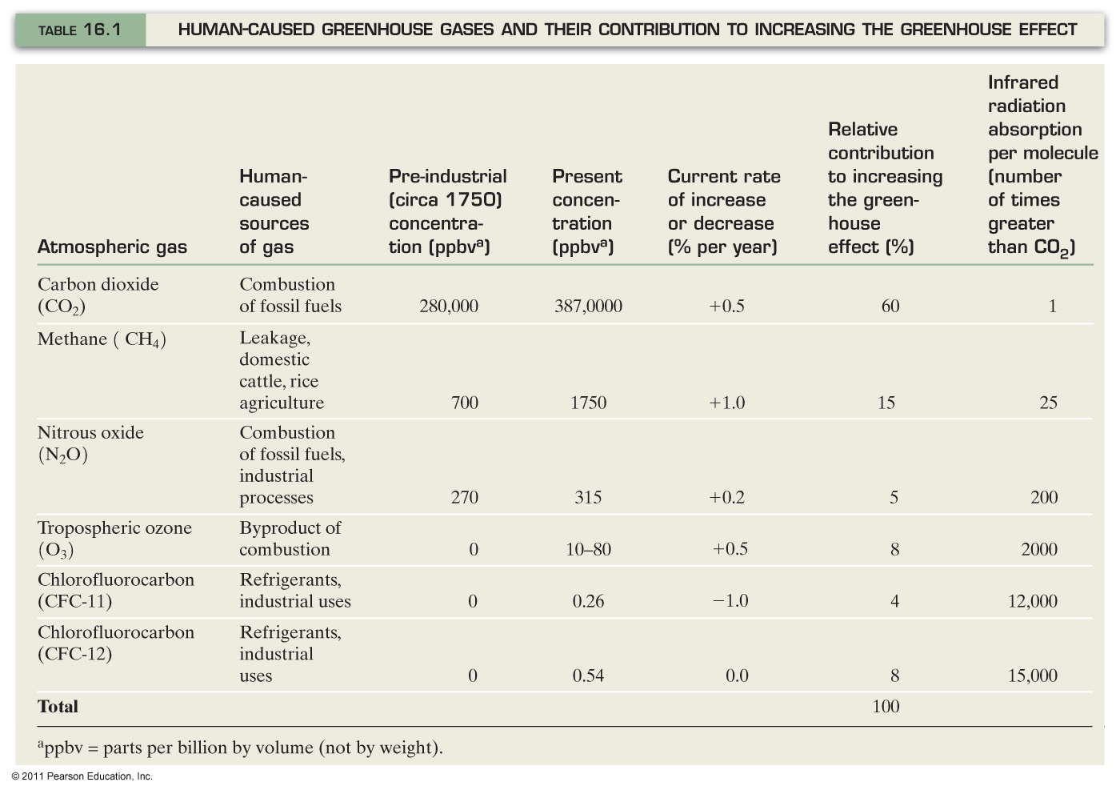
Human-Caused Greenhouse Gases

