Slide 1
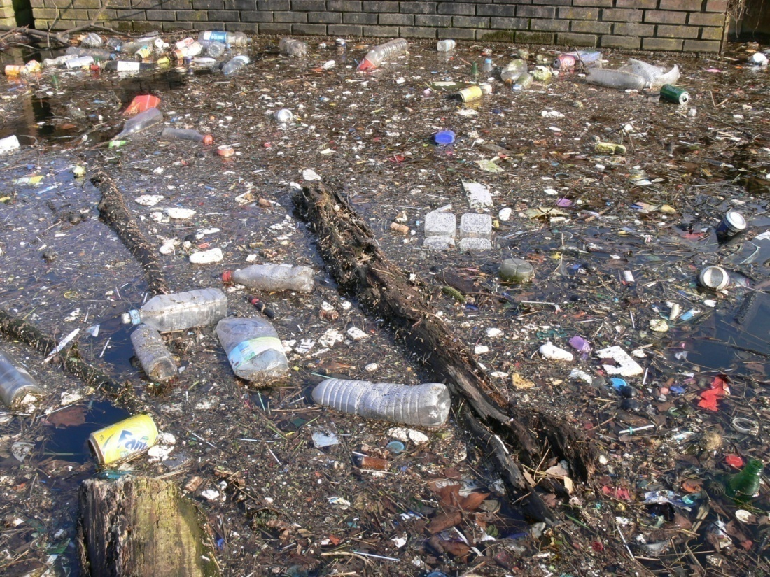
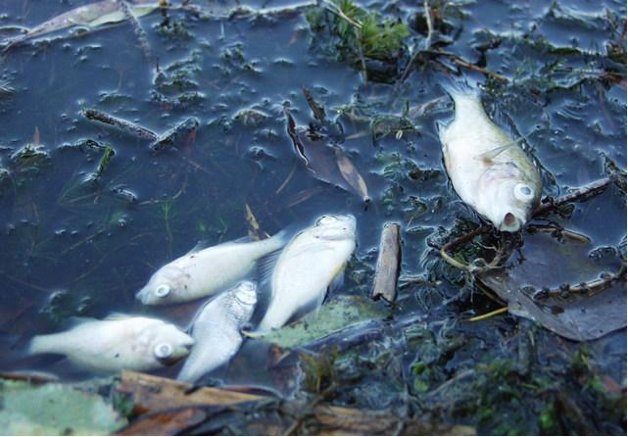
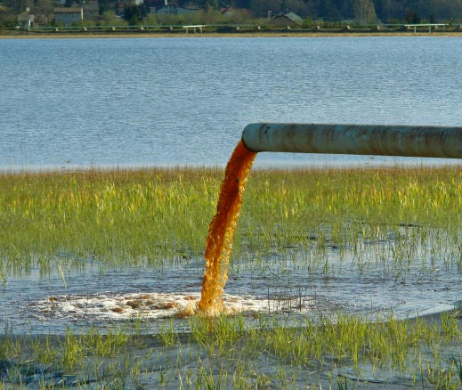
Water Pollution

Slide 2
How does a flood relate to an aquifer?
A flood occurs when an aquifer is completely saturated and water cannot move downward
POTABLE: drinkable water

Slide 3
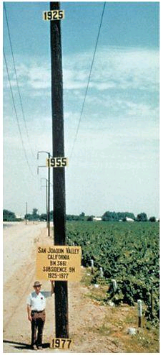
Subsidence is when the aquifer is over pumped and the ground slowly compacts

Slide 4
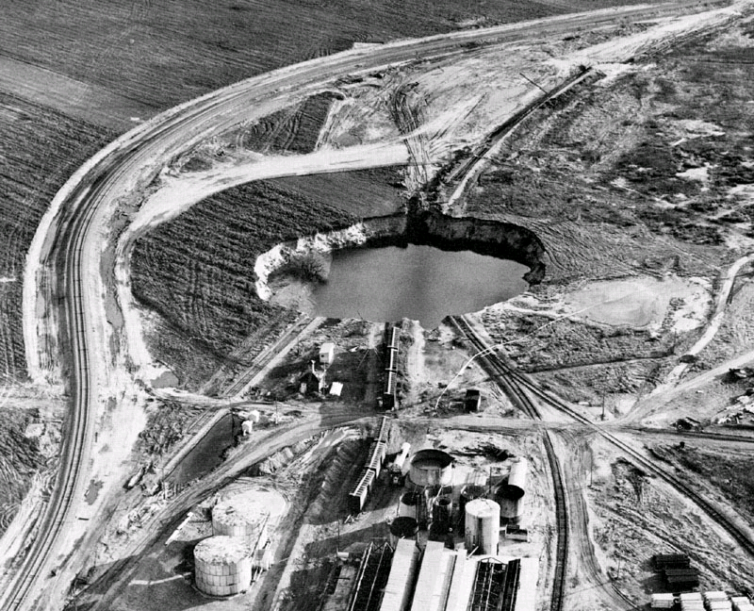
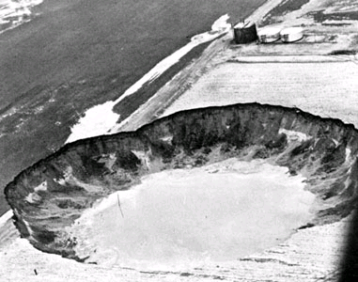
Sinkholes don’t just come from over pumping groundwater…
This sinkhole is 300 ft in diameter, and 18 feet deep.
Formed from salt mining.
Note the person in the lower
left corner for size reference.
Formed from oil drilling.

Slide 5
SALT WATER INTRUSION
What’s going on here?
Ever noticed this at the beach?
So… what is this caused by again?
Aquifer depletion!
Sinkholes!

Slide 6
WATER POLLUTION
Two main types of freshwater pollution
1. Point Source: Pollution that comes from a known and specific location
EX) Factory pipes, tail pipe, leaking land fill, leaking storage tank
2. Non-Point: does not have a specific point of origin
EX) Runoff - water that flows over the land rather
than seeping into the ground.
Eutrophication
- Nutrients enter surface water & too many nutrients cause
environmental problems
Large amounts of phosphates & nitrates promote
runaway growth of algae and plants
- Open water is choked with plant growth.
- Plants die – increase in the # of decomposing bacteria
- Oxygen in water decreases

Slide 7
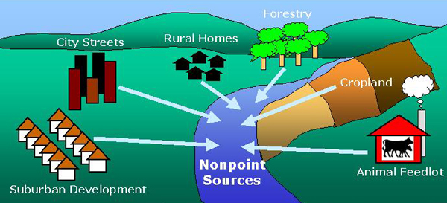
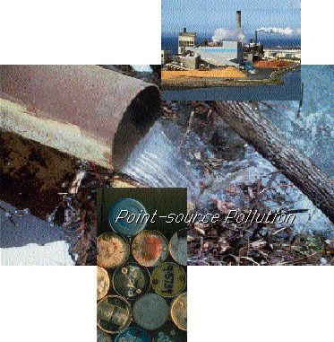
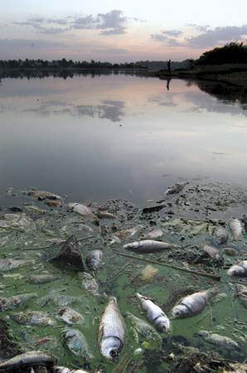
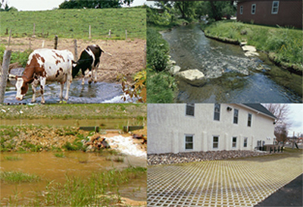
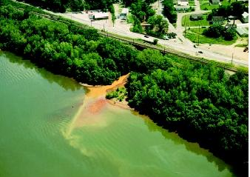

Slide 8
Sources of Water Pollution
1. Agriculture
2. Municipal:
Contains salts, asbestos, chlorides, copper, cyanides, grease, lead, zinc, hydrocarbons, motor oil, organic wastes, phosphates, sulfuric acid
3. Industrial
-Toxic compounds, sludge
- Some industries are cleaning water before they discharge it

Slide 9
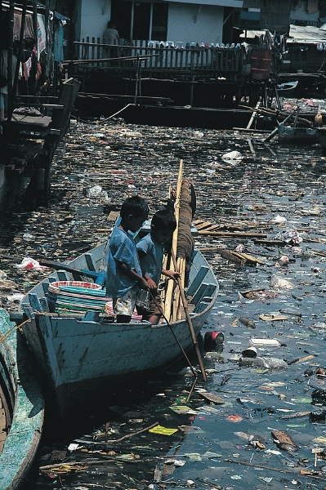
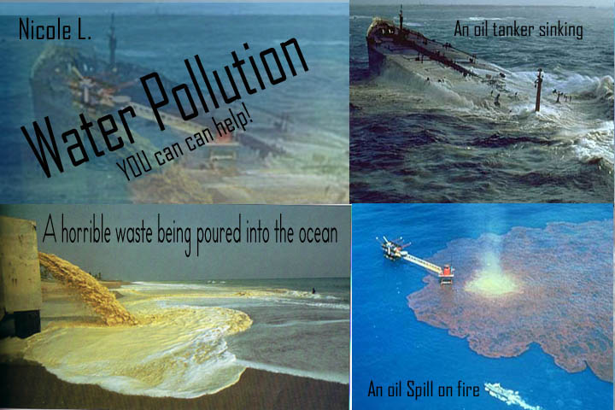
RESOURCE DEGRADATION = pollution!
Controlling Water Pollution
- 1898 Rivers and Harbors Act
- First legislation to address water pollution
- Individual states were responsible for enforcing
laws on water pollution
- Studies not accurate
- People not held accountable for pollution
Rachel Carson- wrote the book Silent Spring
- Brought water pollution problems to the
common man in terms they could understand
- Helped lead to water pollution control act

Slide 10
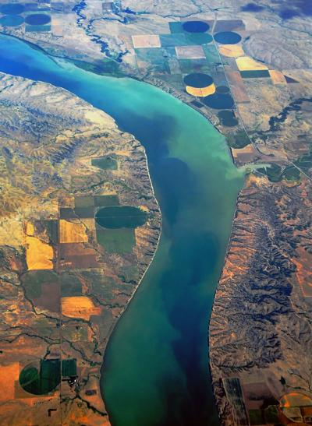
1972 FEDERAL WATER POLLUTION CONTROL ACT
"Clean Water Act"
Set water-quality standards for all 50 states
Provides a vision of water quality standards and a means of measuring improvement
-Does not set laws for enforcement
- Many states have improved their water quality, but there are still problems
Sewage treatment, soil erosion, removal of toxic chemicals, and heavy metals
Cancer causing agents identified in drinking water

Slide 11
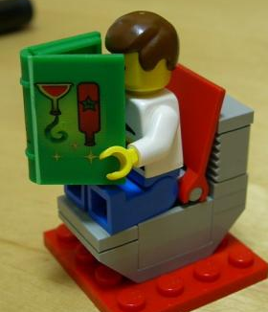
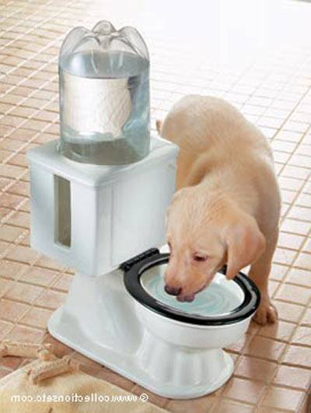
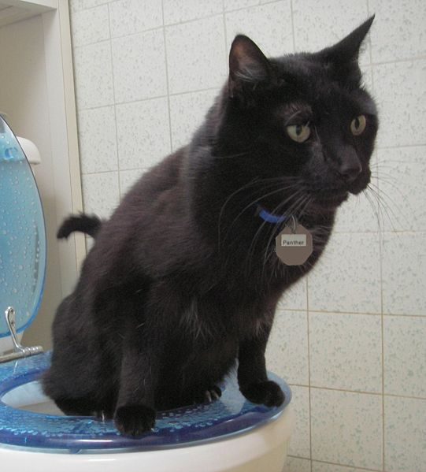
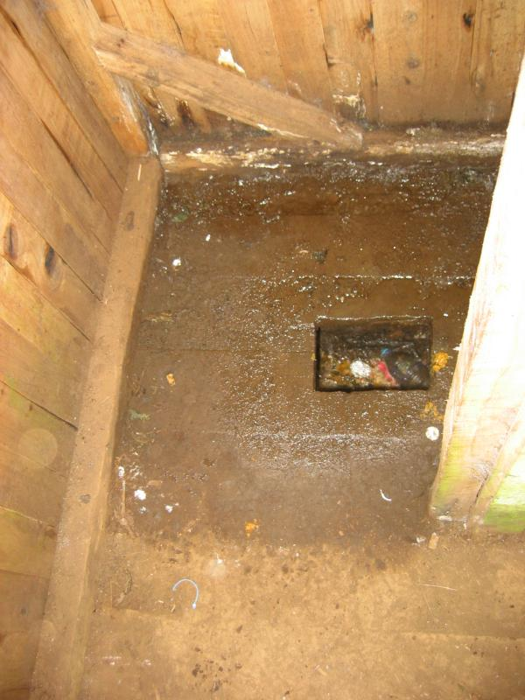
Municipal Sewage Treatment
Waste water undergoes several treatments at a sewage treatment plant to prevent environmental and public health problems. The treated water is then discharged into rivers, lakes or the ocean

Slide 12
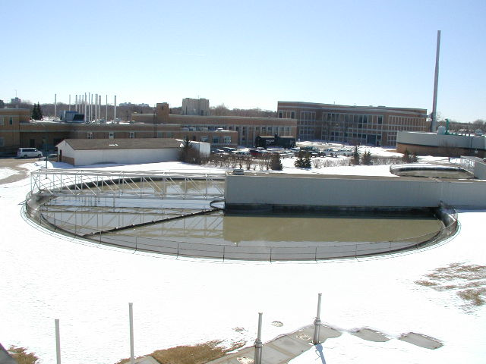
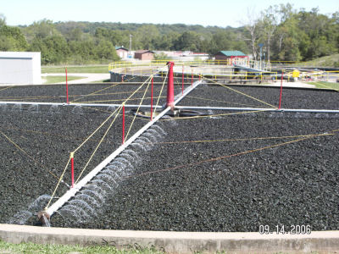
Process:
Primary Treatment
Removes suspended & floating particles
Screening & gravitational settling
Solid material that settles out is known as primary sludge
Does not eliminate the inorganic & organic compounds remaining in the wastewater.

Slide 13
Secondary Treatment
Uses microorganisms to decompose the suspended organic material
Trickling filters: wastewater trickles through rock beds containing bacterial which degrade the organic material
Activated sludge process: Wastewater is aerated and circulated through bacteria rich particles.
Particles and microorganisms are allowed to settle out forming Secondary Sludge
** Water is clear and free of organic wastes such as sewage**

Slide 14
Primary and Secondary Treatment

Slide 15
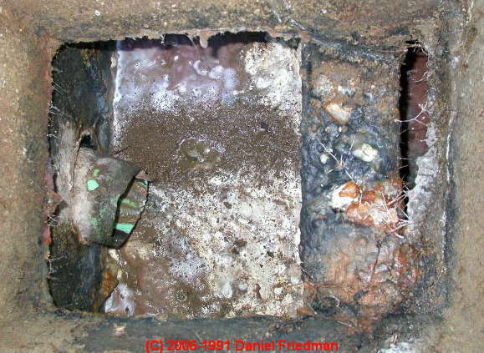
Individual Septic Systems
Many private residences use individual septic systems instead of municipal sewage treatment.
Household sewage is piped into the septic tank
Particles settle to the bottom
Grease and oils form a scummy layer where bacteria decomposes it
Waste water containing suspended organic and inorganic material flows into the drain field through a network of perforated pipes set in trenches of crushed stone
Purified wastewater then percolates into
the groundwater or evaporates from the soil

Slide 16
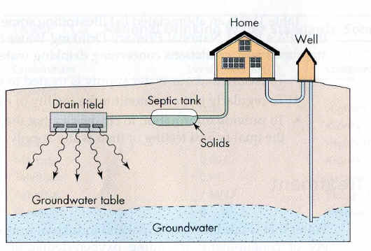
Do you see how there could be a contamination problem here?

Slide 17
Septic Systems
The septic tank works much like primary treatment in municipal sewage treatment- sewage from the house is piped to the septic tank, where particles settle to the bottom
Wastewater containing suspended organic and inorganic material flows into the drain field and gradually seeps into the soil

