Slide 1
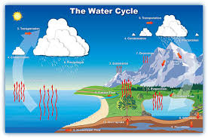
Water Cycle
Water that is constantly moving among the oceans, the atmosphere, the ground, and the biosphere
There are six parts to the Water Cycle

Slide 2
Parts of the Water Cycle
1. Transpiration → Water vapor is released by plants during natural processes (plant sweat)
2. Evaporation → Water to water vapor (liquid to gas)
3. Condensation → Water vapor to water (gas to liquid)
4. Precipitation → A downing of a water form from clouds (rain, snow, sleet, and hail)
5. Infiltration → Water moving through /into the ground
6. Runoff → Water flowing on the ground

Slide 3
Balancing a Cycle
All water must be balanced in the hydrosphere, with precipitation equaling the amount of water that is evaporated from the oceans and LRS (lakes, rivers, and streams)

Slide 4
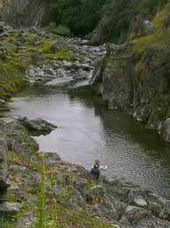
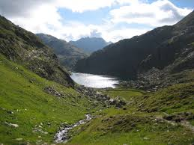
River Systems
*** All water flows naturally downhill, caused by gravity, into one of the four oceans
All rivers begin with a source and end at the delta
The beginning of a river will be called a young river
This is where the water is moving the fastest, cutting down into the rocks and creating a deep V shaped valley around the river that is also deeper and straighter than the rest of the river

Slide 5
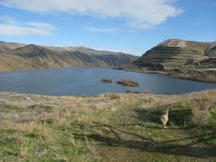
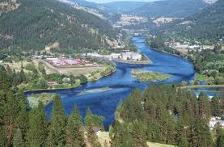

Slide 6
River Systems
As you continue down the river, it begins to meander (moving back and forth) across a landscape, flattening it out
This is called the mature part of the river
The water is moving slower, and the valley that the river will cut will be wide and very curvy

Slide 7
River Systems
Every river system has a drainage basin
Land area that contributes water to a main stream or river
What does this mean?
Every stream, creek, and pond will drain in one direction towards a large river, that will lead out to the oceans eventually

Slide 8
River Systems
Each drainage basin is separated by a watershed which is a higher elevation divide between 2 basins
Examples of watersheds
Mountain Ranges
Highlands
Plateaus
Watershed for North Carolina→ Appalachian Mountains/ Blue Ridge

Slide 9
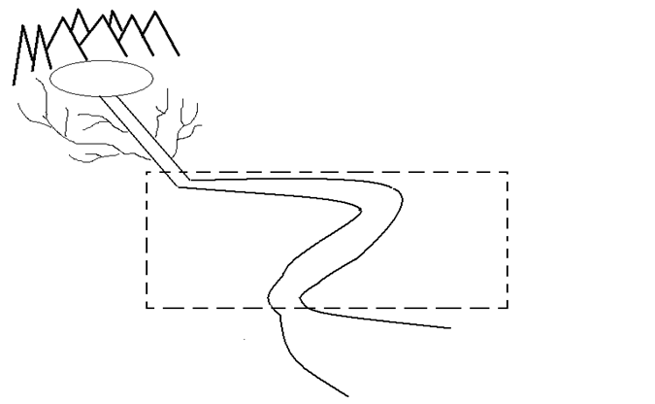
Source→ Beginning of a river system (lake, pond, or waterfall) (Higher elevations for flowing down hill)
Mature River → Middle of river that is longer, shallow, slower, and curvy
Tributaries→ Small streams and creeks that add water and drain into the main system
Young River→ Shorter beginning of a river, faster, deeper, and straighter than the rest
Floodplain → Flattened area surrounding a mature river, forms when a river floods and leaves behind nutrients in the soil
Delta→ End of the river that opens to another river or an ocean, forms when sediments will slow and drop to the river bed

Slide 10
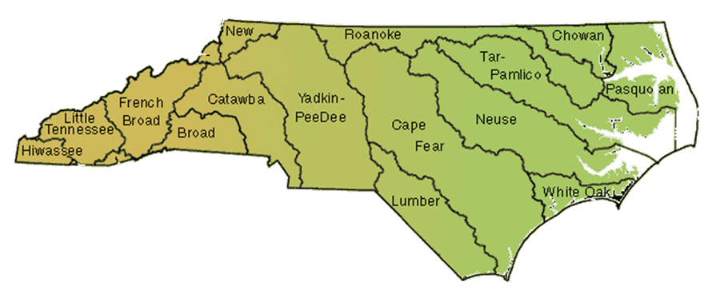

Slide 11
Categories | Western North Carolina | Eastern North Carolina
Geography | Mountains | Beaches and Flat Lands
Wetlands | None Present | Located inland from the beaches
Groundwater | Much runoff means the groundwater is low | Runoff from river basins and increased ocean water
Biodiversity | Mountain lions, bears, bobcats, pine trees, larger birds of prey, wolves | Smaller marine birds, palm trees, marine life, large reptiles, swamp plants
Climate | Colder temperatures and larger amounts of precipitation in the winter | Warm temperatures and larger amounts of precipitation in the summer
Human Population | Smaller towns means smaller amounts of people and pollution created | Larger towns and cities means larger amounts of people and pollution creates

Slide 12
NC River Basins
A River Basin is the land that water flows across or under on its way to a river
Same thing as a drainage basin
Sends all the water falling on the surrounding land into:
1. Ocean
2. Another river basin
3. Larger body of water
Five of the river basins flow into the Mississippi River:
French Broad, Hiwassee, Little Tennessee, Savannah, Watauga
The other 12 flow into the Atlantic Ocean

Slide 13
River Basin Characteristics
Each river basin has its own characteristics
Geography → Shape of the land
Wetlands → Areas where groundwater is very close to the surface and allows for specialized plants to grow and act as filters for the land
Groundwater → water in the ground and how close it is to the surface
Biodiversity → the total amount of species (plant or animal) that make up the area of the river basin
Climate → How much precipitation and temperature changes occur over a long period of time

Slide 14
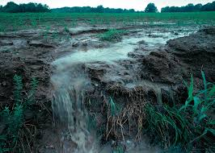
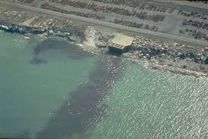
Human Population →How much pollution is being added to the river basin
We have a way of destroying the natural buffers that clean out the river system
1. Point Source Pollution → Where the source of pollution is a specific place, like a pipe or barrel of trash
2. Nonpoint Source Pollution → Pollution that is coming off of a general area
Runoff from landfills or farms with fertilizers and other sources

Slide 15
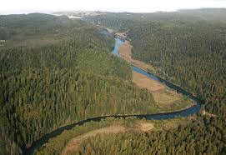
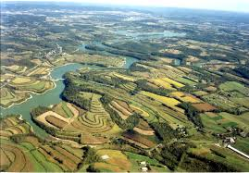
What can we do?
1. Change Government Policies
2. Protect river banks from erosion
It will allow the natural filters and boundaries of the rivers to maintain their balance
3. Land Conservation → Using only the land needed or land previously used to minimize the human impact on the land

Slide 16
What can we do?
4. Try to reduce the impact of nonpoint and point source
pollution
5. Environmental Education → What we are doing right now
6. Urban Stream Renewal →Cities have either polluted or moved streams and creeks to make way for development, so cities are trying to find ways to revive/renew and make the streams useful and pretty again
A. Here in Charlotte → Greenways

Slide 17
Groundwater
Water in the ground
Groundwater moves through the pore spaces in the ground by soaking and seeping through the crack through the process of infiltration
There are 3 places that groundwater will go when it gets into the ground
1. When water falls to the ground, a lot of it will seep into the ground and be absorbed by the roots of plants
2. Much of the water will runoff of the land into the LRS system (This is considered one place, not three!)

Slide 18
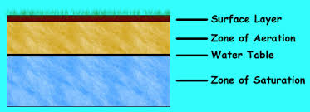
Groundwater
3. Most of it will reach the zone of saturation where water fills all the open spaces in the sediment and rocks below us
The top limit of this zone is called the watertable line

Slide 19
Groundwater
Sometimes, there is a rock layer in the ground that is above the zone of saturation that can hold water and allow groundwater to be drill out and delivered to our homes
This is known as an aquifer
Underneath, holding the water above the zone of saturation, is a rock layer that will not allow the water to flow down, and this layer is known as an aquitard

Slide 21
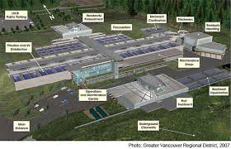
Water For Humans
Everyone receives their water from the ground in some way
People who live in the city receive their water from a filtration plant, where the water is cleaned and then the water from their homes returns through the sewer and is cleaned at the same filtration plant

Slide 22
Water for Humans
If you live in the countryside, you probably have a well, which is a hole that is drilled in your backyard and the groundwater is pumped up into your house
This well needs to be drilled into the zone of saturation in order to receive a continuous flow of water into your home
Wells are naturally cleaned by the filtration of water by the rocks and soils in the ground.

Slide 23
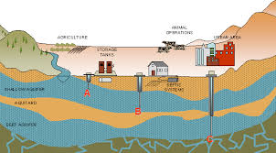

Slide 24
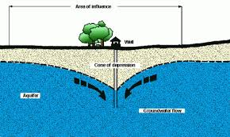
Water For Humans
When too much water has been drawn out of the ground by multiple homes, a cone of depression will form because there is not enough groundwater refilling the supply (recharging) the water in the zone of saturation.
This usually happens when 3 or more homes are close together.

Slide 25
Porosity and Permeability
Porosity is the amount of pore spaces (openings) within the dirt and rocks beneath the surface of the Earth
Larger sediments will have a higher porosity because the rocks do not fit together well
Smaller sediments will have a lower porosity because the rocks pieces are touching each other closely and can fit together well.

Slide 26
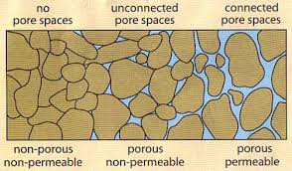
Porosity and Permeability
Permeability is the interconnectedness of the pore spaces in rocks
If there is a high permeability, then that means that water can flow freely through the pore spaces
If there is a low permeability, then water cannot flow easily through the rocks, and it is said to be impermeable

Slide 27
Ocean Movements
Masses of ocean water that flow from one place to another are called currents
Could be at the bottom of the ocean or on the surface of the ocean
Surface Currents → Movements of the water that flow horizontally in the upper part of the ocean’s surface
These currents develop from friction between the water and the wind that blows across the water
Large whirls of water within the four ocean basins are called gyres
These are usually a collection of smaller currents.

Slide 28
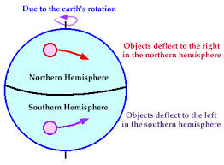
Ocean Movements
Another factor that affects the surface currents of the ocean is the Coriolis Effect
The deflection of currents away from their original course as a result of the rotation of the Earth
In the Northern Hemisphere, water will spin to the right, or clockwise
In the Southern Hemisphere, water will spin to the left, or counterclockwise

Slide 30
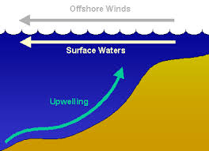
Upwelling
Cold water rising from the bottom of the ocean to replace warmer surface water
This usually happens closer to coastlines
Brings greater concentrations of dissolved nutrients to the ocean surface from the ocean bottom
When this happens, fish and plankton flourish because there is a renewed food source for these animals and plants

Slide 31
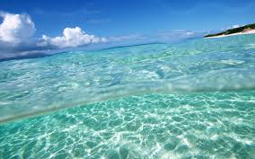
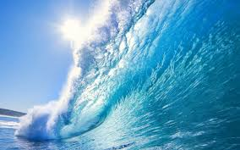
Salt Water Properties
The major difference between seawater and freshwater is the presence of sodium chloride that gives the salty taste of the water
Seawater is 95% water in a given sample, and 5% salts

Slide 32
Properties
Temperature Variations
Warmest water is found on the surface of the oceans
In lower latitudes (near the equator), the water on top is the warmest and then rapidly decreases in temperature because ________________________________________
______________________________________________
This rapid decent in temperatures is called the thermocline
In the higher latitudes (near the poles), water is constantly cold because the Sun is not shining as long or as such a high intensity

Slide 33
Thermocline at Lower Latitudes

Slide 34
Properties
Density Variations
Density → A given amount of mass in a given volume
The higher the density, the heavier the object
The lower the density, the lighter the object
Freshwater is denser than seawater
Two factors that will affect seawater density is the temperature and salinity
Colder seawater is denser than warmer seawater
In lower latitudes, densities will rapidly increase as you move further down in the depths of the ocean
This rapid increase in density is known as the pycnocline

Slide 35
Pycnocline in Lower Latitudes

