Slide 1
Universe Formation

Slide 2
Warm up

Slide 3
Sketch a diagram in your notebook of the Sun and Moon location during the four different types of tides. (Spring, Neap, High, Low)
Below each diagram give a quick description of the picture.

Slide 4
The Big Bang Theory

Slide 5
The Big Bang Theory
The current theory accepted by most scientists
Occurred 13.7 billion years ago
Explains the formation of the the universe and everything in the universe
Sun, other stars, planets, galaxies

Slide 6
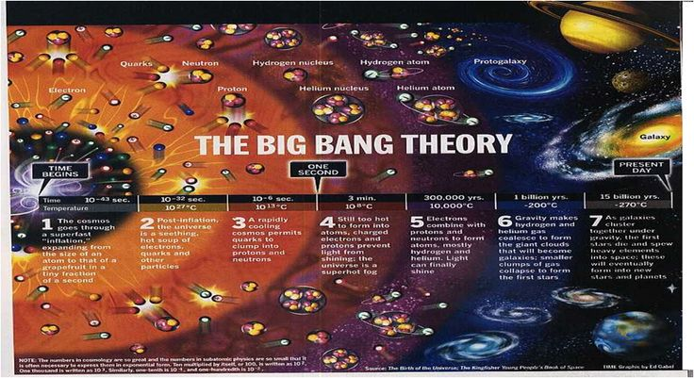

Slide 7
The Birth of the Universe
The Universe formed in a huge explosion
Initially all matter and energy was concentrated into a small ball
The ball of matter and energy became too full and too hot
The ball of matter and energy burst

Slide 8
What Happened Next?
The explosion caused the Universe to start rapidly expanding
All the matter and energy came out

Slide 9
What Happened Next?
The Universe was very, very hot and dense
As the expansion continued, the Universe got cooler
As the expansion continued, the Universe got less dense

Slide 10
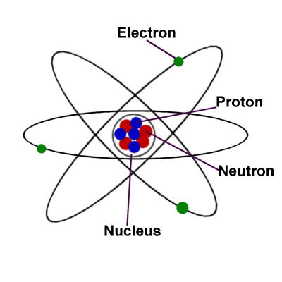
Seconds After…..
Protons formed
Neutrons formed
Electrons formed

Slide 11
Protons
Positively charged particle
Located in the center of the atom or nucleus

Slide 12
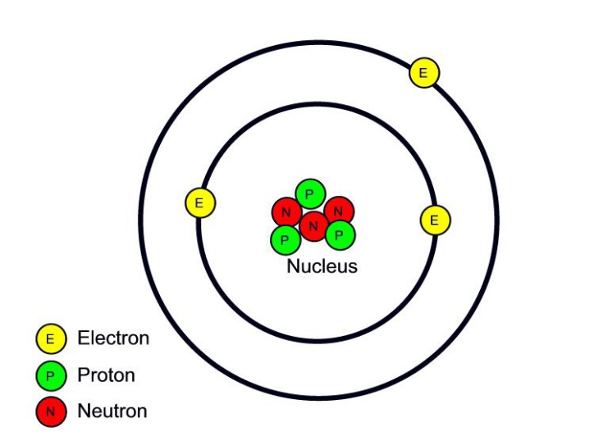
Neutron
Neutral or No Charge
Located in the center of the atom or nucleus

Slide 13
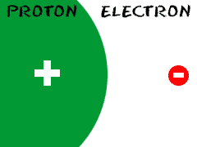
Electron
Negatively charged
Located in the cloud around the nucleus

Slide 14
Proof
Not immediately accepted
Universe is still expanding
There is still heat remaining

Slide 15
Rising Raisin Bread Dough
Explains our expanding universe
As the bread rises and expands, the raisins move farther away from each other, but they are still stuck in the dough
Raisins we cannot see
Gravity keeps our “raisins” together

Slide 16
Nebular Hypothesis

Slide 17
Nebular Hypothesis
Explains the formations of the solar system
The Sun, Planets, other stars
4.6 billion years ago

Slide 18
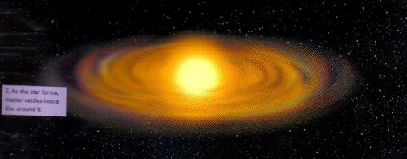
Formation of the Sun
Large cloud of dust and gas collapsed
Gravity pulled the cloud together
As it got smaller, it spun faster and formed a rotating disk

Slide 19
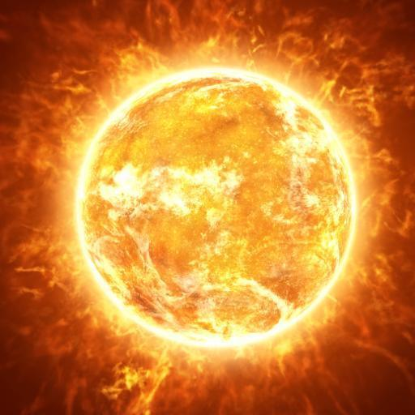
Formation of the Sun
Gravity pulled the majority of the gas into the center
The gas became hot and dense enough for nuclear fusion to begin
The Sun formed

Slide 20
Formation of the Sun
4.6 billion years ago

Slide 21
Formation of the Planets
Away from the center of mass where the Sun was forming, there were smaller clumps of dust and gas were colliding
These smaller clumps of dust are called planetesimals

Slide 22
Formation of the Planets
As the spinning continues, the planetesimals combine to form larger masses
These larger masses are called planets

Slide 23
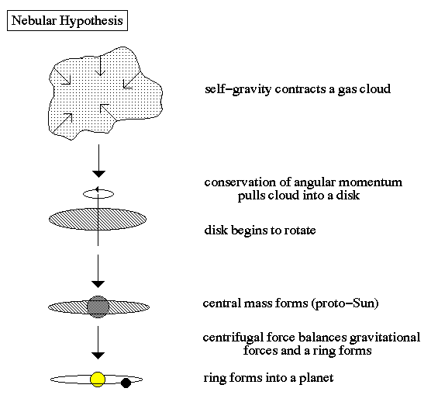

Slide 24
https://www.youtube.com/watch?v=fgqnh_6cCE4

Slide 25
Video Questions
What is the name of a star before it is born?
What is the molecular cloud made mostly of?
When does nuclear fusion start?
How does fusion exist?

Slide 26
Video Question Answers
Nebula
Molecular Hydrogen
When it turns into a hydrogen burning star
Turning hydrogen into helium

Slide 27
Exit Ticket

Slide 28
Big Bang Quiz
1) The Big Bang Theory is a hypothesis that states that all matter and energy were at one time compressed into a small volume and then ____________.
Imploded
Expanded outward
Stayed compressed
None of the above
2) The first stars didn’t form until about 4.6 billion years after the Big Bang.
True
False

Slide 29
3) According to the Big Bang theory, the universe began
1 billion years ago
3.7 billion years ago
13.7 billion years ago
23.7 billion years ago
4) At the time of the Big Bang and just after
All the matter and energy of the universe was compressed into a point.
After a few seconds, protons, neutrons and electrons formed.
After a few minutes, hydrogen formed.
All of the above.

Slide 30
5) During the immediate aftermath of the Big Bang, hydrogen nuclei collided and fused into __________ nuclei.
Oxygen
Carbon
Helium
Potassium
6) In the early universe, matter was held together by which force?
Gravity
Centrifugal
Inertia
Attractive

Slide 31
7) Scientists have discovered the temperature of space is 3ºC.
True
False
8) Which of the following is true?
The temperature of space in the universe is 0 Kelvin.
A tiny amount of heat left over from the Big Bang is spread around the universe.
Galaxies and the space between them are the same temperature.
There is no evidence for the Big Bang beyond the expanding universe.

