Slide 1
Chapter 17
The Atmosphere: Structure and Temperature
Notes:
Who is Stan Hatfield and Ken Pinzke

Slide 2
17.1 Atmosphere Characteristics
Weather is constantly changing, and it refers to the state of the atmosphere at any given time and place.
Climate, however, is based on observations of weather that have been collected over many years. Climate helps describe a place or region.

Slide 3
17.1 Atmosphere Characteristics
Composition of the Atmosphere
◆ Major Components
• Air is a mixture of different gases and particles, each with its own physical properties.

Slide 4
17.1 Atmosphere Characteristics
Two major gases:
Nitrogen (78%)
Oxygen (21%)
Other gases vary
Carbon dioxide is increasing due to human activities
CO₂ raises temperatures in the atmosphere by trapping heat near the surface

Slide 5
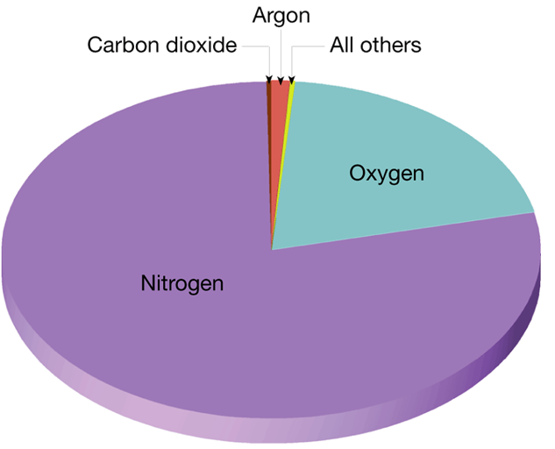
Volume of Clean, Dry Air
1%
<1%
<1%
21%
78%
Notes:
Makes no sense without caption in book

Slide 6
17.1 Atmosphere Characteristics
Composition of the Atmosphere
• Water vapor is the source of all clouds and precipitation. Like carbon dioxide, water vapor absorbs heat given off by Earth. It also absorbs some solar energy.
• Ozone is a form of oxygen that combines three oxygen atoms into each molecule (O₃).
• If ozone did not filter most UV radiation and all of the sun’s UV rays reached the surface of Earth, our planet would be uninhabitable for many living organisms.

Slide 7
17.1 Atmosphere Characteristics
Composition of the Atmosphere
◆ Human Influence
• Emissions from transportation vehicles account for nearly half the primary pollutants by weight (46.2%)

Slide 8
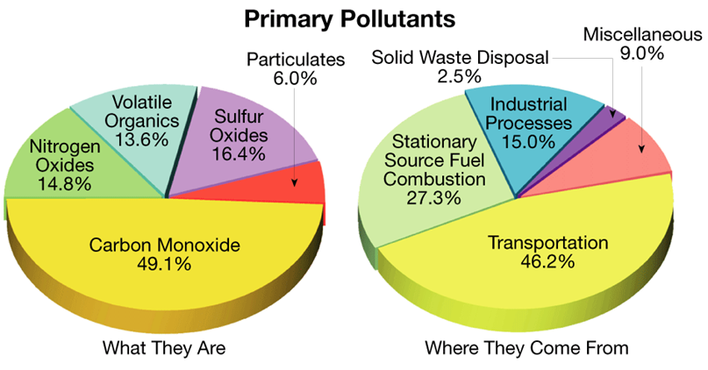
Primary Pollutants
Notes:
Makes no sense without caption in book

Slide 9
17.1 Atmosphere Characteristics
Height and Structure of the Atmosphere
◆ The atmosphere rapidly thins as you travel away from Earth until there are too few gas molecules to detect.
◆ Pressure Changes
• Atmospheric pressure is simply the weight of the air above.

Slide 10
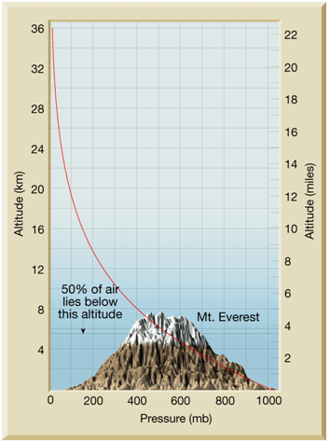
Atmospheric Pressure vs. Altitude
Notes:
Makes no sense without caption in book

Slide 11
17.1 Atmosphere Characteristics
Height and Structure of the Atmosphere
◆ Temperature Changes
• The atmosphere can be divided vertically into four layers based on temperature.
•
•

Slide 12
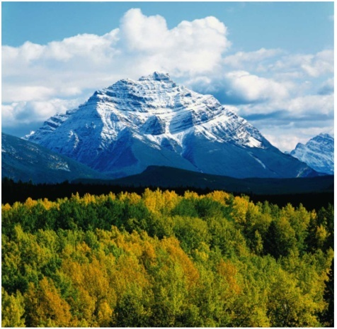
Snowy Mountaintops Contrast with Warmer Snow-Free Lowlands
Notes:
Makes no sense without caption in book

Slide 13
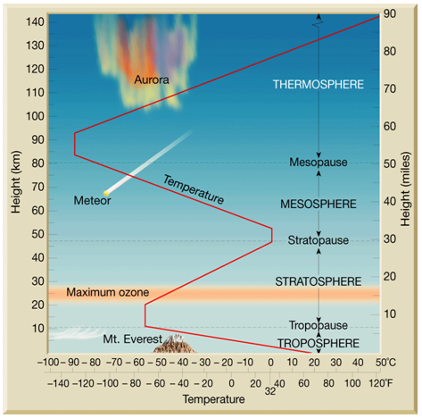
Thermal Structure of the Atmosphere
Notes:
Makes no sense without caption in book

Slide 14
17.1 Atmosphere Characteristics
Height and Structure of the Atmosphere
◆ Temperature Changes
• Earth’s atmosphere can be divided vertically into four layers based on temperature.

Slide 15
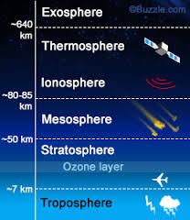
Layers of the Atmosphere
Exosphere→ Space
contains very small amounts of gases; temperatures increase
Thermosphere→ Highest level of the atmosphere
immediately above the mesosphere and is characterized by increasing temperatures due to the absorption of very short-wave solar energy by oxygen.
Location of satellites and the northern lights
Mesosphere→ layer of the atmosphere immediately above the stratosphere and is characterized by decreasing temperatures with height
Air begins to get thicker and meteorites will begin to burn up with friction

Slide 16
Layers of the Atmosphere
Stratosphere→ The layer of the atmosphere where temperature remains constant to a height of about 20 kilometers. I
Temp. begins gradual increase until the stratopause is reached.
Location of ozone layer
HALO jump flights and military flights
Troposphere→ The bottom layer of the atmosphere where we live
temperature decreases with an increase in altitude.
air is thickest due to gravitational pull (downward)
all weather is located in this layer

Slide 17
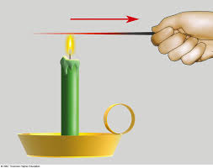
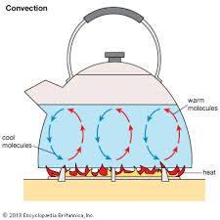
Heat transfer on earth
Heat on Earth is transferred in 3 ways
Conduction
Heat transfer through direct contact with an object
Examples: Hand touching a hot pan, lava touching a forest, hot iron on hair/clothes
Convection
Heat transfer through the
circulation of heat
Examples: Mantle convection,
air and water currents, convection oven

Slide 18
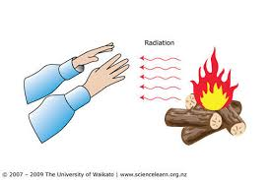
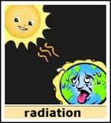
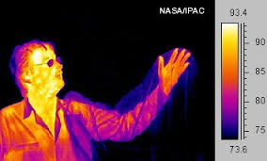
Heat transfer on earth
Radiation
Heat transfer through in which heat travels by waves through empty space
When radiation strikes an object, there usually are three different results.
1. Absorption→ Some energy is absorbed by the object (grass, clouds)
2. Reflection → Substances, such as water and air, are transparent to certain wavelengths of radiation.
3. Scattering → Some radiation may bounce off the object without being absorbed or transmitted.

Slide 19
17.2 Heating the Atmosphere
What Happens to Solar Radiation?
◆ Absorption
• About 50% of the solar energy that strikes the top of the atmosphere reaches Earth’s surface and is absorbed.
• The greenhouse effect is the heating of Earth’s surface and atmosphere from solar radiation being absorbed and emitted by the atmosphere, mainly by water vapor and carbon dioxide.

Slide 20
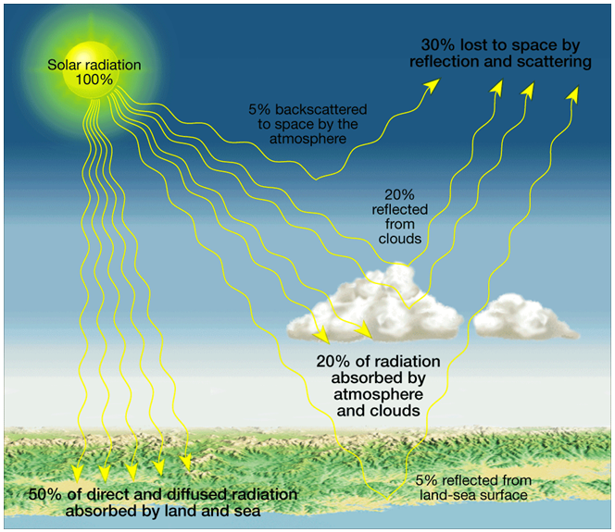
Solar Radiation
Notes:
Makes no sense without caption in book

Slide 21
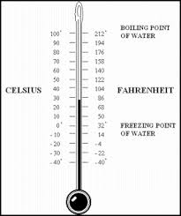
Temperature
a measure of the warmth of an object or substance with reference to some standard value
Most of the world uses Celsius as a tool for measuring temperature; Americans use Fahrenheit.
Temperatures have a great effect on the biomes and different environments on Earth
Can change over long term or short term
Example of long term→ Plate tectonics and Ice Ages
Example of short term→ Volcanic Eruptions and Storm Fronts

Slide 22
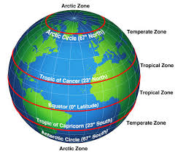
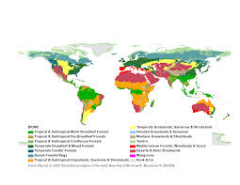
Temperature effects on Biomes
The amount of radiation different parts of Earth receives will create different zones on Earth which are created by their respective temperatures
The elevation changes also affect the biomes because temperatures change as you go up mountains and plateaus

Slide 23
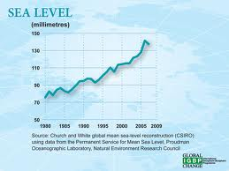
Temperature effects on Sea Levels
Sea level has naturally changed due to changes in plate movements as well as global cooling and warming trends
Since the Industrial Revolution, there has been a general increase in sea level due to the increasing amount of carbon dioxide found in our atmosphere
This in turn:
keeps heat near the surface of the Earth
Causes glaciers to melt thus adding to the amount water found in our oceans

