Slide 1
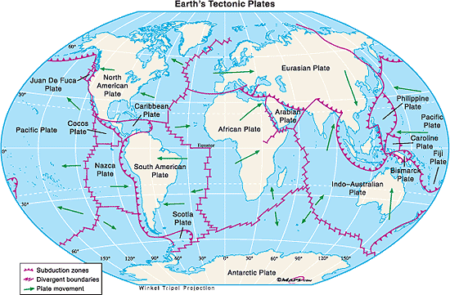
TESTING PLATE TECTONICS
Sections 9.4 and 9.5

Slide 2
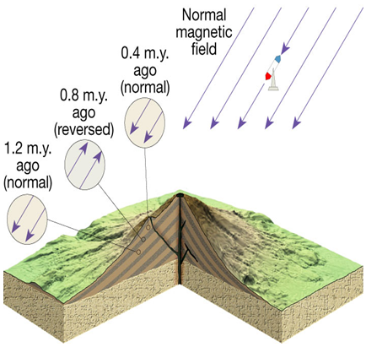
TESTING PLATE TECTONICS
Paleomagnetism
When a rock forms, it becomes magnetized in the direction parallel to Earth’s existing magnetic field
Normal polarity – when rocks show the same magnetism as the present magnetic field
Reverse polarity – when rocks show the opposite magnetism as the present magnetic field

Slide 3
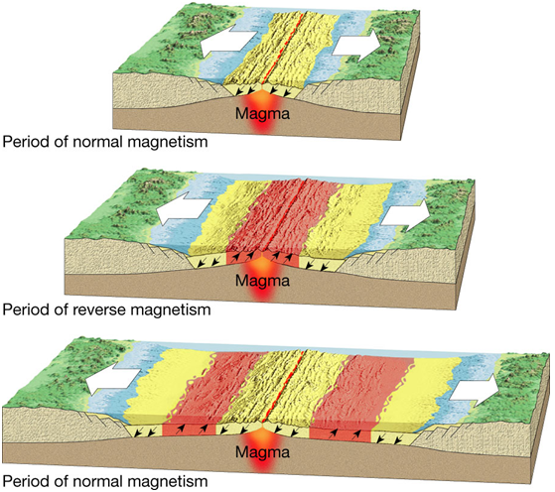
EVIDENCE FOR PLATE TECTONICS
The discovery of strips of alternating polarity, which lie as mirror images across ocean ridges, is among the strongest evidence of seafloor spreading

Slide 4
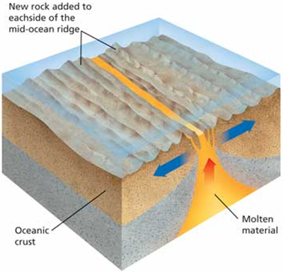
EVIDENCE FOR PLATE TECTONICS
Earthquake Patterns
Scientists discovered a close link between earthquake origins and ocean trenches
Earthquakes occur only within the subducted slab of oceanic lithosphere
Ocean Drilling
Youngest oceanic crust is at the ridge crest, the oldest crust is at the continental margins
Data on the ages of seafloor
sediment confirmed the seafloor
spreading hypothesis

Slide 5
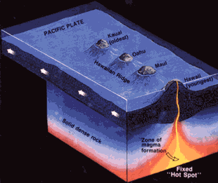
EVIDENCE FOR PLATE TECTONICS
Hot Spot
A concentration of heat in the mantle produces magma, which rises to Earth’s surface creating volcanic mountains
Hot Spot evidence supports the theory that plates move over Earth’s surface
Hawaiian Islands

Slide 6
Causes of Plate Motion
Convection occurring in the mantle, specifically asthenosphere is the driving force for plate movement
Convective flow is the motion of matter resulting from changes in temperature
Warm, less dense material rises
Cool, more dense material sinks
The unequal distribution of heat within Earth causes convection in the mantle, which drives plate motion

Slide 7
CAUSES OF PLATE MOTION
Slab-pull occurs when the cool, dense oceanic crust sinks into the mantle and “pulls” the lithosphere along
This is called the downward arm of the convection cell.
Occurs at convergent boundaries

Slide 8
CAUSES OF PLATE MOTION
Ridge-push causes oceanic lithosphere to slide down the sides of the oceanic ridge under the pull of gravity
Pushing lithosphere away from upper part of convection cell
Occurs at divergent boundaries

Slide 9
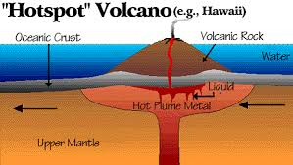
CAUSES OF PLATE MOTION
Mantle Plume
The rising of magma in the upper part of the convection cell can happen in a single place (middle of a plate) and create a hot spot/island
Example: Hawaii

