Slide 1
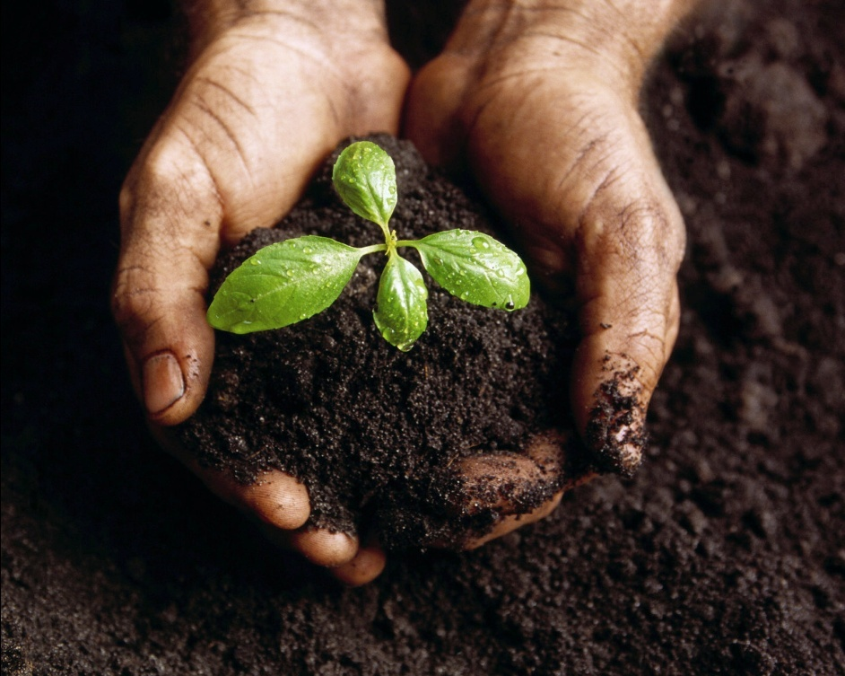
Soil
Section 5.2

Slide 2
Characteristics of Soil
Regolith – the layer of rock and mineral fragments that covers nearly all of Earth’s surface
Soil – part of the regolith that supports plant growth
Soil has three important characteristics:
Soil Composition
Texture
Structure

Slide 3
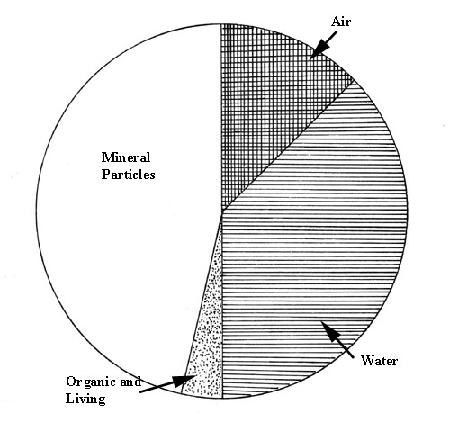
Characteristics of Soil
1. Soil Composition:
Four major components: mineral matter or broken down rock, organic matter or humus (decayed remains of organisms), water, and air
The proportions of these components vary in different soils

Slide 4
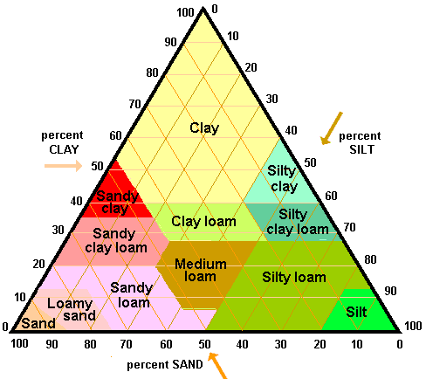
Characteristics of Soil
2. Soil Texture:
The proportions of different particle sizes
The U.S. Department of Agriculture has established categories based on the percentage of clay, sand and silt in soil
What soil texture is found at ❶?
❶

Slide 5
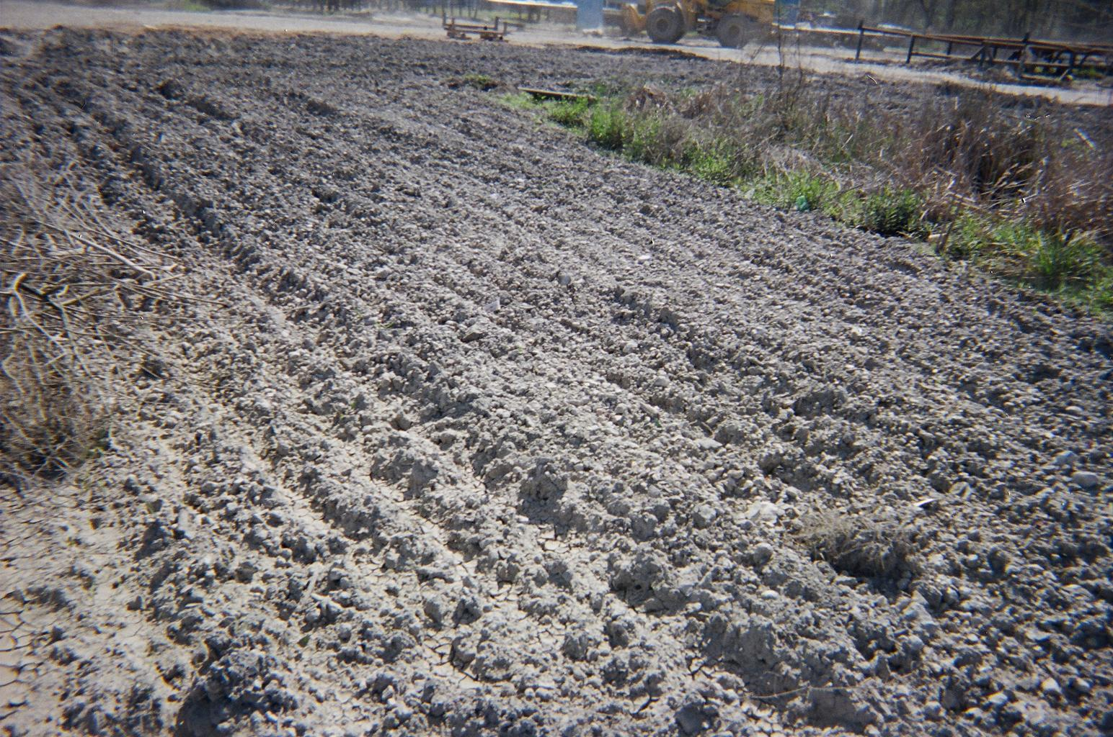
Characteristics of soil
3. Soil Structure
Determines how easily a soil can be cultivated and how vulnerable it is to erosion
Affects the ease with which water can enter the soil

Slide 6
Soil Formation
Parent Material:
Source of the mineral matter in soil
Affects the rate of weathering and soil formation
Time:
The longer soil has been forming, the more thick
Climate:
Greatest effect on soil formation
Influence rate, depth and type of weathering

Slide 7
Soil Formation continued
Organisms:
The type and number of organisms have a major impact on the soil’s physical and chemical properties
Slope:
Variations in slope results in very different soil types
The differences are seen in the water content and erosion

Slide 8
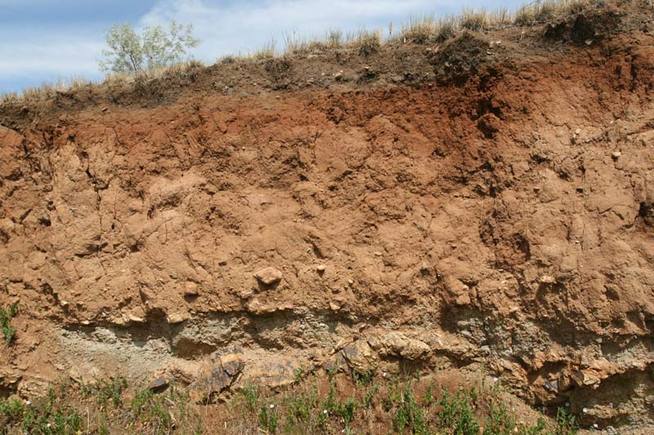
Soil Profile
Soil varies in composition, texture, structure and color at different depths
Soil horizons – a layer of soil that has identifiable characteristics produced by chemical weathering and other soil forming processes

Slide 9
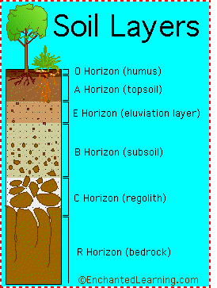
Soil Profile continued…
Soil profile – a vertical section through a soil showing its succession of horizons and the underlying parent material
A Horizon (topsoil) – consists mostly of humus, insects, fungi, and microorganisms
B Horizon (subsoil) – contains clay particles washed out of A horizon
C Horizon – contains partially weathered parent material

Slide 10
Soil Erosion
Water erodes soil
Rates of erosion
Human activities that remove natural vegetation, such as farming, logging, and construction, have greatly accelerated erosion

