Slide 1
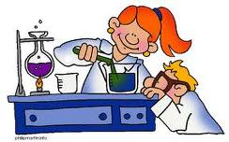
Science Skills and Methods

Slide 2
How do you gain knowledge about the world around you?
Much of your knowledge comes from personal experiences
Science is a particular way of gathering and organizing information about the natural world
Science involves observing, experimenting, and studying information in an orderly and objective way

Slide 3
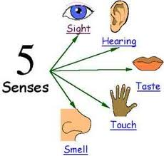
Science Skills
When scientists study, observe, and experiment, they gather information, or data
The most direct way of gaining knowledge about something in nature is to observe it
Your ability to observe can be extended through the use of tools, such as telescopes, thermometers, and rulers

Slide 4
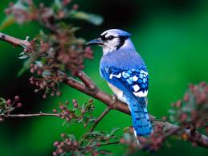
What observations can you make…

Slide 5
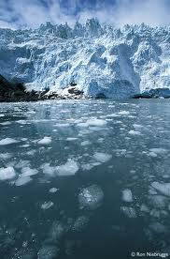
Science Skills continued
When you infer, or make an inference, you suggest a possible explanation for an observation
What can you infer about where the chucks of ice came from?

Slide 6
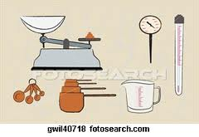
Science Skills continued
When you estimate, you make careful guesses
When you need exact and careful information about an observation, you measure
Measurements include both a number and a unit
When you predict, you state what you think might happen in the future

Slide 7
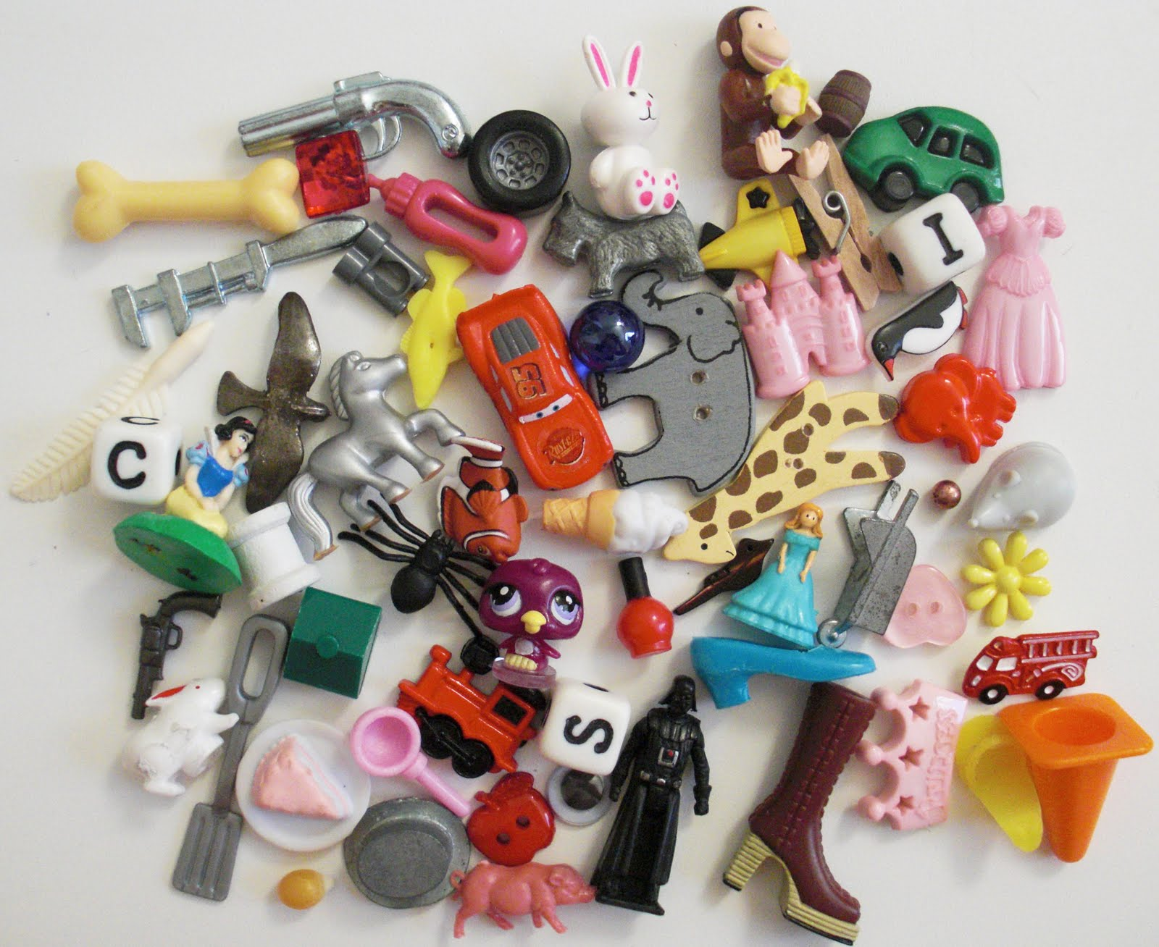
Science Skills continued
When you classify, you group things based on how they are alike
How would you classify the items shown in the picture?

Slide 8
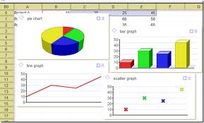
Science Skills continued
When you state a hypothesis, you suggest an answer to a problem
There are a number of ways you can record and organize data
Tables, charts, graphs, and diagrams
Once data have been recorded and organized, you need to analyze the data by looking for trends or patterns

Slide 9
Experiment
An experiment is a way of testing a hypothesis
A hypothesis relates one factor or variable to another
A variable that causes a change in another is an independent variable
The variable that changes in response to the independent variable is the dependent variable
A control, all variables are identical to those in the experimental setup except the independent variable, is used to ensure other factors don’t affect the outcome

Slide 10
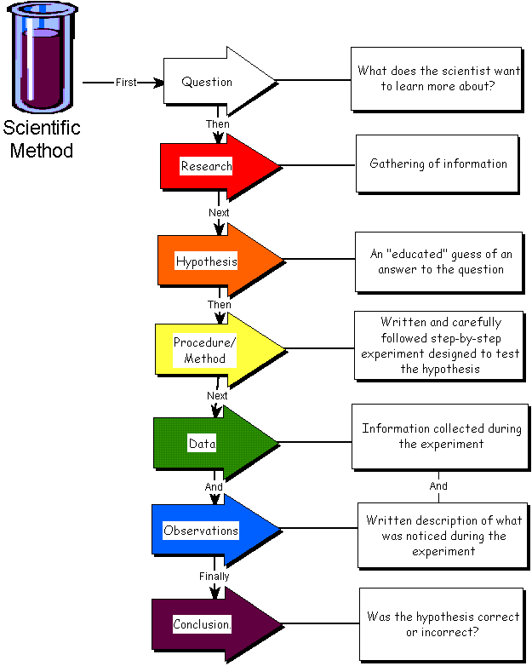

Slide 11
Additional Terms:
Qualitative: Descriptions; data that is observed but not measured
Ex. Color, texture, smells, tastes, appearance
Quantitative: numbers, data that can be measured
Ex. Length, volume, height, temperature, mass, speed, distance, inertia, sound levels, time, costs, ages
Independent Variable: can be manipulated or changed. Causes a change in another. Only have 1 in an experiment.
Dependent Variable: what you measure during the experiment. It is affected and changes in response to the independent variable.
Control: Used to compare your results to
Constant: part of the experiment that doesn’t change

