Slide 1
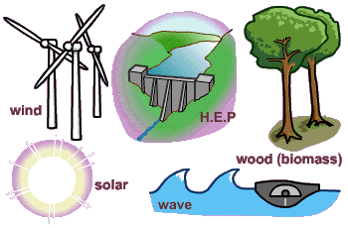
Renewable Resources
Section 4.1 and 4.2

Slide 2
Renewable Resource
A resource that can be replenished over a fairly short time period such as months, years, or decades
Examples include plants and animals for food, natural fibers for clothing, and trees for lumber and paper
Energy from flowing water,
wind, and the sun are also
renewable resources

Slide 3
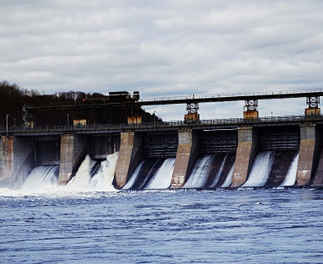
Hydroelectric Energy
Hydroelectric energy is the power that falling water generates
Water held in a reservoir behind a dam is a form of stored energy that can be released through the dam to produce electric power
Disadvantages:
Hydroelectric dams stop producing
energy when sediment fills the
reservoir
Availability of appropriate sites-needs
height for the water to fall and a high
rate of flow
Future expansion is limited

Slide 4
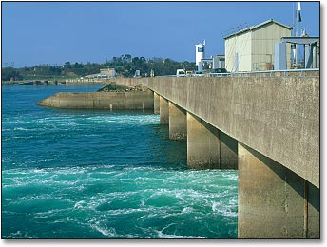
Tidal Power
Tidal power is generating energy from the ocean
A dam is built across coastal areas with a large tidal range. The in-and-out flow of water drives turbines and electric generators

Slide 5
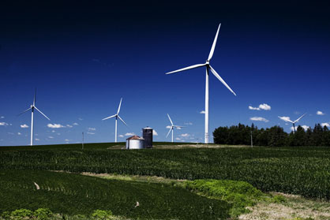
Wind Energy
Wind energy is used for electricity, to power sailing ships, windmills for grinding grain, and wind turbines
Wind energy disadvantages:
Cost and availability of land
in populated areas
Noise pollution
Need for technical advances

Slide 6
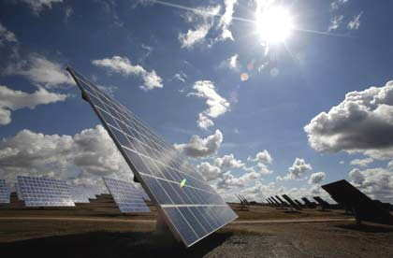
Solar Energy
Solar energy is the direct use of the sun’s rays to supply heat or electricity
Two advantages:
Solar energy is free
Solar energy is non-polluting
There are some disadvantages to using solar energy
The equipment and installation to use the energy collected is expensive
Another heating unit is needed when there is less solar energy – cloudy days, winter time, at night

Slide 7
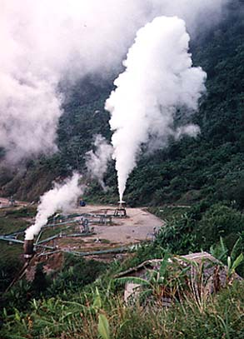
Geothermal Energy
Geothermal energy is extracted from Earth’s internal heat, by tapping reservoirs of steam and hot water
Disadvantage – when the hot fluids are pumped out, engineers have to drill new wells to maintain power production

Slide 8
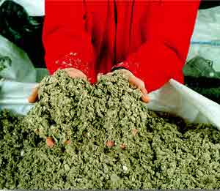
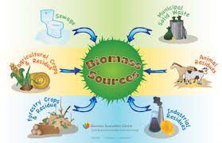
Biomass
Using plant debris or animal waste to produce heat energy
Main type of energy used in less developed countries because it’s available

