Slide 1
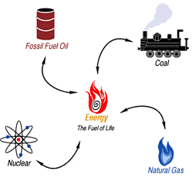
Nonrenewable Resources
Section 4.1

Slide 2
Nonrenewable Resource
Takes millions of years to form and accumulate
Nonrenewable metals include iron, copper, uranium and gold
Fun Fact: 6% of the world’s population lives in the US, but we use 30% of the world’s annual production of mineral and energy resources

Slide 3
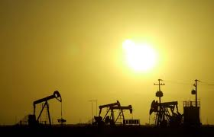
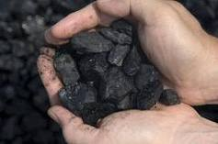
Fossil Fuels
A fossil fuel is any hydrocarbon that may be used as a source of energy
Fossil Fuels include coal, oil and natural gas

Slide 4
Fossil Fuel Formation
Formed from prehistoric plants and animals that lived hundreds of millions of years ago
During the millions of years that passed, the dead plants and animals slowly decomposed into organic materials
Different types of fossil fuels were formed depending on what combination of animal and plant debris was present, how long the material was buried, and what conditions of temperature and pressure existed when they were decomposing

Slide 5
Fossil Fuel: Coal
Coal was formed millions of years ago when Earth was covered with swamps. Plants died, becoming covered with dirt and water. The weight of the top layers (heat and pressure) produced chemical and physical changes in the layers, causing the formation of coal.

Slide 6
Stages of Coal Formation
Peat, partially decayed plant material
Peat becomes lignite (brown coal), a sedimentary rock
Lignite becomes bituminous coal (soft coal), a sedimentary rock
Bituminous coal becomes anthracite (hard coal), a metamorphic rock

Slide 7
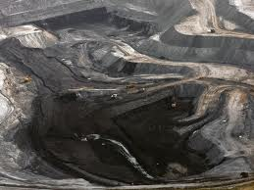
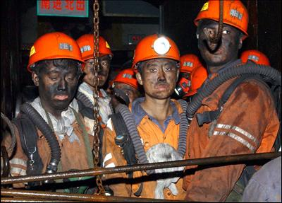
Coal Disadvantages
Even though coal is abundant, the recovery and use present problems
Surface mining scars the land
Underground mining has costly health problems and can cause death
Burning coal creates air pollution, that can lead to acid rain

Slide 8
Oil and Natural Gas Formation
Oil (petroleum) and natural gas were created from organisms that lived in the water and were buried under ocean or river sediments.
Ocean floor sediments protected the remains from decay and oxidation
Chemical reactions transformed the remains into the liquid and gaseous hydrocarbons

Slide 9
Oil (Petroleum)
Advantages
Easy to burn/use
Can be used in a variety of processes to create energy
Inexpensive
Easy to transport
Disadvantages
Burning of oil releases carbon dioxide into the air (causing the formation of the greenhouse gases and/or acid rain)
Oil spills from tanker ships have caused extensive damage to ocean ecosystems

Slide 10
Natural Gas
Advantages
More environment friendly than oil or coal because it produces fewer emissions
Can be safely stored and burned
Transportation of the gas is easy through pipelines
Disadvantages
Highly flammable
Naturally colorless and odorless – dangerous if there is a leak
Constructing and managing transportation pipelines costs a lot

Slide 11
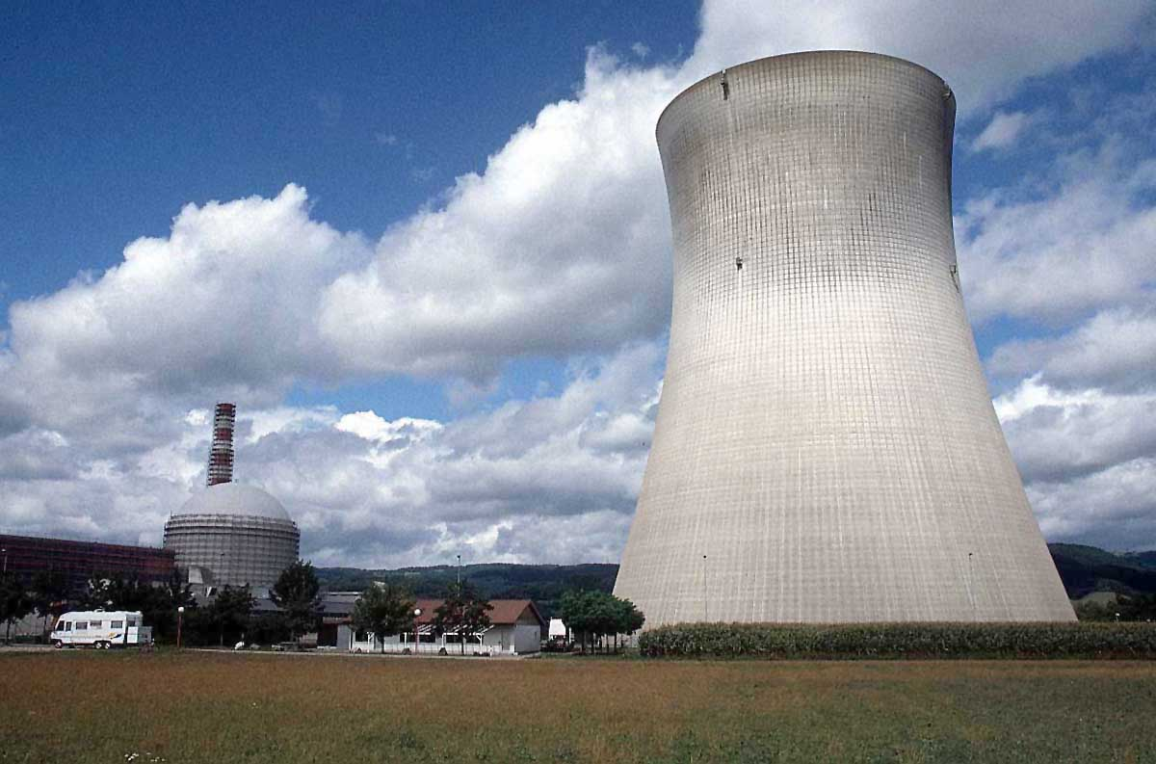
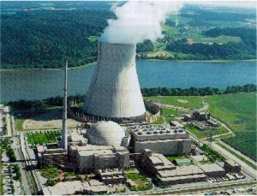
Nuclear Energy
Nuclear fission uses uranium to create energy
In nuclear fission, uranium-235 are split into smaller nuclei and emit neutrons and heat energy

Slide 12
Nuclear Energy Advantages
Nuclear reactions release more energy compared to hydro or wind energy
No greenhouse gases are released during nuclear reaction
Small amounts of uranium are needed to generate a large amount of energy
Inexpensive and easy to transport

Slide 13
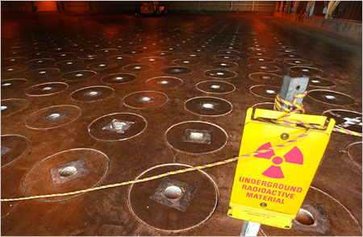
Nuclear Energy Disadvantages
It takes around 15-20 years to develop a single nuclear power plant
The waste produced contains unstable elements that are highly radioactive
The waste is very dangerous to the environment as well as human health, and remains for thousands of years

Slide 14
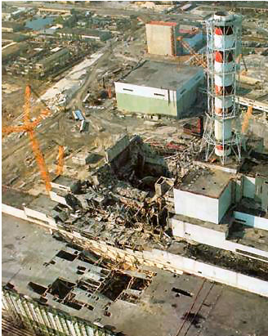
Chernobyl Disaster
The Chernobyl disaster that occurred in 1986 in Ukraine was the worst nuclear power plant disaster. One of the nuclear reactors of the plant exploded, releasing high amounts of radiation in the environment. It resulted in thousands of deaths.

