Slide 1
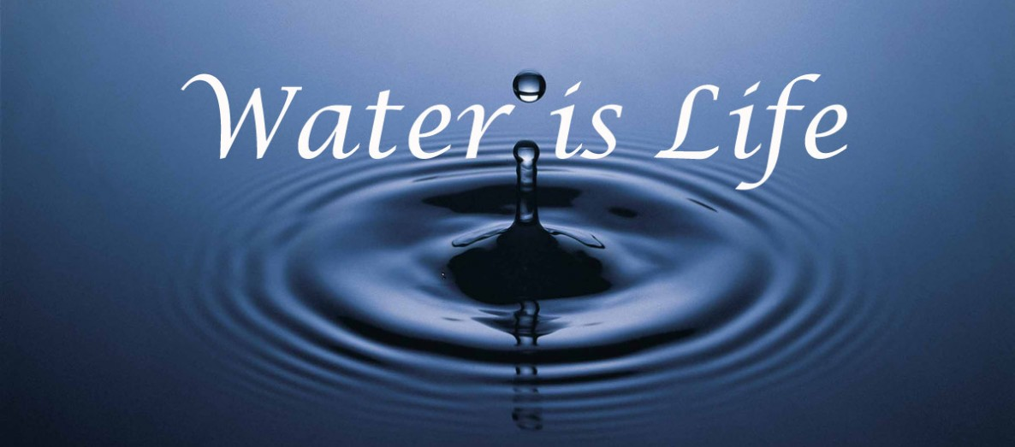
HYDROSPHERE
OBJECTIVE 1
ESSENTIAL QUESTION
HOW IS WATER STORED AND TRANSFERRED
GLOBALLY AND LOCALLY?

Slide 2
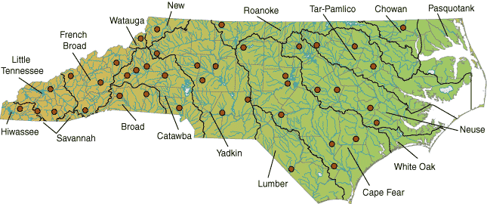
AICE QUESTION
WHAT IS MEANT BY THE TERMS:
WATER TABLE
IMPERMEABLE
SUBMARINE SPRING

Slide 3
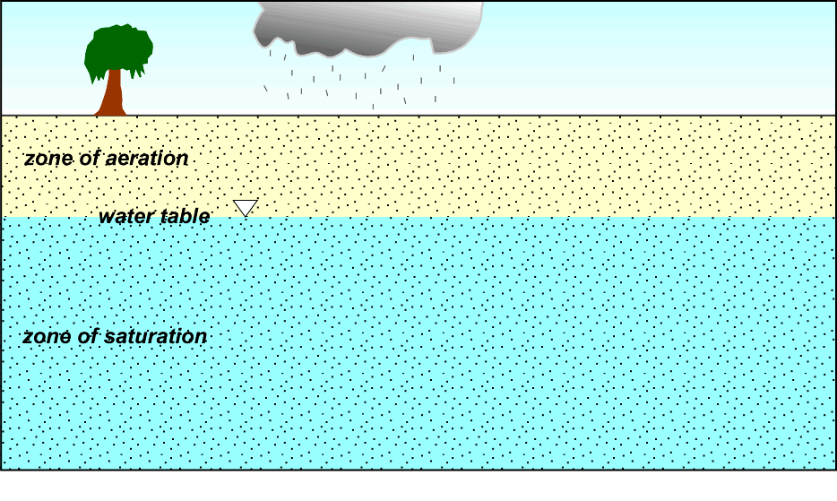
separating the zone of aeration (the subsurface region of soil and rocks in which the pores are filled with air and usually some water
WATER TABLE: UPPER LEVEL OF SATURATION WITHIN
PERMEABLE ROCK
from the zone of saturation (the subsurface region in which the pores are filled only with water).

Slide 4
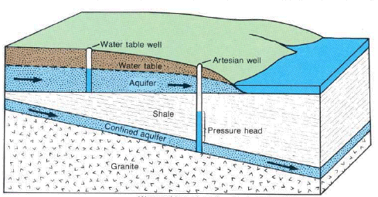
a layer of solid material, such as rock or clay, which does not allow water to pass through.
impermeable layer

Slide 5
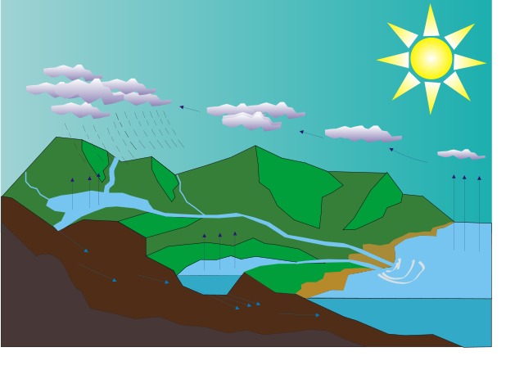
AICE QUESTION
DESCRIBE THE CHANGES IN THE STATE
OF WATER (SOLID, LIQUID AND GAS) IN
THE WATER/HYDROLOGIC CYCLE.

Slide 7
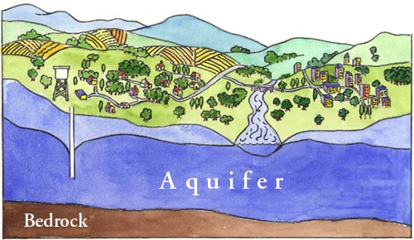
AICE QUESTION
EXPLAIN THE FORMATION OF THE AQUIFER.

Slide 8
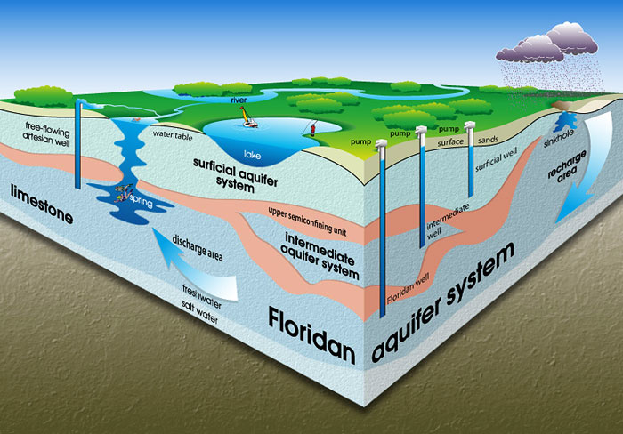
THE PORUS SANDSTONE LIES BETWEEN
IMPERMEABLE SHALE AND GRANITE.
2. WATER FROM THE RECHARGE ZONE PERCOLATES
DOWN INTO THE STORAGE ZONE.
3. THE AQUIFER FORMS BETWEEN THE TWO
IMPERMEABLE LAYERS, WATER IS TRAPPED IN THE
SANDSTONE BETWEEN GRANITE AND SHALE.

Slide 9
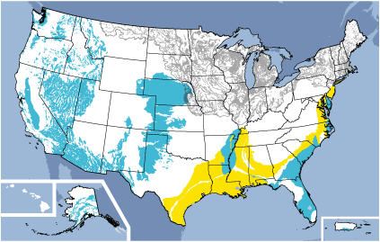
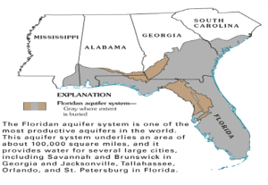

Slide 10
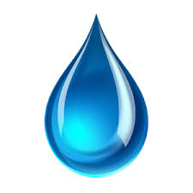
Why Is the Hydrological Cycle a Closed System?
The water cycle, also known as the hydrologic cycle describes the continuous movement of water on, above and below the surface of the earth. The hydrological cycle is a closed system because water is neither created nor destroyed on a large scale. Most of this water is stored in reservoirs such as the oceans, in glaciers and ice caps, underground, and in the atmosphere.

Slide 11
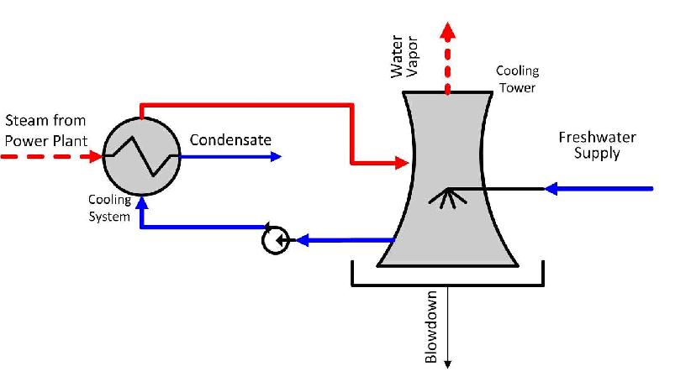
The simplest design is a once through or open cooling water system. Fresh water is retrieved from a convenient source, such as a local river. It is then pumped around the cooling water circuit before being ejected back into the environment – at a slightly higher temperature. While this is a simple system, it uses an extremely large quantity of water. This may make it impractical or unacceptable to the local environmental authorities.

Slide 12
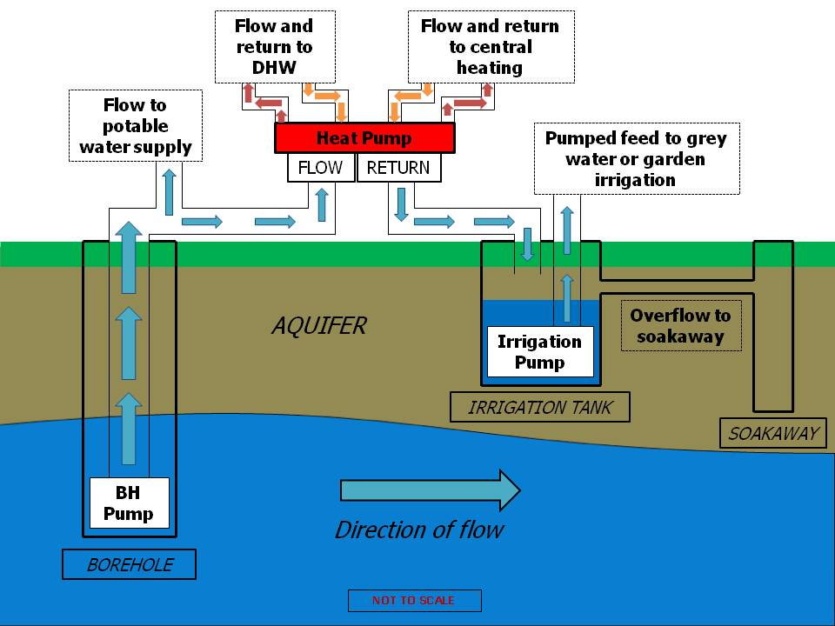

Slide 13
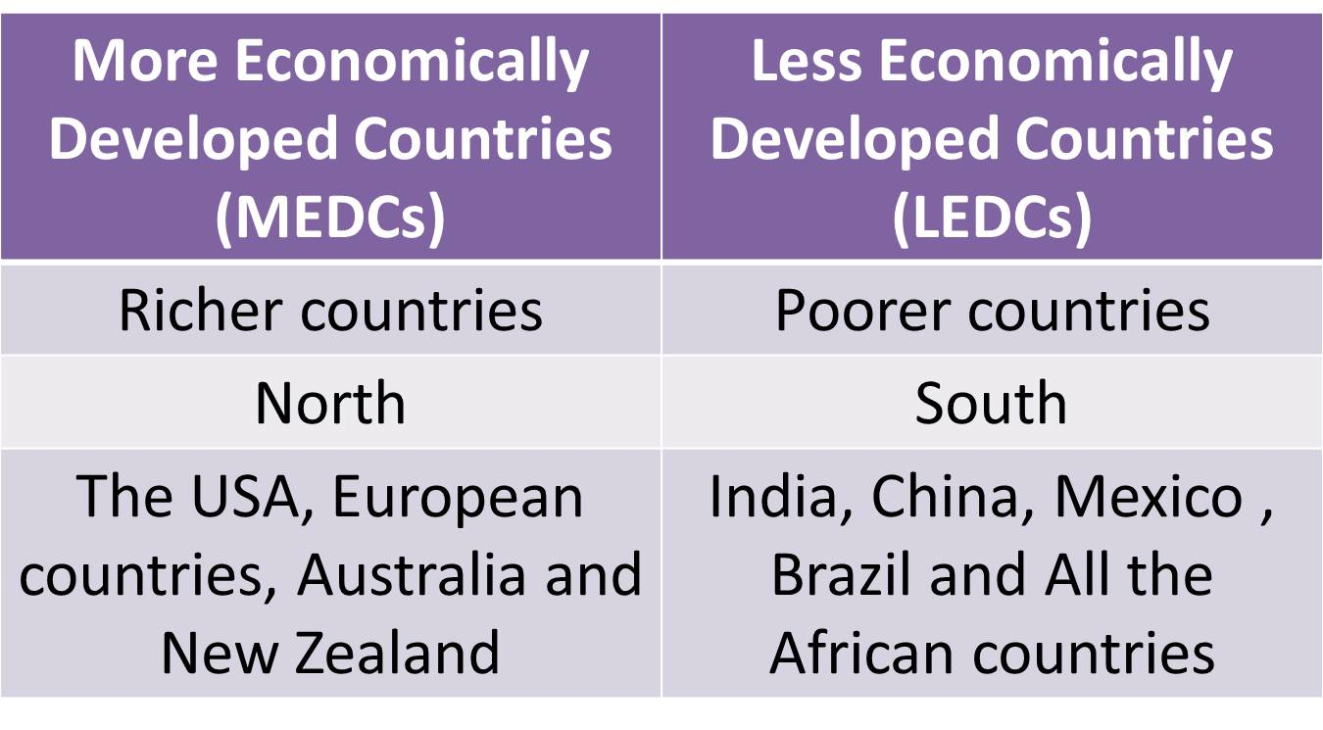

Slide 14
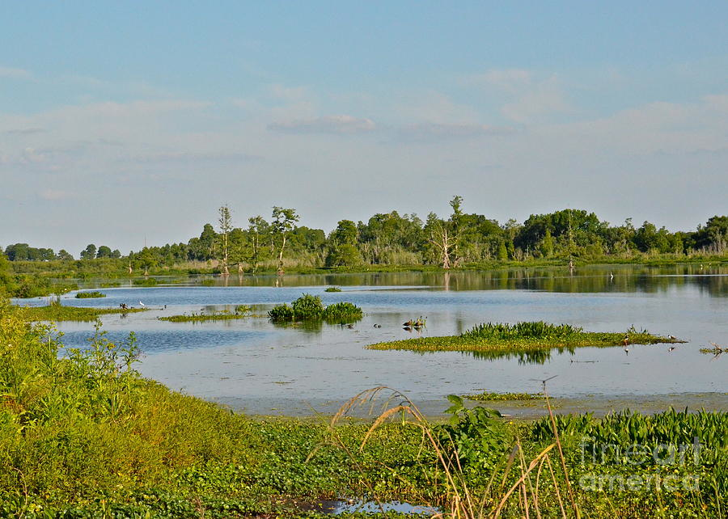
AICE QUESTION
EXPLAIN THE FORMATION OF A SWAMP

Slide 15
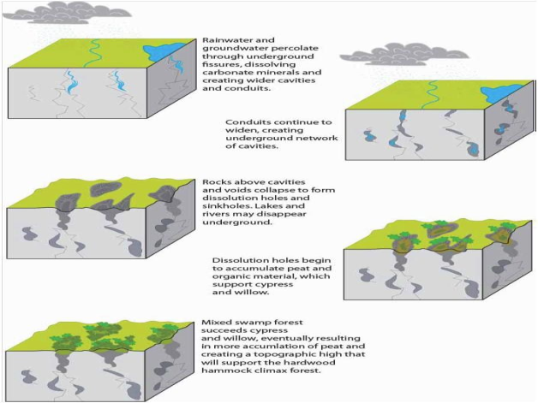

Slide 16
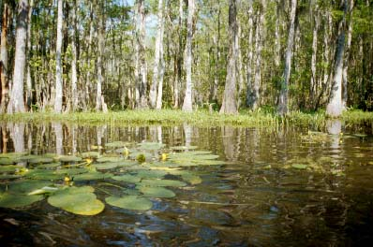
A swamp is a wetland that is forested. Many swamps occur along large rivers, where they are critically dependent on natural water level changes. Other swamps occur on the shores of large lakes
THE SWAMPY GROUND FORMS WHERE, THE LEVEL SURFACE LIES WITHIN, THE SATURATION
ZONE IN THE SANDSTONE

Slide 17
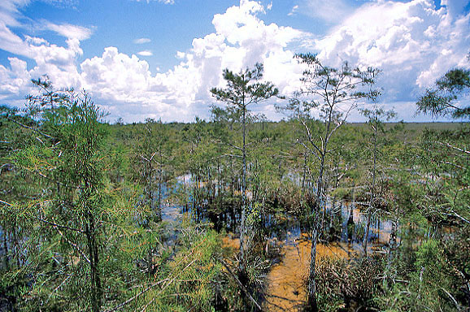
Swamp, wetland ecosystem characterized by mineral soils with poor drainage and by plant life dominated by trees. The latter characteristic distinguishes a swamp from a marsh, in which plant life consists largely of grasses. Swamps are found throughout the world. They exist in areas with poor drainage and sufficient water supply to keep the ground waterlogged.

