Slide 1
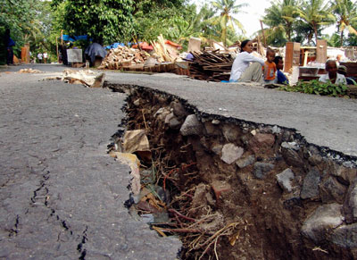
Earthquakes
Chapter 8

Slide 2
What is an earthquake?
The vibration of Earth produced by the rapid release of energy
Often caused by slippage along a break in Earth’s crust
Focus is the point within Earth where the earthquake began
Seismic waves are produced, generating in all directions, from the released energy
Epicenter is the location on Earth’s surface directly above the focus
Faults are fractures in Earth’s crust and mantle where movement has occurred

Slide 3
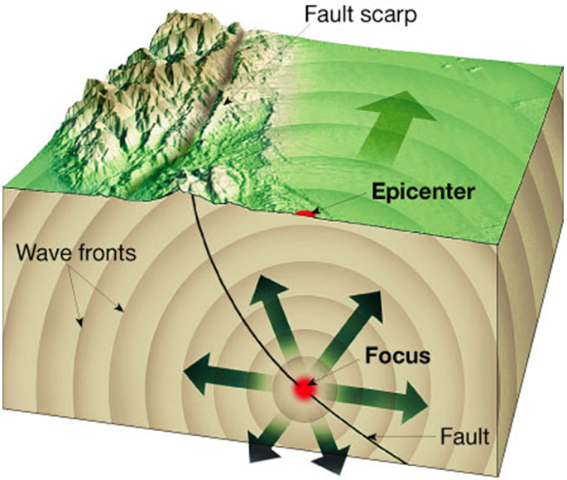

Slide 4
Causes of Earthquakes
Most earthquakes are produced by the rapid release of elastic energy stored in rock
When the strength of the rock is pushed over its limit, it breaks, causing the vibrations of an earthquake
Elastic Rebound Theory
The explanation stating that when rocks are deformed, they first bend then break. The rocks will snap back into place, returning to its original shape

Slide 5
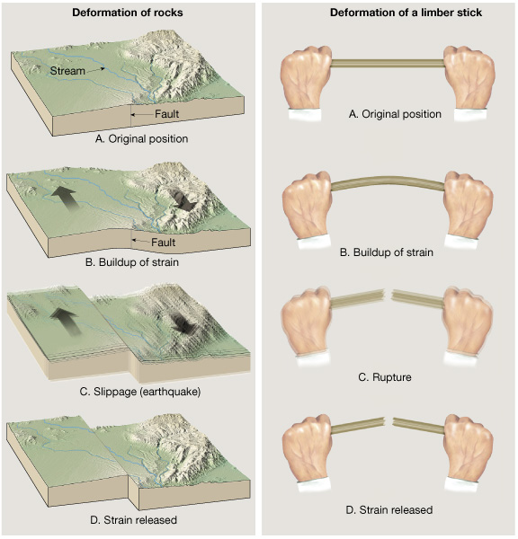
Figure 4 on page 220

Slide 6
Before and After
Foreshocks
Small earthquakes that often come before a major earthquake
Aftershocks
Following a major earthquake, there are often movements that produce smaller earthquakes
Can North Carolina experience earthquakes?
http://www.youtube.com/watch?v=jg2ryI5RlO0&NR=1&feature=fvwp

Slide 7
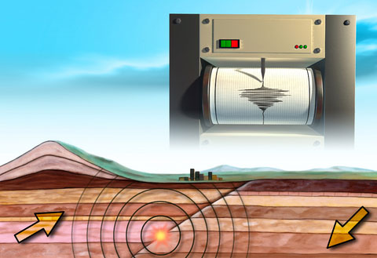
Measuring Earthquakes
Seismology is the study of earthquakes
Seismograph is an instrument used to record earthquake waves
Seismogram is a record from a seismograph

Slide 8
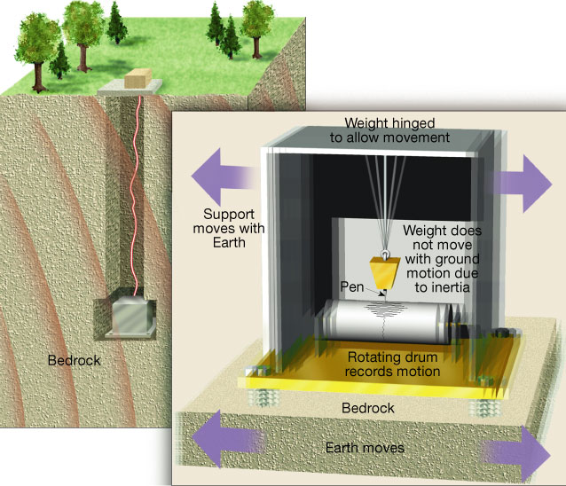
Seismograph

Slide 9
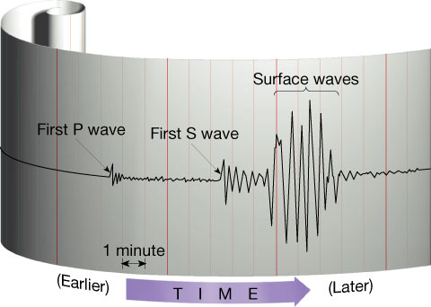
Seismogram

Slide 10
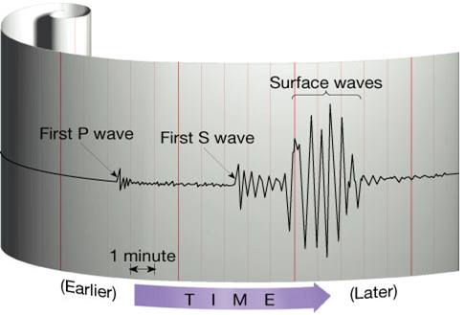
Earthquake Waves
Surface Waves
Body Waves
P Waves
S Waves

Slide 11
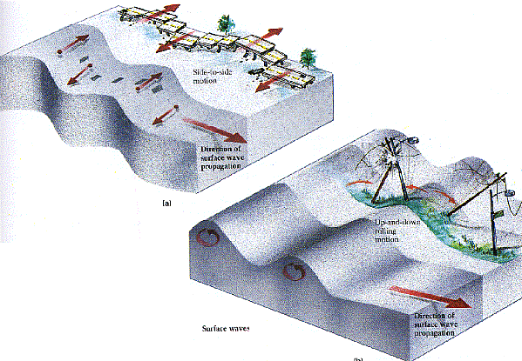
Earthquake Waves
Surface Waves
Travel along Earth’s outer layer, most destructive
Waves move in an up-and-down motion and a side-to-side motion

Slide 12
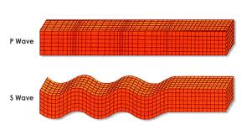
Earthquake Waves
Body Waves
P waves (Primary wave)
Waves that push [compress] and pull [expand] rocks in the direction the waves travel
Temporarily change the volume of the material they pass through
Can pass through all layers of Earth; solids, liquids, and gases
Greatest velocity
Also known as a compression or longitudinal wave

Slide 13
Earthquake Waves
Body Waves
S waves (Secondary wave)
Shake particles at right angles to their direction of travel
Temporarily change the shape of the material they pass through
Can only move through solids
Also known as shear wave or elastic S-wave

Slide 14
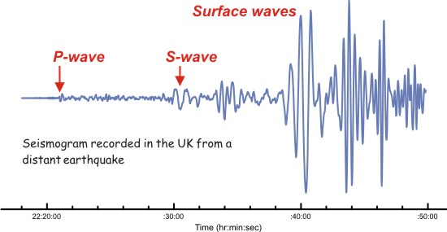
Earthquake Waves
Waves travel at different speeds
P waves travel about 1.7 times faster than S waves
Surface waves travel the slowest

Slide 15
Measuring an Earthquake
Scientists have used two different types of measurements to describe the size of an earthquake: intensity and magnitude
Richter Scale
Measures the magnitude
Magnitude is a measure of the amount of energy released at the source of the earthquake
Mercalli Intensity Scale
Measures the intensity
Estimates the damage from an earthquake in a specific location

Slide 16
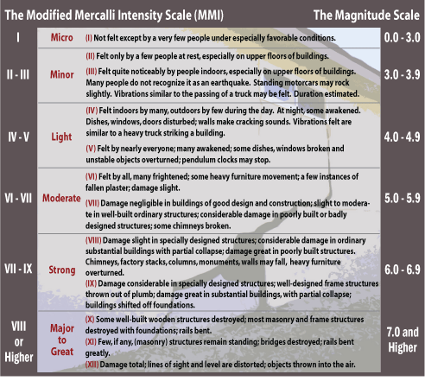
Richter and Mercalli Scale

Slide 17
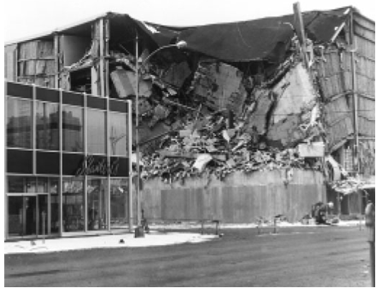
Destruction from Earthquakes
The damage to buildings and other structures from earthquake waves depends on several factors
The intensity and duration of the vibrations
The nature of the material on which the structure is built
The design of the structure

Slide 18
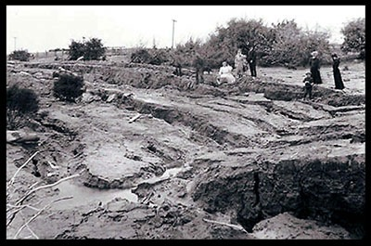
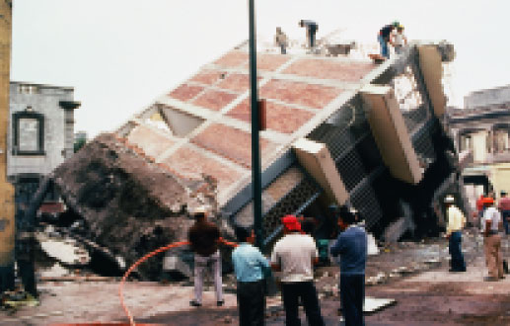
Destruction from Earthquakes
Liquefaction
Saturated material turns fluid
Underground objects may float to the surface

Slide 19
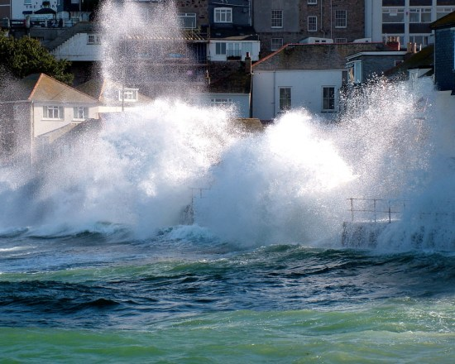
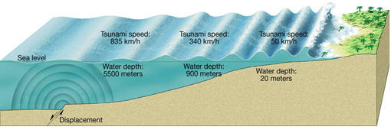
Destruction from Earthquakes
Tsunamis
Japanese word for “seismic sea wave”
A very large ocean wave caused by an underwater earthquake or volcanic eruption

Slide 20
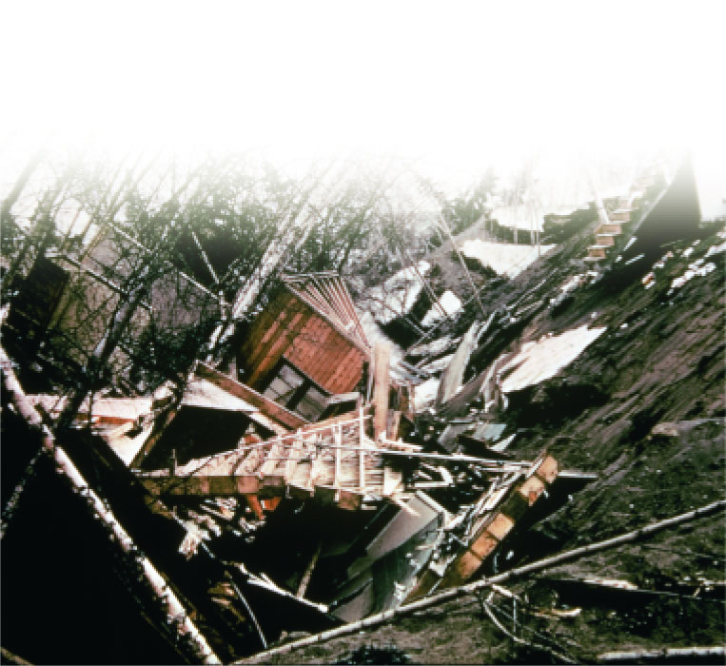
Destruction from Earthquakes
Landslides
The violent shaking from an earthquake can cause the ground to sink
Fire
Can occur if gas and electrical lines are damaged

