Slide 2
This lecture will help you understand:
The relationship between soils and agriculture
Major agricultural developments
The fundamentals of soil science
Causes and consequences of soil erosion and degradation
Soil conservation: principles, solutions, and policies
Techniques for watering and fertilizing crops and sustainable alternatives to the traditional methods

Slide 3
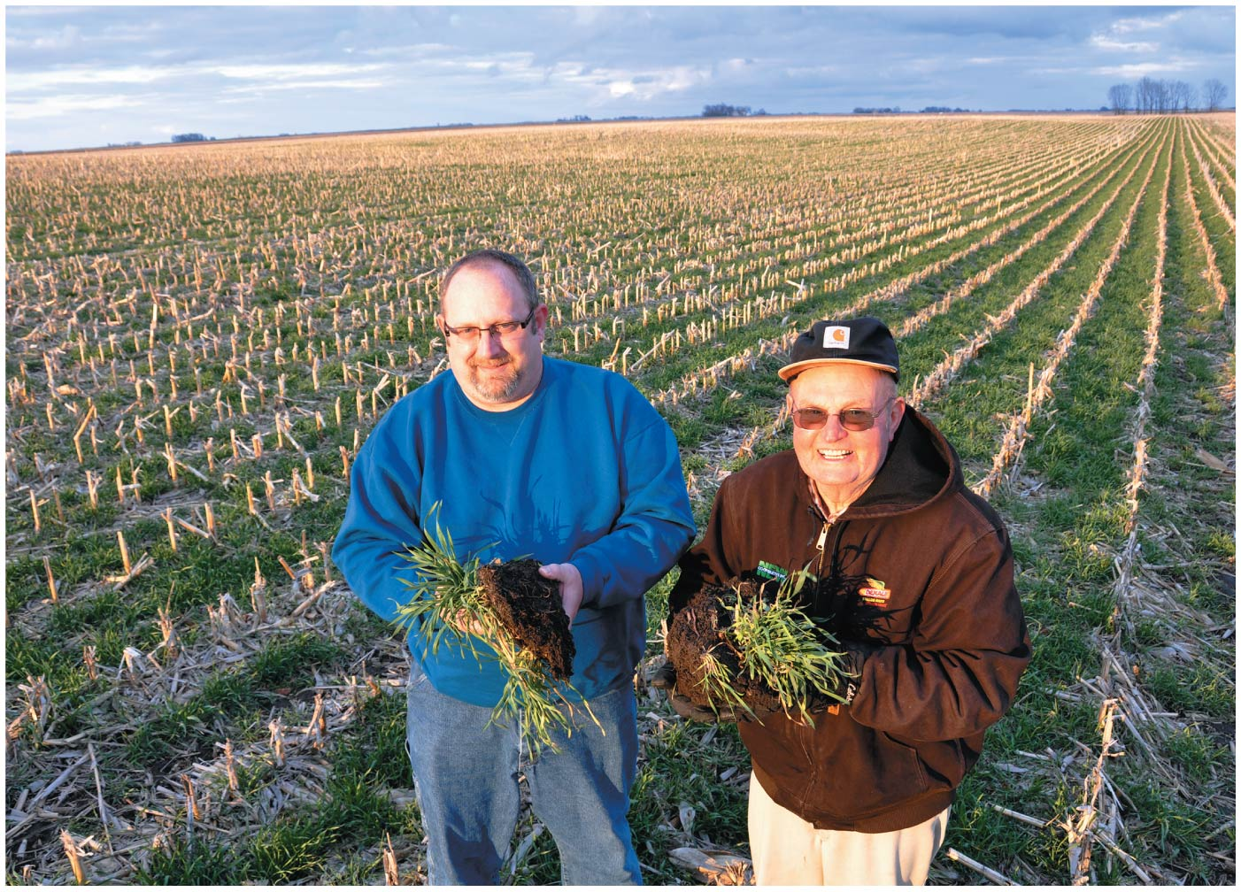

Slide 4
Central Case Study: Iowa’s Farmers Practice No-Till Agriculture
Repeated plowing and planting damage soil
No-till farming = leaving crop residue atop the fields
Benefits the soil
Saves time and money
Cover crops = crops planted to hold soil in place between the times that main food crops are growing
Other conservation measures:
Careful use of fertilizers
Preventing erosion
Retiring fragile soils

Slide 5
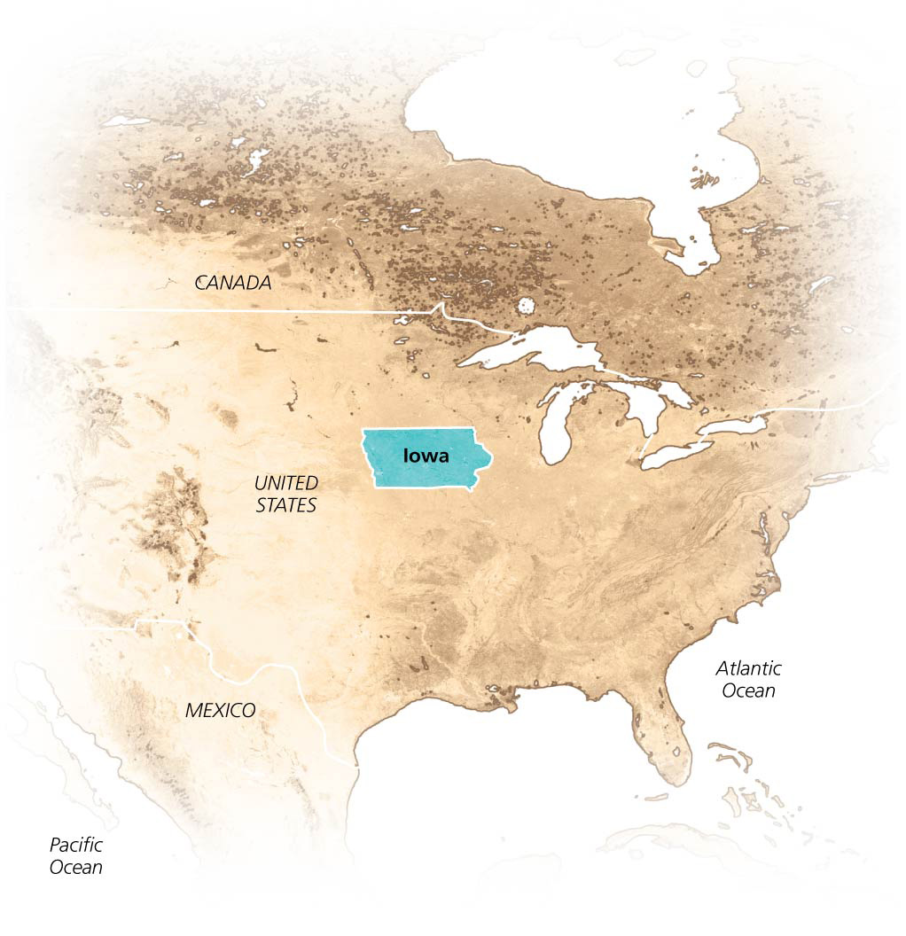

Slide 6
Soil: The Foundation for Sustainable Agriculture
Agriculture = practice of raising crops and livestock for human use and consumption
Cropland = land used to raise plants for human use
Rangeland or pasture = land used for grazing livestock
Land devoted to agriculture covers 38% of Earth’s land

Slide 7
Soil: The Foundation for Sustainable Agriculture
Soil = a complex plant-supporting system
Consists of disintegrated rock, organic matter, water, gases, nutrients, and microorganisms
It is a renewable resource that can be depleted
Sustainable agriculture = agriculture we can practice in the same way and same place far into the future

Slide 8
Soil supports agriculture
Agriculture and plants require healthy soil to
Provide nutrients
Have a structure that allows roots to penetrate deeply
Retain water
Livestock depend on healthy soil because they depend on the plants that grow there
Soils has sustained agriculture for thousands of years

Slide 9
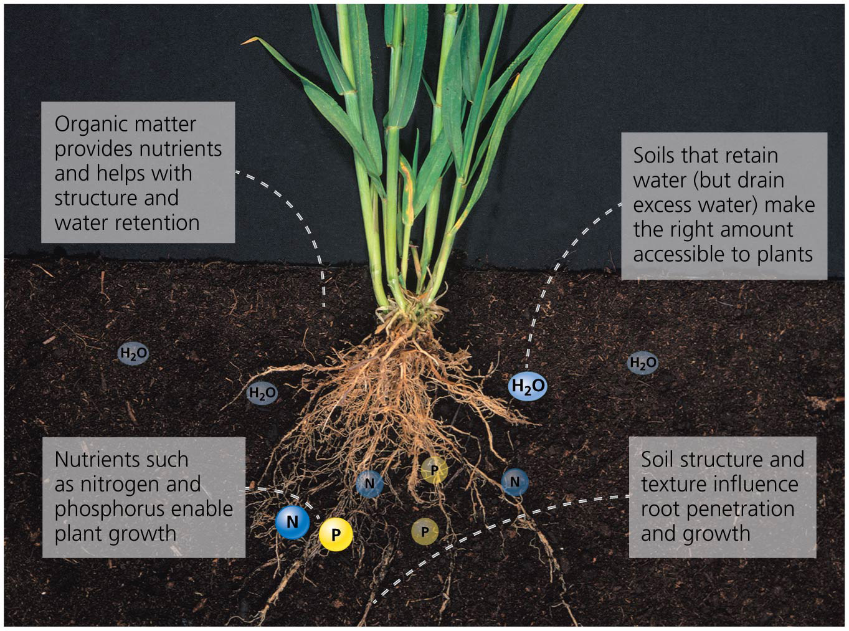

Slide 10
Agriculture arose 10,000 years ago
Different cultures independently invented agriculture
Evidence for the earliest plant and animal domestication is from the “Fertile Crescent” of the Middle East
Agriculture rose independently in at least China, Africa, and the Americas
Raising crops was a positive feedback cycle
Harvesting the crops required people to be sedentary
Being sedentary encouraged the planting of more crops and production of more food
More crops allowed larger populations
Larger populations required planting more crops

Slide 11
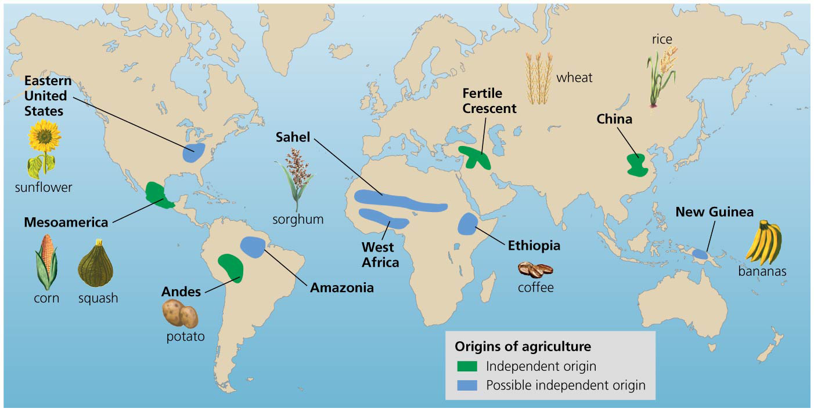

Slide 12
Industrial agriculture dominates today
Traditional agriculture = biologically powered form of agriculture that uses human and animal muscle power
Hand tools, simple machines
Subsistence agriculture = form of agriculture in which families produce only enough food for themselves
Polyculture = different crops are planted in one field
Market economies allowed farmers to sell their product
Increased use of irrigation and fertilizer

Slide 13
Industrial agriculture dominates today
Industrialized agriculture = form of agriculture that uses large-scale mechanization and fossil fuels to boost yields
Also uses pesticides, irrigation, and fertilizers
Monoculture = uniform planting of a single crop
Green Revolution = new technology, crop varieties, and farming practices were introduced to developing countries
Increased yields and decreased starvation
Degraded the integrity of the soil

Slide 14
Soil as a System
Soil consists of 50% mineral matter
Up to 5% organic matter
Dead and living microorganisms
Decaying material from plants and animals
The remainder is pore space taken up by air and water
Soil is teeming with bacteria, algae, fungi, and protists and provides habitat for earthworms, insects, mammals, reptiles, and amphibians
Since soil is composed of interacting living and nonliving matter, it is considered an ecosystem

Slide 15
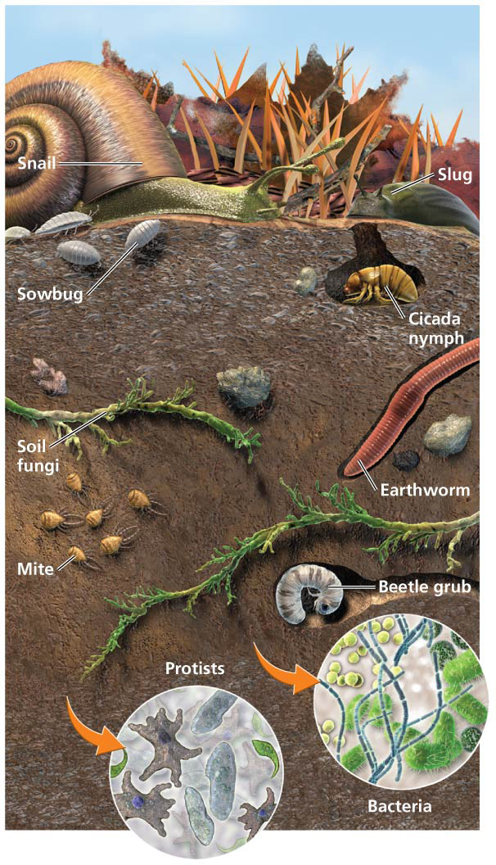

Slide 16
Soil forms slowly
Parent material = the base geologic material of soil
Lava, volcanic ash, rock, dunes
Bedrock = solid rock comprising the Earth’s crust
Weathering = processes that break large rock particles down into smaller ones
Physical (mechanical) = wind and rain; no chemical changes in the parent material
Chemical = parent material is chemically changed
Biological = organisms produce soil through physical or chemical means
Humus = spongy material formed by partial decomposition of organic matter; holds moisture

Slide 17
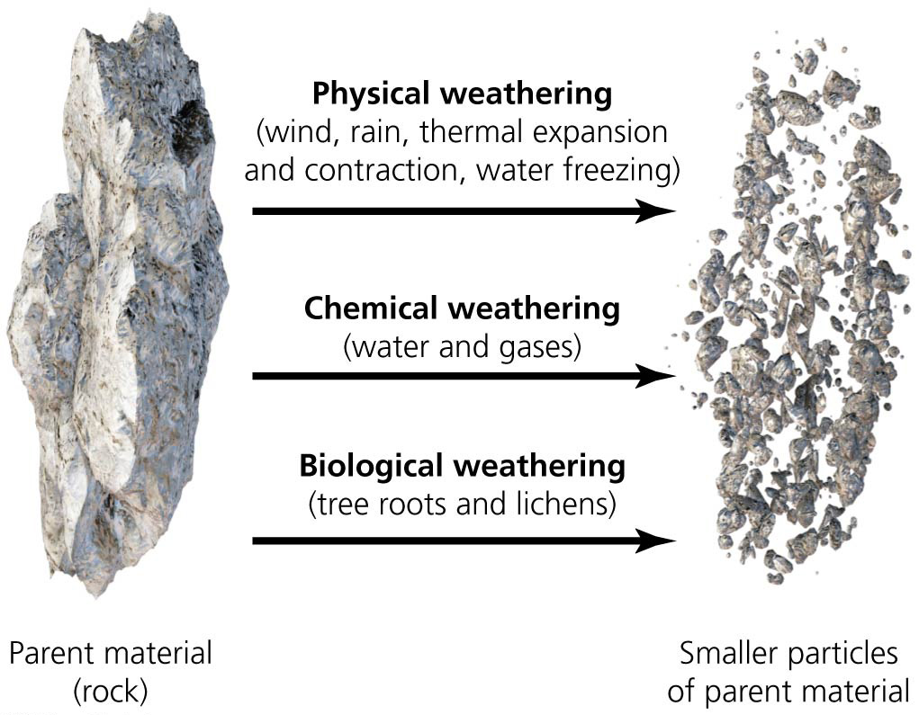

Slide 18
Soil forms slowly
Key processes in forming soil: weathering and the accumulation and transformation of organic matter
They are influenced by the following factors:
Climate: soils form faster in warm, wet climates
Organisms: plants and decomposers add organic matter
Topography: hills and valleys affect exposure to sun, wind, and water
Parent material: influences properties of resulting soil
Time: soil can take decades to millennia to form

Slide 19
Soil Formation and Nutrient Uptake—Soil Formation Right-click/Select Play

Slide 20
A soil profile consists of horizons
Horizon = each layer of soil
Soil can have up to six horizons
Soil profile = the cross-section of soil as a whole
Degree of weathering and amount of organic matter decrease in lower horizons

Slide 21
A soil profile consists of horizons
Leaching = process whereby dissolved particles move down through horizons and may end up in drinking water
Some materials in drinking water are hazardous
Topsoil = inorganic and organic material most nutritive for plants
Vital for agriculture

Slide 22
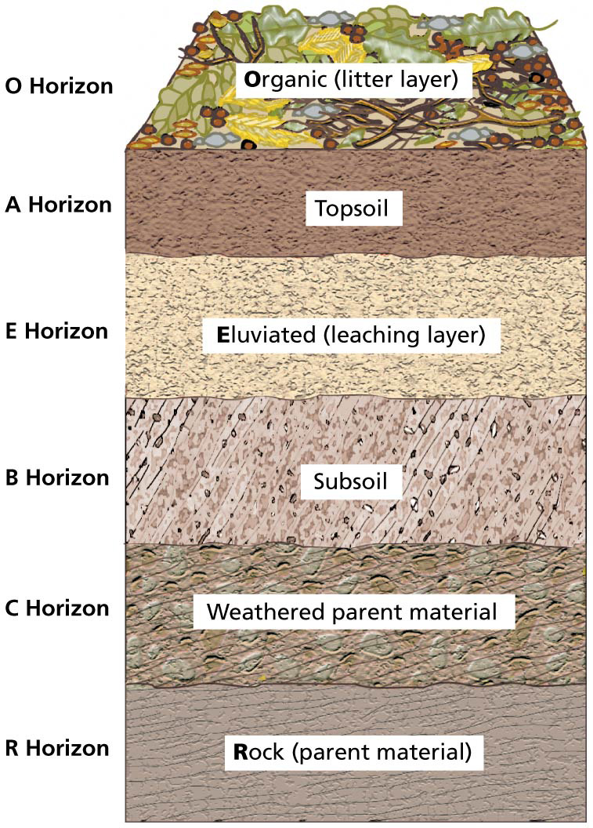

Slide 23
Soils differ in color, texture, structure, and pH
Soil color indicates its composition and fertility
Black or dark brown soil is rich in organic matter
Pale gray or white soil indicates leaching
Soil texture is determined by the size of particles
From smallest to largest: clay, silt, sand
Loam = soil with an even mixture of the three
Affects how easily air and water travel through the soil
Influences how easy soil is to cultivate

Slide 24
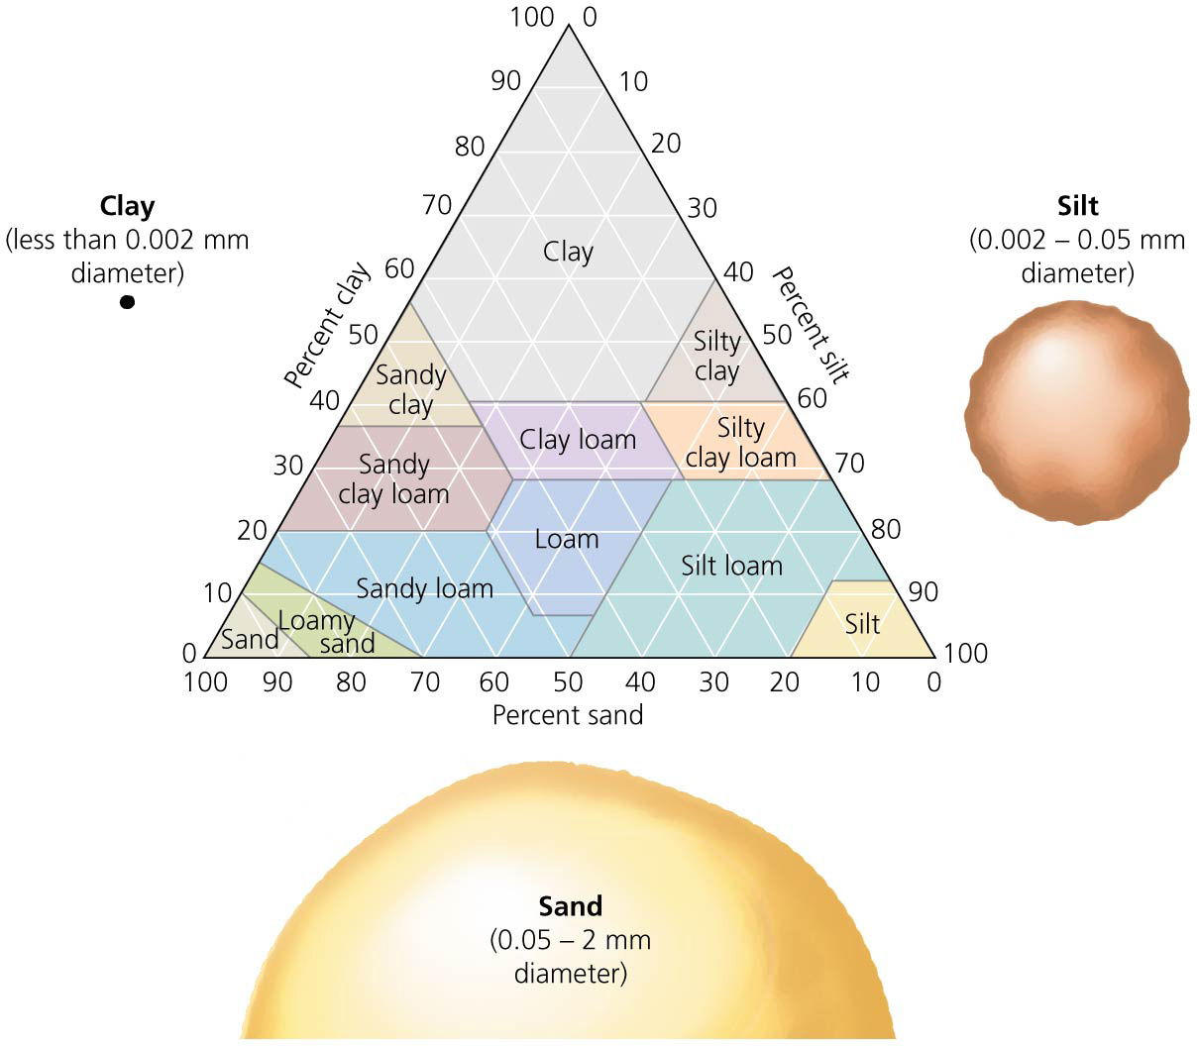

Slide 25
Soils differ in color, texture, structure, and pH
Soil structure is a measure of soil’s “clumpiness”
A medium amount of clumpiness is best for plants
Repeated tilling compacts soil, decreasing its water-absorbing capabilities
Soil pH affects a soil’s ability to support plant growth
Soils that are too acidic or basic can kill plants
pH influences the availability of nutrients for plants

Slide 26
Cation exchange is vital for plant growth
Cation exchange = process that allows plants to gain nutrients
Negatively charged soils hold cations (positively charged ions) of calcium, magnesium, and potassium
Roots donate hydrogen to soil in exchange for these nutrients

Slide 27
Cation exchange is vital for plant growth
Cation exchange capacity = a soil’s ability to hold cations
Cations that don’t leach are more available to plants
A useful measure of soil fertility
Greatest in fine textured or richly organic soils
Decreases with lower pH

Slide 28
Soil Formation and Nutrient Uptake—Nutrient Availability
Right-click/Select Play

Slide 29
Regional soil differences affect agriculture
Soil characteristics vary from place to place
In rainforests the nutrients are in plants, not the soil
Rain leaches minerals and nutrients, reducing their accessibility to roots
Rapid decomposition of leaf litter results in a thin topsoil layer with little humus

Slide 30
Regional soil differences affect agriculture
Swidden agriculture = traditionally used in tropical areas
After cultivation, a plot is left to grow back into forest
Soils are depleted if not enough time is given
Temperate prairies have lower rainfall and less nutrient leaching and are able to build rich topsoil

Slide 31
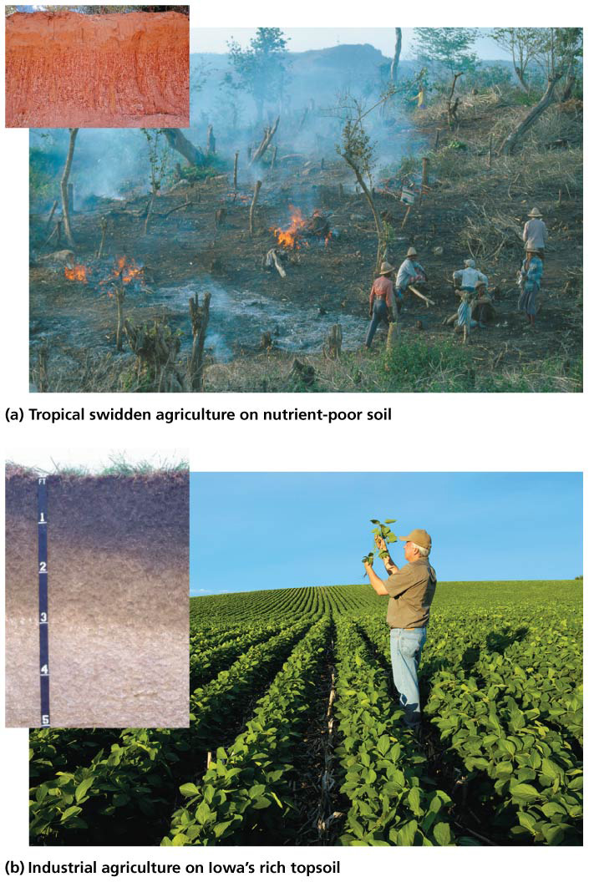

Slide 32
Conserving Soil
Feeding the world’s rising human population requires changing our diet or increasing agricultural production
But land suitable for farming is running out
Mismanaged agriculture turns grasslands into deserts, removes forests, diminishes biodiversity and encourages the growth of non-native species
It also pollutes soil, air, and water with chemicals
Fertile soil is blown and washed away
We must improve the efficiency of food production while we decrease our impact on natural systems

Slide 33
Damage to soil and land makes conservation vital
Soil degradation = a decline in soil quality and productivity
Primarily from deforestation, cropland agriculture, overgrazing
Over the past 50 years, soil degradation has reduced potential food crop production by 13%
Land degradation = a general deterioration of land, decreasing its productivity and biodiversity
Erosion, nutrient depletion, water scarcity, salinization, waterlogging, chemical pollution

Slide 34
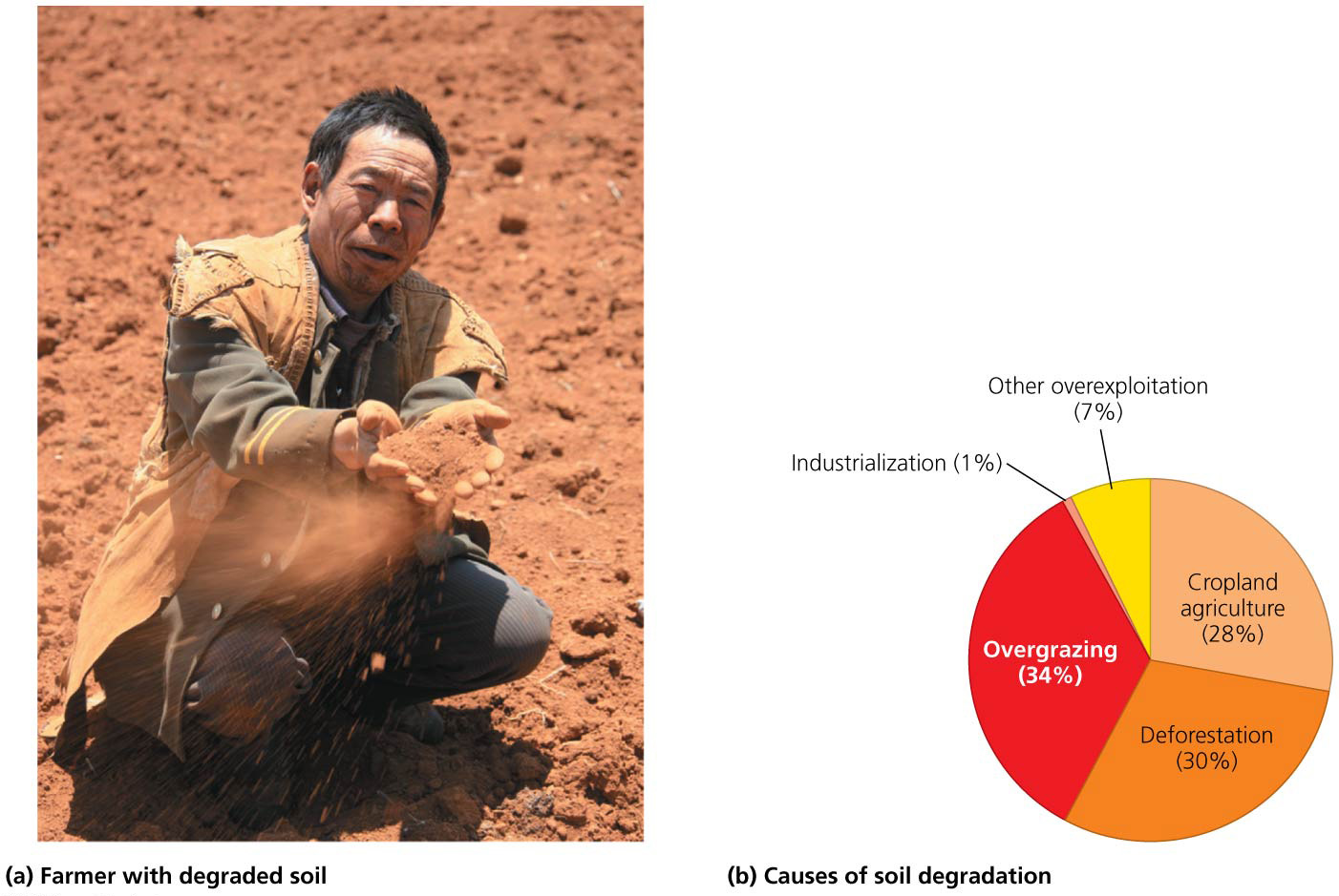

Slide 35
Erosion threatens ecosystems and agriculture
Erosion = removal of material from one place to another by wind or water
Deposition = arrival of eroded material at a new location
Flowing water deposits nutrient-rich sediment in river valleys and deltas
Floodplains are excellent for farming
Erosion occurs faster than soil is formed
It tends to remove topsoil—the most valuable layer for plant growth

Slide 36
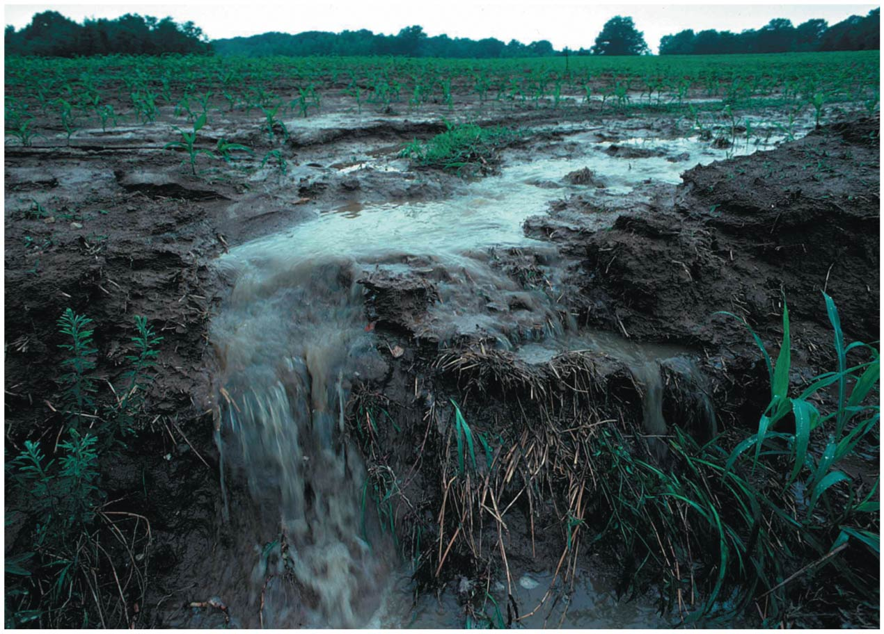

Slide 37
Erosion threatens ecosystems and agriculture
Windy regions with sparse plant cover suffer from wind erosion
Areas with steep slopes, high precipitation, and little plant cover suffer from water erosion
Land is made more vulnerable to erosion through:
Overcultivating fields through poor planning or excessive tilling
Overgrazing rangelands
Clearing forests on steep slopes or with large clear-cuts
U.S. croplands lose about 2.5 cm (1 in.) of topsoil every 15–30 years

Slide 38
Erosion threatens ecosystems and agriculture
Erosion can be hard to detect and measure
Physical barriers to capture soil can prevent erosion
Plants prevent soil loss by slowing wind and water flow
Roots hold soil in place
No-till agriculture leaves plant residue on fields
Cover crops protect soil between crop plantings

Slide 39
Soil erosion is a global issue
Humans are the primary cause of erosion
Human activities move over 10 times more soil than all natural processes combined
Conservation farming decreases erosion rates over conventional agriculture
More than 19 billion ha (47 billion acres) of the world’s croplands suffer from erosion and other forms of soil degradation resulting from human activity
U.S. farmlands lose 5 tons of soil for each ton of grain harvested
In Africa, erosion could reduce crop yields by half in coming decades

Slide 40
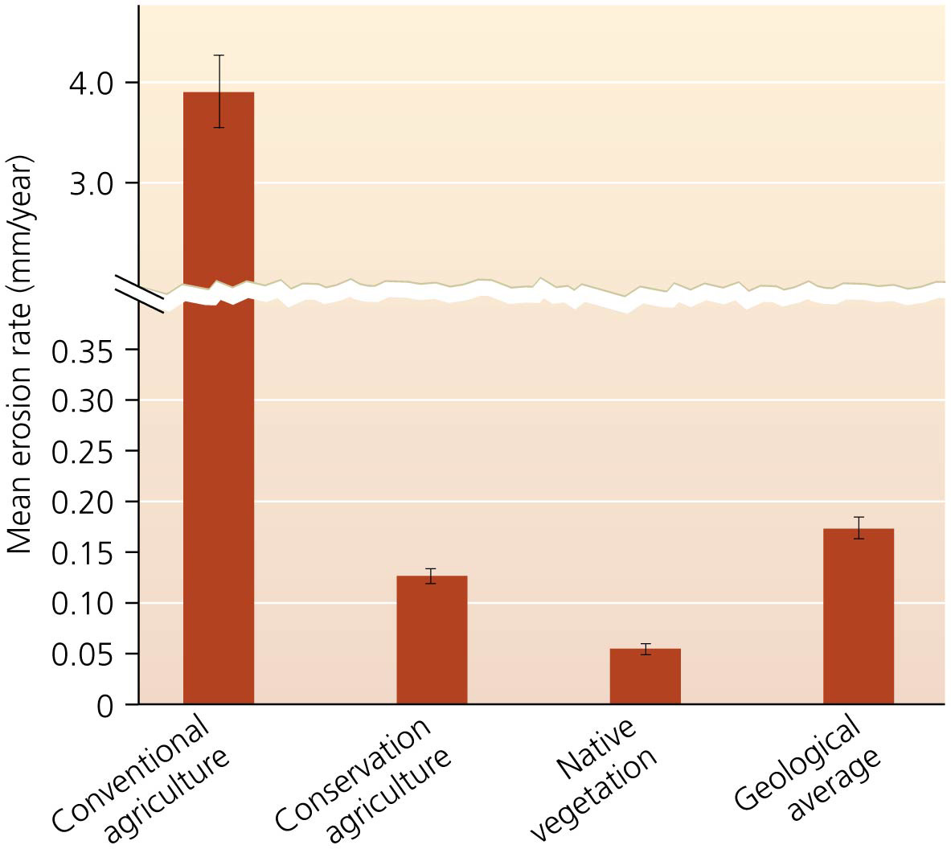

Slide 41
Desertification reduces productivity of arid lands
Desertification = a form of land degradation with more than a 10% loss of productivity
Caused primarily by wind and water erosion, but also by:
Deforestation, soil compaction, and overgrazing
Drought, salinization, water depletion
Climate change
Arid and semiarid lands (drylands) are most prone to desertification
Cover about 40% of the Earth’s surface

Slide 42
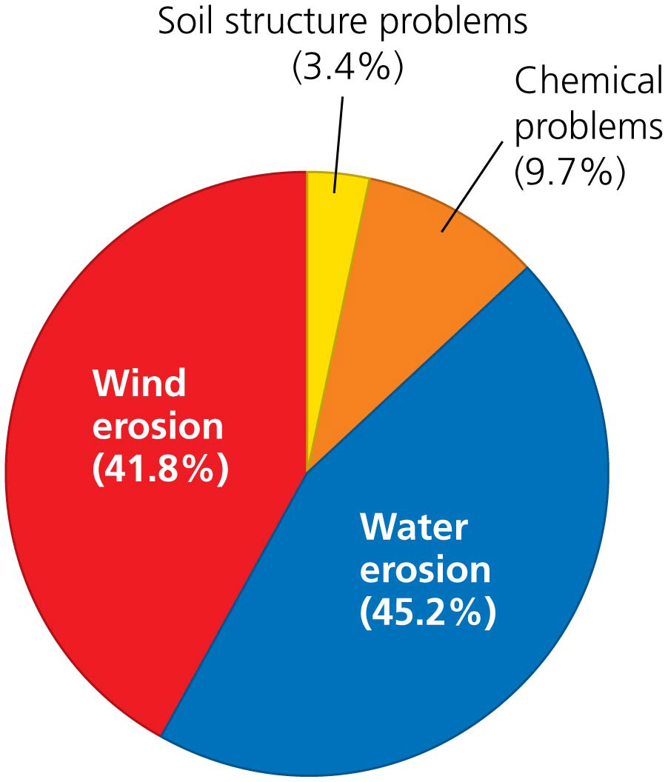

Slide 43
Desertification reduces productivity of arid lands
Desertification affects one-third of the planet’s land area
In over 100 countries
Endangering food supplies of 1 billion people
It costs tens of billions of dollars each year
China loses over $6.5 billion/year
80% of land in Kenya is vulnerable to desertification from overgrazing and deforestation
Desertification is intensified by positive feedback
Degradation forces farmers onto poorer land
Farmers reduce fallow periods, so land loses nutrients

Slide 44
The Dust Bowl shook the United States
Prior to industrial agriculture in the Great Plains, the native short-grass prairie held the soil in place
In late 1800 and early 1900, farmers and ranchers:
Grew wheat, grazed cattle
Used unsuitable land and removed native grasses
Dust Bowl = massive dust storms from erosion of millions of tons of topsoil in the 1930s
Drought worsened the human impacts
Dust storms traveled up to 2000 km (1250 miles)
Thousands of farmers left their land

Slide 45
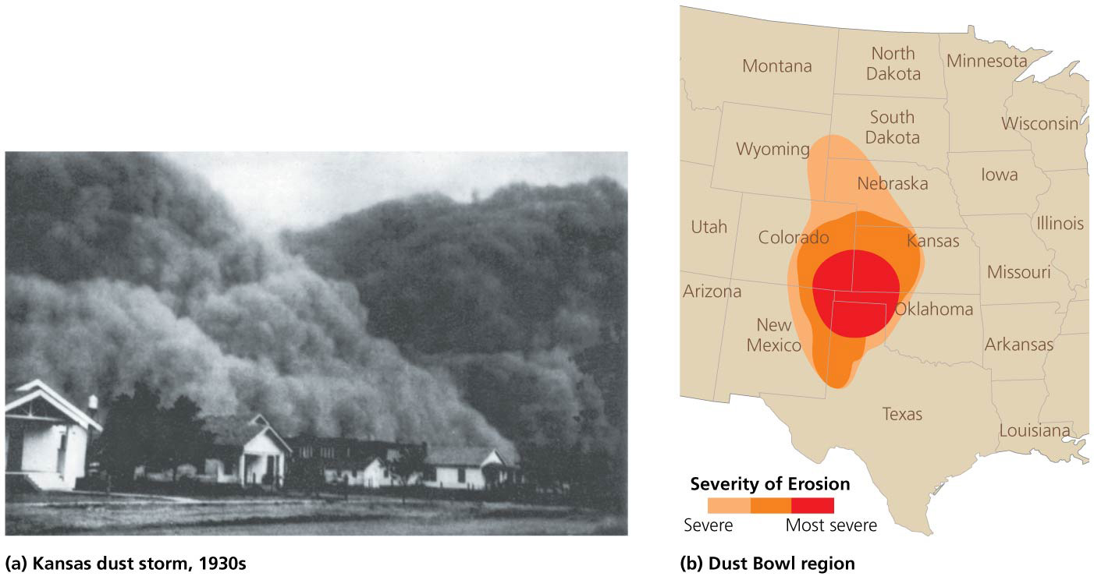

Slide 46
The Soil Conservation Service pioneered measures to address soil degradation
In response to the Dust Bowl, the U.S. Congress created the Soil Conservation Service
Started in 1935, the Service works with farmers to develop conservation plans for individual farms
Conservation districts = districts that promote soil conservation practices at the county level
Operate with federal direction, authorization, and funding and are organized by the states

Slide 47
The Soil Conservation Service pioneered measures to address soil degradation
In 1994, the Service was renamed Natural Resources Conservation Service (NRCS)
Responsibilities expanded to also include water quality protection and pollution control

Slide 48
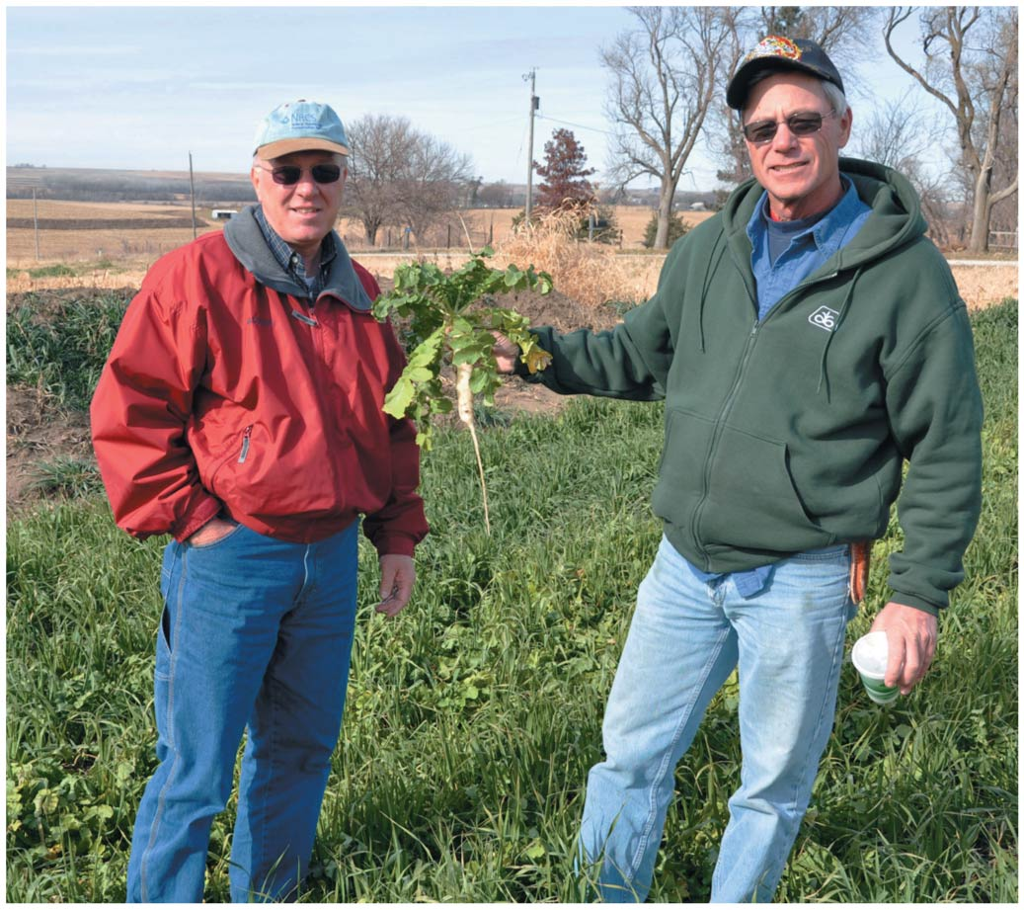

Slide 49
Soil conservation is thriving worldwide
The SCS and NRCS serve as models for efforts around the world
The majority of farmland in Argentina, Brazil, and Paraguay uses no-till farming
Resulted from grassroot farmers’ organizations
Helped by agronomists and government extension agents

Slide 50
Farmers protect soil in many ways
Crop rotation = growing different crops from one year to the next
Returns nutrients to soil
Prevents erosion, reduces pests
Like crop rotation, no-till farmers may alternate wheat or corn with nitrogen-fixing soybeans
Contour farming = plowing furrows sideways across a hillside perpendicular to its slope
Sides of furrows trap water and prevent erosion
Terracing = cutting level platforms into steep hillsides
The steps of this “staircase” hold water

Slide 51
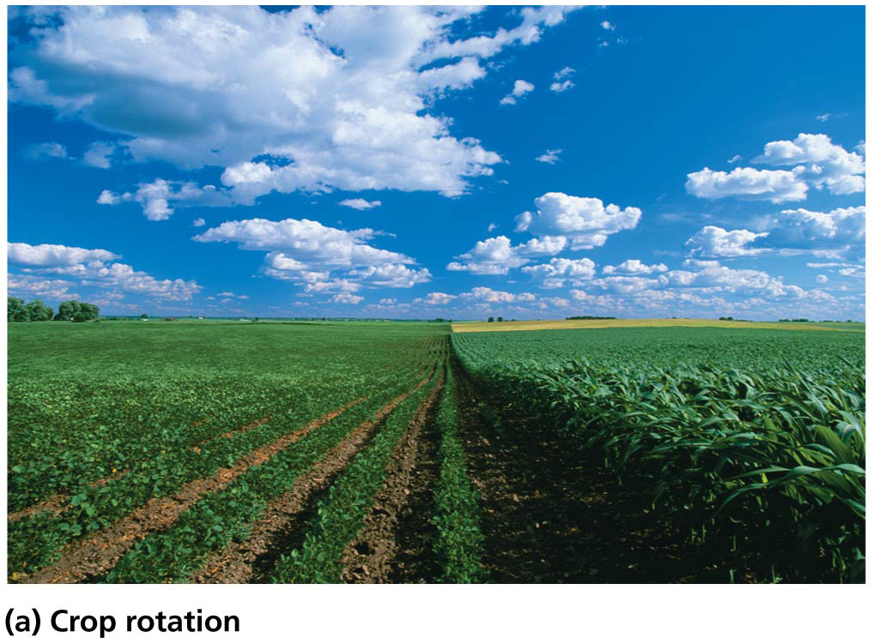
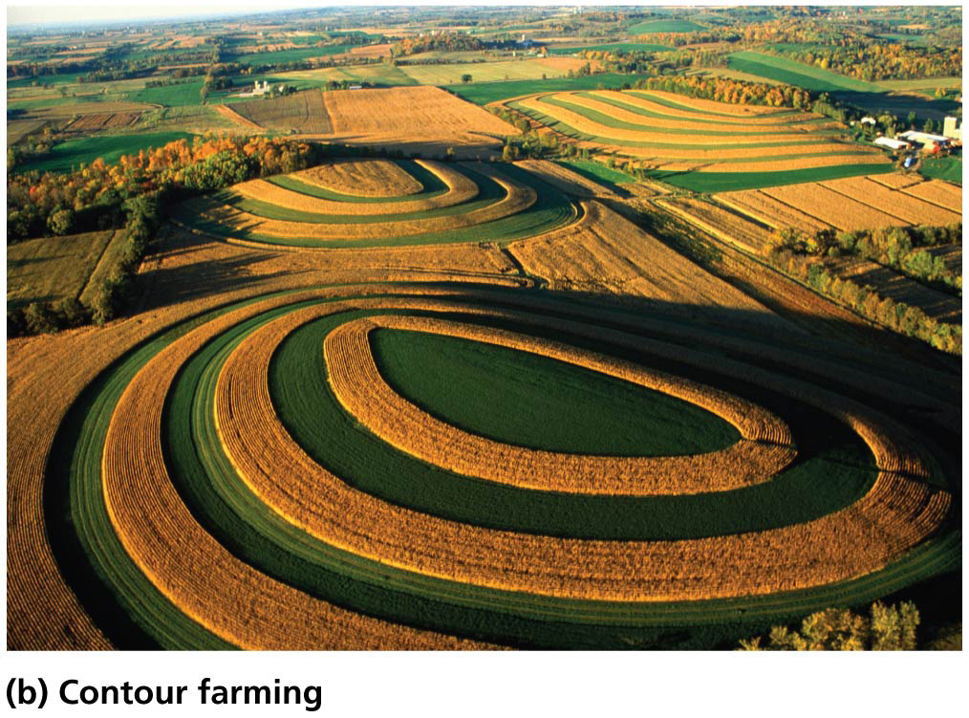
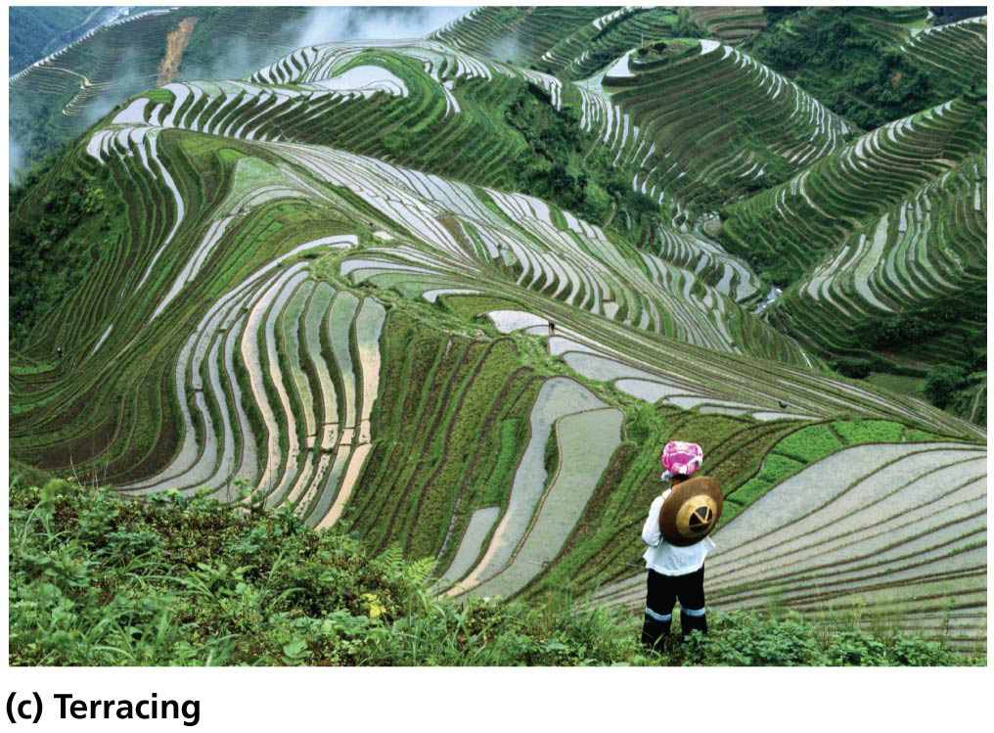

Slide 52
Farmers protect soil in many ways
Intercropping = planting different crops in alternating bands or mixed arrangements
Increases ground cover, preventing erosion
Decreases pests and disease
Replenishes soil

Slide 53
Farmers protect soil in many ways
Shelterbelts (windbreaks) = rows of trees planted along edges of fields to slow the wind
Can be combined with intercropping
Conservation tillage = strategies that reduce the amount of tilling relative to conventional farming
Leaves at least 30% of crop residues in the field
No-till farming disturbs the soil even less

Slide 54
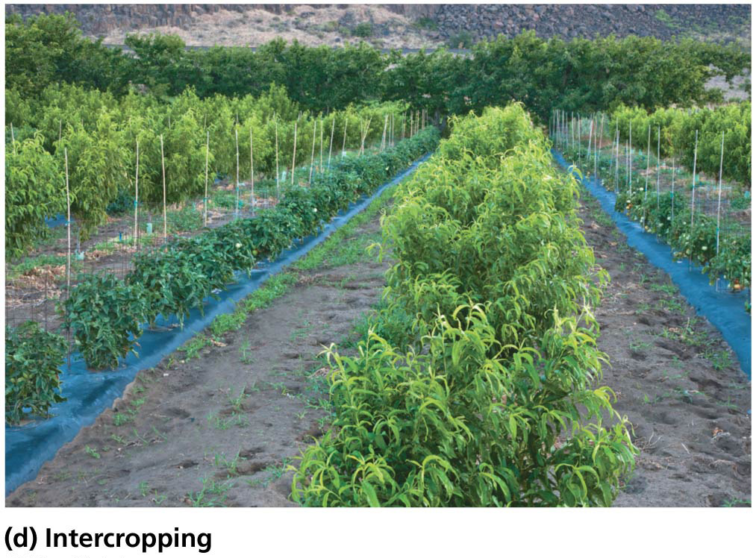
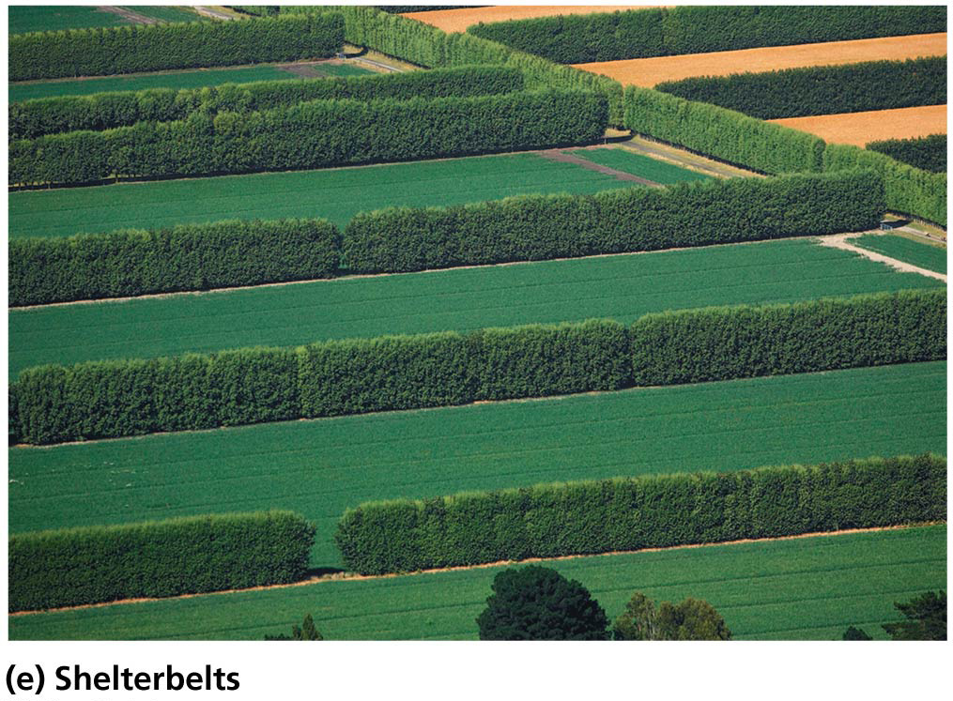
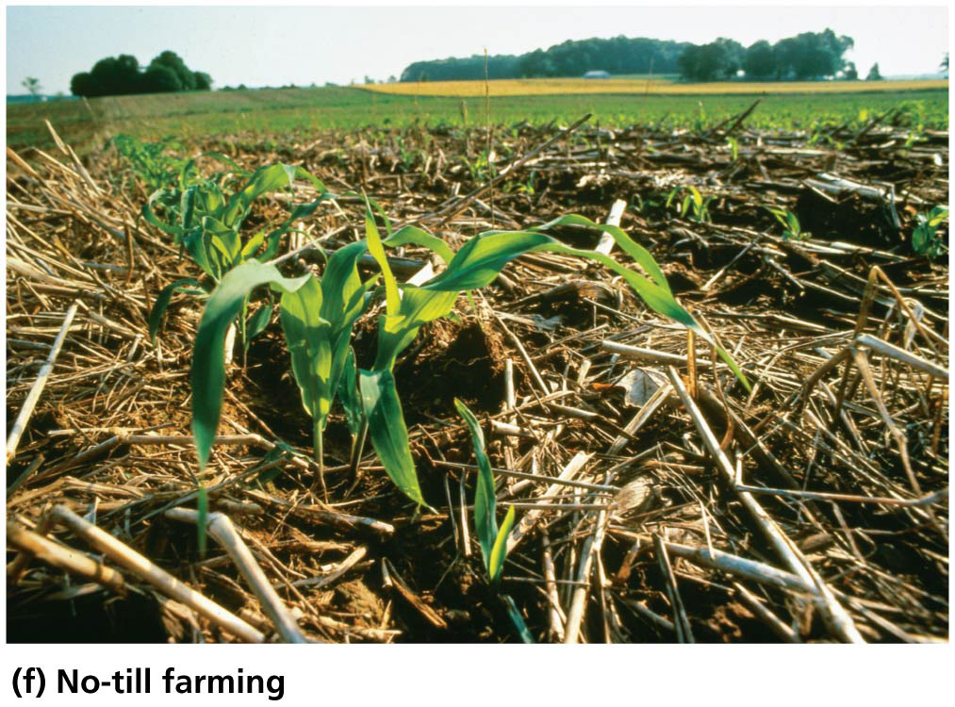

Slide 55
No-till farming has many benefits
It increases organic matter and soil biota
Reduces erosion and improves soil quality
Uses less labor, saves time, causes less wear on machinery
Prevents carbon from entering the atmosphere (carbon storage)—may help mitigate climate change
Reduces fossil fuel use due to less use of the tractors
Adds organic matter to soils that is kept from the atmosphere

Slide 56
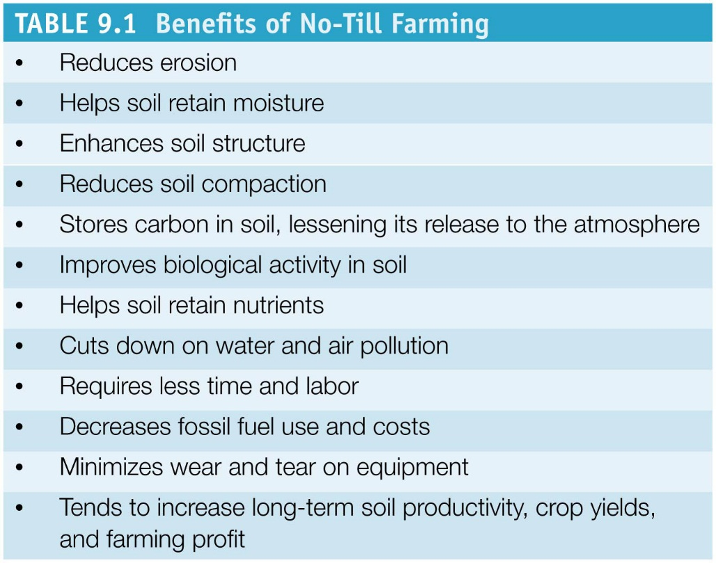
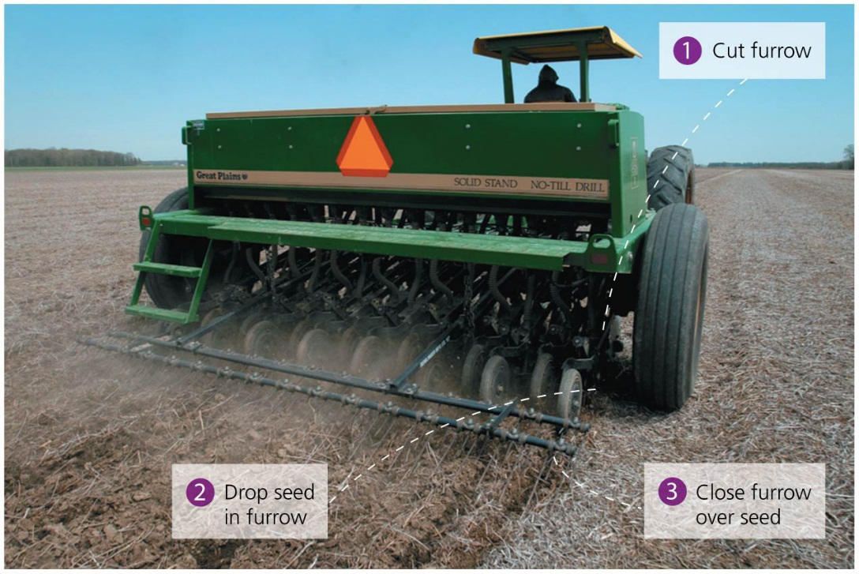

Slide 57
No-till farming has many benefits
40% of U.S. farmland uses conservation tillage
Erosion rates in the United States declined from 9.1 tons/ha (3.7 tons/acre) in 1982 to 5.9 tons/ha (2.4 tons/acre) in 2003
In Brazil, Argentina, and Paraguay, over half of all cropland is now under no-till cultivation
Crop yields have increased while costs have dropped
May require increased use of herbicides and fertilizers
To minimize problems:
Use green manure (dead plants as fertilizer)
Rotate fields with cover crops

Slide 58
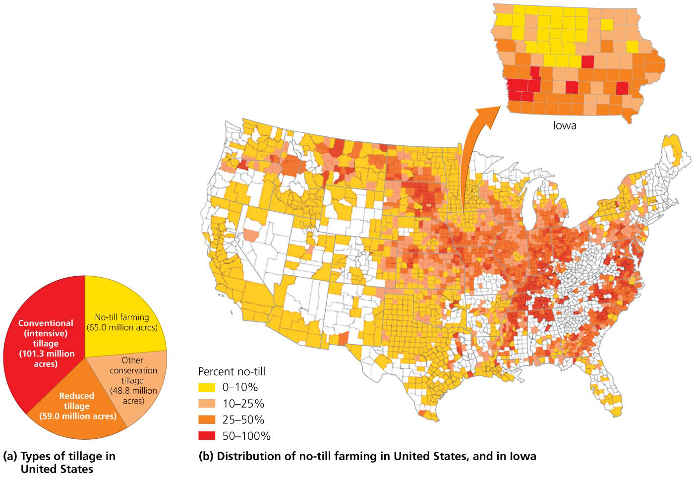

Slide 59
Plant cover is the key to erosion control
Farming methods to reduce erosion have one goal—keep the plant cover in place
Move livestock to prevent overgrazing
Cut fewer trees in an area rather than clear-cut
Plant vegetation along riverbanks and roadsides
China’s huge tree-planting program slows erosion
However, the monocultures are not ecologically functioning forests

Slide 60
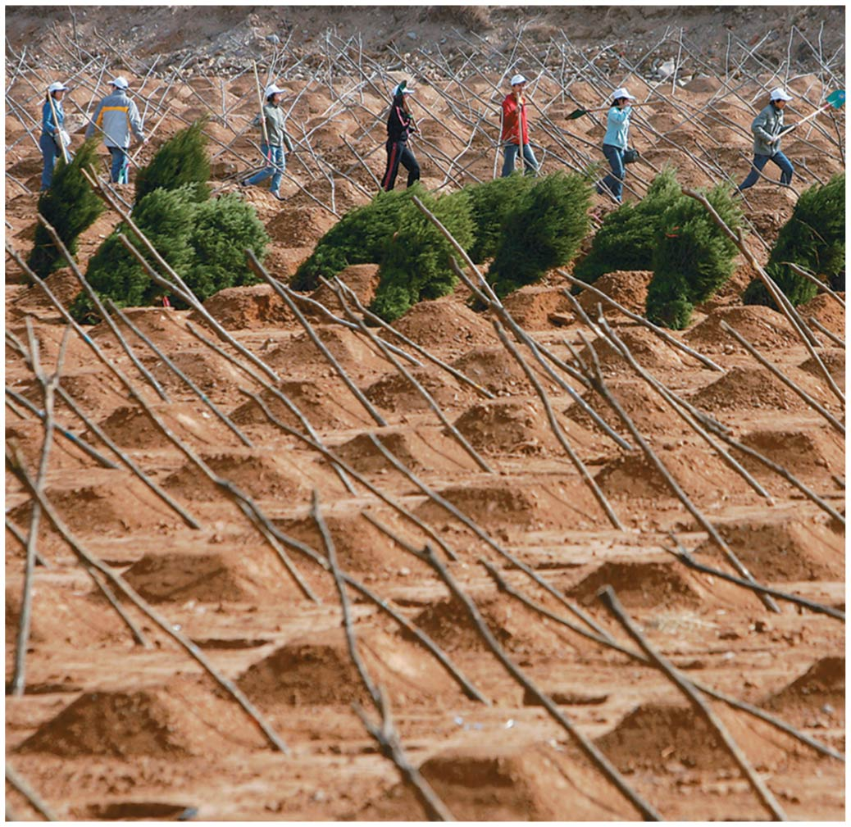

Slide 61
Overgrazing can degrade soil
Grazing animals on rangeland can be sustainable if the total number of grazing animals is kept below the rangeland’s carrying capacity
Overgrazing = occurs when too many animals eat too much of the plant cover
Impedes plant regrowth
Soil is exposed, allowing erosion, less regrowth, and positive feedback of more erosion

Slide 62
Overgrazing can degrade soil
Non-native invasive species invade
Less palatable to livestock so not eaten
Outcompete native vegetation
Trampling compacts the soil, preventing water infiltration

Slide 63
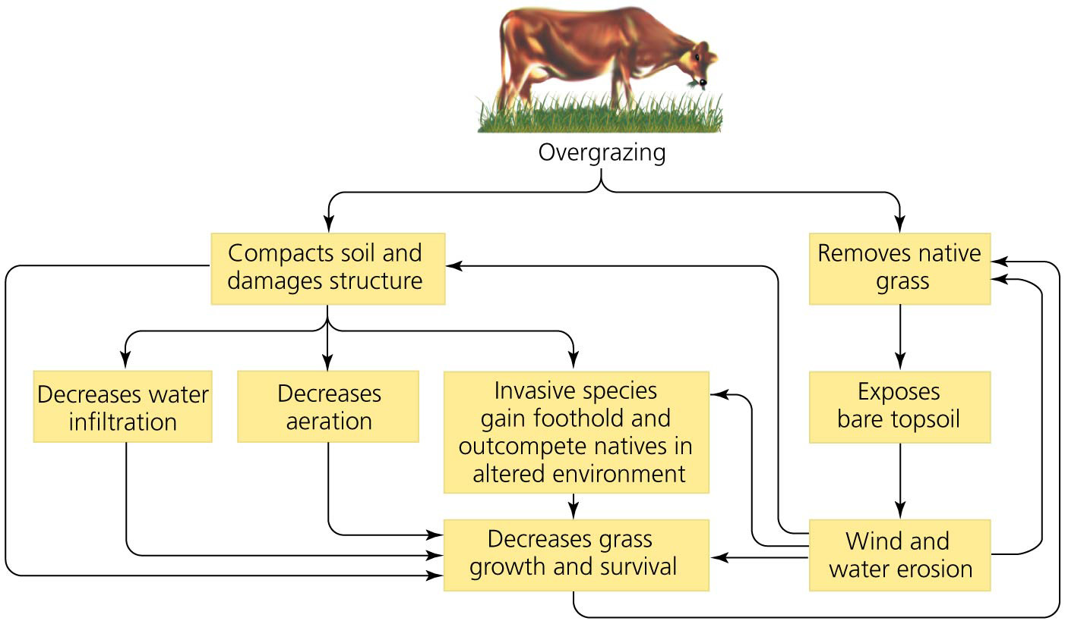

Slide 64
Overgrazing can degrade soil
Degraded rangeland costs over $23 billion worldwide
Grazing exceeds the sustainable supply of grass in India by 30% and in parts of China by up to 50%
U.S. government subsidies increase harm
Ranchers pay little to graze their animals on public lands
Few incentives to protect rangeland—“tragedy of the commons”
Ranchers are now working with environmental scientists on ways to raise livestock more sustainably

Slide 65
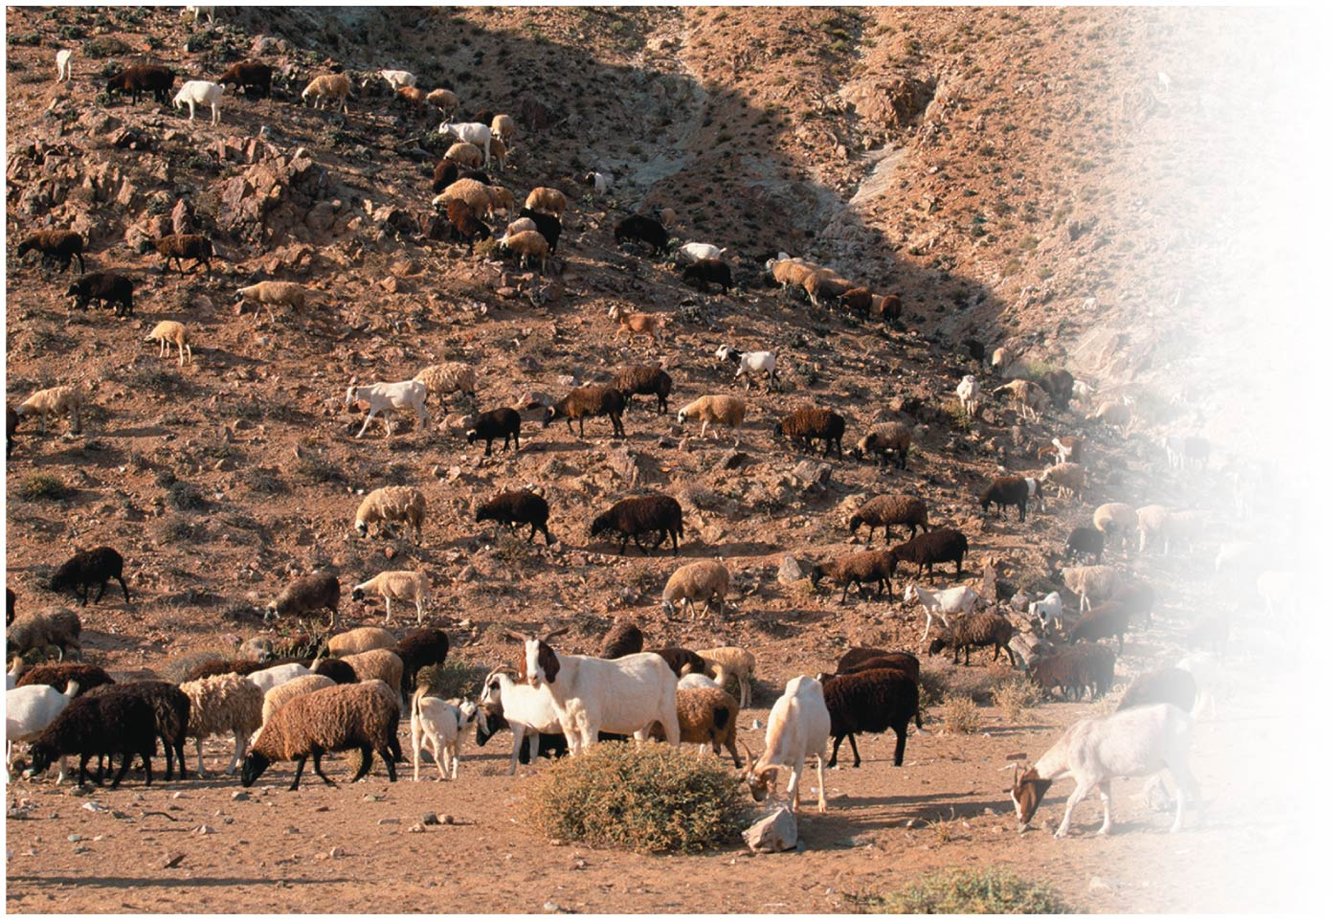

Slide 66
Irrigation boosts productivity but can damage soils
Irrigation = artificially providing water to support agriculture
Unproductive regions become productive farmland
Can grow water-intensive crops like rice and cotton
70% of all fresh water used by humans goes to irrigation
Can deplete aquifers and dry up rivers and lakes

Slide 67
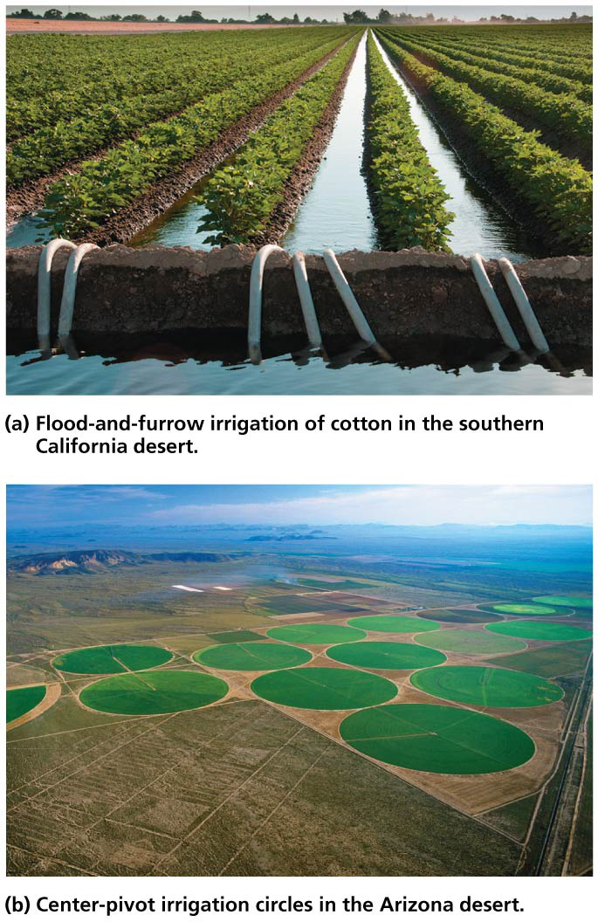

Slide 68
Sustainable approaches to irrigation maximize efficiency
Matching crops to the climate can reduce or eliminate the need for irrigation
Growing cotton in dry climates requires extensive irrigation while wheat does not
In conventional irrigation, as little as 43% of the water applied is used by the crops
Drip irrigation targets water directly to plants, and plants use as much as 90% of the water

Slide 69
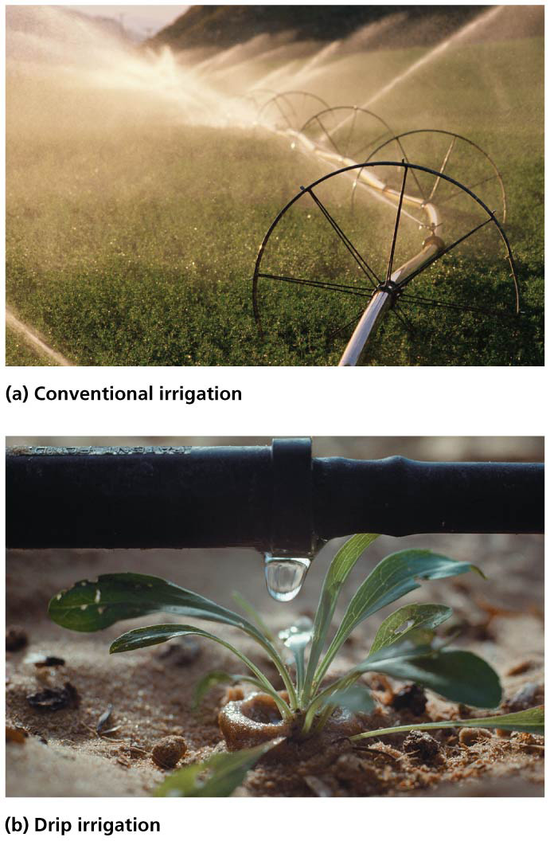

Slide 70
Salinization and waterlogging are easier to prevent than correct
Waterlogging = experienced by overirrigated soils when the water table rises to cover and suffocates roots
Salinization = the buildup of salts in surface soil layers
Worse in arid areas
Evaporation pulls salts up from lower soil horizons

Slide 71
Salinization and waterlogging are easier to prevent than correct
It is easier and cheaper to prevent salinization than to fix it
Do not plant water-guzzling crops in sensitive areas
Irrigate with low-salt water
Irrigate efficiently and only as much as needed
Fixing requires flushing soils with large amounts of water

Slide 72
Fertilizers boost crop yields but can be overapplied
Fertilizers = substances containing essential nutrients
Plants require nitrogen, phosphorus, and potassium and remove them from the soil, possibly limiting growth
Inorganic fertilizers = mined or synthetically manufactured mineral supplements
Organic fertilizers = the remains or wastes of organisms
Manure, crop residues, fresh vegetation
Compost = mixture produced when decomposers break down organic matter

Slide 73
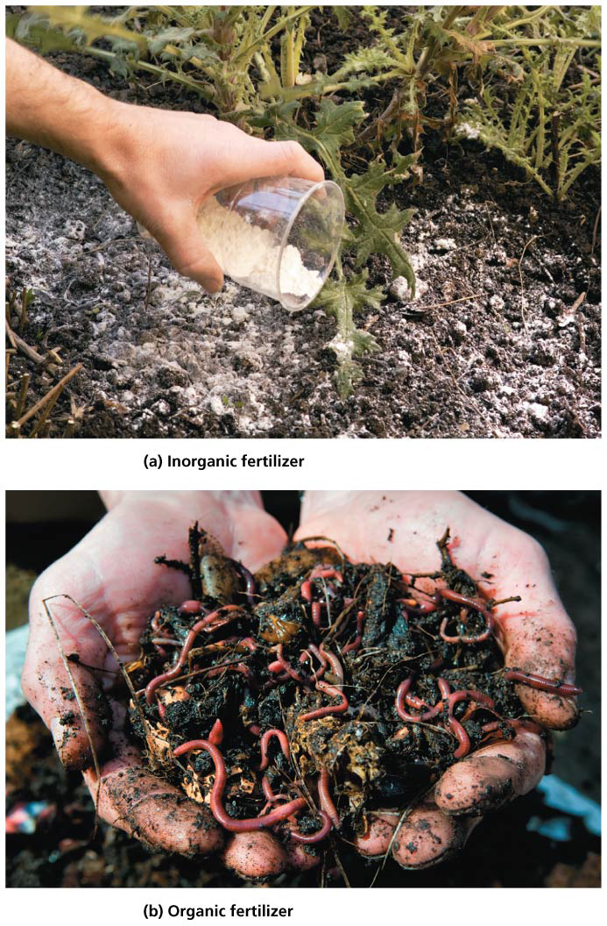

Slide 74
Fertilizers boost crop yields but can be overapplied
Traditional agriculture relied on organic fertilizers
The Green Revolution brought on increased use of inorganic fertilizers
Inorganic fertilizers are more susceptible to leaching and runoff
Runoff into surface waters far from the point of application, causing “dead zones” in water bodies
Nitrates volatilize (evaporate) into the air and contaminate groundwater
Nitrates and phosphates in drinking water can cause cancer and blue-baby syndrome in infants

Slide 75
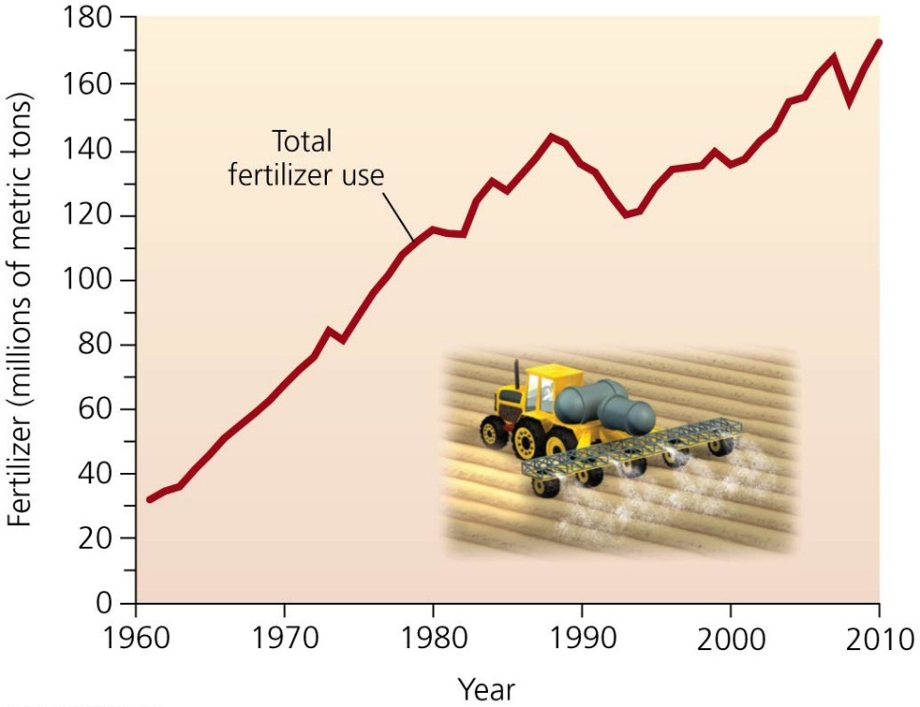
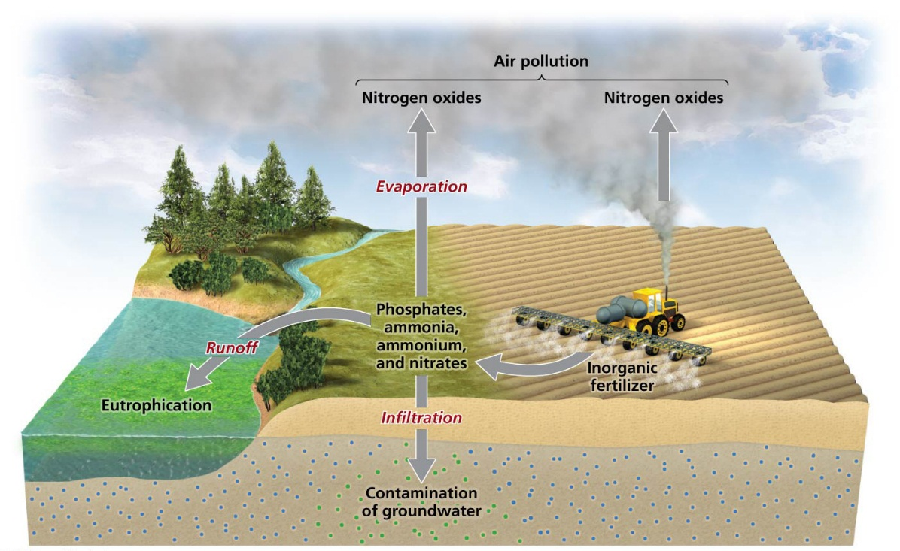

Slide 76
Sustainable fertilizer use involves targeting and monitoring nutrients
Nutrients can be added to drip irrigation and are delivered directly to the plants
No-till planting allows the application of fertilizers with the seeds rather than spreading it across the soil

Slide 77
Sustainable fertilizer use involves targeting and monitoring nutrients
Monitoring of soil nutrients can prevent unneeded applications
Organic fertilizers provide needed nutrients as well as improving the soil by
Improving soil structure
Increasing nutrient-holding capacity
Increasing water-retaining capacity

Slide 78
Agricultural Policy
Governments have long used policy to encourage agricultural production
Recent policy has tried to lessen the environmental impacts of external costs
Market forces should discourage practices that degrade the land, but degradation occurs slowly
Farmers and ranchers can not go without profits in the short term

Slide 79
Some policies worsen land degradation
Governments spend billions on farm subsides that may be unsustainable
Some subsidies support growing water-intensive crops in desert regions
Some encourage use of easily degraded land
Proponents argue that uncertainty of crop success justifies subsidies
Grazing on federally owned land costs $1.35 per animal unit per month
Low cost encourages overgrazing
Ranchers are now teaming up with environmental activists to prevent loss of rangeland from development

Slide 80
Wetlands have been drained for farming
Wetlands = swamps, marshes, bogs, river floodplains
Over 50% have been drained for agriculture in the U.S.
Government policy encouraged draining
Swamp Lands Acts (1849, 1950, 1860) = drained and converted wetlands to control floods and malaria

Slide 81
Wetlands have been drained for farming
Wetlands are now seen as vital ecosystems
Habitat, flood control, recharged water supplies
Despite regulations, loopholes allow wetland losses
Wetlands Reserve Program = landowners are paid to protect, restore, and enhance wetlands

Slide 82
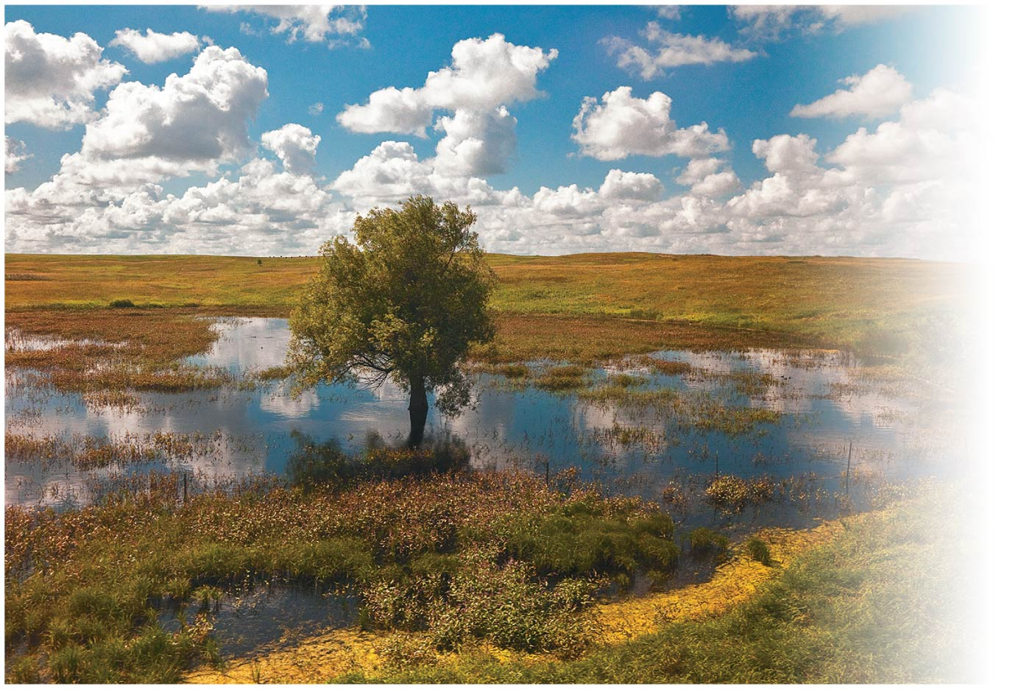

Slide 83
A number of programs promote soil conservation
The 2008 “farm bill” funded 15 programs that provided subsidies to farmers who adopted soil conservation plans
Conservation Reserve Program (1985) = farmers are paid to put highly erodible land in conservation reserves
Each dollar spent saves 1 ton of topsoil
Generates income for farmers
Improves water quality
Provides habitat for native wildlife

Slide 84
A number of programs promote soil conservation
The 2012 farm bill was never called for a vote in the House of Representatives
The future of conservation programs is unclear

Slide 85
A number of programs promote soil conservation
The Food and Agriculture Organization (FAO) is the United Nations’ main agricultural program
The FAO’s Farmer-Centered Agricultural Resource Management Program (FARM):
Supports innovative approaches to resource management and sustainable agriculture in Asia
Helps farmers duplicate agricultural success stories
Uses local communities to educate and encourage farmers to conserve soils and secure the food supply

Slide 86
Conclusion
Programs in the United States and the world have been successful in reducing topsoil erosion
These programs require research, education, funding, and commitment from farmers and governments
To avoid a food crisis caused by population growth while achieving sustainable agricultural production, we need:
Better technology
Wider adoption of soil conservation techniques

Slide 87
QUESTION: Review
Industrial agriculture uses all of the following EXCEPT
animal power.
irrigation.
monocultures.
fossil fuels.
Notes:
Answer: a

Slide 88
QUESTION: Review
Biological weathering is characterized by
the chemical interaction of water with parent material.
organisms breaking down parent material.
wind or rain breaking down parent material.
the dislodging or movement of soil by wind.
Notes:
Answer: b

Slide 89
QUESTION: Review
Which horizon is the most valuable for agriculture?
A horizon
E horizon
B horizon
R horizon
Notes:
Answer: a

Slide 90
QUESTION: Review
Erosion increases through all of the following EXCEPT
excessive tilling.
overgrazing.
clearing forests.
All of the above increase erosion.
Notes:
Answer: d

Slide 91
QUESTION: Review
Which sustainable farming method involves planting different crops from year to year?
Terracing
Crop rotation
Shelterbelts
Contour farming
Notes:
Answer: b

Slide 92
QUESTION: Review
Differences between organic fertilizers and inorganic fertilizers include which of the following?
Inorganic improves soil structure.
Organic increases water holding capacity.
Organic has higher rates of nutrient runoff.
Inorganic does not provide needed nutrients.
Notes:
Answer: b

Slide 93
QUESTION: Weighing the Issues
Do you think that financial incentive programs such as the Conservation Reserve Program and the Wetlands Reserve Program are a good use of taxpayers’ money?
Yes. We need to offer financial incentives for farmers to do the right thing.
Yes. We all benefit from having healthier agriculture and a healthier environment.
No. We should let the market solve the problem for us.
No. There are other problems more important than preventing land degradation.
Notes:
Answer: any

Slide 94
QUESTION: Interpreting Graphs and Data
According to this graph, which land use causes the least erosion?
Conventional agriculture
Conservation agriculture
Native vegetation
Cannot tell
Notes:
Answer: c

