Slide 2
This lecture will help you understand:
Environmental policies and their societal context
The role of science in policymaking
Major U.S. environmental policies and laws
International environmental policy and important institutions
Approaches to environmental policy

Slide 4
Central Case Study: Hydrofracking the Marcellus Shale
The Marcellus Shale is a vast rock formation that underlies portions of Pennsylvania, New York, West Virginia, and Ohio and contains shale gas.
Companies use the process of hydraulic fracturing or hydrofracking = injecting liquid into the shale after it has been broken up to release the gas
Hydrofracking gets the gas more efficiently, keeping prices low
More natural gas use means less coal and less greenhouse gasses
Some claim that hydrofracking is polluting drinking water

Slide 5
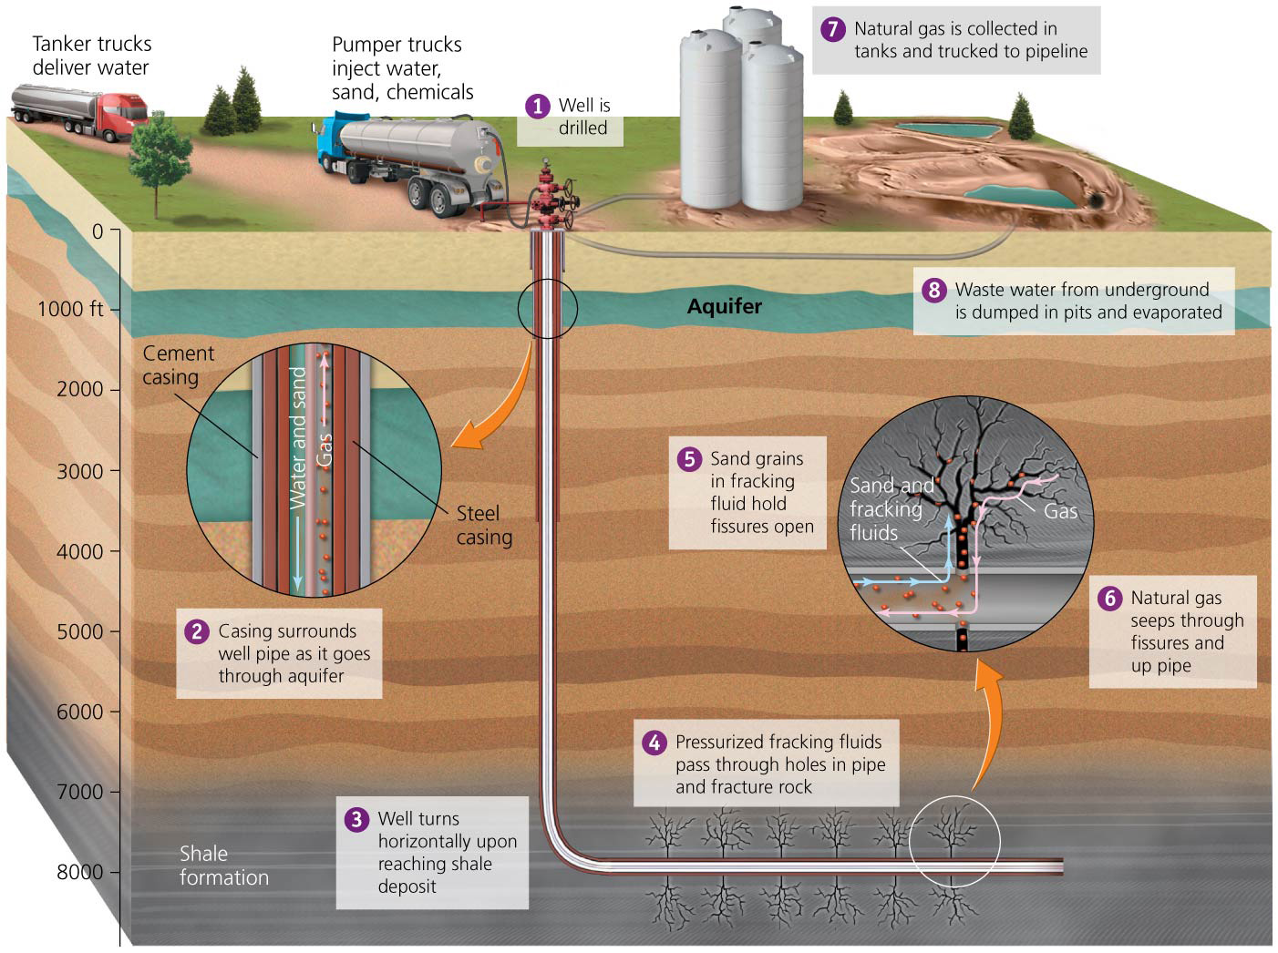

Slide 6
Environmental Policy: An Overview
Policy = a formal set of general plans and principles to address problems and guide decision making
Public policy = policy made by governments
Laws, regulations, orders, incentives, and practices
Intended to advance societal welfare
Environmental policy = policy that pertains to human interactions with the environment
Regulates resource use or reduces pollution to promote human welfare and/or protect resources

Slide 7
Environmental policy addresses issues of fairness and resource use
Science, ethics, and economics help formulate policy
Science provides information and analysis
Ethics and economics clarify how society can address problems
Government interacts with citizens, organizations, and the private sector

Slide 8
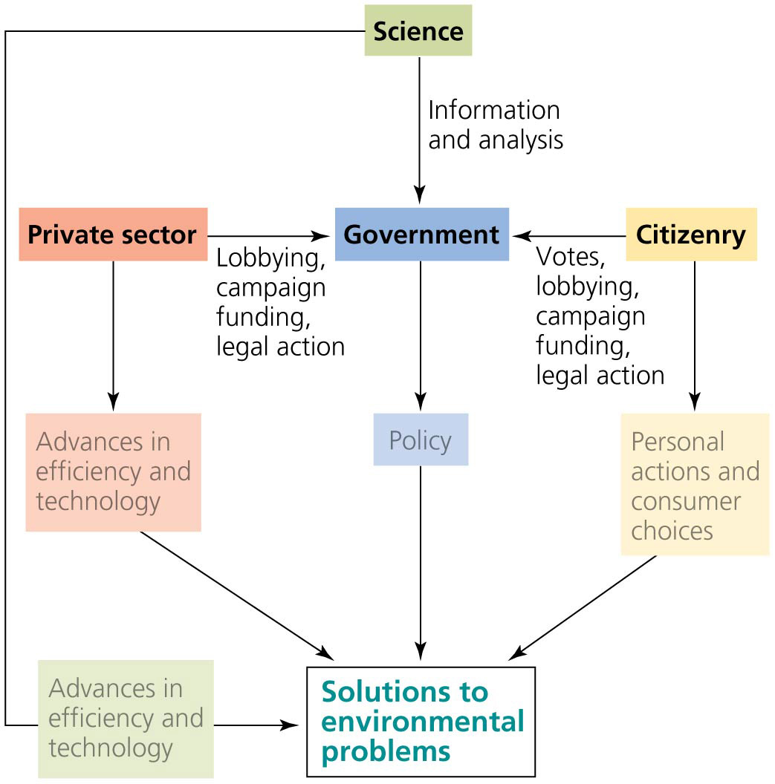

Slide 9
Environmental policy addresses issues of fairness and resource use
In mixed market economies, governments intervene to:
Provide social services (national defense, medical care, education)
Provide safety nets for elderly, disaster victims, etc.
Eliminate unfair advantages held by single buyers or sellers
Manage publicly held resources
Mitigate pollution and other threats to health and quality of life

Slide 10
Tragedy of the commons
Tragedy of the commons = concept that commonly held resources will become overused and degraded
Each user will be motivated by self interest and overuse the resource
Forests, fisheries, grazing land, clean air and water

Slide 11
Tragedy of the commons
Traditional societies may safeguard against exploitation
Cooperative approach where users and together to take care of the resource
Privatization works if property rights are clear
Does not work with air, water, etc.
Public oversight through government is often used
Most assured way to avoid overexploitation

Slide 12
Free riders
Free rider = one entity (business, factory, etc.) that does not participate in a voluntary effort to improve the environment (e.g., reduce pollution)
Avoids sacrifices made by others
Get a “free ride”
Private voluntary efforts are less effective than efforts mandated by public policies
All parties sacrifice equally

Slide 13
External costs
Environmental policies aim to promote fairness by dealing with external costs
External costs = harmful impacts of market transactions are borne by people not involved in the transaction
Companies internalize costs when they are forced to pay for external costs
Polluter-pays principle = principle specifying that polluters cover costs of impacts
Addresses misuse of common resources, free riders (since all polluters pay), and external costs

Slide 15
Many factors hinder environmental policy
Why are environmental laws challenged, ignored, and rejected by citizens and policymakers?
Environmental policy involves government regulations
Property owners and businesspeople think regulations are overly restrictive, bureaucratic, and costly
Problems develop gradually and over the long term
Human behavior is geared toward short-term needs
Businesses opt for short-term economic gain
News media have short attention spans
Politicians act out of short-term interest

Slide 16
Vested interests and Lobbying
Vested interest = special interest shown by people, organizations, or corporations that stand to benefit from a policy
Often are serving their own interests, not society’s
Frequently have the most influence over policymakers
Lobbying = spending time or money to influence an elected official’s decision
Anyone can lobby, but it is easier for professional lobbyists to gain access
Industries wishing to change policy have invested many millions of dollars in lobbying efforts

Slide 17
Campaign contributions and The revolving door
Political Action Committees (PACs) raise money for political campaigns
Corporations and industries can not make direct campaign contributions, so they establish PACs to help candidates win
A 2010 Supreme Court decision allows corporations and unions to buy ads for or against candidates
Revolving door = movement of people between the private sector and government
Proponents: intimate knowledge of an issue
Opponents: conflict of interest

Slide 18
Science informs policy but is sometimes disregarded
Effective decisions are informed by scientific research
The EPA and decision makers look to the scientific literature or commission research studies
Sometimes policymakers ignore science
They let political ideology determine policy
Government scientists have had their work censored, suppressed, or edited and their jobs threatened
The public has been misled by the misrepresenting of scientific knowledge
When taxpayer-funded research is suppressed or distorted for political ends, everyone loses

Slide 19
Federal policy arises from the three branches of government
The U.S. has pioneered innovative policies
Role models and influence for other nations
Legislative branch: Congress creates legislation = statutory law
Bills must move through committees and both houses of Congress before being passed on
Executive branch: enacts or vetoes legislation
Laws are implemented and executed by agencies
Executive orders = specific legal instructions for government agencies

Slide 20
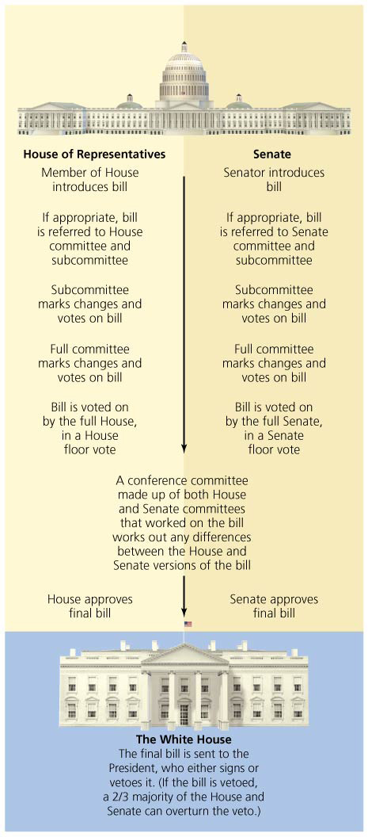

Slide 21
Federal policy arises from the three branches of government
Administrative agencies: established by the president or Congress to enact legislation
A source of policy through regulations
Monitor and enforce compliance
Regulations = specific rules or requirements to achieve objectives of broadly written statutory laws
Judicial branch: interprets laws and builds a history of decisions known as case law
Precedents = case law used as guides for later cases
Lawsuits are filed for and against environmental legislation and regulations

Slide 22
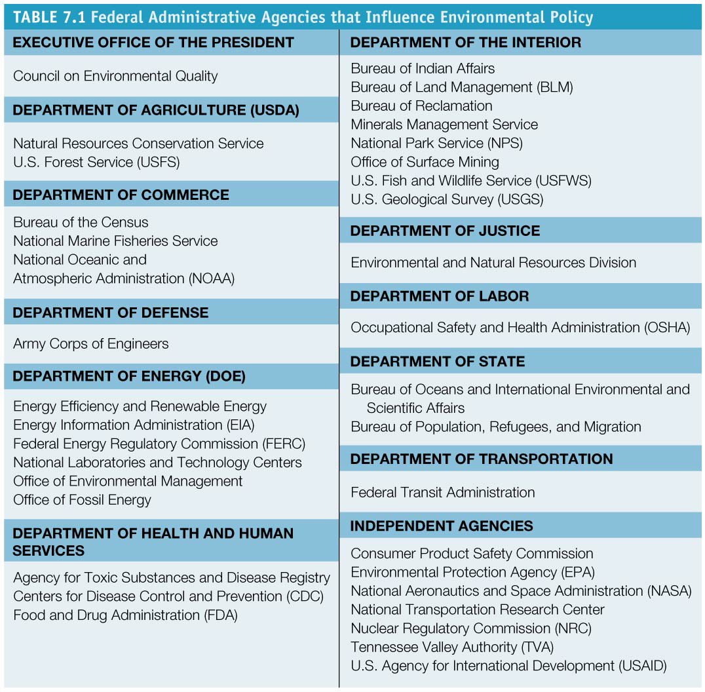

Slide 23
Courts interpret the constitutionality of policy
The fifth amendment, the takings clause, has become particularly important in environmental policy
Regulatory taking = occurs when the government deprives a property owner of some or all of the economic use of their property
In 1992 the Supreme Court ruled that a state law intending to prevent serious public harm violated the takings clause
Lucas, a land developer, was allowed to build homes on beachfront property although a state agency had prohibited construction on the property to prevent beachfront erosion

Slide 24
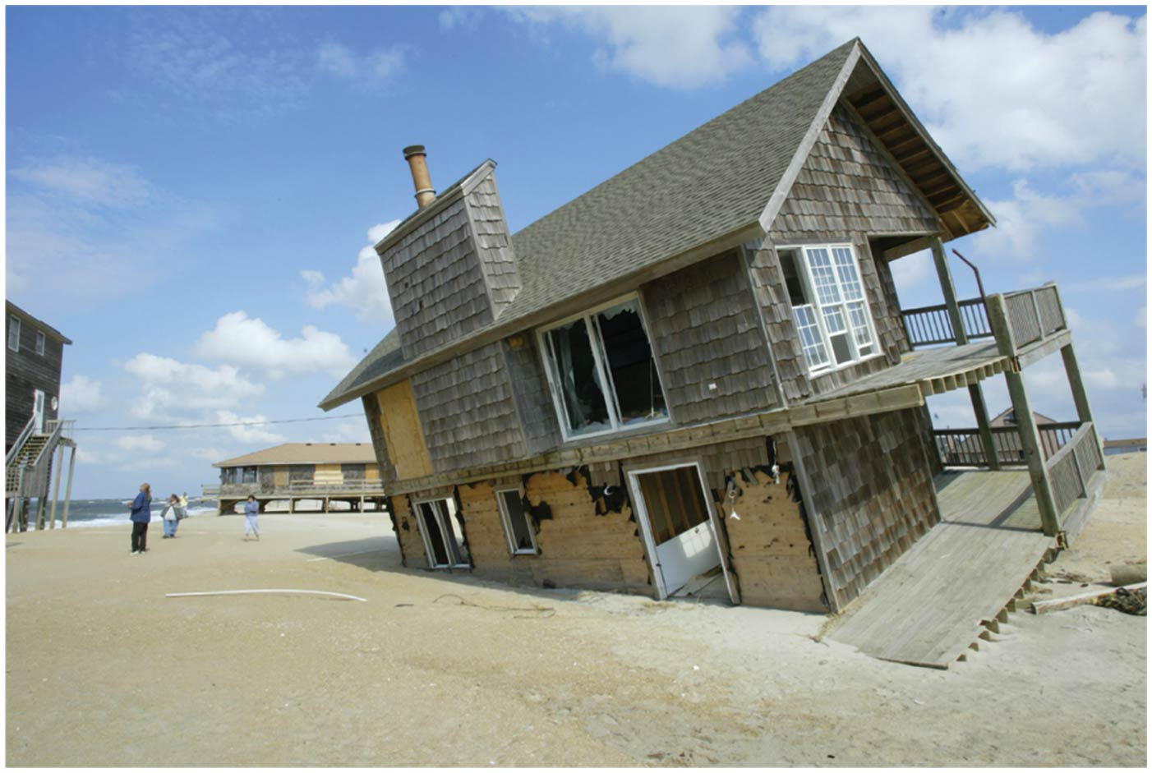

Slide 25
State and local governmental also make environmental policy
State governments typically mirror the structure of the federal government
States, counties, and municipalities also generate environmental policies
They can experiment with novel concepts
State laws cannot violate principles of the U.S. Constitution
If laws conflict, federal laws take precedence

Slide 26
State and local governmental also make environmental policy
The federal government can influence state laws
Rarely, federal laws may force states to change
Federal policymakers can give financial incentives to encourage change (this works, if funds are adequate)
“Cooperative federalism” = is an approach whereby an agency works with state agencies to achieve national standards

Slide 27
State and local governmental also make environmental policy
Despite pressure to weaken laws, federal control is often vitally important
Protection for all citizens is ensured
One national effort is more efficient than 50 efforts
Transboundary disputes are minimized

Slide 28
Early U.S. environmental policy promoted development
From 1780s to the late 1800s, laws promoted settlement and extraction of resources
General Land Ordinances of 1785 and 1787
The federal government managed unsettled lands, surveying and readying them for sale
Increased prosperity for citizens and railroad companies
Relieved crowding in Eastern cities
Displaced millions of Native Americans
People believed land was infinite and inexhaustible

Slide 29
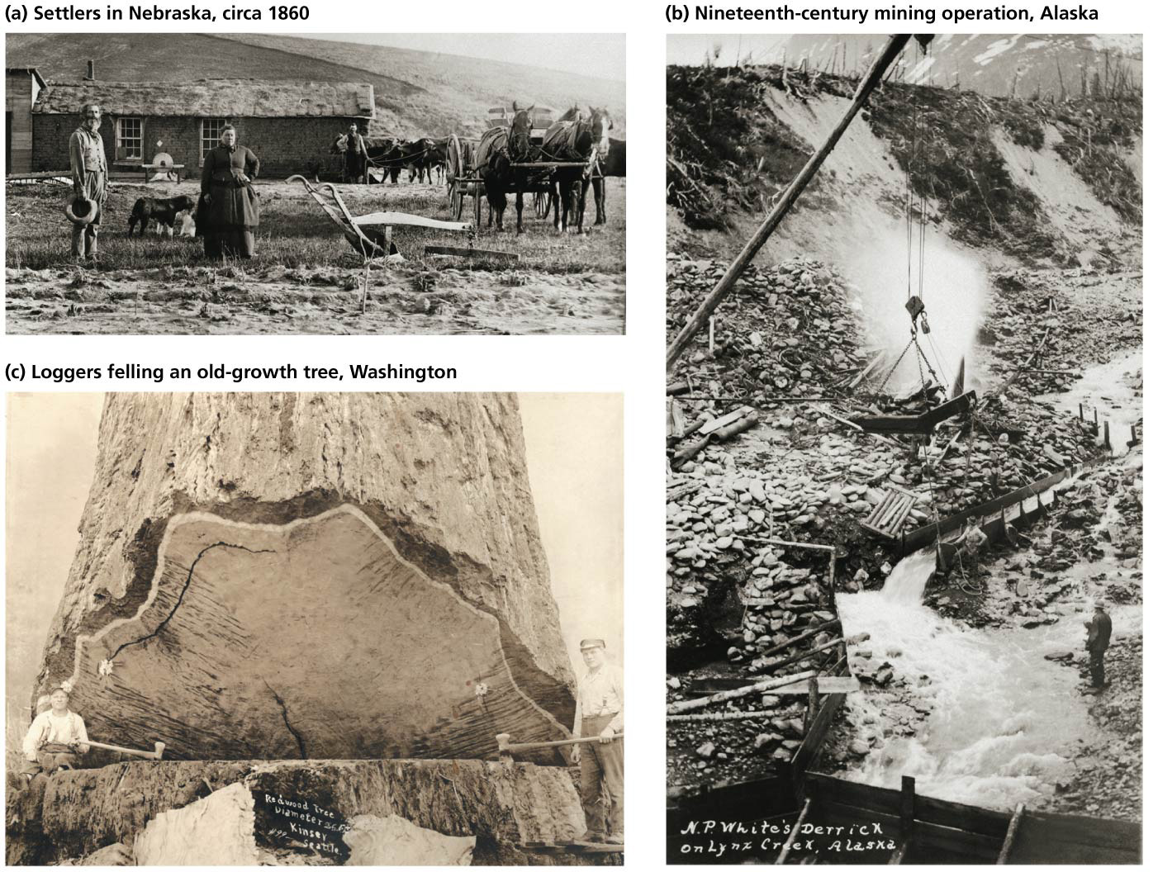

Slide 30
Early U.S. environmental policy promoted development
Homestead Act (1862) = anyone could buy or settle on 160 acres of public land
General Mining Act (1878) = people could mine on public land for $5/acre with no government oversight
Timber Culture Act (1873) = 160 acres to anyone promising to plant trees on 25% of that land

Slide 31
The second wave of U.S. policy encouraged conservation
Public perception and government policy shifted
Laws mitigated problems caused by westward expansion
Yellowstone National Park, the world’s first national park, opened in 1872
Also, national wildlife refuges, parks, and forests
It was understood that the West’s resources were exhaustible
They required legal protection
Land management policies addressed soil conservation
The 1964 Wilderness Act preserves pristine land

Slide 32
The third wave of U.S. environmental policy responded to pollution
Mid- to late-20th century people were better off economically
Nation was more densely populated, had more heavy industry, and was consuming more resources
But Americans lived with dirtier air, dirtier water, and more waste and toxic chemicals
Increased awareness of environmental problems shifted public priorities and policies

Slide 33
The third wave of U.S. environmental policy responded to pollution
Rachel Carson’s Silent Spring (1962) described the ecological and health effects of pesticides and chemicals
The Cuyahoga River was so polluted that it caught fire multiple times in the 1950s and 1960s
The public demanded more environmental protection
First Earth Day was celebrated in 1970

Slide 34
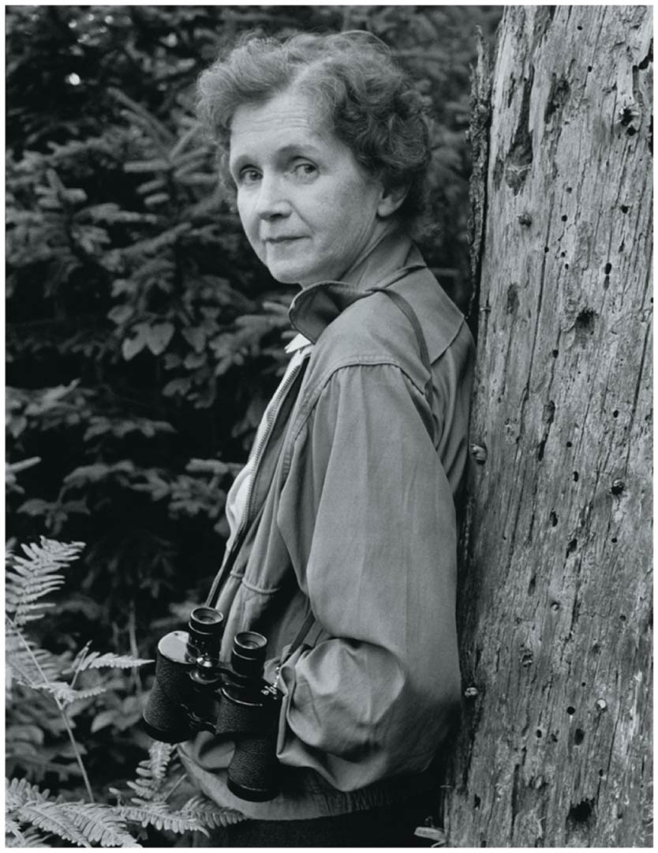
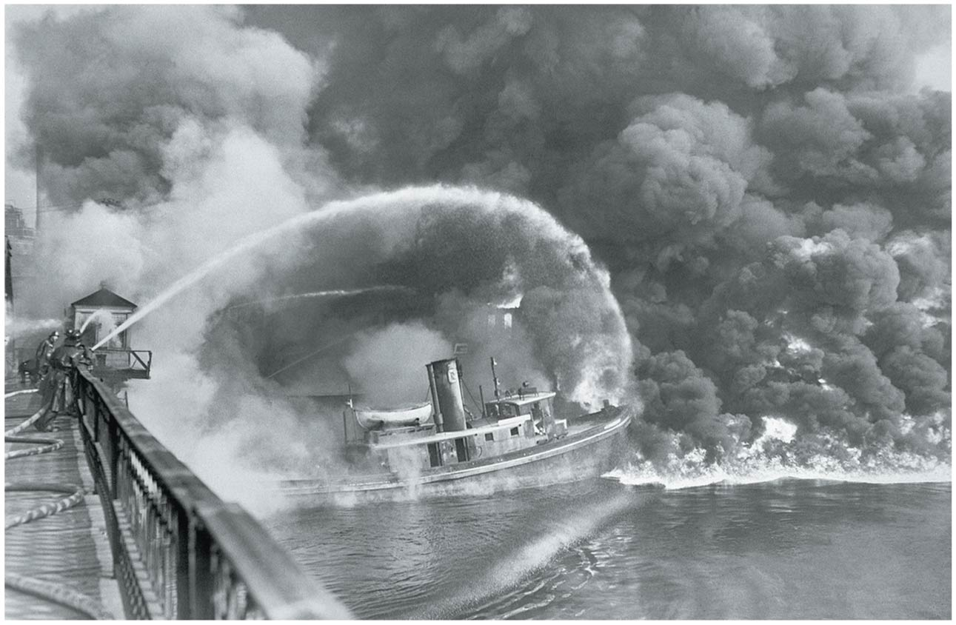

Slide 35
NEPA and the EIS process grant citizens input
The National Environmental Protection Act (NEPA) began the modern era of environmental policy
Created the Council on Environmental Quality
Requires an environmental impact statement (EIS) for any federal action or federally funded project that might significantly impact the environment

Slide 36
NEPA and the EIS process grant citizens input
It forces the government and businesses to evaluate the environmental impacts of a project
Its cost-benefit approach usually does not halt projects
It provides incentives to decrease damage
Citizens are granted input into the policy process

Slide 37
Creation of the EPA marked a shift in environmental policy
President Nixon’s executive order created the Environmental Protection Agency (EPA)
Attempts to organize federal environmental programs
Conducts and evaluates research
Monitors environmental quality
Sets and enforces standards for pollution levels
Assists states in meeting standards and goals
Educates the public

Slide 38
Other prominent laws followed
The public demanded a cleaner environment and supported tougher environmental legislation
Clean Air Act (1963) set standards for air quality, imposes emissions limits on new sources, funds research on pollution control, allows citizens to sue violators
Endangered Species Act (1973) protects species threatened with extinction
Protects habitat as well as individual organisms
Funds species recovery efforts

Slide 39
Other prominent laws followed
Safe Drinking Water Act (1974) set standards for tap water from public water supplies
Toxic Substances Control Act (1976) directs the EPA to monitor thousands of industrial chemicals and ban them if found to pose too much risk
Resources Conservation and Recovery Act (1976) deals with solid and hazardous waste
Sets standards and permitting procedures
Requires tracking of hazardous wastes
Clean Water Act (1977) regulates discharge of waste, especially from industry, into rivers

Slide 40
Other prominent laws followed
Soil and Water Conservation Act (1977) directs the Department of Agriculture to assess soil and water conditions across the country and to prepare national plans for conservation
CERCLA (“Superfund”) (1980) establishes a fund to clean up hazardous waste from worst polluted sites
Existing laws have periodically been strengthened and expanded
Clean Water Act was amended in 1987
Clean Air Act was amended in 1990

Slide 41
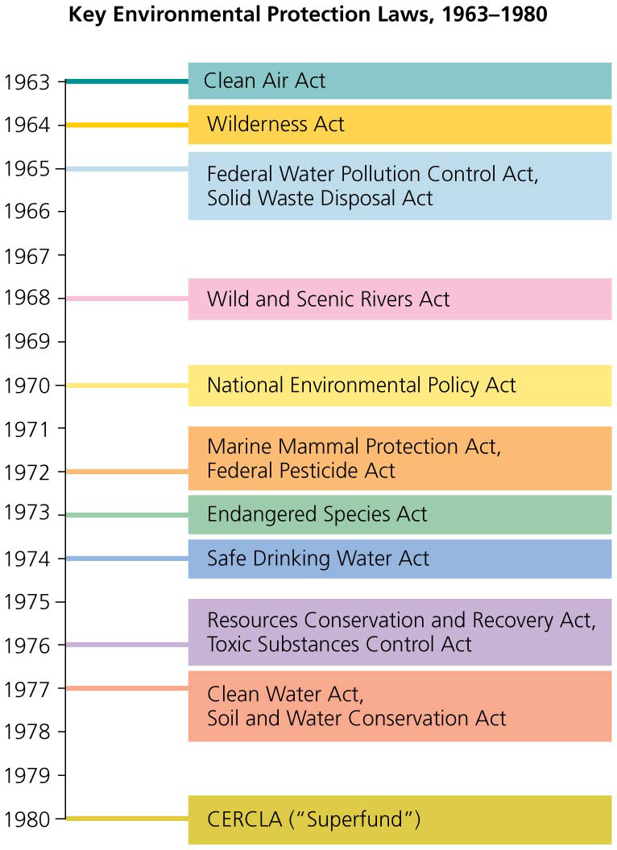

Slide 42
The social context for policy evolves over time
Several factors converged to allow major advances in environmental policy in the 1960s and 1970s
Wide evidence of environmental problems
People could visualize policies to deal with problems
The political climate was ripe, with a supportive public and leaders who were willing to act
First images of the entire Earth from space became widely available
Made people aware of the finite nature of the planet

Slide 43
The social context for policy evolves over time
By 1990, many felt that regulations were too strict
Attempts were made to weaken federal laws by Reagan, George W. Bush, and the Republican-controlled Congresses from 1994 to 2006
“The Death of Environmentalism” (2004) was an essay stating that the environmental movement had to be reinvented
Can not simply label a problem as “environmental”
It must appeal to core values with an inspiring vision
Show that these problems affect our quality of life
Legal protections for health and the environment remain strong in some areas, but have eroded in others

Slide 44
Environmental policy advances today on the international stage
Other nations have taken over leadership on some issues through research and progressive environmental policy
This fourth wave of policy focuses on sustainability and sustainable development
The world community has come together to address issues
The 1992 Earth Summit
The 2002 World Summit on Sustainable Development
Climate change now dominates much of the discussion on environmental policy

Slide 45
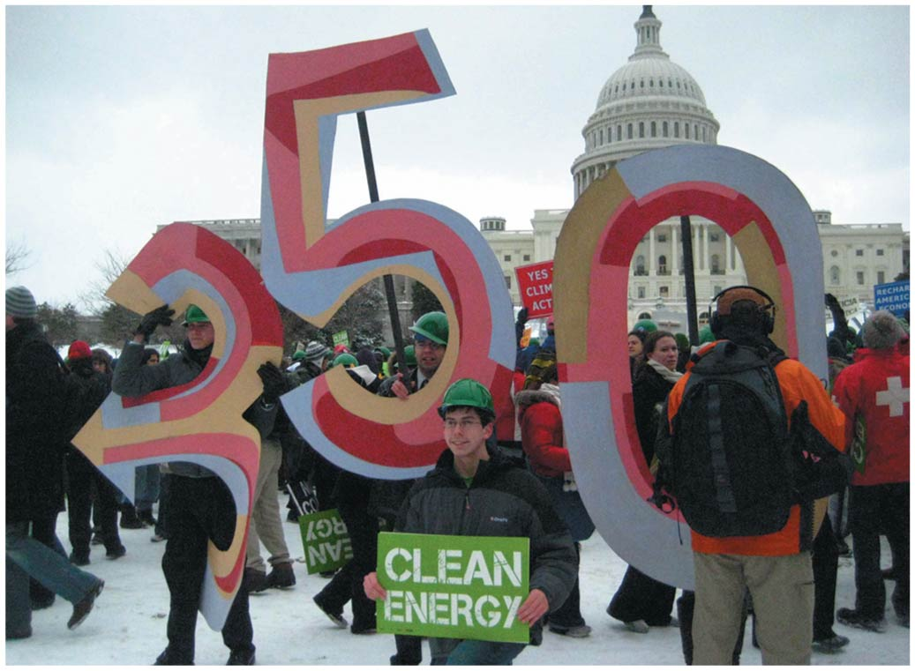

Slide 46
International law includes customary law and conventional law
Environmental problems are not restricted by national borders
Customary law = practices or customs held by most cultures
Conventional law comes from conventions or treaties = written contracts among nations
Montreal Protocol = nations agreed to reduce ozone-depleting chemicals
Kyoto Protocol = reduces fossil fuel emissions causing climate change; over 180 countries have signed the agreement

Slide 47
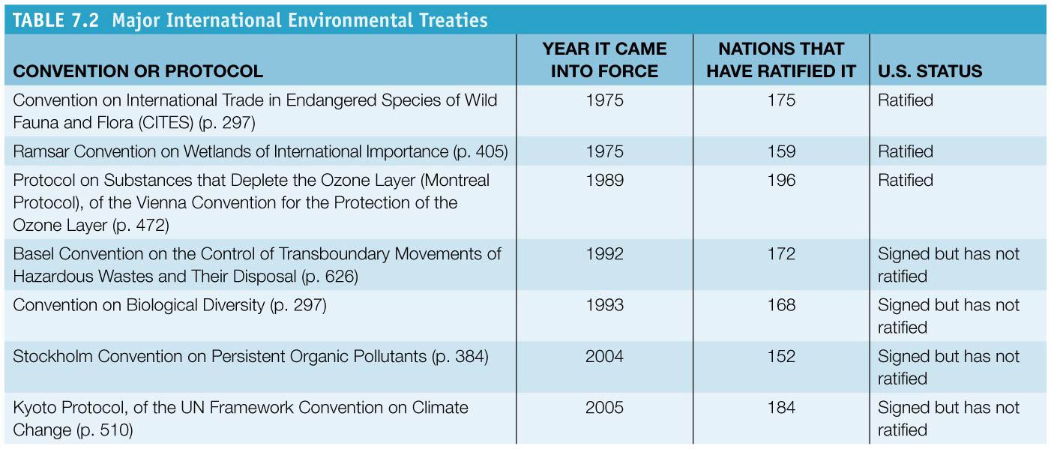

Slide 48
International law includes customary law and conventional law
Some treaties are signed between a pair of a small group of nations
North American Free Trade Agreement (NAFTA) = eliminates trade barrier and tariffs on imports and exports between Canada, Mexico, and the United States
Reduced prices on traded goods
Undermined protection for workers and the environment

Slide 49
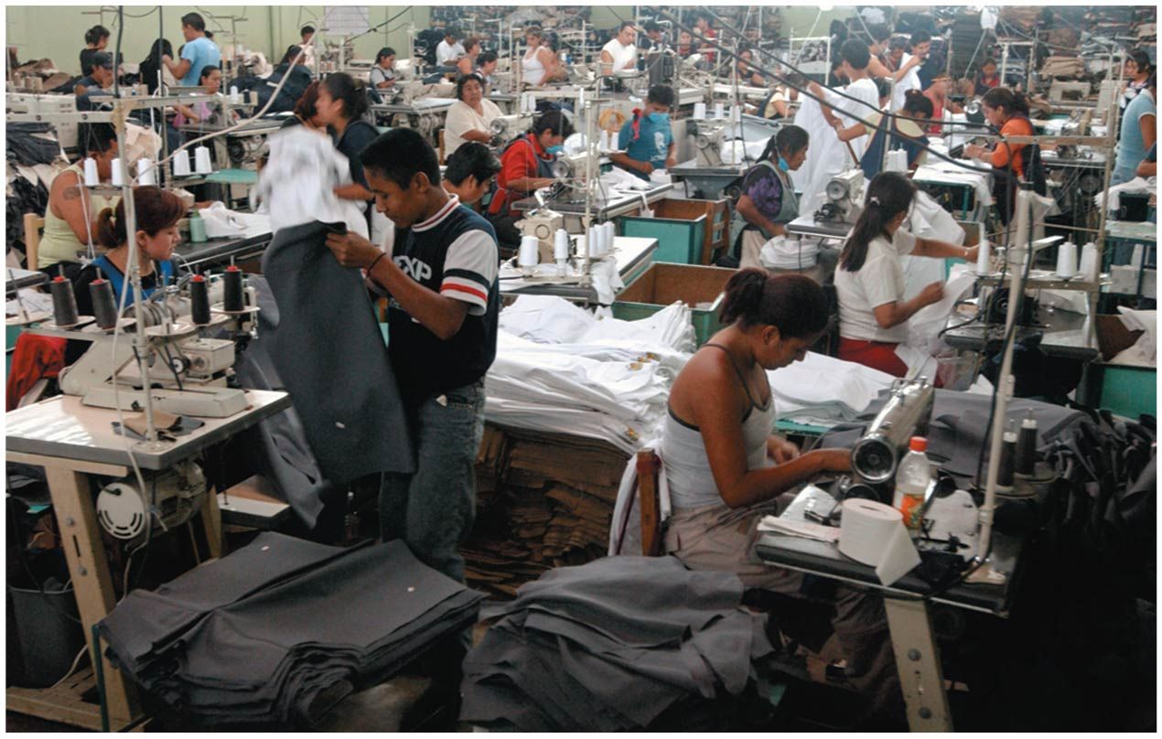

Slide 50
Several organizations shape international environmental policy
International organizations influence nations through funding, peer pressure, and media attention
The United Nations (UN) seeks to develop friendly relations among nations and help solve international economic, social, cultural, and humanitarian problems
Sponsors conferences, coordinates treaties, publishes research
United Nations Environment Programme (UNEP)
Promotes sustainability through research and outreach to policymakers and scientists

Slide 51
The World Bank and European Union
World Bank = one of the world’s largest funding sources for economic development ($35 billion in loans in 2013)
Funds dams, irrigation, infrastructure
Has funded unsustainable, environmentally damaging projects
European Union (EU) = seeks to promote Europe’s unity, economic and social progress
Can sign binding treaties and enact regulations
Can also issue advisory directives
Has classified some environmental regulations as barriers to trade

Slide 52
The World Trade Organization and NGOs
World Trade Organization (WTO) = represents multinational corporations by promoting free trade
Can impose penalties on nations that do not comply with its directives
Interprets some environmental laws as unfair barriers to trade; may aggravate environmental problems
Nongovernmental organizations (NGOs) = entities that influence international policy
Some actively work on environmental issues on the ground (e.g., buying and protecting land)
Others try to shape policy through research, education, lobbying, or protest

Slide 53
International institutions wield influence in a globalized world
Globalization is making our world more interconnected
Societies and ecosystems are being changed at unprecedented rates
Trade and technology allow increased consumption
Consumptive nations exert incredible impacts
Multinational corporations operate outside the reach of national laws
They do not have the incentive to conserve resources or act sustainably
Organizations and institutions that shape policy are vital

Slide 54
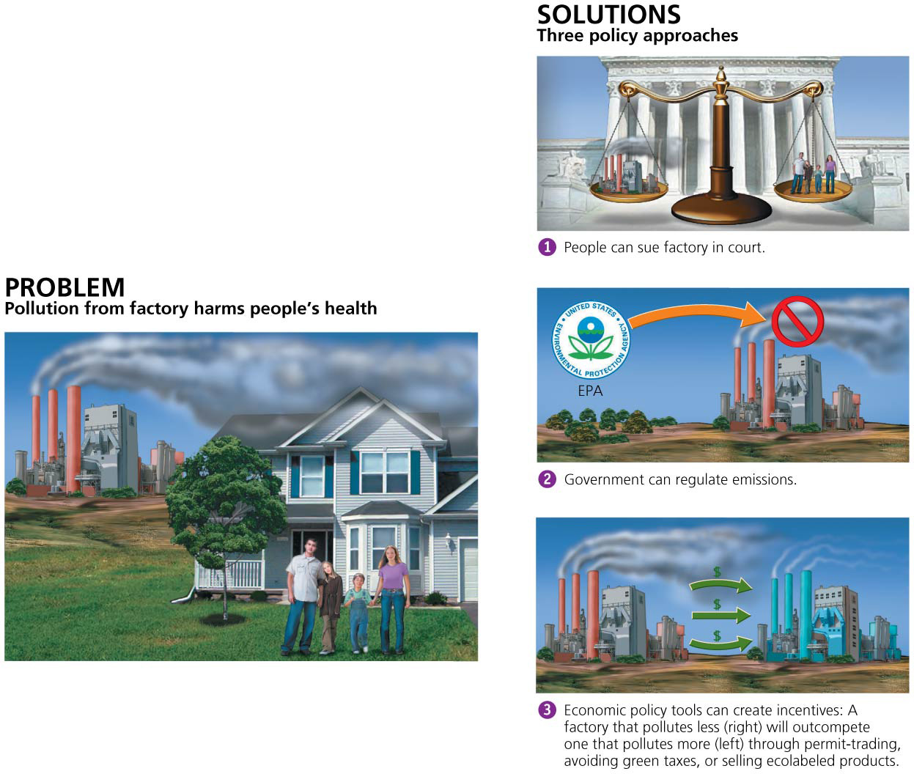
Approaches to Environmental Policy

Slide 55
Conflicts can be addressed in court
Before legislation, lawsuits addressed U.S. policy issues
Tort law = law that deals with one entity harming another
Individuals suffering external costs from pollution would seek redress through lawsuits
Courts make polluters stop through injunctions or fines
But justices were reluctant to hinder industry

Slide 56
Conflicts can be addressed in court
In Boomer v. Atlantic Cement Company, the company had to pay people for damages but could still operate
Cost of shutting down was greater than cost of harm
The market decided between right and wrong
This is not a viable option to prevent pollution

Slide 57
Command-and-control policy has improved our lives
Command-and-control = an approach in which a regulating agency sets rules or limits or prohibits actions
Threatens punishment for violators
Brings cleaner air, water, safer workplaces, etc.
Benefits from environmental regulations outweigh costs
Approach may fail if there are unforeseen outcomes

Slide 58
Command-and-control policy has improved our lives
Interest groups = small numbers of people seeking private gain who may unduly influence politicians and work against public interests
Citizens view policies as restrictions on freedom

Slide 59
Economic tools can help achieve policy goals
Command-and-control is seen as too costly and inefficient
Other approaches use market forces to benefit the public
Allow for innovative approaches to solve problems
Aim to internalize external costs

Slide 60
Economic tools can help achieve policy goals
Green taxes = taxes on environmentally harmful activities
Businesses reimburse the public for damage they cause
The more pollution, the higher the tax payment
Give companies financial incentives to reduce pollution with freedom to decide how to do so
But costs are passed on to consumers
Used widely in Europe, but not in the United States

Slide 61
Subsidies promote certain activities
Subsidy = a government giveaway of cash or resources to encourage a particular activity
Tax break = type of subsidy that helps an entity by relieving its tax burden
They have often been used to support unsustainable activities
Nations give $1.45 trillion/year in harmful subsidies
From 2002 to 2008, U.S. fossil fuel companies received $72 billion of taxpayer money, while renewable energy received only $29 billion

Slide 62
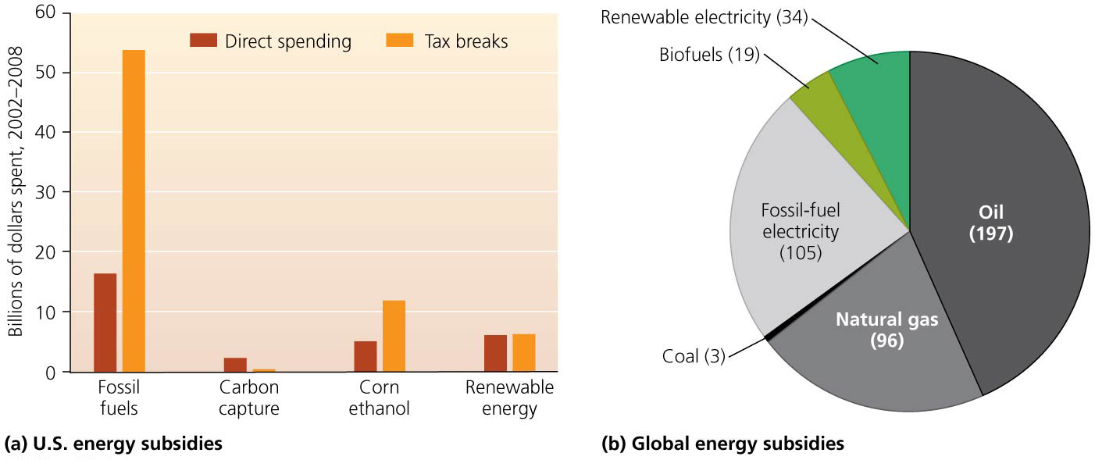

Slide 63
Subsidies promote certain activities
Environmentally harmful subsidies:
The General Mining Act of 1872
Mining companies get $500 million–$1 billion in minerals from U.S. public lands each year, but they do not pay a penny in royalties to taxpayers
The government has given away $250 billion in mineral resources
Mining activities have polluted 40% of Western watersheds

Slide 64
Subsidies promote certain activities
Environmentally harmful subsidies:
The U.S. Forest Service spends $35 million of taxpayer money/year building roads for logging companies
Companies sell the trees for profit

Slide 65
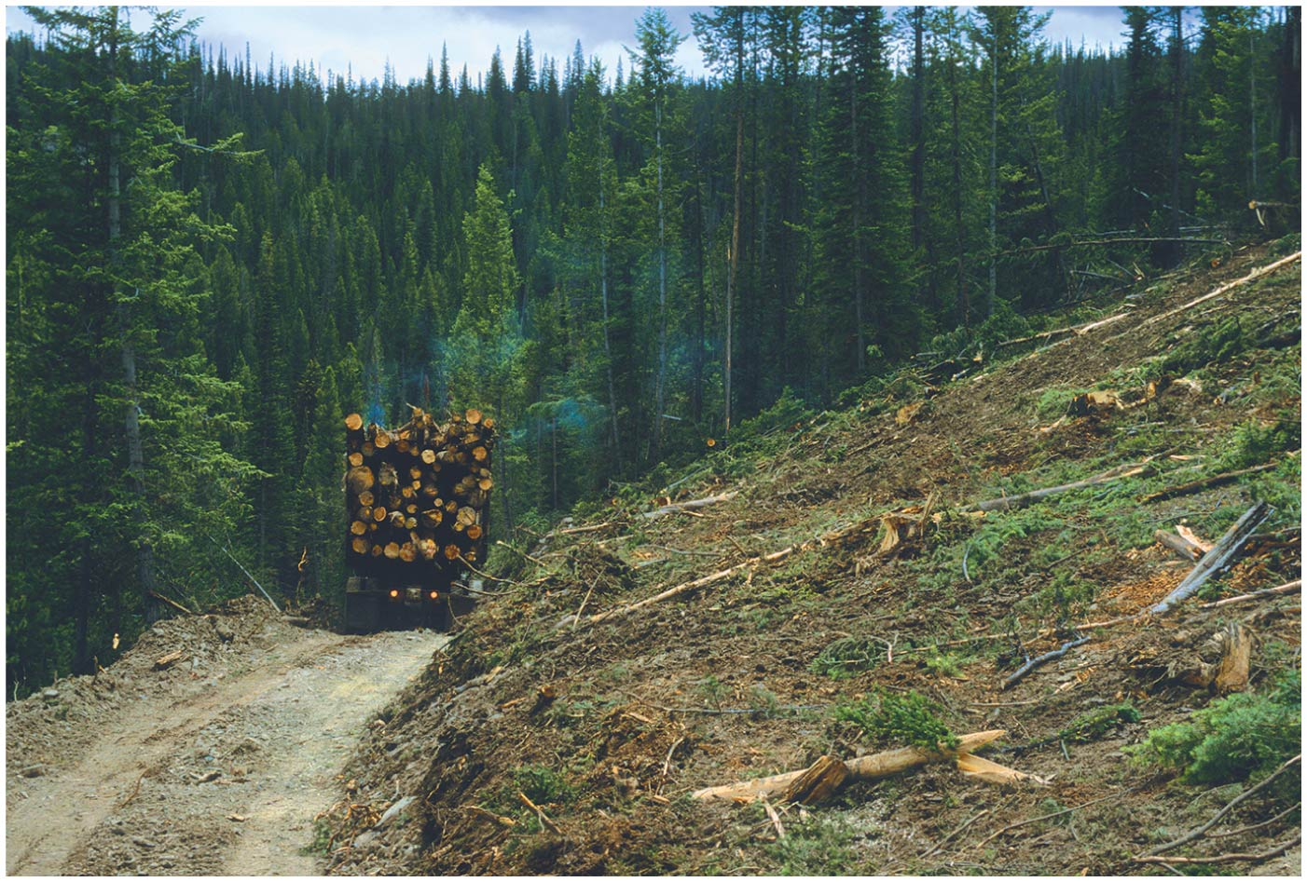

Slide 66
We can harness market dynamics to promote sustainability
Financial incentives and market dynamics can also help in obtaining policy goals
In ecolabeling, sellers advertise that they use sustainable practices
Businesses win consumer confidence and outcompete less sustainably produced brands
Permit trading = approach using a government-created market in permits for an environmentally harmful activity
Emissions trading system allows businesses to buy, sell, and trade these permits

Slide 67
Permit trading can save money and produce results
Cap-and-trade = an emissions trading system in which the government sets pollution levels (“caps”) and issues permits
Polluters can buy, sell, and trade these permits
Pollution is reduced overall, but does increase around polluting plants
Government can reduce number of permits to reduce pollution levels
Companies have an economic incentive to reduce emissions
Encourages innovative ideas to reduce pollution

Slide 68
Permit trading can save money and produce results
A cap-and-trade system in the United States mandates lower sulfur dioxide emissions
Emissions have decreased by 43%
Cuts were obtained cheaper and more efficiently than command-and-control regulation with no effects on supply or economic growth
Benefits outweigh costs 40 to 1
Markets in carbon emissions have been started
Permit prices have been too low to be effective

Slide 69
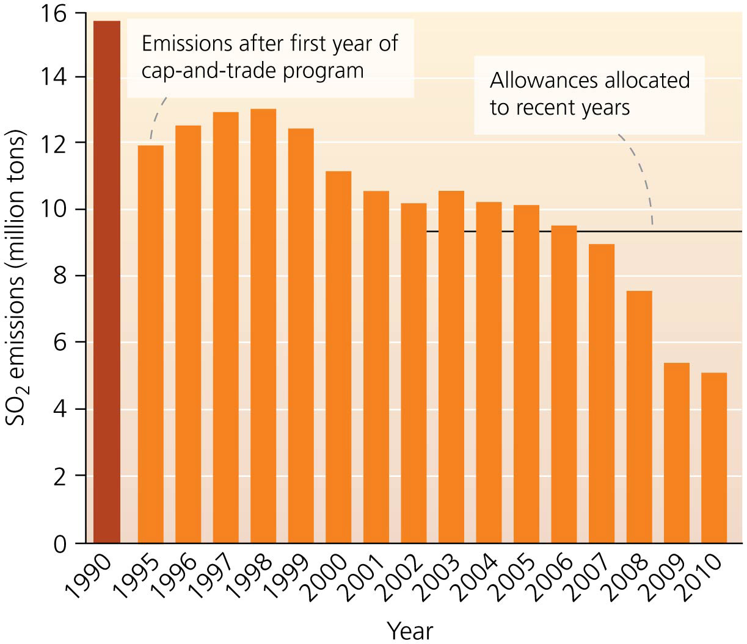

Slide 70
Market incentives also operate at the local level
Municipalities charge residents for waste disposal according to the amount of waste generated
Cities tax disposal of costly items (tires, motor oil)
Some cities give rebates for buying water-efficient appliances
Less costly than upgrading water treatment plants
Power utilities give discounts to those buying efficient lightbulbs and appliances
Less costly than building a new power plant

Slide 71
Conclusion
Environmental policy is a problem-solving tool
It uses science, ethics, and economics
Conventional command-and-control approach uses legislation and regulations to make policy
It is the most common approach
Tort law is still influential
Market-based policies are being developed
Environmental issues span political boundaries
Require international cooperation

Slide 72
QUESTION: Review
_______ involves “laws and regulations that affect resource use.”
Tort law
Environmental policy
Market failure
Tragedy of the commons
Notes:
Answer: b

Slide 73
QUESTION: Review
Which of the following is NOT a goal of environmental policy?
Protecting resources against the tragedy of the commons
Elimination of free riders
Externalizing internal costs
Promoting equity
Notes:
Answer: c

Slide 74
QUESTION: Review
Why are environmental laws challenged, ignored, and rejected by citizens and policymakers?
Many think regulations cause economic loss.
Businesses opt for short-term economic gain.
Politicians act out of short-term interest.
All of these are reasons environmental laws are not well-liked by many people.
Notes:
Answer: d

Slide 75
QUESTION: Viewpoints
According to the Fifth Amendment, should a landowner be able to oppose an environmental restriction and build a hazardous waste dump in a residential neighborhood?
Yes, property owners should be allowed to do whatever they want with their land.
Yes, if the neighbors agree.
Yes, but only if the courts allow it.
No, private property development must be restricted if it affects other people’s property.
Notes:
Answer: any

Slide 76
QUESTION: Review
Under the General Mining Act (1878),
economically expensive projects are proposed.
anyone could buy or settle on 160 acres of public land.
people could mine on public land for $5/acre with no government oversight.
anyone promising to plant trees on 25% of their land could get 160 acres.
Notes:
Answer: c

Slide 77
QUESTION: Review
Which of the following is NOT a duty of the Environmental Protection Agency (EPA)?
Conducts and evaluates research
Monitors environmental quality
Sets and enforces standards for pollution levels
All of these are duties of the EPA.
Notes:
Answer: d

Slide 78
QUESTION: Review
Which of the following entities provides funding to build dams, irrigation facilities, and infrastructure?
NGOs
The EU
The World Bank
The WTO
Notes:
Answer: c

Slide 79
QUESTION: Viewpoints
Should the United States continue providing subsidies and tax breaks to private industries that negatively affect the environment?
Yes. The free market must not be interrupted.
Yes, but only if the negatively affected region is poor and has a high jobless rate.
No. Companies should survive or fail on their own, without government help.
Notes:
Answer: any

Slide 80
QUESTION: Interpreting Graphs and Data
What major conclusion can be drawn from this graph on emissions trading of sulfur dioxide?
Emissions have increased since 2000.
The permit program has failed to reduce pollution.
The United States no longer emits sulfur dioxide.
Emissions have decreased by more than 50% since the start of the program.
Notes:
Answer: d

