Slide 2
This lecture will help you understand:
Culture, worldviews, and choices
Environmental ethics
Economics and the environment
Classical and neoclassical economics
Economic growth, well-being, and sustainability
Environmental and ecological economics
Sustainable development

Slide 3
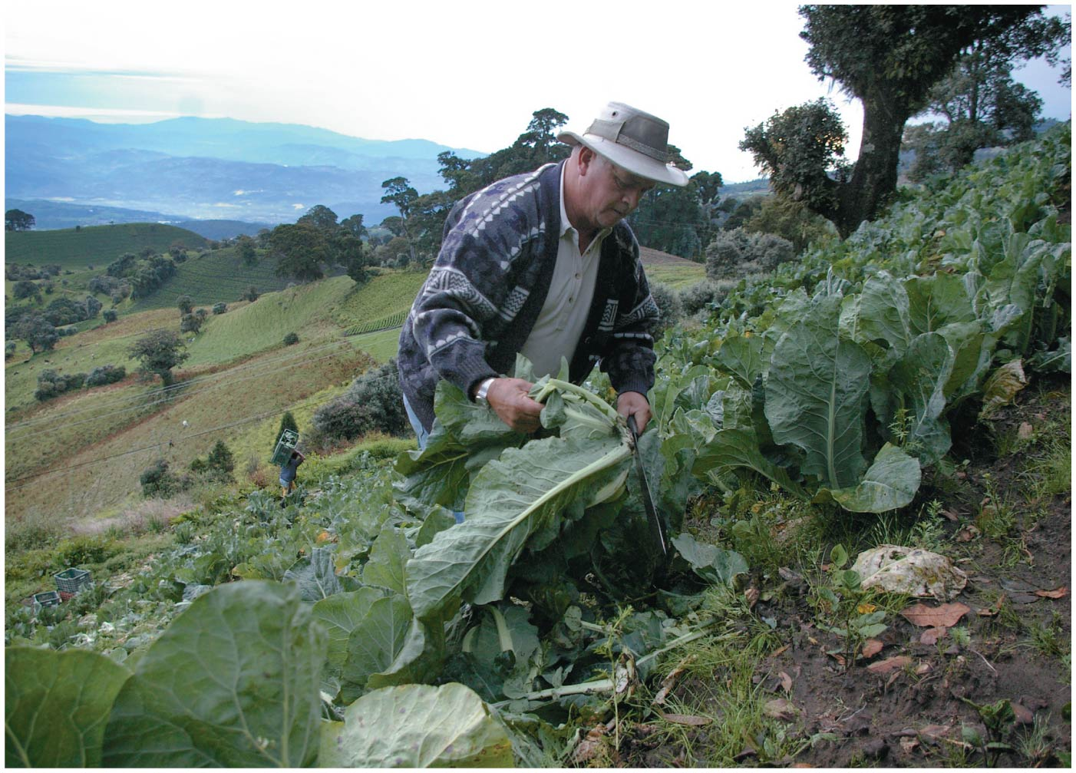

Slide 4
Central Case Study: Costa Rica Values Its Ecosystem Services
Costa Rica was once losing its rainforests to logging faster than almost any other country
Government began paying landowners to protect ecosystem services by planting or saving forest
Forests cleanse water, prevent erosion, etc.
Forest cover has gone from 17% of the country in 1983 to 52% today
Per capita income has increased by 50%

Slide 5
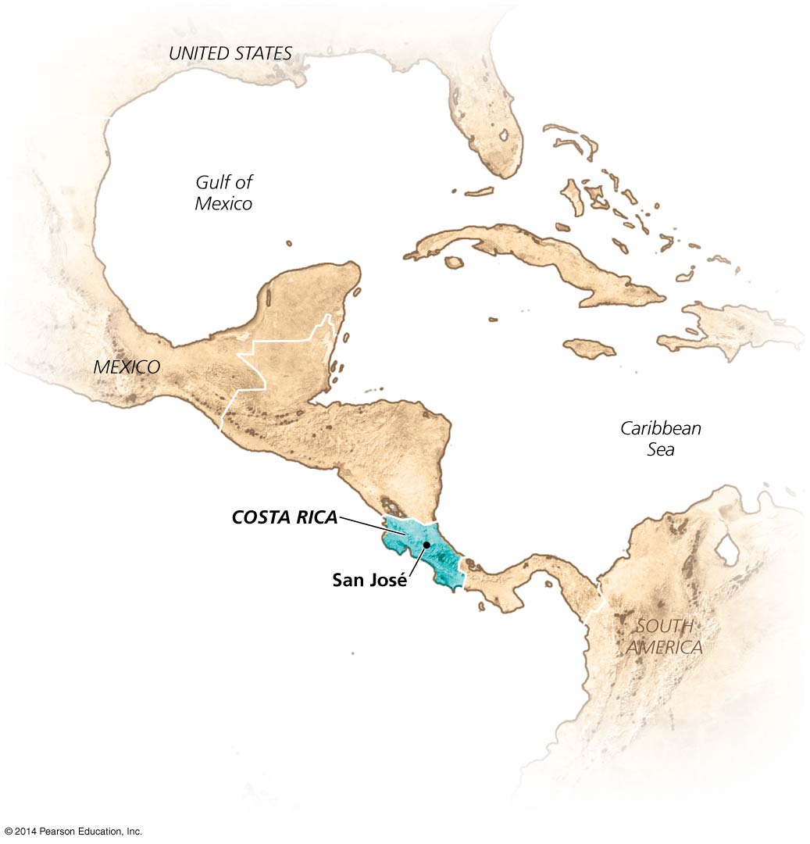

Slide 6
Ethics and economics involve values
Both disciplines deal with what we value
Values affect our decisions and actions
Solving environmental problems needs more than understanding how natural systems work
Values shape human behavior
Culture = knowledge, beliefs, values, and learned ways of life shared by a group of people
Worldview = a person’s or group’s beliefs about the meaning, operation, and essence of the world
How a person sees his or her place in the world

Slide 7
Many factors shape our worldviews
Religious and spiritual beliefs shape our worldview and perception of the environment
Political ideology: government’s role in protecting the environment
Shared cultural experiences if members of the community have lived through similar experiences
To find sustainable solutions, scientific knowledge must be used in the context of ethics and economics

Slide 8
Environmental Ethics
Ethics = the study of good and bad, right and wrong
Moral principles or values held by a person or society
For example, promoting human welfare, maximizing freedom, minimizing pain and suffering
Relativists = those who believe ethics varies with social context
Universalists = those who believe right and wrong remains the same across cultures and situations
Ethics is a prescriptive pursuit: it tells us how we ought to behave

Slide 9
Ethical standards help us judge right from wrong
Ethical standards = criteria that help differentiate right from wrong
Categorical imperative: the Golden Rule
Treat others as we would prefer to be treated ourselves
Most world religions teach this same lesson
Principle of utility states that something is right when it produces the most practical benefits for the most people

Slide 10
We value things in two ways
Instrumental (utilitarian) value = to value something for its pragmatic benefits by using it
Forests are valuable because we can harvest timber from them
Intrinsic (inherent) value = to value something for its own sake because it has a right to exist
Forests are valuable because they provide homes to countless organisms that all have the right to live

Slide 11
We value things in two ways
Things can have both instrumental and intrinsic value
But different people emphasize different values
Costa Rica paying to protect ecosystem services is an attempt to quantify their forests’ intrinsic value

Slide 12
Environmental ethics pertains to people and the environment
Environmental ethics = application of ethical standards to relationships between human and nonhuman entities
Many questions raised in environmental ethics are hard to resolve:
Should we save resources for future generations?
Should humans ever drive other species to extinction?
When is it OK to destroy a forest to create jobs?
Is it OK for some communities to be exposed to more pollution?

Slide 13
We have expanded our ethical consideration
People have granted intrinsic value and ethical consideration to more and more people and things
Including animals, communities, and nature
Animal rights activists voice concern for animals that are hunted, raised in pens, or used for testing
Rising economic prosperity broadens our ethical domain
Science shows people are part of nature
All organisms are interconnected
Non-Western cultures often have broader ethical domains

Slide 14
We have expanded our ethical consideration
Anthropocentrism = belief that only humans have intrinsic value
Biocentrism = belief that some nonhuman life has intrinsic value
Ecocentrism = belief that whole ecological systems have value
A holistic perspective that preserves connections

Slide 16
Environmental ethics has ancient roots
Christianity’s attitude toward the environment: anthropocentric hostility or stewardship?
The Industrial Revolution increased consumption and pollution
John Ruskin: people no longer appreciated nature
Transcendentalism = philosophical movement asserting that nature is a manifestation of the divine
People need to experience nature
Ralph Waldo Emerson, Walt Whitman, Henry David Thoreau’s Walden

Slide 17
Conservation and preservation arose with the 20th century
Preservation ethic = view that unspoiled nature should be protected for its own intrinsic value
John Muir had an ecocentric viewpoint
He was a tireless advocate for wilderness preservation
Conservation ethic = view that people should use natural resources wisely for the greatest good for the most people (the utilitarian standard)
Gifford Pinchot had an anthropocentric viewpoint

Slide 18
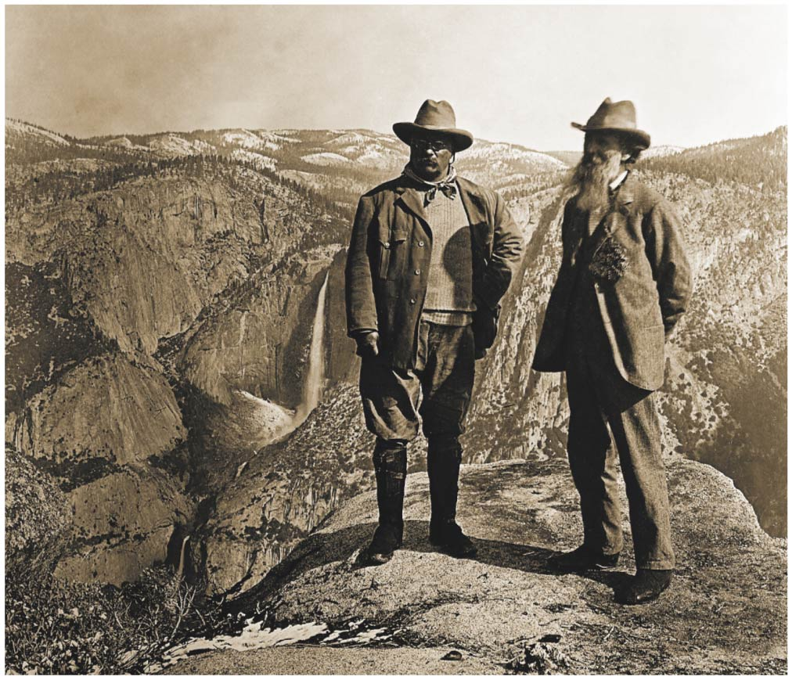
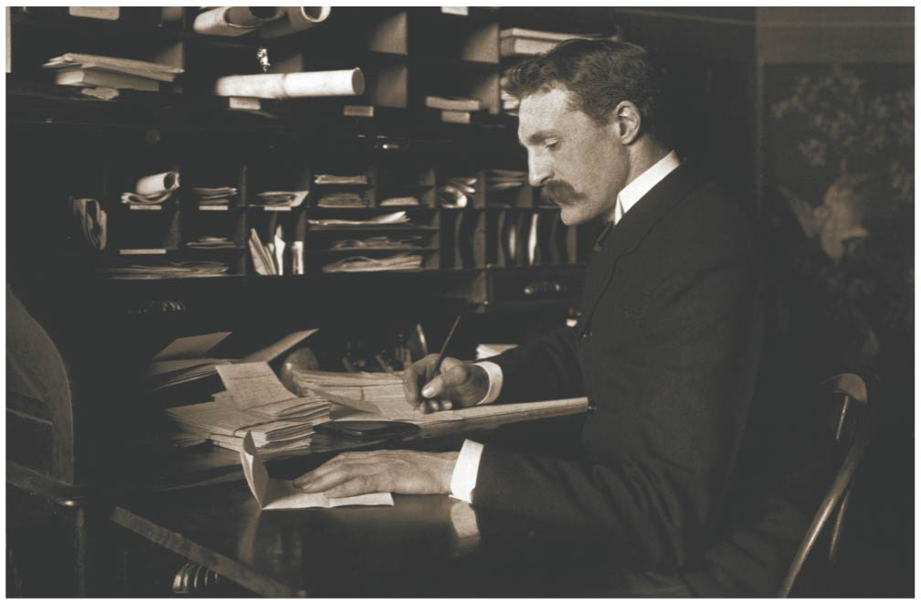

Slide 19
Aldo Leopold’s land ethic inspires many people
Healthy ecological systems depend on protecting all parts
Aldo Leopold applied ecological principles to land policy
He believed the land ethic changes the role of people from conquerors of the land to citizens of it
The land ethic can help guide decision making

Slide 20
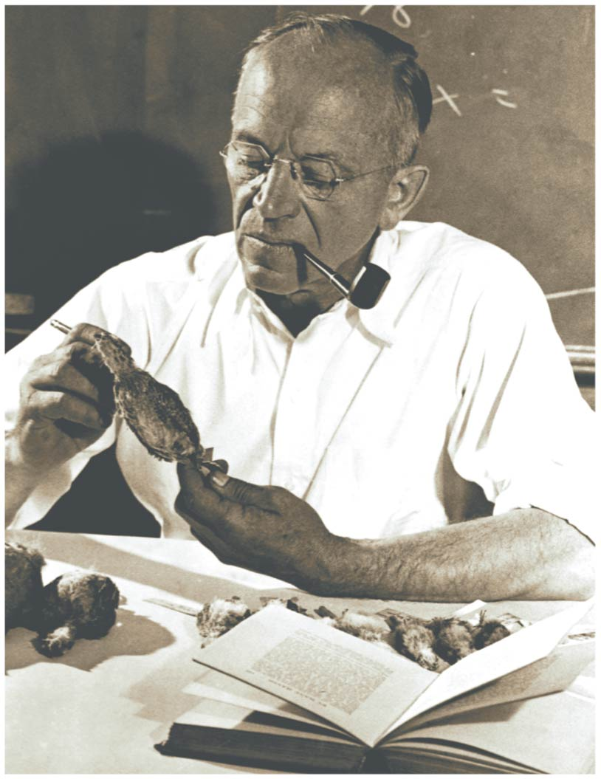

Slide 21
Environmental justice seeks equal treatment for all races and classes
Environmental justice = the fair and equitable treatment of all people regarding environmental issues
The poor and minorities have less information, power, and money
They are also exposed to more pollution, hazards, and environmental degradation
The gap between rich and poor continues to widen

Slide 22
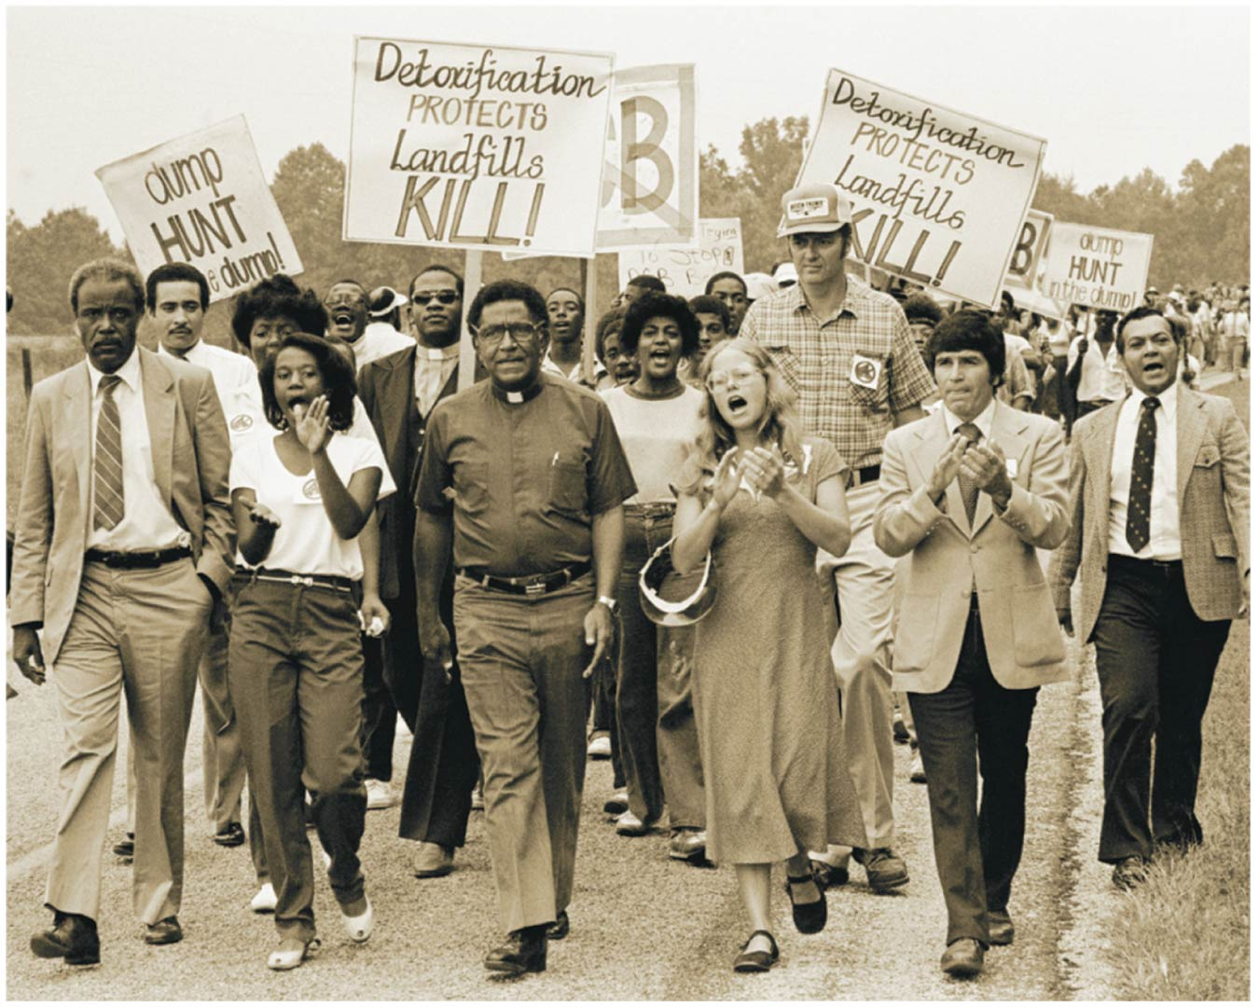

Slide 23
Environmental justice seeks equal treatment for all races and classes
From 1948 to the 1960s, neither the U.S. government nor the mining industry provided Navajo uranium miners with information or protection
The miners suffered health effects like lung cancer
Low-income white residents of the Appalachian region have had their water polluted and environment damaged by mountaintop removals for coal mining
The most negatively impacted after hurricane Katrina were those in poor, non-white communities

Slide 24
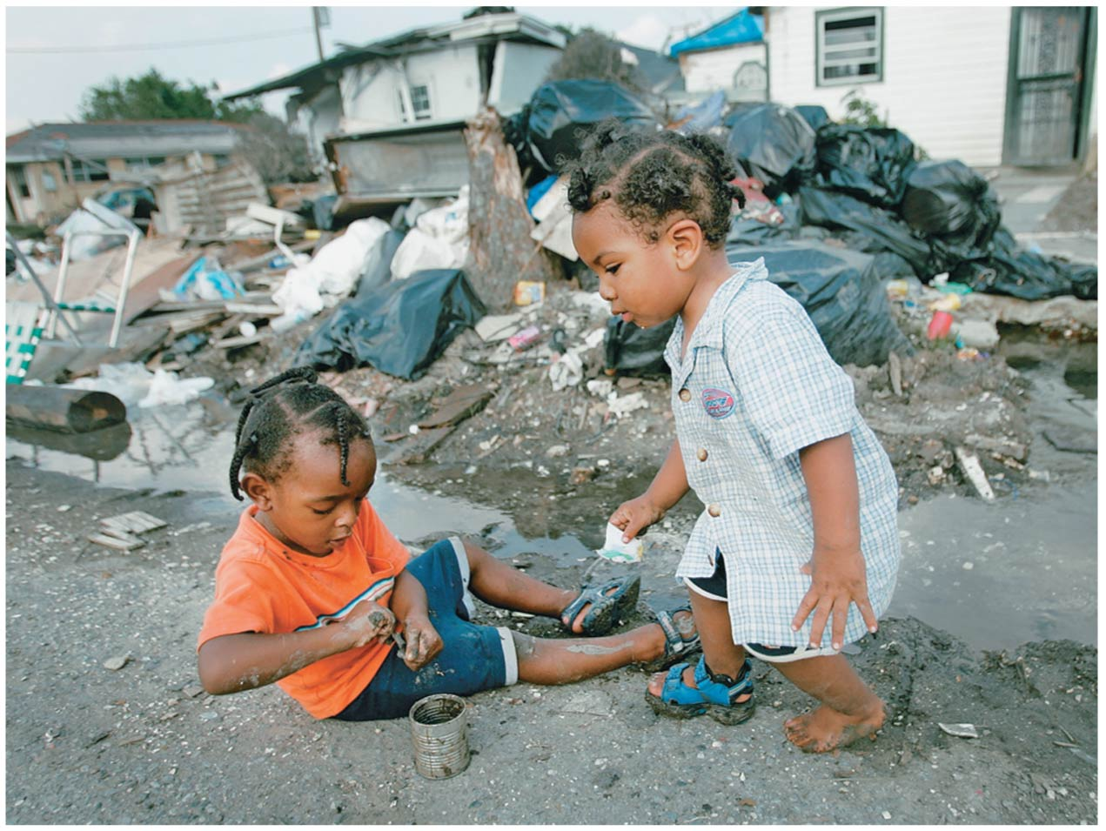

Slide 25
Is there a trade-off between the economy and the environment?
Friction occurs between ethical and economic impulses
Some say protection costs too much money, interferes with progress, or causes job losses
Others argue that environmental protection is good for the economy

Slide 26
Is there a trade-off between the economy and the environment?
Difference in view is often the result of thinking in the short term vs. the long term
Traditional economic thought ignores or underestimates contributions of the environment to the economy
Human economies depend on the environment

Slide 27
Economics studies resource allocation
Economics = the study of how people use resources to provide goods and services in the face of demand
Most environmental and economic problems are linked
Root oikos, meaning “household,” gave rise to both ecology and economics
Economy = a social system that converts resources into:
Goods: manufactured materials that are bought, and
Services: work done for others as a form of business

Slide 28
Several types of economies exist
Subsistence economy = economy in which people get their daily needs directly from nature or their own production
They do not purchase or trade products
Capitalist market economy = economy in which buyers and sellers interact to determine prices and production of goods and services

Slide 29
Several types of economies exist
Centrally planned economy = economy in which the government determines how to allocate resources
Mixed economy = economy in which governments intervene to some extent
Most national economies are a balance of approaches
Lack of balance can cause problems—unregulated financial practices caused the 2009 recession

Slide 30
Economies rely on goods and services from the environment
Economies receive inputs (resources)
Process them
Discharge outputs (waste)
Traditional economics ignores the environment
Resources are free and “limitless”
Wastes are absorbed at no cost

Slide 31
Economies rely on goods and services from the environment
Natural resources are the materials and forces that sustain our lives (sun’s energy, water, trees, fossil fuels)
Environmental systems naturally perform functions that support economic activities:
Soil formation
Pollination
Water purification
Nutrient cycling
Climate regulation
Waste treatment

Slide 32
Economies rely on goods and services from the environment
Economic activities affect and often degrade the environment and its ability to provide services
Depleting natural resources, generating pollution

Slide 33
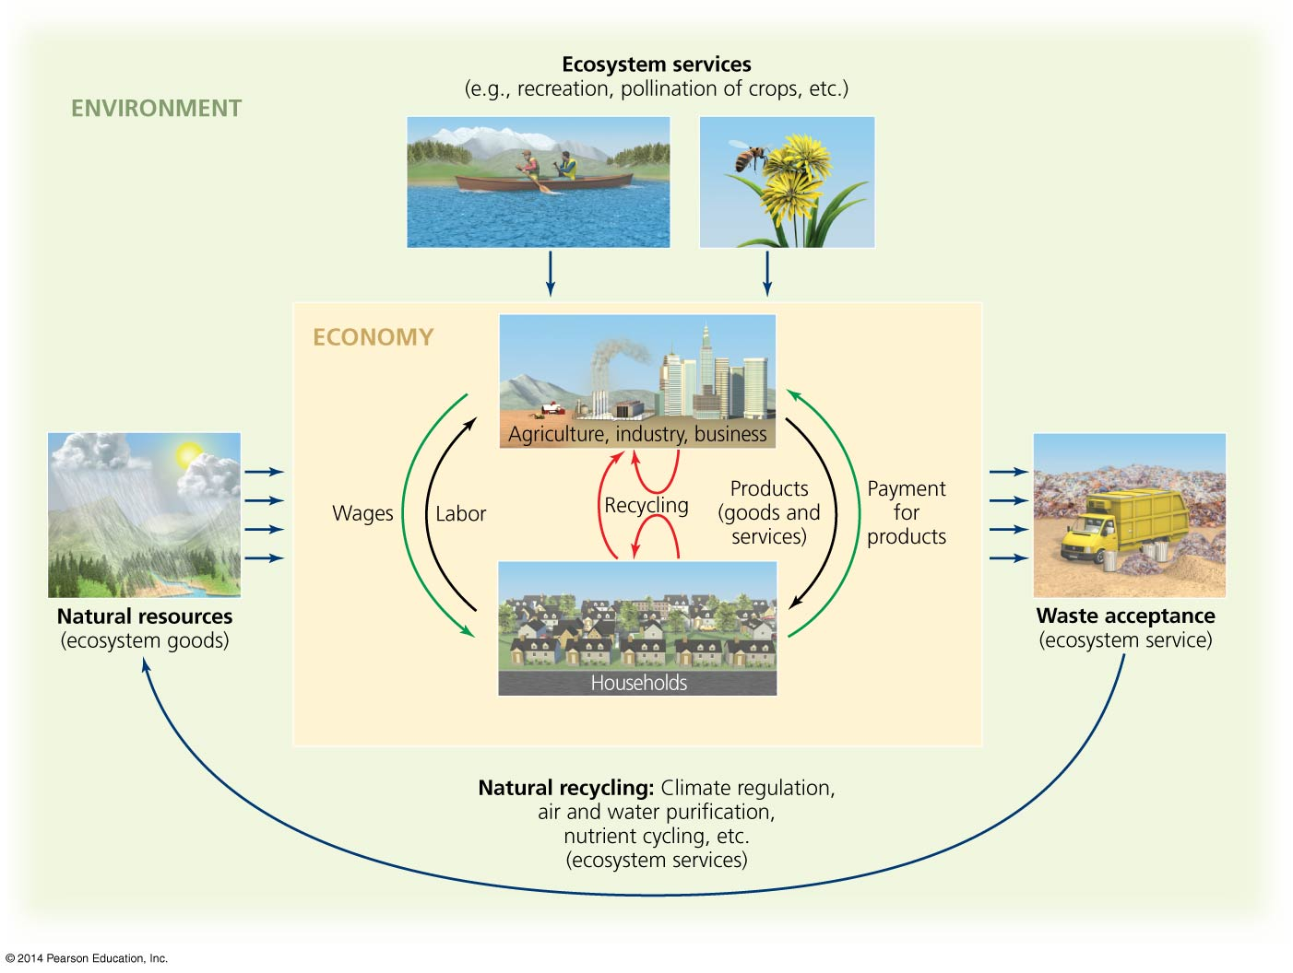

Slide 34
Adam Smith proposed an “invisible hand”
Classical economics = when people pursue economic self-interest in a competitive marketplace
The market is guided by an “invisible hand”
Society as a whole benefits
Differing opinions exist about this pillar of free-market thought
It is responsible for the gains in material wealth
It is responsible for economic inequality between rich and poor
It promotes environmental degradation

Slide 35
Neoclassical economics considers supply, demand, costs, and benefits
Market price is determined by consumer preferences
Market price for a product reflects balance between
Supply = amount offered at a given price
Demand = amount people will buy at a given price
The “right” quantities of a product are produced
“Optimal” levels of pollution, resource use can be determined in the same way

Slide 36
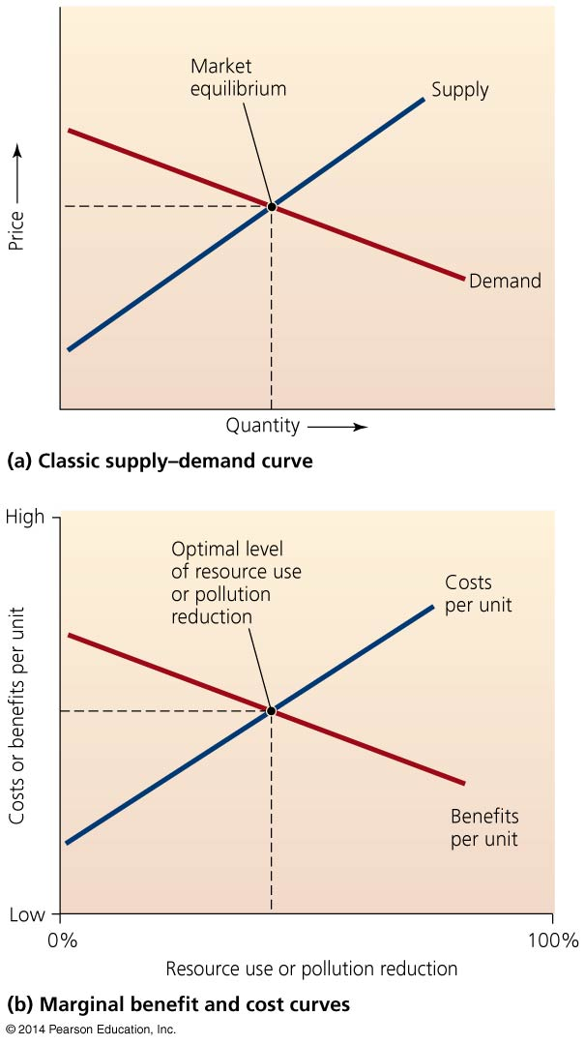

Slide 37
Neoclassical economics considers supply, demand, costs, and benefits
Cost-benefit analysis = costs of a proposed action are compared to benefits that result from the action
If benefits are greater than the costs: pursue the action
Cost-benefit analysis is controversial: not all costs and benefits can be identified or defined
It is easy to quantify value of bananas grown or cattle raised on land cleared of forest
But hard to assess the cost of lost ecosystem services

Slide 38
Neoclassical economics considers supply, demand, costs, and benefits
Monetary benefits are overrepresented
Analysis is biased in favor of economic development
Biased against environmental protection

Slide 39
Are resources infinite or substitutable?
Neoclassical economics treats resources as substitutable and interchangeable
A replacement resource will always be found
Goods and services are treated as “free gifts of nature”
Infinitely abundant, resilient, and substitutable

Slide 40
Are resources infinite or substitutable?
But Earth’s resources are limited
Nonrenewable resources can be depleted
Renewable resources (e.g., forests) can also be depleted
Resources can become so polluted they are not usable

Slide 41
Are costs and benefits internal?
Neoclassical economics assumes that only the buyer and seller experience costs and benefits—they are “internal”
External costs = costs borne by someone not involved in a transaction
Health problems, resource depletion, property damage
If prices ignore social, environmental, or economic costs of pollution and degradation, taxpayers pay for them
Governments develop some environmental policies to deal with external costs

Slide 42
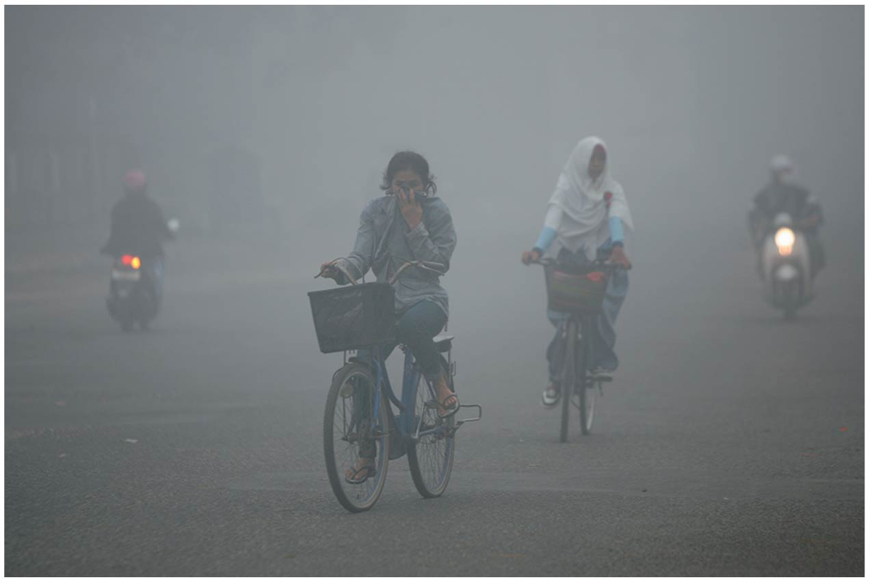

Slide 43
Should we discount the future?
Neoclassical economics assumes future events count less than present ones
Discounting = short-term costs and benefits are more important than long-term costs and benefits
Present conditions are more important than future ones
Cutting trees now brings in more money than cutting them in the future would bring in
Policymakers ignore long-term consequences of actions
Puts costs of habitat degradation, resource depletion, pollution on to future generations

Slide 44
Is all growth good?
Neoclassical economics assumes that growth is good
Economic growth = an increase in an economy’s production and consumption of goods
It is necessary to maintain social order
Promoting economic growth creates opportunities for poor to become wealthier
But economic activity and true wealth are not the same
Affluenza = material goods do not always bring contentment
Runaway growth can destroy our economic system if resources are not limitless

Slide 45
How sustainable is economic growth?
All measures of economic activity are higher than they have ever been
Economic growth comes from:
Increased inputs (labor, natural resources)
Economic development = improved efficiency of production (technology, ideas, equipment)
Nonrenewable resources, and therefore inputs, are finite
Technological advances are improving economic development
We produce more goods with fewer resources

Slide 47
How sustainable is economic growth?
Cornucopians = those who believe human ingenuity and improved technology will allow continued economic growth
Human innovation, technologies, and market forces increase access to resources and avoid depletion
Cassandras = those who believe Earth’s natural capital is finite, so continuous growth is not sustainable
Computer models predict economic collapse under current conditions as resources become scarce

Slide 48
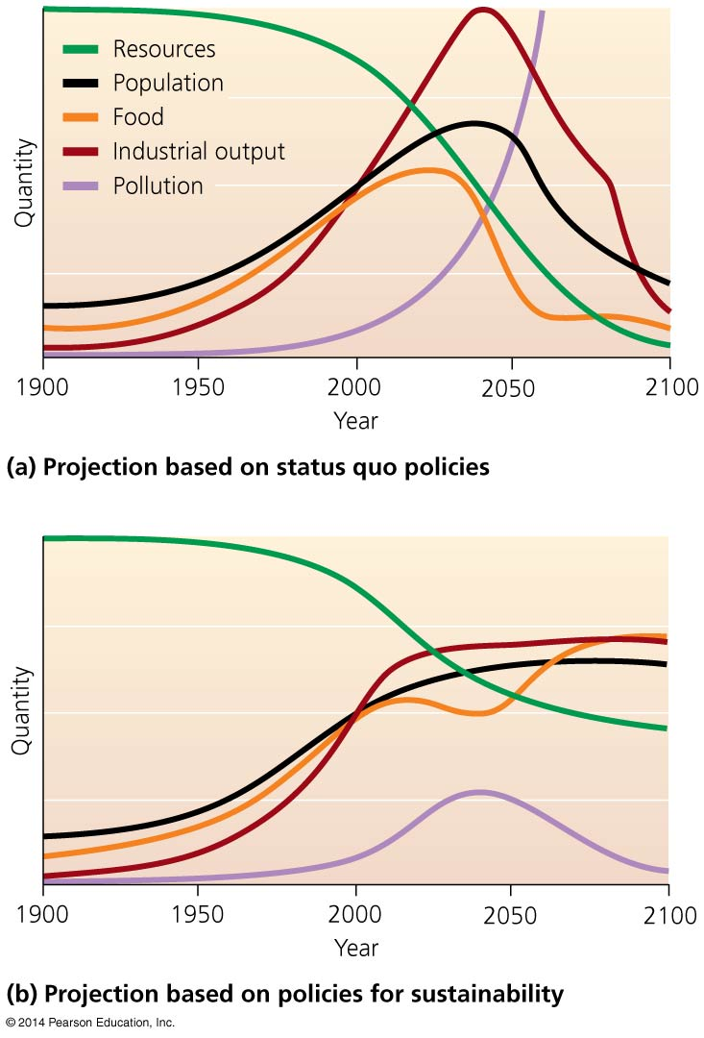

Slide 49
Environmental economists devise strategies for sustainability
Environmental economics = field that maintains we must reduce our demand for resources and make their use more efficient to achieve sustainable growth
Calls for reform of neoclassical economics
Addresses external costs and discounting

Slide 50
Environmental economists devise strategies for sustainability
Ecological economics = field that maintains that civilizations cannot surpass environmental limitations; endless growth is not possible
Natural systems operate in self renewing cycles
Calls for revolution—abandon neoclassical economics
Steady-state economies = economies that mirror natural ecological systems—they neither grow nor shrink

Slide 51
We can assign monetary value to ecosystem goods and services
Our society mistreats the very systems that sustain it
The market ignores/undervalues ecosystem services
Nonmarket values = values not included in the price of a good or service (e.g., ecological, cultural, spiritual)

Slide 52
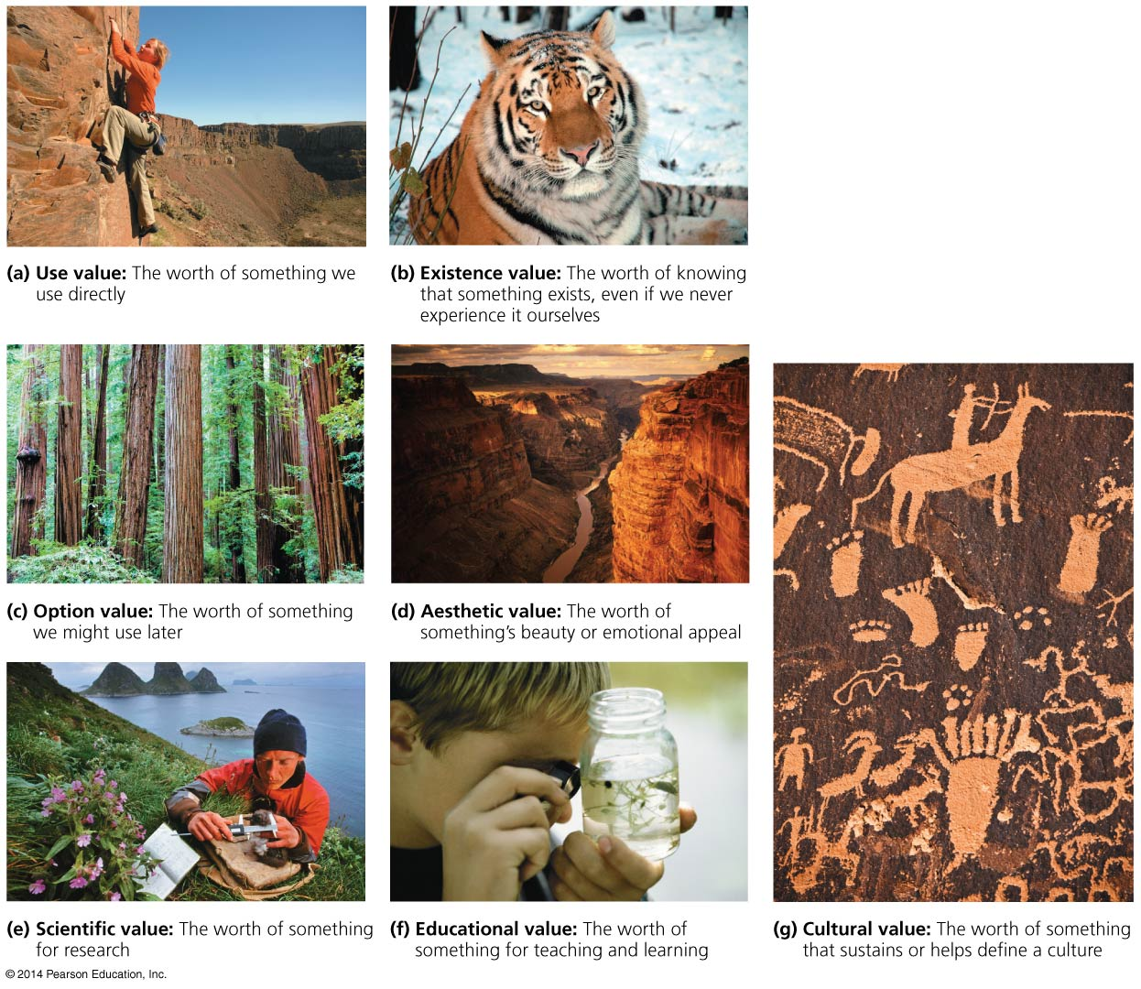

Slide 53
We can assign monetary value to ecosystem goods and services
Contingent valuation = technique that uses surveys to determine how much people are willing to pay to protect or restore a resource
Measures expressed preferences
But since people do not really pay, they may overinflate values
Researchers can find a value for a service revealed by actual behavior
Includes time, money, effort people spend to travel to a location
Measures actual costs of restoration, cleanup, etc. to restore lost functions

Slide 54
We can assign monetary value to ecosystem goods and services
Researchers calculated the global value of 17 major ecosystem services (water supply, recreation, raw materials, etc.)
The global economic value of all ecosystem services equals $48 trillion
More than the GDP of all nations combined
Protecting certain areas gives 100 times more value than converting them to some extractive use

Slide 55
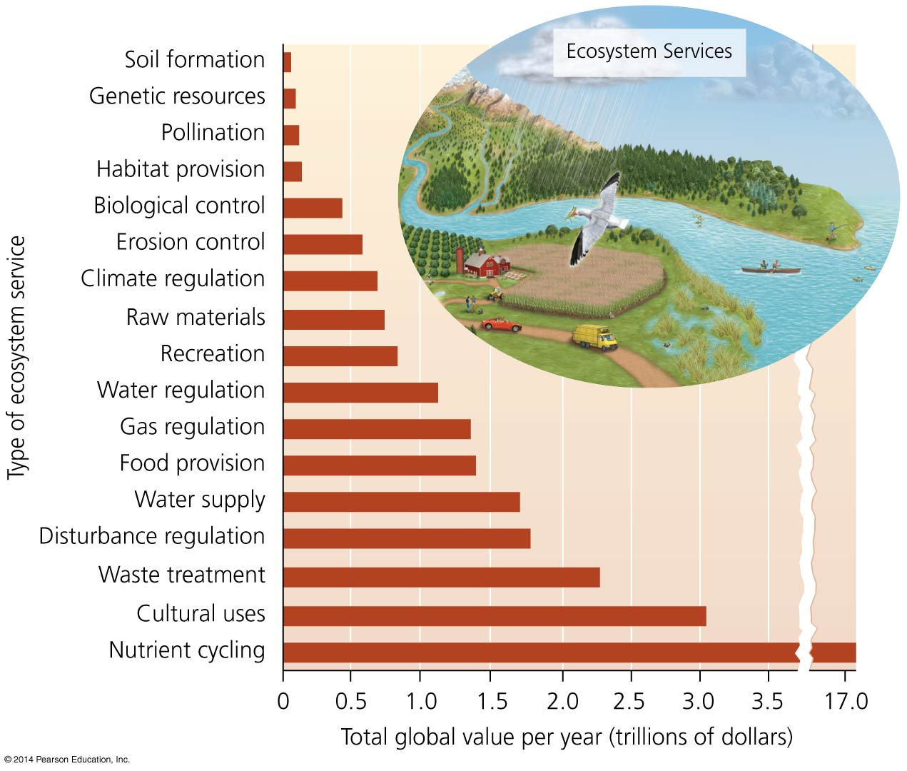

Slide 56
We can measure progress with full cost accounting
Gross Domestic Product (GDP) = the total monetary value of goods and services a nation produces
Does not account for nonmarket values
Does not express only desirable economic activity
Pollution, oil spills, disasters, etc. increase GDP

Slide 57
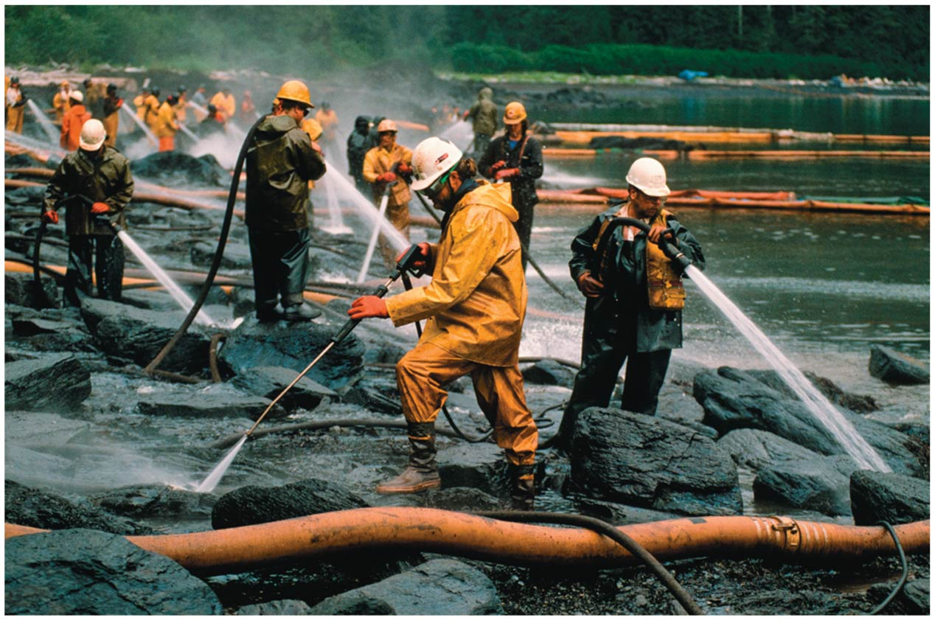

Slide 58
We can measure progress with full cost accounting
Genuine Progress Indicator (GPI) = GDP alternative that differentiates between desirable and undesirable economic activity
Positive contributions (e.g., volunteer work) not paid for with money are added to economic activity
Negative impacts (crime, pollution) are subtracted
In the United States, GDP has risen greatly, but GPI only slightly

Slide 59
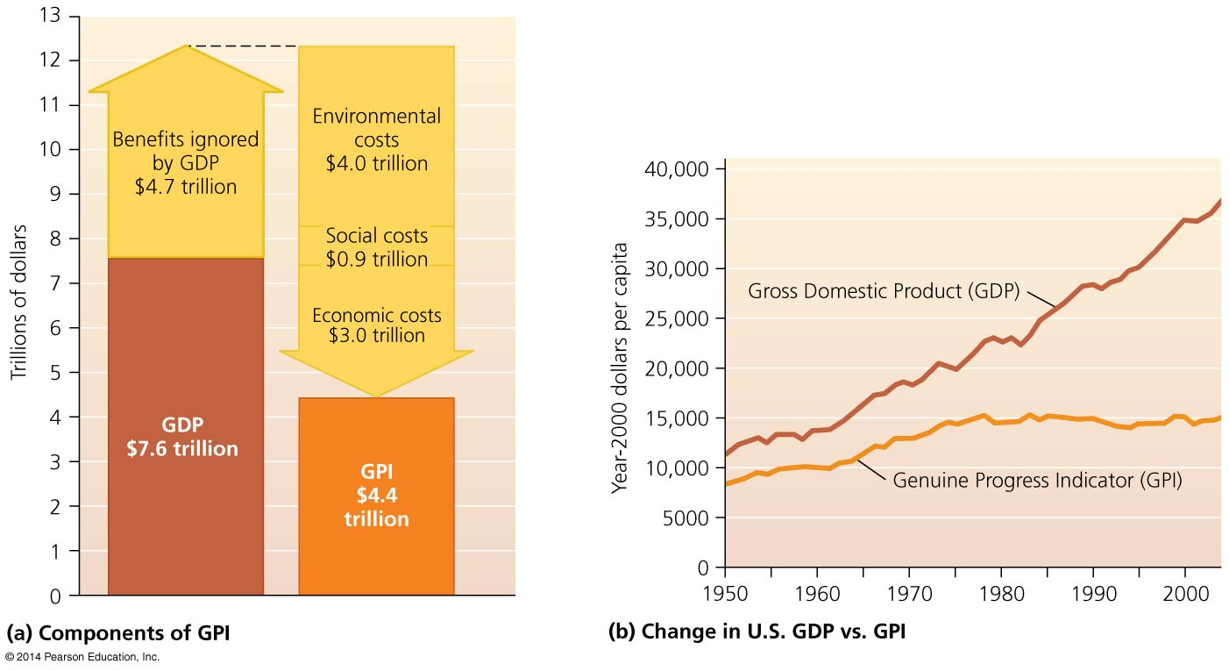

Slide 60
We can measure progress with full cost accounting
Full cost accounting = attempts to monetize all costs and benefits (GPI is one example)
Happy Planet Index divides number of happy years of life by ecological footprint
Measures happiness per amount of resource input
These indicators give a more accurate indication of a nation’s welfare
Critics claim the valuation is too subjective

Slide 61
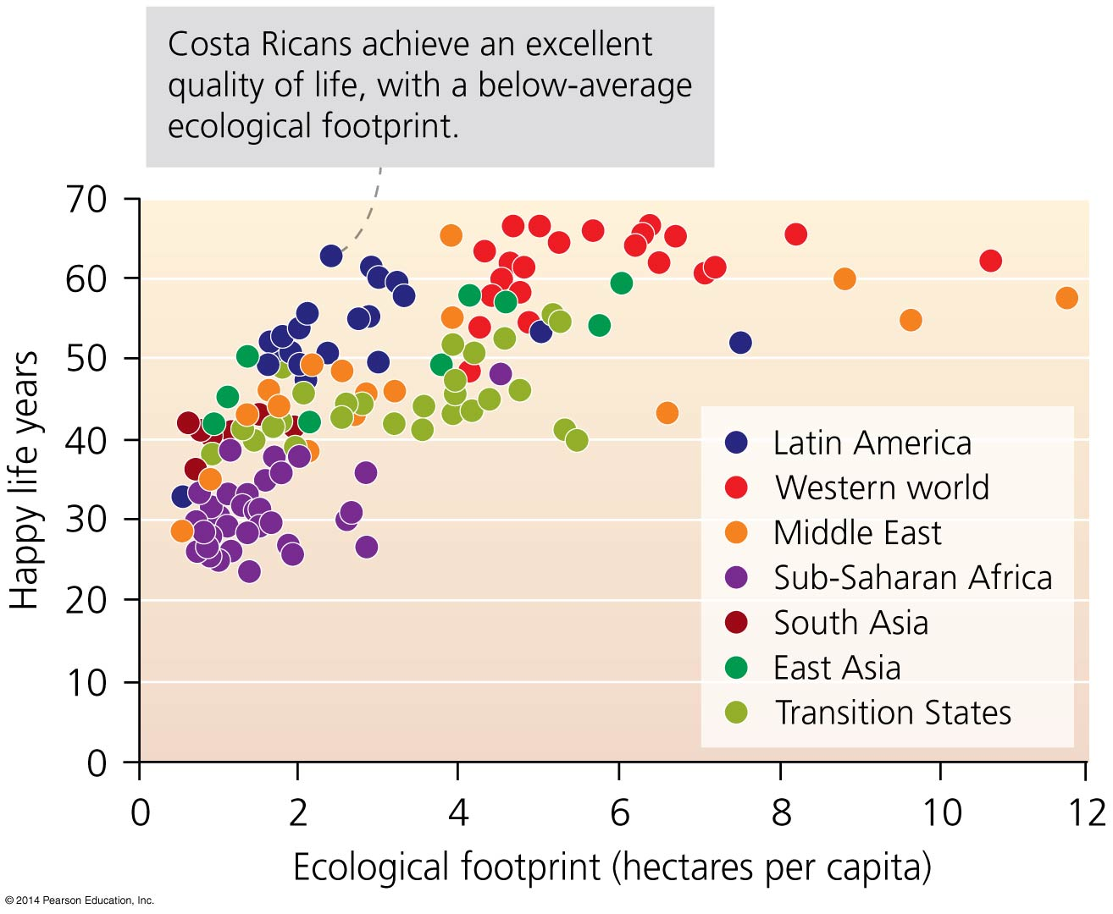

Slide 62
Markets can fail
Market failure = occurs when markets ignore the environment’s positive impacts or the negative effects of activities on the environment or people (external costs)
Government intervention counters market failure
Laws and regulations
Tax harmful activities
Economic incentives to promote fairness, conservation, and sustainability (e.g., pollution permits, pay landowners for ecosystem services)

Slide 63
Ecolabeling helps address market failure
Ecolabeling = labeling approach that tells consumers which brands use environmentally benign processes
A powerful incentive for businesses to change
Dolphin-safe tuna, organic food
Socially responsible investing = investing in companies that have met criteria for environmental or social sustainability
$3.7 trillion in 2012, 11% of all investments

Slide 64
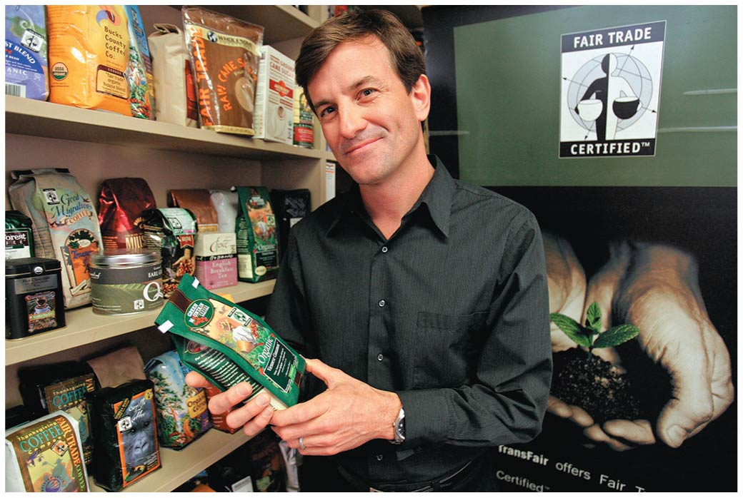

Slide 65
Businesses are responding to sustainability concerns
Industries, businesses, and corporations make money by “greening” their operations
Many find that reducing waste and conserving energy reduce costs and increase profits
Industries donate to environmental groups, preserve land, etc.
Manufacturers recycle, use recycled materials, cut energy use, reduce the use of toxic substances, etc.
Thousands of local sustainable businesses have been started around the world

Slide 66
Businesses are responding to sustainability concerns
Any changes made by large companies will have far-reaching impacts
Some of the world’s largest corporations have joined in: McDonald’s, Starbucks, Intel, Ford Motor Company, Toyota, IKEA, Dow, DuPont, BASF, IBM, Hewlett Packard, Nike, Wal-Mart
Greenwashing = consumers can be misled into thinking companies are acting more sustainably than they are
“Pure” bottled water may not be safer or better
Corporate actions hinge on consumer behavior
People must support sustainable economics

Slide 67
Sustainable Development
Sustainable development = the use of resources to satisfy current needs without compromising future availability of resources
Development = the use of natural resources for economic advancement
Making purposeful changes to enhance the quality of human life
Some have viewed protecting the environment as being incompatible with development
The poor suffer the most from environmental degradation

Slide 68
Sustainable development involves environmental protection, economic well-being, and social equity
Triple bottom line = sustainable solutions that meet the goals of:
Environmental protection
Economic advancement
Social equity
Humans must apply knowledge from the sciences to
Limit environmental impacts
Maintain functioning environmental systems

Slide 69
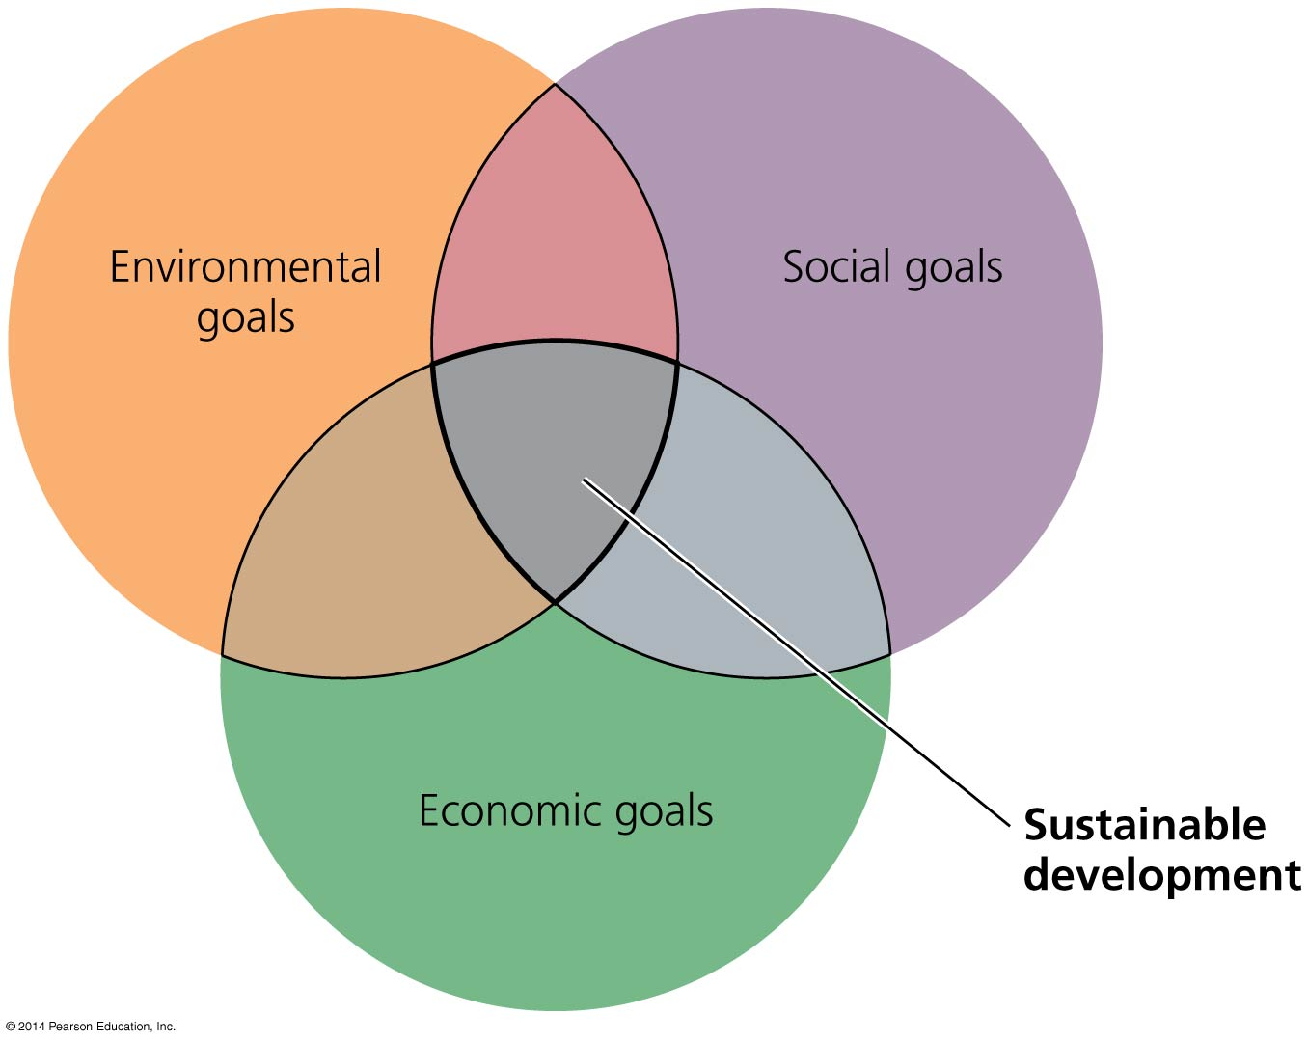

Slide 70
Sustainable development is a global movement
Millennium Development Goals = established by the United Nations as broad goals for global development:
Eradicate extreme poverty and hunger
Achieve universal primary education
Promote gender equality and empower women
Reduce child mortality
Improve maternal health
Combat HIV/AIDS, malaria, and other diseases
Ensure environmental sustainability
Develop a global partnership for development

Slide 71
Conclusion
Recent developments have brought economic approaches to bear on environmental protection and conservation
Corporate sustainability, ecolabeling, new ways of measuring growth, valuation of ecosystem services
Environmental ethics has expanded people’s ethical considerations
Environmental justice
Economic welfare can be enhanced without growth, increasing economic health and environmental quality
Sustainable development seeks the triple bottom line

Slide 72
QUESTION: Review
An anthropocentric worldview would consider the impact of an action on
humans only.
animals only.
plants only.
all living things.
all nonliving things.
Notes:
Answer: a

Slide 73
QUESTION: Review
Which ethic holds that unspoiled nature should be protected for its own intrinsic value?
Land ethic
Preservation ethic
Conservation ethic
Deep ecology
Biocentrism
Notes:
Answer: b

Slide 74
QUESTION: Review
Which of the following is an ecosystem service?
Water purification in wetlands
Climate regulation in the atmosphere
Nutrient cycling in ecosystems
Waste treatment by bacteria
All of the above are ecosystem services.
Notes:
Answer: e

Slide 75
QUESTION: Review
Which is NOT an assumption of neoclassical economics that can lead to environmental degradation?
Resources are unlimited.
Long-term effects are downplayed.
Costs and benefits are experienced by buyers, sellers, and the public.
Growth is good.
Notes:
Answer: c

Slide 76
QUESTION: Review
Which of the following statements would be spoken by an environmental economist?
The current economic system is working well.
The current economic system simply needs to be fine-tuned.
The current economic system is broken and a new one needs to be developed.
Economic systems never work.
Notes:
Answer: b

Slide 77
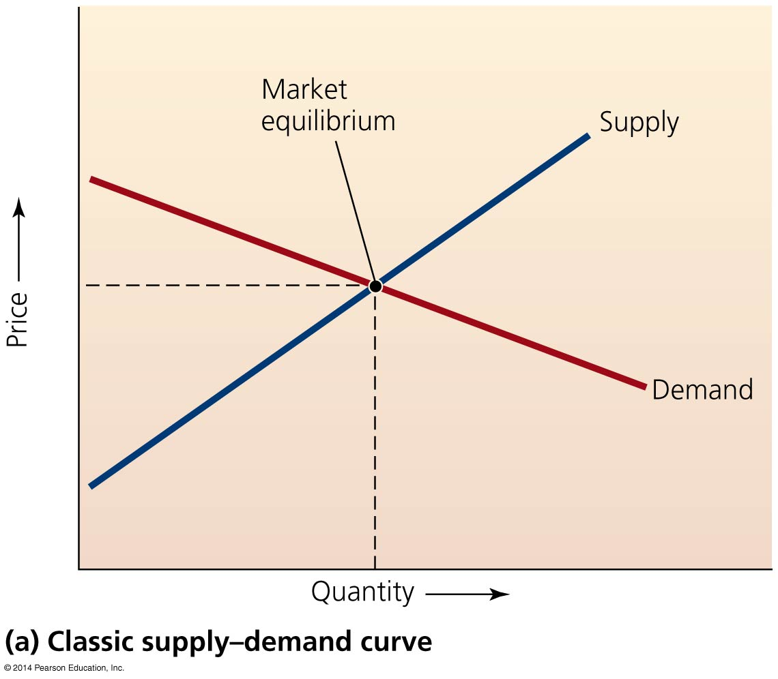
QUESTION: Interpreting Graphs and Data
Market equilibrium, which sets the price of a product, is reached
when supply exceeds demand.
when demand exceeds supply.
by demand when quantity is low and by supply when quantity is high.
when supply equals demand.
Notes:
Answer: d

Slide 78
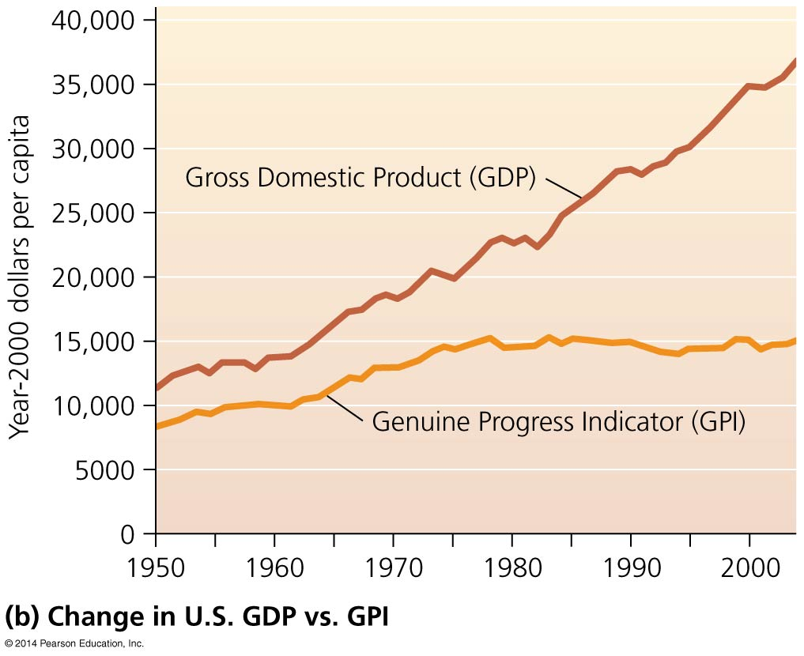
QUESTION: Interpreting Graphs and Data
Which conclusion can you draw from this graph?
GDP has not increased since 1950.
Despite spending more money, our lives are not much better.
We are spending less money, and our lives are much better.
The GPI is not as accurate as GDP.
Notes:
Answer: b

Slide 79
QUESTION: Viewpoints
Think of an issue in your community that could pit environmentalists against economic development. What do you think should prevail: environmental protection or economic development?
Economic growth; we need the jobs
Environmental protection; we need the environment
Both; a compromise must be reached
Whatever costs the taxpayers the least
Notes:
Answer: any

Slide 80
QUESTION: Viewpoints
What entities do you include in your domain of ethical concern?
Humans only
Humans and pets
Humans, pets, and other animals
Humans, pets, other animals, and nature
Notes:
Answer: any

