Slide 2
This lecture will help you understand:
Environmental systems
Ecosystems and their services
How living and nonliving entities interact
Landscape ecology, GIS, and ecological modeling
The water, carbon, nitrogen, and phosphorus cycles
Human impacts on biogeochemical cycles

Slide 3
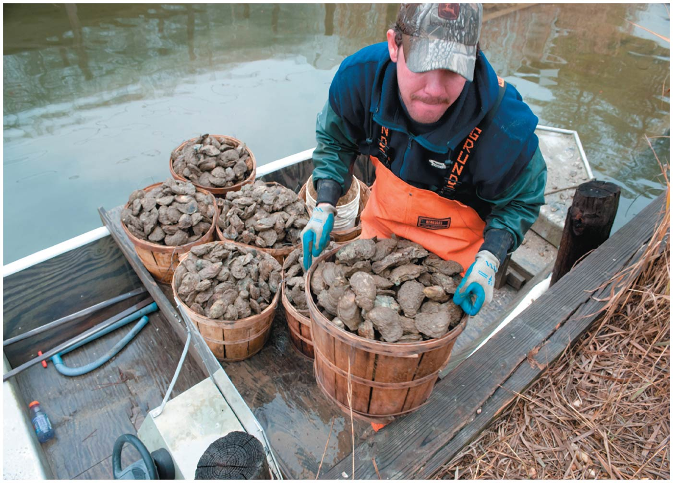

Slide 4
Central Case Study: The Vanishing Oysters of the Chesapeake Bay
Chesapeake Bay used to be the world’s largest oyster fishery
By 2010, output reduced to 1% of historical levels
Numerous causes of the decline:
Overharvesting
Habitat destruction
Disease
More recently, nutrient addition (nitrogen and phosphorus) from fertilizer, fossil fuel emissions, storm water runoff
Hypoxia = low concentrations of oxygen in water

Slide 5
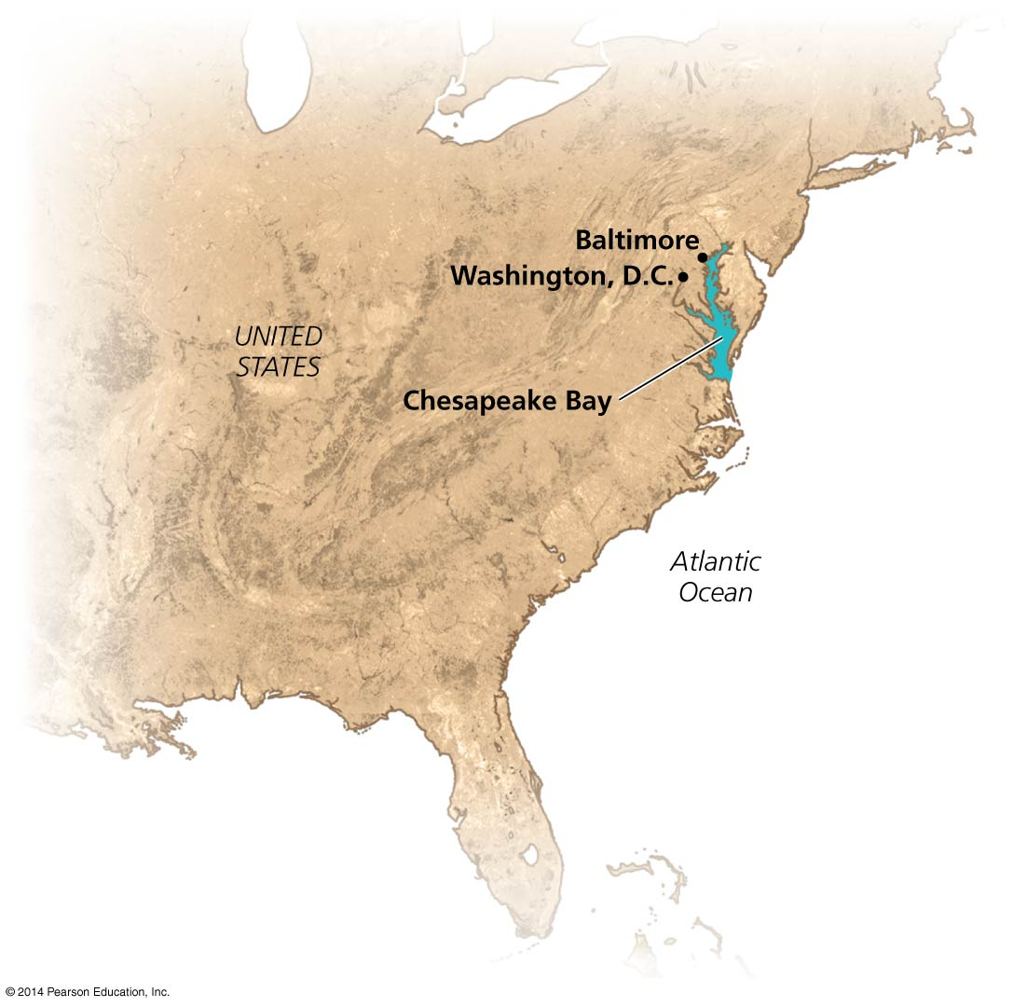

Slide 6
Earth’s Environmental Systems
Our planet’s environment consists of complex networks of interlinked systems
Matter and molecules
Organisms, populations, interacting species
Nonliving entities (rocks, air, water, etc.)
A systems approach assesses questions holistically
Helps address complex, multifaceted issues
But systems can show behavior that is hard to understand and predict

Slide 7
Systems involve feedback loops
System = a network of relationships among parts, elements, or components
They interact with and influence one another
They exchange energy, matter, or information
Systems receive inputs of energy, matter, or information
They process these inputs and produce outputs
Feedback loop = a circular process in which a system’s output serves as input to that same system
Negative and positive feedback loops do not mean bad and good

Slide 8
Systems involve feedback loops
Negative feedback loop = system changes and moves in one direction; that movement acts as an output, and as an input back into the system; the input then moves the system in the other direction
Input and output neutralize one another
Stabilizes the system
Example: body temperature
Most systems in nature

Slide 9
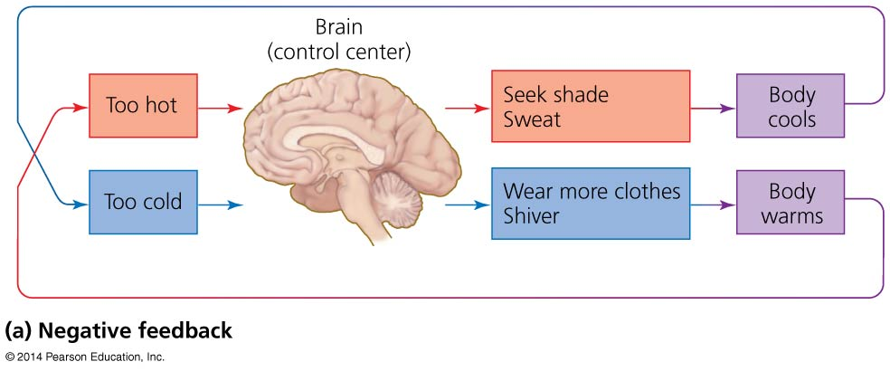

Slide 10
Systems involve feedback loops
Positive feedback loop = system output causes the system to change in the same way and drives it further toward one extreme or another
Exponential population growth, spread of cancer, melting sea ice
Rare in nature
But is common in natural systems altered by humans

Slide 11
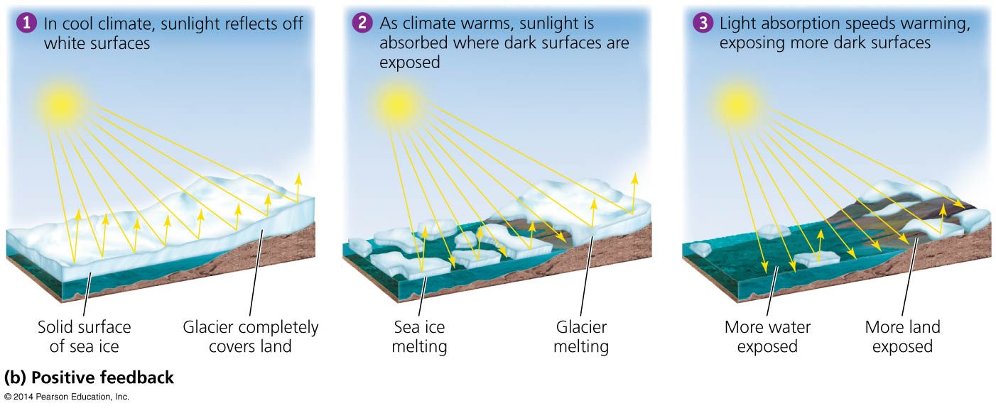

Slide 12
Systems show several defining properties
Dynamic equilibrium = when system processes move in opposing directions; balancing their effects
Homeostasis = when a system maintains constant (stable) internal conditions
Emergent properties = system characteristics that are not evident in the components alone
The whole is more than the sum of the parts
It is hard to fully understand systems; they connect to other systems and do not have sharp boundaries

Slide 13
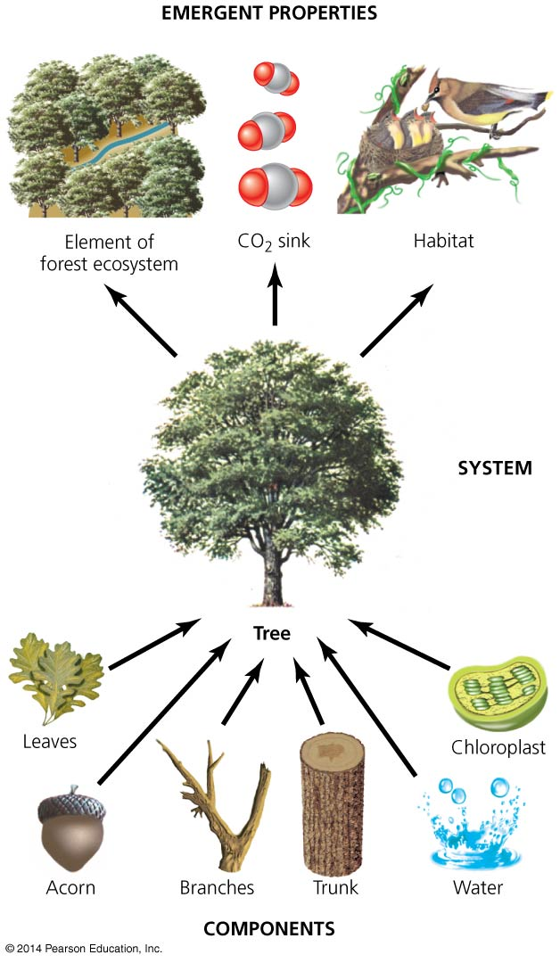

Slide 14
Environmental systems interact
Environmental systems often interact and can profoundly impact each other
The Chesapeake Bay is fed by river systems and the surrounding farms, cities, and forests
Runoff = precipitation that flows over land and enters waterways
Airshed = the geographic area that produces air pollutants that are likely to end up in a waterway
Both move nutrients from land to rivers to the Bay
Defining the boundaries of a system depends on the questions being asked

Slide 15
Environmental systems interact
Addition of excess nutrients to a water body leads to:
Blooms of algae
Increased production of organic matter that dies and sinks
Decomposition and loss of dissolved oxygen

Slide 16
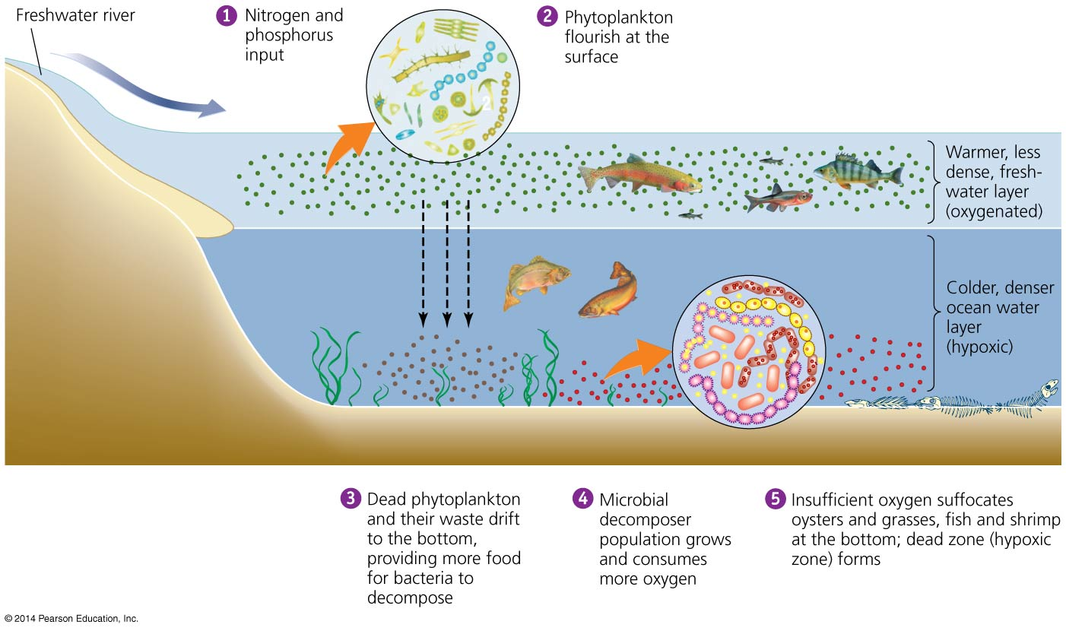

Slide 17
Environmental systems interact
Inputs to the Chesapeake Bay from adjacent systems cause eutrophication and loss of oxygen (hypoxia)

Slide 18
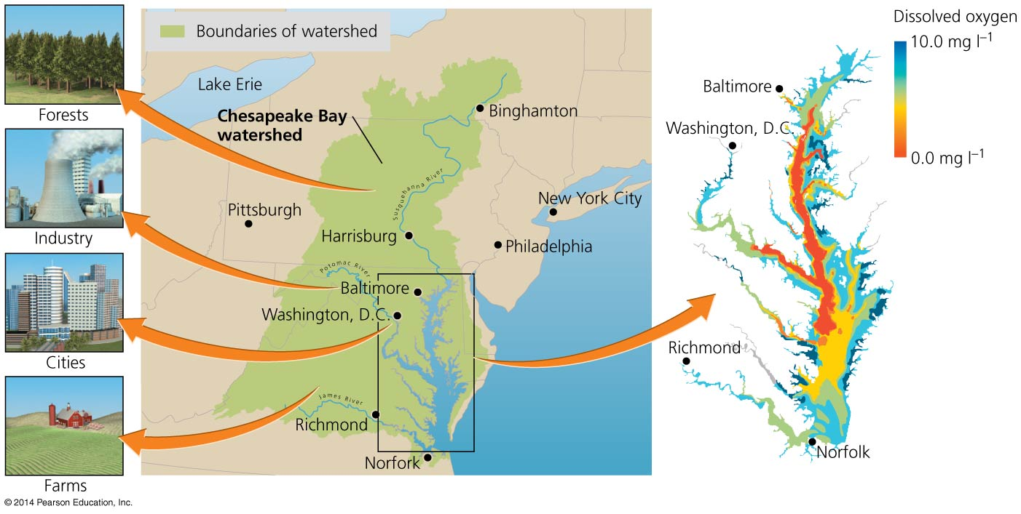

Slide 19
We may perceive Earth’s systems in various ways
Categorizing environmental systems helps make Earth’s dazzling complexity comprehensible
The Earth can be divided into structural spheres
Lithosphere = rock and sediment
Atmosphere = the air surrounding our planet
Hydrosphere = liquid, solid, or vapor water
Biosphere = the planet’s living organisms and the abiotic (nonliving) portions of the environment
Boundaries overlap, so the systems interact

Slide 20
Ecosystems
Ecosystem = all organisms and nonliving entities that occur and interact in a particular area at the same time
It includes abiotic and biotic components
Focuses on movement of energy and matter
Energy flows through an ecosystem
Matter is cycled among the ecosystem components
Notes:
20
20

Slide 21
Ecosystems are systems of interacting living and nonliving entities
Energy from the sun flows in one direction, arriving as radiation and leaving as heat
Matter is recycled within ecosystem, through food-web relationships and decomposition
Notes:
21
21

Slide 22
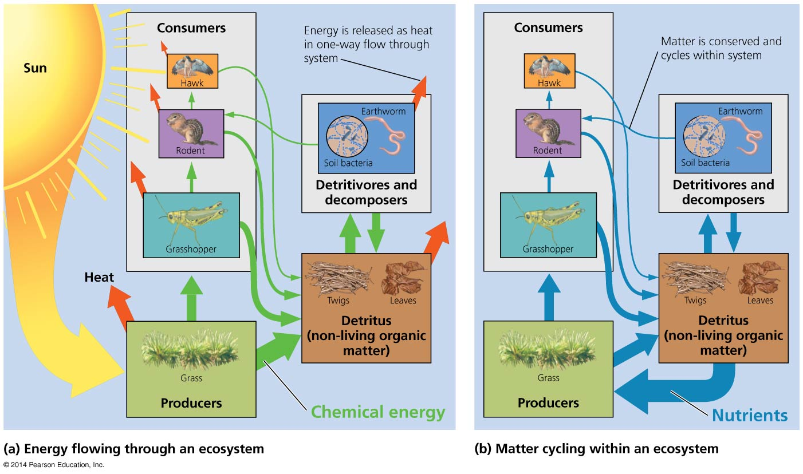

Slide 23
Energy is converted to biomass
Primary production = conversion of solar energy to chemical energy in sugars by autotrophs
Gross primary production (GPP) = total amount of energy captured by autotrophs
Net primary production (NPP) = energy remaining after respiration—used to generate biomass
Available for consumption by heterotrophs
Secondary production = biomass generated by heterotrophs from consuming autotrophs
Productivity = rate at which ecosystems generate biomass
Notes:
23
23

Slide 24
Energy is converted to biomass
Ecosystems differ in net primary productivity
High net primary productivity = ecosystems whose plants rapidly convert solar energy to biomass

Slide 25
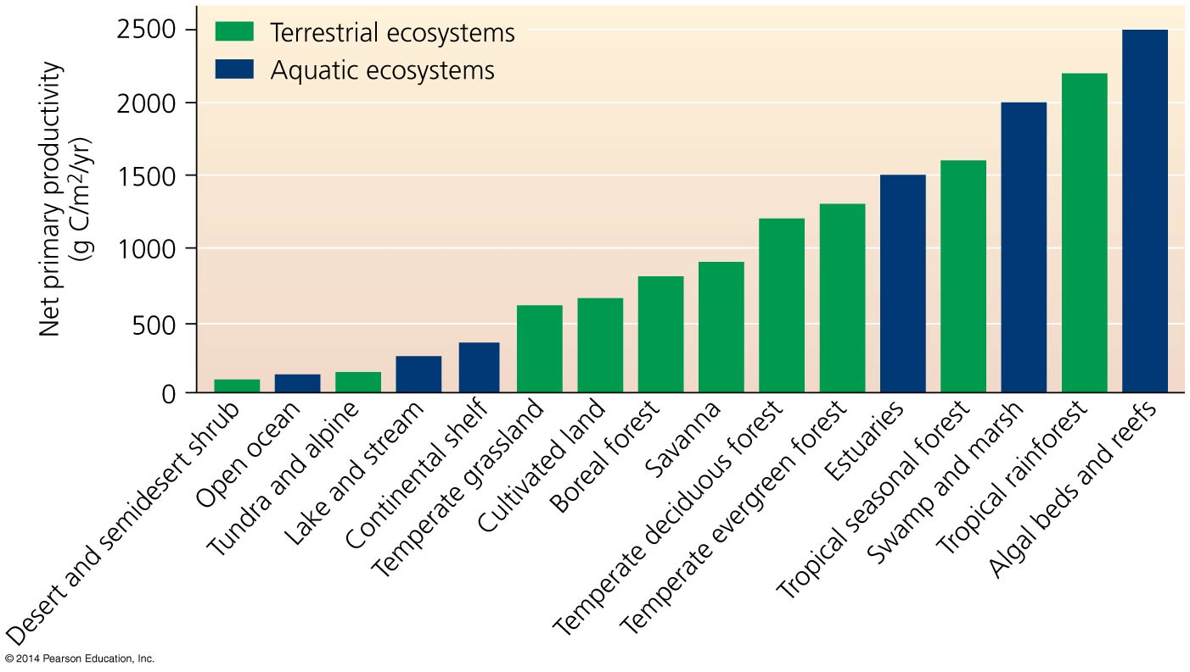

Slide 26
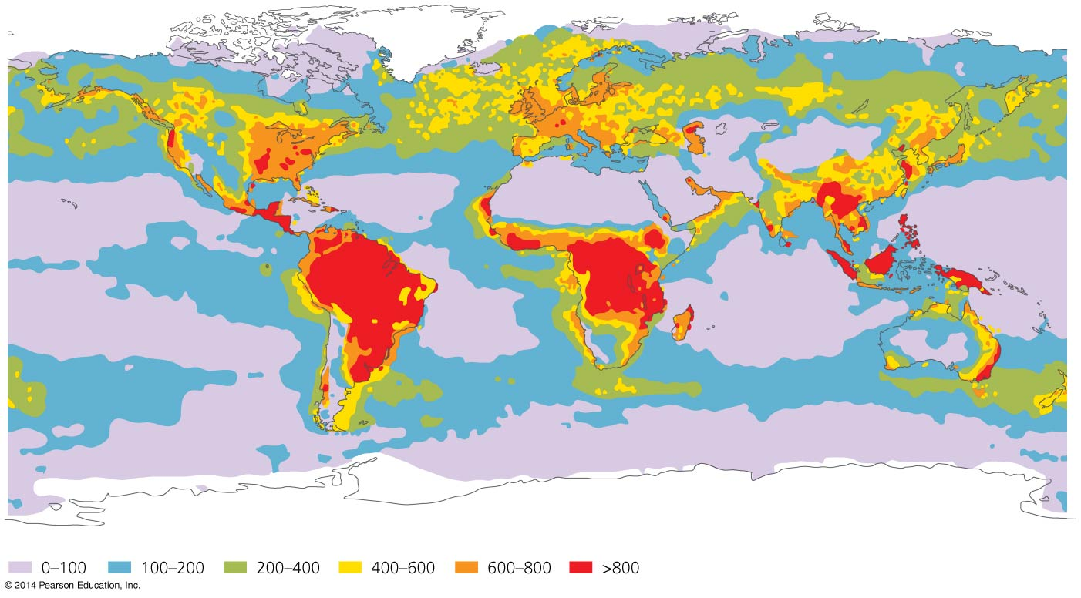
NPP increases with temperature and precipitation on land, and with light and nutrients in aquatic ecosystems

Slide 27
Nutrients influence productivity
Nutrients = elements and compounds required for survival that are consumed by organisms
Macronutrients = nutrients required in larger amounts
Nitrogen, carbon, phosphorus
Micronutrients = nutrients needed in smaller amounts
Nutrients stimulate plant production
Nitrogen and phosphorus are often limiting for plant and algal growth; oceans are limited by nitrogen; freshwater by phosphorus
Notes:
27
27

Slide 28
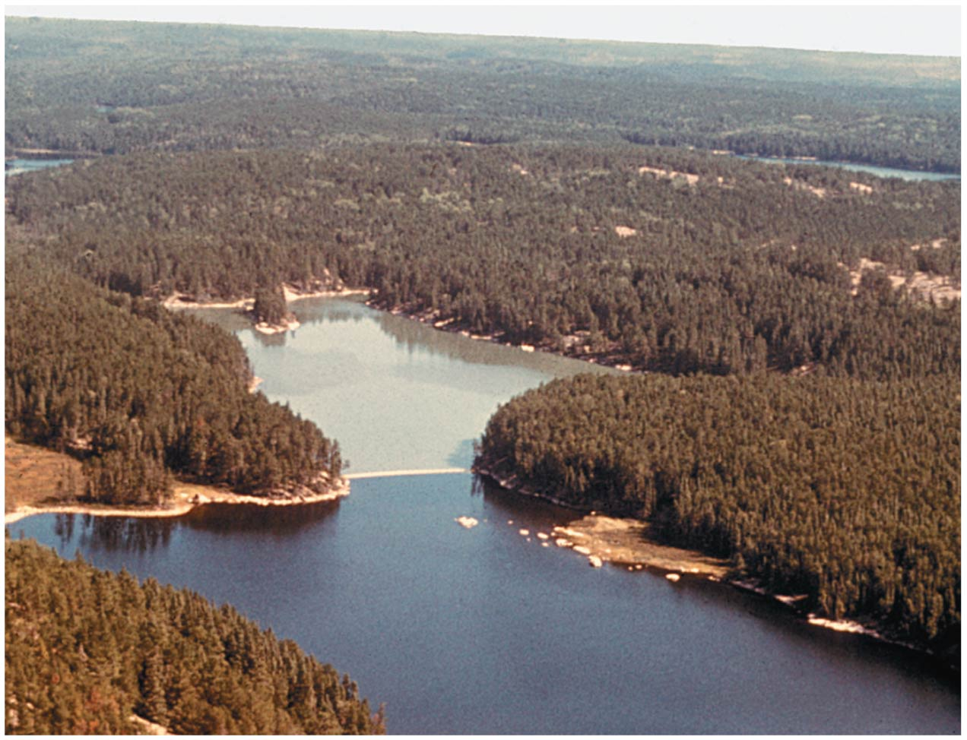

Slide 29
Nutrients influence productivity
Over 500 hypoxic dead zones occur globally
Most are off the coasts of Europe and the U.S.
Mostly due to farm, city, and industrial pollution
Some are seasonal; others are permanent
Fisheries and ecosystems are devastated
Causes over $2 billion/year in lost harvests

Slide 30
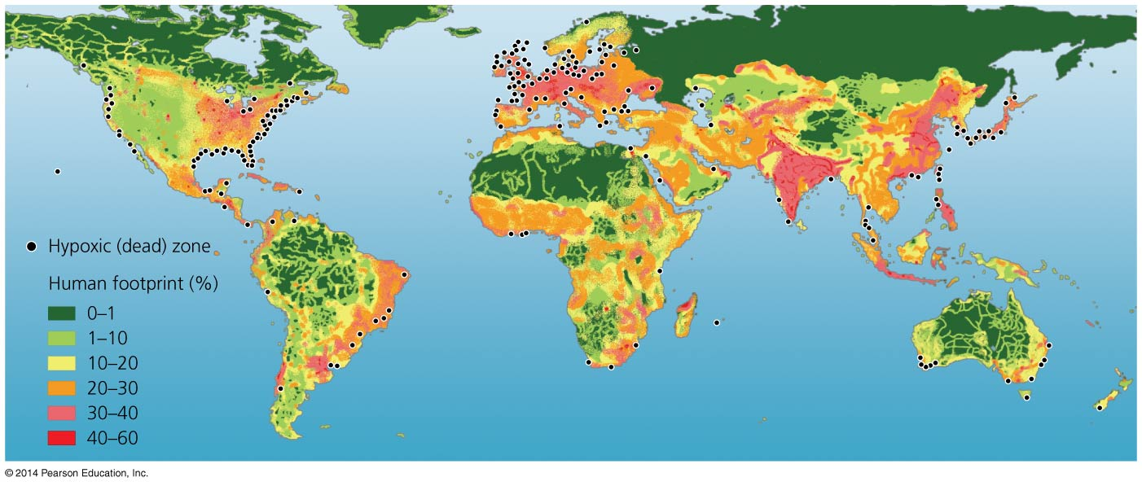

Slide 31
Ecosystems interact with one another
Ecosystems vary greatly in size
For example, from a puddle of water to a bay
The term “ecosystem” is most often applied to self-contained systems of moderate geographic extent
Adjacent ecosystems may share components and interact
For example, rain water from a forest moves nutrients into a lake
Ecotones = transitional zones between two ecosystems
Elements of each ecosystem mix
Notes:
31
31

Slide 32
Landscape ecologists study geographic patterns
Landscape ecology = studies how interacting ecosystems affect the abundance, distribution, and interaction of organisms
Patches = separate areas of similar habitat
Are spread spatially in complex patterns (a mosaic)
Notes:
32
32

Slide 33
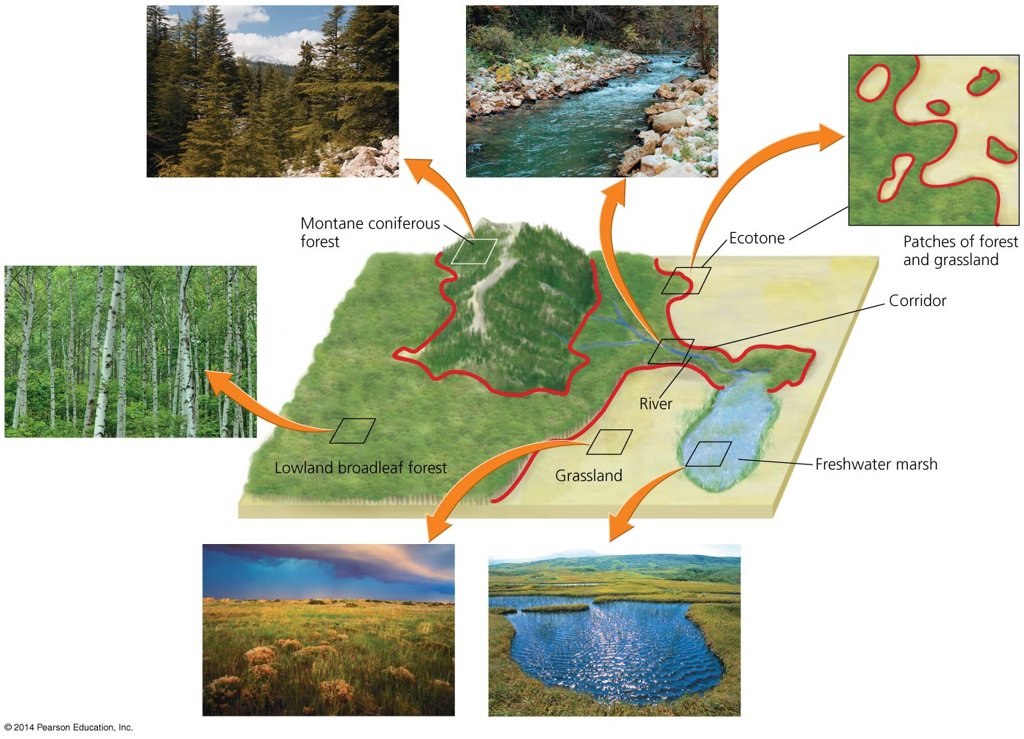

Slide 34
Landscape ecologists study geographic patterns
Metapopulation = a network of separated subpopulations, each occupying a patch in a mosaic
Some individuals may move among patches or mate with those of other patches
Subpopulations in small, isolated patches risk extinction
Conservation biologists = study the loss, protection, and restoration of biodiversity
Human development fragments habitats, creating small, isolated patches
Habitat corridors that link patches protect biodiversity

Slide 35
Remote sensing helps us apply landscape ecology
Remote sensing allows scientists to take a landscape perspective
Geographic information system (GIS) = computer software used in landscape ecology research
Analyzes how elements of a landscape are arranged
Divides landscape into layers
Helps in planning and land-use decisions
Notes:
35
35

Slide 36
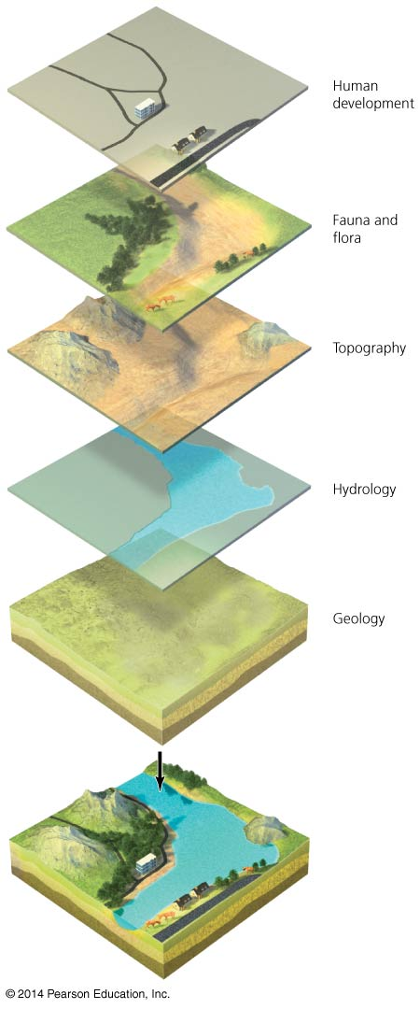

Slide 37
Modeling helps ecologists understand systems
Model = a simplified representation of a complex natural process
Helps us understand the process and make predictions
Ecological modeling = constructs and tests models to explain and predict how ecological systems work
Researchers gather data and form a hypothesis about relationships
Models predict how the system will behave
New data refine and increase the model’s accuracy

Slide 38
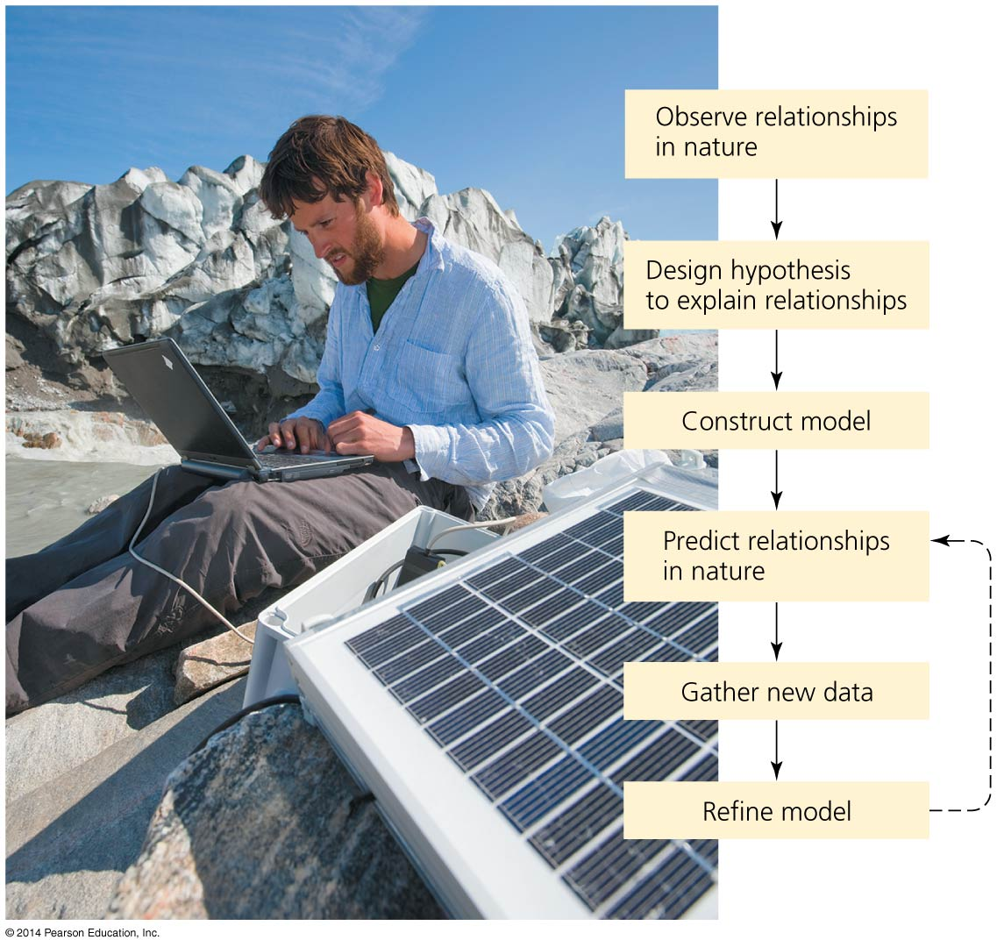
Ecological modeling resembles the scientific method

Slide 39
Ecosystems services sustain our world
Human society depends on healthy, functioning ecosystems
They provide goods and services we need to survive
Ecosystem services are provided by the planet’s systems
Soil formation, water and air purification, pollination
Breakdown of some pollutants and waste
Quality of life issues (inspiration, spiritual renewal)
Nutrient cycling

Slide 40
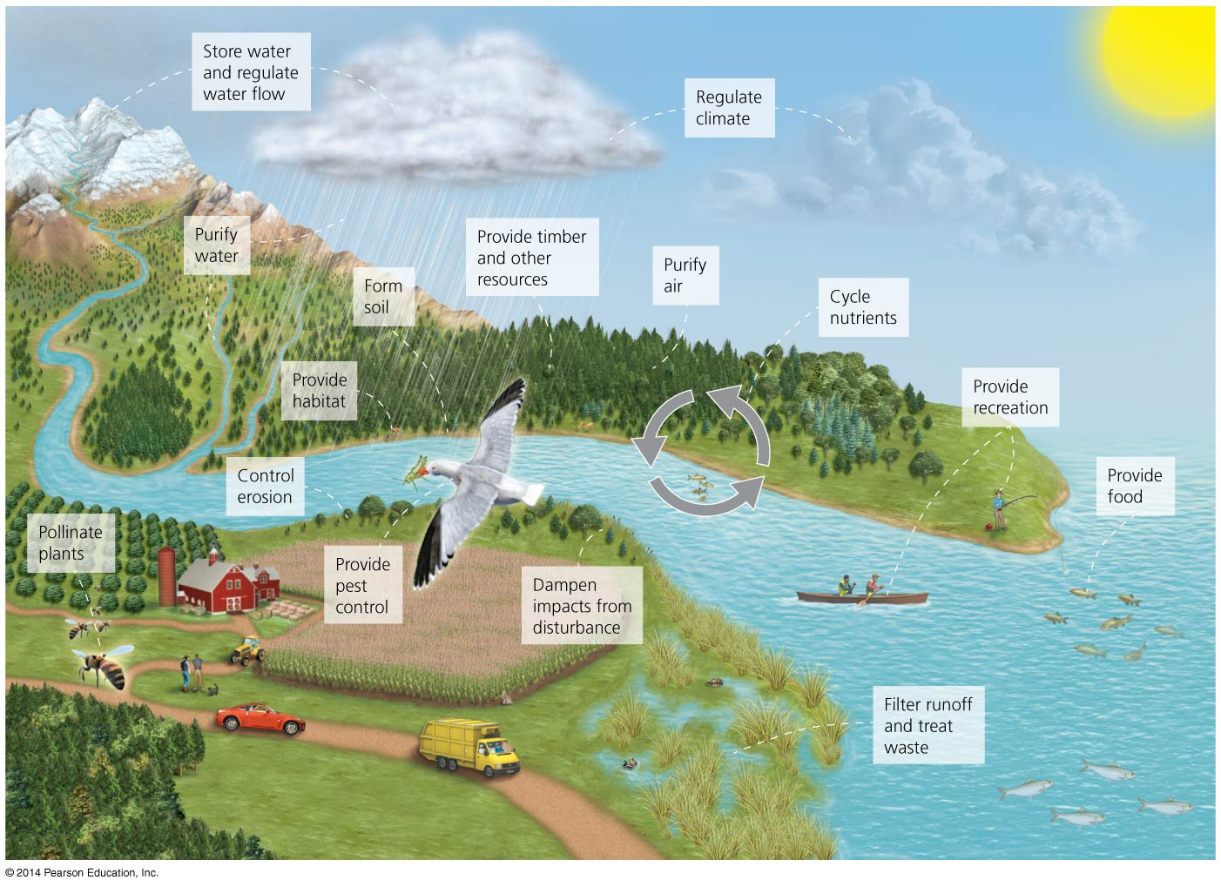

Slide 41
Nutrients circulate through ecosystems in biogeochemical cycles
Matter is continually circulated in ecosystems
Nutrient (biogeochemical) cycles = the movement of nutrients through ecosystems
May move through the atmosphere, hydrosphere, lithosphere, and biosphere
Pools (reservoirs) = where nutrients reside for varying amounts of time (the residence time)
Flux = the rate at which materials move between pools
Can change over time
Is influenced by human activities
Notes:
41
41

Slide 42
Nutrients circulate through ecosystems in biogeochemical cycles
Source = a pool that releases more nutrients than it accepts
Sink = a pool that accepts more nutrients than it releases

Slide 43
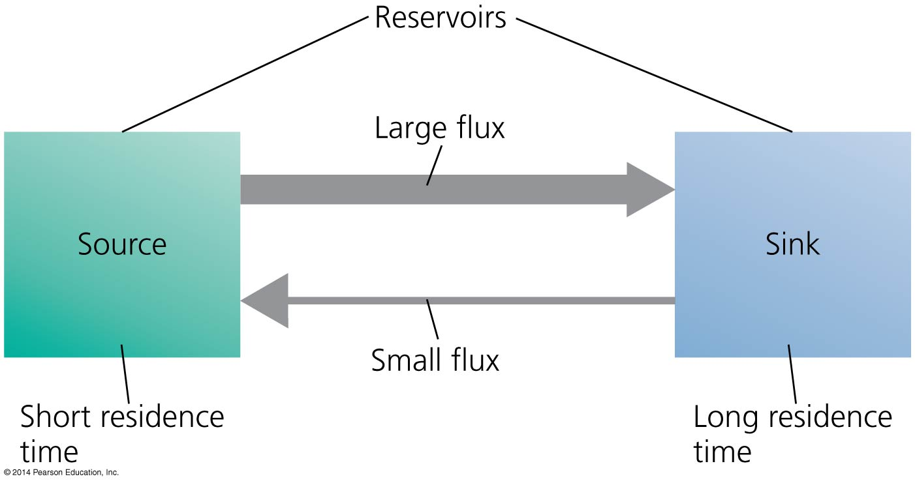

Slide 44
The water cycle affects all other cycles
Water is essential for biochemical reactions
It is involved in nearly every environmental system
Hydrologic cycle = summarizes how liquid, gaseous, and solid water flows through the environment
Oceans are the main reservoir
Evaporation = process by which water moves from aquatic and land systems into the atmosphere
Transpiration = release of water vapor by plants
Precipitation, runoff, and surface water = water returns to Earth as rain or snow and flows into streams, oceans, etc.

Slide 45
Groundwater
Groundwater = water found underground beneath layers of soil
Aquifers = underground reservoirs of groundwater found in spongelike regions of rock and soil
Recharges from water seeping through soil
Water in some aquifers may be ancient (thousands of years old) and take many years to recharge

Slide 46
Groundwater
Water table = the upper limit of groundwater in an aquifer
Groundwater becomes exposed to the air where the water table reaches the surface
Exposed water runs off to the ocean or evaporates

Slide 47
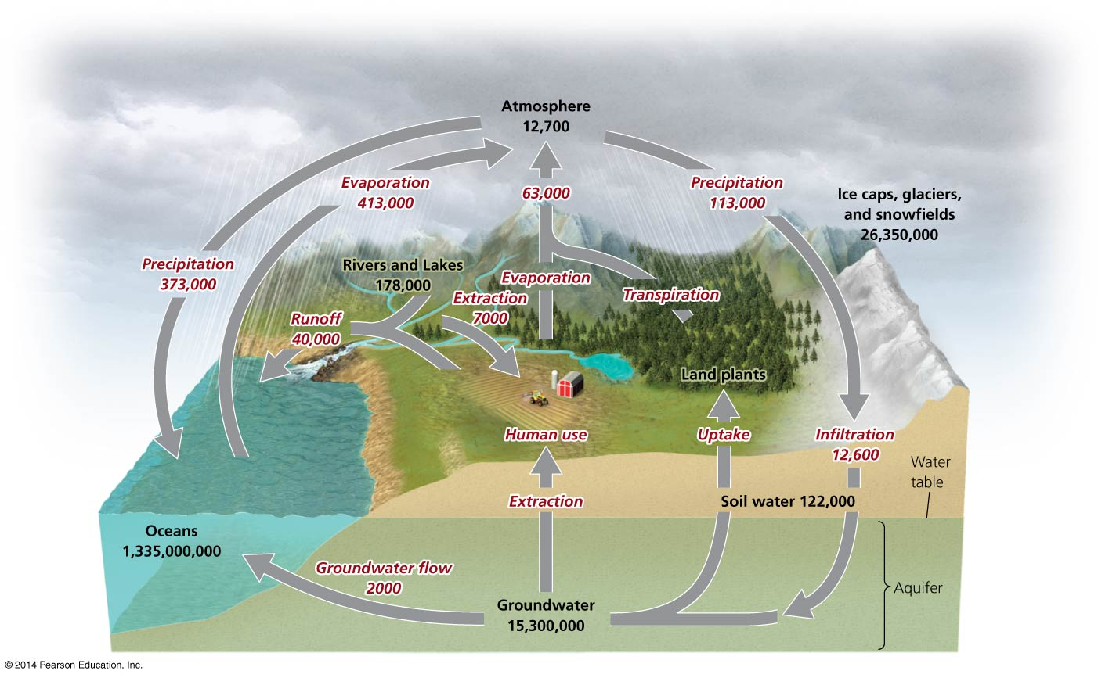

Slide 48
Our impacts on the water cycle are extensive
Removing forests and vegetation increases runoff and soil erosion and reduces transpiration and infiltration
Irrigating agricultural fields depletes rivers, lakes, and streams and lowers water tables
Damming rivers slows movement of water from land to the sea and increases evaporation
Emitting air pollutants changes the nature of precipitation, sabotaging the natural distillation process of evaporation and transpiration
Notes:
48
48

Slide 49
The carbon cycle circulates a vital organic nutrient
Carbon is found in carbohydrates, fats, proteins, bones, cartilage, and shells
Carbon cycle = describes the route of carbon atoms through the environment
Photosynthesis by plants, algae, and cyanobacteria
Removes carbon dioxide from air and water
Produces oxygen and carbohydrates
Plants are a major reservoir of carbon
Respiration returns carbon to the air and oceans
Plants, consumers, and decomposers
Notes:
49
49

Slide 50
Sediment storage of carbon and The oceans
Decomposition returns carbon to the sediment
The largest reservoir of carbon
May be trapped for hundreds of millions of years
Aquatic organisms die and settle in the sediment
Older layers are buried deeply and undergo high pressure
Ultimately, it may be converted into fossil fuels
Oceans are the second largest reservoir of carbon
Compounds enter the oceans from runoff from land, detritus from marine organisms
Carbon dioxide is dissolved directly into the water from the atmosphere, making the water more acidic

Slide 51
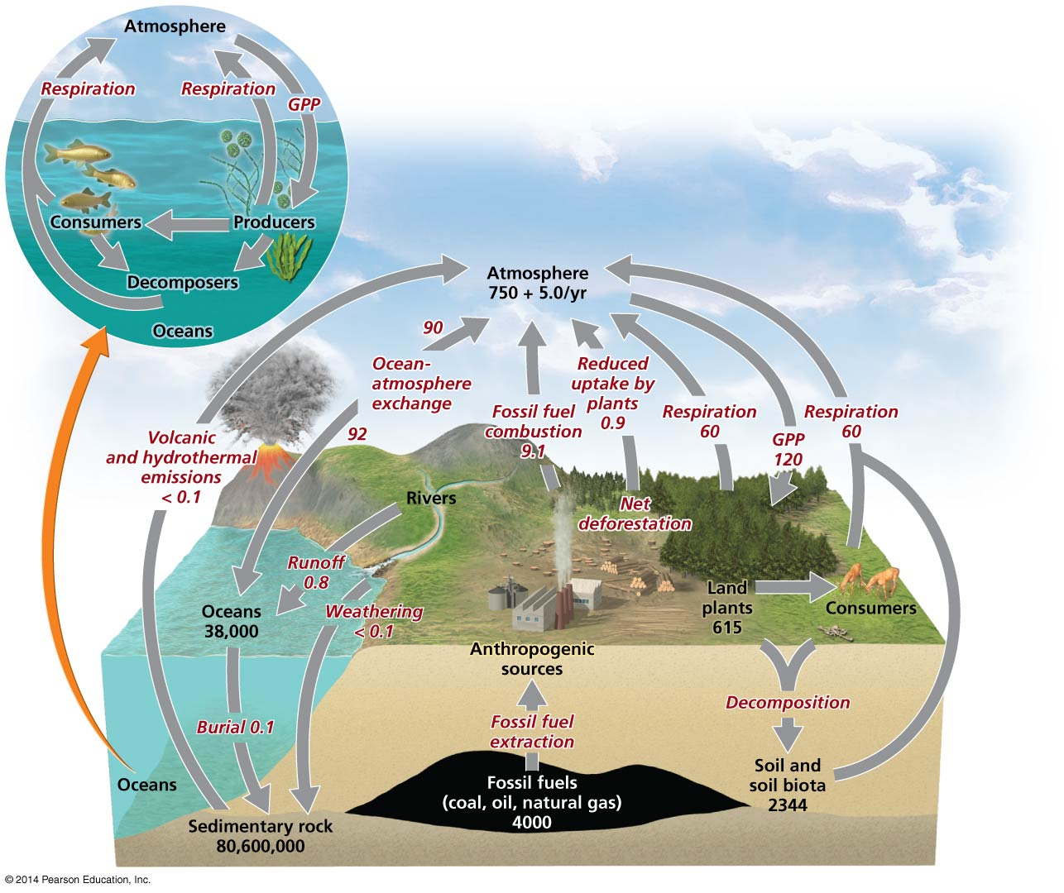

Slide 52
We are shifting carbon from the lithosphere to the atmosphere
Burning fossil fuels moves carbon from the ground to the air
Cutting forests and burning fields move carbon from vegetation to the air
Today’s atmospheric carbon dioxide reservoir is the largest in the past 800,000 years
It is the driving force behind climate change
Uncertainties remain—there is a missing carbon sink: 1–2 billion metric tons of carbon are unaccounted for
It may be taken up by plants or soils of northern temperate and boreal forests

Slide 53
The nitrogen cycle involves specialized bacteria
Nitrogen comprises 78% of our atmosphere
It is contained in proteins, DNA, and RNA
Nitrogen cycle = describes the routes that nitrogen atoms take through the environment
Nitrogen gas cannot be used by most organisms
Nitrogen fixation = lightning or nitrogen-fixing bacteria combine (fix) nitrogen with hydrogen to form ammonium, which can be used by plants

Slide 54
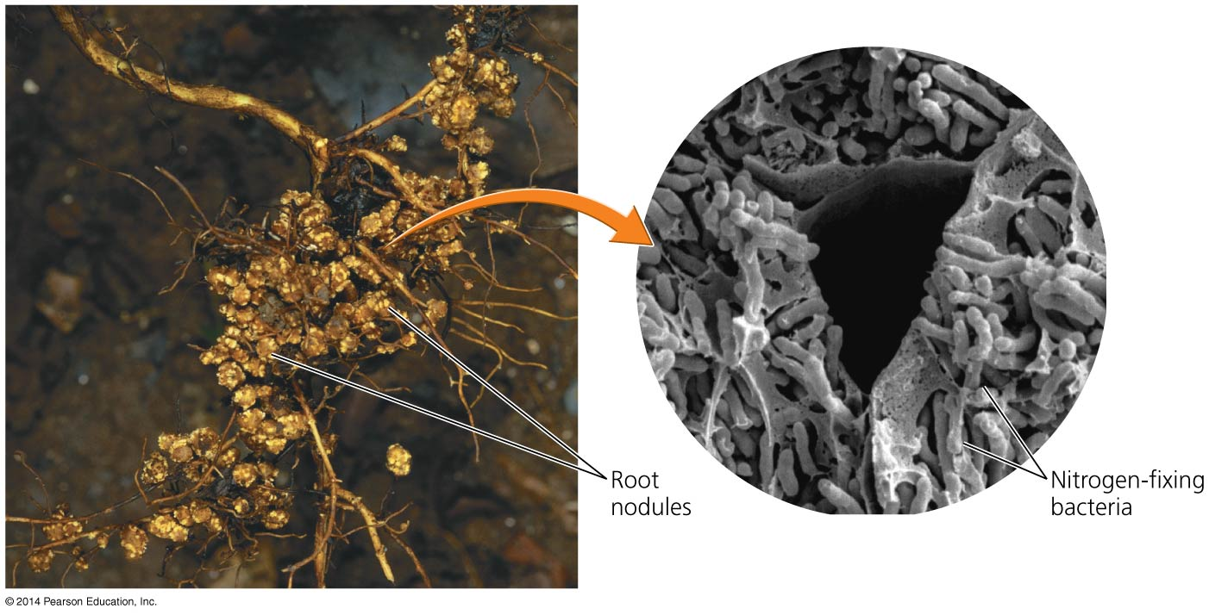

Slide 55
Nitrification and denitrification
Nitrification = process by which bacteria convert ammonium ions, first into nitrite ions, then into nitrate ions
Plants can take up nitrate most easily
Animals obtain nitrogen by eating plants or other animals
Decomposers get nitrogen from dead and decaying plants or other animals, releasing ammonium ions to nitrifying bacteria

Slide 56
Nitrification and denitrification
Denitrifying bacteria = bacteria that convert nitrates in soil or water to gaseous nitrogen, releasing it back into the atmosphere and completing the nitrogen cycle

Slide 57
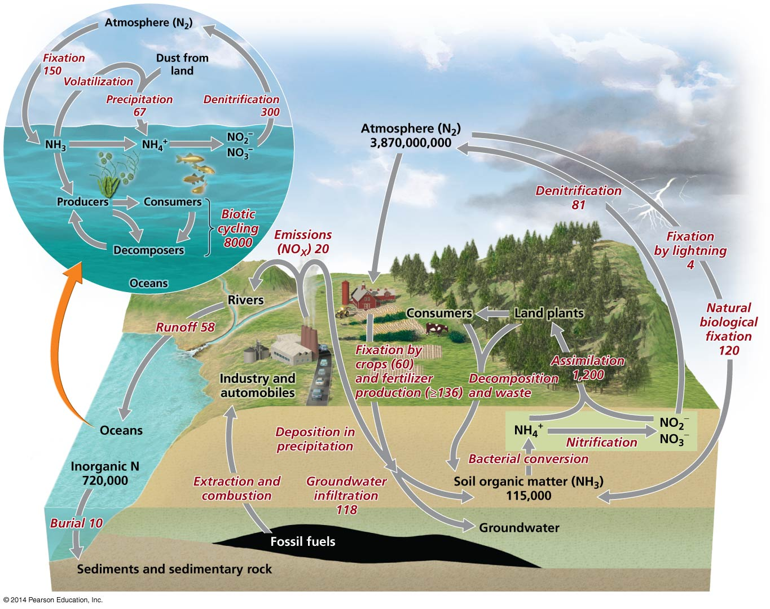

Slide 58
We have greatly influenced the nitrogen cycle
Nitrogen fixation was a crop production bottleneck = the limiting factor in crop production
Haber-Bosch process = production of fertilizers by combining nitrogen and hydrogen to synthesize ammonia
Humans overcame the bottleneck on crop productivity

Slide 59
We have greatly influenced the nitrogen cycle
Overuse of fertilizers has negative side effects:
Increases the flux of nitrogen from the atmosphere to the land
Causes eutrophication in estuaries and coastal ecosystems and fisheries
Washes essential nutrients out of the soil
Burning fossil fuels adds nitrogen compounds to the atmosphere that contribute to acid precipitation

Slide 60
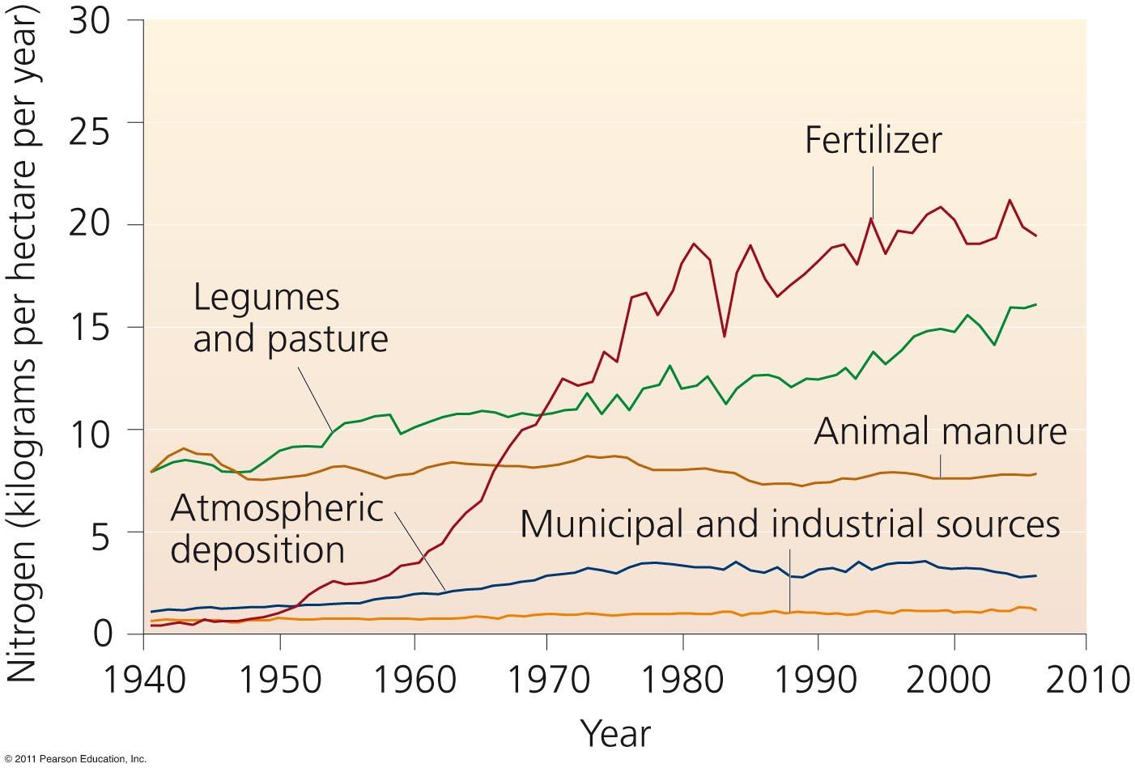
Human activity has doubled the amount of nitrogen entering the environment, overwhelming nature’s denitrification abilities

Slide 61
The phosphorus cycle circulates a limited nutrient
Phosphorus (P) is a key component of cell membranes, DNA, RNA, ATP, and ADP
Phosphorus cycle = describes the routes that phosphorus atoms take through the environment
Most phosphorus is within rocks
It is released by weathering
There is no significant atmospheric component
There is naturally low environmental concentrations
Phosphorus can be a limiting factor for plant growth

Slide 62
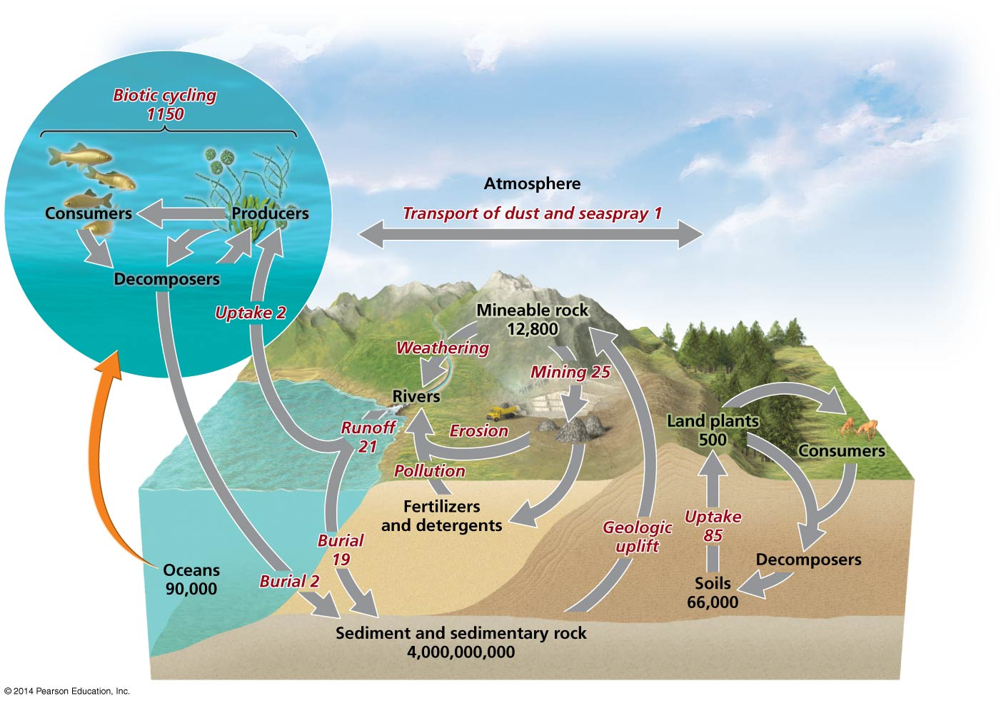

Slide 63
We affect the phosphorus cycle
Humans add phosphorus to fertilizers to promote crop growth
Runoff from farm fields and lawns contains phosphorus
Increases phytoplankton growth
Results in eutrophication and hypoxia
Wastewater discharge also releases phosphorus
Detergents have traditionally contained high levels of phosphates

Slide 64
Tackling nutrient enrichment requires diverse approaches
We rely on synthetic fertilizers and fossil fuels
Nutrient enrichment will be an issue we must address
There are a number of ways to control nutrient pollution
Reduce fertilizer use on farms and lawns
Apply fertilizer at times that minimize runoff
Plant vegetation “buffers” around streams
Restore wetlands and create artificial ones
Improve sewage treatment technologies
Reduce fossil fuel combustion
These approaches have varying costs

Slide 65
Conclusion
Thinking in terms of systems teaches us how to avoid disrupting Earth’s processes and how to mitigate any disruptions we cause
Life interacts with its nonliving environment in ecosystems through which energy flows and matter recycles
Understanding biogeochemical cycles is crucial
Humans are significantly changing the ways these cycles function
Environmental systems have survived for ages
Negative feedback has kept these systems stable
We can learn how to be sustainable from these examples
Notes:
65
65

Slide 66
QUESTION: Review
Which of the following describes a negative feedback loop?
It drives a system toward an extreme.
It stabilizes the system.
It causes the system to move in one direction at a time.
It is rare in nature.
Notes:
66
Answer: b

Slide 67
QUESTION: Review
Which of the following statements is NOT correct?
A system is a network of relationships among various components.
In a dynamic equilibrium, system processes move in opposing directions to balance their effects.
A system in homeostasis is not able to maintain constant (stable) internal conditions.
A system with emergent properties has characteristics that are not evident in the components alone.
Notes:
67
Answer: c

Slide 68
QUESTION: Review
Which of the following is a correct statement?
Energy and matter flow in one direction only.
Energy and matter both cycle repeatedly.
Energy flows in one direction, while matter recycles.
Matter flows in one direction, while energy recycles.
Notes:
68
Answer: c

Slide 69
QUESTION: Review
What is the definition of secondary production?
Biomass generated by heterotrophs from consuming autotrophs
Elements and compounds that are required for survival
Energy remaining after respiration that is used to generate plant biomass
Assimilation of energy by autotrophs
Notes:
69
Answer: a

Slide 70
QUESTION: Review
Which biogeochemical cycle uses photosynthesis and respiration to cycle its atoms?
Carbon
Nitrogen
Water
Phosphorus
Notes:
70
Answer: a

Slide 71
QUESTION: Review
Which biogeochemical cycle is being affected by increased fertilizer production through the Haber-Bosch process?
Carbon
Nitrogen
Water
Phosphorus
Notes:
71
Answer: b

Slide 72
QUESTION: Review
Which of the following is NOT a way to decrease hypoxia in estuaries and coastal oceans?
Reduce fertilizer use on farms and lawns
Apply fertilizer during heavy spring rains
Restore wetlands
Improve sewage treatment technologies
Notes:
72
Answer: b

Slide 73
QUESTION: Weighing the Issues
Which of the following ecosystem services do you think is the most important?
Providing services such as water purification
Providing goods such as food
Enhancing the quality of our lives, such as spiritual renewal
All of these are fundamentally important.
Notes:
73
Answer: any

Slide 74
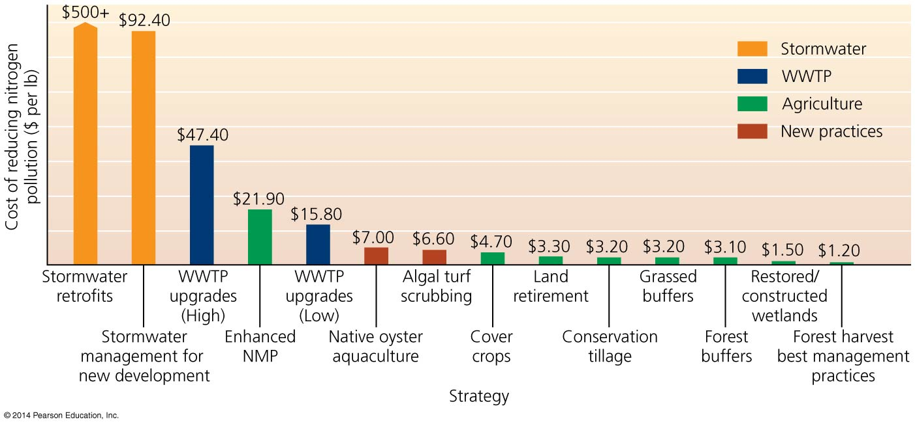
QUESTION: Interpreting Graphs and Data
How many management strategies shown here cost less than $4 per pound of nitrogen reduced?
One
Four
Six
Eight
Notes:
74
Answer: c

