Slide 2
This lecture will help you understand:
University efforts to promote sustainability
The concept of sustainable development
How environmental protection promotes economic well-being
Approaches to designing sustainable solutions
How time is limited, but human potential to solve problems is tremendous

Slide 3
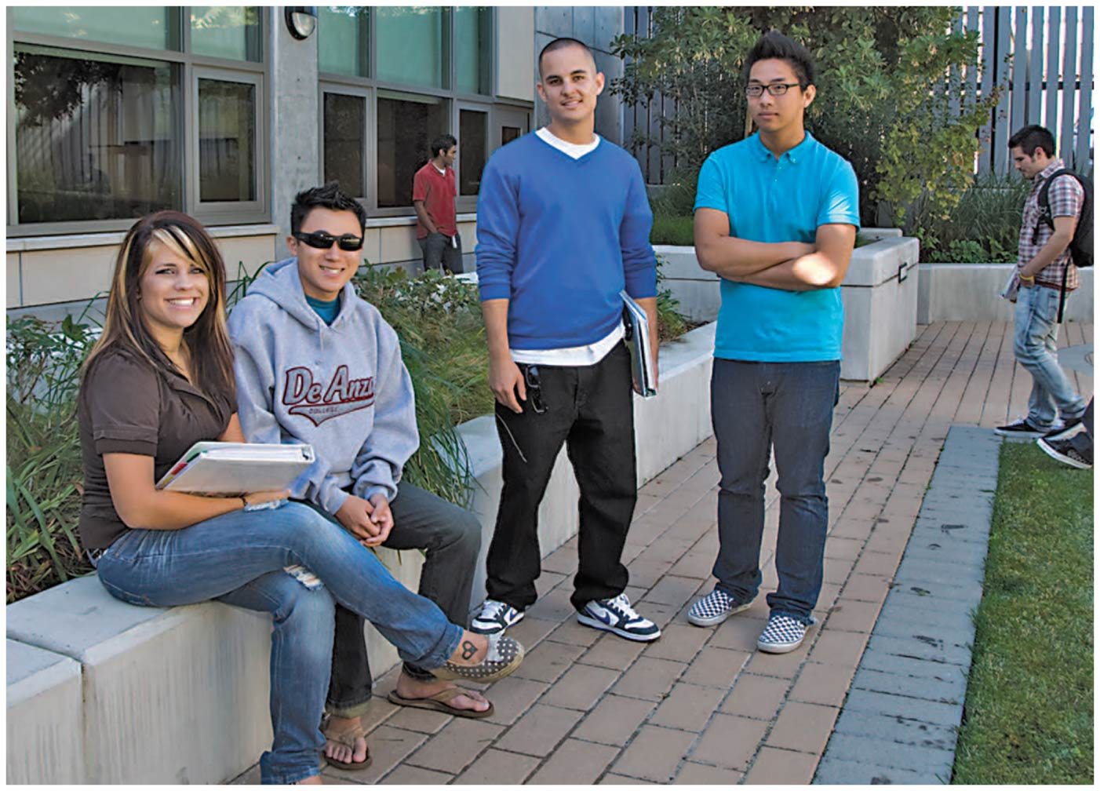

Slide 4
Central Case Study: De Anza College Strives for a Sustainable Campus
De Anza College (California) is one of the greenest community colleges
Colleges and universities are microcosms of society
They consume resources, pollute, recycle, etc.
It has the nation’s first LEED-Platinum sustainable building as well as five other LEED certified buildings
That teaches about sustainability
The college has incorporated sustainability into almost everything it does
Thousands of students take the college’s environmental studies and sciences classes each year

Slide 5
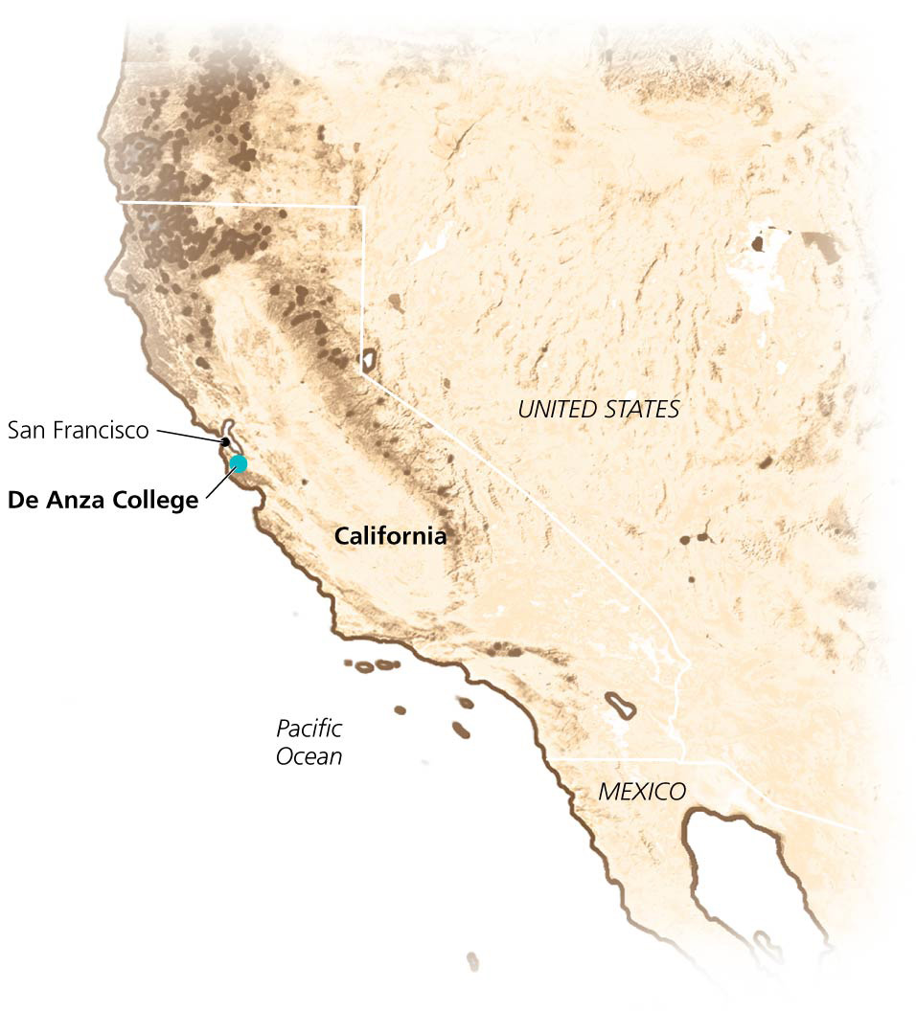

Slide 6
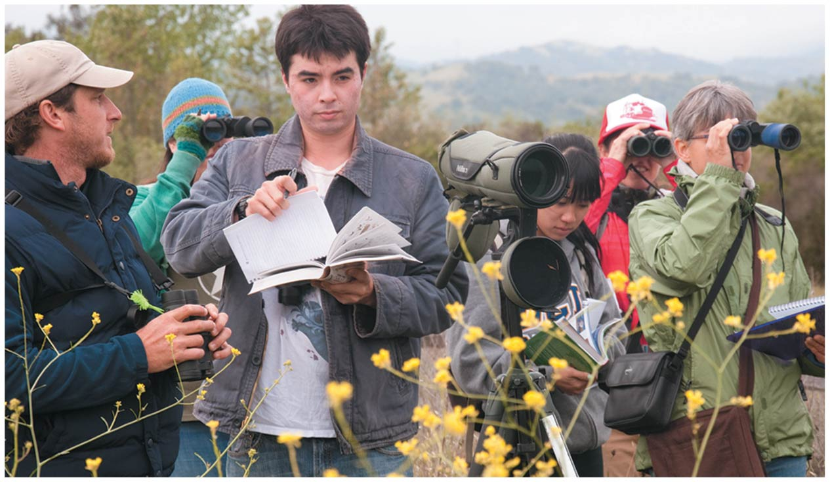

Slide 7
Sustainability on Campus
Sustainability means living in a way that can be lived far into the future
Conserving resources to prevent their depletion
Reducing waste and pollution
Protecting ecological processes and ecosystem services

Slide 8
Sustainability on Campus
A sustainable solution ensures environmental quality, economic well-being, and social justice
Efforts need to be made at every level from the individual to the nation
Colleges and universities and the students they educate are playing a crucial role
Serve as models for diverse sustainability initiatives

Slide 9
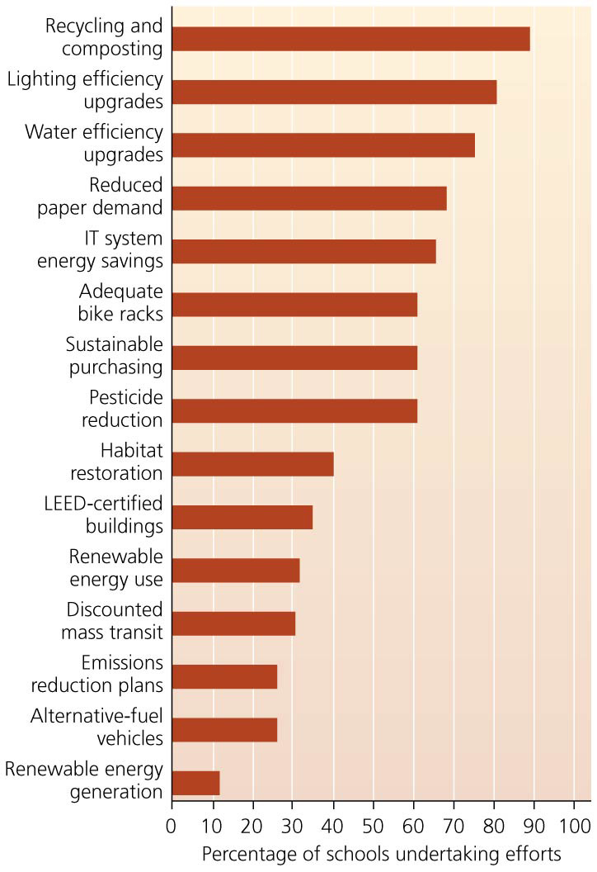

Slide 10
An audit is a useful way to begin
An audit of the institution provides baseline information
Also helps set priorities and goals
Includes measuring energy use, emissions, waste, food, water use, transportation
Audits can be conducted by students, classes, or outside professional
To be useful, audits should result in specific recommendations or actions
For instance, identify appliances to replace
Once changes are made, progress can be monitored using the baseline data

Slide 11
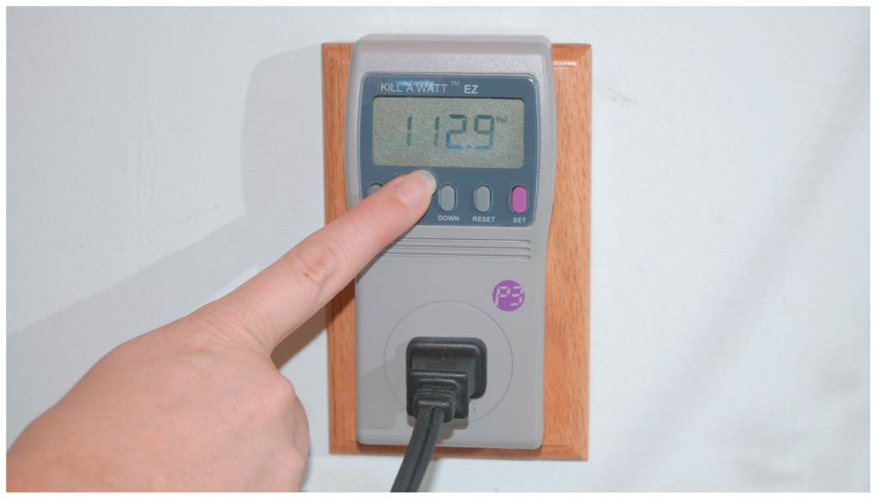

Slide 12
Recycling and waste reduction are common campus efforts
Campus sustainability efforts frequently involve waste reduction, recycling, or composting
Offer many opportunities for small-scale improvements
In RecycleMania, schools compete to see who recycles the most over a ten-week period
523 schools participated in 2013
Trash audits show how much trash can be recycled
Information can be used to encourage more recycling

Slide 13
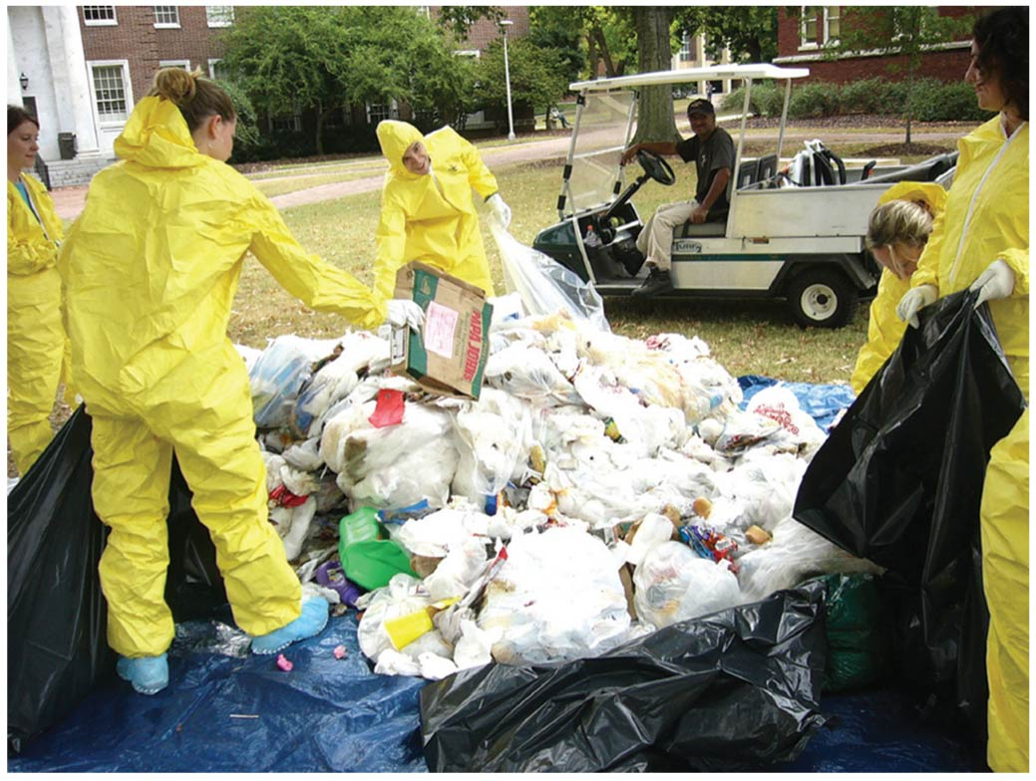

Slide 14
Recycling and waste reduction are common campus efforts
Composting is becoming popular as well
Campuses are composting a variety of materials from bulky wood waste (furniture and pallets) to paper to food waste
Ithaca College in NY composts 44% of its food waste, saving $11,500 in disposal costs
Reuse is more sustainable than recycling
Unwanted items are collected and donated to charity
The University of Texas collects 40–50 tons of items from students as they move out in the spring and sells them at low cost when students return in the fall

Slide 15
Green building design is a key to sustainable campuses
Buildings are responsible for 70–90% of a campus’s greenhouse gas emission
Campus green buildings are constructed from sustainable, energy-efficient building materials
Reduce pollution, use renewable energy, and encourage efficiency in energy and water use
Leadership in Energy and Environmental Design (LEED) standards guide the design and certification of construction and renovation of buildings

Slide 16
Green building design is a key to sustainable campuses
De Anza College’s Kirsch Center for Environmental Studies has a platinum LEED ranking
It is energy- and water-efficient and is solar-powered
Materials are made from nontoxic recycled and renewable materials: recycled steel, plastic, fly ash
The Adam Joseph Lewis Center at Oberlin College in Ohio used recycled or reused building materials
Energy-efficient lighting, heating, appliances
Solar energy from PV panels and passive solar heating

Slide 17
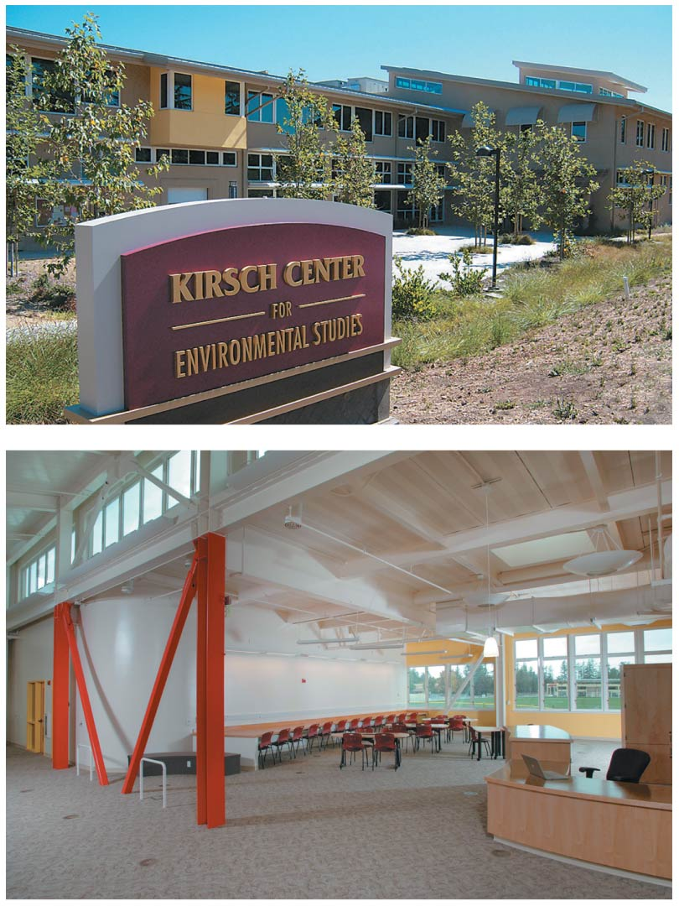

Slide 18
Green building design is a key to sustainable campuses
Bren Hall at the University of Santa Barbara in California uses solar panels, white roofing, recycled materials
It has few toxic substances and conserves water
Many universities have LEED-certified buildings using similar design principles
The movement of “green buildings” continues to grow
The University of Florida has started construction on 18 green buildings since 2003
Sustainable design is not limited to just the building
Landscaping can use native plants and require little irrigation water or prevent erosion

Slide 19
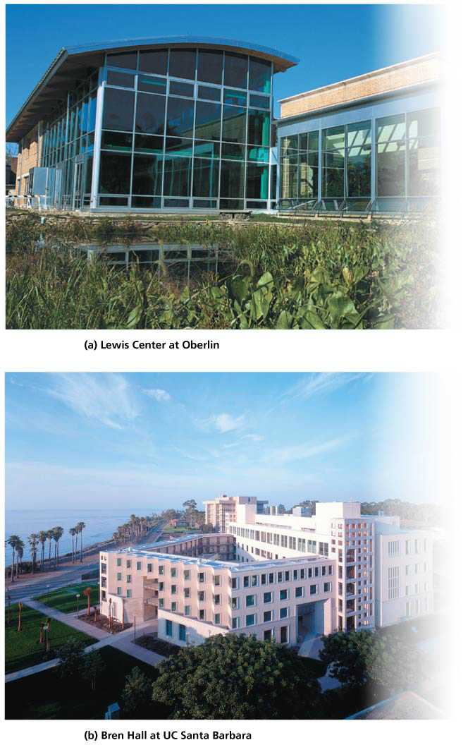

Slide 20
Water conservation is important
Conserving water is a key element of sustainable campuses, especially in arid regions
Campus landscape design can redirect rainwater so that it can nourish plants and recharge aquifers
Rather than causing erosion and carrying pollutants
Indoor water is conserved
Low-flow toilets, faucets, and showerheads
Fill water bottles with tap water instead of buying bottled water
Universities save millions of dollars and drastically reduce water use

Slide 21
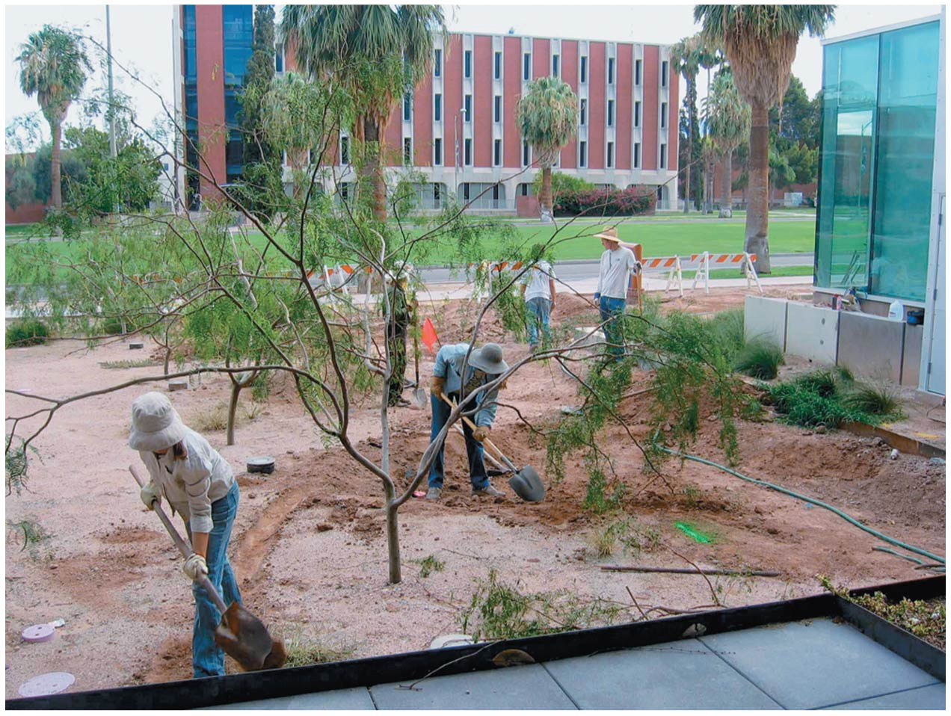

Slide 22
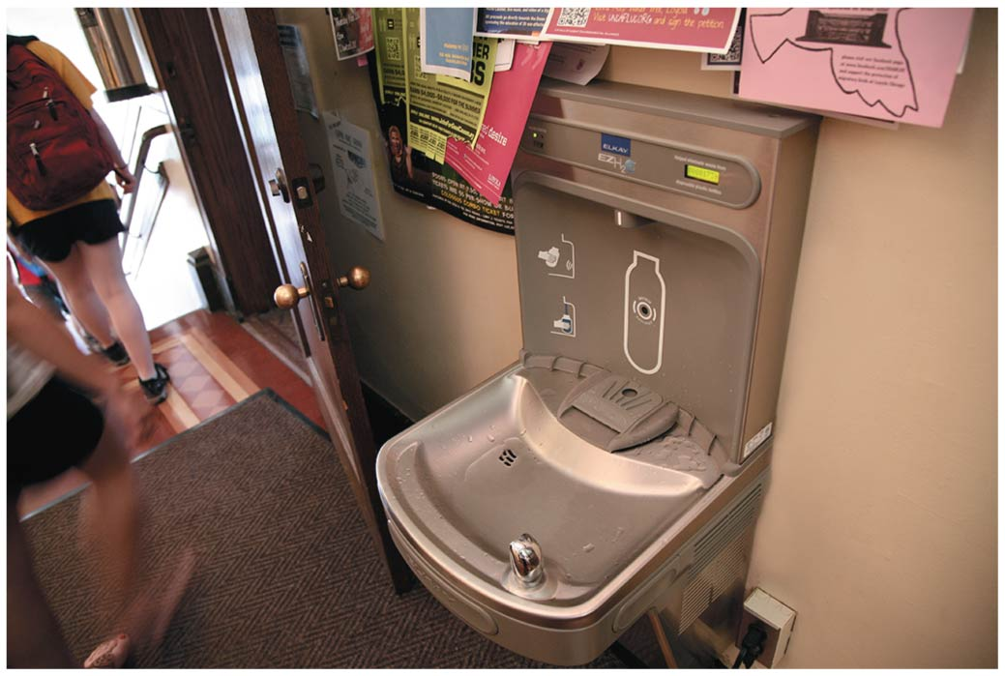

Slide 23
Energy efficiency is easy to improve
Competitions to save energy are one means campuses are using to cut energy use and educate themselves
185 participated in the 2013 Campus Conservation Nationals while others held their own competitions

Slide 24
Energy efficiency is easy to improve
Simple measures have resulted in large energy savings
Students saved one school $86,000/year by turning down hot water temperatures 5 degrees
Replacing 35-watt bulbs with 25-watt bulbs saved another school $50,000/year and prevented 425 tons of CO₂ emissions
Powering down empty buildings saves energy, money, and greenhouse gas emissions

Slide 25
Students are promoting renewable energy
Campuses reduce energy use and emissions by altering their energy source, for example, switching from fuel oil to carbon-neutral wood chips
Campuses use solar and wind power
PV systems, solar thermal, and wind turbines provide emission-free electricity

Slide 26
Students are promoting renewable energy
Institutions buy “green tags” or carbon offsets that subsidize renewable energies
Students vote to increase their fees (they “tax” themselves) to buy renewable energy
In 2011, 20 college teams from around the United States competed in the fifth Solar Decathalon, building solar houses of the student’s own designs

Slide 27
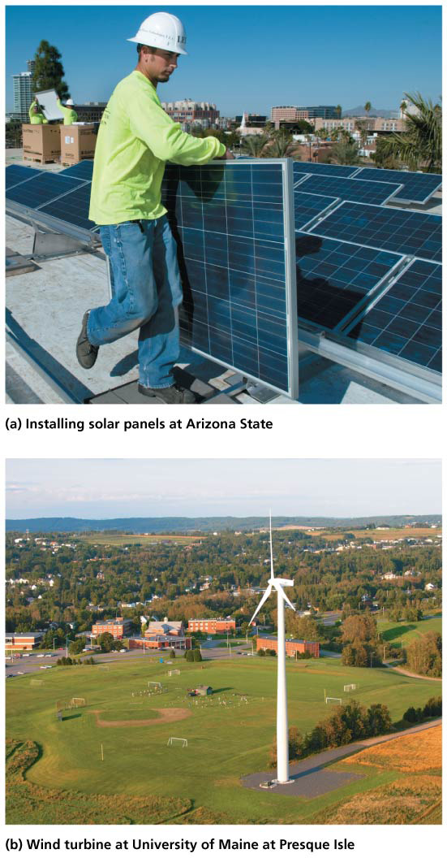

Slide 28
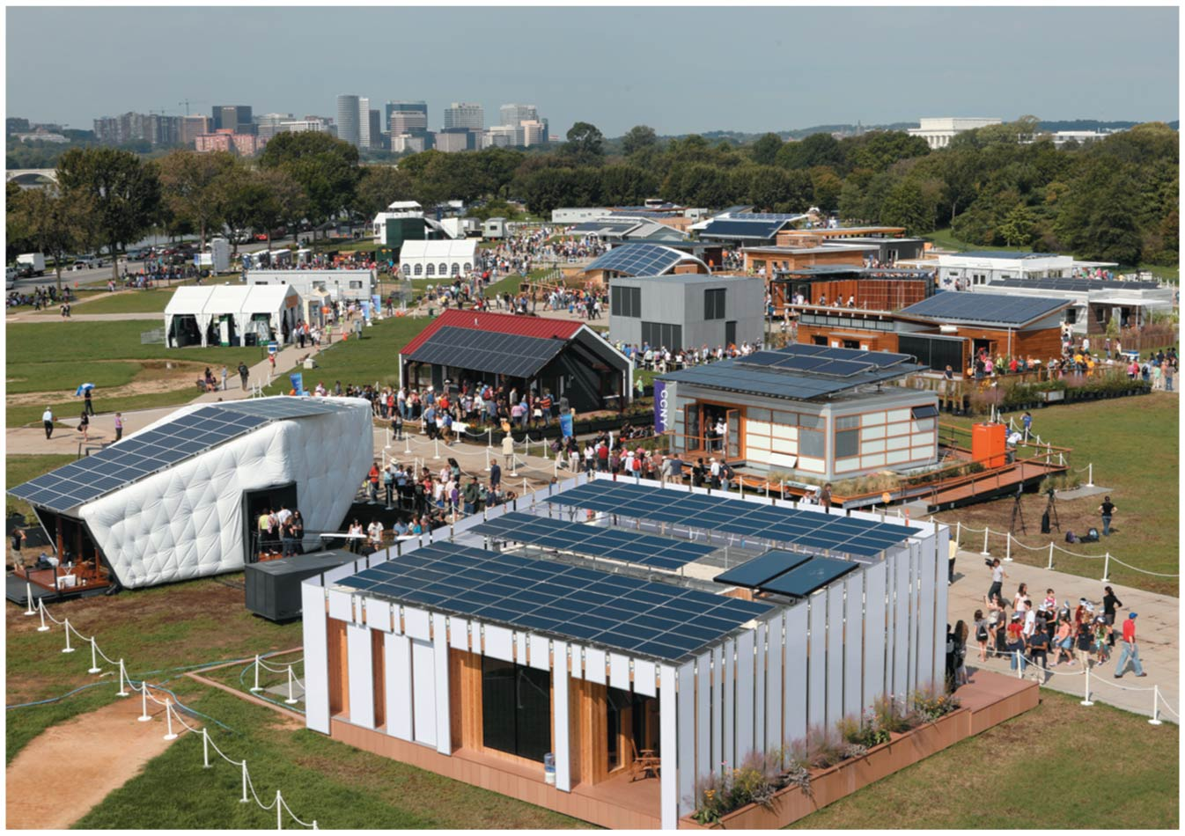

Slide 29
Dining services and campus farms can promote more sustainable food
25% of the food students take in cafeterias becomes waste
Going trayless and making students carry plates reduce food waste (and save water and energy)
Food services can purchase in bulk and buy organic, locally grown food
Some campuses have gardens or farms
Students can grow food used in dining halls
Students volunteer at community gardens
George Mason University and Loyola University Chicago have established apiaries (for honeybees)

Slide 30
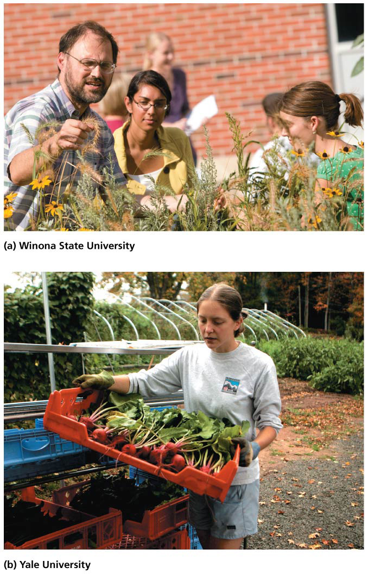

Slide 31
Purchasing decisions wield influence
Campuses can support green initiatives by purchasing:
Recycled paper
Certified sustainable wood
Energy-efficient appliances
Goods with less packaging
Ecolabeled products
Campuses can also switch to nontoxic cleaning supplies and save thousands of dollars a year
Students can work with ground staff to eliminate the use of herbicides and pesticides

Slide 32
Transportation alternatives are many
Many campuses struggle with traffic congestion, parking shortages, commuting delays, and pollution from exhaust
Commuting accounts for over half of the CO₂ emission of the average college or university

Slide 33
Transportation alternatives are many
Many campuses have tried to encourage bicycling
Bike sharing programs
Refurbished bicycles free to students
Solutions include:
Expanding bus and shuttle systems
Encouraging bicycling, walking, and carpooling
Introducing alternative vehicles and alternative fuels to university fleets

Slide 34
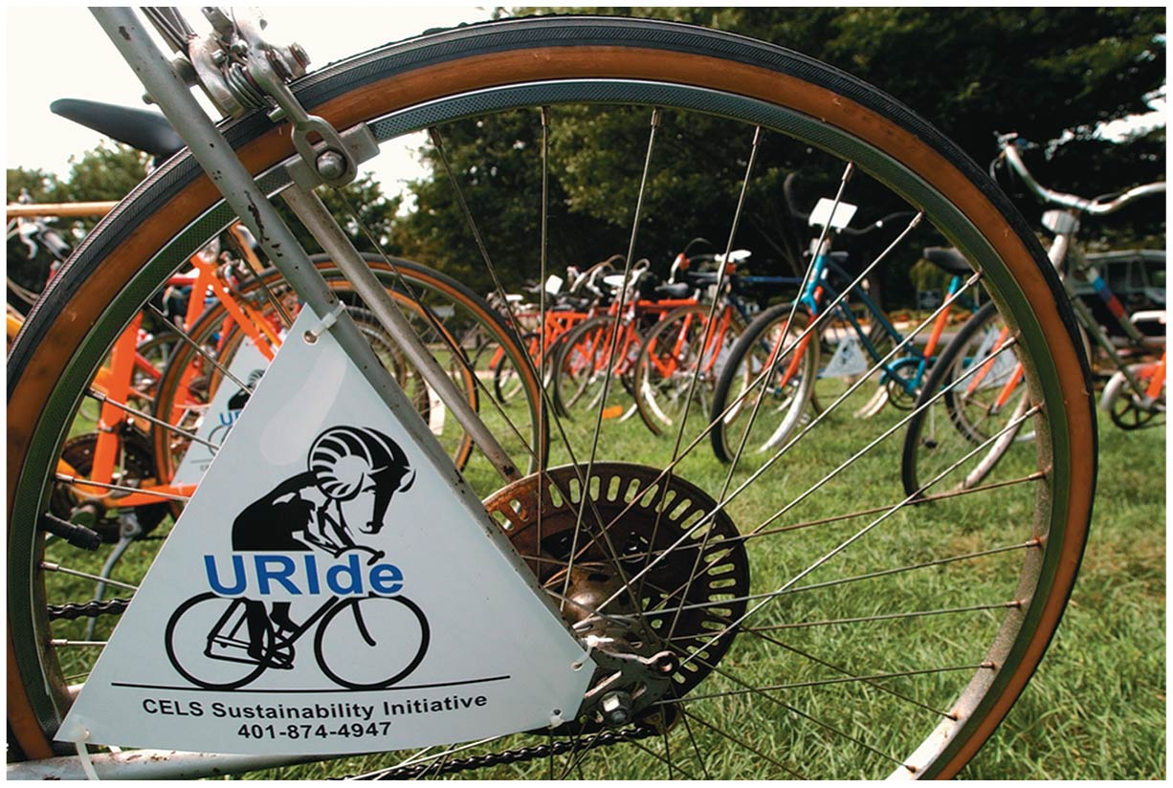

Slide 35
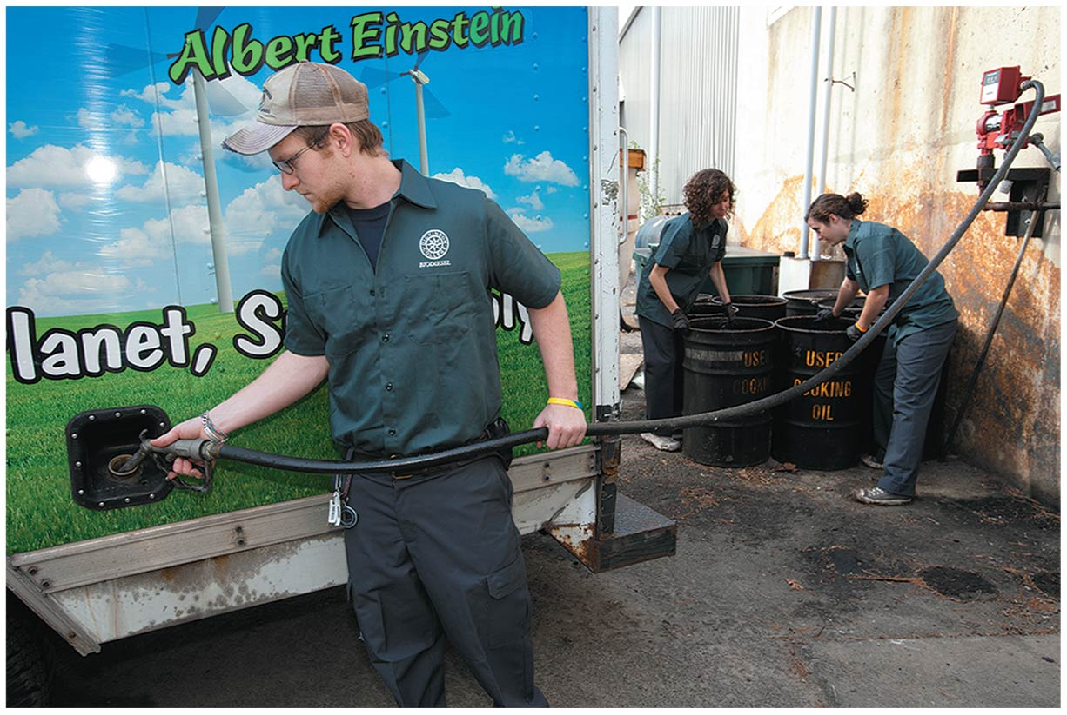

Slide 36
Campuses are restoring native plants, habitats, and landscapes
Universities have been enhancing their natural environment through a diversity of efforts
Removing invasive species
Restoring native plants and communities
Improving habitat for wildlife
Enhancing soil and water quality
Restoring wetlands
Campus managed lands are being used for
Conservation
Education

Slide 37
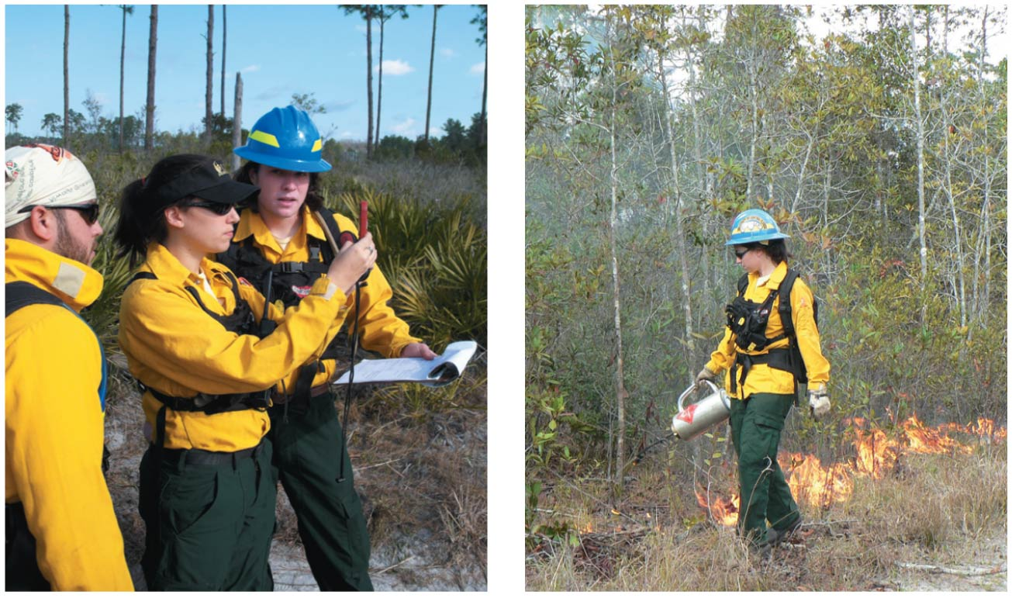

Slide 38
Carbon-neutrality is a major goal
Reducing greenhouse gas emissions from fossil fuel combustion is a top priority for campus sustainability
Some universities are complying with the Kyoto Protocol
It typically costs just $10/student/year to comply
Reductions are achieved through conservation or purchasing carbon offsets

Slide 39
Carbon-neutrality is a major goal
Students present administrators with proposals to eliminate carbon emissions
Student pressure has nudged reluctant administrators to set targets to reduce greenhouse emissions
Focus the Nation is a national “teach-in” on solutions to climate change, America’s energy future, etc.

Slide 40
Students are demanding divestment from fossil fuel corporations
U.S. higher education has over $400 billion of endowment money, much of it invested in the stock market
Some of this is in the stock of corporations in the coal, oil, and gas industries
Students are working to convince their campus leadership to sell off stocks in fossil fuel companies
Modeled on efforts to divest from companies doing business in apartheid-era South Africa
Since 2012, over 200 campuses have active divestment movements

Slide 41
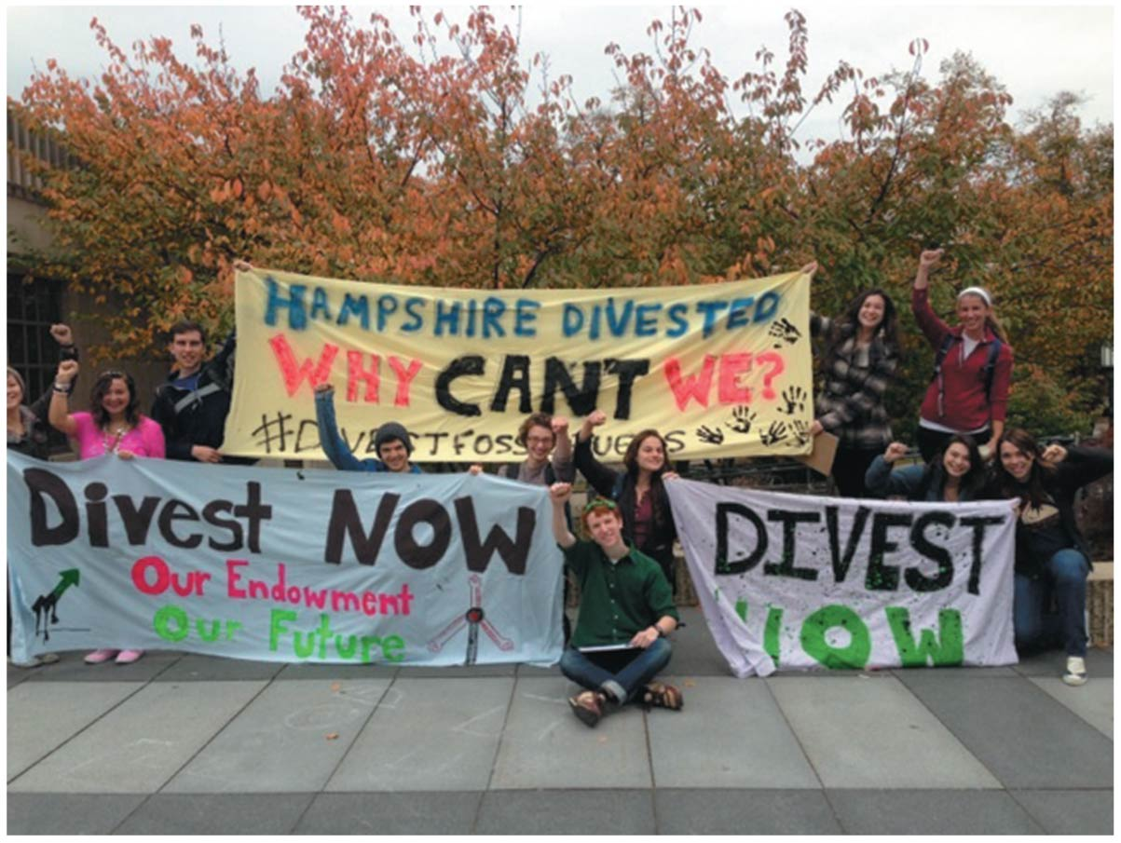

Slide 42
Organizations assist campus efforts
Many organizations support campus sustainability
Association for the Advancement of Sustainability in Higher Education
National Wildlife Federation’s Campus Ecology program
They provide information on sustainability efforts
The NWF program recognizes the most successful campus sustainability initiatives
It is easier than ever to start sustainability efforts on your own campus

Slide 43
Sustainable development aims to achieve a triple bottom line
Sustainability efforts on campus parallel efforts in the rest of the world
More people are beginning to appreciate Earth’s limited capacity
They are voicing concerns about our current behaviors

Slide 44
Sustainable development aims to achieve a triple bottom line
Sustainability does not mean just protecting the environment from humans
Triple bottom line: Finding ways to promote social justice, economic well-being, and environmental quality at the same time
This goal is the primary challenge for this century

Slide 45
Environmental protection can enhance economic opportunity
Environmental protection and economic well-being do not conflict
Our well-being depends on a healthy environment
Reducing consumption and waste saves money
New jobs arise as old ones decline
Logging, mining, and manufacturing have declined
Opportunities in renewable energy are opening
People desire to live in areas with clean air and water, intact forests, and parks and open spaces
Protecting these boosts property values and tax revenues

Slide 46
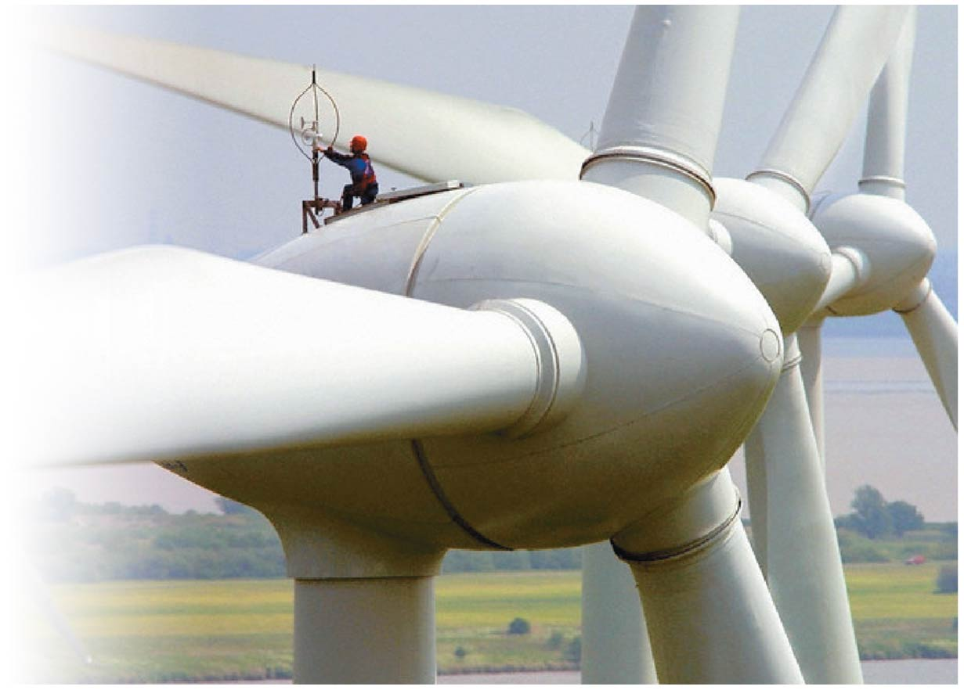

Slide 47
Environmental protection can enhance economic opportunity
Environmental protection helps the economy
Economic benefits of environmental regulation greatly exceed costs
Economies around the world have expanded over the past 45 years
At the same time environmental protection measures have proliferated
When external costs and benefits are factored in, the economic value of sustainably managed ecosystems exceeds the value of harvested ecosystems

Slide 48
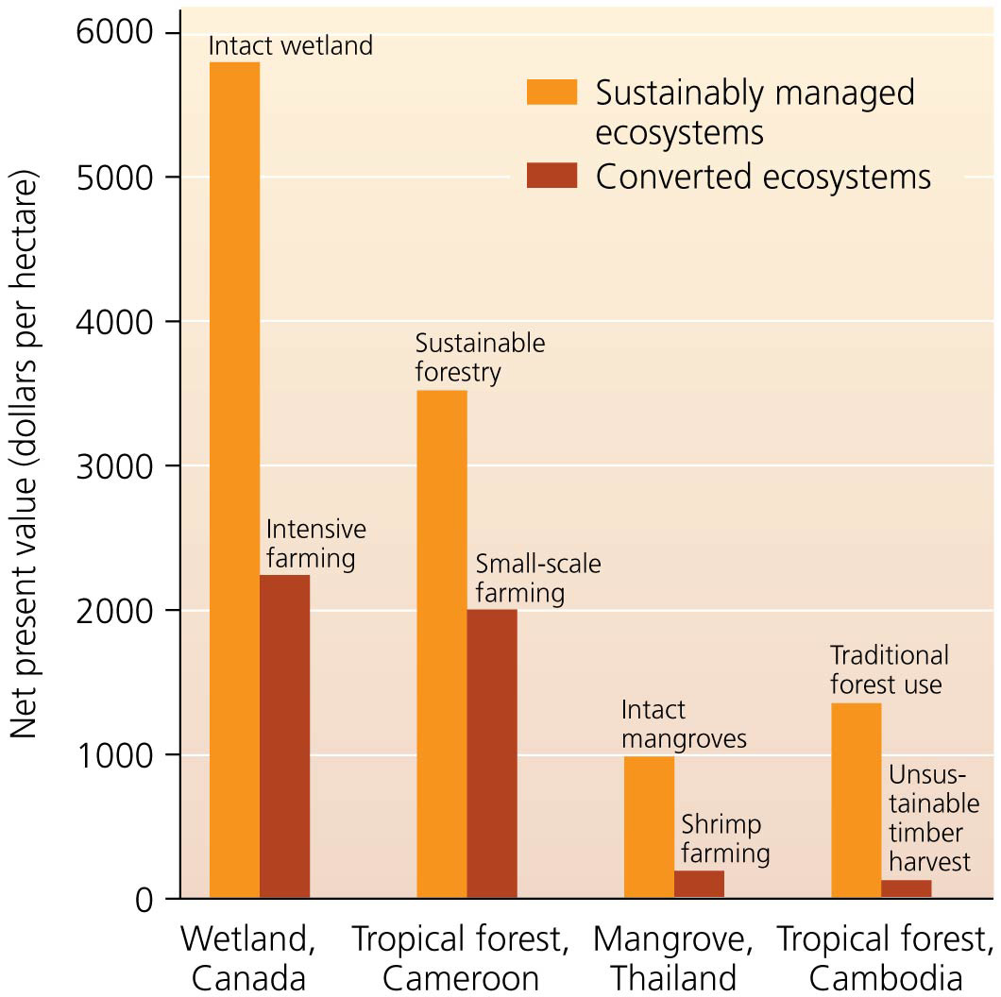

Slide 49
We are part of our environment
It is easy to feel disconnected from our natural environment
Millions of urban residents have never set foot in an undeveloped area
Most people no longer have an understanding of where their food, water, and clothing come from
When we consider where our things come from, it becomes easier to see how we are part of the environment
Then we can see that what is good for the environment can also be good for people

Slide 50
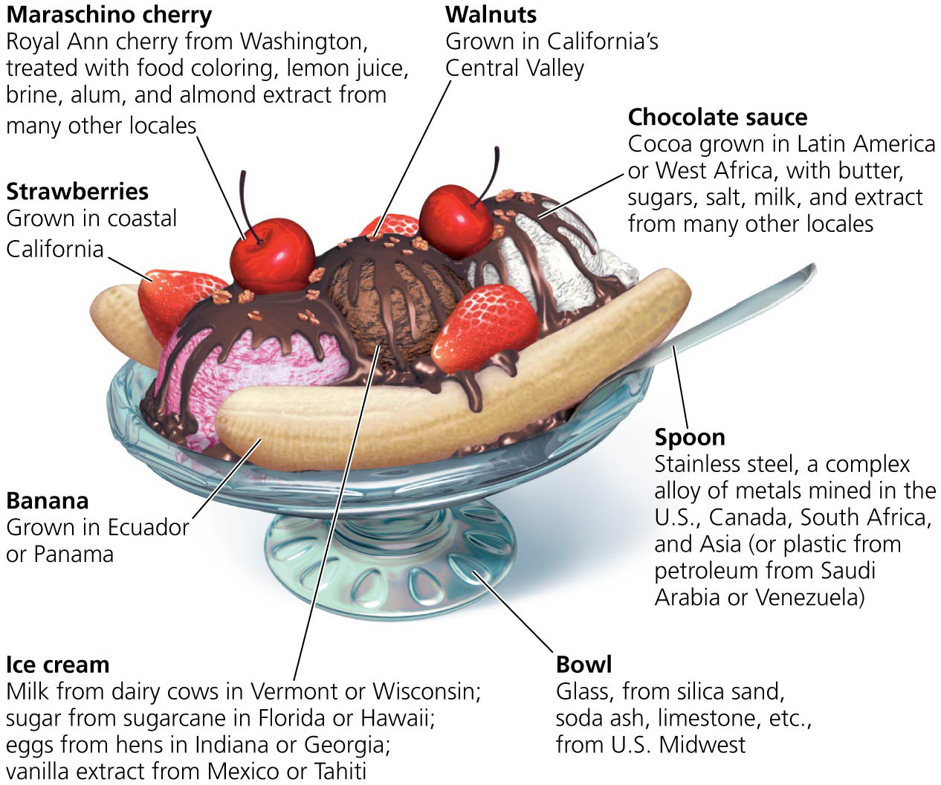

Slide 51
We can follow a number of strategies toward sustainable solutions
Sustainable solutions to environmental problems are numerous
Political engagement will be needed to guide our political leaders to enact policies for sustainability
Corporations and interest groups influence politicians
Citizens have the same power if they choose
A person can exercise power by:
Voting, attending public hearings, donating to advocacy groups
Writing letters and making phone calls

Slide 52
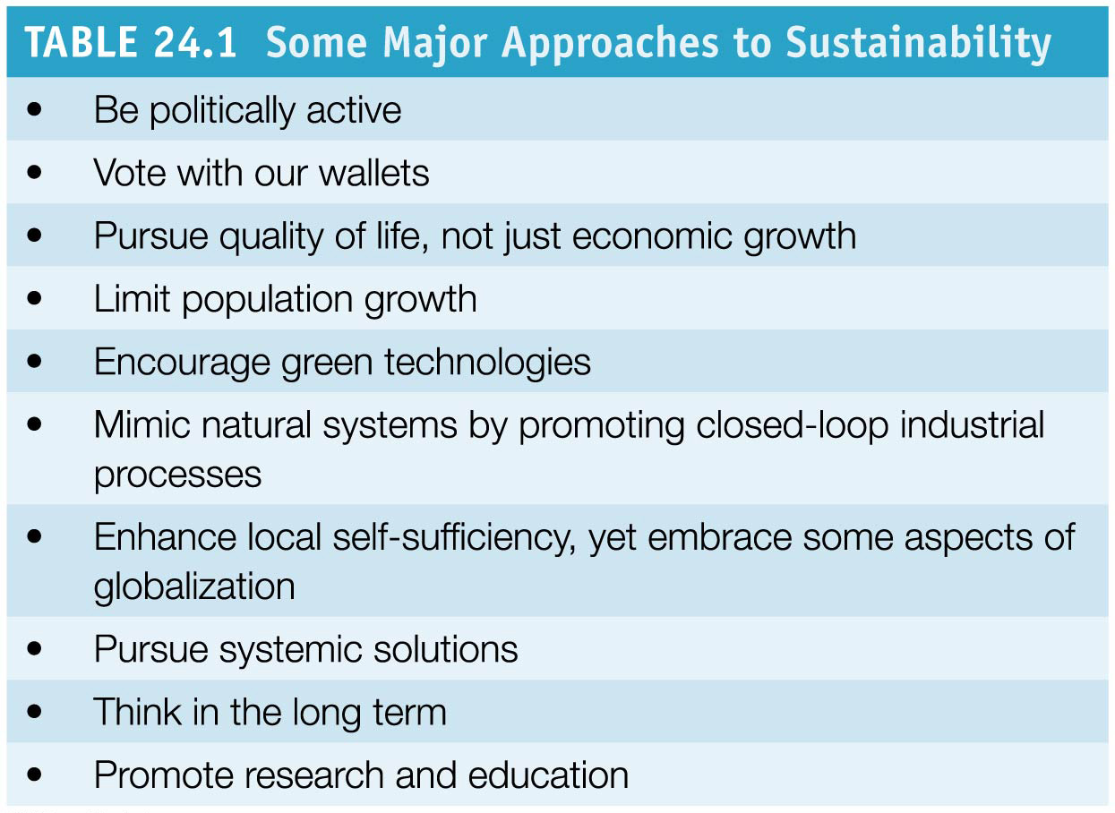

Slide 53
Consumer power
We wield influence in the choices we make as consumers
Consumers can buy ecolabeled products to increase sales
Recycled paper, “dolphin-safe” tuna, etc.
Consumers can also promote “green” purchasing at work and school
Buy certified sustainable wood, organic food, energy-efficient appliances, etc.
Employees can voice their preferences in purchasing decisions

Slide 54
Quality of life
Economists and policymakers talk of economic growth as an ultimate goal
Growth is a tool to attain the real goal of maximizing human happiness
We believe that more, bigger, and faster are better
The United States, with 5% of the world’s population, uses 20% of its energy resources
But more income does not translate into being happier
We will not have long-term happiness by endlessly expanding our economy

Slide 55
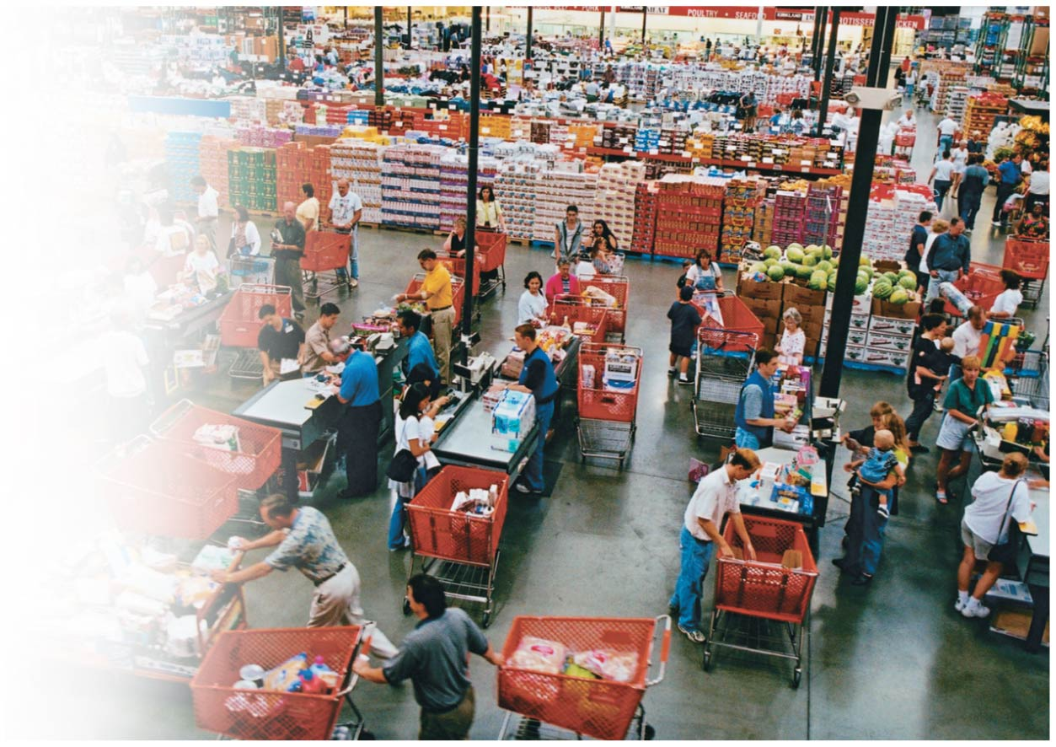

Slide 56
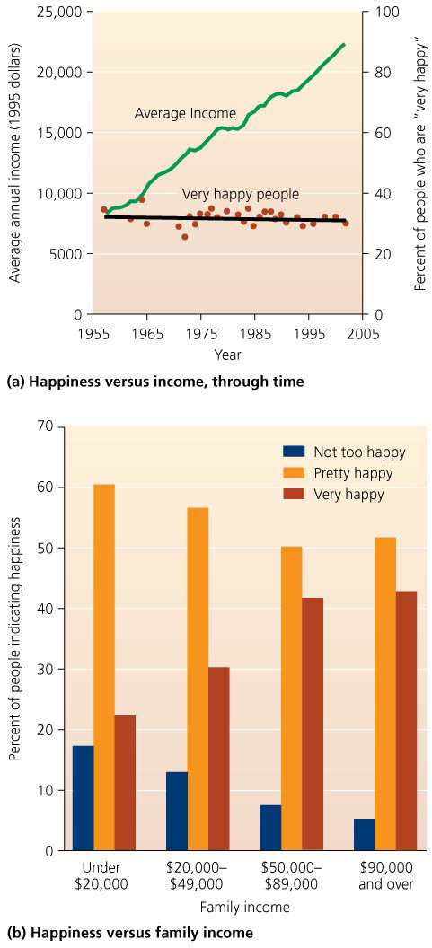

Slide 57
Quality of life
To enhance our quality of life:
Improve technology and efficiency in industry
Develop a sustainable manufacturing system
Modify our behavior, attitudes, and lifestyles to minimize consumption

Slide 58
Quality of life
We need to modify our economic approach
We must incorporate external costs into market prices of goods and services
Green taxes and phasing out harmful substances could encourage sustainability
This will provide a clearer view of the true costs and benefits of our decision

Slide 59
Population stability
Continued human population growth is not sustainable
Technology has expanded the Earth’s carrying capacity
Sooner or later, growth will end, but how?
Through wars, plagues, famine
Or through voluntary means as a result of wealth and education
The demographic transition may help developing countries, as it helped developed countries

Slide 60
Green technologies
Technology has spurred population increase
The agricultural and industrial revolutions
Advances in medicine and health
Technology magnifies our impact on Earth
The IPAT equation

Slide 61
Green technologies
Shortsighted uses of technology have created a mess
But wiser use of green technology can help us get out
Developed countries have exported technologies to developing countries, intensifying their impacts
But technology is being used to mitigate environmental impacts
Pollution controls and green energy generation

Slide 62
Mimicking nature
Environmental systems operate in cycles
They have feedback loops and circular material flows
Output is recycled into input
Human systems are linear
Raw materials are processed, which generates waste
Linear pathways can be transformed into circular ones through recycling
Virtually all products can be recycled, given the right technology
The ultimate vision is to create a closed-loop process to generate no waste

Slide 63
The local and the global
Local self-sufficiency builds sustainable societies
People closely tied to an area tend to value it and seek to sustain its environment and human community
Meeting needs locally cuts down on the energy expended in shipping, particularly with food
Critics of globalization object to the homogenization of the world’s societies
Languages are vanishing
Traditional ways of life are being abandoned

Slide 64
The local and the global
Large multinational corporations are obtaining growing power over global trade. Critics argue that they promote high-consumption lifestyles but not environmental protection
Protests against globalization have accompanied every World Trade Organization meeting since 1999
But globalization brings positive aspects
Communication and learning between cultures have made us more likely to celebrate our differences
The spread of Western democracy allows entrepreneurship and encourages creativity in art, science, and education

Slide 65
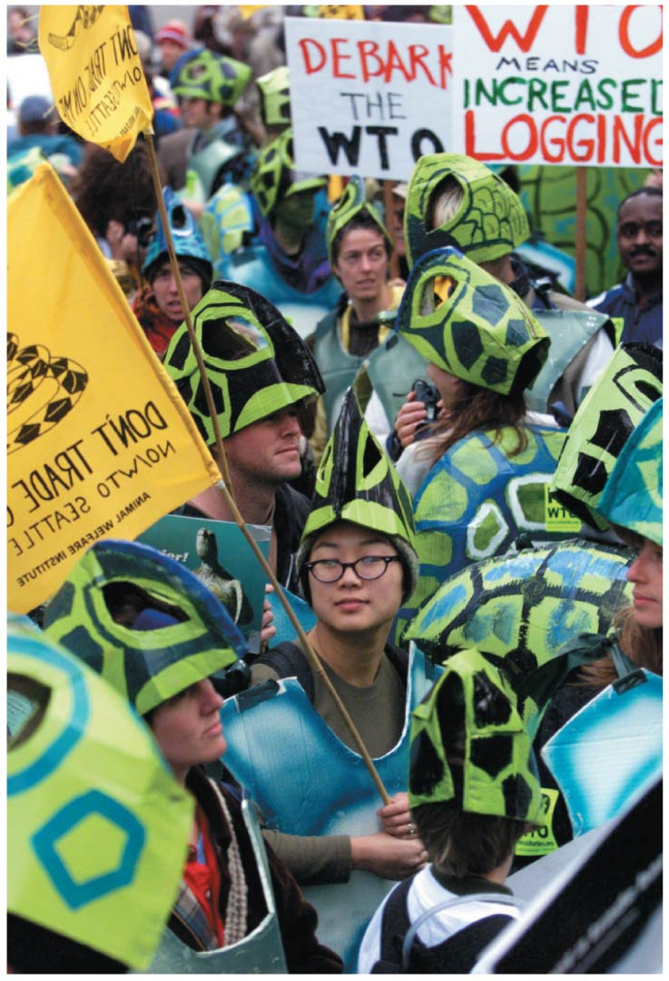

Slide 66
Systemic solutions
We can solve problems by
Addressing the symptoms
Addressing the root cause
Addressing symptoms one-by-one is often easier but does not solve the problem
Need to adopt a more systemic approach
View the sum of the parts and address the root cause
Rather than reaching further for new fossil fuel sources (addressing the symptom of depleting energy supplies), we can switch to renewable energy sources that will not deplete

Slide 67
Long-term perspective
We must base our decisions on long-term thinking
The best long-term solution is not the best short-term one
This is why we are currently not sustainable
Policymakers act for the short-term good
They want quick results that help them get reelected
But environmental problems are cumulative
They worsen gradually and need long periods to be solved
Costs of solving problems are short term
But benefits are long term

Slide 68
Research and education
We can magnify our influence by educating others and serving as role models through our actions
Campus sustainability efforts do both
Environmental science provides information that people can use to make wise decisions about issues
Scientific research and education can help us find sustainable solutions

Slide 69
Precious Time
The natural systems we depend on are changing rapidly
Human impacts are intensifying
Deforestation, overfishing, wetland loss, resource extraction, and climate change
Our window of opportunity to turn these trends around is short
We need to find time to implement solutions before we do irreparable harm

Slide 70
We need to reach again for the moon
President Kennedy created NASA in 1961 in response to the prospect of “losing” the space race to the moon
The technology to get to the moon did not exist
But the nation rallied behind the goal and provided the support for the development of the technology
Humanity faces a challenge more important than any previous one: achieving sustainability
It is larger and more complex than going to the moon
Government, industry, and citizens can contribute
Human ingenuity is capable—we simply need to rally public resolve and engage governments
Notes:
70

Slide 71
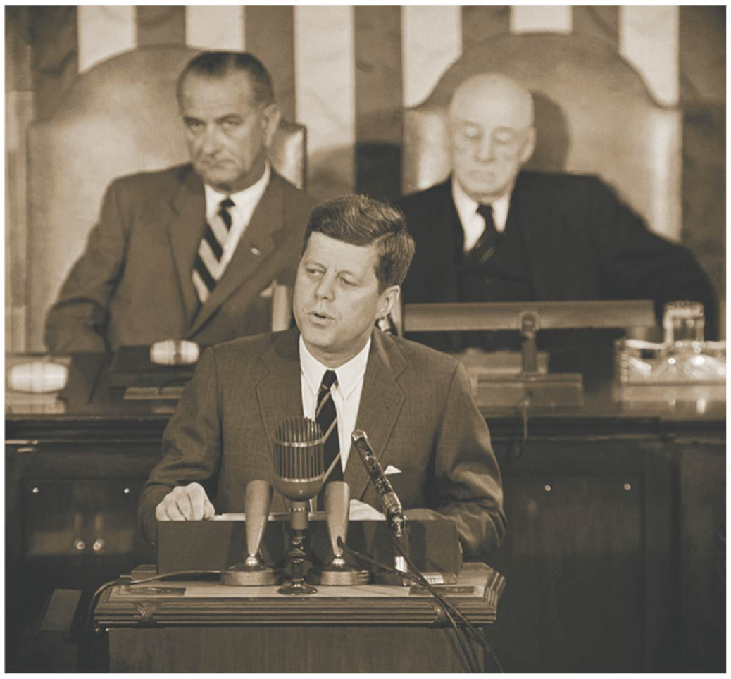

Slide 72
We must think of Earth as an island
Earth is, indeed, an island
Islands can be paradise, or they can have their resources depleted and their environment degraded
It would be folly to allow the latter for our planet as a whole
We can live happily and sustainably if we recognize this and
Modify our individual behavior and cultural institutions to encourage sustainable practices
Employ science to achieve these ends

Slide 73
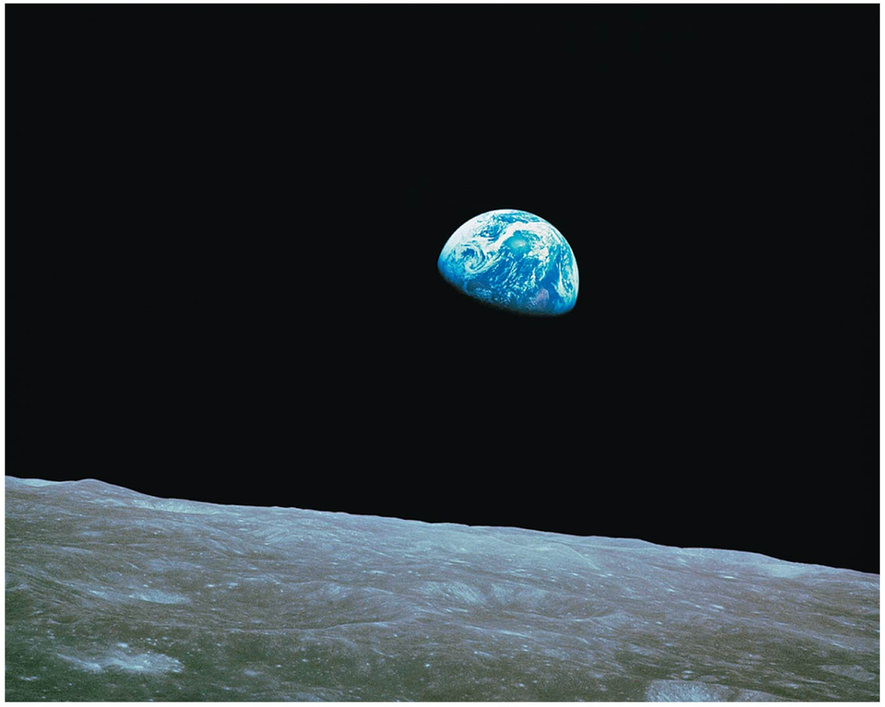

Slide 74
Conclusion
In any society facing dwindling resources and environmental degradation:
There will be those who raise alarms
There will be those who ignore them
We are gaining detailed knowledge and understanding of our dynamic planet
What it offers us and what it can bear
Notes:
74

Slide 75
Conclusion
The challenge for our society today is to support that science
So we may distinguish false alarms from real problems and legitimate concerns from thoughtless denial
Notes:
75

Slide 76
QUESTION: Review
Which of the following is NOT helpful for reaching sustainability?
Use water efficiently.
Conserve energy.
Promote renewable energy.
Use fossil fuels.
Notes:
Answer: d

Slide 77
QUESTION: Review
How can campuses become more sustainable?
Recycle paper.
Buy goods with less packaging.
Grow some of the food used in dining halls.
All of the above
Notes:
Answer: d

Slide 78
QUESTION: Review
A LEED certified building would most likely
cost more to heat and cool.
not have drinking fountains to reduce water use.
use recycled materials in its construction.
All of the above
Notes:
Answer: c

Slide 79
QUESTION: Review
Which of the following is NOT a major approach to sustainability?
Reduce unnecessary consumption.
Limit population growth.
Listen to politicians and policymakers—they have our best interests at heart.
Think in the long term.
Notes:
Answer: c

Slide 80
QUESTION: Review
Which of the following is NOT part of the triple bottom line, the new goal for sustainability?
Promote social justice.
Ensure economic well-being.
Protect environmental quality.
These are all part of the triple bottom line of sustainability.
Notes:
Answer: d

Slide 81
QUESTION: Review
To achieve sustainability, human systems should
mimic linear ecological systems.
use only positive feedback loops.
use raw materials that flow into landfills.
use circular material flows that mimic environmental systems.
Notes:
Answer: d

Slide 82
QUESTION: Weighing the Issues
What would you like your university to do regarding sustainability?
As much as it can, even if it means increasing my tuition a bit
As much as it can, as long as it does not raise my tuition
A bit more than it does now, but not much more
Nothing else; my university already does a lot.
Notes:
Answer: any

Slide 83
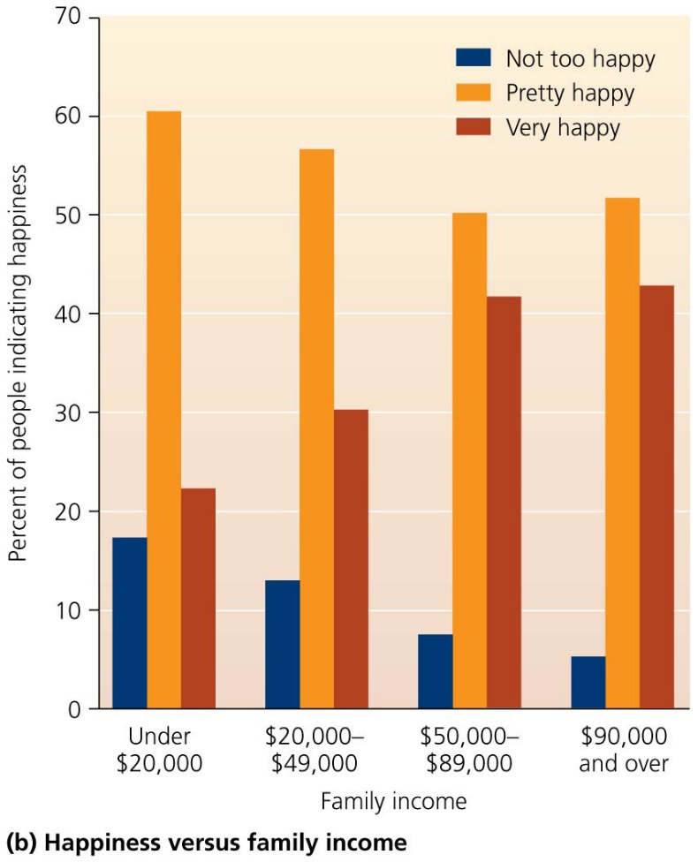
QUESTION: Interpreting Graphs and Data
Which is the best interpretation of this graph about Americans in higher income brackets?
They are much happier than others.
They are happier, but not as much as one would think.
They are less happy than others.
Happiness and income are not related.
Notes:
Answer: b

