Slide 2
This lecture will help you understand:
Mineral resources and their contributions to society
Mining methods
Social and environmental impacts of mining
Reclamation efforts and mining policy
Sustainable use of mineral resources

Slide 3
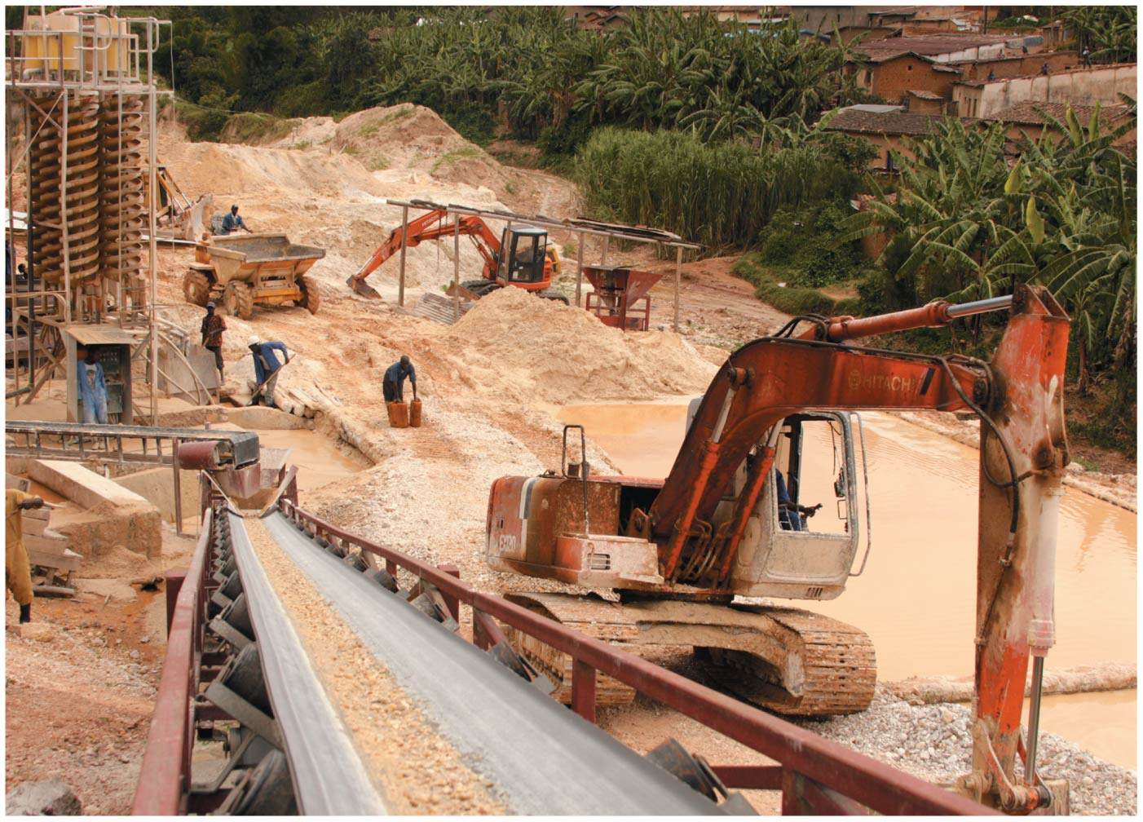

Slide 4
Central Case Study: Mining for … Cell Phones?
Cell phones and other high-tech products require the metal tantalum
Coltan ore = columbite + tantalum
The Democratic Republic of the Congo was at war
Since 1998, 5 million have died and millions more have fled

Slide 5
Central Case Study: Mining for … Cell Phones?
Soldiers controlled mining operations and forced farmers and others to work, while taking most of the ore
People entered national parks, killing wildlife and clearing rainforests
Profits from coltan sales financed the war
U.S. and international efforts have tried to limit sales of “conflict”-mined minerals such as tantalum

Slide 6
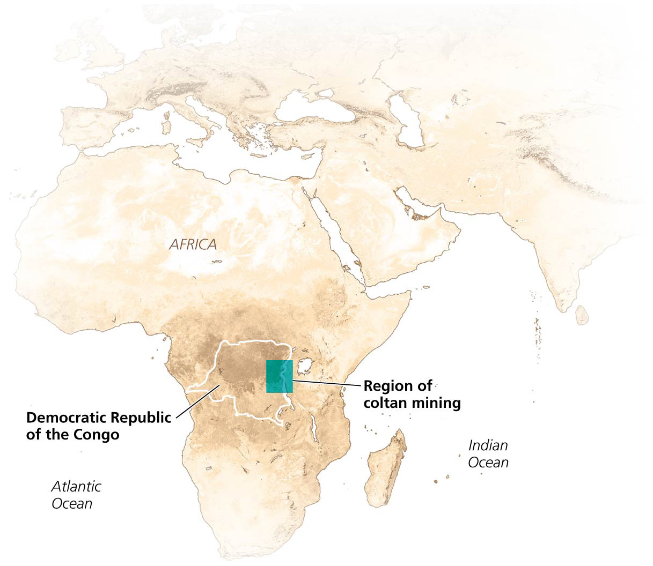

Slide 7
Earth’s Mineral Resources
We extract raw minerals from beneath our planet’s surface
They are turned into products we use everyday
Rock and resources from the lithosphere contribute to our economies and lives
New rock is created and existing rock is altered here
Plate tectonics here builds mountains and causes volcanoes
Minerals are nonrenewable, so we need to be aware of their finite and decreasing supplies

Slide 8
Rocks provide the minerals we use
Rock = a solid aggregation of minerals
Mineral = a naturally occurring solid chemical element or inorganic compound
It has a crystal structure, specific chemical composition, and distinct physical properties
We depend on a wide array of mineral resources as raw materials for our products
Without the resources from beneath the ground, civilization as we know it would not exist

Slide 9
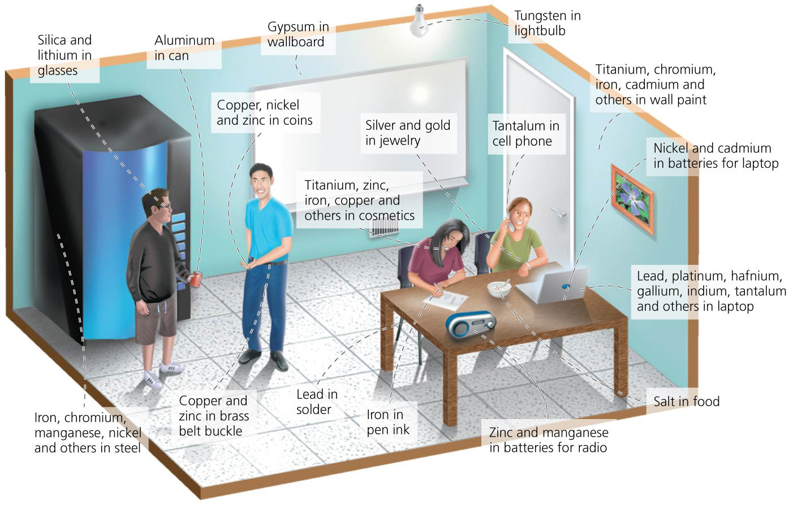

Slide 10
We obtain minerals by mining
We obtain minerals through the process of mining
Mining = in the broad sense, the extraction of any resource that is nonrenewable
We mine minerals, fossil fuels, and groundwater
Mining = in relation to minerals, the systematic removal of rock, soil, or other material to extract the minerals of economic interest
Because minerals occur in low concentrations, concentrated sources must be found before mining

Slide 11
We use mined materials extensively
We often don’t notice how many mined resources we use
In 2013, the average American consumed more than 17,200 kg (38,000 lb) of new minerals and fuels every year
A child born in 2012 will, at current use rates, use 1.3 million kg (2.9 million lb) during their lifetime

Slide 12
We use mined materials extensively
More than half of the annual mineral and fuel use is from coal, oil, and natural gas
Much of the rest is from sand, gravel, and stone used in constructing buildings and paving (roads, etc.)
Metal use is small comparatively, but the average American will use more than 3 tons of aluminum

Slide 13
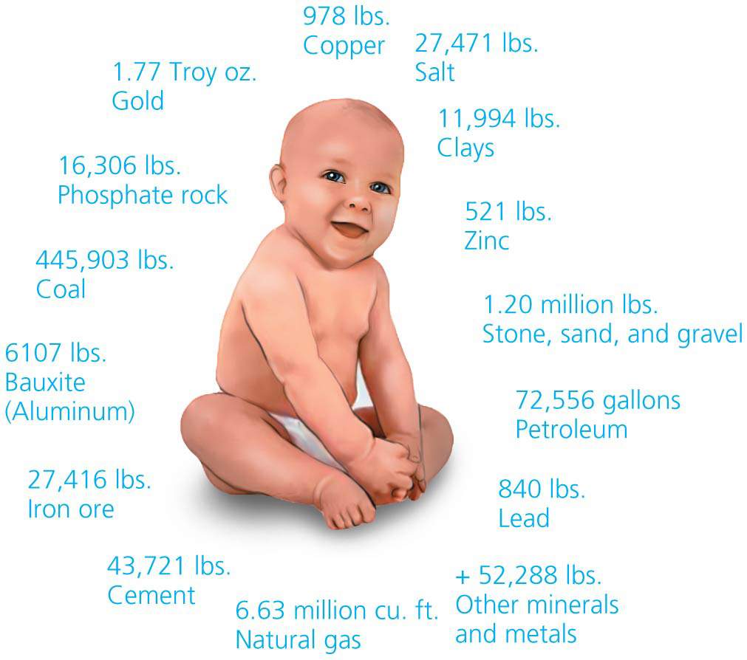

Slide 14
Metals are extracted from ores
Metal = an element that is lustrous, opaque, and malleable and can conduct heat and electricity
Few metals are found in pure form
Ore = a mineral or grouping of minerals from which we extract metals
Economically valuable metals include copper, iron, lead, gold, aluminum
Tantalite ore is mined (often found mixed with columbite in a ore called coltan), processed into tantalum, and used in electronic devices

Slide 15
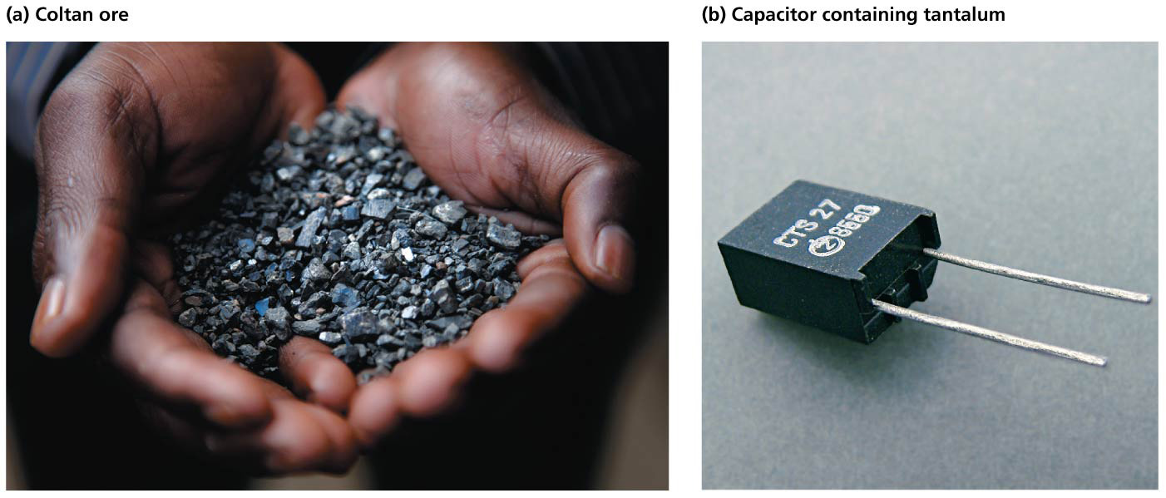

Slide 16
We process metals after mining ore
Most minerals must be processed after mining
After mining the ore, rock is crushed and the metals are isolated by chemical or physical means
The material is processed to purify the metal
This often requires the use of chemical solvents
Alloy = a metal mixed, melted, or fused with another metal or nonmetal substance
Steel is an alloy of iron and carbon
Smelting = heating ore beyond its melting point then combining it with other metals or chemicals

Slide 17
We process metals after mining ore
Processing minerals has environmental costs
Most methods are water- and energy-intensive
Chemical reactions and heating to extract metals from ores emit toxic air pollution

Slide 18
We process metals after mining ore
Tailings = ore left over after metals have been extracted
Pollute soil and water
They may contain heavy metals or acids and chemicals used for extraction (cyanide, sulfuric acid)
Waste water is stored in large reservoirs called surface impoundments
Breaches of surface impoundments can have massive environmental impacts

Slide 19
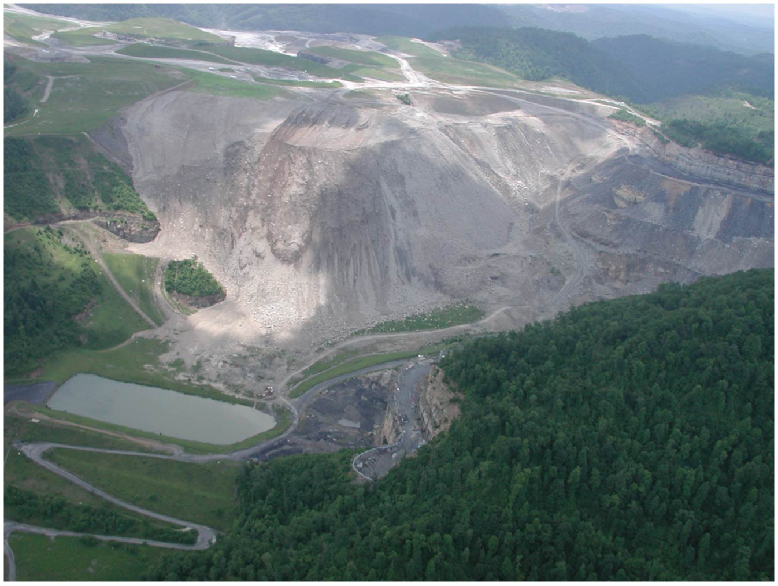

Slide 20
We also mine nonmetallic minerals and fuels
Nonmetallic minerals include sand, gravel, phosphates, limestone, and gemstones
$7 billion/year of sand and gravel are mined in the United States and used as fill and for construction materials
Phosphates provide fertilizer
“Blood diamonds” are mined and sold to fund, prolong, and intensify wars in Angola and other areas
Substances are mined for fuel
Uranium for nuclear power
Coal, petroleum, natural gas, oil sands, oil shale, and methane hydrates are not minerals (they are organic), but they are also extracted from the Earth

Slide 21
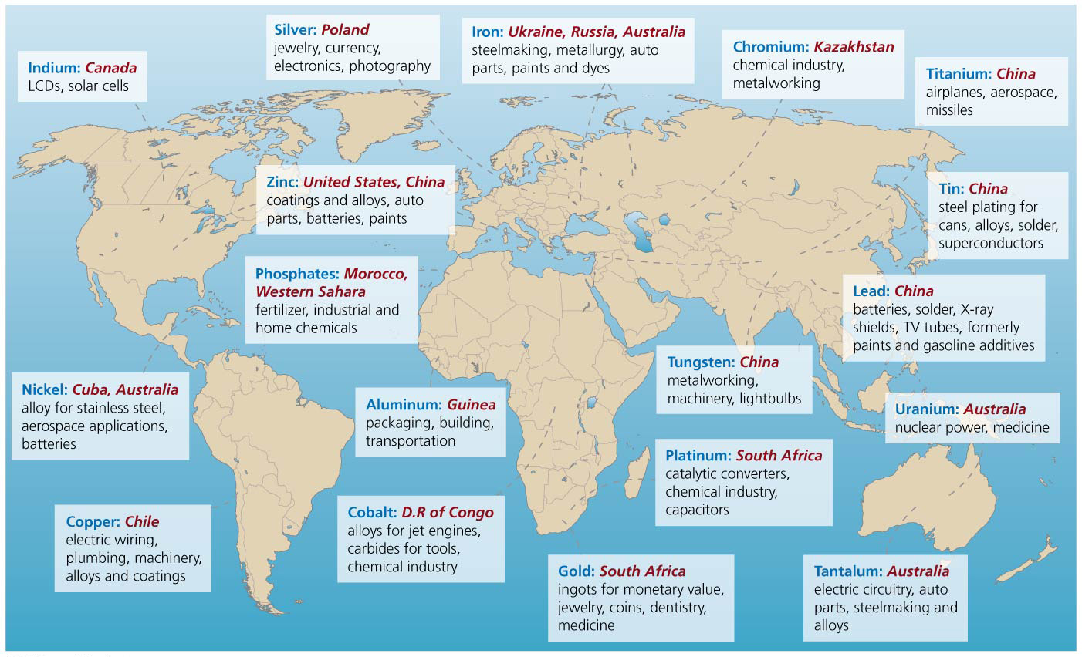

Slide 22
Mining Methods and Their Impacts
Mining provides jobs for people and revenue for many communities
In 2012, raw materials from mining gave $76 billion to the U.S. economy
After processing, minerals contributed $704 billion
175,000 Americans were directly employed for mining
Large amounts of material are removed during mining
Disturbing lots of land
Different mining methods are used to extract minerals
Economics determines which method to use

Slide 23
Strip mining removes surface layers of soil and rock
Strip mining = method of mining shallow horizontal deposits in which layers of soil and rock are removed to expose the resource
Overburden = overlying soil and rock that is removed by heavy machinery
After extraction, each strip is refilled with the overburden
Used for coal, oil sands, sand, gravel
Economically efficient, but environmentally damaging

Slide 24
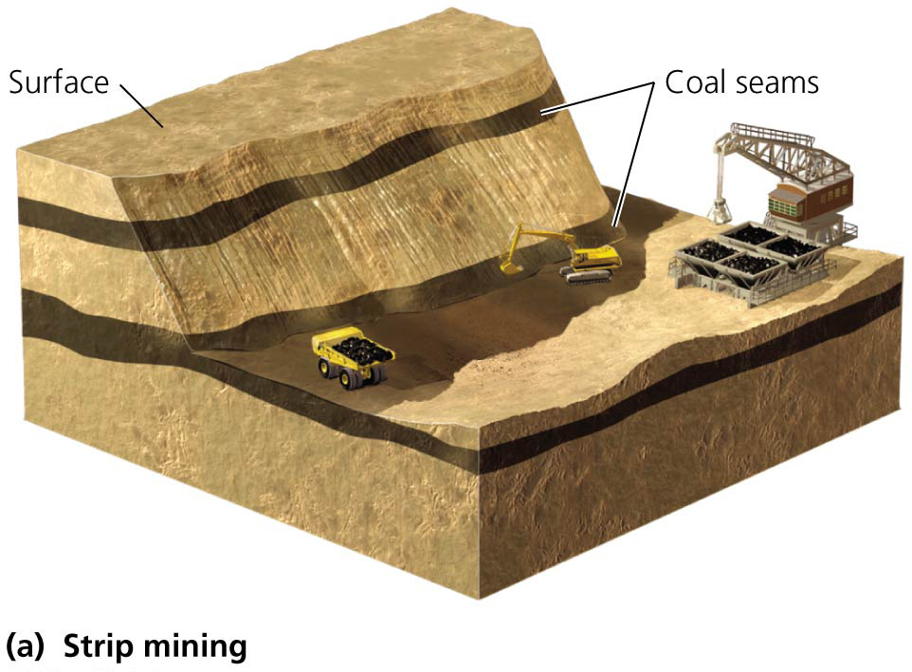

Slide 25
Strip mining removes surface layers of soil and rock
Destroys natural communities over large areas
Removes nutrient-rich topsoil
Triggers erosion
Acid drainage = sulfide minerals in exposed rock form sulfuric acid and flow into waterways
Acids leach metals from the rock
This leachate is toxic to many animals
Acid drainage is natural, but accelerated by mining

Slide 26
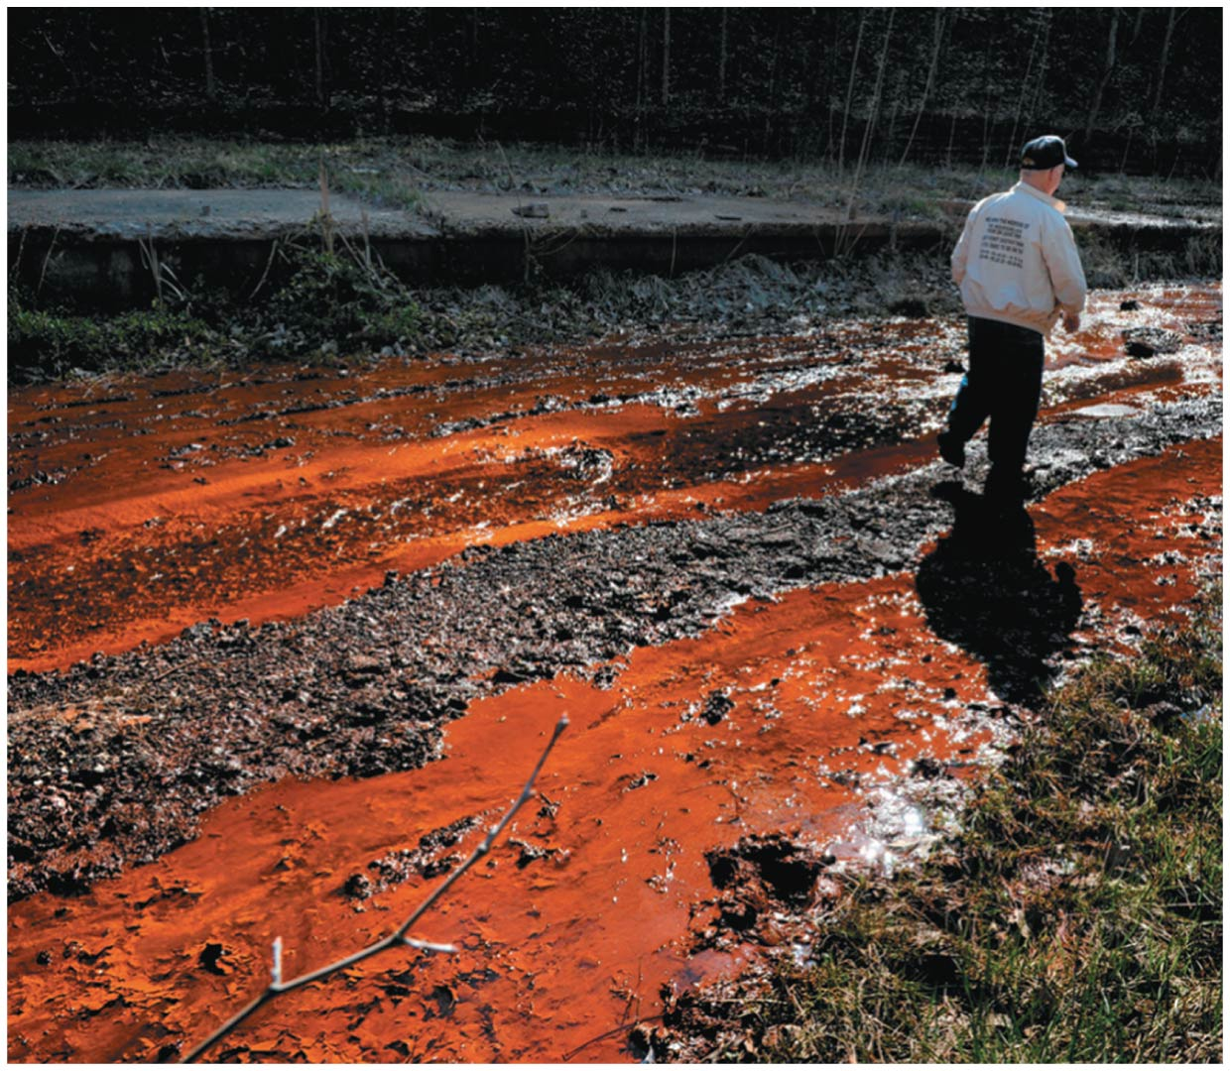

Slide 27
In subsurface mining, miners work underground
Subsurface mines = mines that access deep pockets of a mineral through shafts and tunnels that follow deposits
The deepest mines extend 4 km (2.5 mi) underground
Zinc, lead, nickel, tin, gold, diamonds, phosphate, salt, coal
The most dangerous form of mining
Dynamite blasts, gas explosions, collapsed tunnels
Toxic fumes and coal dust
Mines can cause damage, even after they are closed
Acid drainage pollutes groundwater, sinkholes from collapsed tunnel, underground fires

Slide 28
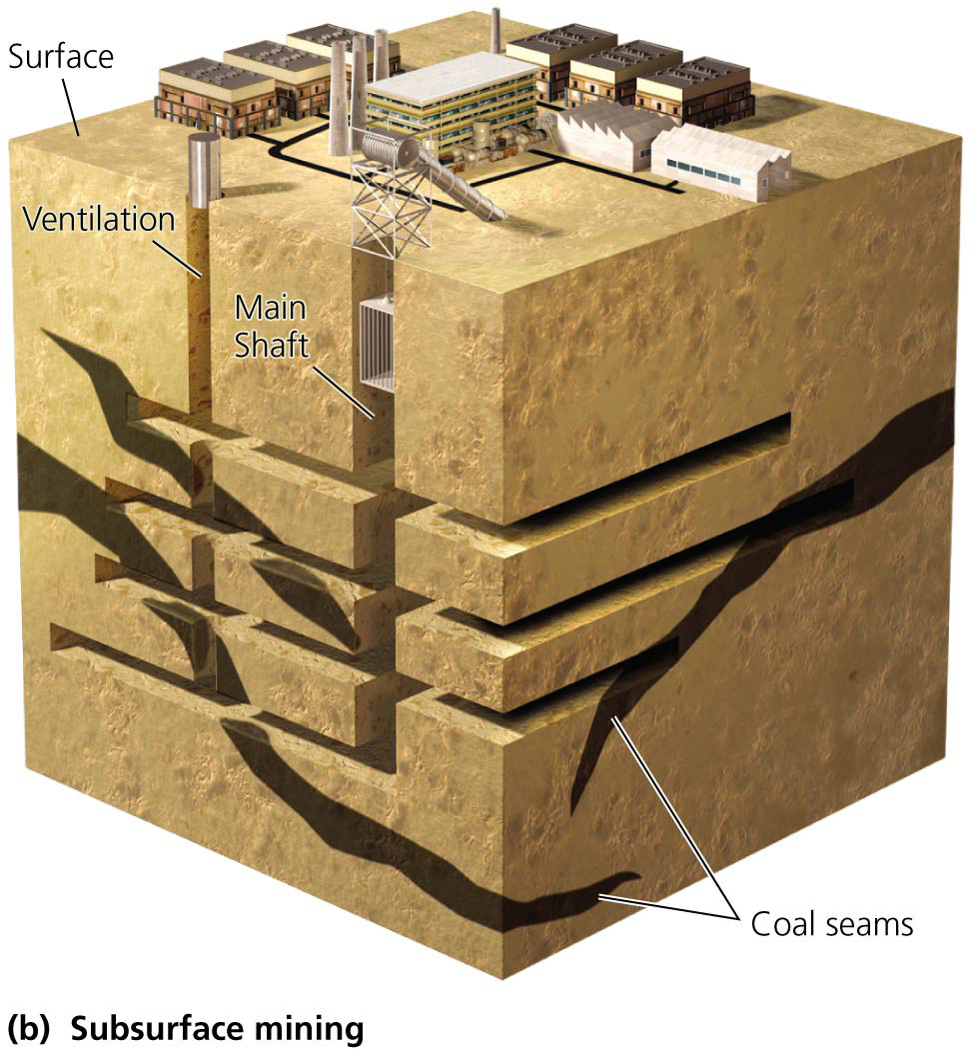

Slide 29
Open pit mining creates immense holes in the ground
Open pit mining is used with evenly distributed minerals
Produces huge pits and massive mounds of waste rock
Copper, iron, gold, diamonds, coal
Quarries = open pits for clay, gravel, sand, stone (limestone, granite, marble, slate)
Huge amounts of rock must be removed to get the small amounts of ore containing the trace amounts of minerals

Slide 30
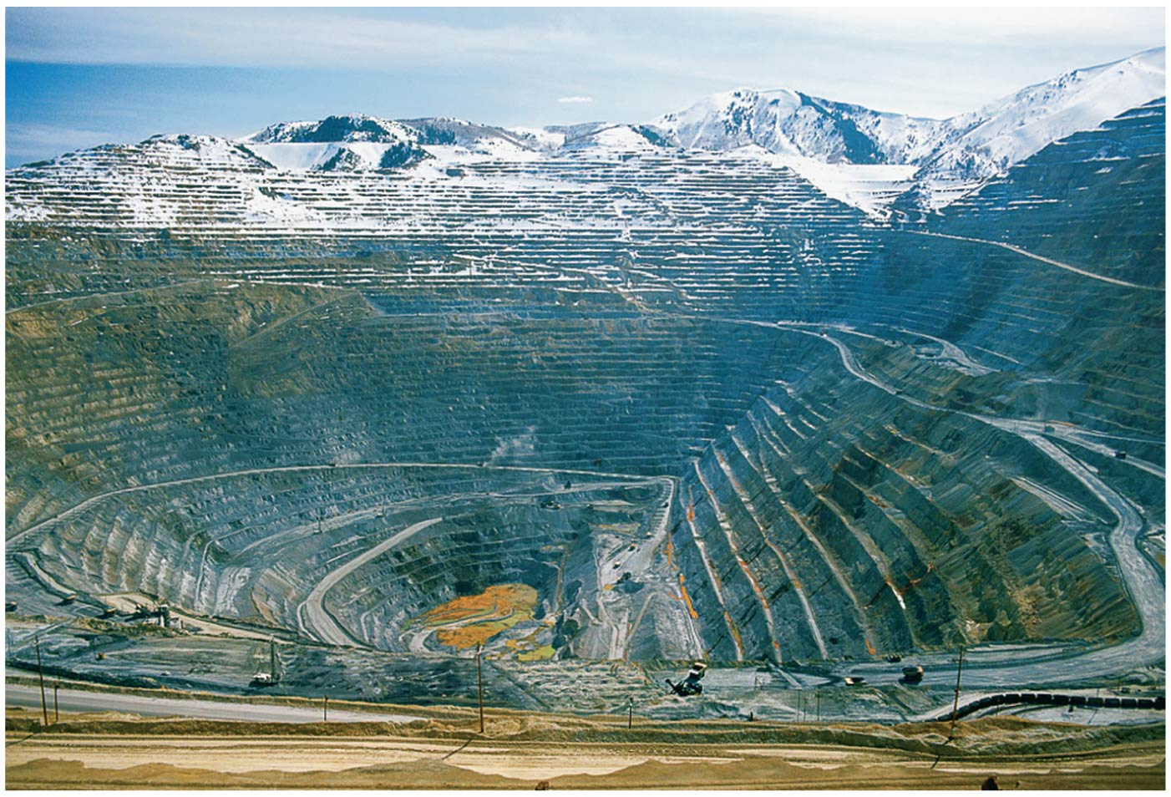

Slide 31
Open pit mining creates immense holes in the ground
The huge scale means large-scale habitat loss and aesthetic degradation
Acid drainage comes from two sources
Runoff from waste heaps
Pits fill with water
Water in abandoned pits becomes extremely acidic and can be harmful to wildlife and pollute groundwater
Regulations require waste heaps to be capped and planted with vegetation
Mines will likely leach acid for hundreds of years

Slide 32
Placer mining uses running water to isolate minerals
Some minerals and gems accumulate in riverbed deposits
Placer mining = mining that uses running water to separate the lighter materials from the heavier minerals
Coltan miners, California’s Gold Rush of 1849
Debris washed into streams makes them uninhabitable for wildlife
Disturbs stream banks; causes erosion
Harms riparian plant communities

Slide 33
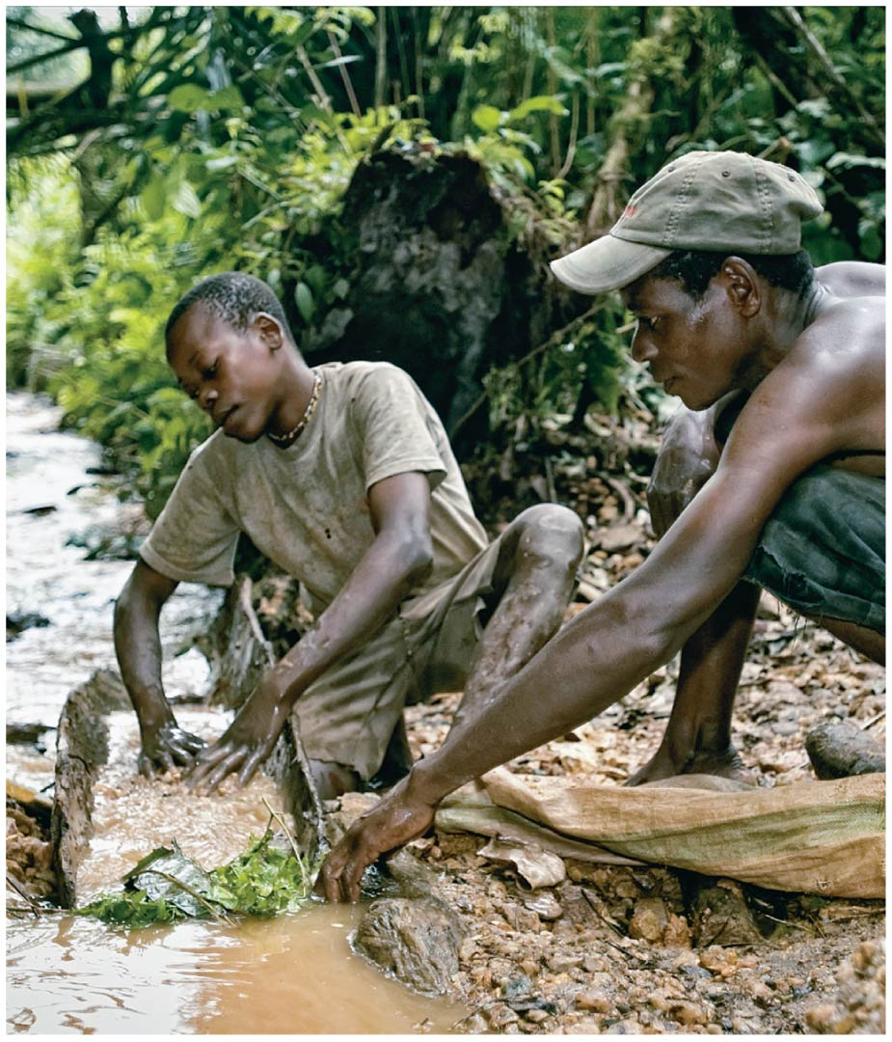

Slide 34
Mountaintop mining reshapes ridges and can fill valleys
When the resource occurs in seams near the top of a ridge or mountain, it can be accessed by mountaintop removal mining = process in which several hundred vertical feet of mountaintop are removed to allow recovery of entire seams of a resource
Used to mine for coal in the Appalachian Mountains of the eastern United States
An area the size of Delaware has already been removed

Slide 35
Mountaintop mining reshapes ridges and can fill valleys
“Valley filling” is the practice of dumping excess rock and debris into valleys
3200 km (2000 miles) of streams have been buried
Has been expanding since it is economically efficient

Slide 37
Mountaintop mining reshapes ridges and can fill valleys
Dumping debris into valleys degrades and destroys vast areas
Pollutes streams, deforests areas, causes erosion, mudslides, flash floods
Valley filling has been challenged under the Clean Water Act
Also numerous health and social impacts
Floods and rock slides affect properties while blasting cracks foundations and wells
Coal dust and contaminated water cause illness
Fewer jobs created than traditional mining

Slide 38
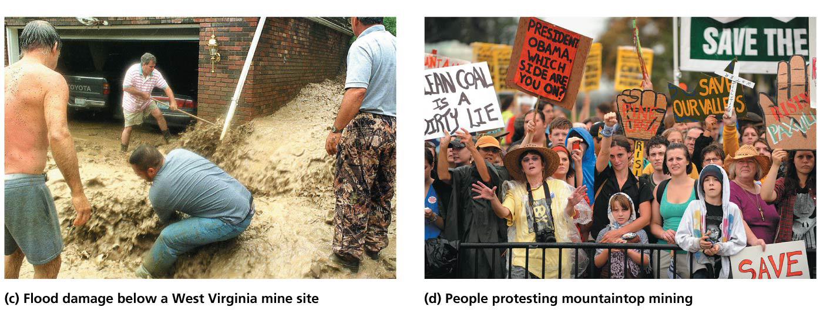

Slide 39
Solution mining dissolves and extracts resources in place
Solution mining (in-situ recovery) = resources in a deep deposit are dissolved in a liquid and siphoned out
Narrow holes are drilled into the deposit and water, acid, or other solutions are used
Salts, lithium, boron, bromine, potash, copper, uranium
Less environmental impact than other methods
Less surface area is disturbed
Acids, heavy metals, uranium can accidentally leak
Could contaminate groundwater

Slide 40
Some mining occurs in the ocean
We extract some minerals (e.g., magnesium, salts) from seawater
Other minerals are vacuumed from the ocean floor
Sulfur, phosphate, calcium carbonate (for cement), silica (insulation and glass), copper, zinc, silver, gold
Manganese nodules are small, ball-shaped ores scattered across the ocean floor
Mining them is currently uneconomical
Hydrothermal vents may have gold, silver, zinc
Mining would destroy habitats and organisms and likely release toxic metals that could enter the food chain

Slide 41
Restoration helps to reclaim mine sites
Governments in developed countries require companies to reclaim (restore) surface-mined sites
Reclamation = restoration that aims to bring a site to a condition similar to its pre-mining condition
Remove structures, replace overburden, replant vegetation

Slide 42
Restoration helps to reclaim mine sites
The U.S. 1977 Surface Mining Control and Reclamation Act mandates restoration
Companies must post bonds before mining is approved to ensure restoration when mining is done
Other nations (e.g., Congo) have no regulations at all

Slide 43
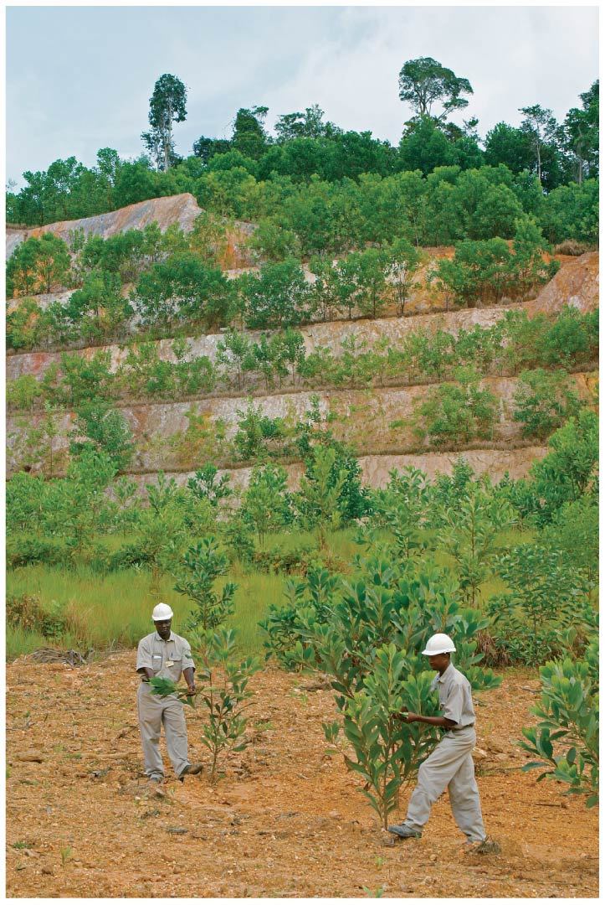

Slide 44
Restoration helps to reclaim mine sites
The mining industry employs ecologists and engineers to carry out reclamation, but even on restored sites, impacts (like soils and water damage) may be severe and long-lasting
Complex communities are simplified
Forests, wetlands, etc., are replaced by grasses
Essential symbioses are eliminated and often not restored
Water can be reclaimed if
Heavy metals are removed
pH is moderated

Slide 45
An 1872 law still guides U.S. mining policy
General Mining Act of 1872 = act that encourages metal and mineral mining on federal land
Any citizen or company can stake a claim on any public land open to mining for $5 per acre
The public gets no payment for any minerals found
Once a person owns the land, that land can be developed for any reason, having nothing to do with mining

Slide 46
An 1872 law still guides U.S. mining policy
Supporters say it encourages a domestic industry that is risky and provides essential products
Critics say it gives land basically free to private interests
Efforts to amend the act have failed in Congress

Slide 47
Minerals are nonrenewable resources in limited supply
Some minerals are abundant, but others are rare enough that we may soon run out
Once known reserves are mined, minerals will be gone
For example, indium, used in LCD screens, might only last 30 more years
Gallium (for solar power) and platinum (fuel cells) are also scarce

Slide 48
Minerals are nonrenewable resources in limited supply
Reserve estimates are uncertain
New discoveries, technologies, consumption patterns, and recycling affect mineral supplies
As minerals become scarcer, demand and price rise, and harder to access sources are mined

Slide 49
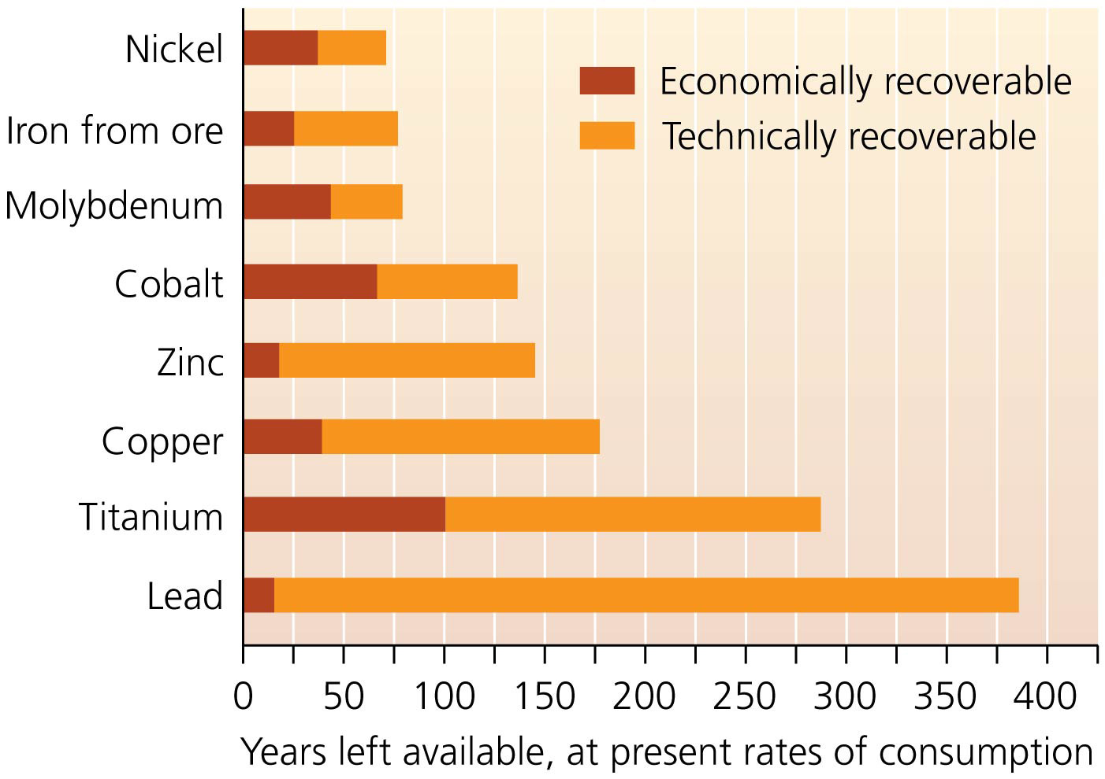

Slide 50
Several factors affect how long mineral deposits may last
Discovery of new reserves: increases known reserves
Minerals worth over $1 trillion were discovered in Afghanistan in 2010
New extraction technologies: reach more minerals at less expense

Slide 51
Several factors affect how long mineral deposits may last
Changing social and technological dynamics: modify demand in unpredictable ways
Lithium batteries are replacing cadmium-nickel ones
Changing consumption patterns: affect how fast we exploit reserves (e.g., a recession depresses demand)
Recycling: extends the lifetimes of minerals

Slide 52
We can make our mineral use more sustainable
Recycling addresses both finite supplies and the environmental damage mining causes
35% of metals were recycled in 2010 from U.S. municipal solid waste
80% of the lead and 33% of the copper we use comes from recycled sources
We recycle much of our gold, steel, iron, chromium, zinc, aluminum, and nickel

Slide 53
We can make our mineral use more sustainable
Recycling reduces energy use
Recycled aluminum uses 20 times less energy than making new aluminum from ore
Reduces greenhouse gases by 25 million metric tons

Slide 54
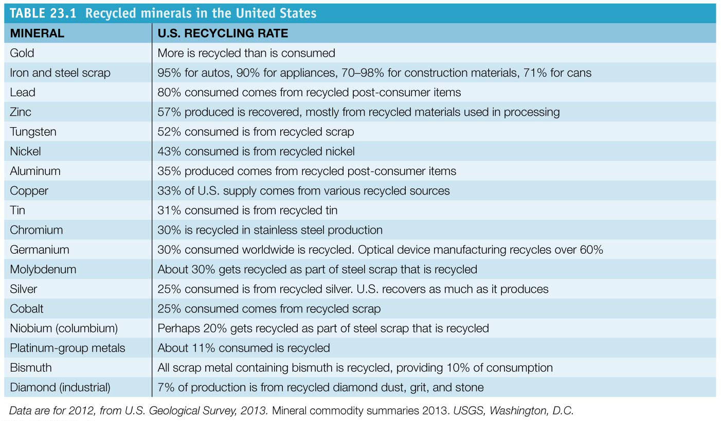

Slide 55
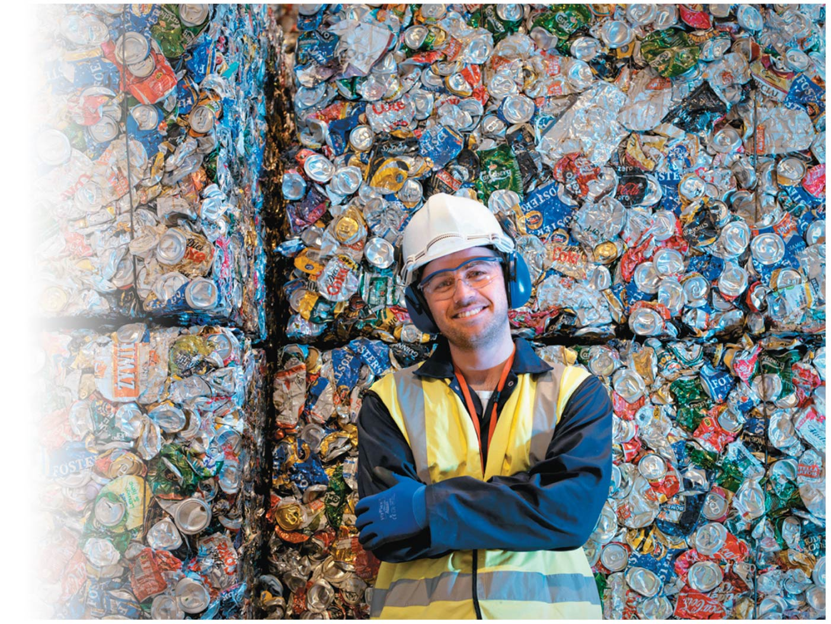

Slide 56
We can recycle rare metals from e-waste
Electronic waste (e-waste) from computers, printers, cell phones, etc. is rapidly rising
Recycling keeps hazardous wastes out of landfills while conserving mineral resources
1.2 billion cell phones sold each year contain 200 chemicals and precious metals
Phones can be refurbished and resold or dismantled and their parts reused or recycled
Only 10% of cell phones are recycled
Recycling reduces demand for virgin ores and reduces pressure on ecosystems

Slide 57
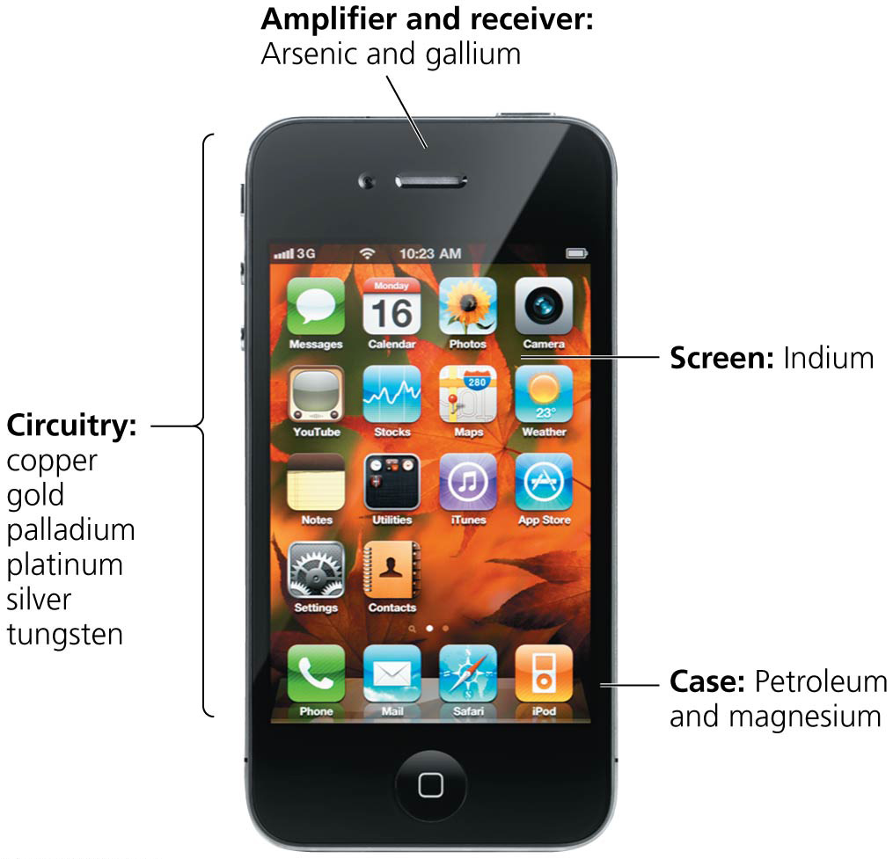

Slide 58
Conclusion
We depend on minerals and metals to make the products we use
Mineral resources are mined by various methods
Contributing to material wealth
But causing extensive environmental damage (habitat loss, acid drainage, etc.)
Restoration and regulations help minimize the environmental and social impacts of mining
Access to mineral resources can be lengthened and made more sustainable by maximizing recovery and recycling of minerals
Notes:
58

Slide 59
QUESTION: Review
Which of the following is defined as “a mineral or grouping of minerals from which we extract metals”?
Sedimentary rock
Mined materials
Ore
Smelting
Notes:
Answer: c

Slide 60
QUESTION: Review
Why are mine tailings dangerous?
They pollute soil and water.
They may contain heavy metals or acids.
Tailings ponds may leach pollutants into the environment.
All of these are reasons tailings are dangerous.
Notes:
Answer: d

Slide 61
QUESTION: Review
To strip-mine for coal, what must first be removed?
Acid drainage
Coal
Overburden
Ore
Notes:
Answer: c

Slide 62
QUESTION: Review
Which mining method uses very deep holes to extract minerals that are evenly distributed in low concentrations?
Strip
Placer
Open pit
Mountaintop removal
Notes:
Answer: c

Slide 63
QUESTION: Review
Which mining method cracks foundations and walls and causes floods and rock slides while mining for coal?
Strip
Placer
Open pit
Mountaintop removal
Notes:
Answer: d

Slide 64
QUESTION: Review
The best ways to use mineral resources sustainably are
recycling and efficiency.
larger pit mines and recycling.
deeper mines and larger pit mines.
finding new mines and recycling.
Notes:
Answer: a

Slide 65
QUESTION: Weighing the Issues
Should the General Mining Act of 1872 be reformed?
Absolutely; it’s time companies paid their fair share of money from publicly owned resources.
Only partially, so that companies can’t sell or develop the land for non mining uses
Maybe, but only if it reduces our taxes
Probably not, since we are already hurting economically
Notes:
Answer: any

Slide 66
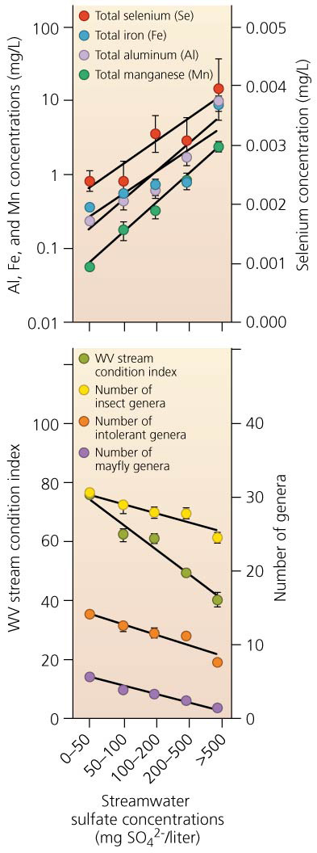
QUESTION: Interpreting Graphs and Data
What can be concluded from these graphs?
Insect diversity increases with increased sulfates.
Insect diversity decreases with increased sulfates.
Insect diversity is not related to sulfate concentrations.
Sulfates are not related to mining activities.
Notes:
Answer: b

Slide 67
QUESTION: Interpreting Graphs and Data
Which statement about mineral resources is supported by this figure?
Our technically recoverable supplies are at least twice that of the economically recoverable.
We will run out of copper before zinc.
We have the smallest economically recoverable supplies of nickel.
All of these are true.
Notes:
Answer: a

