Slide 2
This lecture will help you understand:
The types of waste we generate
Managing waste
The scale of the waste dilemma
Conventional waste disposal: landfills and incineration
Ways to reduce waste
Industrial solid waste management
Managing hazardous waste

Slide 3
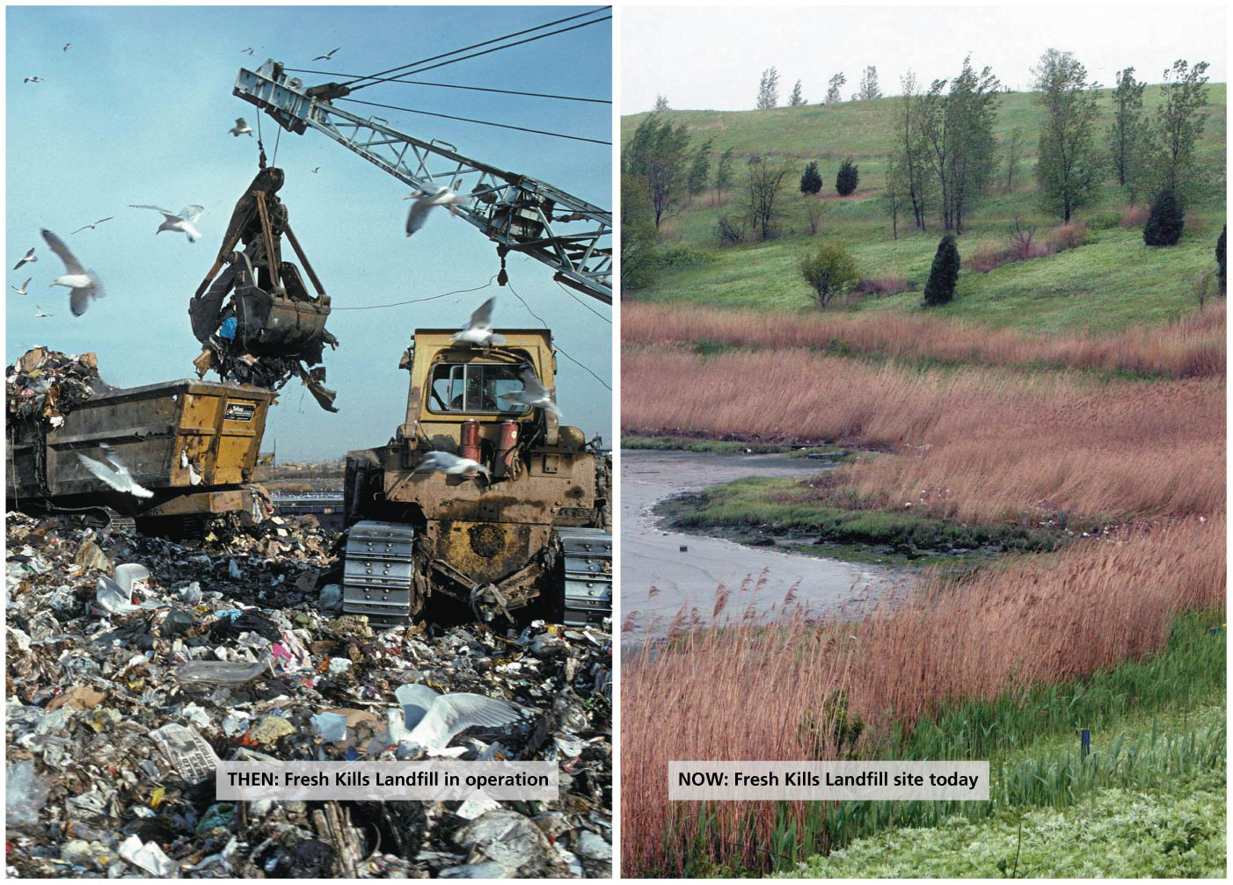

Slide 4
Central Case Study: Transforming New York’s Fresh Kills Landfill
The largest landfill in the world closed in 2001
Staten Island residents viewed the landfill as a civic blemish
Without a landfill, New York City was forced to export its garbage, and sanitation costs doubled
It was briefly reopened to bury rubble from the World Trade Center after the September 11, 2001 attack
It will take 30 years to turn it into a world-class public park
New York City is still paying to export its garbage

Slide 5
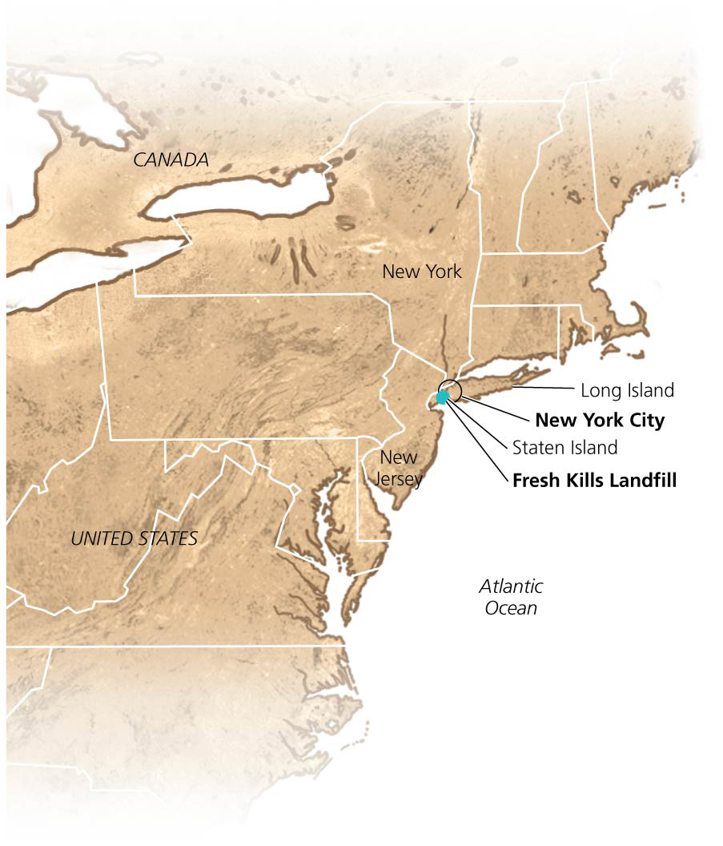

Slide 6
Approaches to Waste Management
Waste = any unwanted material or substance that results from human activity or process
Municipal solid waste = nonliquid waste from homes, institutions, and small businesses
Industrial solid waste = waste from production of goods, mining, agriculture, petroleum extraction, and refining

Slide 7
Approaches to Waste Management
Hazardous waste = solid or liquid waste that is toxic, chemically reactive, flammable, or corrosive
Wastewater = used water from households, businesses, or industry
Also, polluted runoff from streets and storm drains

Slide 8
We have several aims in managing waste
Waste management aims to:
Minimize the amount of waste generated (source reduction)
Recover waste materials and recycle them
Dispose of waste safely and effectively
Source reduction is the preferred approach
Waste stream = the flow of waste as it moves from its sources toward disposal destinations
To reduce the amount of material that enters the waste stream, we can use materials efficiently, consume less, buy goods with less packaging, use goods longer

Slide 9
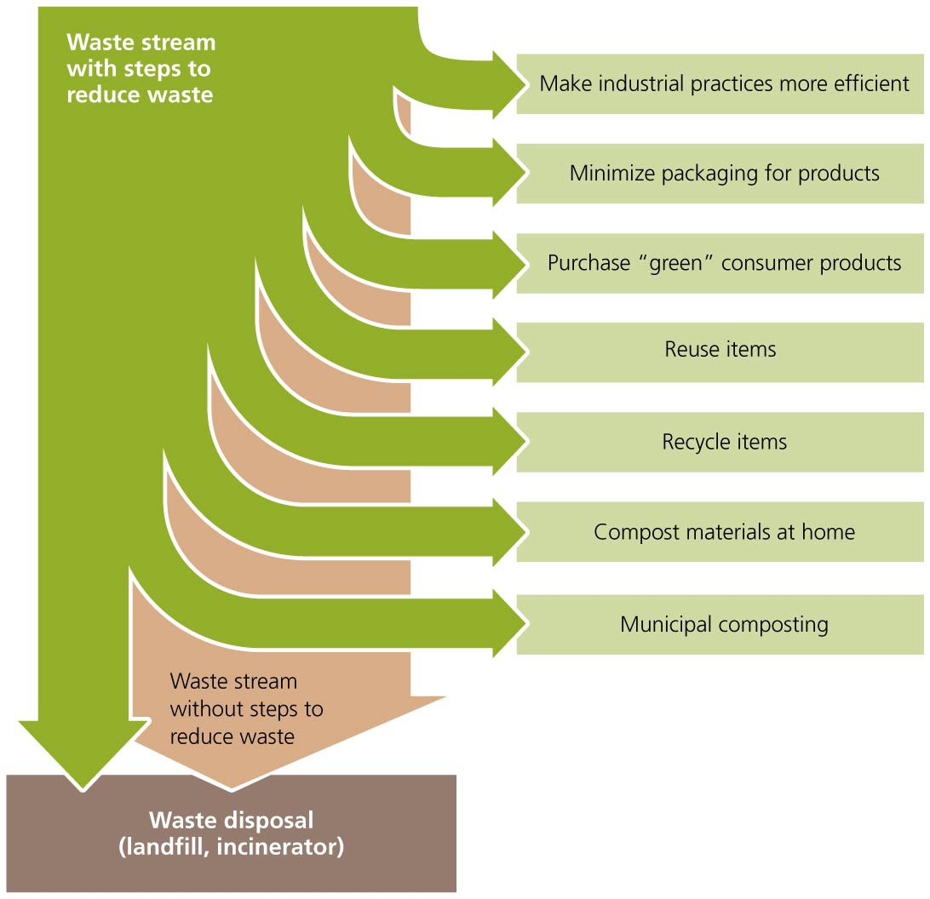

Slide 10
We have several aims in managing waste
Recovery = recovering or removing waste from the waste stream
The next best strategy in waste management
Recovery includes two processes
Recycling = collects and sends used goods to facilities to manufacture into new goods
Composting = recovery of organic waste by converting it into mulch or humus through decomposition
But there will always be some waste left to dispose of
In landfills or through incineration

Slide 11
Municipal Solid Waste
Municipal solid waste is the waste we generate in our homes, public facilities, and small businesses
Also called “trash” or “garbage”
In the United States, paper, yard debris, food scraps, and plastics are the principal components of municipal solid waste
Paper and yard waste are recovered at high rates
But even after recycling, paper is the largest component, followed by food scraps and plastics

Slide 12
Municipal Solid Waste
Most municipal solid waste comes from packaging and nondurable goods (discarded after a short time of use)
Plastics have accounted for the greatest relative increase in the waste stream over the last few decades

Slide 13
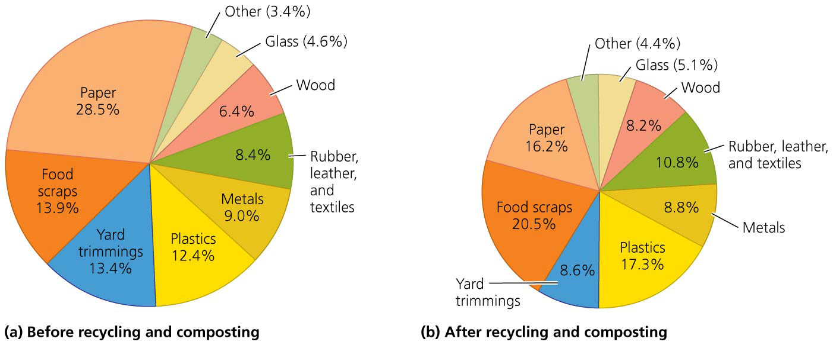

Slide 14
Consumption leads to waste
As we acquire more good, we generate more waste
Since 1960, waste generation increased 2.8 times
Per capita waste generation increased 65%
In 2010, close to 1 ton of municipal solid waste was generated per person in the United States
About 2 kg (4.4 lb) per person per day
Much more than people in other countries
Critics have labeled the United States “the throwaway society”
Source reduction and reuse have helped reduce waste generation slightly between 2005 and 2010

Slide 15
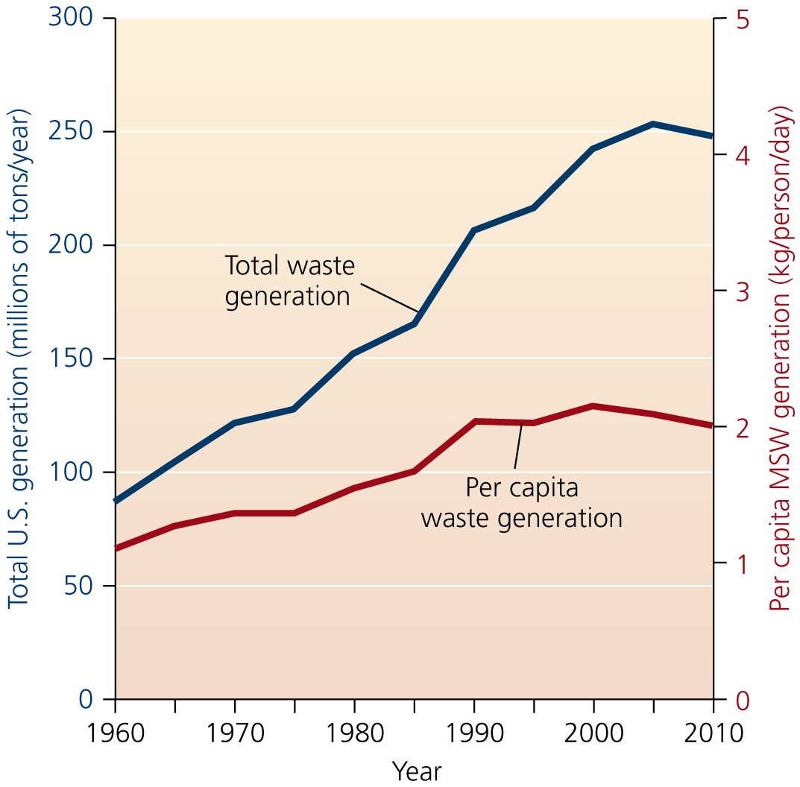

Slide 16
Consumption leads to waste
People in developing nations typically consume fewer resources and generate less waste
Consumption is greatly increasing in developing nations
Rising standard of living, more packaging, poor-quality goods
Waste generation rates over the past three decades have more than doubled in Latin America and risen more than fivefold in the Middle East
Wealthy consumers often discard items that can still be used, while poor people support themselves by selling items they scavenge from dumps

Slide 17
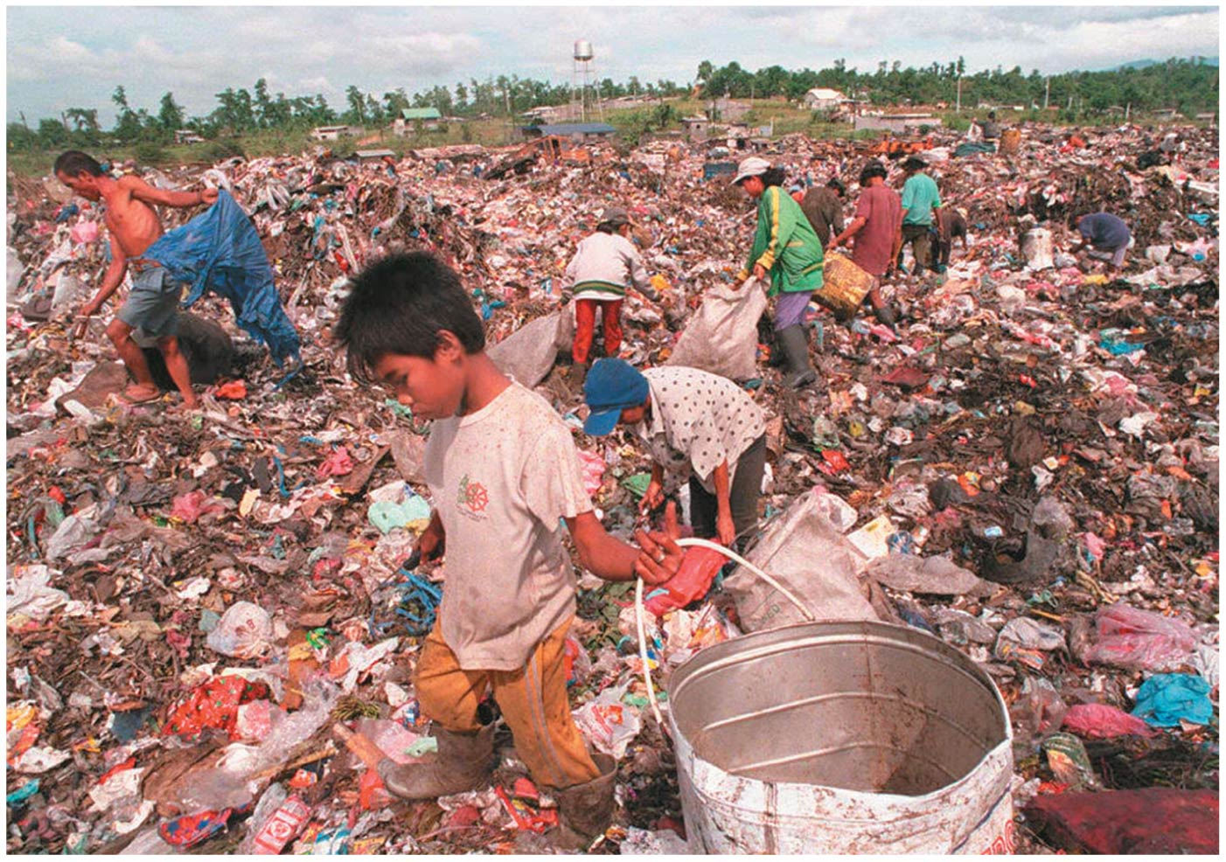

Slide 18
Open dumping has led to improved disposal methods
People dumped their garbage wherever it suited them
As populations increased, waste was consolidated into open dumps that were burned to reduce volume
Most industrialized nations now bury waste in lined and covered landfills or burn it in incineration facilities

Slide 19
Open dumping has led to improved disposal methods
In the 1980s in the United States, increased waste generation and restricted incineration led to limits on landfill space
There was talk of a “solid waste crisis”
Since the late 1980s, recycling has decreased pressure on landfills
As of 2010, 54% of waste was landfilled, 12% incinerated, and 34% recovered

Slide 20
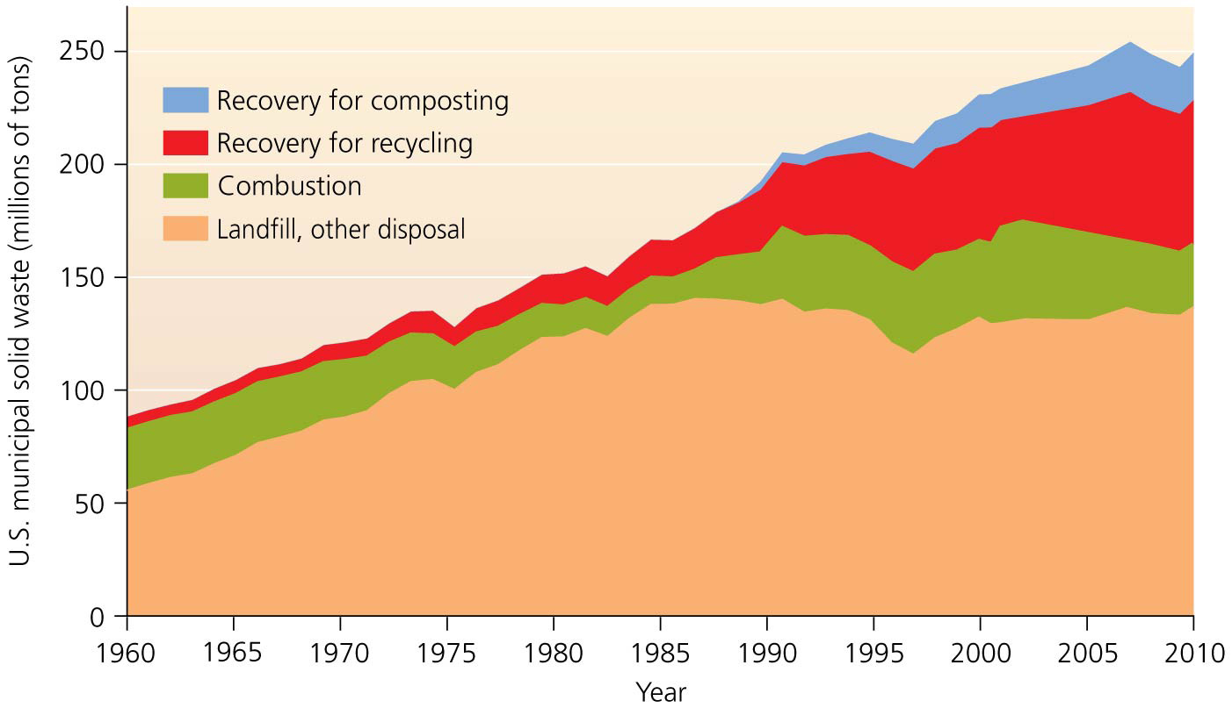

Slide 21
Sanitary landfills are regulated with health and environmental guidelines
Sanitary landfills = waste buried in the ground or piled in large, engineered mounds to prevent contamination and health threats
U.S. landfills must meet the EPA’s national standards under the Resource Conservation and Recovery Act (RCRA) of 1976
Waste is partly decomposed by bacteria and compresses under its own weight to make more space
Soil is layered in to reduce odor, speed decomposition, and reduce infestation by pests
Some water is allowed in to help decomposition

Slide 22
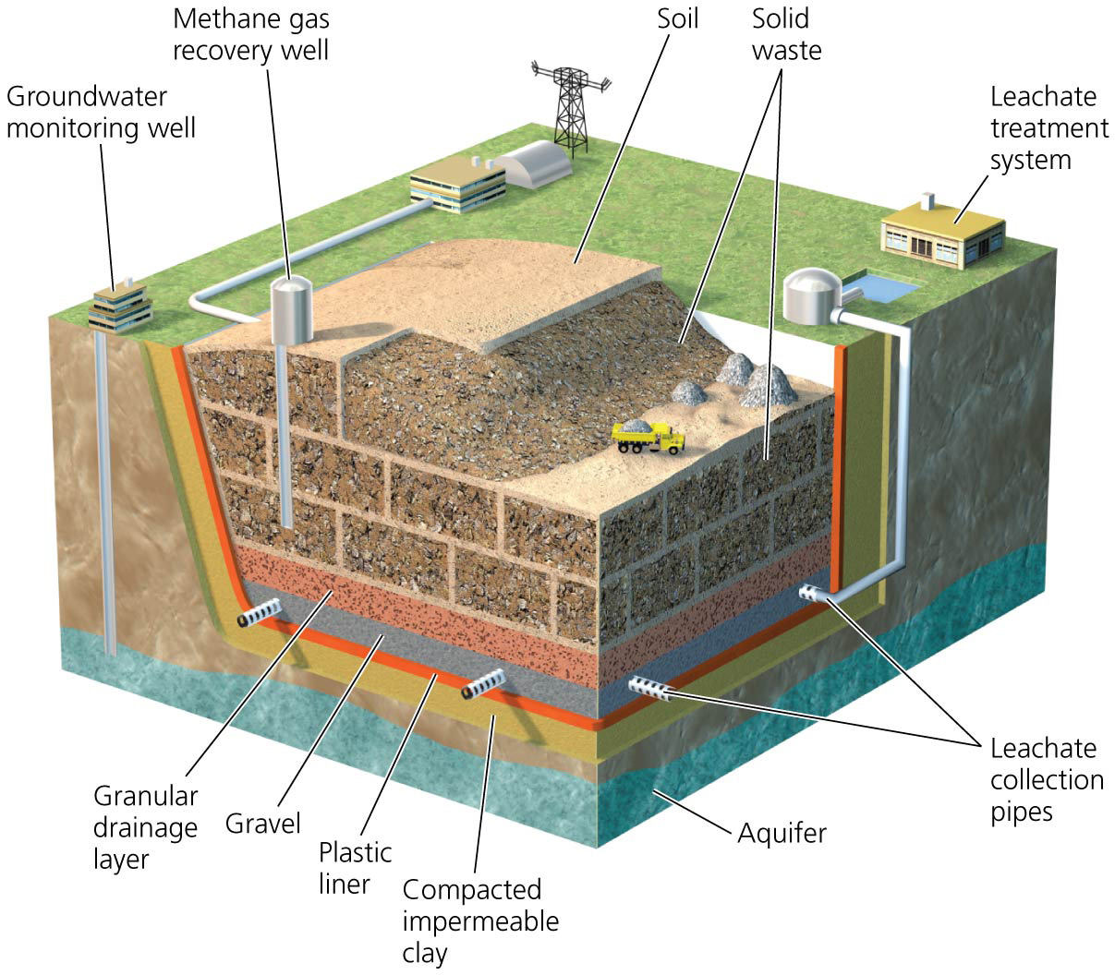

Slide 23
Sanitary landfills are regulated with health and environmental guidelines
To protect against environmental contamination, landfills must be located away from wetlands and earthquake-prone faults and be 20 ft above the water table
The bottom and sides must be lined with plastic and clay

Slide 24
Sanitary landfills are regulated with health and environmental guidelines
Leachate = liquid from trash dissolved by rainwater
It is collected in a series of pipes and treated
But it can escape if the liner is punctured
Once closed, it must be capped and maintained
Leachate must be collected for 30 years
Groundwater must be monitored for contamination
The 8000 landfills in the United States in 1988 have been consolidated to 200 larger landfills today

Slide 25
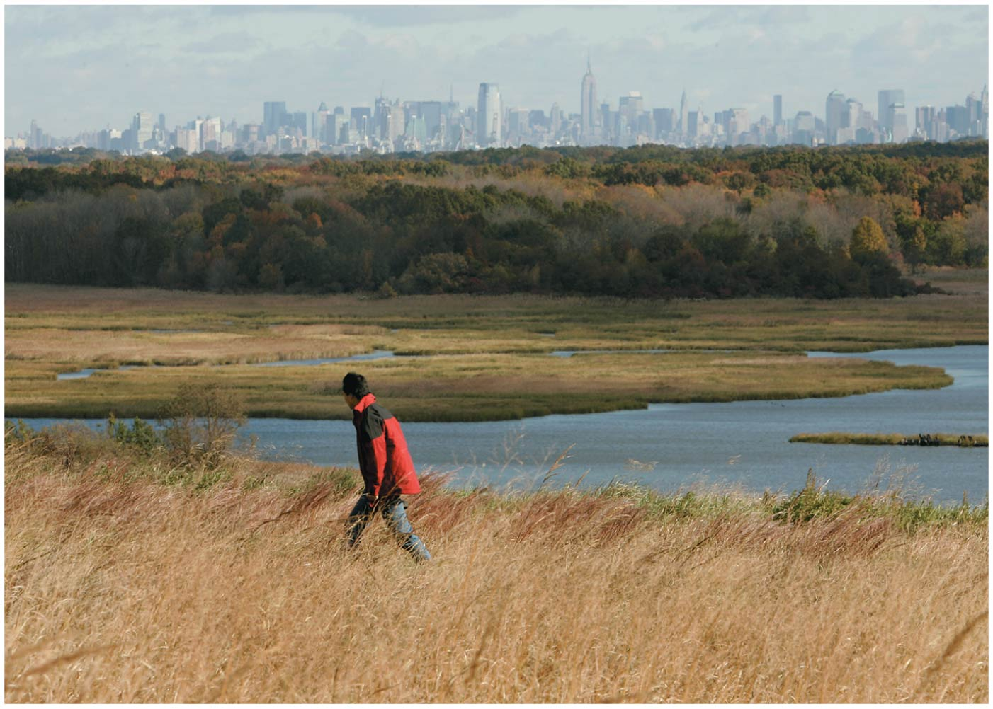

Slide 26
Landfills have drawbacks
Liners get punctured, and leachate collection systems won’t be maintained
To avoid leachate, water is kept out and waste kept dry
But dry waste doesn’t decay much

Slide 27
Landfills have drawbacks
Finding suitable areas to put landfills is difficult because of the not-in-my-backyard (NIMBY) syndrome
The “garbage barge” case in Islip, New York in 1987
Full landfills forced a barge to take the waste to North Carolina, Louisiana, and Mexico
All rejected the medical-waste-contaminated load
After a 6000 mile journey it returned to New York, where the waste was incinerated

Slide 28
Incinerating trash reduces pressure on landfills
Incineration = a controlled process that burns garbage at very high temperatures
Incinerating waste reduces its weight by 75% and volume by 90%
But the remaining ash must be disposed of in a hazardous waste landfill

Slide 29
Incinerating trash reduces pressure on landfills
Hazardous chemicals are created and can be released into the atmosphere
Scrubbers chemically treat the gases produced in combustion
Remove hazardous parts and neutralize acidic gases
A baghouse removes polluted fly ash from the exhaust

Slide 30
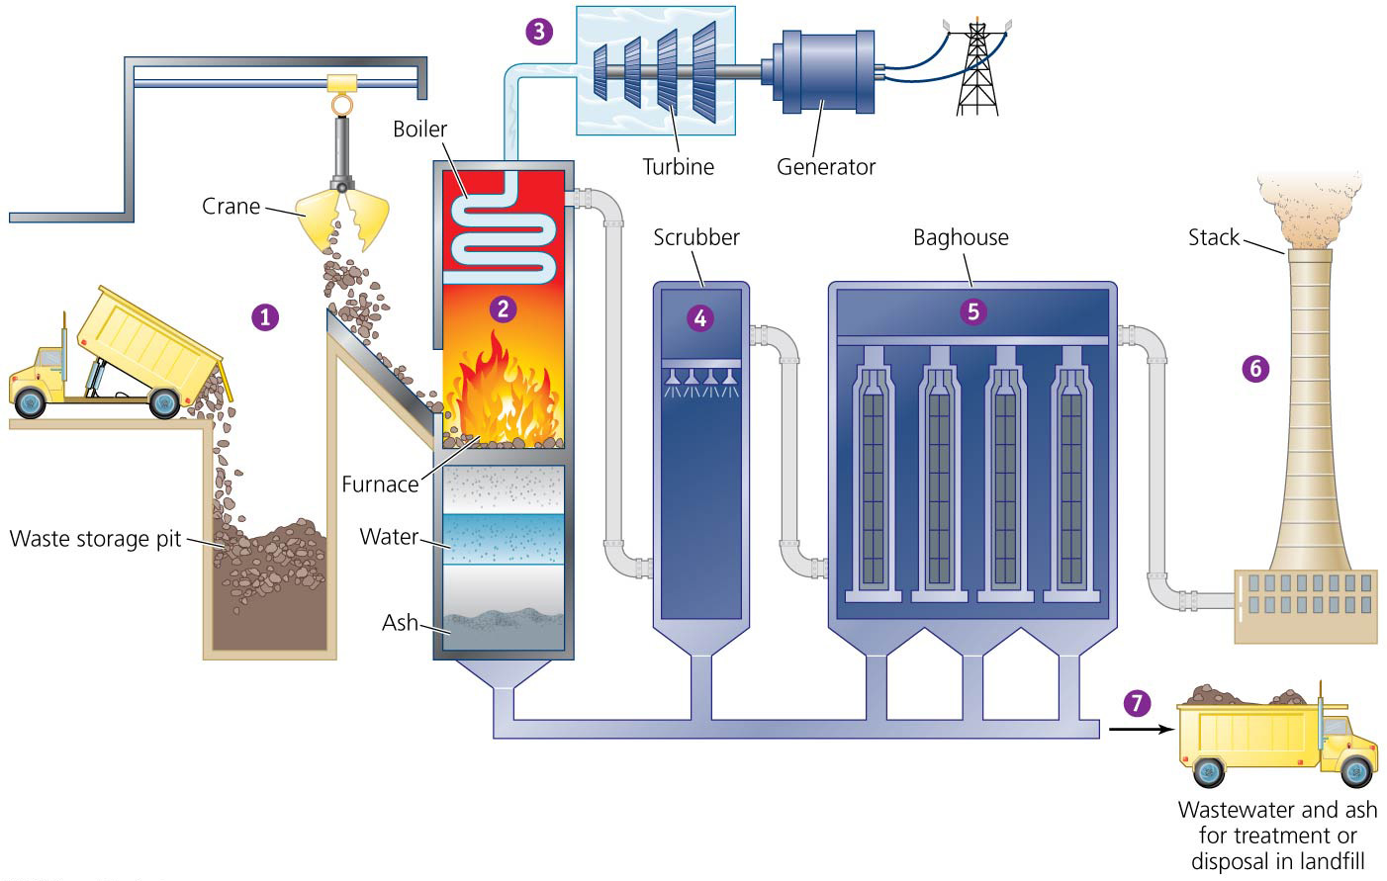

Slide 31
We gain energy from incineration
Incineration was done initially just to reduce the volume of waste, but it can generate electricity as well
Waste-to-energy (WTE) facilities = use the heat produced by waste combustion to create electricity
Over 115 facilities are in use across the United States
They process nearly 100,000 tons of waste per day
But they take many years to become profitable
Companies contract with communities to guarantee a minimum amount of garbage
Long-term commitments interfere with the communities’ efforts to reduce and recycle waste

Slide 32
Landfills can produce gas for energy
Bacteria decompose waste in a landfill’s oxygen-deficient environment
Landfill gas = a mix of gases that consists of 50% methane
Can be collected, processed, and used like natural gas
At Fresh Kills, the city sells the gas for $12 million/year and provides energy for 22,000 homes
When not used commercially, landfill gas is burned off to reduce odors and greenhouse emissions

Slide 33
Reducing waste is our best option
Source reduction = preventing waste in the first place
Avoids costs of disposal and recycling
Helps conserve resources
Minimizes pollution
Can save consumers and businesses money

Slide 34
Reducing waste is our best option
Much of the waste stream consists of materials used to package goods
If consumers choose items with minimal or recyclable packaging, producers will be encourage to reduce packaging waste
Many are already reducing the size or weight of goods and materials

Slide 35
Reducing waste is our best option
Some government address a major source of litter and waste: plastic grocery bags
Grocery bags can take centuries to decompose
They choke and entangle wildlife and cause litter
100 billion of them are discarded each year in the United States

Slide 36
Reducing waste is our best option
Many governments have banned nonbiodegradable bags
San Francisco’s ban save 14,000 bags every day
Ireland’s tax on bags reduces their use by 90%
Companies maximize sales by producing short-lived goods that need frequent replacement
Increasing the longevity of goods also reduces waste

Slide 37
Reuse is a major strategy to reduce waste
To reduce waste generation
Reuse items
Replace disposable goods with durable ones
Donate items to resale centers (Goodwill and the Salvation Army)
Rent or borrow items instead of buying them
Bring your own cup to coffee shops
Buy rechargeable batteries
Make double-sided copies
Use cloth napkins instead of paper ones

Slide 38
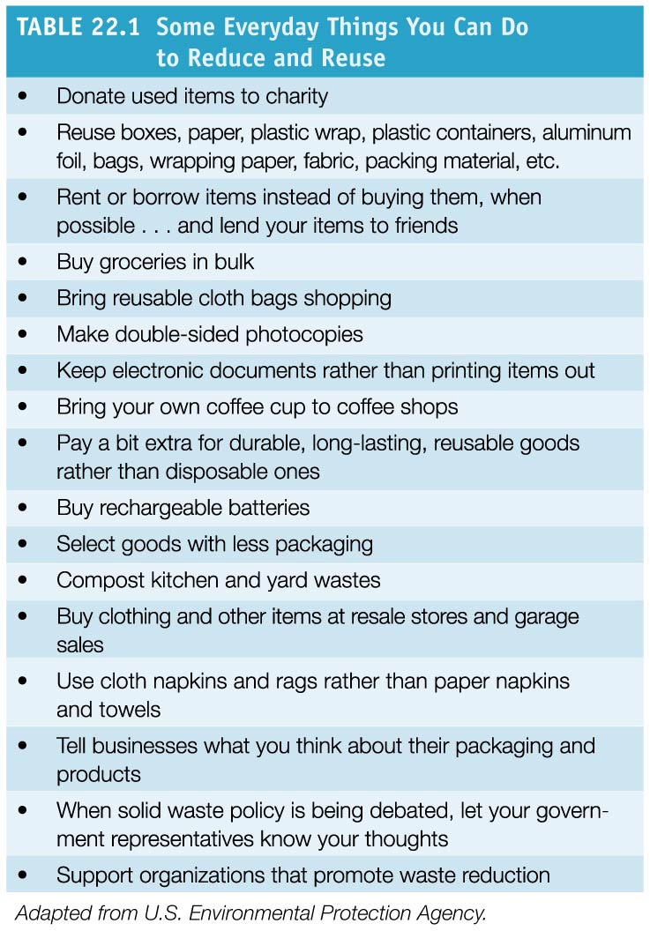

Slide 39
Composting recovers organic waste
Composting = the conversion of organic waste into mulch or humus through natural decomposition
It can be used to enrich soil
The composting process:
Waste is placed into composting piles, underground pits, or specially constructed containers
Heat from microbial action builds up and decomposition proceeds
Earthworms, bacteria, and other organisms convert organic waste into high-quality compost

Slide 40
Composting recovers organic waste
These programs divert yard waste from the waste stream to central composting facilities
The resulting mulch can be used for gardens and landscaping
Nearly half of U.S. states now ban yard wastes from the municipal waste stream
Accelerating the move to composting

Slide 41
Composting recovers organic waste
Some municipal programs also accept food scraps
Municipal composting reduces landfill waste
Enriches soil and encourages soil biodiversity
Makes healthier plants and more pleasing gardens
Reduces the need for chemical fertilizers

Slide 42
Recycling consists of three steps
Recycling = collecting materials that can be broken down and reprocessed to manufacture new items
Recycling diverted 65 million tons of materials away from U.S. incinerators and landfills in 2010

Slide 43
Recycling consists of three steps
The recycling loop consists of three basic steps
Collection and processing of recyclable materials through curbside recycling or designated locations
Some communities have central dropoff locations for recyclables
Others collect recyclables from homes (curbside)
Materials recovery facilities (MRFs) = workers and machines sort, clean, shred, and prepare items

Slide 44
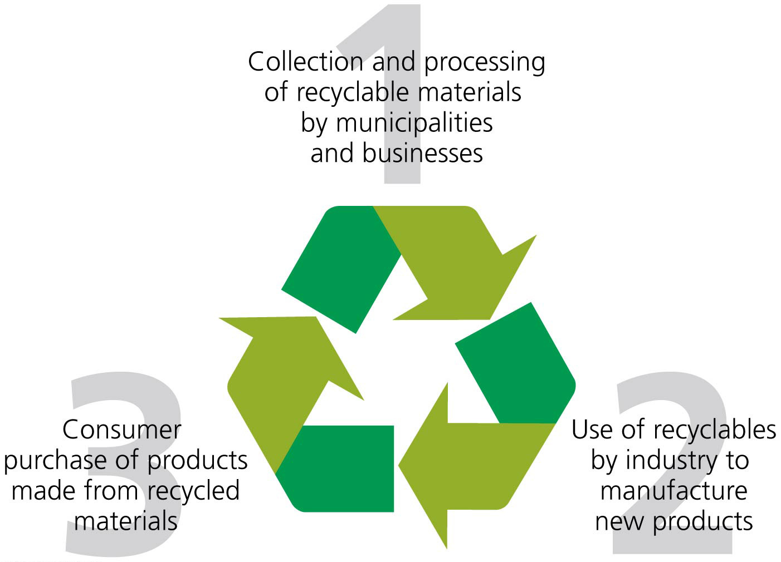

Slide 45
Recycling consists of three steps
Using recyclables to produce new goods
Many products use recycled materials
Paper, glass, and metal containers can be made from recycled material
Benches and walkways in parks are being made from recycled plastic
Consumers buying goods made from recycled materials
Must occur if recycling is to function
Buying goods made from recycled materials provides economic incentive for recycling and for the production of more recycled content products

Slide 46
Recycling has grown rapidly
There are now 9000 curbside programs spanning all 50 states and serving half of all Americans
This has happened in the last 25 years
U.S. recycling rates rose from 6.4% in 1960 to 26% in 2010 (34.1% if composting is included)
Recycling rates vary depending on the product and state

Slide 47
Recycling has grown rapidly
Recycling’s growth has been propelled by:
Businesses seeing prospects for saving money
Entrepreneurs seeing opportunities for new businesses
Municipal leaders wanting to reduce waste
The satisfaction people get from recycling

Slide 48
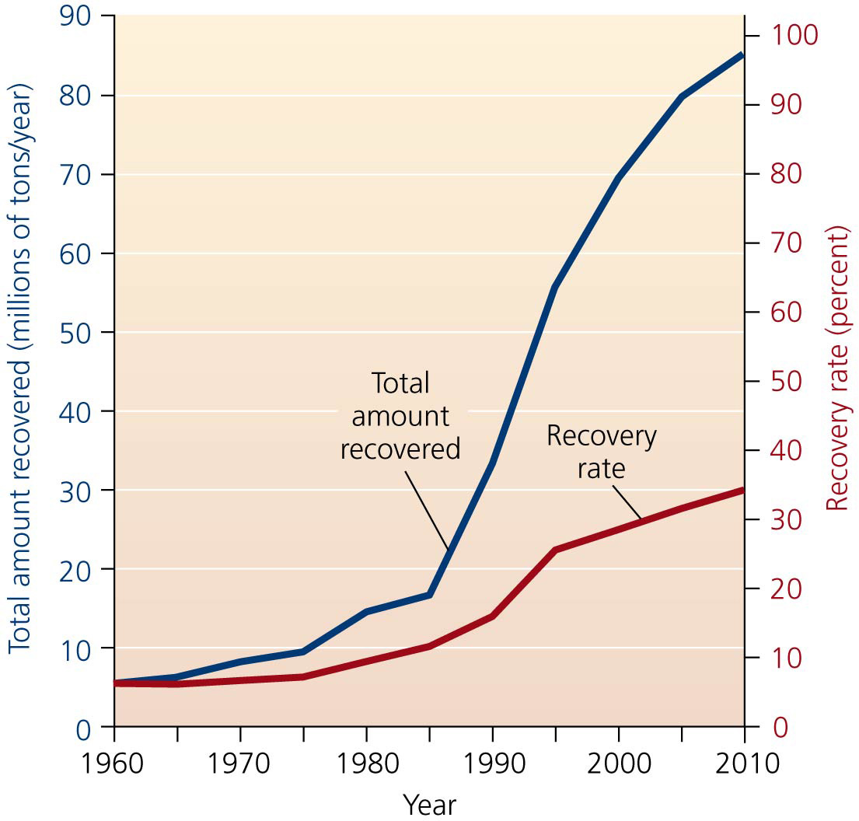

Slide 49
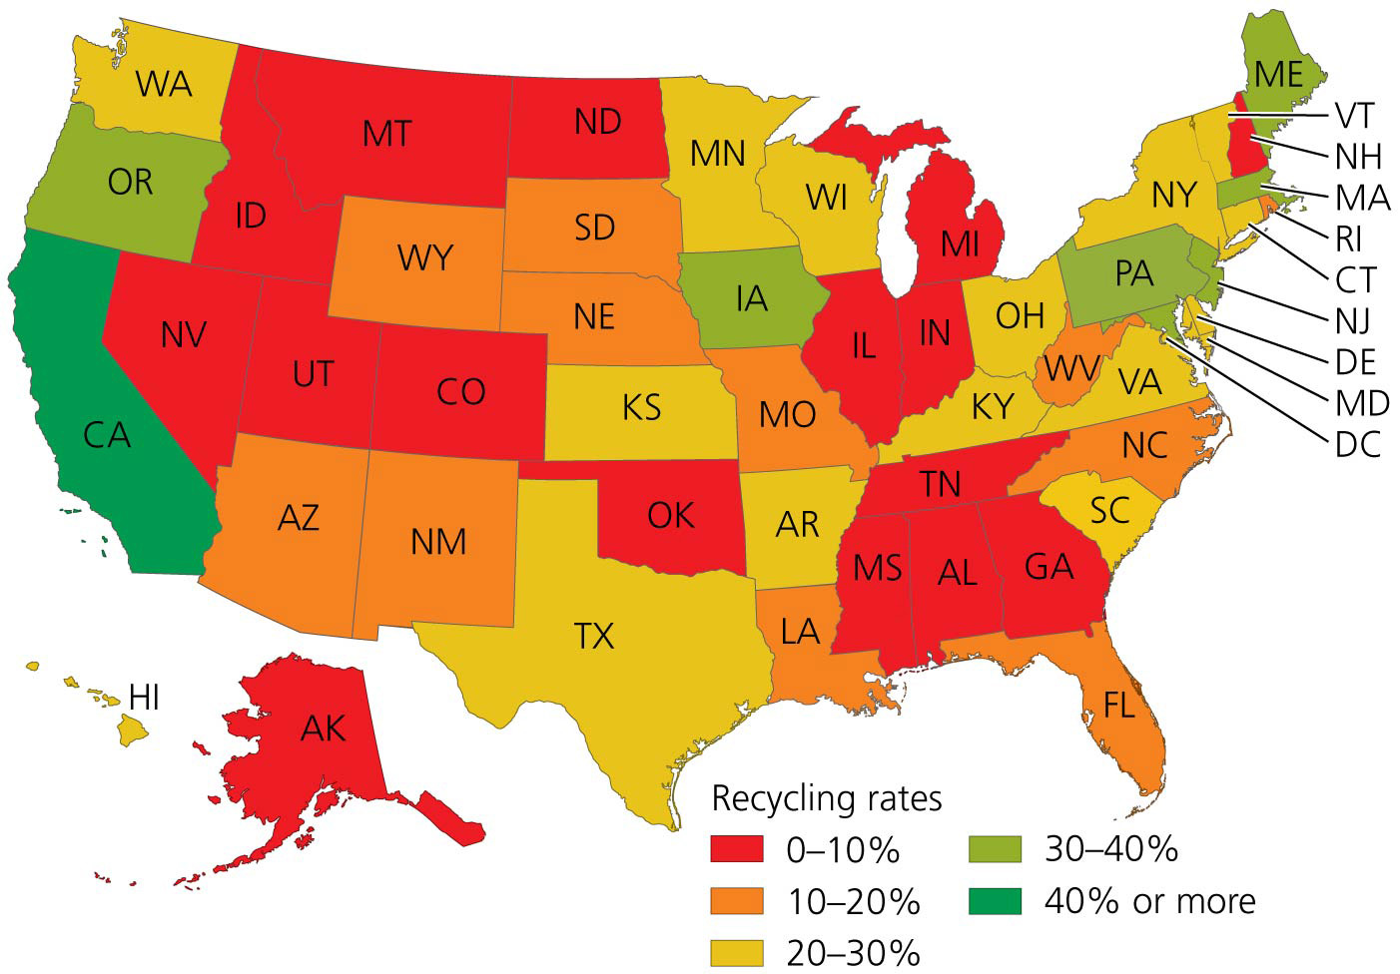

Slide 50
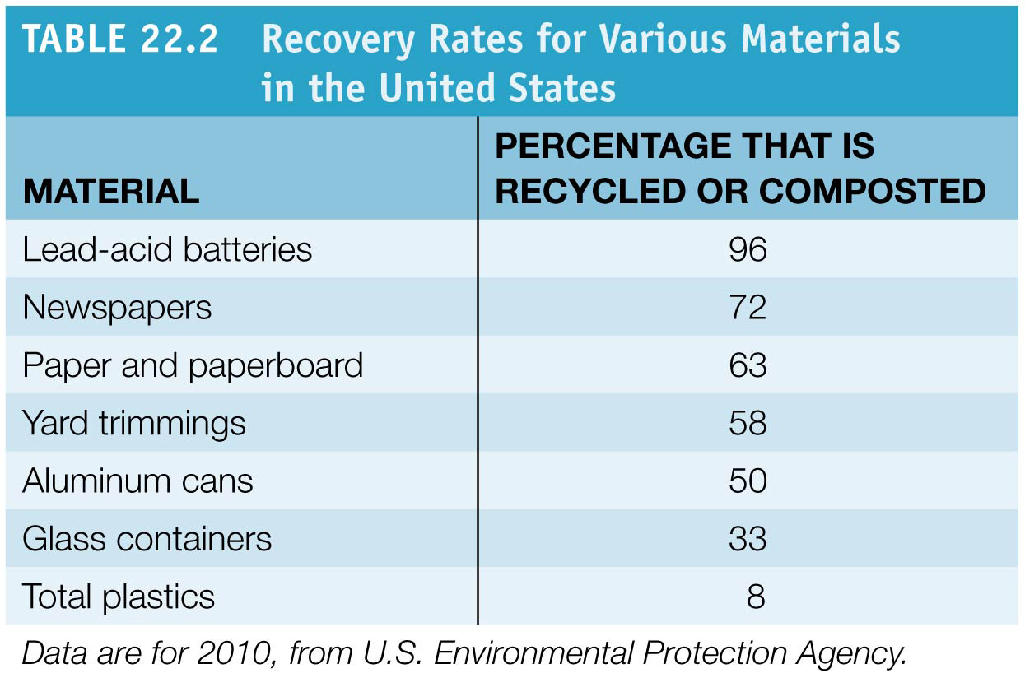

Slide 51
Recycling has grown rapidly
Recycling programs may operate at a loss
It is expensive to collect, sort, and process materials
Plus, the more material that is recycled, the lower the price paid for the collected material

Slide 52
Recycling has grown rapidly
But market forces do not take into account the health and environmental effects of not recycling
There are enormous energy and material savings
U.S. recycling saves the energy equivalent of 230 million barrels of oil and prevents the CO₂ production equal to 36 million cars
As more businesses use recycled materials, markets should continue to expand

Slide 53
We can recycle materials from landfills
Businesses are weighing the benefits of salvaging materials in landfills that can be recycled
Metals (aluminum, steel, copper)
Organic waste for compost
Harvesting methane leaking from open dumps in developing countries
These approaches work when market prices are high
But costs and regulatory requirements have made investing in landfill mining risky

Slide 54
Financial incentives help address waste
“Pay-as-you-throw” approach = homeowner pays based on the amount of trash they put out
Uses financial incentives to influence consumer behavior
The less waste a house generates, the less it is charged for trash collection

Slide 55
Financial incentives help address waste
Bottle bills = consumers pay a deposit on and receive a refund for returning bottles
They are profoundly successful in encouraging recycling
Also reduce litter from beverage containers 69–84%
But beverage industries and groceries fight them

Slide 56
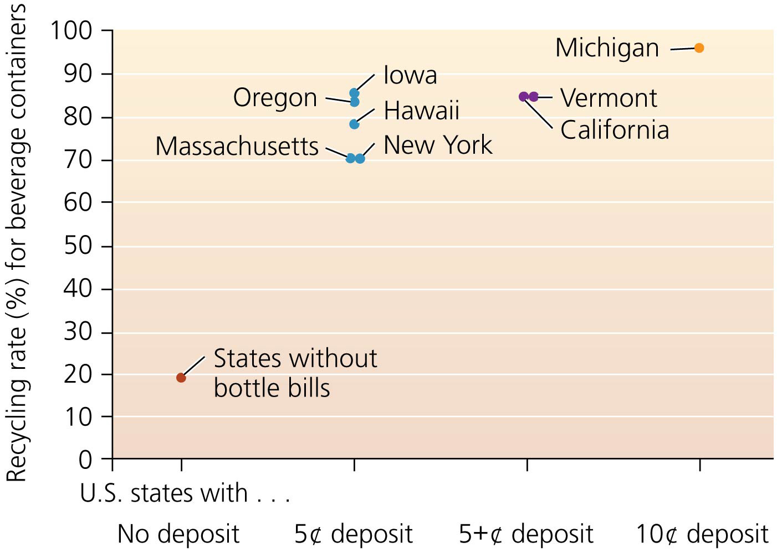

Slide 57
One Canadian city showcases reduction and recycling
Edmonton, Alberta has one of the most advanced waste management programs
Waste: Only 40% is landfilled, 15% is recycled, 45% is composted
It produces 80,000 tons/year in its composting plant
Its state-of-the-art MRF handles 30,000–40,000 tons of waste annually
The facility also collects and sells landfill gas
Local businesses re-process the recyclables
Edmonton is upgrading its facilities with the goal of 90% recovery

Slide 58
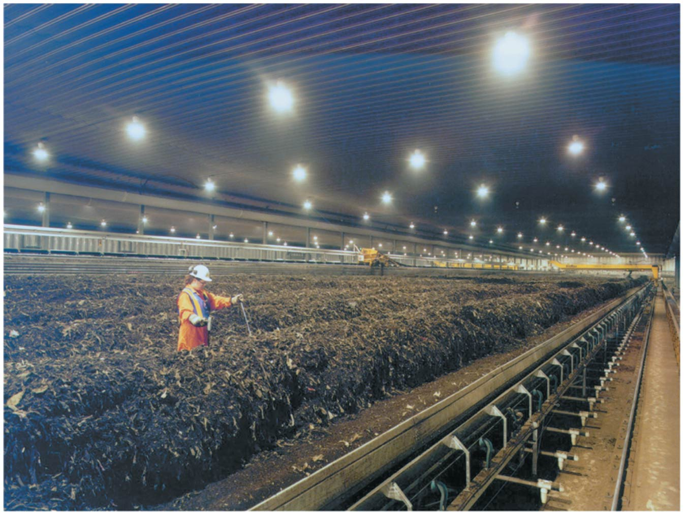

Slide 59
Industrial Solid Waste
Industrial solid waste = not municipal or hazardous waste
U.S. industries generate 7.6 billion tons of waste/year
97% is wastewater
So very roughly, 230 million tons is solid waste
Generated at various points along the process from raw material to finished goods
Most methods and strategies of waste disposal, reduction, and recycling are similar to municipal solid waste

Slide 60
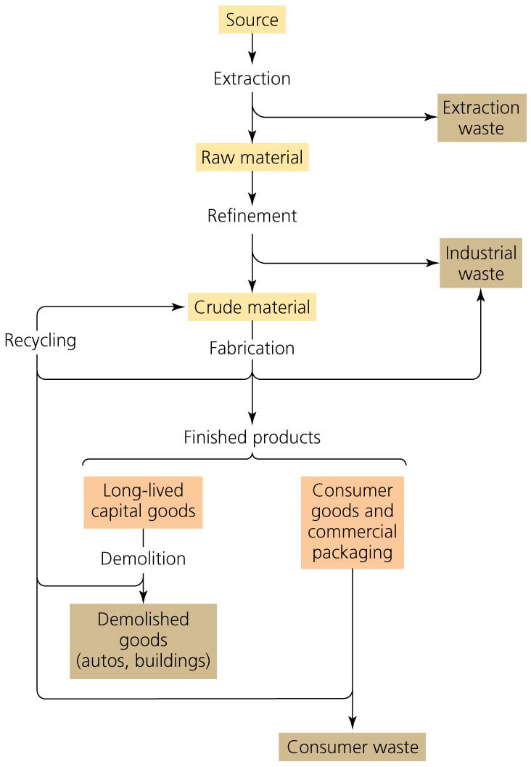

Slide 61
Regulation and economics each influence industrial waste generation
State or local governments regulate industrial solid waste
Their regulations tend to be less strict than federal regulations on municipal solid waste
Industries may not be required to have permits, or install liners or leachate collection systems, or monitor groundwater for contamination
It may be cheaper to generate waste than to avoid it
Industries are awarded for economic, not physical, efficiency
So they don’t have incentives to decrease waste

Slide 62
Industrial ecology seeks to make industry more sustainable
Industrial ecology = redesigning industrial systems to reduce resource inputs while maximizing physical and economic efficiency
Industrial systems should function like ecological systems, with little waste

Slide 63
Industrial ecology seeks to make industry more sustainable
Life cycle analysis = examines the life cycle—from raw materials, to manufacture, to use, to disposal—of a product to make the process more ecologically efficient
Waste products can be used as raw materials
Eliminates harmful products and materials
Creates durable, recyclable, or reusable products

Slide 64
Businesses are adopting industrial ecology
Businesses are saving money while reducing waste
American Airlines switched from hazardous to nonhazardous materials in its Chicago facility
It decreased its need to secure permits from the EPA
It used 50,000 reusable plastic containers to ship goods, reducing packaging waste by 90%
It recycled enough aluminum cans and white paper in 5 years to save $205,000
15 ideas from employees saved over $8 million in 1 year

Slide 65
Businesses are adopting industrial ecology
Breweries in Canada, Sweden, Japan, and Namibia use waste from the beer brewing process to fuel other processes
They make money from bread, mushrooms, pigs, gas, and fish
Produce little waste

Slide 66
Businesses are adopting industrial ecology
Interface, a carpet tile company, made a number of changes to increase sustainability. As a result it:
Cut its waste generation by 80%
Cut its fossil fuel use by 45% and water use by 70%
Saved $30 million per year, held prices steady, and raised profits by 49%

Slide 67
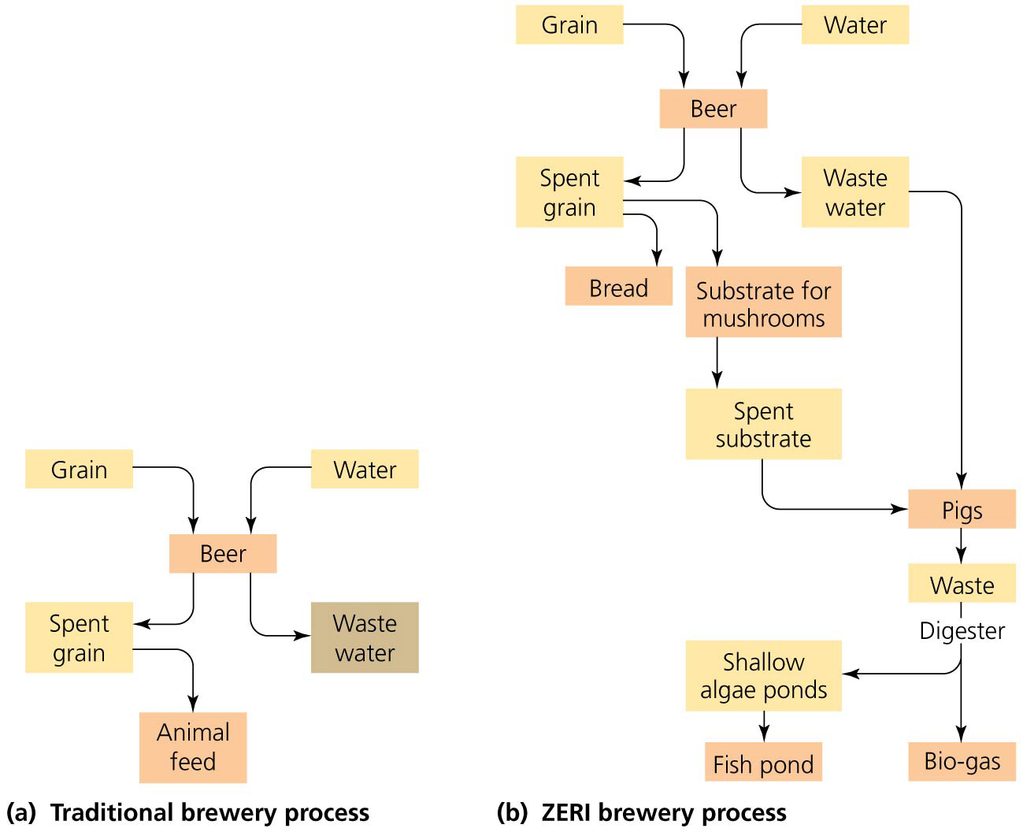

Slide 68
Hazardous Waste
Hazardous waste = a liquid, solid, or gas and is one of the following:
Ignitable = easily catches fire (natural gas, alcohol)
Corrosive = corrodes metals in storage tanks or equipment (strong acids and bases)
Reactive = chemically unstable and readily reacts with other compounds, often explosively or by producing noxious fumes
Toxic = harms human health when inhaled, ingested, or touched to human skin (pesticides, heavy metals)
Substances with any of the characteristics can harm human health and the environment

Slide 69
Hazardous wastes are diverse
Industry produces the largest amount of hazardous waste
But waste generation and disposal are highly regulated
Mining, small businesses, agriculture, utilities, and building demolition all produce hazardous wastes

Slide 70
Hazardous wastes are diverse
Households are the largest source of unregulated hazardous waste
Paint, batteries, solvents, cleaners, pesticides, etc.
1.6 million tons of household hazardous waste is produced in the United States annually
Organic compounds and heavy metals are particularly hazardous because their toxicity persists over time

Slide 71
Organic compounds and heavy metals pose hazards
Synthetic organic compounds resist bacterial, fungal, and insect activity
Plastics, tires, pesticides, solvents, wood preservatives
Their resistance to decay makes them persistent pollutants
They are toxic because they are readily absorbed through the skin
They can act as mutagens, carcinogens, teratogens, and endocrine disruptors

Slide 72
Organic compounds and heavy metals pose hazards
Heavy metals are used widely in industry for wiring, electronics, metal plating and fabrication, pigments, and dyes
Lead, chromium, mercury, arsenic, cadmium, tin, and copper
They enter the environment when
Batteries and electronics are disposed of improperly
Lead from fishing weights and ammunition accumulates in lakes and rivers
Heavy metals that are fat soluble and break down slowly can bioaccumulate and biomagnify

Slide 73
E-waste is growing
Electronic waste (“e-waste”) = waste involving electronic devices
Computers, printers, cell phones, TVs, MP3 players
2% of the U.S. solid waste stream
Americans discard over 300 million devices/year
67% are still in working order
One-quarter of them are now recycled
They are put in landfills, but should be treated as hazardous waste
They contain heavy metals and toxic flame retardants
Recycling keeps these out of landfills

Slide 74
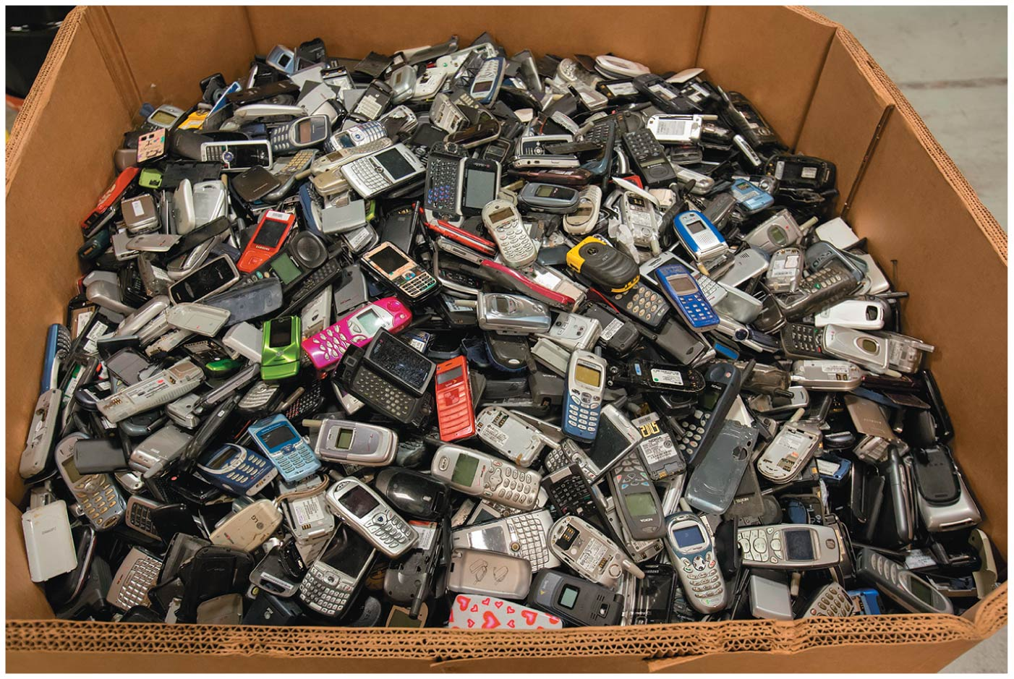

Slide 75
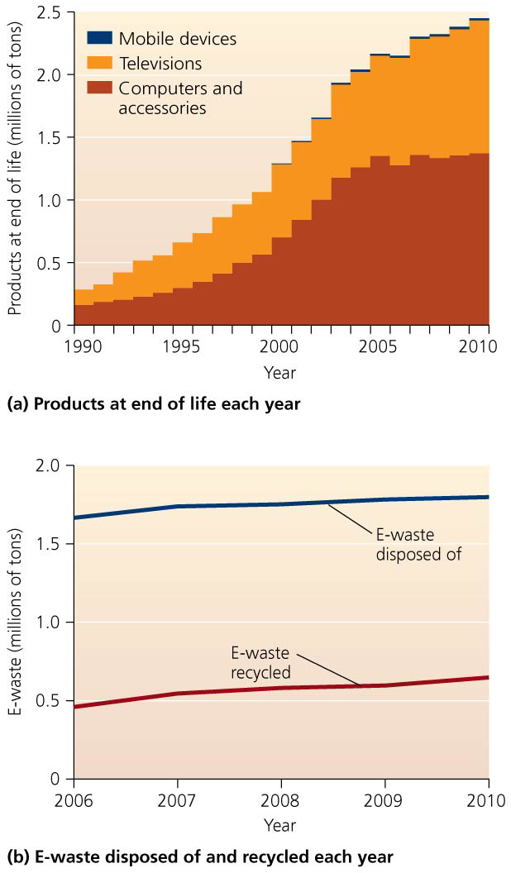

Slide 76
E-waste is growing
Recycling e-waste requires dismantling the devices
Parts and materials are refurbished and reused in new products
There are concerns about health risks to workers who do the recycling

Slide 77
E-waste is growing
Lead-containing cathode ray tubes from old TVs and monitors are not needed so they are not being recycled
E-waste recycling also recovers rare trace metals
A typical cell phone contains $2.50 worth of precious metals
These valuable trace minerals can be recovered—the 2010 Olympic medals were made from e-waste!

Slide 78
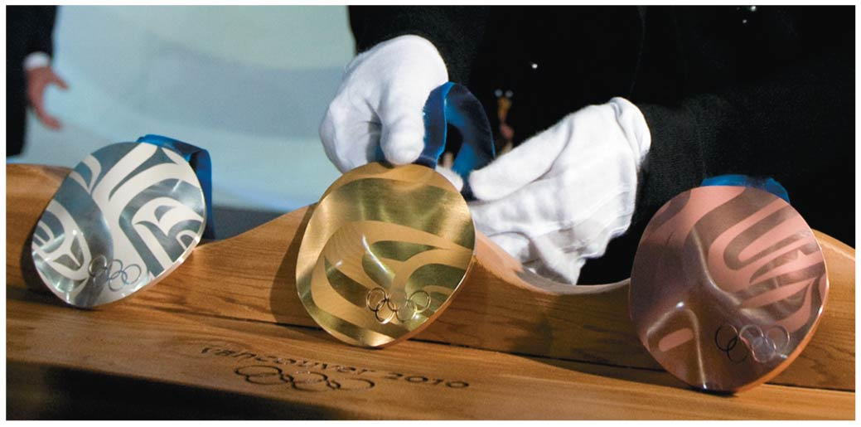

Slide 79
Several steps precede the disposal of hazardous waste
Hazardous waste used to be discarded without special treatment
People did not know it was harmful to human health
They assumed the substances would disappear or be diluted
Resurfacing of toxic chemicals in the Love Canal residential area of upstate New York convinced the public that something more needed to be done
Since the 1980s, cities have designated sites or collection days to gather household hazardous waste
It can then be treated and properly disposed of

Slide 80
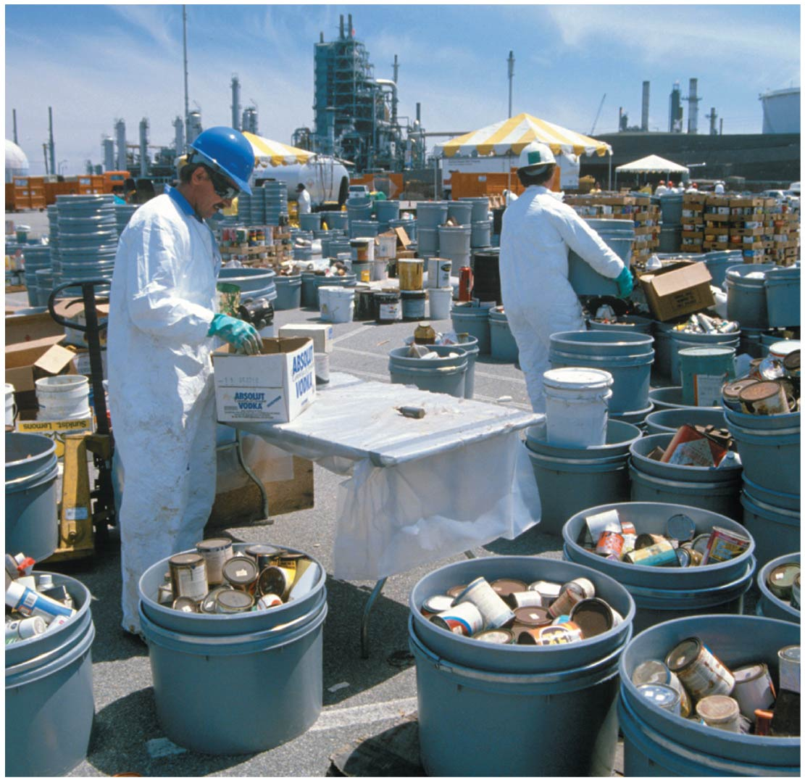

Slide 81
Several steps precede the disposal of hazardous waste
The Resource Conservation and Recovery Act (RCRA) established how states must manage hazardous waste
Large generators of hazardous waste must obtain permits
Materials must be tracked “from cradle to grave”: all the way from production until properly disposed of
Intended to prevent illegal dumping
Proper disposal is costly, so illegal dumping is done
Creating health risks and financial problems for governments forced to deal with the mess

Slide 82
Several steps precede the disposal of hazardous waste
Industrial nations find it cheaper to pay developing nations to take the waste rather than pay to have it properly treated.
Others illegally dump in developing nations
The Basel Convention, an international treaty, should prevent dumping, but it still happens
High costs also encourage companies to invest in reducing their hazardous waste
Incineration and bacterial decomposition destroy toxic substances
Special plants can pull toxic substances from the soil

Slide 83
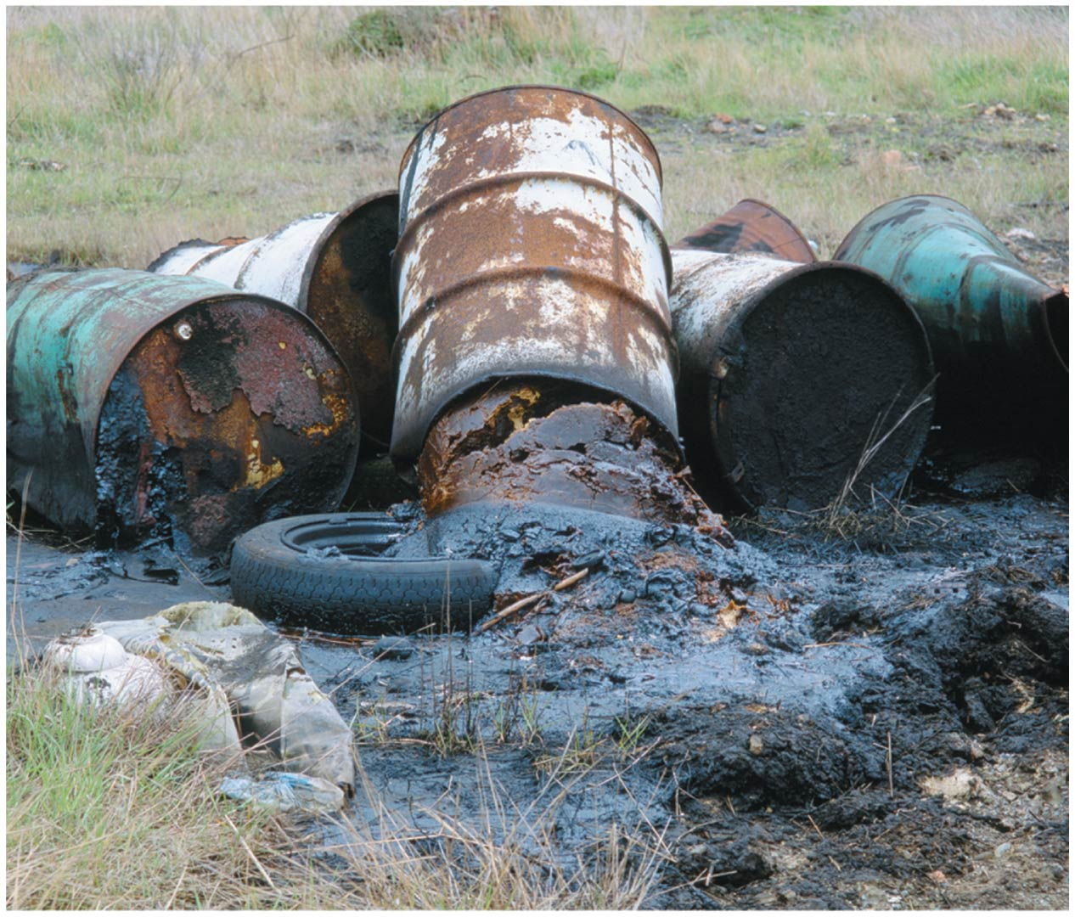

Slide 84
We use three disposal methods for hazardous waste
These do not lessen the hazards of the substances
But they help keep the substance isolated from people, wildlife, and ecosystems
Landfills must have several impervious liners and leachate removal systems
Design and construction standards are stricter than for ordinary sanitary landfills
Must be located far from aquifers

Slide 85
We use three disposal methods for hazardous waste
Surface impoundments = store liquid hazardous waste in shallow depressions lined with plastic and clay
The water evaporates, and the residue of solid hazardous waste is transported elsewhere
The clay layer can crack and leak waste
Rainstorms can cause overflow, contaminating nearby areas

Slide 86
We use three disposal methods for hazardous waste
Deep-well injection drills deep beneath the water table into porous rock and injects waste into it
Wells can corrode and leak wastes into soil, contaminating aquifers

Slide 87
Radioactive waste is especially hazardous
Radioactive waste is very dangerous and persistent
The United States has no designated single disposal site
Waste is accumulating around the nation
The Waste Isolation Pilot Plant (WIPP) = the first underground repository for transuranic waste from nuclear weapons development
Caverns are 655 m (2150 ft) below ground in a huge salt formation thought to be geologically stable
WIPP became operational in 1999 and is receiving thousands of shipments of waste

Slide 88
Contaminated sites are being cleaned up, slowly
Globally, thousands of former military and industrial sites are contaminated with hazardous waste
Dealing with them is difficult, time consuming, and expensive (too expensive for some countries)
The Comprehensive Environmental Response Compensation and Liability Act (CERCLA) (1980), also called Superfund, is administered by the EPA
Established a federal program to clean up U.S. sites polluted with hazardous waste
The EPA must also clean up brownfields = lands whose reuse or development is complicated by the presence of hazardous materials

Slide 89
Contaminated sites are being cleaned up, slowly
Two events spurred creation of Superfund legislation
In Love Canal, Niagara Falls, New York, in 1978–1980, families were evacuated after buried chemicals rose to the surface
Times Beach, Missouri, was evacuated after contamination with dioxin from oil sprayed on roads
Once a Superfund site is identified, EPA scientists note:
How close the site is to human habitation
If wastes are currently confined or likely to spread
If the site threatens drinking water supplies

Slide 90
Contaminated sites are being cleaned up, slowly
Harmful sites are placed on the National Priority List
They are ranked by their level of risk to human health
Cleanup goes on a site-by-site basis as funds are available
The EPA must hold public hearings to inform area residents of its findings and to receive feedback
CERCLA operates under the polluter pays principle = charge polluting parties for cleanup
For roughly 30% of sites so far, the responsible party cannot be found or held liable

Slide 91
Contaminated sites are being cleaned up, slowly
For sites without a responsible party, a trust fund was established by a federal tax on petroleum and chemical industries
Congress let the tax lapse in 2004, bankrupting the fund, and has not restored it
So taxpayers now pay all costs of cleanup
Fewer cleanups are being completed
1320 sites remain as of 2013, and only 365 have been cleaned up
The average cleanup costs $25 million and takes 12–15 years

Slide 92
Conclusion
Societies have made great strides in addressing our waste problems
Modern methods of waste management are far safer for people and gentler on the environment
Recycling and composting are growing rapidly
Our prodigious consumption has created more waste than ever before
We still face challenges from hazardous and radioactive wastes and local opposition to disposal sites
The best solution to our waste problem is to reduce generation of waste

Slide 93
QUESTION: Review
Which of the following components of waste management is the most preferred?
Minimizing the amount of waste we generate
Recovering waste materials and finding ways to recycle them
Disposing of waste safely and effectively
Any of these components works well—they are all equal in their effectiveness
Notes:
Answer: a

Slide 94
QUESTION: Review
Another name for municipal solid waste is
yard waste.
industrial waste.
hazardous waste.
trash or garbage.
Notes:
Answer: d

Slide 95
QUESTION: Review
Within a sanitary landfill, waste is
poured into deep wells.
stored in large piles and then burned.
buried in the ground or piled up in large, carefully engineered mounds.
put onto barges and shipped overseas.
Notes:
Answer: c

Slide 96
QUESTION: Review
What are some ways we can reuse items to keep them from entering the waste stream?
Donate used items to charity.
Borrow items you need, instead of buying them.
Make double-sided copies.
All of the above are ways to reduce the waste stream.
Notes:
Answer: d

Slide 97
QUESTION: Review
There are several reasons why recycling is increasing; which of the following is NOT a reason?
Municipalities want to reduce waste inputs.
The public obtains satisfaction from recycling.
It is usually profitable.
There are enormous energy and material savings.
Notes:
Answer: c

Slide 98
QUESTION: Review
By EPA definition, hazardous waste can be
ignitable.
hot.
large.
moveable.
Notes:
Answer: a

Slide 99
QUESTION: Review
Which of the following disposal method for hazardous waste involves shallow depressions lined with clay to hold liquid waste?
Sanitary landfills
Specialized landfills
Surface impoundments
Injection wells
Notes:
Answer: c

Slide 100
QUESTION: Review
Radioactive waste
is dangerous, but not persistent in the environment.
is not harmful to the environment, but is persistent.
is dangerous to human health and is persistent.
is not dangerous to human health, but is dangerous to the environment.
Notes:
Answer: c

Slide 101
QUESTION: Weighing the Issues
Should the government subsidize recycling programs, even if they operate at a loss?
Yes; it is worth it to increase recycling.
Yes, because I’d get more money from bringing in recyclable materials.
No; subsidies are never a good idea.
No; I don’t recycle anyway.
Notes:
Answer: any

Slide 102
QUESTION: Weighing the Issues
Which method would you support to reduce the waste stream?
Government mandates that force manufacturers to use less packaging
Charging the consumer more for products that use lots of packaging
Letting industries determine how much packaging they want to use
Leaving it alone; this is not a high priority for me.
Notes:
Answer: any

Slide 103
QUESTION: Interpreting Graphs and Data
The red line representing per capita generation of waste since 1990 can best be explained by
increased recycling and source reduction.
each person creating more waste.
the population shrinking.
increased incineration.
Notes:
Answer: a

Slide 104
QUESTION: Interpreting Graphs and Data
Which statement regarding this figure is false?
More waste is going to landfills.
Recycling plays a larger role than in 1985.
Combustion is still being used.
Composting is increasing.
Notes:
Answer: a

