Slide 2
This lecture will help you understand:
The major sources of renewable energy
Solar energy
Wind energy
Geothermal energy
Ocean energy
Hydrogen fuel cells

Slide 3
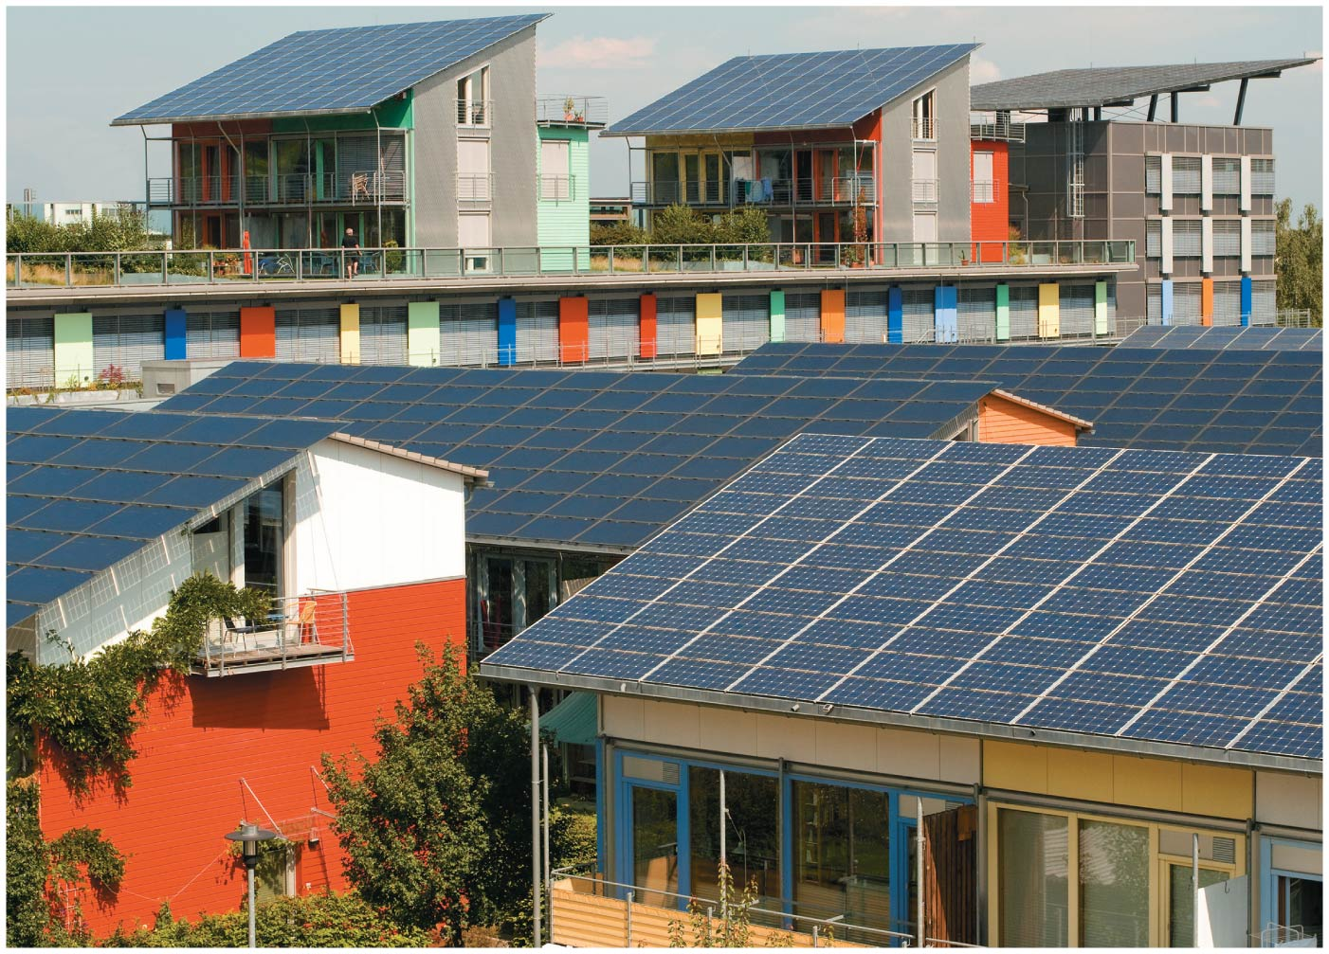

Slide 4
Central Case Study: Germany Goes Solar
Germany produces the world’s most solar power
Yet it is cool and cloudy
Its feed-in tariff system requires utilities to buy power from anyone who generates it
Homeowners and businesses have installed photovoltaic solar systems to generate energy

Slide 5
Central Case Study: Germany Goes Solar
German industries are world leaders in “green technologies”
Germany produces the most renewable energy per person of any country
German leaders see renewables as a great economic opportunity

Slide 6
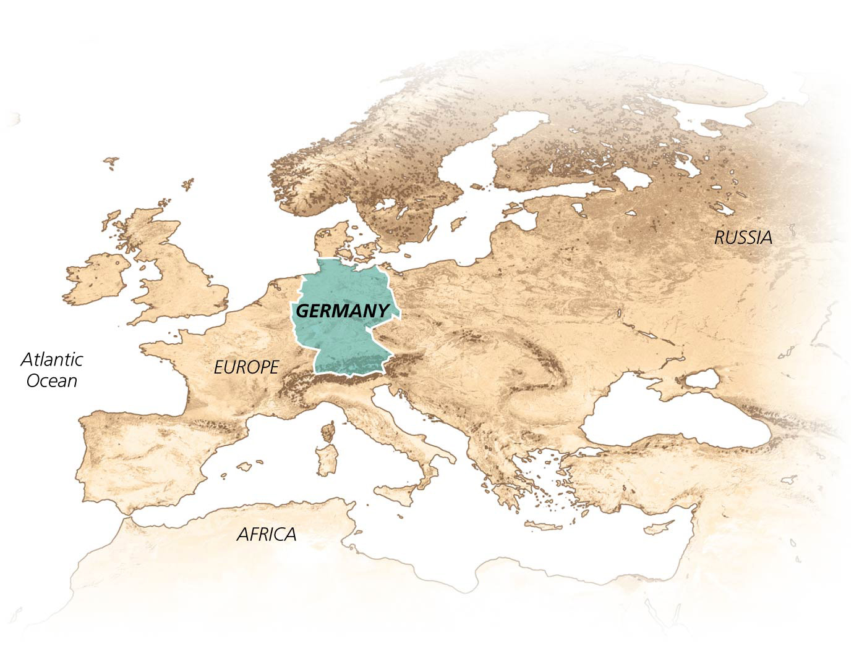

Slide 7
“New” Renewable Energy Sources
The economic, social, and environmental impacts of fossil fuels are intensifying
“New” renewables are a group of alternative energy sources that include the sun, wind, geothermal heat, and ocean water
They are referred to as “new” because:
They are just beginning to be used on a wide scale
Their technologies are still in a rapid phase of development
They will play a much larger role in our future energy use

Slide 8
New renewable sources are growing fast
New renewables provide energy for electricity, heating, fuel for vehicles
New renewables provide only 1% of energy
Only 20% of our electricity is from renewable sources
Four-fifths of that is from hydropower

Slide 9
New renewable sources are growing fast
Nations vary in the renewable sources they use
Most U.S. renewable energy comes from biomass and hydropower
Growth is faster than for conventional energy sources
Wind power is growing at 50% per year
Since these sources began at low levels, it will take time to build them up

Slide 10
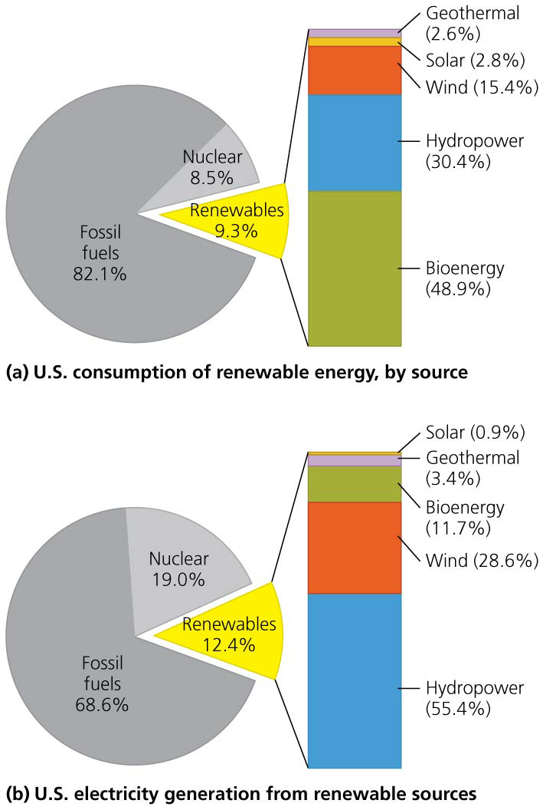

Slide 11
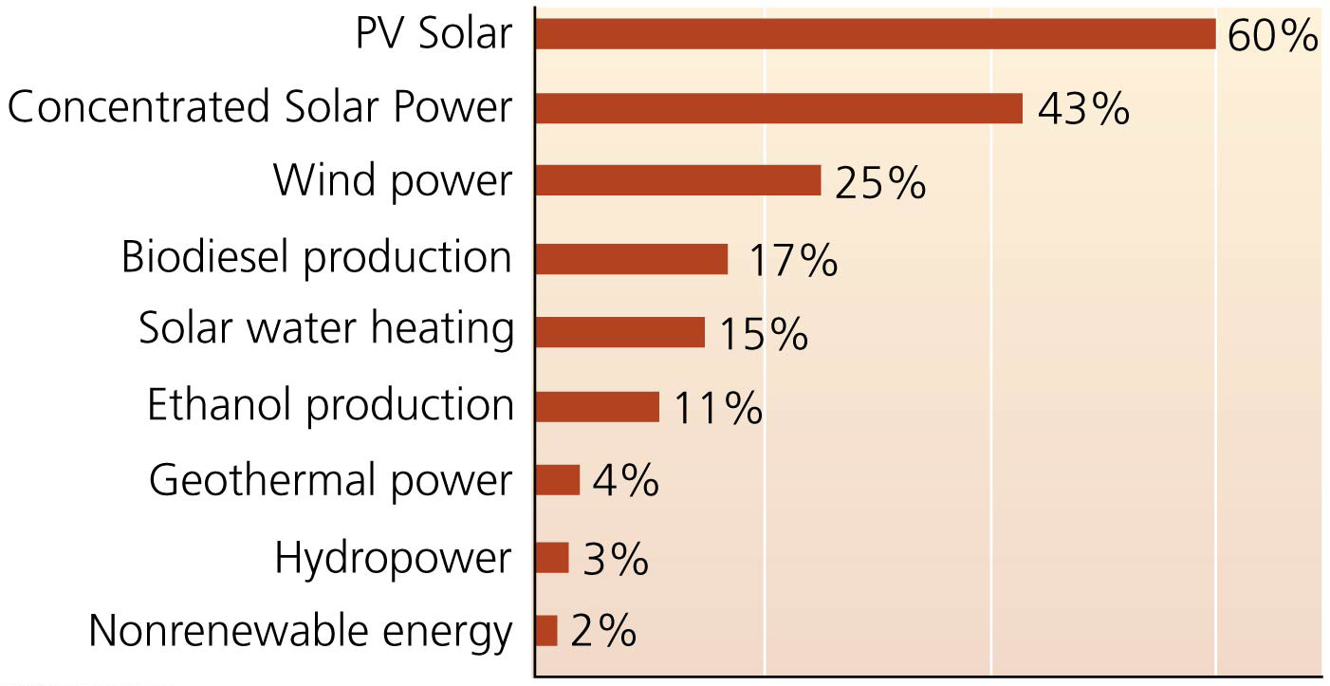

Slide 12
The new renewables offer advantages
Expansion of new renewables has been driven by:
Growing concerns over diminishing fossil fuel supplies
Environmental and health impacts of burning fossil fuels
Advances in technology making it easier and cheaper

Slide 13
The new renewables offer advantages
Benefits of the new renewables include:
Alleviating air pollution and greenhouse gas emissions
They are inexhaustible, unlike fossil fuels
They help diversify a country’s energy economy
They create jobs, income, and taxes, especially in rural areas
Green-collar jobs = design, installation, maintenance, and management of renewable energy technologies

Slide 14
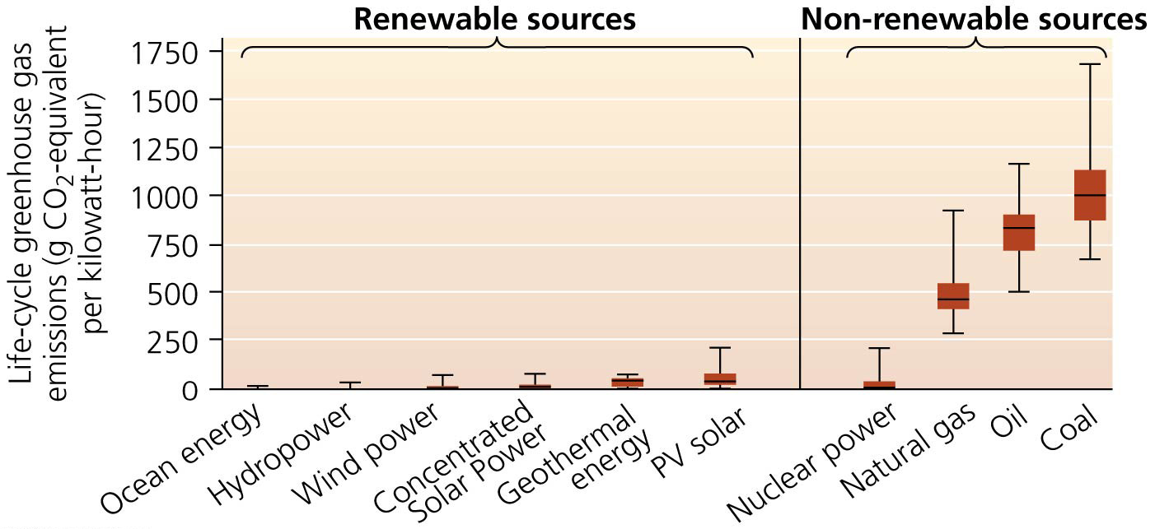

Slide 15
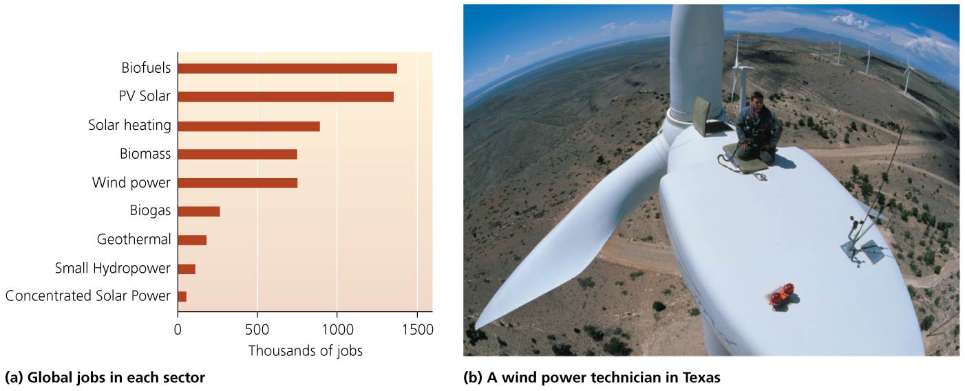

Slide 16
Policy and investment can accelerate our transition
We can not wholly convert to renewable energy overnight
The infrastructure is not in place to transfer energy from renewable sources cheaply and efficiently
Stimulus packages during the 2008–2009 economic downturn often provided funds for green energy programs
Most renewable energy is more expensive than nonrenewables
Renewable use has grown anywhere government policies supported it
Financial incentives and mandated goals have helped

Slide 17
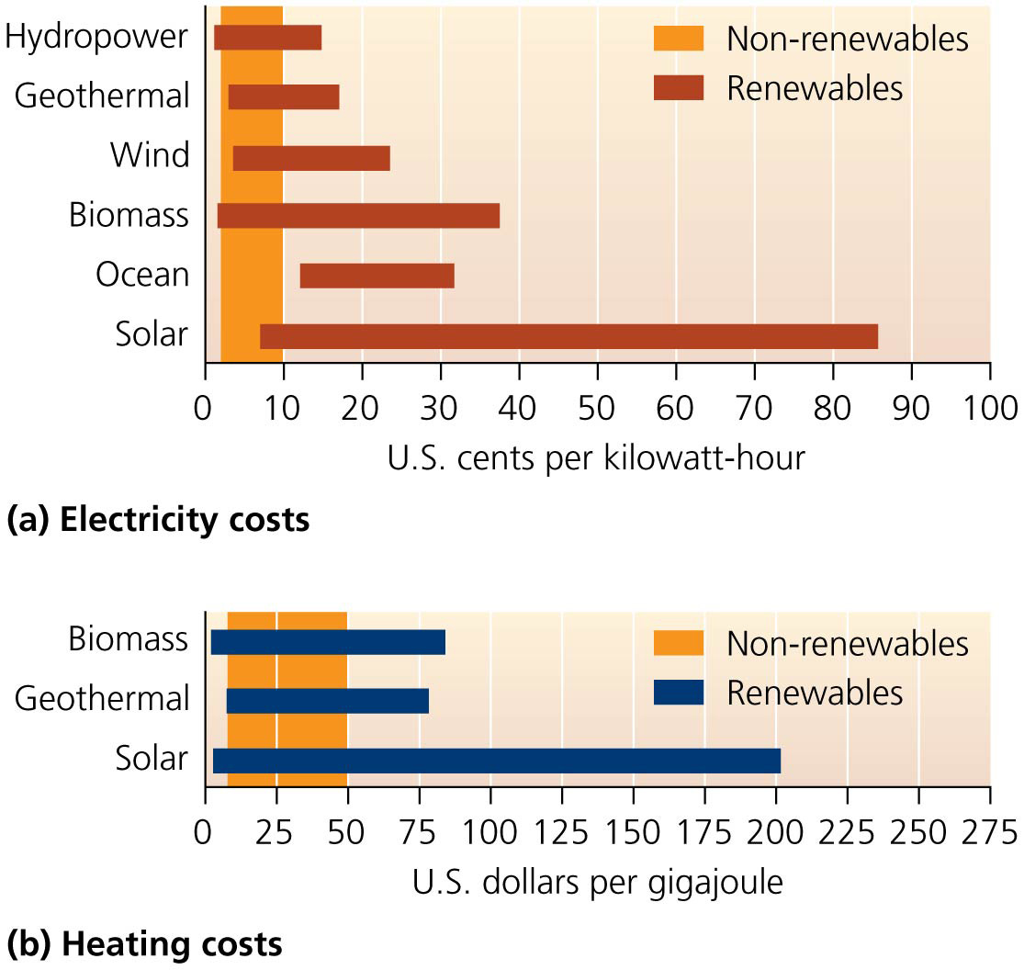

Slide 18
Policy and investment can accelerate our transition
Government support often results in private sector investment
Advances in technology have accompanied national or state policy that encourages renewable energy sources
Government policies regarding renewable sources have been erratic; therefore, so have the economics

Slide 19
Policy and investment can accelerate our transition
Subsidies have overwhelmingly favored nonrenewables
Oil and gas have received 75 times more subsidies than new renewable energy sources in total
In the earliest years of each energy source, oil, gas, and nuclear received far more in subsidy support than new renewables have

Slide 20
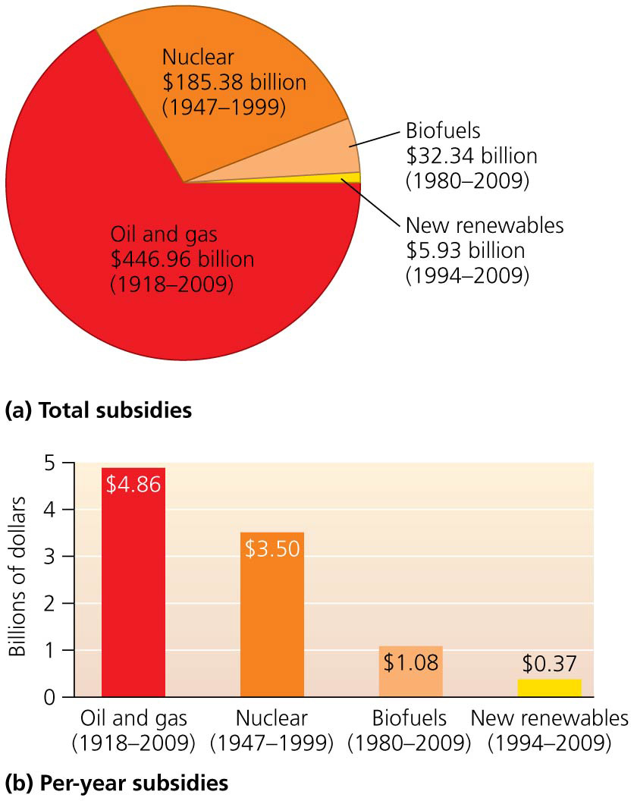

Slide 21
Solar Energy
The sun provides energy for Earth’s processes
Each square meter of Earth receives about 1 kilowatt of solar energy = energy from the sun
17 times the energy of a lightbulb

Slide 22
Solar Energy
Passive solar energy collection = buildings are designed to maximize absorption of sunlight in winter
Overhangs block sunlight to keep cool in summer
Uses thermal mass = materials that store heat such as straw, brick, or concrete
Active solar energy collection = uses technology to focus, move, or store solar energy

Slide 23
We can collect solar using passive or active methods
Flat plate solar collectors = dark-colored, heat-absorbing metal plates mounted on rooftops
Water, air, or antifreeze runs through the collectors, transferring heat throughout the building
Heated water is stored and used later
200 million households heat water with solar collectors
Only 1.5 million in the United States and mostly for pools
They can be used in isolated locations
For heating, cooling, water purification
It is not restricted to wealthy, sunny regions

Slide 24
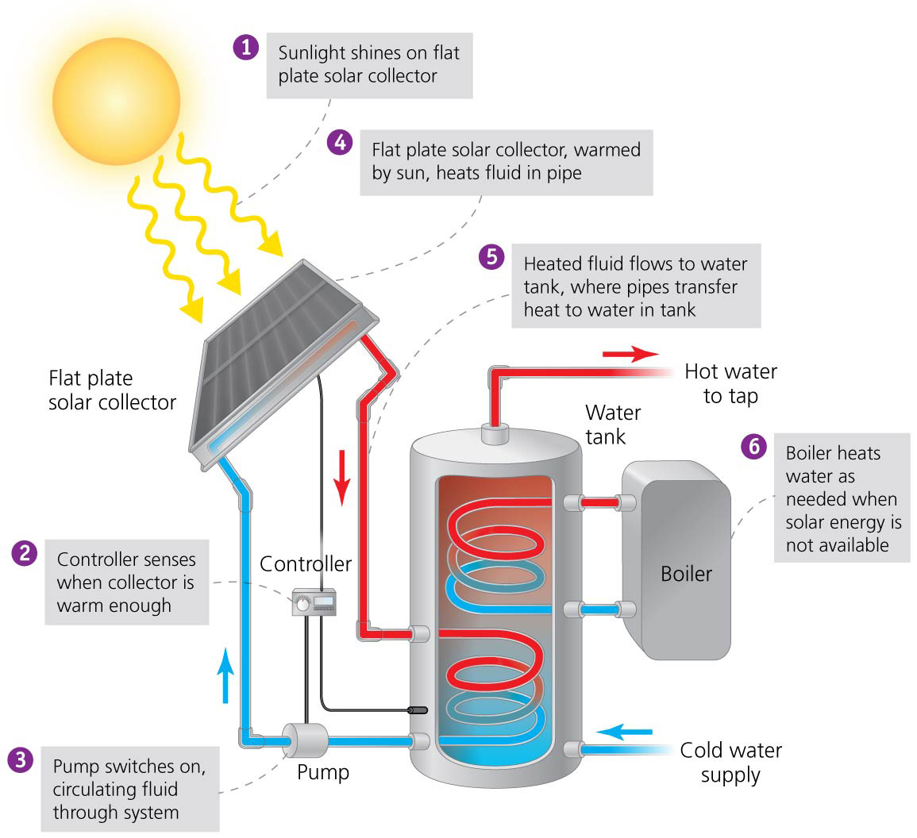

Slide 25
Concentrating solar rays magnifies energy
Focusing solar energy on a single point magnifies its strength
Solar cookers = simple, portable ovens that use reflectors to focus sunlight onto food
Concentrated solar power (CSP) = technologies that concentrate solar energy
The most widespread is the trough approach
Uses curved mirrors that focus sunlight on synthetic oil in pipes
The heated oil creates steam that drives turbines to produce electricity

Slide 26
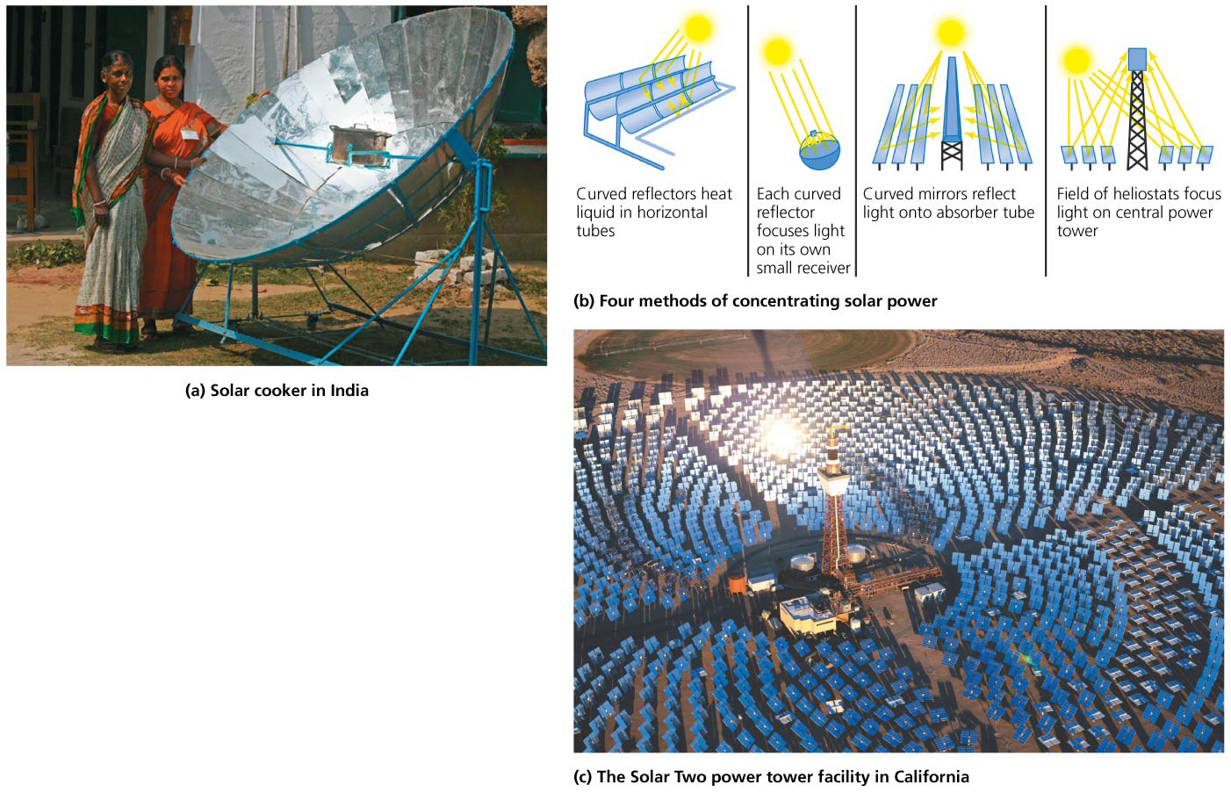

Slide 27
Concentrating solar rays magnifies energy
“Power tower”: numerous mirrors concentrate sunlight onto a receiver on top of a tall tower
Heat is transported by air or fluids (molten salts) to a steam-driven generator to create electricity
Lenses or mirrors track the sun’s movement
CSP facilities must be located in a sunny region
CSP facilities on just 260 km² (100 mi²) in Nevada could generate enough electricity for the entire U.S. economy
Some people are wary of the impacts of the large- scale development needed for most CSPs to work

Slide 28
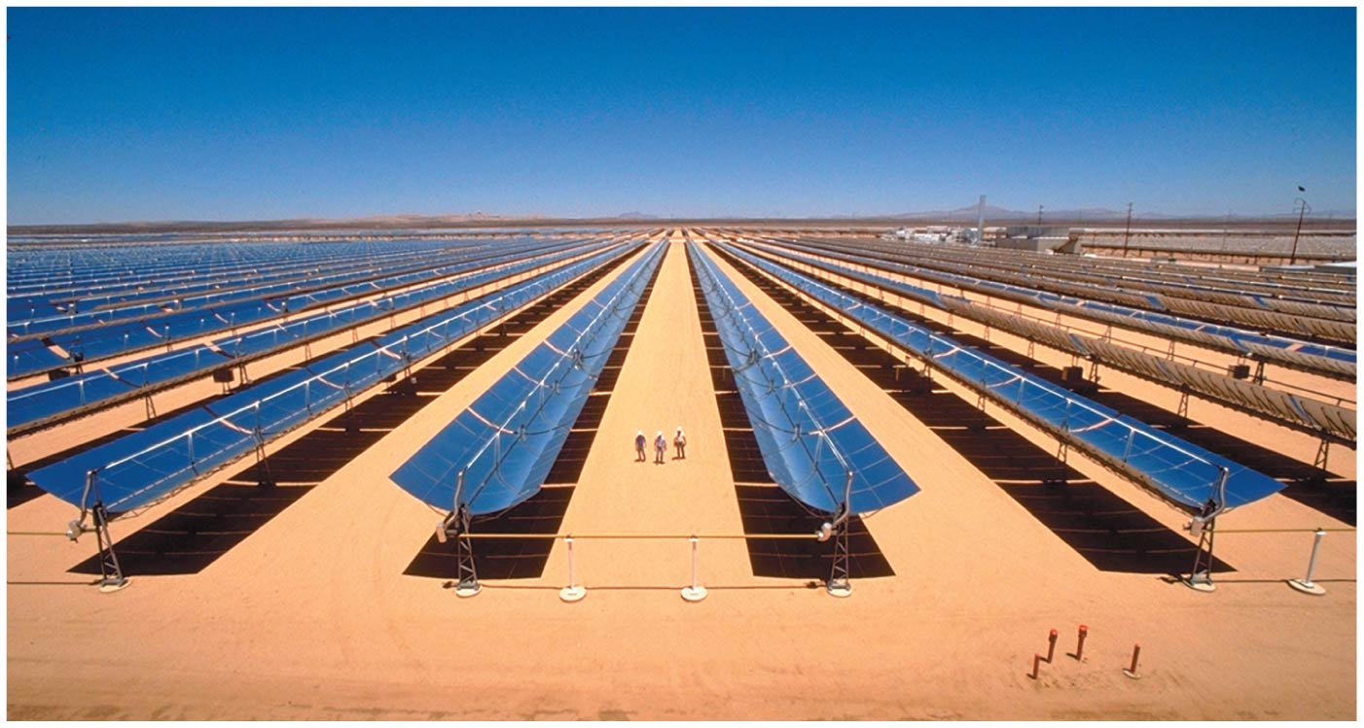

Slide 29
Photovoltaic cells generate electricity directly
Photovoltaic (PV) cells = cells that convert sunlight directly into electrical energy
The photovoltaic (photoelectric) effect occurs when light hits the PV cell and hits a plate made of silicon
Electrons are released by the silicon and are attracted to the opposite plate
Wires connecting the two plates let electrons flow, creating an electric current
Small PV cells are in watches and calculators
On roofs, PV cells are arranged in modules, which comprise panels, which can be gathered into arrays

Slide 30
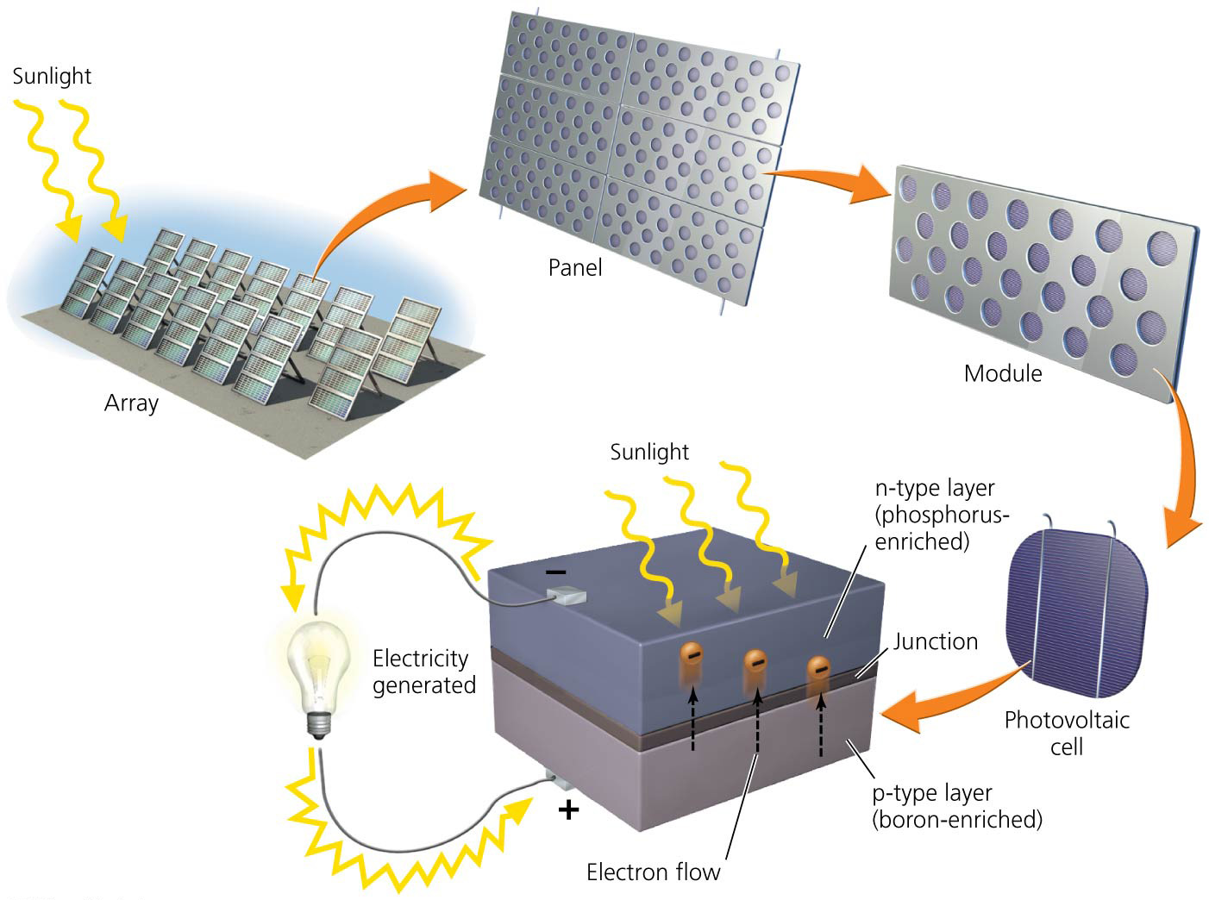

Slide 31
Photovoltaic cells generate electricity directly
Thin-film solar cells = PV materials that are compressed into thin sheets
Less efficient but cheaper
Can be incorporated into roofing shingles, roads, etc.
PV-generated energy can be stored in batteries

Slide 32
Photovoltaic cells generate electricity directly
Net metering = process in which the value of the power the consumer provides is subtracted from the monthly utility bill
Producers of PV electricity can sell their power to a utility
Feed-in tariffs pay producers more than the market price of power, so power producers turn a profit

Slide 33
Solar energy is expanding
Active solar dates to the 19th century but was pushed to the sidelines as fossil fuels dominated our economy
Funding has been erratic for research and development
Largely because of a lack of investment, solar energy contributes only a miniscule part (0.22%) of U.S. energy production and just 0.1% of electricity production
But worldwide solar energy use has increased 30% per year over the last 4 decades

Slide 34
Solar energy is expanding
Solar energy is attractive in developing nations, where hundreds of millions don’t have electricity
They are rich in sun, but poor in infrastructure

Slide 35
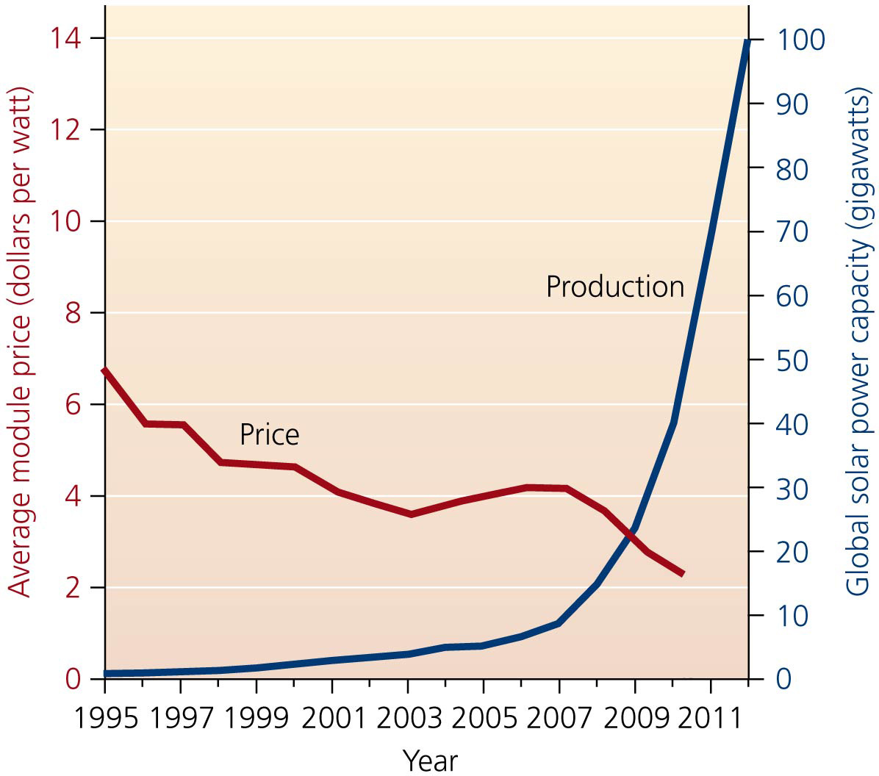

Slide 36
Solar energy is expanding
PV technology is the fastest growing power generation technology today
China leads the world in PV cell production
The United States ranks fifth and accounts for only 4%
Federal tax breaks and state incentives should help boost U.S. PV production
Chinese support of its solar industry has caused overproduction, with firms often selling at a loss and lowering prices worldwide
Solar energy use should increase, due to falling prices, improved technologies increasing efficiency, and economic incentives

Slide 37
Solar energy offers many benefits
Solar technologies use no fuels, are quiet and safe, contain no moving parts, and require little maintenance
An average unit can produce energy for 20–30 years
They allow local, decentralized control over power
Do not need to be near the power grid

Slide 38
Solar energy offers many benefits
Developing nations can use solar cookers to replace the gathering of firewood, decreasing environmental and social stress
Low cost ($2–10 each) makes them available to impoverished areas
Most PV owners can sell excess electricity to their local utility through feed-in tariffs or net metering

Slide 39
Solar energy offers many benefits
Green-collar jobs are being created
PV technology creates the most jobs per unit energy
800,000 jobs worldwide
They reduce the emission of greenhouse gases and air pollution compared to fossil fuels
Fossil fuel energy is used in manufacturing PV cells
No emissions are generated during use
A 5-kilowatt PV system in a home in Fort Worth would provide half its power needs, save $681/year, and prevent 5 tons of CO₂ emissions/year
The same system in cloudy Seattle would still prevent 3.5 tons of CO₂ emissions/year

Slide 40
Location, timing, and cost can be drawbacks
Not all regions are sunny enough to provide enough power, given current technology
However, Germany receives little sun and it is the world leader in solar power
Solar power is an intermittent source
Daily and seasonal variation can limit stand-alone systems
They need storage (e.g., batteries) and backup power
Pumped storage hydropower is sometimes used to supplement solar power production

Slide 41
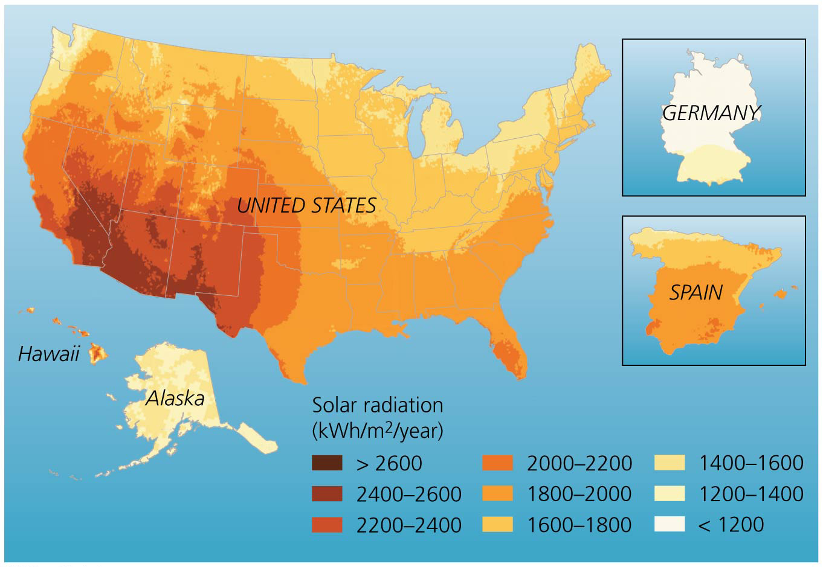

Slide 42
Location, timing, and cost can be drawbacks
Up-front costs are high
This makes solar power the most expensive way to produce electricity
It may take a homeowner 20 years to break even
Fossil fuels and nuclear energy are favored over solar
Government subsidies and not including their external costs have made them cheaper

Slide 43
Location, timing, and cost can be drawbacks
Prices are declining and technologies are improving
PV cells are showing up to 20% efficiency compared with 6% when first produced in the 1950s
Efficiencies of up to 40% have been achieved in lab research

Slide 44
Wind Power
Wind power = energy derived from movement of air
An indirect form of solar energy
Wind turbines = devices that convert wind’s kinetic energy into electric energy
Windmills have been used for 800 years to pump water and grind grain
The first wind turbine for electrical generation was built in the 1880s in Cleveland, Ohio
After the 1973 oil embargo, governments funded research and development
Moderate funding boosted technological progress

Slide 45
Wind turbines convert kinetic energy to electrical energy
Wind blowing into a turbine turns the blades of a rotor, which rotate machinery inside a compartment (called a nacelle) atop a tower
Towers average 80 m (260 ft) tall
The higher the tower, the more it minimizes turbulence and maximizes wind speed
Wind farms = turbines erected in groups of up to hundreds of turbines
Turbines yaw—they rotate in response to changes in wind direction, ensuring they always face into the wind

Slide 46
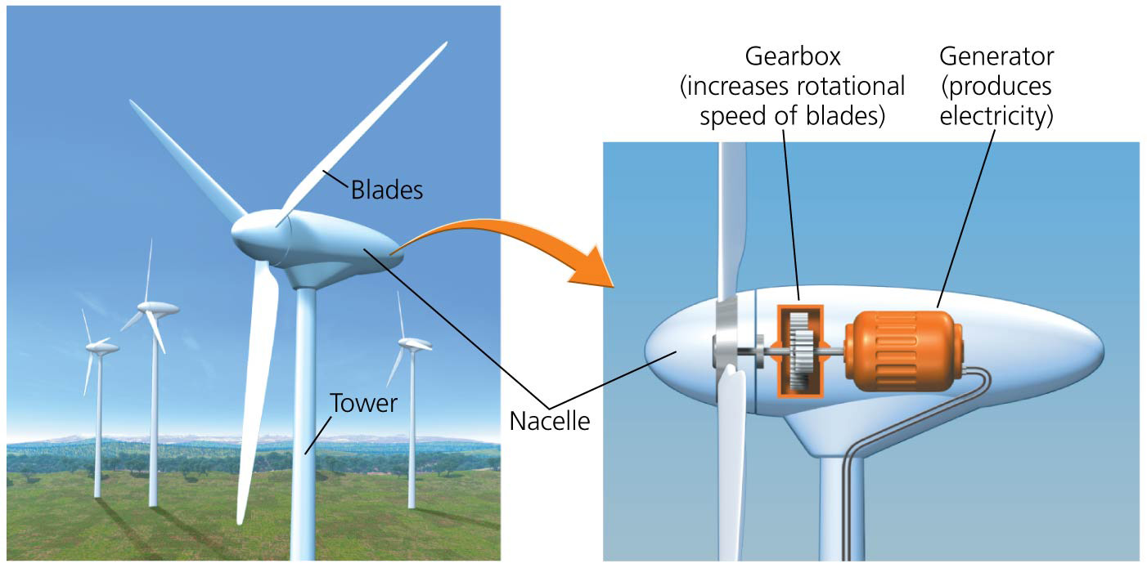

Slide 47
Wind turbines convert kinetic energy to electrical energy
Turbines are designed to harness wind efficiently
Different turbines turn in different wind conditions: some in a gentle breeze, others only in strong winds
Slight differences in wind speed yield significant differences in power output
Energy content increases as the square of its velocity—if a wind’s velocity doubles, its energy quadruples
Increased speeds cause more air molecules to pass through the turbine, increasing power by the wind velocity cubed—if wind velocity doubles, turbine power output rises eightfold

Slide 48
Wind power is growing fast
Wind power provides just a small proportion of the world’s power needs, but wind power has doubled every 3 years in recent years
Five nations produce 75% of the world’s wind power
But dozens of nations now produce wind power

Slide 49
Wind power is growing fast
Wind power growth in the United States has been erratic
No long-term plan has been set by Congress
Only a series of short term renewed tax credits
Wind power will continue to grow
Only a small portion of the resource is being tapped
Wind-generated electricity in favorable locations is almost as cheap as from fossil fuels

Slide 50
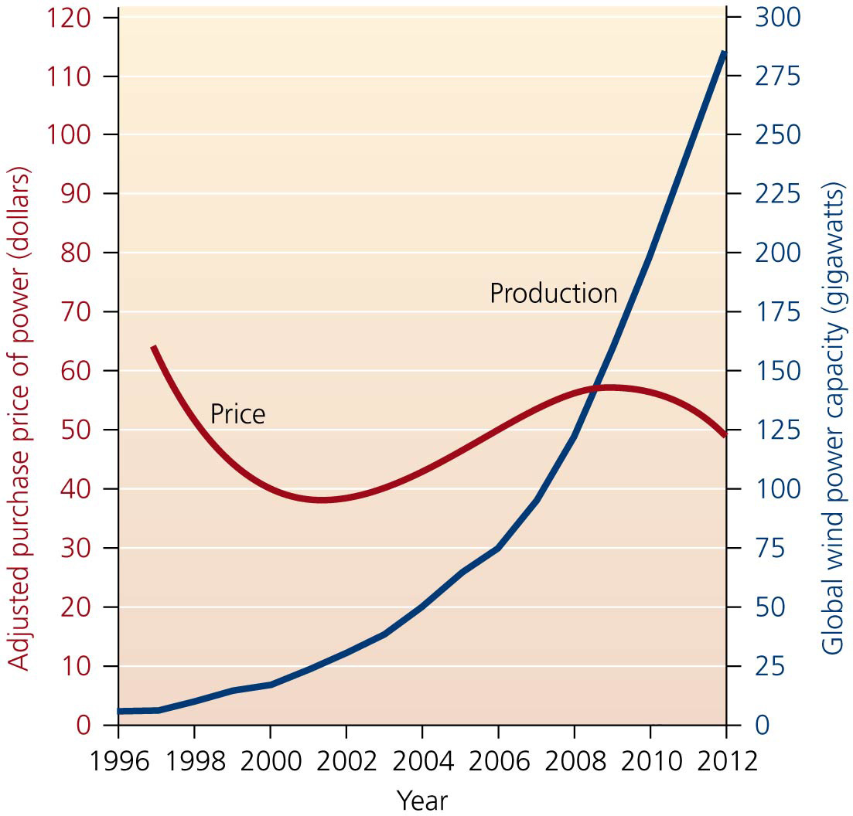

Slide 51
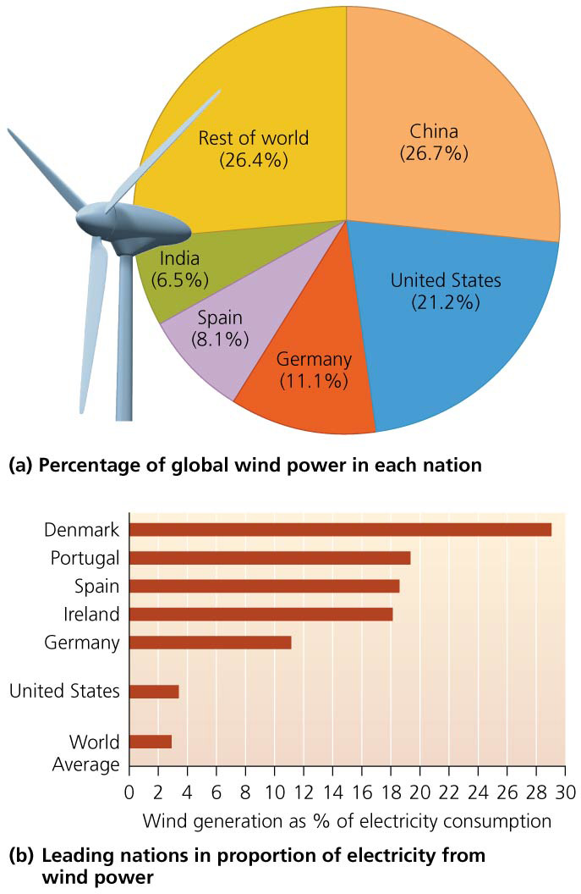

Slide 52
Offshore sites hold promise
Wind speeds are 20% greater over water than over land
Also less air turbulence over water
Costs to erect and maintain turbines in water are higher
But more power is produced, and it is more profitable

Slide 53
Offshore sites hold promise
Currently, turbines are limited to shallow water
Future towers may be on floating pads in deeper waters
Over 1800 wind turbines are operating in 65 wind farms in the waters of 10 European countries
The first U.S. offshore wind farm will have 130 turbines and be located 8 km (5 miles) off Cape Cod, Massachusetts

Slide 54
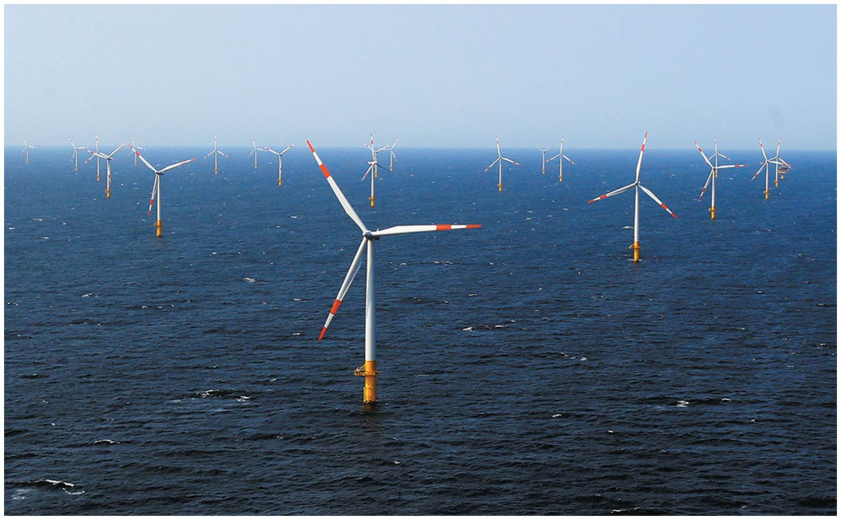

Slide 55
Wind power has many benefits
Wind produces no emissions once installed
Prevents the release of CO₂, SO₂, NO_{x}, mercury
It is more efficient than conventional power sources
EROI = 20:1 (better than most other energy sources)
Turbines use less water than conventional power plants

Slide 56
Wind power has many benefits
Wind power can be used on many scales
Local areas can become more self-sufficient
Farmers and ranchers can lease their land
Produces extra revenue while still using the land
Advancing technology is also reducing the cost of wind farm construction
Has created 85,000 U.S. jobs and 700,000 globally

Slide 57
Wind power has some downsides
We have no control over when wind will occur
Limitation on relying on it for electricity
Need to combine it with other generation technologies, or batteries or hydrogen fuel can store the energy

Slide 58
Wind power has some downsides
Wind sources are not always near population centers that need energy
Mountainous regions tend to be the best locations for wind generation
The U.S. Great Plains are also a good location
Transmission networks need to be expanded to deliver the wind-generated power to distant population centers

Slide 59
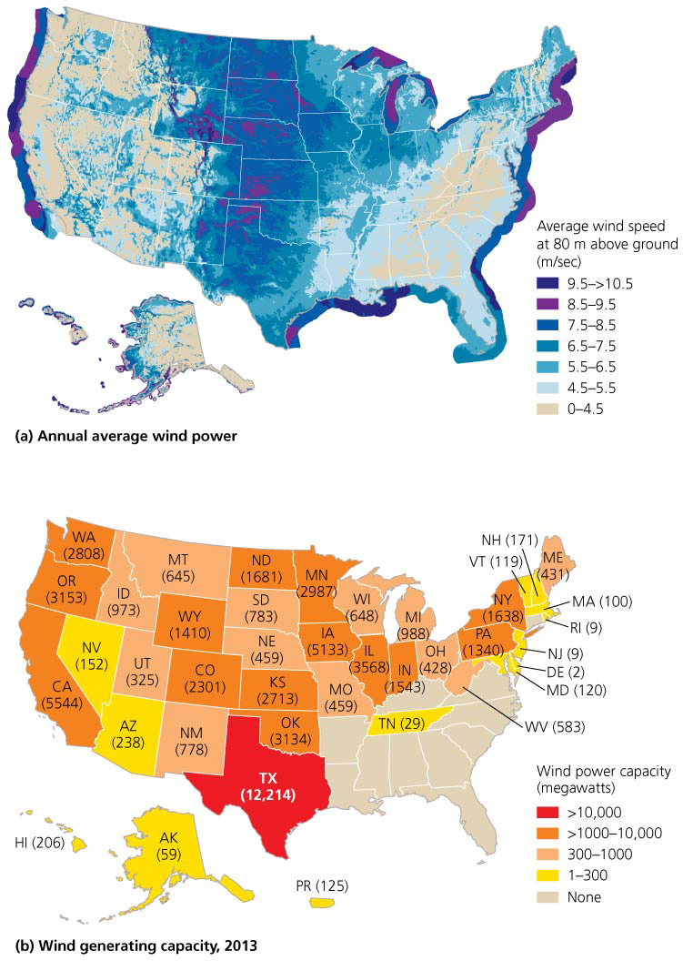

Slide 60
U.S. wind-generating capacity
15% of U.S. energy demand could be met using 16,600 mi² of land
Less than 5% of the land would be occupied by turbines and roads; the rest would still be usable
Local residents often oppose wind farms
Turbines are typically in very exposed locations and some residents object for aesthetic reasons
Not-in-my-backyard (NIMBY) syndrome
Turbines threaten birds and bats, which can be killed when they fly into rotating blades

Slide 61
Geothermal Energy
Geothermal energy = thermal energy from beneath Earth’s surface
Radioactive decay of elements under extremely high pressures deep inside the planet generates heat
Heat rises through magma, fissures, and cracks or heats groundwater, which erupts as geysers or submarine hydrothermal vents
Geothermal power plants use hot water and steam for heating homes, drying crops, and generating electricity
Globally, one-third of geothermal energy is used for electricity, the other two-thirds for direct heating

Slide 62
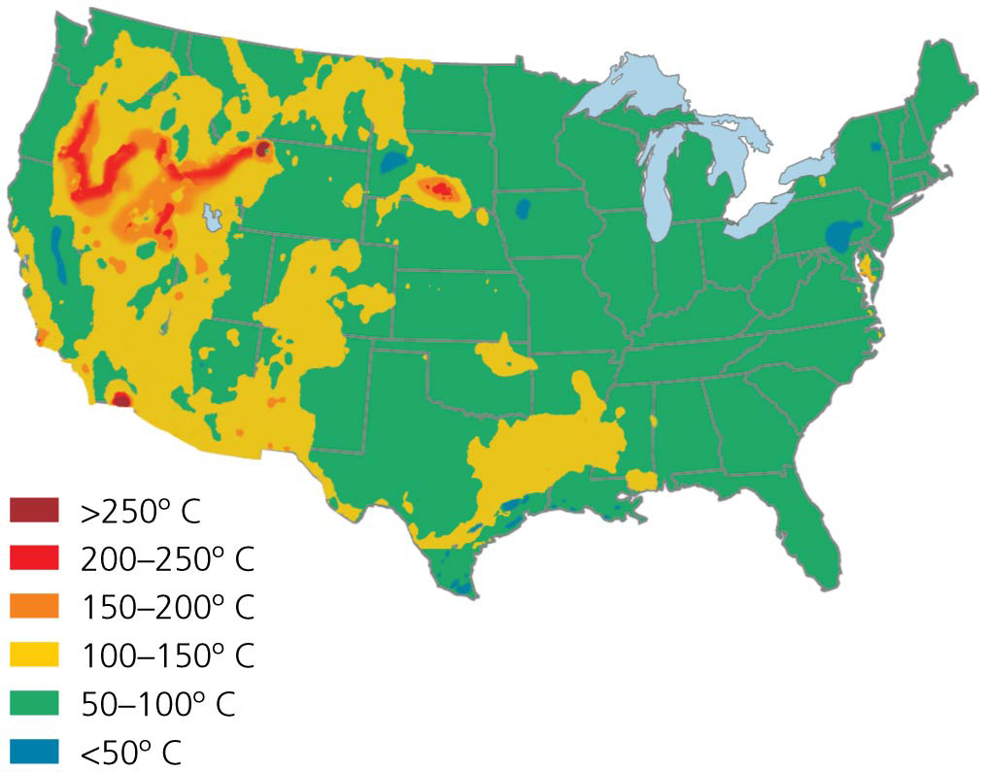

Slide 63
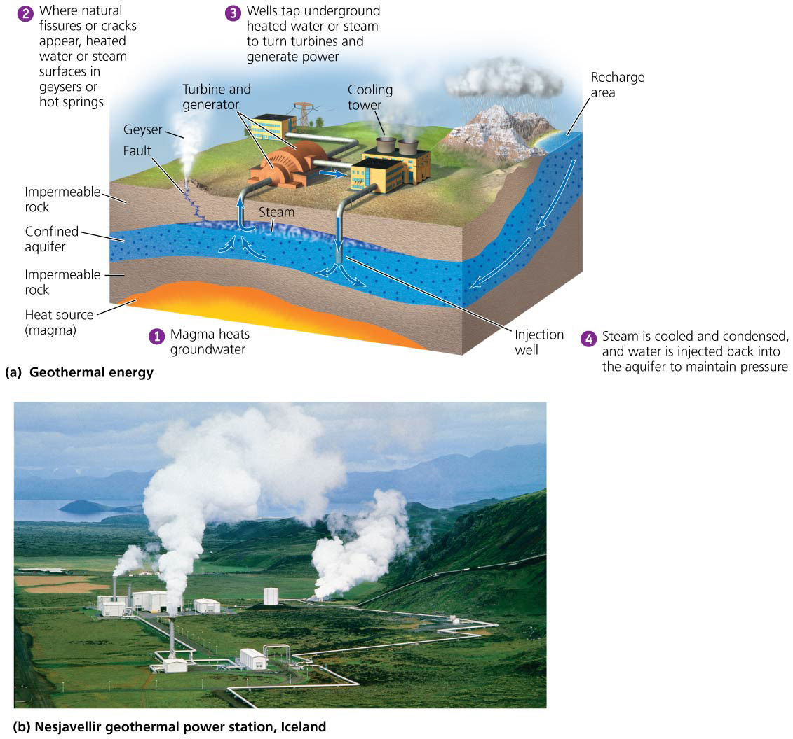

Slide 64
Geothermal power has benefits and limitations
Geothermal power reduces greenhouse gas emissions
Each megawatt of geothermal power prevents release of 7 million kg (15.5 million lb) of CO₂ each year
But it may not be sustainable if the plant withdraws water faster than it can be recharged (water or wastewater can be injected into the ground to replenish the supply)
Patterns of geothermal activity in the crust may shift, cutting off the heated water
Water of many hot springs has salts and minerals that corrode equipment and pollute the air
It is limited to areas where the energy can be trapped

Slide 65
Enhanced geothermal systems might widen our reach
Areas that lack heated water may still be used through enhanced geothermal systems (EGS) = deep holes are drilled into dry rock and the rock is fractured
Cold water is pumped in and is heated by natural thermal energy
It is withdrawn to generate electricity
It could be used in many locations
Heat resources below the United States could power the Earth’s demands for millennia
But EGS can trigger minor earthquakes
Our use of geothermal power will stay localized

Slide 66
Heat pumps make use of temperature differences above and below ground
Soil temperatures vary from season to season less than air temperatures
Soil absorbs and releases heat more slowly
Warmth and cold do not penetrate far belowground
Ground-source heat pumps (GSHPs) = geothermal pumps that heat buildings in the winter by transferring heat from the ground to the building
In summer, heat is transferred from the building to the ground
Because heat is only being moved, not generated, GSHPs are very efficient

Slide 67
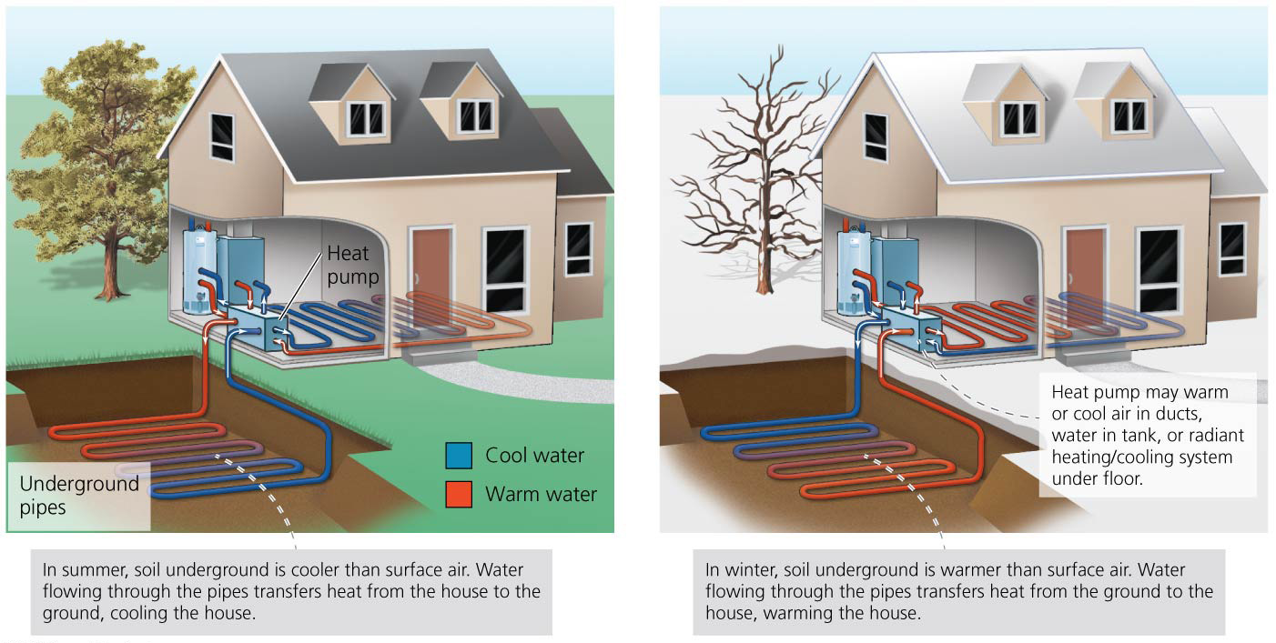

Slide 68
We can harness energy from tides, waves, and currents
Kinetic energy from the natural motion of ocean water can generate electrical power
Wave energy = the motion of waves is harnessed and converted from mechanical energy into electricity
Many designs exist, but few have been adequately tested
Some designs are for offshore facilities and involve floating devices that move up and down the waves
Wave energy is greater at deep ocean sites
But transmitting electricity to shore is very expensive

Slide 69
We can harness energy from tides, waves, and currents
Some designs work along coastlines
One funnels waves into elevated reservoirs
Another uses waves to push air into and out of chambers, turning turbines
Kinetic energy from the natural motion of ocean water can generate electrical power
The rising and falling of ocean tides twice each day move large amounts of water
Differences in height between low and high tides are especially great in long, narrow bays

Slide 70
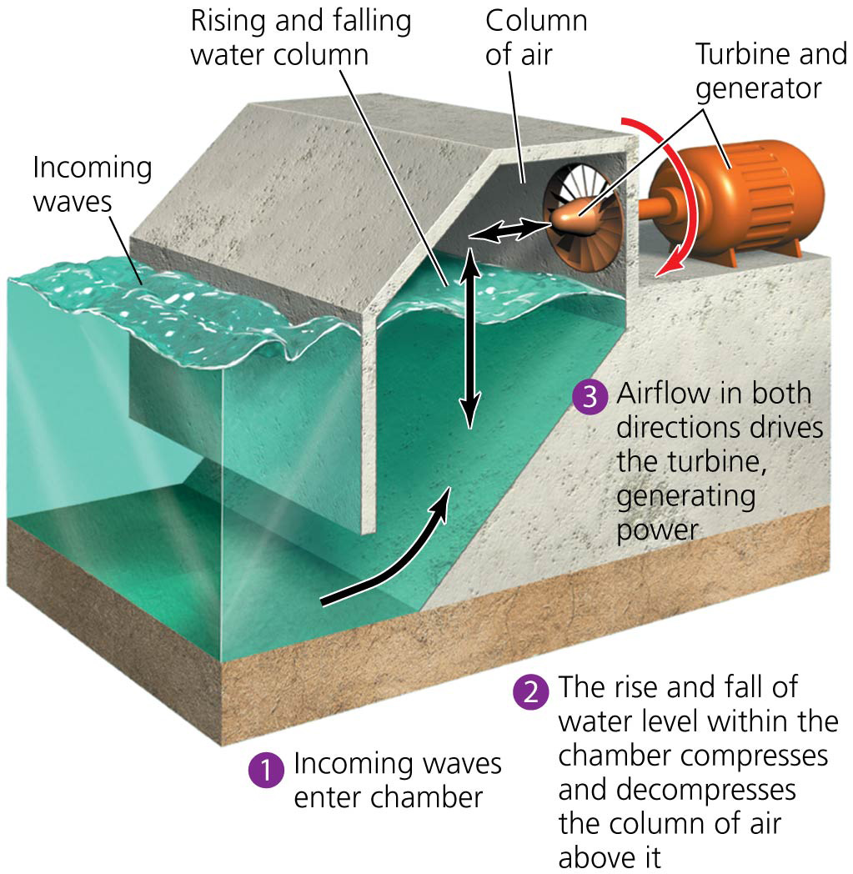

Slide 71
We can harness energy from tides, waves, and currents
Tidal energy = energy harnessed from dams that cross the outlets of tidal basins
Water is trapped behind gates
Outgoing tides turn turbines to generate electricity
Tidal stations release few or no pollutant emissions
But they can affect the ecology of estuaries and tidal basins
Another design uses the motion of ocean currents, such as the Gulf Stream
Devices similar to underwater turbines have been erected off of Europe to test this technology

Slide 72
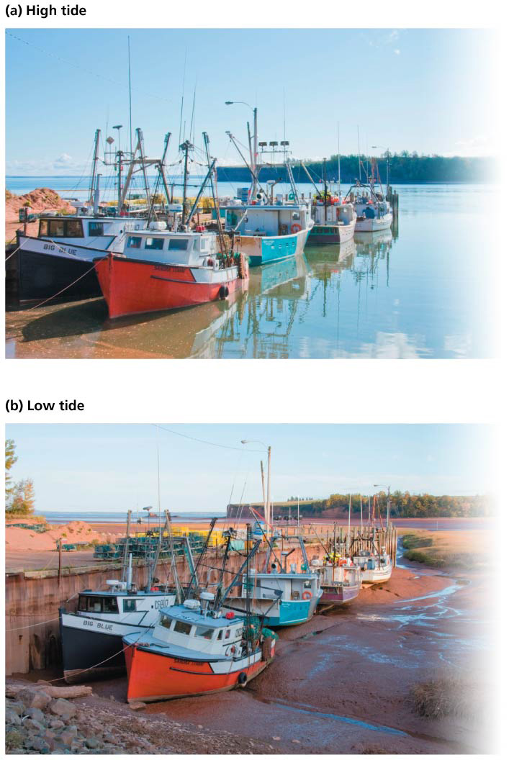

Slide 73
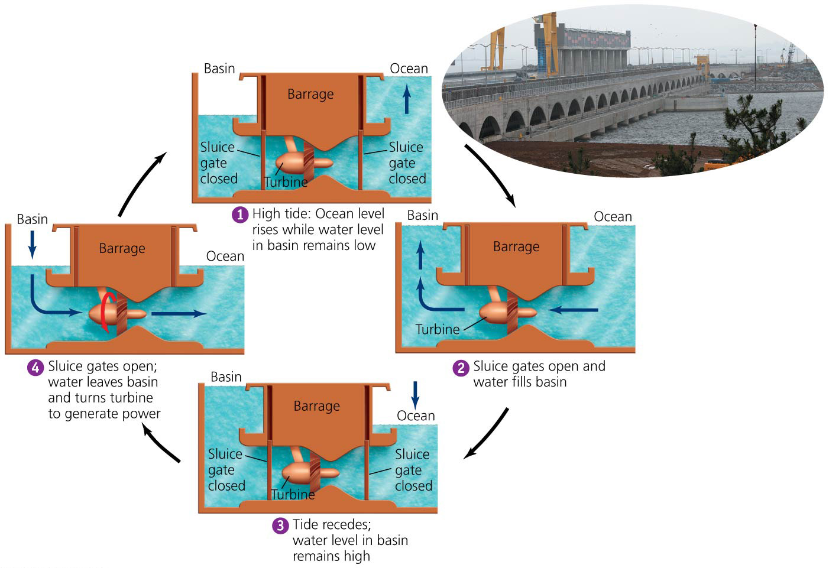

Slide 74
The ocean stores thermal energy
Each day, tropical oceans absorb solar radiation equal to the heat content of 250 billion barrels of oil
Ocean thermal energy conversion (OTEC) = uses temperature differences between the ocean’s warm surface water and cold deep water

Slide 75
The ocean stores thermal energy
Closed cycle approach = warm surface water evaporates chemicals, which spin turbines to generate electricity
Cold water condenses the gases to be reused
Open cycle approach = warm surface water is evaporated in a vacuum and its steam turns turbines
Costs are high, and no facility operates commercially yet

Slide 76
Hydrogen
Energy produced by the new renewables is not easily stored in large quantities for use when needed
This is why most vehicles rely on gasoline from oil
Fuel cells and their fuel, hydrogen, promise a way to store considerable quantities of energy cleanly and efficiently
Hydrogen is an energy carrier, not a primary source
Like electricity and batteries, its energy can be converted for use at a later time in a different location

Slide 77
Some yearn for a “hydrogen economy”
A hydrogen economy would provide a clean, safe, and efficient energy system
Electricity produced from intermittent sources (sun, wind) would be used to produce hydrogen
Fuel cells (essentially, hydrogen batteries) would use hydrogen to produce electricity to power vehicles, homes, computers, cell phones, etc.
Governments are funding research into hydrogen and fuel cell technology
Iceland and Germany have converted their public buses to run on hydrogen

Slide 78
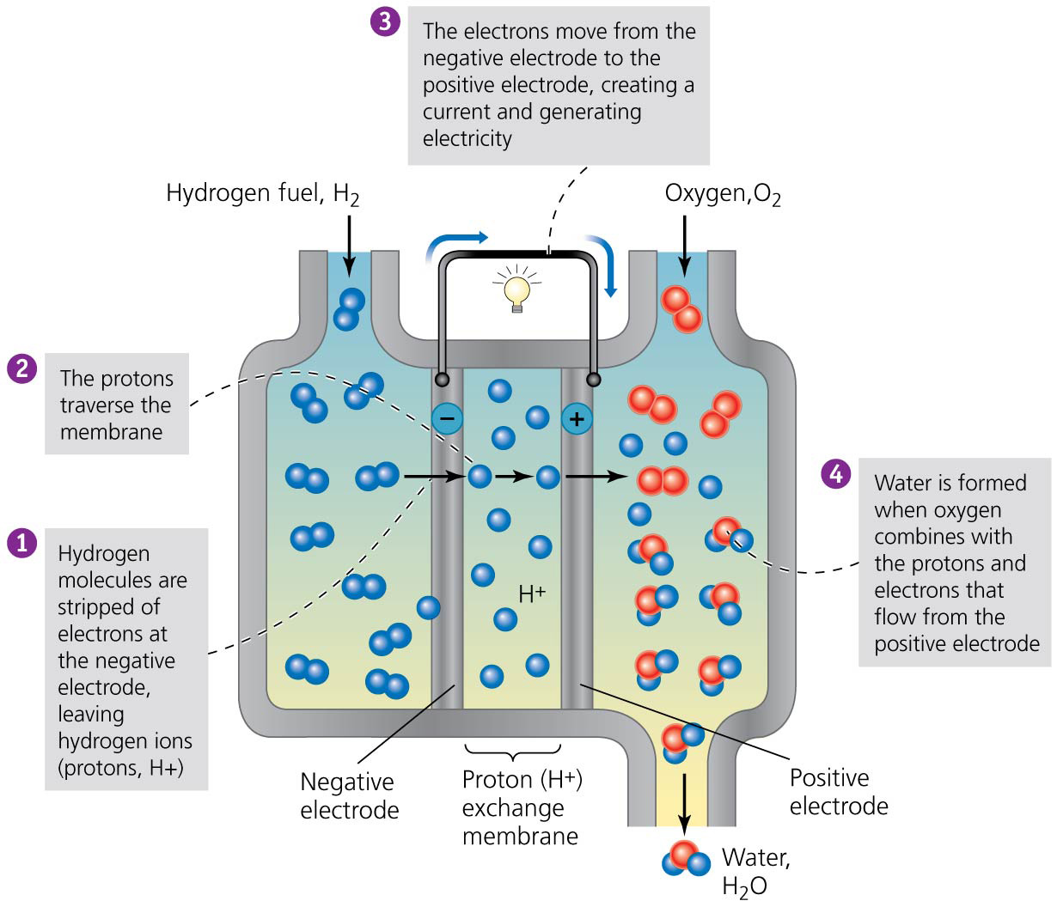

Slide 79
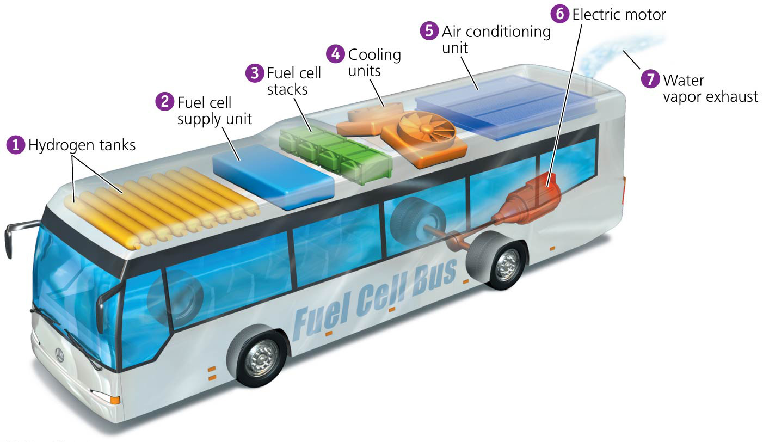

Slide 80
Hydrogen fuel may be produced from water or from other matter
Hydrogen gas does not exist freely on Earth
Energy is used to force molecules to release hydrogen
Electrolysis = electricity splits hydrogen from water
2H₂O ⇒ 2H₂ + O₂
It may cause pollution, but only if the source of energy for the electricity produces pollution

Slide 81
Hydrogen fuel may be produced from water or from other matter
The environmental impact of hydrogen production depends on the source of hydrogen
Using methane, biomass, or fossil fuels produces the greenhouse gas CO₂
CH₄ + 2H₂O ⇒ 4H₂ + CO₂

Slide 82
Fuel cells produce electricity by joining hydrogen and oxygen
Once isolated, hydrogen gas can be used as a fuel to produce electricity within fuel cells
The chemical reaction is the reverse of electrolysis
2H₂ + O₂ ⇒ 2H₂O
The movement of the hydrogen’s electrons from one electrode to the other creates electricity

Slide 83
Hydrogen and fuel cells have costs and benefits
Need massive and costly development of infrastructure
Some research suggests that leakage of hydrogen can deplete stratospheric ozone
We will never run out of hydrogen
It can be clean and nontoxic to use
It may produce few greenhouse gases and pollutants
If kept under pressure, it is no more dangerous than gasoline in tanks
Cells are typically 35–70% energy efficient (up to 90%)
Fuel cells are silent and nonpolluting and won’t need to be recharged

Slide 84
Conclusion
The concern over global climate change and the health impacts, security risks of dependence, and decline of fossil fuels have convinced many people we need to shift to renewable energy
Renewable sources include solar, wind, geothermal, and ocean energy sources and hydrogen fuel
Renewable energy sources have been held back by inadequate funding and by artificially cheap prices for nonrenewable resources
But there is hope that we can shift to renewable energy
The limit on environmental impact will be based on how soon, how quickly, and how carefully we make the switch

Slide 85
QUESTION: Review
Which of these is NOT a benefit of solar energy?
It is quiet, but requires maintenance of its moving parts.
It allows local, decentralized control over power.
It decreases environmental and social stress.
It does not emit greenhouse gases.
Notes:
Answer: a

Slide 86
QUESTION: Review
When would geothermal energy NOT be renewable?
When the Earth cools down
When too much salt is put into the substance holding the hot water
When too much hot water is extracted
Never; geothermal energy can not be depleted.
Notes:
Answer: c

Slide 87
QUESTION: Review
Which energy source has doubled every three years and its cost of electric production is almost as cheap as fossil fuels?
Solar
Wind
Geothermal
Hydrogen
Notes:
Answer: b

Slide 88
QUESTION: Review
Which energy source does NOT emit greenhouse gases but has great potential to disrupt or change ecosystems?
Solar cells
Wind farms
Geothermal sources
Tidal energy
Notes:
Answer: d

Slide 89
QUESTION: Review
What is a major drawback of hydrogen fuel?
It could pollute if facilities are built too large.
It could pollute if fossil fuels are used to produce the hydrogen.
There is a slight danger of causing earthquakes during production.
People will never want to use it.
Notes:
Answer: b

Slide 90
QUESTION: Weighing the Issues
Which energy source would you most support in your housing community?
Solar
Wind
Nuclear
Coal
Notes:
Answer: any

Slide 91
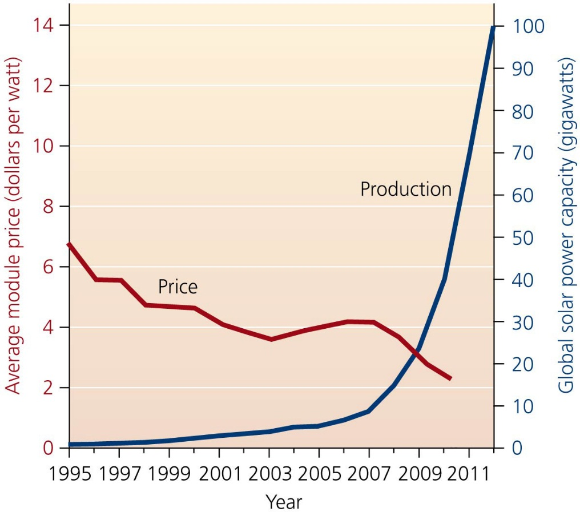
QUESTION: Interpreting Graphs and Data
What conclusions can you draw from this graph?
Production of PV cells grew and prices fell.
Production of PV cells fell and prices also fell.
Production of PV cells grew and prices increased.
Production of PV cells fell and prices increased.
Notes:
Answer: a

Slide 92
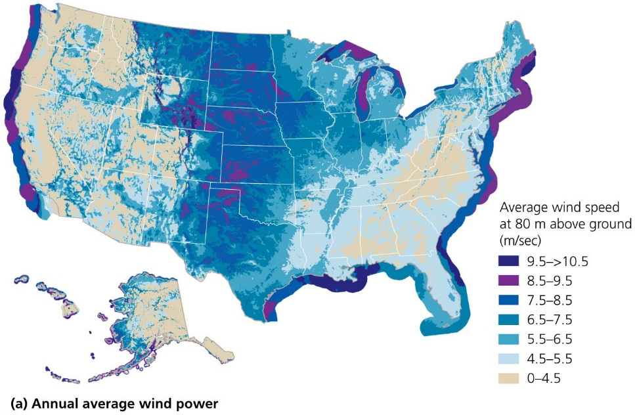
QUESTION: Interpreting Graphs and Data
What conclusions can be drawn from these maps?
Coastlines are a poor place for wind power.
The Midwest and Great Plains have good geothermal potential.
The East Coast has great geothermal potential.
California has great potential for both wind power and geothermal power.
Notes:
Answer: d

