Slide 2
This lecture will help you understand:
Reasons for seeking alternative fuels
Contributions to world energy by conventional alternative fuels
Nuclear energy
The social debate over nuclear power
Bioenergy
Hydroelectric power

Slide 3
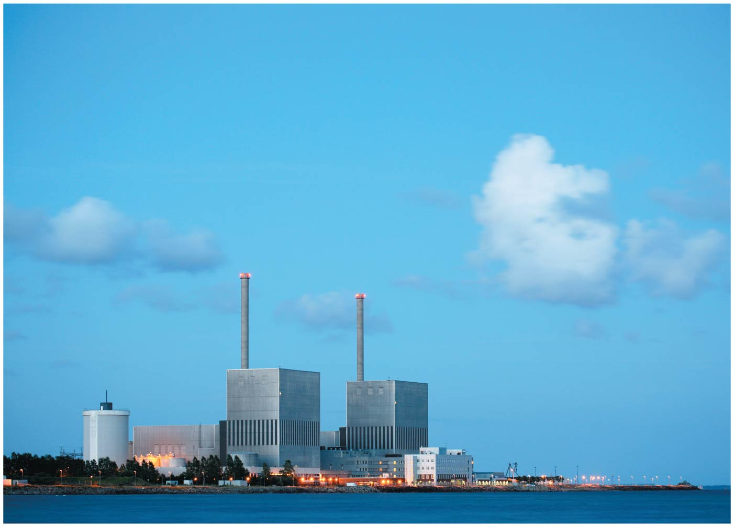

Slide 4
Central Case Study: Sweden’s Search for Alternative Energy
In 1980, Sweden’s people voted to phase out nuclear energy
The government has promoted hydroelectric, biomass, and wind power
The government decided not to go through with the phaseout and will still use nuclear power instead of fossil fuels
The Fukushima nuclear accident ignited protests against nuclear power and caused Germany to phase theirs out
A Swedish state-owned firm had contracts to work on Germany’s nuclear plants and sued because of lost work

Slide 5
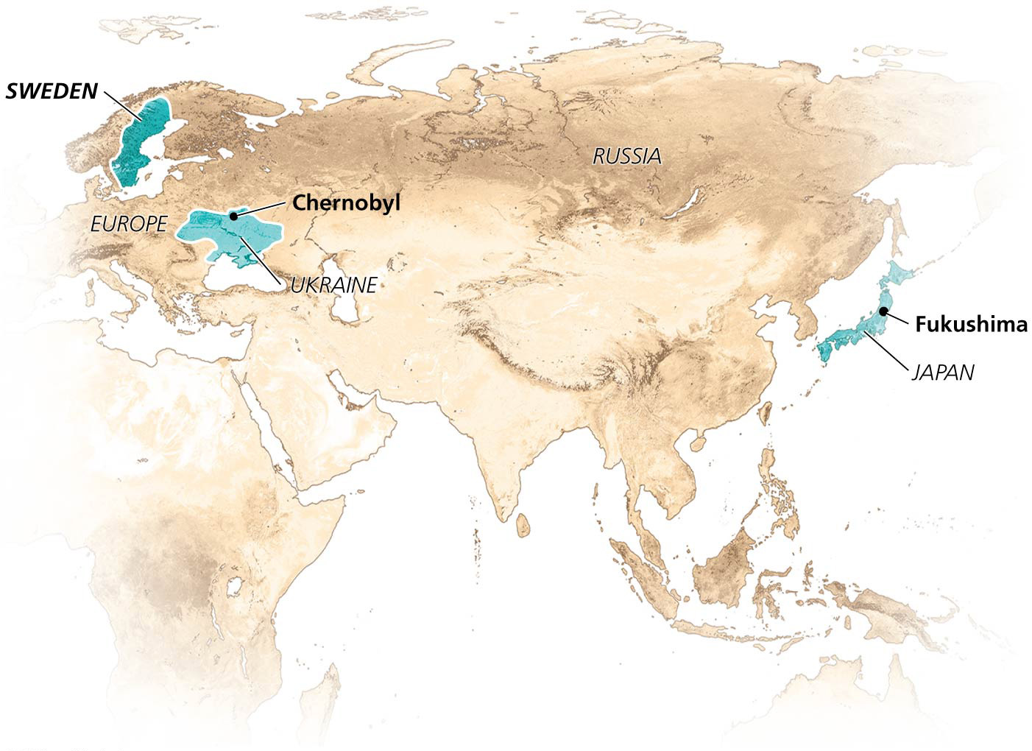

Slide 6
Alternatives to Fossil Fuels
Our global economy is powered by fossil fuels
They account for over 80% of energy use
These fuels also power two-thirds of electricity generation
Fossil fuels are limited and pollute
We need to shift to resources that are less easily depleted and environmentally gentler

Slide 7
Alternatives to Fossil Fuels
We have alternatives to fossil fuels, which help diversify an economy’s mix of energy
But they are more expensive in the short term when external costs are not included in market prices
Although prices should come down as technology develops and we invest in infrastructure

Slide 8
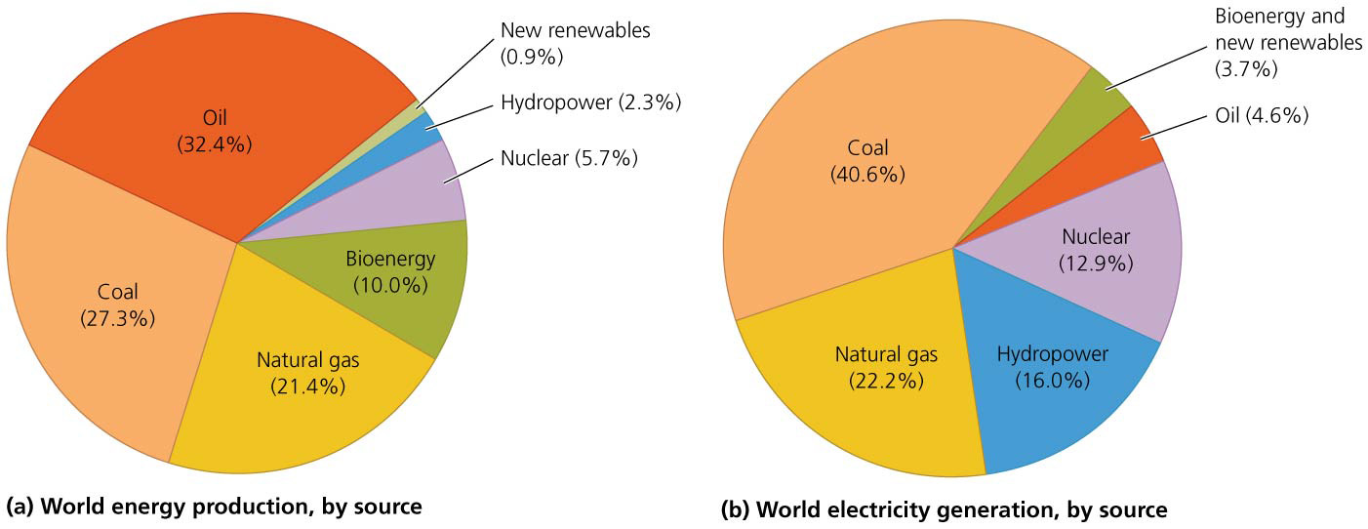

Slide 9
Nuclear power, bioenergy, and hydropower are conventional alternatives
The most developed and widely used “conventional alternatives” to fossil fuels are nuclear, hydroelectric, and biomass energy
They exert less environmental impact than fossil fuels
But more impact than the “new renewables”
These are intermediates along a continuum of renewability

Slide 10
Conventional alternatives provide much of our electricity
Conventional alternatives play minor, yet substantial, roles
Bioenergy provides 10% of the world’s energy
Nuclear provides about 6%, hydropower about 2%
Nuclear and hydropower account for 30% of the world’s electricity production

Slide 11
Conventional alternatives provide much of our electricity
In the United States, the use of conventional alternatives has been growing more slowly than fossil fuels
The United States relies more on fossil fuels and nuclear power than other countries
Sweden has shown that using more alternatives is possible

Slide 12
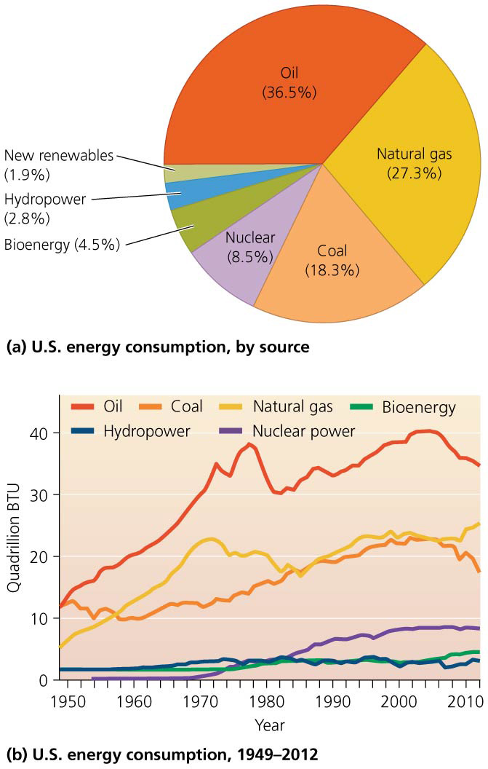

Slide 13
Nuclear Power
Nuclear energy occupies an odd and conflicted position in our debate over energy
It is free of air pollution produced by fossil fuels
Yet it has been clouded by weaponry, waste disposal, and accidents
Public safety concerns have led to limited development
The United States generates the most electricity from nuclear power
But only 19% of U.S. electricity comes from nuclear
France gets 75% of its electricity from nuclear power

Slide 14
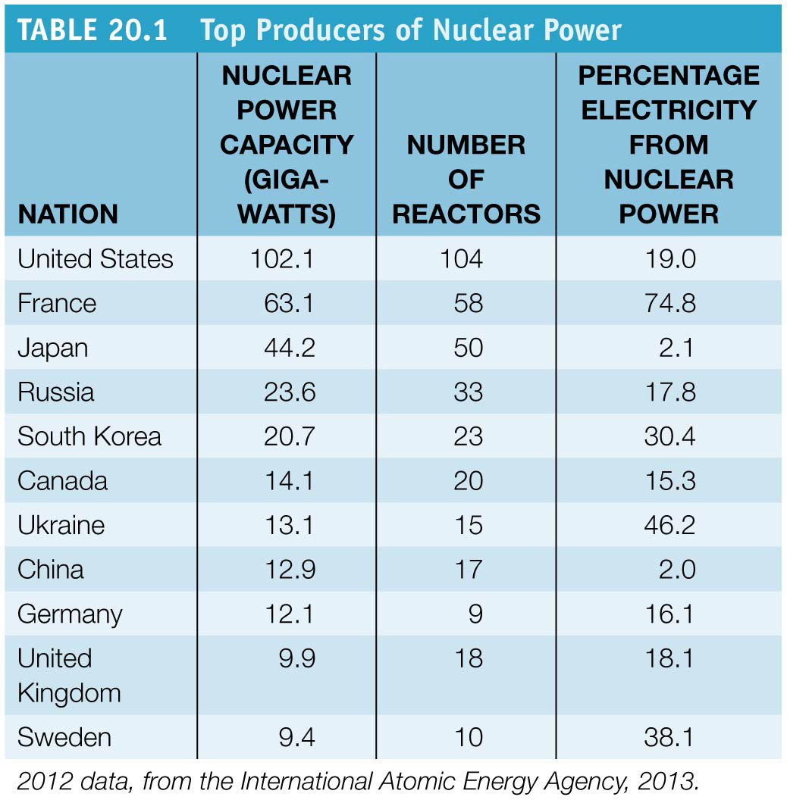

Slide 15
Fission releases nuclear energy in reactors to generate electricity
Nuclear energy = the energy that holds together protons and neutrons within the nucleus of an atom
Nuclear reactors = facilities within nuclear power plants that convert nuclear to thermal energy
Nuclear fission = the splitting apart of atomic nuclei
Drives the release of nuclear energy in power plants
Nuclei of large atoms are bombarded with neutrons, releasing energy in the form of heat, light, radiation, and more neutrons, which can split more atoms
This generates a self-sustaining chain reaction

Slide 16
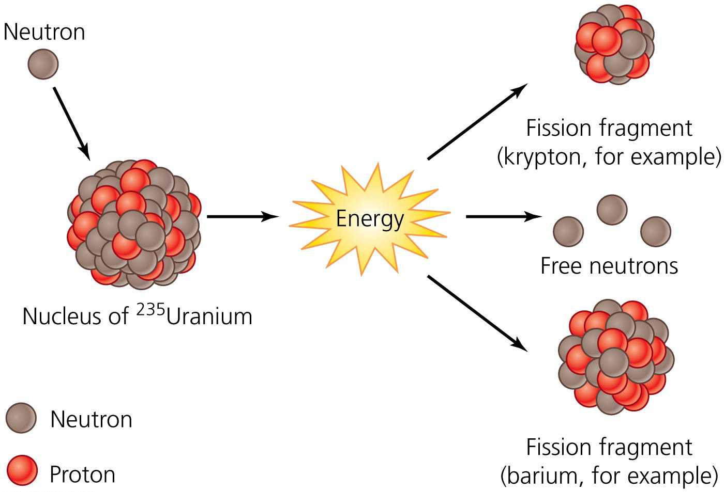

Slide 17
Fission releases nuclear energy in reactors to generate electricity
If not controlled, the chain reaction becomes a runaway process of positive feed back
This creates the explosive power in an atomic bomb
Normally, neutrons move to quickly to split nuclei; they have to be slowed down
Done by a moderator, usually water or graphite
Control rods = metallic alloys that absorb neutrons
They are placed into the reactor among the water-bathed fuel rods
They are moved into and out of the water to control the rate of the reaction

Slide 18
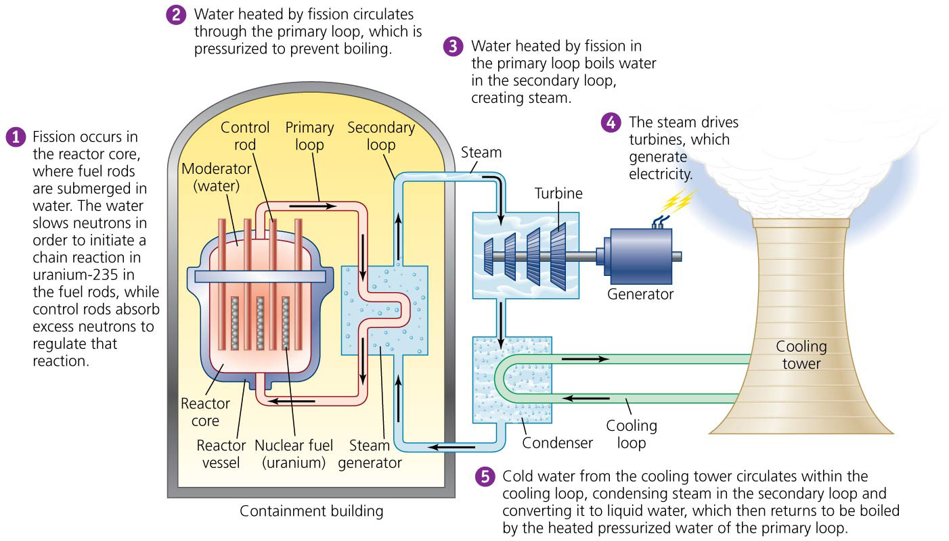

Slide 19
Fission releases nuclear energy in reactors to generate electricity
Fission takes place in the reactor core
The reactor core is housed in a reactor vessel
The vessel, steam generator, and plumbing are located in a containment building
Containment buildings are constructed to prevent leaks of radioactivity due to accidents or natural catastrophes
Not all nations require containment buildings

Slide 20
Nuclear energy comes from processed and enriched uranium
Uranium is used for nuclear power because it is radioactive
Radioisotopes = emit subatomic particles and high-energy radiation as they decay into lighter radioisotopes
They become stable isotopes
Uranium-235 decays into lead-207
The rate of decay is determined by its half-life = the time it takes for half of the atoms to decay
²³⁵U has a half-life of about 700 million years
Other radioisotopes have different half-lives

Slide 21
Nuclear energy comes from processed and enriched uranium
Over 99% of uranium occurs as uranium-238 (²³⁸U)
It does not emit enough neutrons for a chain reaction
So we use ²³⁵U, which is only 1% of total uranium
²³⁵U is enriched to 3% and formed into pellets (UO₂), which are incorporated into metallic tubes called fuel rods used in nuclear reactors
After several years in a reactor, uranium is depleted
The fuel no longer generates enough energy
Spent fuel can be reprocessed, but it is expensive
So it is disposed of as radioactive waste

Slide 22
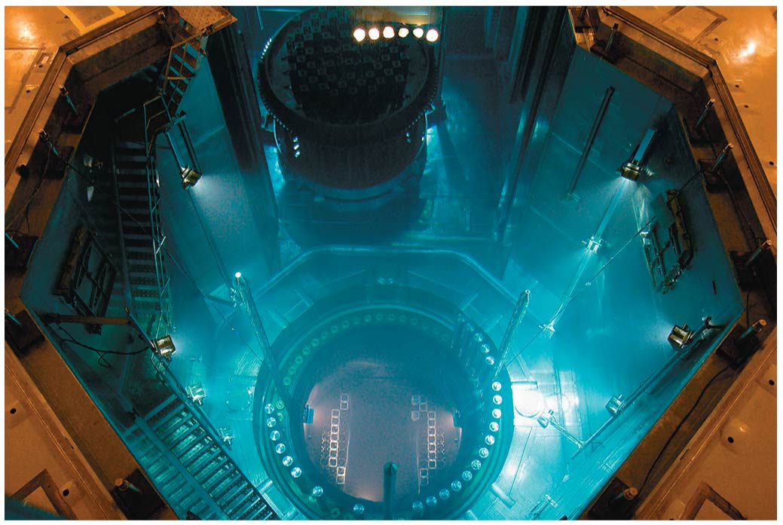

Slide 23
Nuclear power delivers energy more cleanly than fossil fuels
Nuclear power has no stack emissions
Burning fossil fuels emits sulfur dioxide, particulate matter, and carbon dioxide
Nuclear power helps the United States avoid emitting 600 million metric tons of carbon each year
Power plants pose fewer health risks from pollution
Uranium mining damages less land than coal mining

Slide 24
Nuclear power delivers energy more cleanly than fossil fuels
Drawbacks of nuclear power:
Nuclear waste is radioactive
If an accident or sabotage occurs, the consequences can be catastrophic
The world has 435 operating nuclear plants in 31 nations

Slide 25
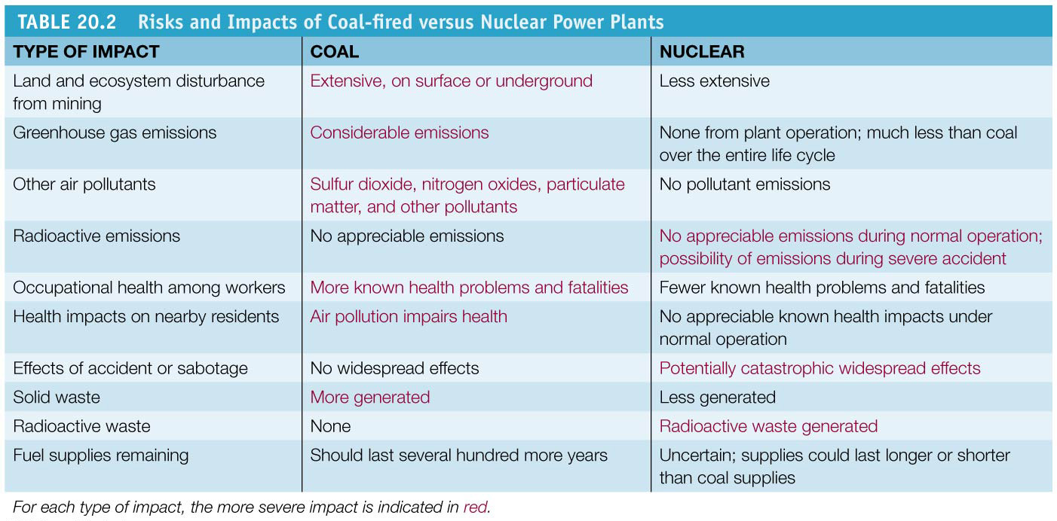

Slide 26
Fusion remains a dream
Nuclear fusion = process that forces together small nuclei of lightweight elements under extremely high temperature and pressure
Tremendous energy is released when deuterium and tritium are fused to form helium
So far, the energy required to produce fusion is greater than the energy generated
It has a loss in net energy despite billions of dollars of funding and decades of research

Slide 27
Fusion remains a dream
If we could control fusion, we could produce vast amounts of energy from water
The International Thermonuclear Experimental Reactor (ITER) in southern France is the latest attempt

Slide 28
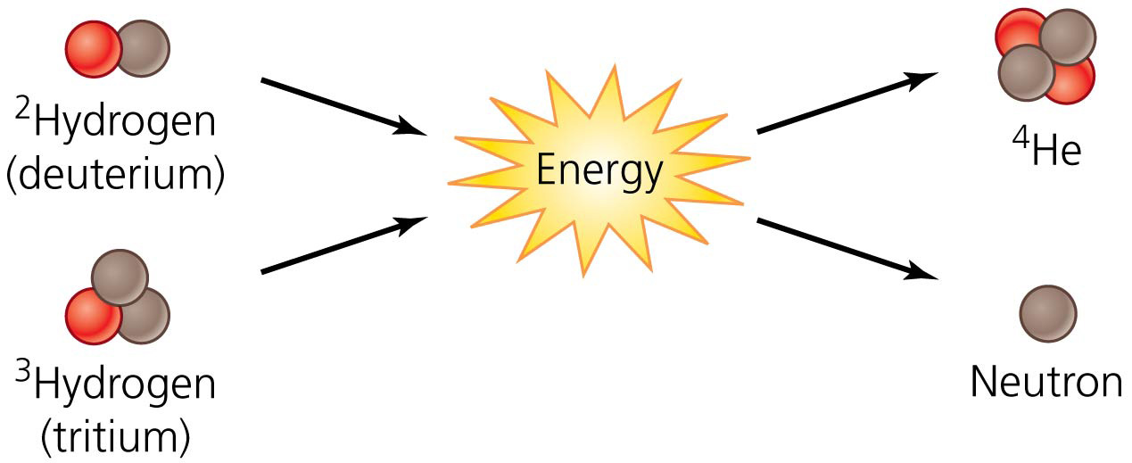

Slide 29
Nuclear power poses small risks of large accidents
Although cleaner than fossil fuels, nuclear power poses the possibility of catastrophic accidents
The most serious accident in the United States was at the Three Mile Island plant in Pennsylvania in 1979
A combination of human and mechanical errors caused coolant water to drain from the reactor causing a meltdown = temperatures rise inside the reactor core, melting the metal surrounding the fuel rods and releasing radiation
Half of one reactor core experienced meltdown, but most radiation was trapped in the containment building

Slide 30
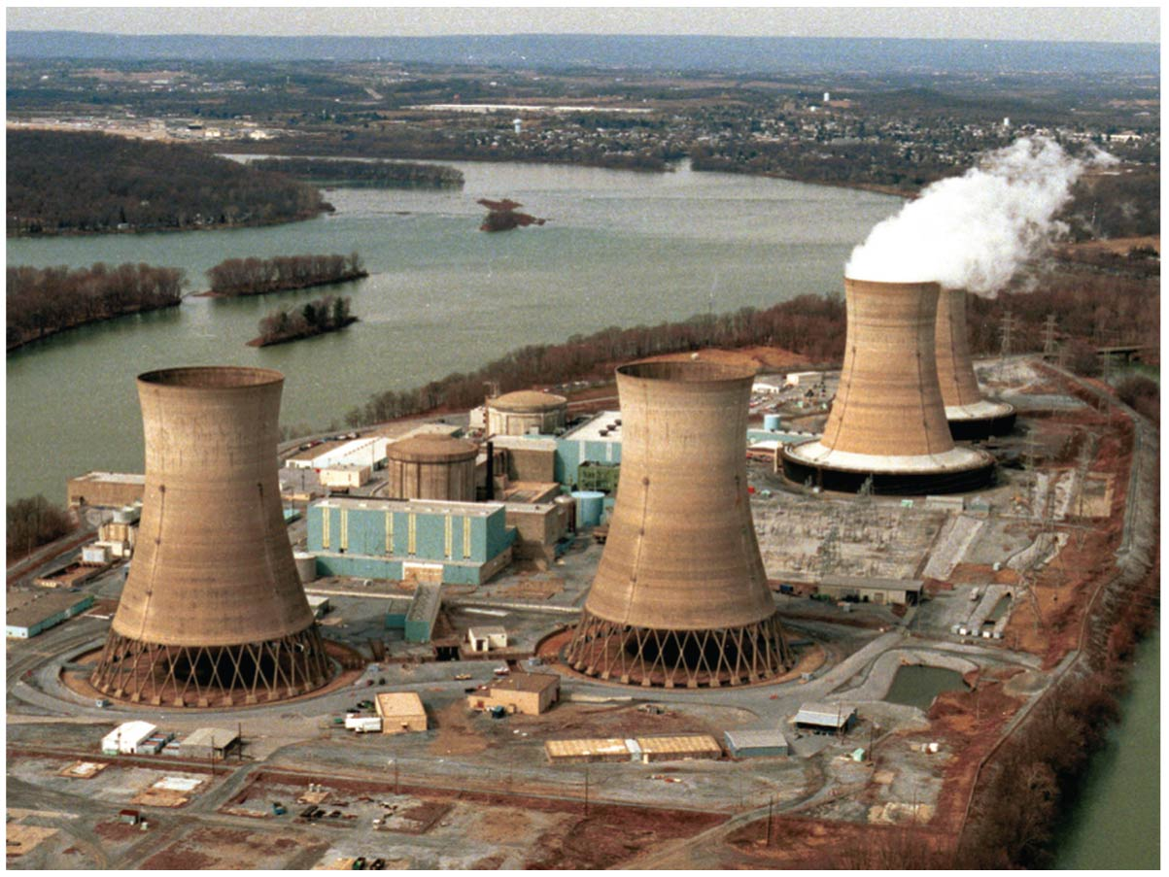

Slide 31
Chernobyl
1986 explosion at the Chernobyl plant in Ukraine
The most severe nuclear plant accident yet seen
It was due to human error and unsafe design
For 10 days, radiation escaped while crews tried to put out the fire
More than 100,000 residents were evacuated
The landscape for 19 miles still remains contaminated
The accident killed 31 people directly
Thousands more became sick or developed cancer
Radioactive fallout was carried over much of the Northern Hemisphere

Slide 32
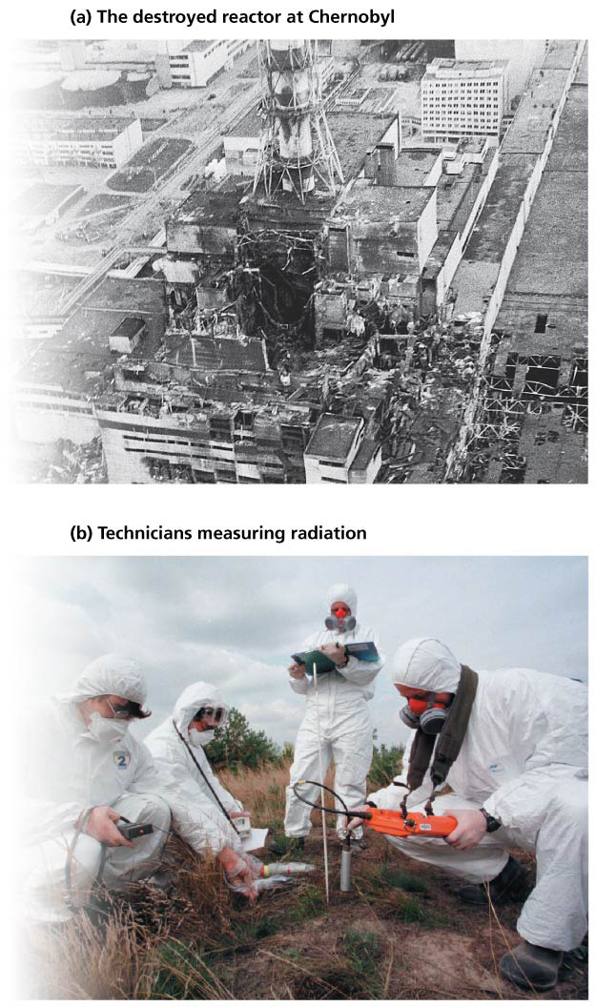

Slide 33
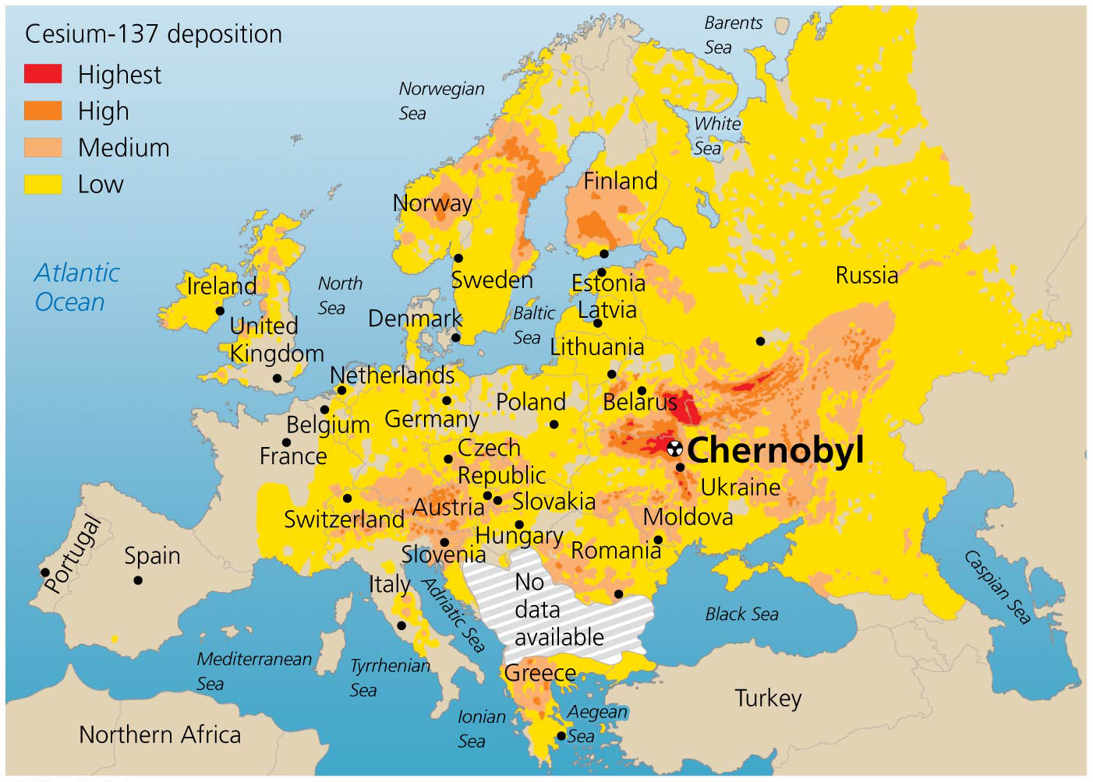

Slide 34
Fukushima Daiichi
A magnitude 9.0 earthquake struck Japan on March 11, 2011, sending a massive tsunami onshore
At the power plant, the storm shut down the power and flooded the emergency generators
Without electricity, the workers could not use the control rods to cool the uranium fuel

Slide 35
Fukushima Daiichi
Three reactors experienced full meltdowns
Several explosions and fires also occurred
Radioactivity released was about one-tenth that of Chernobyl
Most radiation drifted into the Pacific Ocean
Thousands of residents were evacuated, and health effects from the event are uncertain

Slide 36
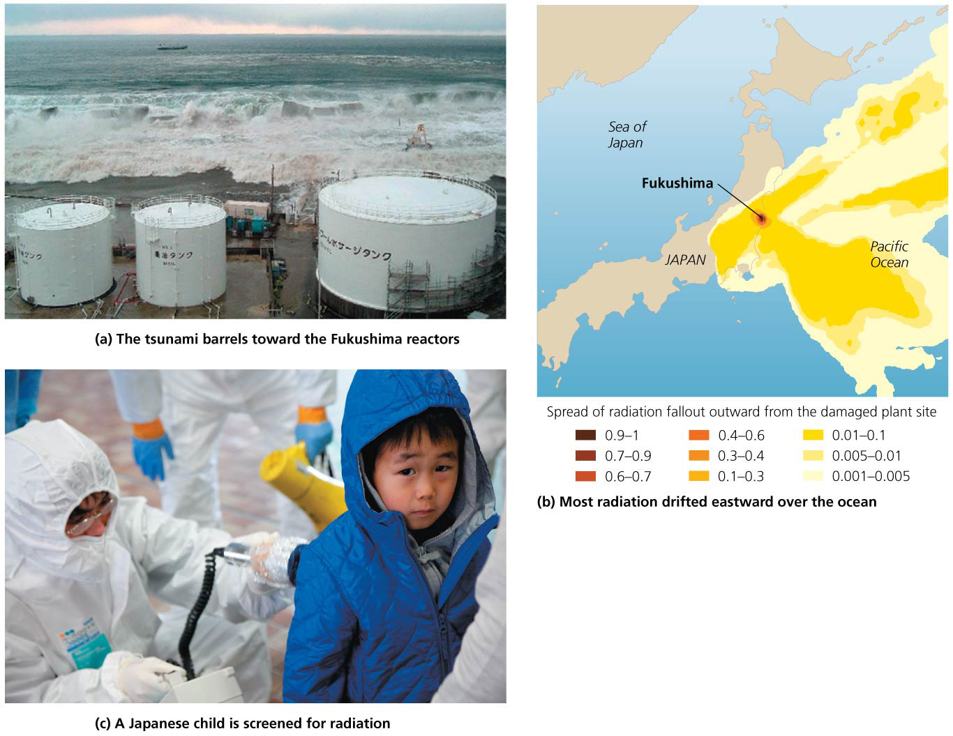

Slide 37
We are managing risks from nuclear power and nuclear weapons with some success
The number of major accidents has been limited
Modern reactors are safer than Chernobyl
But smaller accidents have occurred
Aging plants require more maintenance and are less safe
Recent terrorist attacks raised fears that similar attacks could be carried out against nuclear plants
Or stolen radioactive material could be used in attacks
The U.S. Megatons to Megawatts program buys radioactive material from the former Soviet Union
Used in power plants

Slide 38
Waste disposal remains a challenge
Spent fuel rods and other waste will remain radioactive for thousands of years
It must be stored where leaking radioactivity will not harm future generations
Waste is held in temporary storage at power plants
Spent rods are stored in water

Slide 39
Waste disposal remains a challenge
U.S. plants are running out of room
Waste is now stored in thick barrels of steel, lead, and concrete
Waste is currently held at 125 sites in 39 states
161 million U.S. citizens live within 75 miles of nuclear waste

Slide 40
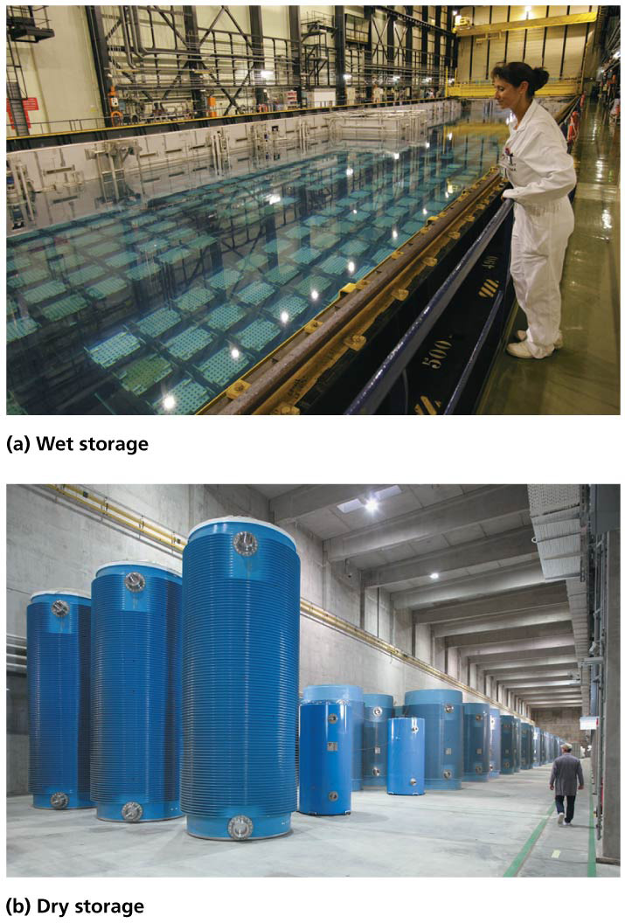

Slide 41
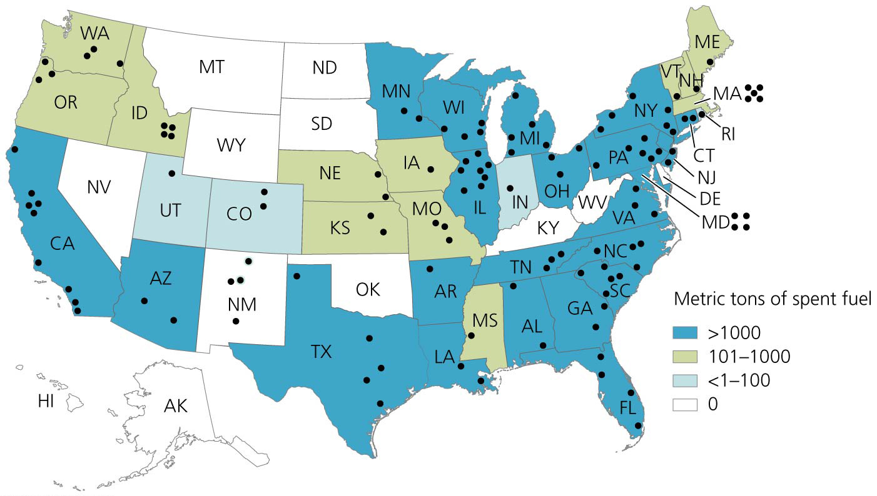

Slide 42
Waste disposal remains a challenge
It is safer to store all waste in a central repository
It can be heavily guarded
Sweden identified a site after a 20-year search
Yucca Mountain, Nevada was chosen for the U.S. site
It was studied extensively, and $13 billion was spent on its development
President Obama’s administration ended support for it

Slide 43
Waste disposal remains a challenge
The issue remains unresolved as of 2013
Multiple lawsuits are challenging the Obama administration’s decision to end support
So waste will remain at its current locations

Slide 44
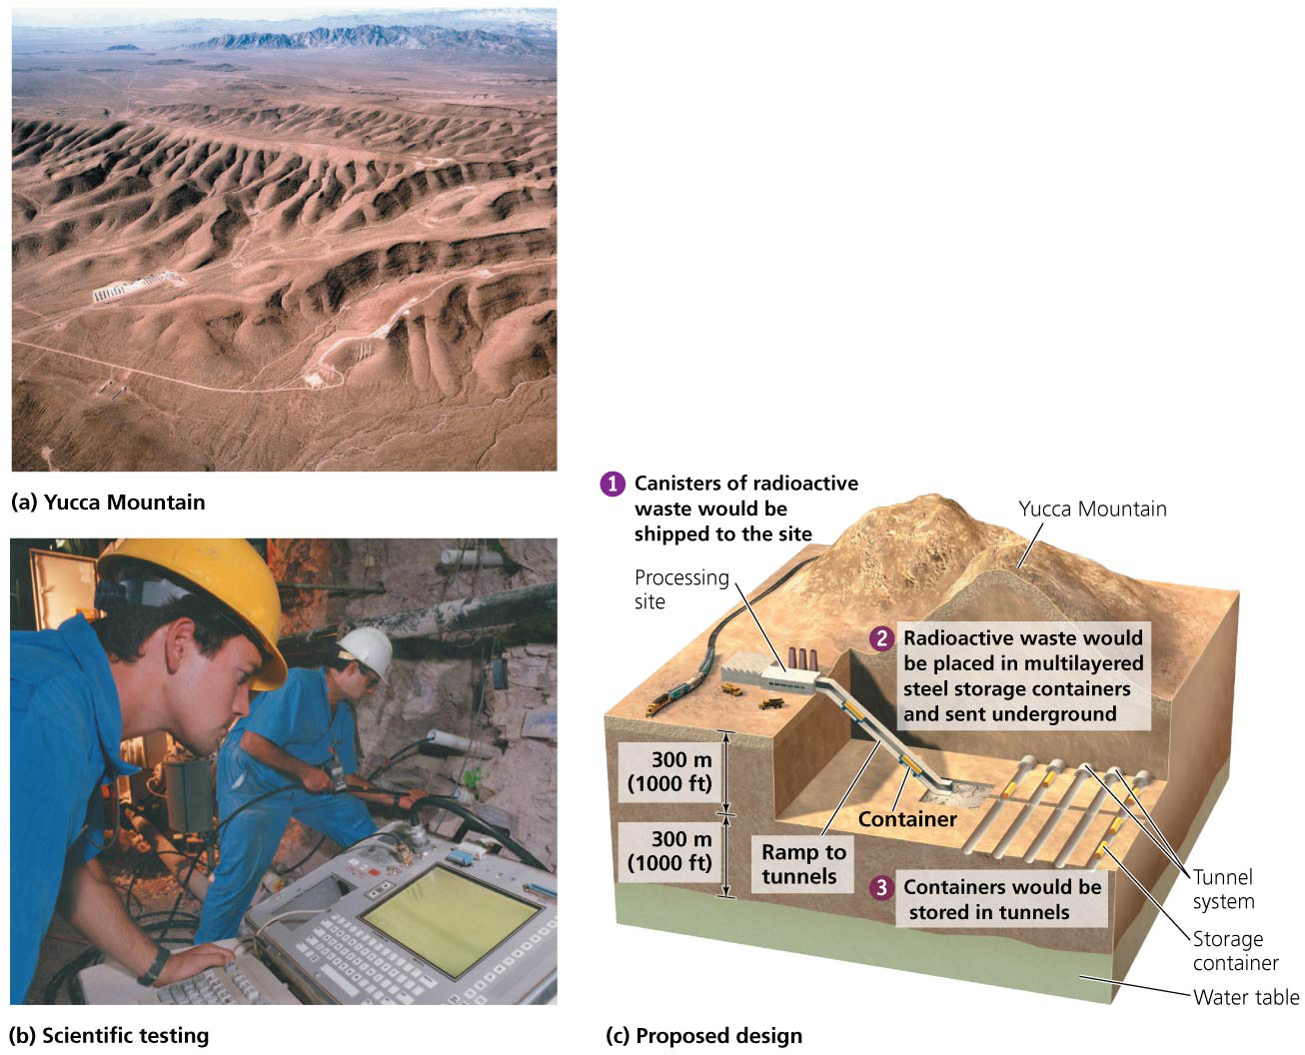

Slide 45
Waste disposal remains a challenge
Yucca Mountain was chosen because:
It is remote and unpopulated
It has minimal risk of earthquakes
Its dry climate and low water table reduce chances of groundwater contamination
It is on federal land so can be protected from sabotage

Slide 46
Waste disposal remains a challenge
Scientists and activists have challenged the conclusions
An additional concern with a central location is that nuclear waste will need to be transported there
Shipments by rail and truck over thousands of miles could cause a high risk of accident or sabotage

Slide 47
Multiple dilemmas have slowed nuclear power’s growth
Concerns over waste disposal, safety, and costs have affected nuclear power’s growth
Public anxiety over Chernobyl and Fukushima have made utilities less willing to build new plants
It is enormously expensive to build, maintain, operate, and ensure the safety of nuclear facilities
Almost every plant has overrun its budget
Plants are aging faster than predicted
Most serve less than half their expected lifetimes
Decommissioning (shutting down) plants can be more expensive than construction

Slide 48
Multiple dilemmas have slowed nuclear power’s growth
Electricity from nuclear power costs more than from coal and other sources
Governments must subsidize nuclear power
The U.S. nuclear industry has stopped building plants
Of the 256 U.S. nuclear reactors ordered since 1957, nearly half have been canceled

Slide 49
Multiple dilemmas have slowed nuclear power’s growth
Expanding nuclear capacity would decrease reliance on fossil fuels and cut greenhouse gas emissions so is being supported by some environmental advocates
Engineers are planning ways to make nuclear power plants safer and less expensive

Slide 50
Bioenergy
Bioenergy (biomass energy) = energy obtained from biomass resources
Biomass = organic material that makes up organisms and contains energy that originated with photosynthesis
Wood, charcoal, agricultural crops, manure
It is renewable and releases no net carbon dioxide
Carbon released by burning was pulled from the atmosphere to make the biomass

Slide 51
We gain bioenergy from many sources
There is a diversity of sources and approaches involved in bioenergy
This give us many ways to address our energy challenges
Over 1 billion people use wood from trees as their primary source of energy
Wood is gathered for heating, cooking, and light

Slide 52
We gain bioenergy from many sources
In developing nations, fuel wood, charcoal, and manure account for one-third of energy use, and up to 90% in the poorest nations
Fuelwood and other traditional biomass sources constitute 75% of all renewable energy used worldwide

Slide 53
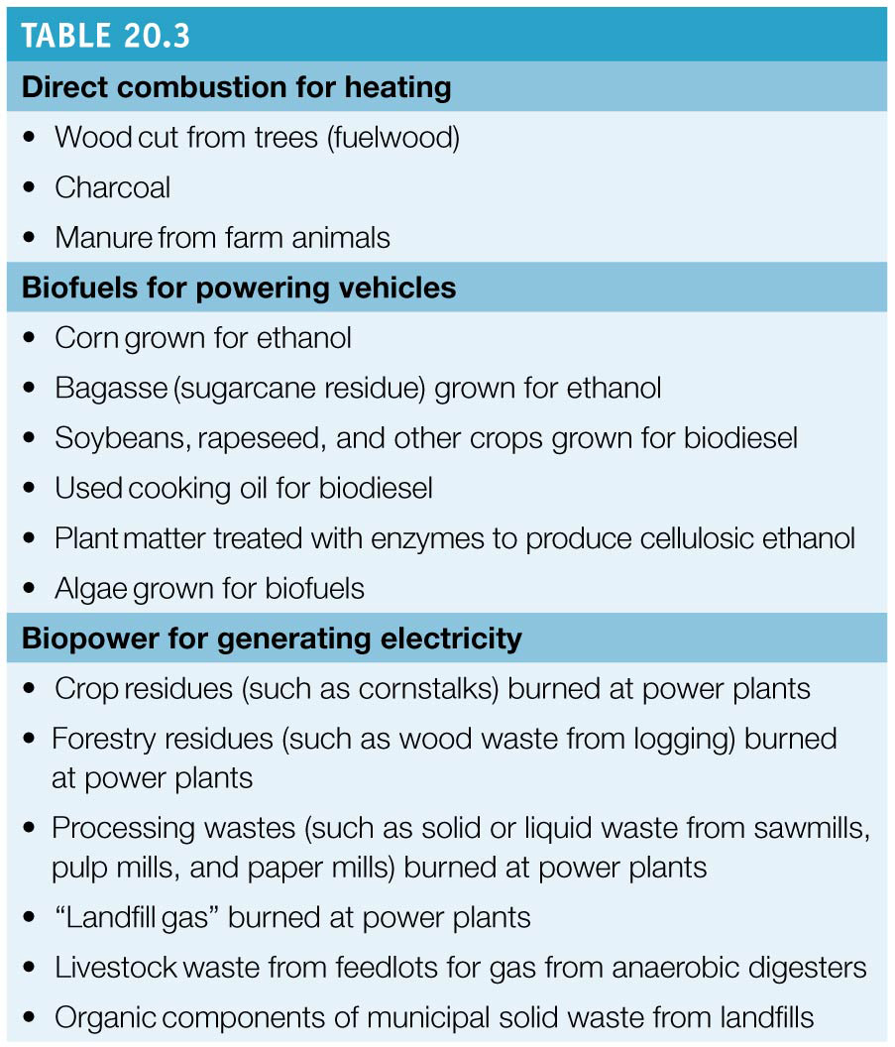

Slide 54
We gain bioenergy from many sources
Biomass is only renewable if it is not overharvested
Overharvesting causes deforestation, erosion, and desertification
Heavily populated arid regions are most vulnerable
When used in cooking, biomass produces indoor air pollution
New biomass sources are being developed using a variety of materials
Biopower = biomass sources are burned in power plants, generating heat and electricity
Biofuels = liquid fuels used to power automobiles

Slide 56
Biopower generates electricity from biomass
Many types of biomass are combusted to generate electricity
Waste products of industries or processes are used
Woody debris from logging and mills, crop residues, animal waste, and organic waste from landfills
Landfill gas is being captured and sold as fuel
Bioenergy crops are being grown specifically to generate power
Fast-growing grasses such as bamboo, switchgrass
Trees such as specially bred willows and poplars

Slide 57
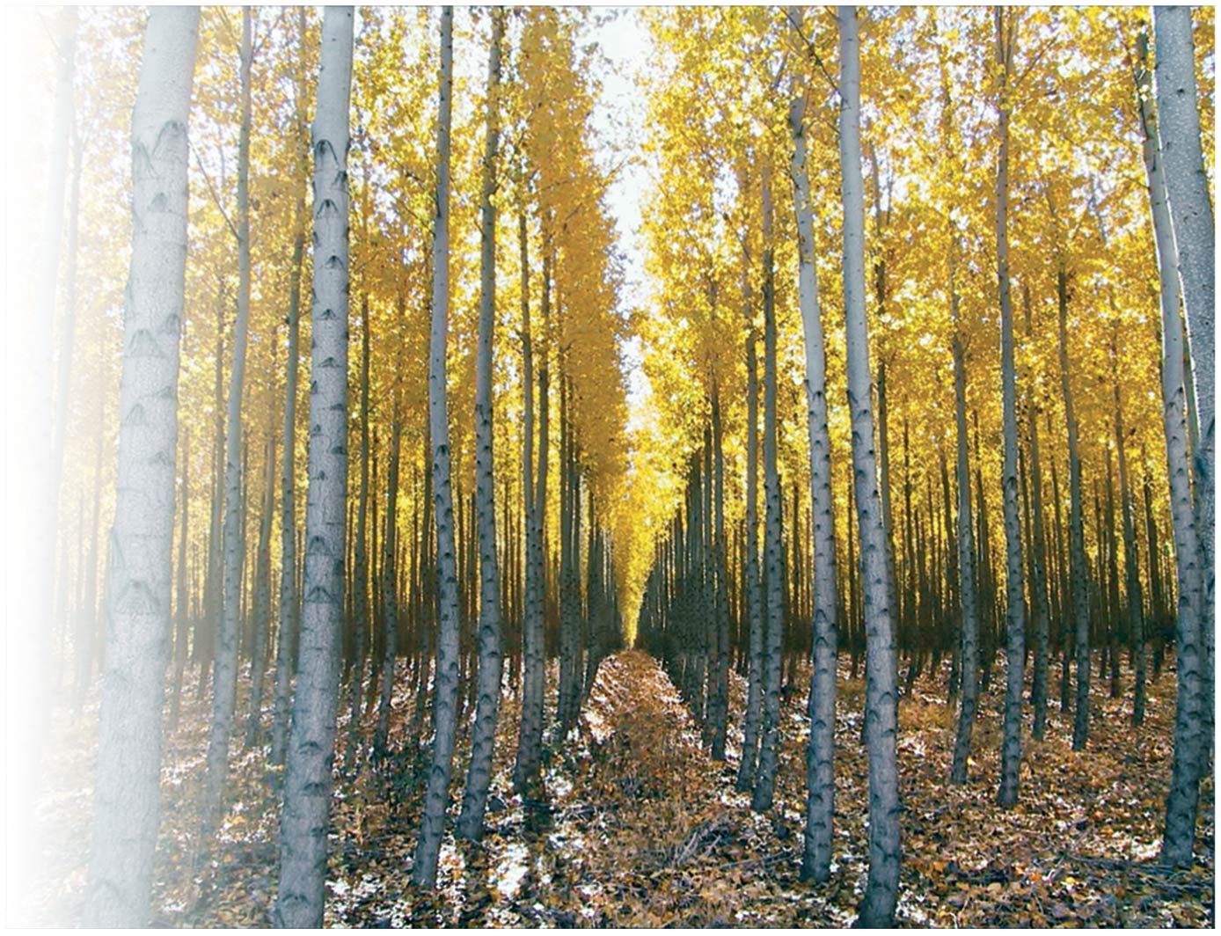

Slide 58
Combustion strategies and Scales of production
Biomass power plants are built like those fired by fossil fuels
Many use cogeneration to provide heat and electricity
Co-firing combines biomass and coal
Gasification turns biomass to vapor in the absence of oxygen and can be used to generate methanol
Pyrolysis produces a liquid fuel

Slide 59
Combustion strategies and Scales of production
At small scales, modular biopower systems can use livestock manure to power a farm or village
Small household biodigesters work in remote areas
In Sweden, one-fifth of the energy supply is from biomass
The United States has dozens of biomass-fueled power plants

Slide 60
Benefits and drawbacks
Biomass power increases efficiency and recycles waste products
It reduces CO₂ emissions and dependence on imported fossil fuels
It is better for health since it produces less sulfur dioxide
Using biomass resources can support rural economies and reduce countries’ dependence on imported fuels
But burning crops deprives the soil of nutrients
Continued use will deplete the soil
Relying solely on bioenergy is not a sustainable option

Slide 61
Ethanol can power automobiles
Liquid fuels from biomass power millions of vehicles
Ethanol = a biofuel made by fermenting carbohydrate-rich crops
Ethanol is widely added to U.S. gasoline to reduce emissions
In 2012 in the United States, 50 billion L (13.3 billion gallons) were made, mostly from corn

Slide 62
Ethanol can power automobiles
Congress has mandated increased ethanol production
Flexible-fuel vehicles run on E-85, a mix of 85% ethanol, 15% gasoline
Brazil uses bagasse = crushed sugarcane residue used to make ethanol

Slide 63
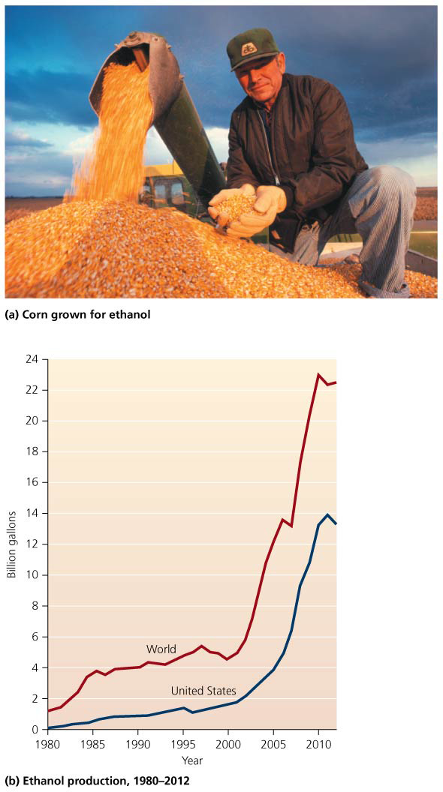

Slide 64
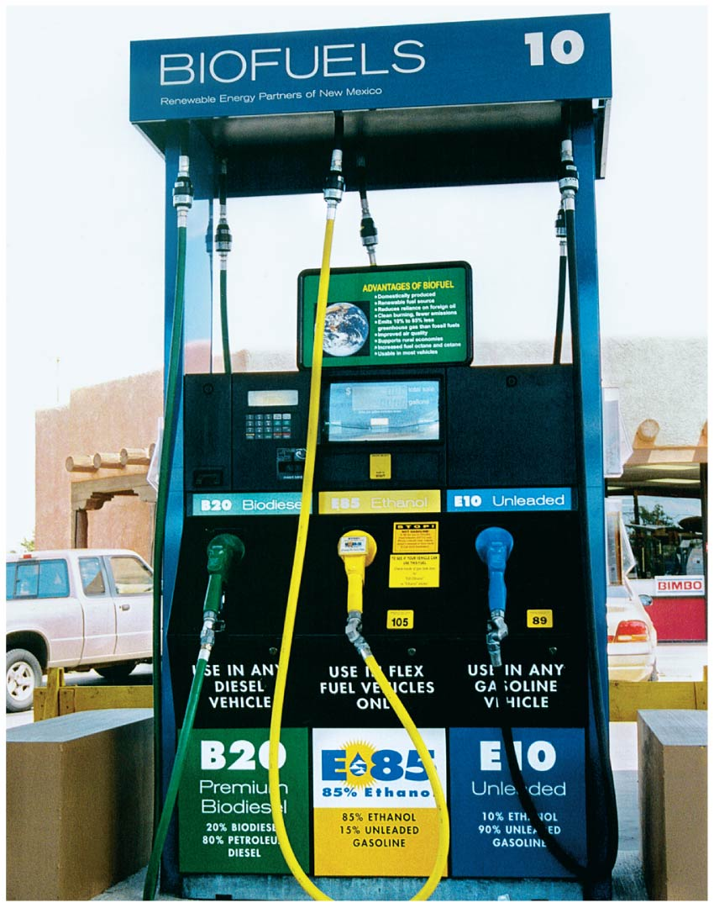

Slide 65
Ethanol is not our most sustainable energy choice
Environmental scientists don’t like corn-based ethanol
Growing corn impacts ecosystems
Pesticides, fertilizers, irrigation
Takes up land that could be left unfarmed
As more corn is used for ethanol, less is left for food
The drop in corn availability increased prices
Mexicans could not afford tortillas, and so they rioted

Slide 66
Ethanol is not our most sustainable energy choice
Growing corn uses fossil fuel energy for equipment, pesticides, and fertilizers
The EROI ratio for corn ethanol is about 1.3:1, so it is inefficient; Brazilian bagasse ethanol is more efficient

Slide 67
Biodiesel powers diesel engines
Biodiesel = fuel produced from vegetable oil, cooking grease, or animal fats
Vehicles can run on 100% biodiesel
Mixing petrodiesel with 20% biodiesel (called B20) is common today

Slide 68
Biodiesel powers diesel engines
Biodiesel reduces emissions, and its fuel economy is good
It costs a bit more than petrodiesel
Using waste oil to make biodiesel is sustainable
Crops are specially grown (like in ethanol production)
Environmental impacts like depleting land, deforestation

Slide 69
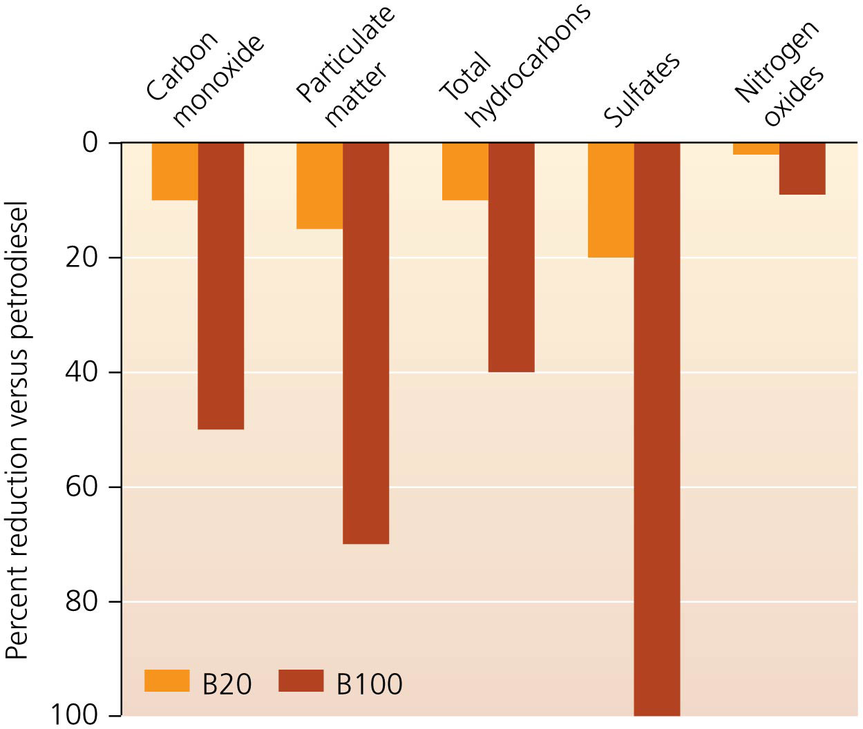

Slide 70
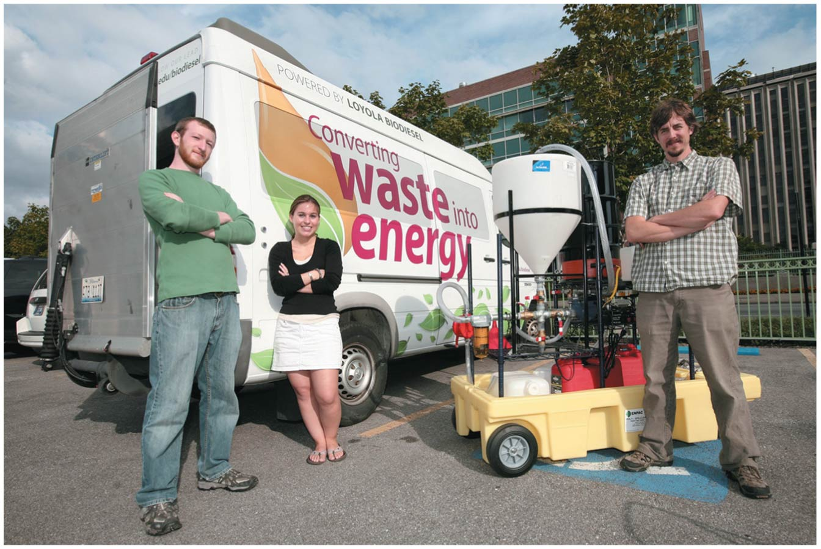

Slide 71
Novel biofuels are being developed
Algae produce lipids that can be converted to biodiesel
Their carbohydrates can be fermented to make ethanol
It can be grown in ponds, tanks, or photobioreactors
Algae grows fast and can be harvested every few days
It can use wastewater, ocean water, or saline water
It can capture CO₂ emissions from smokestacks to speed its growth

Slide 72
Novel biofuels are being developed
Biofuels from algae are currently expensive
Cellulosic ethanol = produced from structural plant material (e.g., corn stalks) that has no food value
Switchgrass provides ethanol, habitat, and high EROI

Slide 73
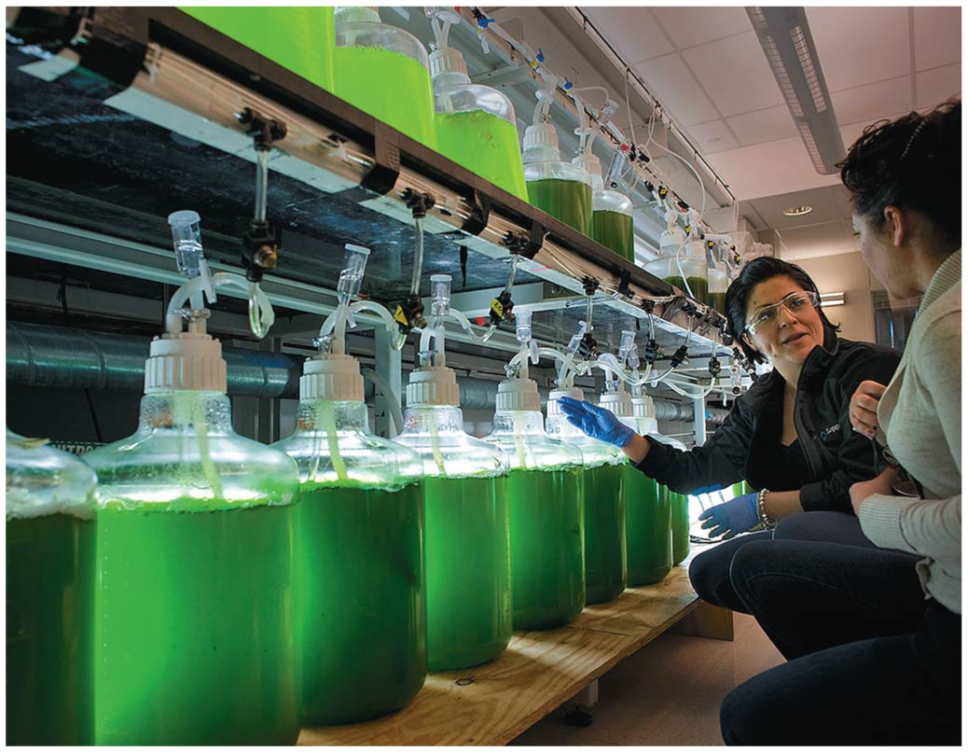

Slide 75
Is bioenergy carbon-neutral?
In principle, biomass energy releases no net carbon
Photosynthesis removes carbon that is released when biomass is burned
Burning biomass is not carbon-neutral:
If forests are destroyed to plant bioenergy crops
If we use fossil fuel energy (tractors, fertilizers, etc.)
The Kyoto Protocol gives incentives to destroy forests for biofuel crops
Only emissions from energy use (not land-use changes) are “counted” toward controlling emissions

Slide 76
Hydroelectric Power
Next to biomass, provides more renewable energy than any other source
Hydropower = uses the kinetic energy of moving water to turn turbines to generate electricity
There are three approaches to hydropower
Storage technique = water stored in reservoirs behind dams passes through the dam and turns turbines
The amount of power generated depends on the distance the water falls and the volume released
Storage allows a predictable supply of water and electricity

Slide 77
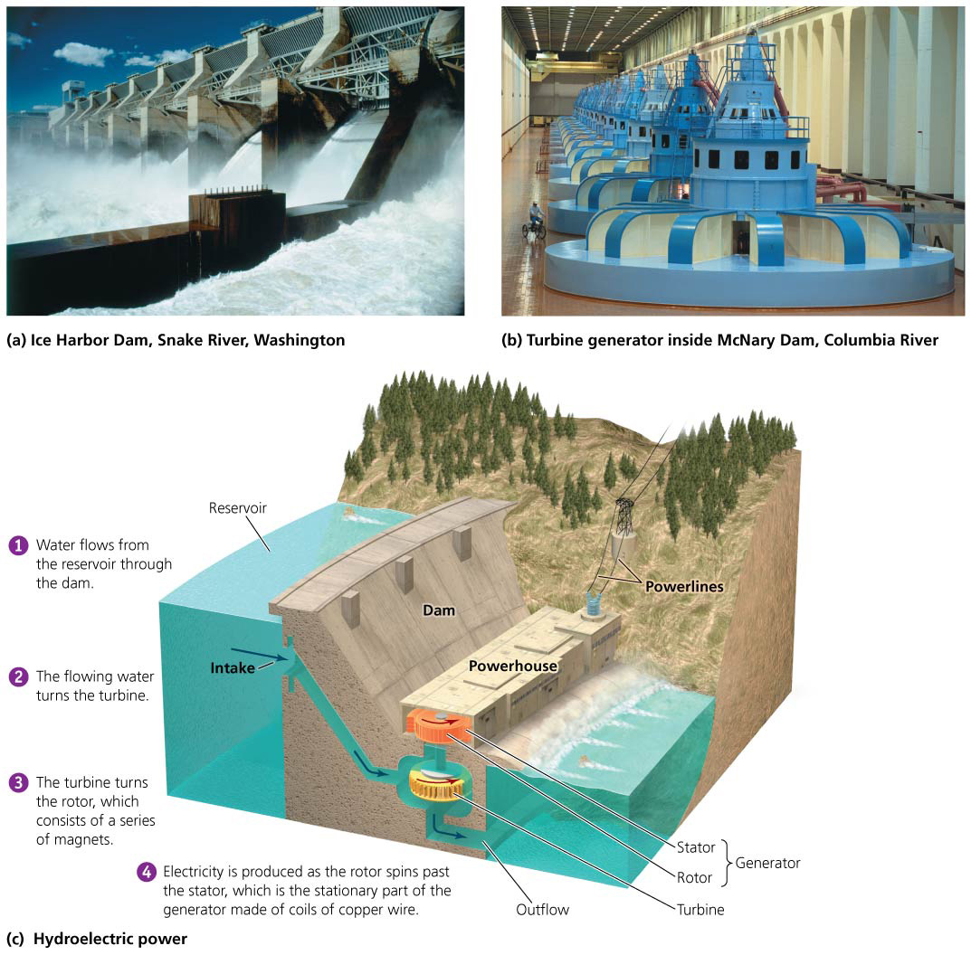

Slide 78
Modern hydropower uses three approaches
Run-of-river approach = generates electricity without disrupting the river’s flow
River water can be diverted through a pipe, passed through a turbine, and returned to the river
A small dam that does not impede fish passage can also be used to divert water
Useful in areas away from electric grids or where a large dam is impractical

Slide 79
Modern hydropower uses three approaches
Pumped storage = water is pumped from a low reservoir to a high reservoir when energy demand is low; uses it when demand is high
Uses energy to pump water

Slide 80
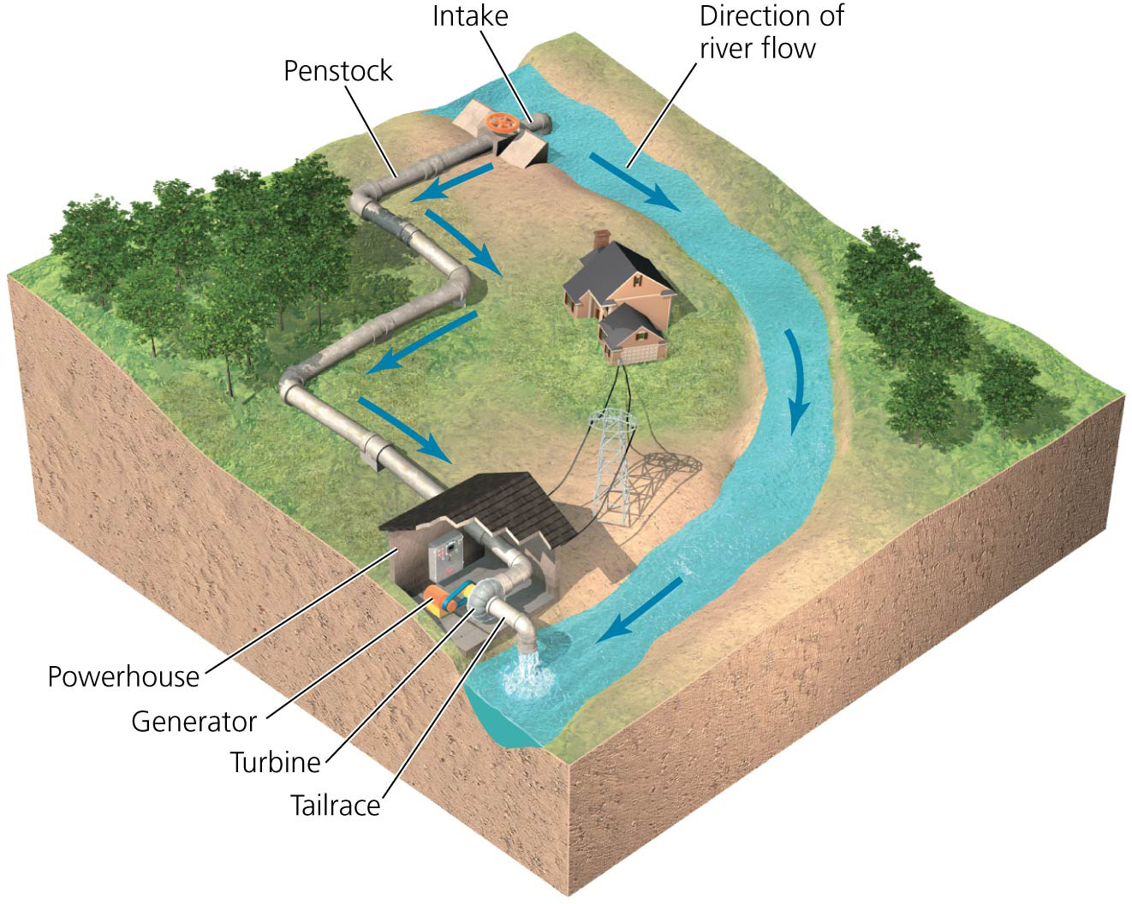

Slide 81
Hydropower is clean and renewable, but also has impacts
Hydropower has three clear advantages over fossil fuels for producing electricity:
It is renewable: as long as precipitation fills rivers we can use water to turn turbines
It is efficient: it is thought to have an EROI (energy returned on energy invested) of 100:1 or more
It is clean: no carbon dioxide or other pollutants are emitted into the atmosphere
There are negative impacts:
Fossil fuels are used in constructing dams
Large reservoirs release the greenhouse gas methane

Slide 82
Hydropower is clean and renewable, but also has impacts
Damming rivers destroys wildlife habitats
Upstream areas are submerged
Downstream areas are starved of water
Natural flooding cycles are disrupted
Downstream floodplains don’t get nutrients
Downstream water is shallower and warmer
Periodic flushes of cold reservoir water can kill fish
Dams block passage of fish, fragmenting the river and reducing biodiversity

Slide 83
Hydroelectric power is widely used
Hydropower accounts for 16% of the world’s electricity production
Nations with large rivers and economic resources to build dams have used hydropower for their development
Sweden receives nearly 50% of its electricity and 11% of its total power from hydropower

Slide 84
Hydroelectric power is widely used
However, many countries have dammed their large rivers
People want some rivers left undammed
The U.S. government built dams to employ people and help end the economic depression of the 1930s
Engineers exported their dam-building techniques to developing countries

Slide 85
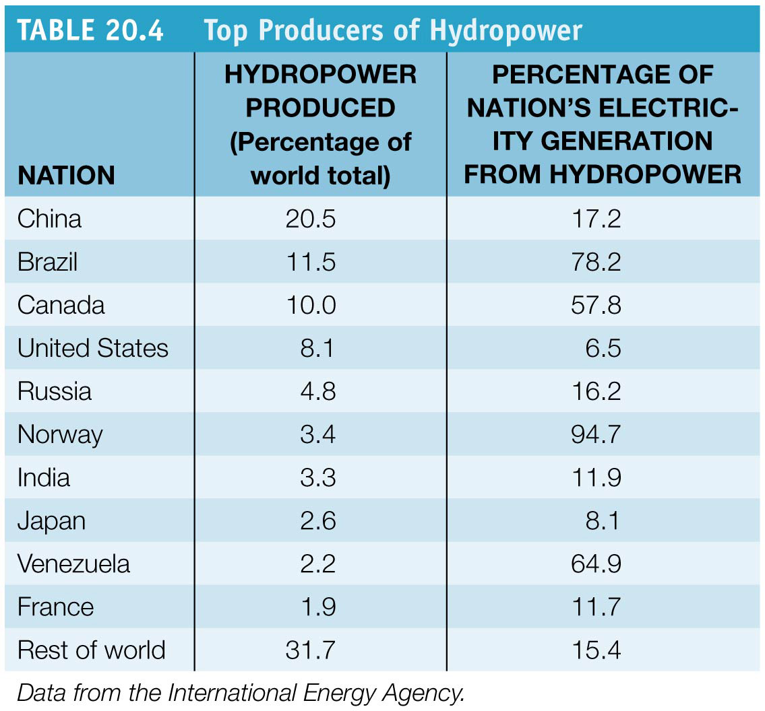

Slide 86
Hydropower’s expansion is limited
There are massive dam construction projects going on
China’s Three Gorges Dam is the world’s largest dam
Displaced 1 million people
Generates as much electricity as dozens of coal-fired or nuclear plants

Slide 87
Hydropower’s expansion is limited
Most of the world’s large rivers have already been dammed, limiting potential expansion
98% of the appropriate rivers in the United States have already been dammed
People have grown aware of the ecological impact of dams and resist more construction
Developing nations with rivers will increase hydropower

Slide 88
Conclusion
With limited fossil fuel supplies, nations are trying to diversify their energy portfolios
Nuclear power showed promise
But high costs and public fears stalled its growth
Biomass energy sources include wood and newer biofuels
They can be carbon-neutral but are not strictly renewable
Hydropower is a renewable, pollution-free alternative
But it is nearing maximal use and can involve substantial ecological impacts

Slide 89
QUESTION: Review
Conventional alternative fuels
exert less environmental impact than fossil fuels but are currently not feasible.
are intermediate sources of fuel that can help us on our path toward sustainability.
are final sources of fuel that will give us energy independence.
are no longer available for widespread use.
Notes:
Answer: b

Slide 90
QUESTION: Review
The reaction that drives the release of energy in today’s nuclear power plants is
nuclear fission.
nuclear fusion.
control rods.
nuclear emergencies.
Notes:
Answer: a

Slide 91
QUESTION: Review
Why have nuclear power plants not been popular in the United States?
Fears about accidents or sabotage.
Storage of nuclear waste is still not solved.
High costs of building and maintaining plants.
All are issues regarding nuclear energy.
Notes:
Answer: d

Slide 92
QUESTION: Review
Ethanol in the United States is made mainly from ______ and is used to ______.
soybeans; heat homes
sugarcane; drive cars
corn; drive cars
willow trees; make electricity
Notes:
Answer: c

Slide 93
QUESTION: Review
Which of the following is an interesting future biofuel?
Corn
Algae
Nuclear
Shale oil
Notes:
Answer: b

Slide 94
QUESTION: Review
Why is the potential for expansion of hydropower limited?
The energy returned on energy invested is too low.
There are concerns about generation of greenhouse gases.
We have already dammed most rivers where hydropower would be useful.
All of these are reasons.
Notes:
Answer: c

Slide 95
QUESTION: Weighing the Issues
Given the choice of living next to a coal-burning power plant or nuclear plant, which would you choose?
The nuclear plant, because it’s cleaner
The coal plant, because it won’t be as likely a target for terrorists
Neither one; I’d move to another place.
Either one; I don’t care.
Notes:
Answer: any

Slide 96
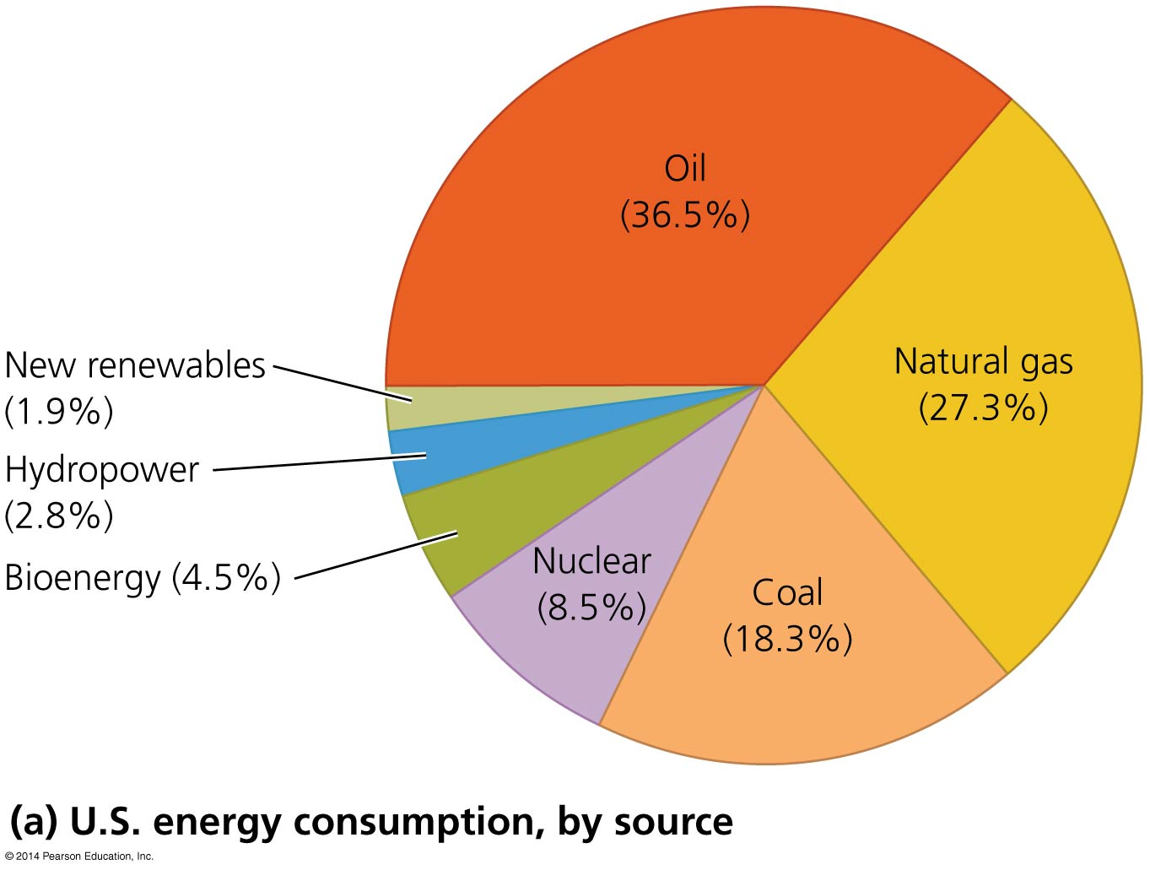
QUESTION: Interpreting Graphs and Data
Which statement can be made based on this graph?
Nuclear power is growing.
More energy comes from natural gas than all non-fossil fuel sources combined.
Hydropower is the largest renewable source of electricity.
None of these
Notes:
Answer: b

Slide 97
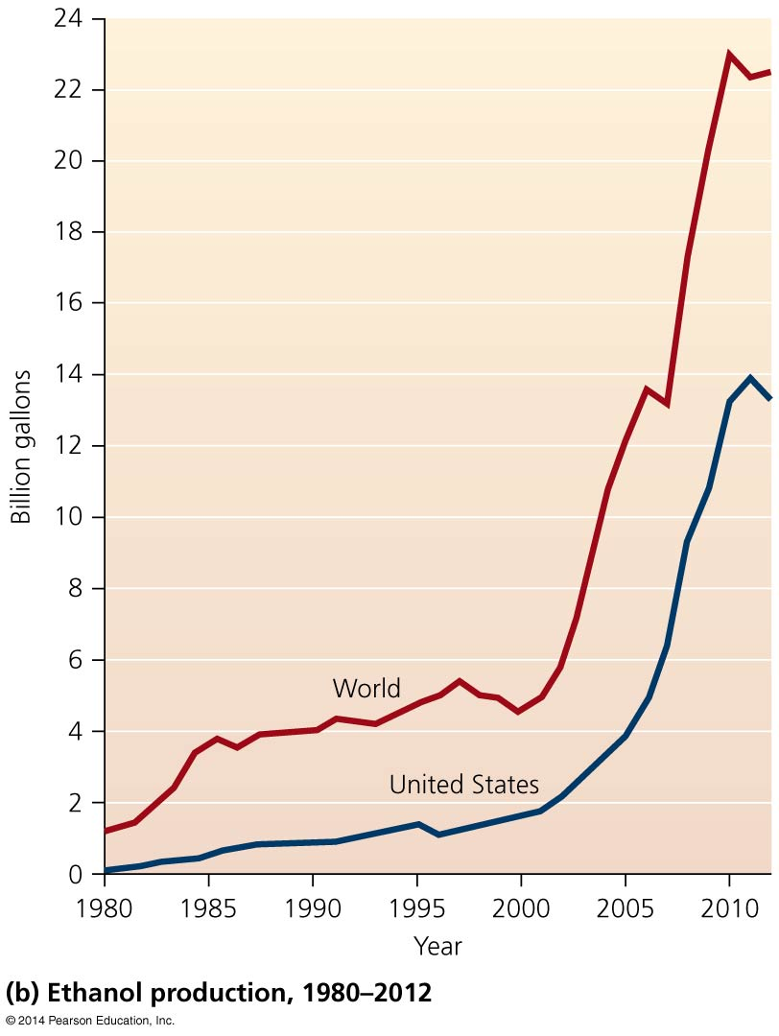
QUESTION: Interpreting Graphs and Data
If ethanol in the United States continues to be produced from corn, a drawback suggested from this graph could be
that more corn is available for ethanol.
more competition between food and fuel.
less land planted in corn.
None of these
Notes:
Answer: b

