Slide 2
This lecture will help you understand:
The fundamentals of matter and chemistry
Energy and energy flow
Photosynthesis, respiration, and chemosynthesis
Plate tectonics and the rock cycle
Geologic hazards and ways to mitigate them

Slide 3
Central Case Study: The Tohoku Earthquake
Earthquake on the Japanese island of Honshu caused a massive tsunami
The waves overtopped the sea walls, causing flooding up to 9.6 km inland
The tsunami knocked out power to the Fukushima Daiichi nuclear power plant, causing the fuel to melt and the release of radioactive material
Many countries are now questioning the safety of nuclear power

Slide 4
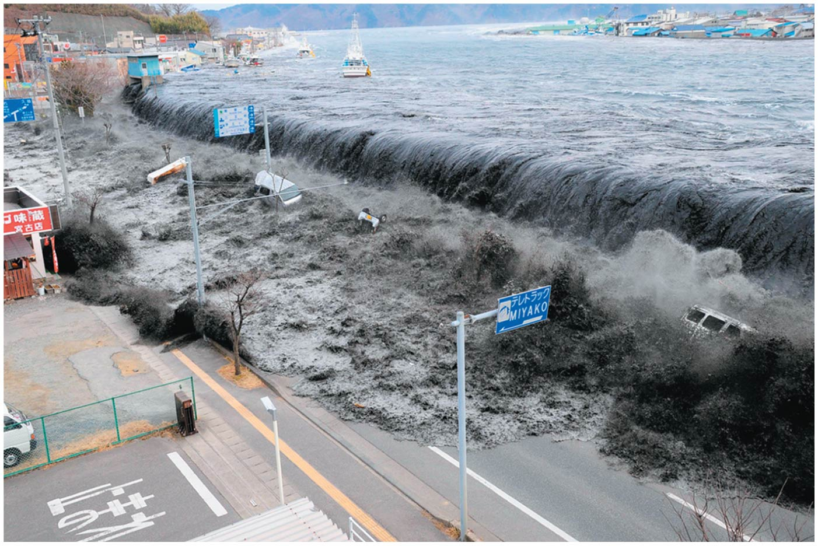

Slide 5
Matter, Chemistry, and the Environment
Chemistry: studies types of matter along with how they interact
Chemistry is crucial for understanding:
How gases contribute to global climate change
How pollutants cause acid rain
Pesticide effects on health of wildlife and people
Water pollution
Wastewater treatment
Atmospheric ozone depletion
Energy issues

Slide 6
Matter is conserved
Matter = all material in the universe that has mass and occupies space
The law of conservation of matter = matter can be transformed from one type of substance into others, but it cannot be destroyed or created
Because the amount of matter stays constant,
it is recycled in nutrient cycles and ecosystems
we cannot simply wish pollution and waste away

Slide 7
Atoms and elements are chemical building blocks
Element = a fundamental type of matter
A chemical substance with a given set of properties
Atoms = the smallest components that maintain an element’s chemical properties
The atom’s nucleus (center) has protons (positively charged particles) and neutrons (particles lacking electric charge)
Atomic number = the number of protons
Electrons = negatively charged particles surrounding the nucleus

Slide 8
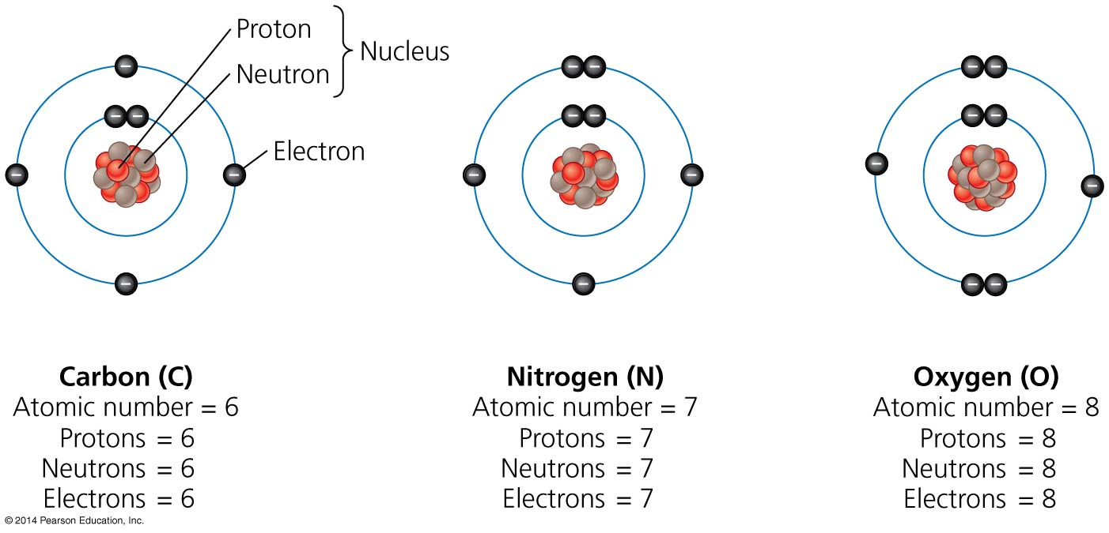

Slide 9
Isotopes and Ions
Isotopes = atoms of the same element with different numbers of neutrons
Isotopes of an element behave differently
Mass number = the combined number of protons and neutrons
Atoms that gain or lose electrons become electrically charged ions

Slide 10
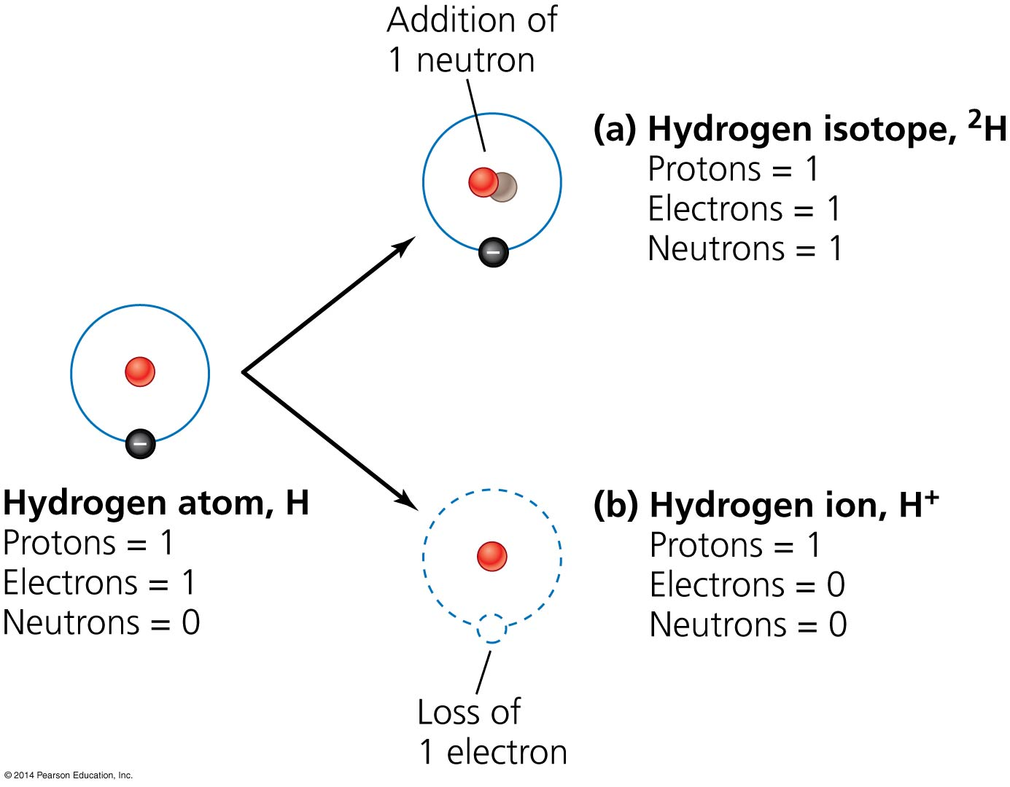

Slide 11
Isotopes and Ions
Radioactive isotopes (radioisotopes) decay until they become non-radioactive stable isotopes
Emit high-energy radiation
This radiation is called ionizing radiation because it generates ions when it strikes other atoms
Half-life = the amount of time it takes for one-half of the atoms to give off radiation and decay
Different radioisotopes have different half-lives ranging from fractions of a second to billions of years
Uranium-235, used in commercial nuclear power, has a half-life of 700 million years

Slide 12
Atoms bond to form molecules and compounds
Molecules = combinations of two or more atoms
Oxygen gas = O₂
Compound = a molecule composed of atoms of two or more different elements
Water = two hydrogen atoms bonded to one oxygen atom: H₂O
Carbon dioxide = one carbon atom with two oxygen atoms: CO₂

Slide 13
Atoms bond to form molecules and compounds
Atoms bond because of an attraction for each other’s electrons
In some bonds, atoms share electrons equally (e.g., H₂)
Atoms may share electrons unequally
The oxygen in water attracts hydrogen’s electrons
= an electron is transferred
Table salt (NaCl): the Na⁺ ion donated an electron to the Ionic compounds (salts)
SolutionsCl⁻ ion
= a mixture of substances with no chemical bonding (e.g., air, ocean water, petroleum, ozone)

Slide 14
Atoms bond to form molecules and compounds
In ionic bonds electrons are transferred between atoms
In covalent bonds electrons are shared between atoms

Slide 15
Water’s chemistry facilitates life
Hydrogen bond = oxygen from one water molecule attracts hydrogen atoms of another
Water’s strong cohesion allows transport of nutrients and waste
Water absorbs heat with only small changes in its temperature
Stabilizes water, organisms, and climate

Slide 16
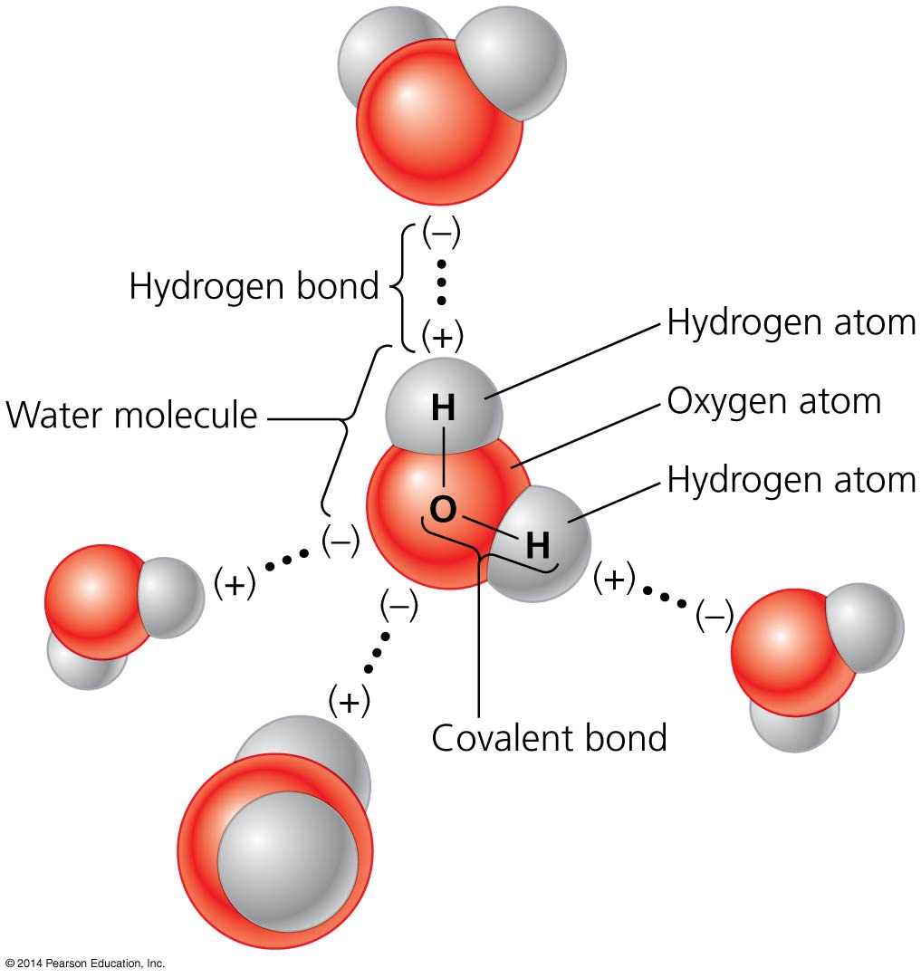

Slide 17
Water’s chemistry facilitates life
Less dense ice floats on liquid water
This insulates lakes and ponds in winter
Water dissolves other molecules that are vital for life

Slide 18
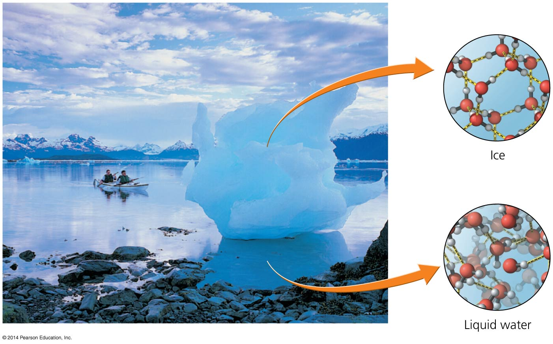

Slide 19
Hydrogen ions determine acidity
The pH scale quantifies the acidity of solutions
Ranges from 0 to 14
Acidic solutions: pH • 7
Basic solutions: pH • 7
Neutral solutions: pH = 7
The pH scale is logarithmic
A substance with pH of 6 contains 10 times as many hydrogen ions as a substance with pH of 7

Slide 20
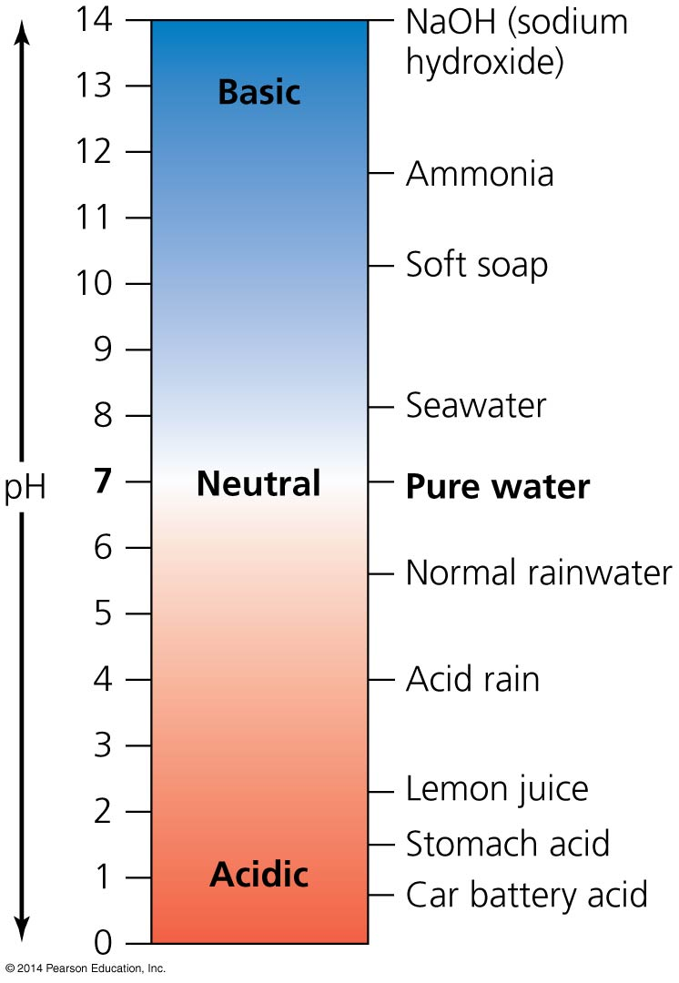

Slide 21
Matter is composed of organic and inorganic compounds
Organic compounds = carbon (and hydrogen) atoms joined by bonds and may include other elements
For example, nitrogen, oxygen, sulfur, phosphorus
Inorganic compounds lack the carbon–carbon bond
Polymers = long chains of carbon molecules
The building blocks of life

Slide 22
Matter is composed of organic and inorganic compounds
Hydrocarbons = contain only carbon and hydrogen
The simplest hydrocarbon is methane (natural gas)
Hydrocarbons can be a gas, liquid, or solid
Fossil fuels consist of hydrocarbons
Some can be harmful to wildlife

Slide 23
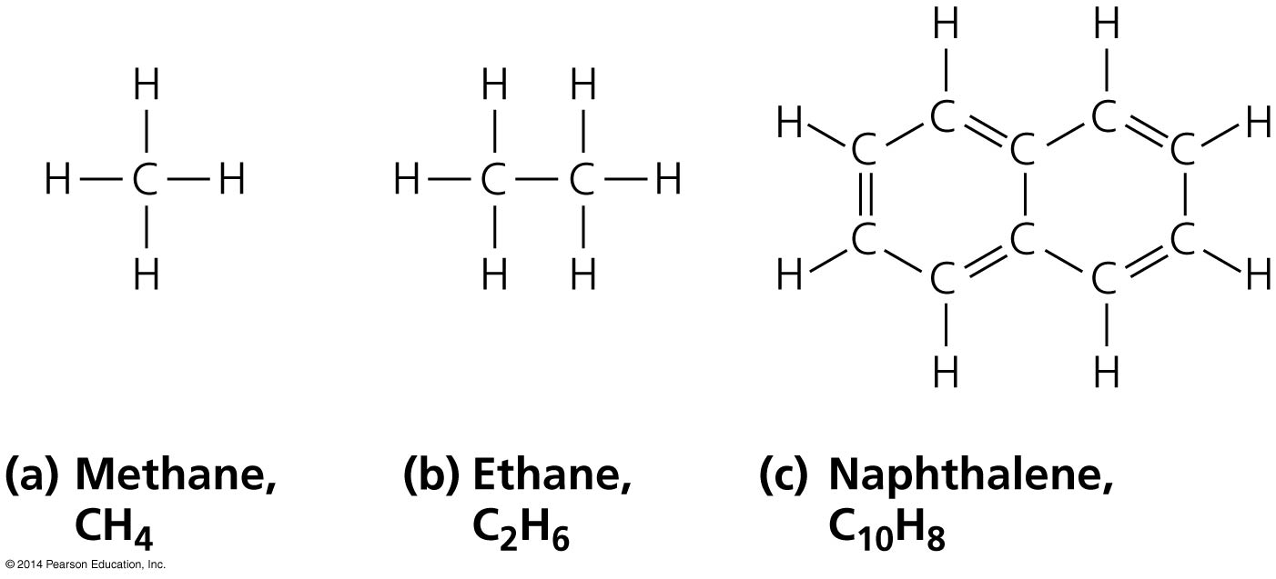

Slide 24
Macromolecules are building blocks of life
Polymers = long chains of repeated molecules
Carbohydrates (polysaccharides) are one type of polymer

Slide 25
Macromolecules are building blocks of life
Macromolecules = large-sized molecules
Three types of polymers are essential to life
Proteins
Nucleic acids
Carbohydrates
Lipids are not polymers, but are also essential
Fats and oils store energy
Phospholipids are structural components of cell membranes
Steroids work as hormones

Slide 26
Macromolecules are building blocks of life
Proteins = long chains of amino acids
They provide structural support, store energy, and transport material
Animals use proteins to generate skin, hair, muscles, and tendons
Some are components of the immune system or work as hormones
They can serve as enzymes, molecules that promote chemical reactions

Slide 27
Macromolecules are building blocks of life
Nucleic acids = long chains of nucleotides that contain sugar, phosphate, and a nitrogen base
Deoxyribonucleic acid (DNA) and ribonucleic acid (RNA) carry hereditary information of organisms
DNA forms a double helix
Genes = regions of DNA that code for proteins that perform certain functions

Slide 28
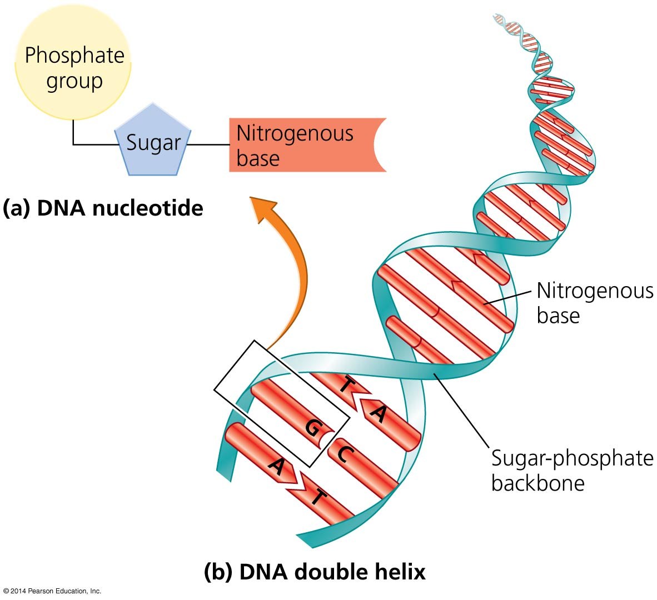

Slide 29
Macromolecules are building blocks of life
Carbohydrates = atoms of carbon, hydrogen, and oxygen
Sugars = simple carbohydrates of 3–7 carbons
Glucose provides energy for cells
Complex carbohydrates build structures and store energy
Starch stores energy in plants
Animals eat plants to get starch
Chitin forms shells of insects and crustaceans
Cellulose is in cell walls of plants

Slide 30
Energy: An Introduction
Energy = the capacity to change the position, physical composition, or temperature of matter
Involved in physical, chemical, biological processes
Potential energy = energy of position
Nuclear, mechanical energy
Kinetic energy = energy of motion
Thermal, light, sound, electrical, subatomic particles
Chemical energy = potential energy held in the bonds between atoms

Slide 32
Energy is always conserved, but it changes in quality
First law of thermodynamics = energy can change forms, but cannot be created or destroyed
Second law of thermodynamics = energy changes from a more-ordered to a less-ordered state
Entropy = an increasing state of disorder
Inputting energy from outside the system increases order

Slide 33
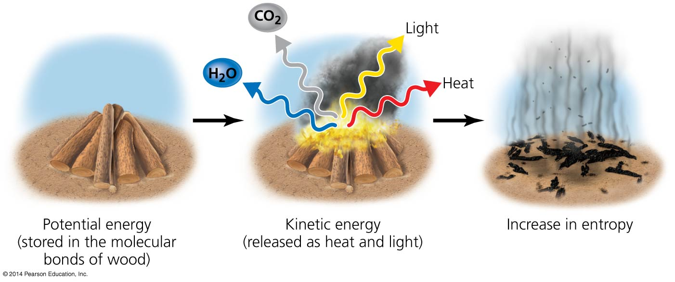

Slide 34
Some energy sources are easier to harness than others
An energy source’s nature determines how easily energy can be harnessed
Fossil fuels provide concentrated energy
Sunlight is spread out and difficult to harness
Energy conversion efficiency = the ratio of useful energy output to the amount needing to be input
16% of the energy released from gasoline is used to power the automobile—the rest is lost as heat
Only 5% of an incandescent light bulb’s energy is converted to light

Slide 35
Light energy from the sun powers most living systems
The sun releases radiation from the electromagnetic spectrum
Solar energy drives weather and climate and powers plant growth
Autotrophs (primary producers) = organisms that produce their own food (e.g., green plants, algae, cyanobacteria)
Photosynthesis = the process of turning the sun’s diffuse light energy into concentrated chemical energy

Slide 37
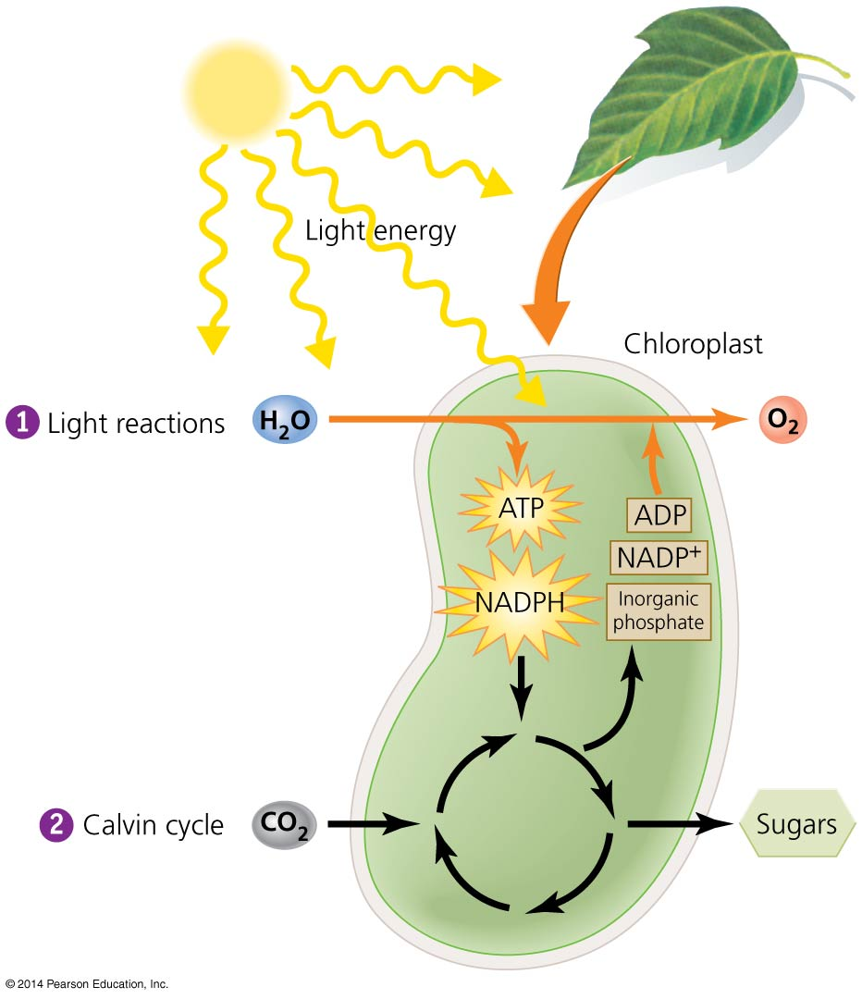

Slide 38
Photosynthesis produces food for plants and animals
Chloroplasts = organelles where photosynthesis occurs
Contain chlorophyll = a light-absorbing pigment
Light reaction = splits water by using solar energy
Calvin cycle = links carbon atoms from carbon dioxide into sugar (glucose)
6CO₂ + 6H₂O + the sun’s energy C₆H₁₂O₆ (sugar) + 6O₂

Slide 39
Cellular respiration releases chemical energy
Cellular respiration occurs in all living things
Organisms use chemical energy stored from photosynthesis
Heterotrophs = organisms that gain energy by feeding on others
Animals, fungi, and microbes are all heterotrophs
The chemical equation for respiration is the exact opposite of that for photosynthesis
C₆H₁₂O₆ (sugar) + 6O₂ 6CO₂ + 6H₂O + energy

Slide 40
Geothermal energy also powers Earth’s systems
Other than the sun, sources of energy include:
The moon’s gravitational pull
Geothermal heat powered by radioactivity
Radioisotopes deep in the planet heat inner Earth
Heated magma erupts from volcanoes
Drives plate tectonics
Warm water can create geysers

Slide 41
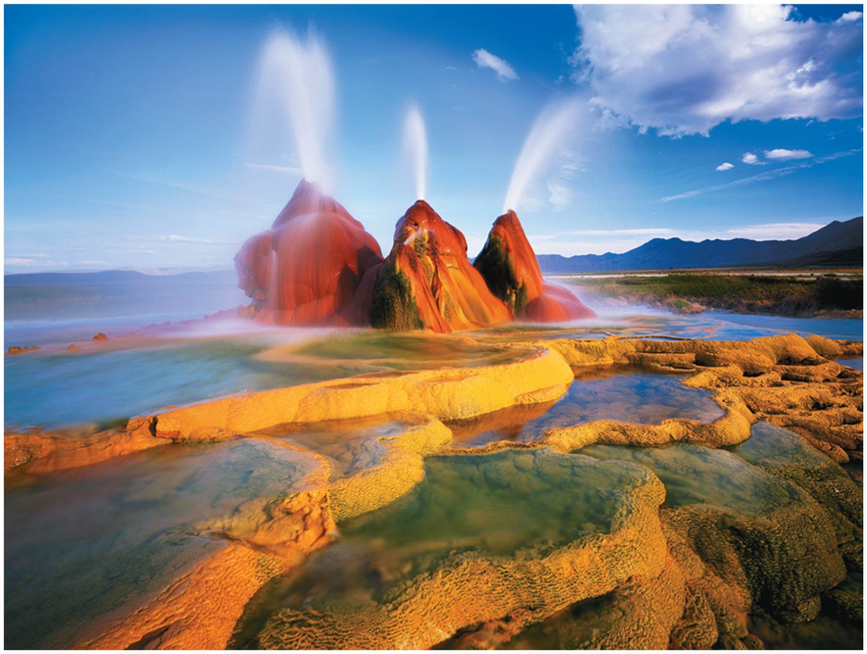

Slide 42
Geothermal energy also powers Earth’s systems
Geothermal energy can power biological communities
Hydrothermal vents = host communities that thrive in high temperature and pressure
Lack of sun prevents photosynthesis
Chemosynthesis = uses energy in hydrogen sulfide to produce sugar
6CO₂ + 6H₂O + 3H₂S C₆H₁₂O₆ (sugar) + 3H₂SO₄

Slide 43
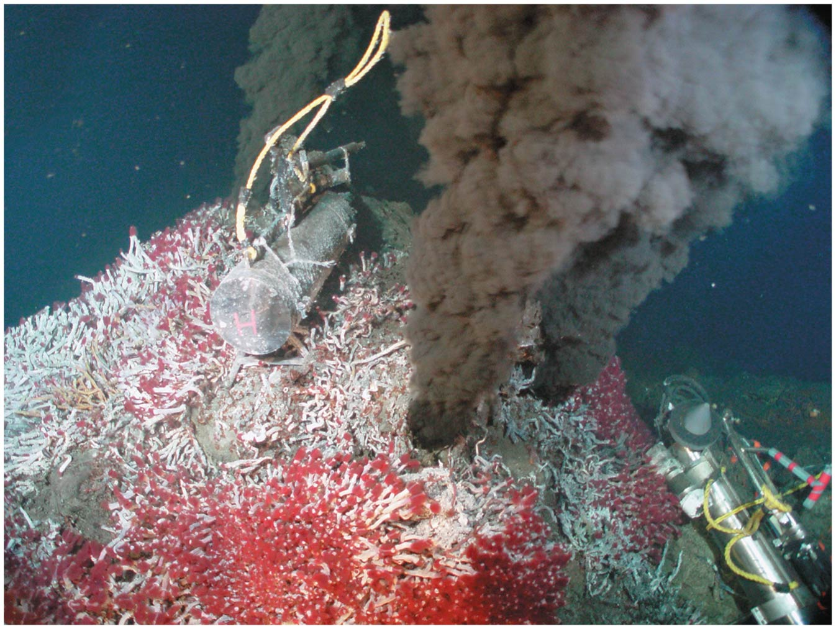

Slide 44
Geology: The Physical Basis for Environmental Science
Physical processes at and below the Earth:
Shape the landscape
Lay the foundation for environmental systems and life
Provide raw materials for industry such as iron, copper, and steel
Provide energy from fossil fuels and geothermal sources
Geology = the study of Earth’s physical features, processes, and history
A human lifetime is just the blink of an eye in geologic time

Slide 45
Earth consists of layers
Core = solid iron in the center
Molten iron in the outer core
Mantle = less dense, elastic rock
Asthenosphere = very soft or melted rock
Area of geothermal energy
Crust = the thin, brittle, low-density layer of rock
Lithosphere = the uppermost mantle and the crust

Slide 46
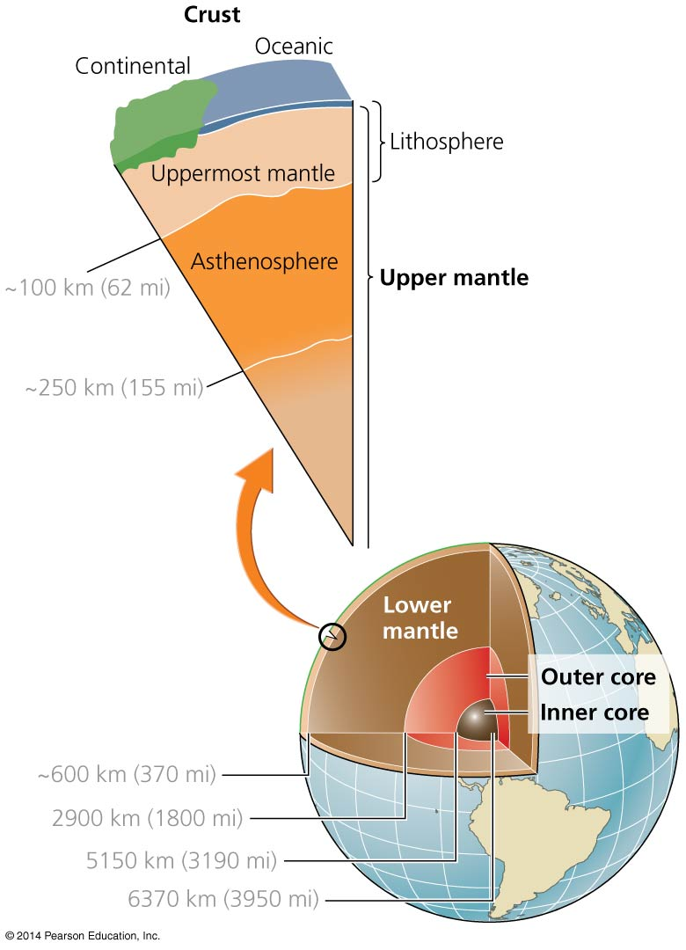

Slide 47
Plate tectonics shapes Earth’s geography
Plate tectonics = movement of lithospheric plates
Heat from Earth’s inner layers drives convection currents
Pushes the mantle’s soft rock up (as it warms) and down (as it cools) like a conveyor belt
The lithosphere is dragged along with the mantle
Continents have combined, separated, and recombined over millions of years
Pangaea = all landmasses were joined into this supercontinent 225 million years ago

Slide 48
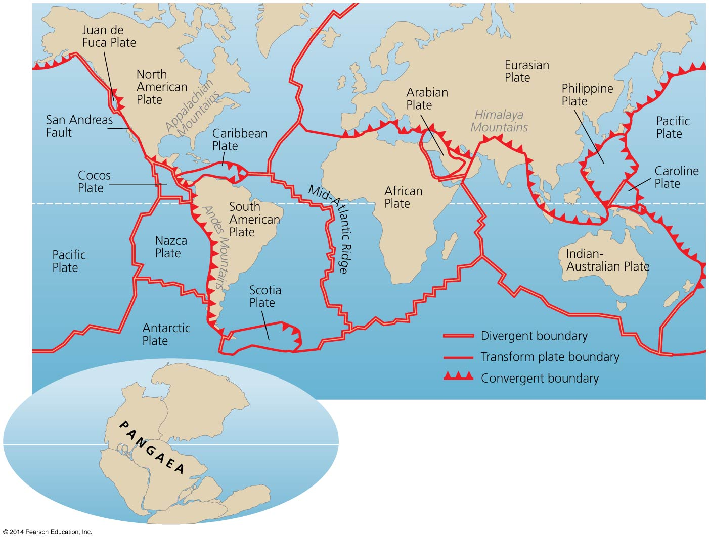

Slide 49
There are three types of plate boundaries
Divergent plate boundaries
Magma rises to the surface
Pushes plates apart
Creates new crust
Has volcanoes and hydrothermal vents
Transform plate boundaries
Two plates meet, slipping and grinding
Friction spawns earthquakes along strike-slip faults

Slide 50
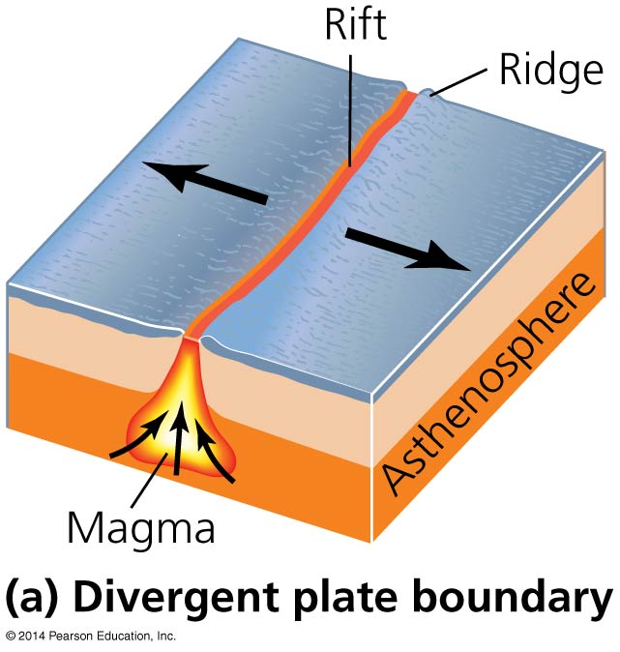
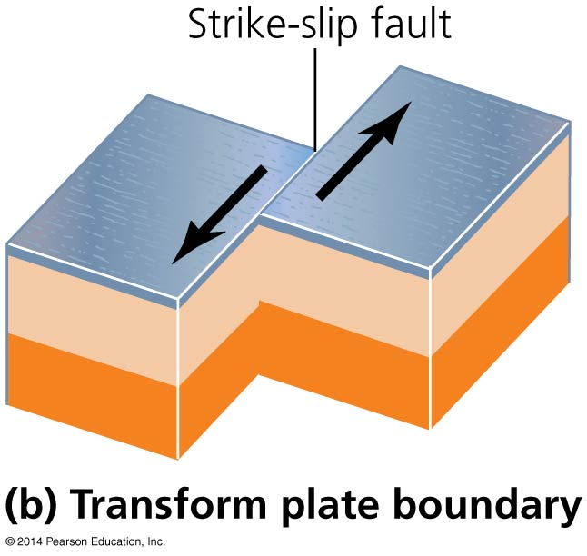

Slide 51
There are three types of plate boundaries
Convergent plate boundaries = where plates collide
Subduction = process in which the oceanic plate slides beneath continental crust (e.g., the Cascades, Andes Mountains)
Magma erupts through the surface in volcanoes
Continental collision = occurs when two plates of continental crust collide
Built the Himalaya and Appalachian Mountains
Notes:
51

Slide 52
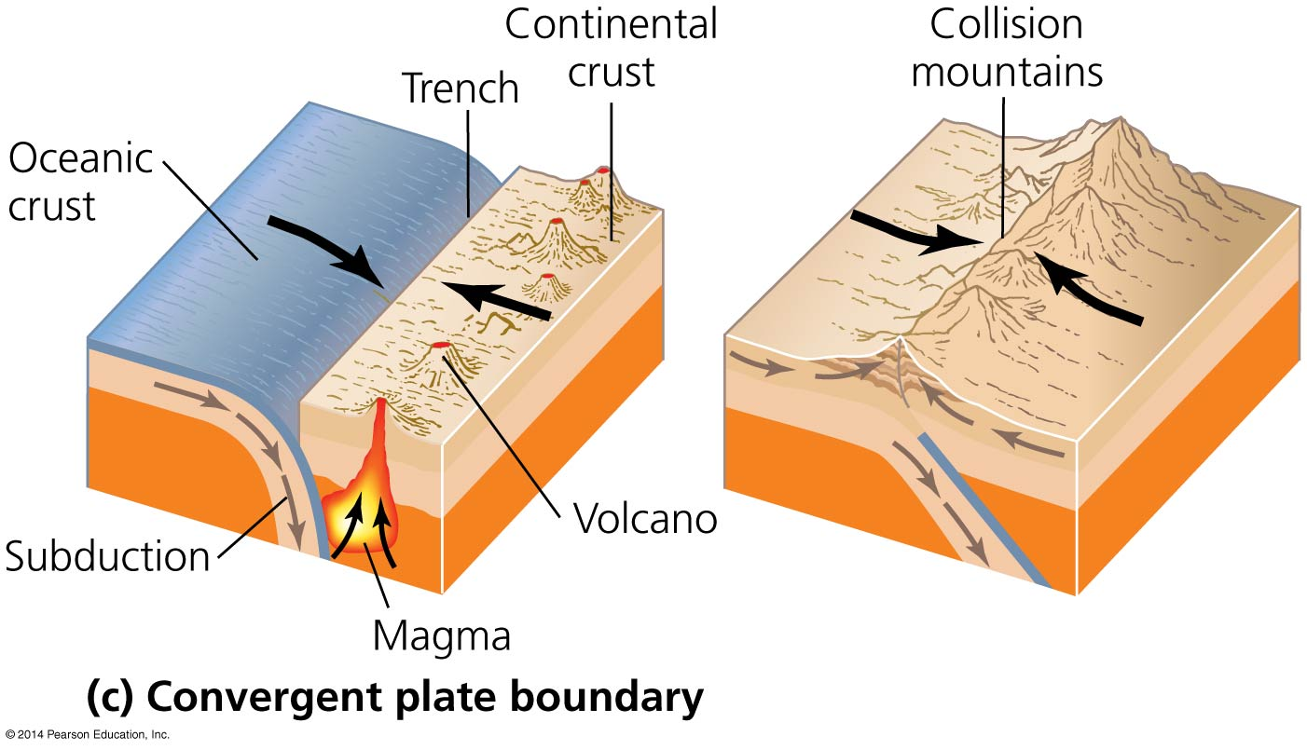

Slide 53
Tectonics produces Earth’s landforms
Tectonics builds mountains
Shapes the geography of oceans, islands, and continents
Gives rise to earthquakes and volcanoes
Topography created by tectonics shapes climate
Alters patterns of rain, wind, currents, heating, cooling
Thereby affecting the locations of biomes and influencing where animals and plants live

Slide 54
The rock cycle alters rock
Rock = any solid aggregation of minerals
Mineral = any element or inorganic compound
Has a crystal structure, specific chemical composition, and distinct physical properties
Rocks help determine soil characteristics, which influences the region’s plants community
Understanding the rock cycle helps us appreciate the formation and conservation of soils, minerals, fossil fuels, and other natural resources
Rock cycle = the heating, melting, cooling, breaking, and reassembling of rocks and minerals
Notes:
54

Slide 55
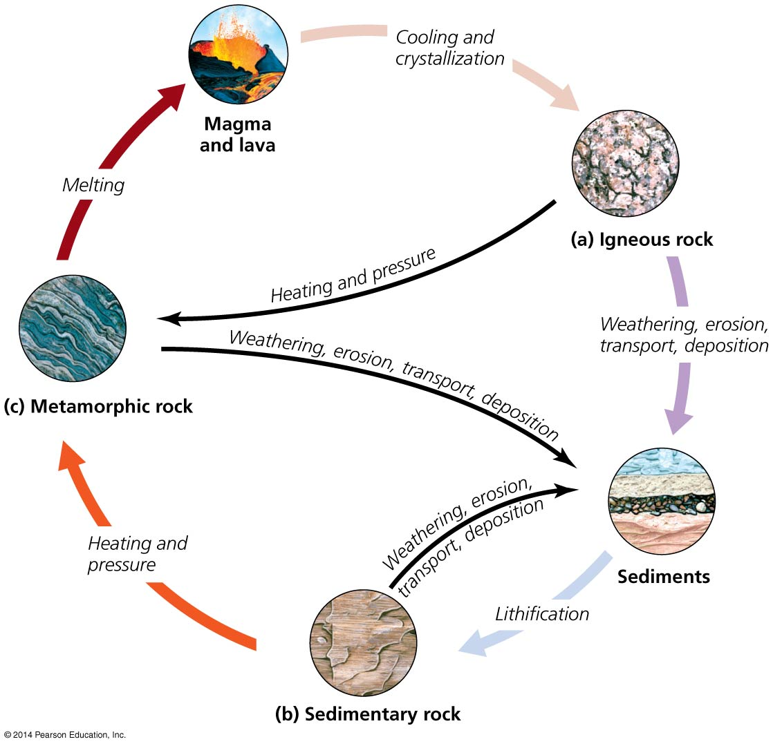
Notes:
55

Slide 56
Igneous rock
Magma = molten, liquid rock
Lava = magma released from the lithosphere
Igneous rock = forms when magma cools
Intrusive igneous rock = magma that cools slowly below Earth’s surface (e.g., granite)
Extrusive igneous rock = magma ejected from a volcano (e.g., basalt)
Notes:
56

Slide 57
Sedimentary rock
Sediments = rock particles blown by wind or washed away by water
Sedimentary rock = formed when sediments are compacted or cemented (dissolved minerals crystallize and bind together)
Sandstone, limestone, shale
Lithification = formation of rock (and fossils) through compaction and crystallization
Notes:
57

Slide 58
Metamorphic rock
Metamorphic rock = formed when great heat or pressure on a rock changes its form
High temperature reshapes crystals, changing rock’s appearance and physical properties
Marble = heated and pressurized limestone
Slate = heated and pressurized shale
Notes:
58

Slide 59
Geologic and Natural Hazards
Some consequences of plate tectonics are hazardous
Plate boundaries closely match the circum-Pacific belt or “ring of fire”:
An arc of subduction zones and fault systems
Has 90% of earthquakes and 50% of volcanoes

Slide 60
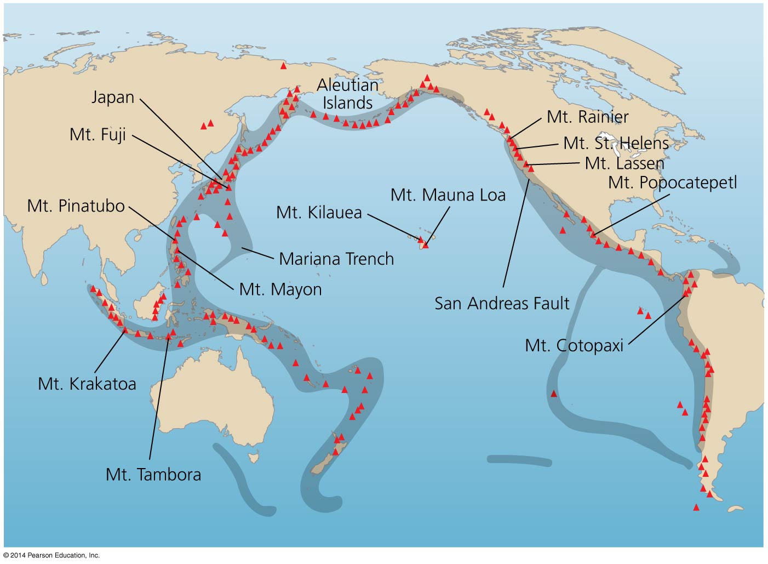

Slide 61
Earthquakes result from movement at plate boundaries and faults
Earthquake = a release of energy (pressure) along plate boundaries and faults
Can do tremendous damage to life and property
Buildings can be built or retrofitted to decrease damage
Buildings are designed to be more flexible
Expensive—buildings in many poorer nations do not have such protections

Slide 62
Volcanoes arise from rifts, subduction zones, or hotspots
Volcano = formed when molten rock, hot gas, or ash erupts through Earth’s surface, cooling and creating a mountain
Hotspots form over areas of lava rising from the mantle
Lava can flow slowly or erupt suddenly
Pyroclastic flow: fast-moving cloud of gas, ash, and rock
Buried Pompeii in A.D. 79

Slide 63
Volcanoes arise from rifts, subduction zones, or hotspots
Volcanic eruptions exert environmental impacts: ash blocks sunlight and sulfur emissions lead to sulfuric acid, blocking radiation and cooling the atmosphere
Large eruptions can decrease temperatures worldwide
Mount Tambora’s eruption caused the 1816 “year without a summer”
Yellowstone National Park is an ancient supervolcano
Past eruptions were so massive they covered much of North America in ash
The region is still geothermally active

Slide 64
Landslides are a form of mass wasting
Landslide = a severe, sudden mass wasting
Large amounts of rock or soil collapse and flow downhill
Mass wasting = the downslope movement of soil and rock due to gravity
Rains saturate soils and trigger mudslides
Erodes unstable hillsides and damages property
Caused by humans when soil is loosened or exposed
Can cause massive damage—mudslides after Hurricane Mitch in 1998 killed over 11,000 people

Slide 65
Tsunamis can follow earthquakes, volcanoes, or landslides
Tsunami = surge of seawater caused when huge volumes of water are displaced by earthquakes, volcanoes, or landslides
Damage can be widespread, across often distant coastlines
Coral reefs, coastal forests, and wetlands can be damaged
Saltwater contamination makes it hard to restore them
Agencies and nations have increased efforts to give residents advance warning of approaching tsunamis
Preserving coral reefs and mangrove forests decreases the wave energy of tsunamis

Slide 66
We can worsen or mitigate the impacts of natural hazards
We face and affect other natural hazards: floods, coastal erosion, wildfire, tornadoes, and hurricanes
Overpopulation: people must live in susceptible areas
We choose to live in attractive but vulnerable areas (beaches, mountains)
Engineered landscapes increase frequency or severity of hazards (damming rivers, suppressing fire, mining)
Changing climate through greenhouse gases changes rainfall patterns and increases drought, fire, flooding, and storms

Slide 67
We can worsen or mitigate the impacts of natural hazards
We can decrease impacts of hazards through technology, engineering, and policy, informed by geology and ecology
Build earthquake-resistant structures
Design early warning systems (tsunamis, volcanoes)
Preserve reefs and shorelines (tsunamis, erosion)
Better forestry, agriculture, mining (mass wasting)
Regulations, building codes, insurance incentives discourage developing in vulnerable areas
Mitigating climate change may reduce natural hazards

Slide 68
Conclusion
Solving environmental problems depends on understanding matter, chemistry, and energy
Physical processes of geology (e.g., plate tectonics, the rock cycle) are centrally important
They shape terrain and form the foundation of living system
Geologic processes can threaten us
Processes in one location can initiate events whose impacts go far beyond that one location

Slide 69
QUESTION: Review
Which of the following parts of an atom has a positive charge?
a) Proton
b) Neutron
c) Electron
d) Hydrogen
Notes:
Answer: a

Slide 70
QUESTION: Review
Isotopes are
a) atoms that share electrons.
b) the result of an atom transferring an electron to another atom.
c) atoms of the same element but with a different number of neutrons.
d) where an atom has lost a neutron.
Notes:
Answer: c

Slide 71
QUESTION: Review
Which of the following is NOT a reason water is essential for life?
a) Water can absorb large amounts of heat without changing temperature.
b) Waste and nutrients can be transported in water.
c) Ice floats on liquid water, so fish survive cold winters.
d) Water usually cannot dissolve other molecules, so it stays pure.
Notes:
Answer: d

Slide 72
QUESTION: Review
Which of the following is NOT a carbohydrate?
a) Chitin
b) Starches
c) Glucose
d) DNA
Notes:
Answer: d

Slide 73
QUESTION: Review
According to the first law of thermodynamics,
a) energy cannot be created or destroyed.
b) things tend to move toward a more disorderly state.
c) matter can be created, but not energy.
d) kinetic energy is the most efficient source of energy.
Notes:
Answer: a

Slide 74
QUESTION: Review
Which of the following organisms is a heterotroph?
a) Rose
b) Pine tree
c) Deep-sea tubeworm
d) None of these
Notes:
Answer: c

Slide 75
QUESTION: Review
Which action created the Himalaya Mountains?
a) Divergent plate boundaries
b) Continental collision
c) Transform plate boundaries
d) A strike-slip fault
Notes:
Answer: b

Slide 76
QUESTION: Review
Which type of rock is formed through compaction or cementation?
a) Igneous rock
b) Metamorphic rock
c) Sedimentary rock
d) Minerals
Notes:
Answer: c

Slide 77
QUESTION: Review
Which natural disaster is defined as “a severe, sudden mass wasting”?
a) An earthquake
b) A volcano
c) A landslide
d) A tsunami
Notes:
Answer: c

Slide 78
QUESTION: Weighing the Issues
Should people be allowed to live in areas that have a high chance of a natural disaster (e.g., earthquake, tsunami), especially after one has already done damage there?
a) Yes, people should be allowed to live anywhere they want.
b) Yes, but they should be forced to carry heavy insurance.
c) No, some areas should not be lived in.
Notes:
Answer: any

Slide 79
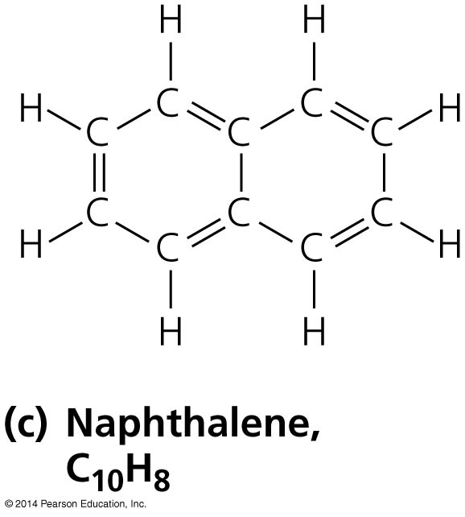
QUESTION: Interpreting Graphs and Data
A molecule of the hydrocarbon naphthalene contains
a) 10 carbon atoms and 8 hydrogen atoms.
b) 8 carbon molecules and 10 hydrogen enzymes.
c) carbon and hydrogen DNA.
d) two different ions.
Notes:
Answer: a

Slide 80
QUESTION: Interpreting Graphs and Data
Which is the most basic material?
Soft soap
Rainwater
Acid rain
Lemon juice
Notes:
Answer: a

