Slide 2
This lecture will help you understand:
Our energy sources
Coal
Natural gas
Crude oil
Oil sands and other alternative fossil fuels
Environmental impacts of fossil fuels
Political, social, and economic aspects
Conserving energy and enhancing efficiency

Slide 3
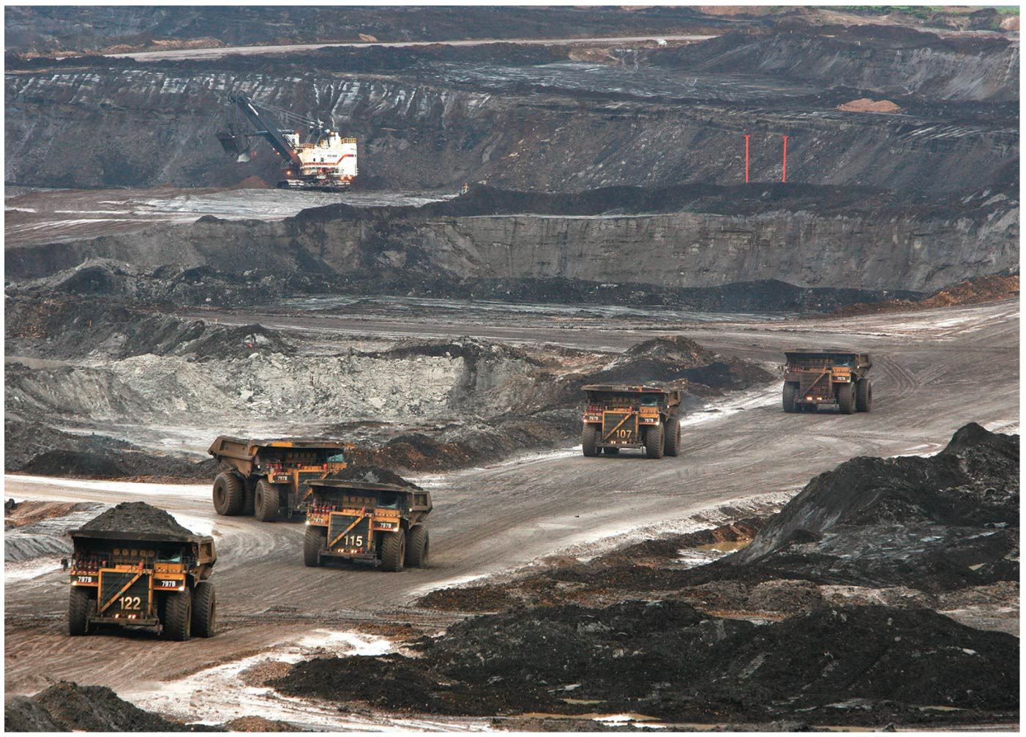

Slide 4
Central Case Study: Alberta’s Oil Sands and the Keystone XL Pipeline
Canada’s oils sands (or tar sands) are layers of sand or clay saturated with a viscous, tarry type of petroleum called bitumen
Are they the answer to continuing our current fossil-fuel-based lifestyle?
Or are they a source of appalling pollution that threatens the Earth’s climate?
To get at the sands, the boreal forest is cleared and the area is strip mined
The sands are mixed with hot water and chemicals, creating toxic wastewater

Slide 5
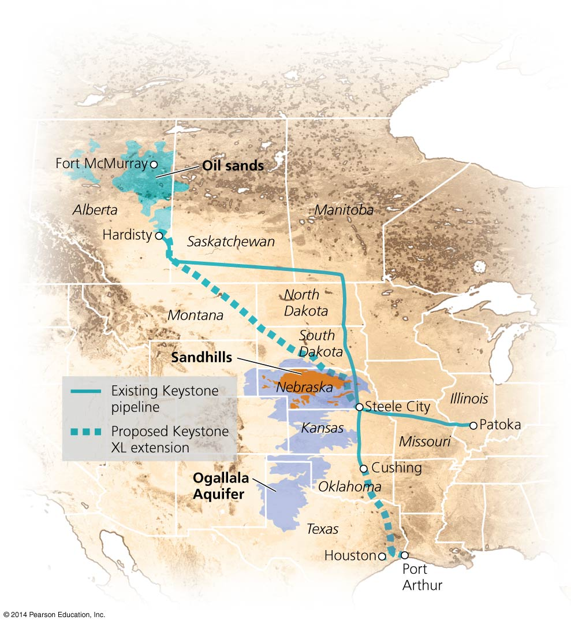

Slide 6
Central Case: Alberta’s Oil Sands and the Keystone XL Pipeline
The oil sands produce 1.7 million barrels of oil per day
Canada has the third largest proven oil reserves
The United States is the major purchaser of this oil
The current pipeline (the Keystone Pipeline) has limited capacity
The TransCanada Corporation wants to build an extension (the Keystone XL extension) to deliver more oil more quickly all the way to Texas

Slide 7
Central Case: Alberta’s Oil Sands and the Keystone XL Pipeline
Proponents want the jobs the pipeline would create
Opponents dislike the destruction of the boreal forests in Canada and the potential for an oil spill over the Ogallala Aquifer in the United States

Slide 9
Nature offers us a variety of energy sources
We use energy in our homes, machinery, and vehicles and to provide comfort and conveniences
Most of our energy comes from the sun
Solar, wind, hydroelectric, photosynthesis, biomass
Fossil fuels = highly combustible substances from the remains of organisms from past geologic ages
A great deal of energy emanates from Earth’s core
Geothermal power
Immense amounts of energy reside in an atom’s bonds
This energy provides us with nuclear power

Slide 10
Nature offers us a variety of energy sources
Renewable energy: supplies will not be depleted by our use
Sunlight, geothermal energy, and tidal energy
Nonrenewable energy: once depleted, supplies will be replaced within any time span useful to our civilization
Oil, coal, natural gas
To replenish the fossil fuels we have depleted so far would take millions of years
We will use up Earth’s accessible store of fossil fuels in decades to centuries

Slide 11
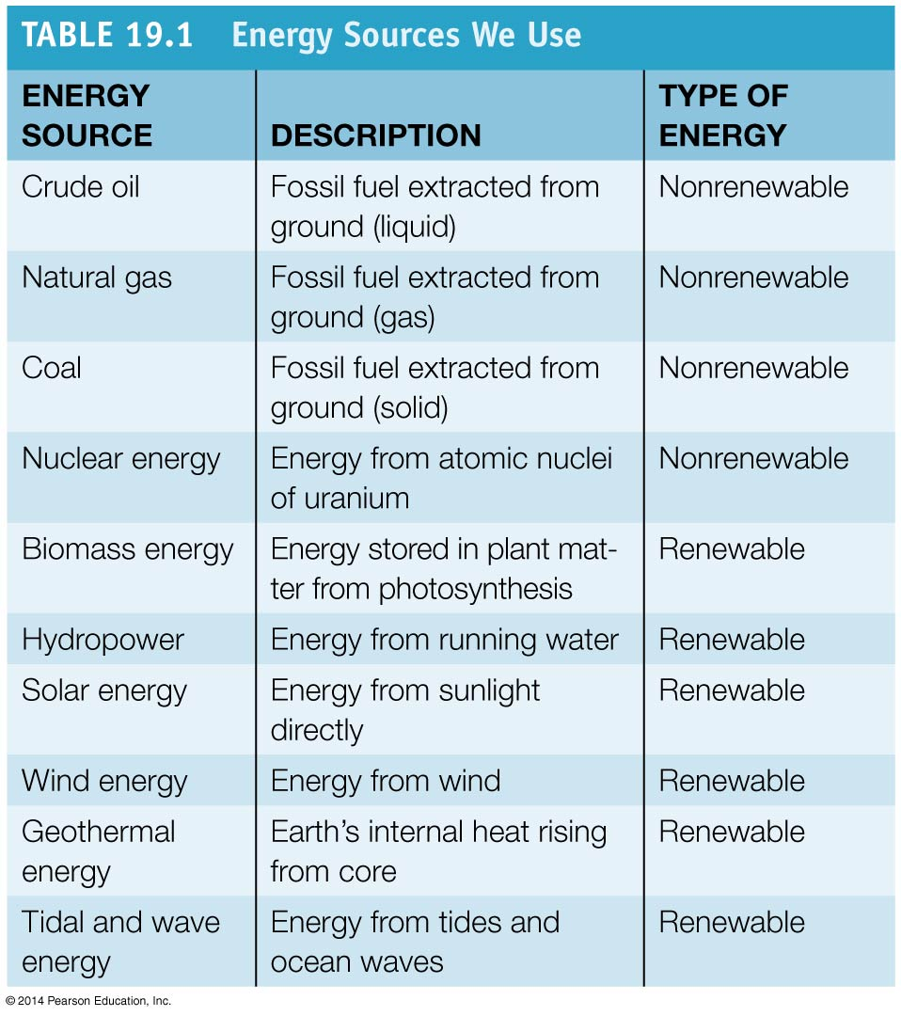

Slide 12
Fossil fuels dominate our energy use
Oil, coal, and natural gas have replaced biomass as our dominant sources of energy
Global consumption is at its highest level ever
The high-energy content of fossil fuels makes them efficient to burn, ship, and store
Used for transportation, manufacturing, heating, cooking and generating electricity
Electricity = a secondary form of energy that is easy to transfer and apply to a variety of uses

Slide 13
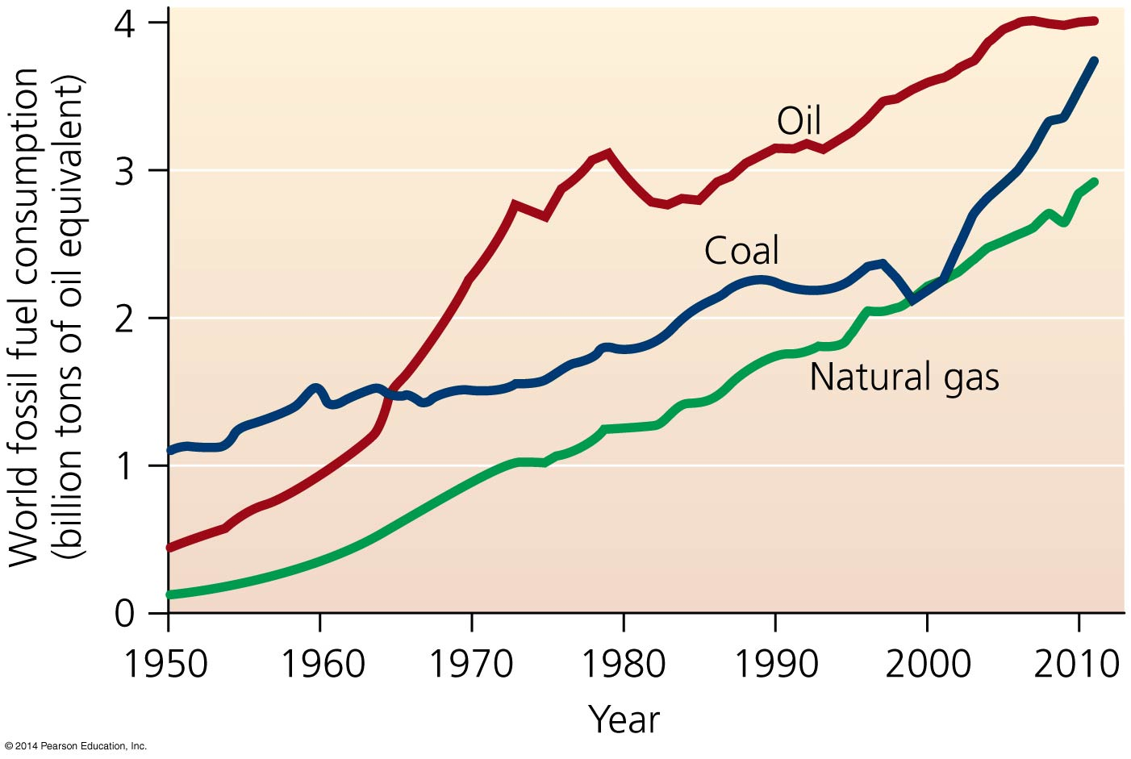

Slide 14
Fossil fuels dominate our energy use
Societies differ in how they use energy
Energy use in industrialized nations is evenly divided between transportation, industry, and other uses

Slide 15
Fossil fuels dominate our energy use
Developing nations use a greater portion of their energy for subsistence activities
Agriculture, food preparation, and home heating
Less for transportation
Often rely on manual or animal energy, not fossil fuels
Industrialized nations rely more on technology and equipment so use more fossil fuels
Fossil fuels supply 82% of the U.S. energy demand

Slide 16
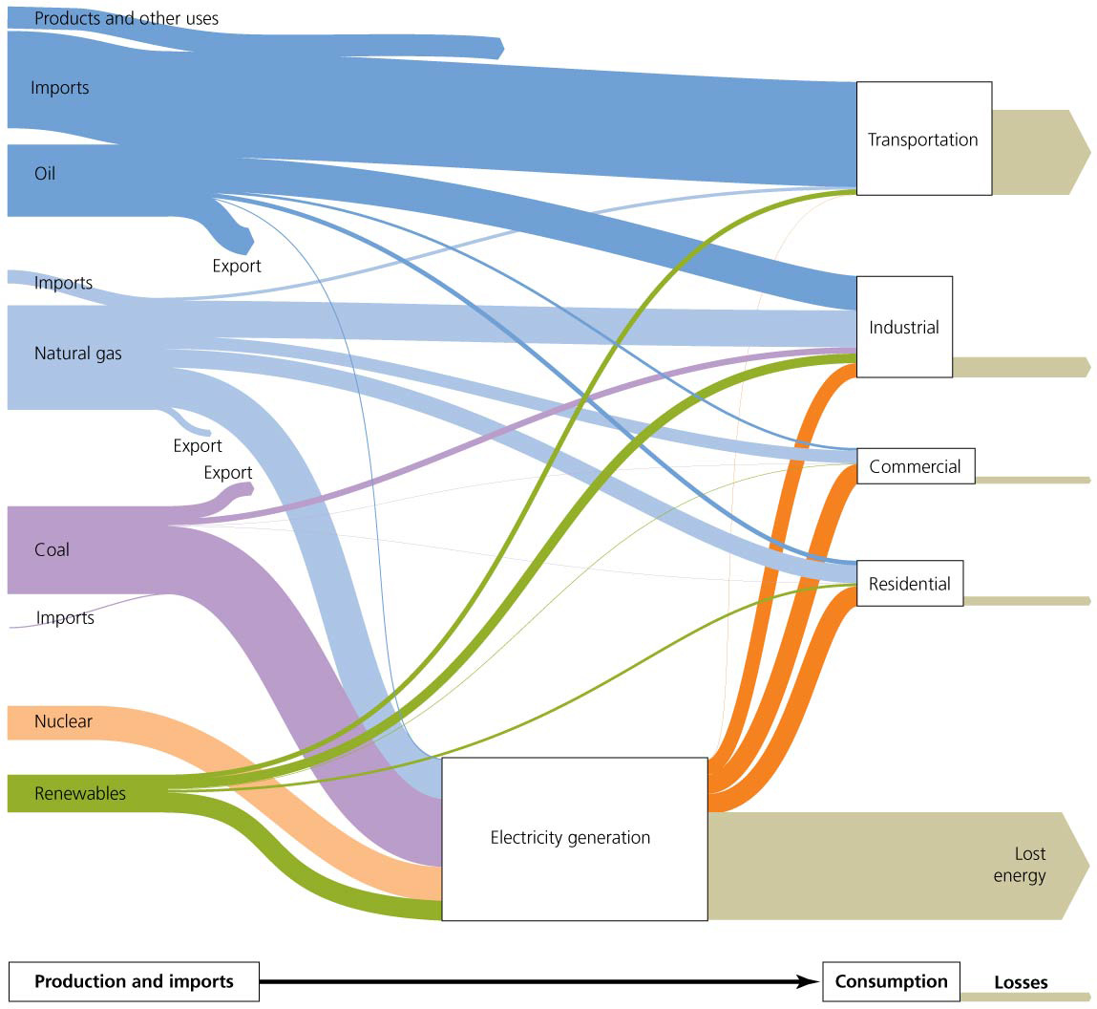
Notes:
Figure 19.3

Slide 17
Energy sources and consumption are unevenly distributed
Industrialized nations use up to 100 times more energy per person than developing nations
The United States has only 4.4% of the world’s population but consumes 19% of its energy
Some regions have substantial reserves of oil, coal, and natural gas, whereas others have very few
Half of the world’s proven reserves of crude oil lie in the Middle East, which is also rich in natural gas
Russia holds the most natural gas
The United States possesses more coal than any other country
Russia and China also have large coal reserves

Slide 18
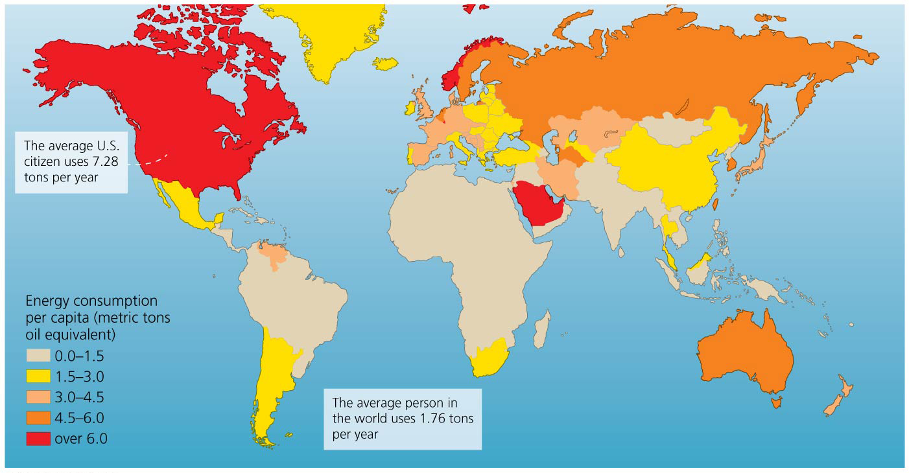

Slide 19
It takes energy to make energy
We don’t get energy for free
To harness, extract, process, and deliver energy requires substantial inputs of energy
Mining oil sands requires powerful vehicles and machinery, roads, pipelines, waste ponds, storage tanks, housing, etc.
All this requires energy
Net energy = the difference between energy returned and energy invested
Net energy = Energy returned − Energy invested

Slide 20
It takes energy to make energy
Energy returned on investment (EROI)
EROI = Energy returned/Energy invested
Higher ratios mean we receive more energy than we invest
Fossil fuels have historically high EROI

Slide 21
It takes energy to make energy
EROI ratios can change
They rise as technology improves
They decline when we extract the easiest deposits first
U.S. oil EROI ratios have gone from 30:1 in the 1950s to 20:1 in the 1970s to around 11:1 today
EROI estimates for oil sands are mostly from 3:1 to 5:1

Slide 22
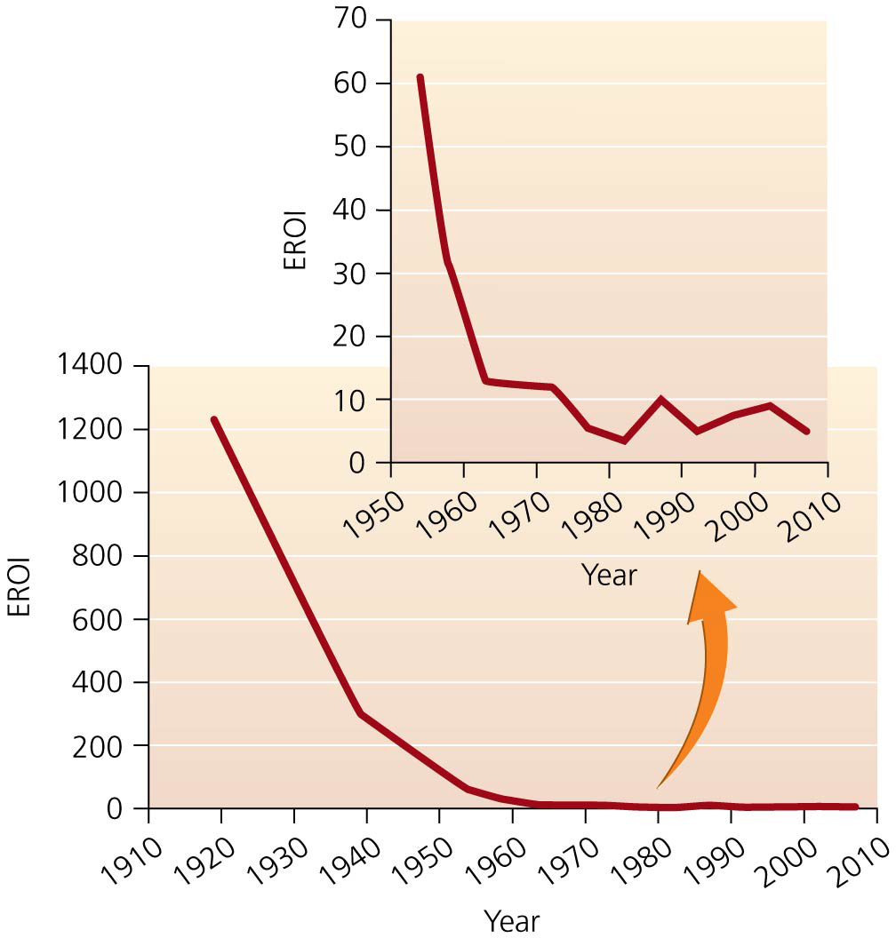

Slide 23
Where will we turn in the future for energy?
The astonishing advances of the 20th century were powered by abundant fossil fuels
Over time we depleted the easy-to-reach sources
EROIs rose, and fuel became more expensive
We developed new technologies to reach new fossil fuel deposits and get more fuel from old ones
We have included new, poorer quality sources such as oil sands and shale oil

Slide 24
Where will we turn in the future for energy?
An alternate strategy to finding more fossil fuels is to switch to clean and renewable energy sources
The switch has begun, but fossil fuels still dominate
Scientists warn that we must switch now or drive our climate into unprecedented territory

Slide 25
Fossil fuels are formed from ancient organic matter
Fossil fuels we use today were formed from organisms that lived 100–500 million years ago
The chemical energy in their tissues was concentrated as the hydrocarbons were altered and compressed
Aerobic decomposition = organic material is broken down and recycled in the presence of air

Slide 26
Fossil fuels are formed from ancient organic matter
Anaerobic decomposition = occurs with little or no air
In deep lakes, swamps, shallow seas
Produces fossil fuels
The fossil fuel produced depends on a number of conditions at the start of and throughout the process

Slide 27
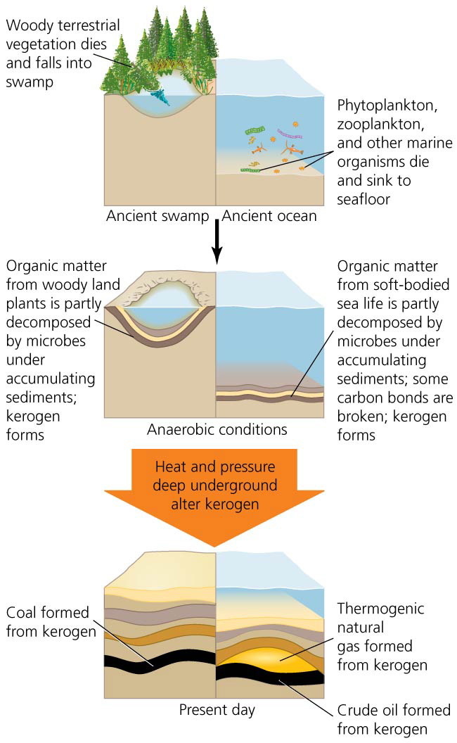

Slide 28
Coal
Coal = a hard blackish substance formed from organic matter (woody plant material) compressed under very high pressure to form dense, solid carbon structures
Very little decomposition occurred to the starting organic material
Coal is the world’s most abundant fossil fuel
Created 300–400 million years ago in swampy environments

Slide 29
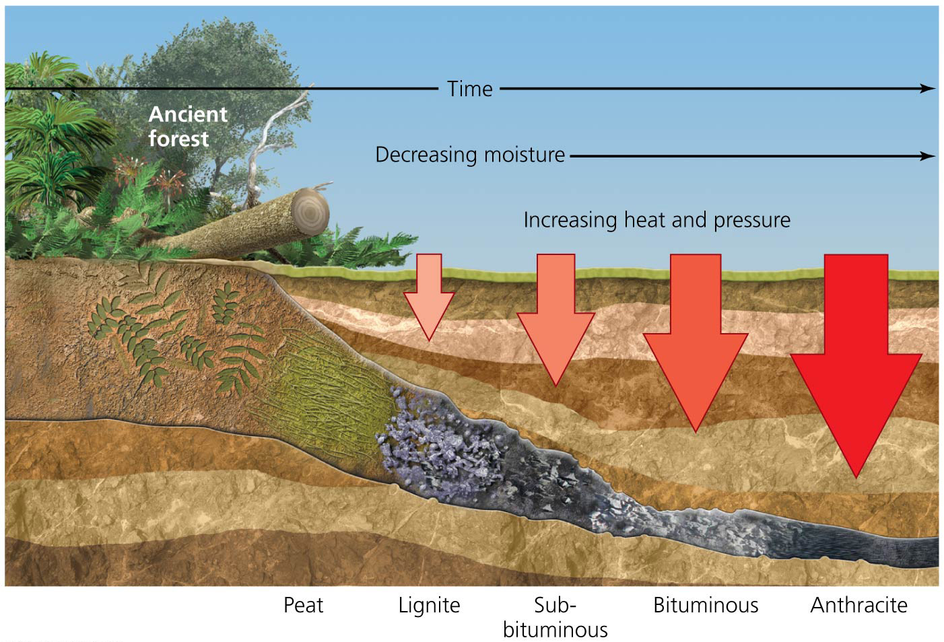

Slide 30
Coal
Coal varies from deposit to deposit in water and carbon content and its amount of potential energy
Peat = organic material that is broken down anaerobically
It is wet, near the surface, and not well compressed
Additional pressure, heat, and time turn peat into coal
Scientists classify coal into four different types

Slide 31
Oil and natural gas
Crude oil (petroleum) = a sludgelike liquid mixture of hundreds of different types of hydrocarbon molecules
Natural gas = methane (CH₄) and other volatile hydrocarbons
Formed when dead organic material was buried in marine sediments and transformed by time, heat, and pressure
Organic matter is turned into kerogen, the source material for both crude oil and natural gas
If the kerogen is 1.5–3 km (1–2 mi) below the surface, it becomes crude oil
If below 3 km, it becomes natural gas

Slide 32
Oil and natural gas
Thermogenic gas = methane and other gases that arise from kerogen through compression and heat deep underground
Most of the gas that is extracted commercially
Often accompanies coal or crude oil deposits
Biogenic gas = nearly pure methane created at shallow depths by bacterial anaerobic decomposition of organic matter
“Swamp gas”
Generated by the decay process in landfills; is being captured and sold as fuel

Slide 33
Oil sands and Oil shale
Oil sands (tar sands) = sand and clay deposits with 1%–20% bitumen = a form of petroleum rich in carbon, poor in hydrogen
Comes from crude oil deposits that have been degraded and chemically altered by water and bacteria
Oil shale = sedimentary rock filled with kerogen
Can be processes to produce shale oil = a liquid form of petroleum
Forms when kerogen was not buried deeply enough or was not subject to enough heat and pressure

Slide 34
Methane hydrate
Methane hydrate (methane clathrate or methane ice) = molecules of methane in a crystal lattice of ice molecules
Occurs in sediments in the Arctic and the ocean floor
Stable at the temperatures and pressures found in those locations
Most formed by bacterial decomposition in anaerobic environments
Some from thermogenic formation deep below the surface

Slide 35
We mine and drill for fossil fuels
Fossil fuels of each type occur in isolated deposits
Oil and natural gas collect in porous rock under impermeable layers
Geologists drill cores and survey the ground and air to predict where fossil fuels may lie
Exploratory drilling = drilling small, deep holes to determine whether extraction should be done
Oil is under pressure and often rises to the surface
Drilling reduces pressure, and oil becomes harder to extract

Slide 36
We mine and drill for fossil fuels
Since coal is a solid, it must be mined rather than drilled for
Strip mining = mining for deposits near the surface
Heavy machinery scrapes away huge amounts of earth to expose the coal
Subsurface mining = underground deposits are reached by digging vertical shafts and horizontal tunnels to follow seams (layers) of coal
Mountaintop removal mining = entire mountaintops are cut off
Environmentally destructive
Common in the Appalachian Mountains

Slide 37
We mine and drill for fossil fuels
Oil sands are extracted using two methods
For surface deposits, a process like strip mining is used
Collected sands are mixed with hot water to separate out the bitumen
Produces three times as much polluted water as oil

Slide 38
We mine and drill for fossil fuels
Deeper oil sands are extracted by drilling shafts into them and injecting steam and solvents
Bitumen separates underground and is pumped out
The bitumen is chemically treated to make syncrude
Oil shale is mined using strip mines
Can be burned like coal or baked in the presence of hydrogen (called pyrolysis) to extract liquid petroleum

Slide 39
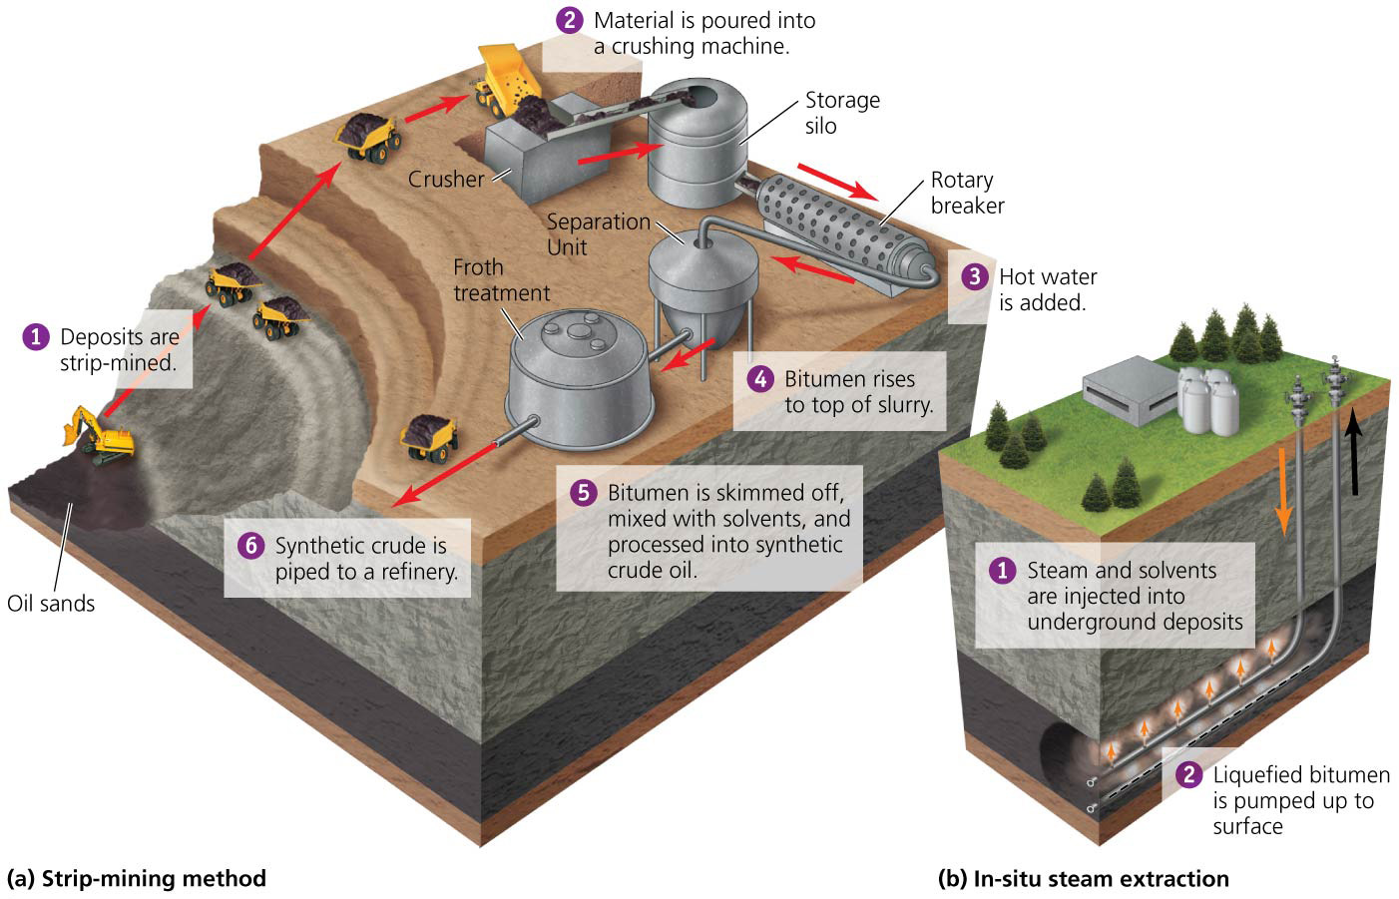

Slide 40
Economics determines how much will be extracted
As we get better technology, we are able to get access to more of the fossil fuels we find
The amount that is “technically recoverable” increases
Technology limits what can be extracted; economics determines how much will be extracted
Some fuel is so hard to extract, it is not worth the cost
As prices rise, economically recoverable amounts approach technically recoverable amounts
Proven recoverable reserve = the amount of oil (or any other fossil fuel) that is technically and economically feasible to remove under current conditions

Slide 41
Refining produces a diversity of fuels
Oil or gas must be processed after extraction
Crude oil is a complex mix of hydrocarbons
Different petroleum products can be made if the hydrocarbons are separated
The hydrocarbons have carbon chains of different lengths
The length of the chain determines the molecule’s properties and use
Refining = hydrocarbons are separated into different size classes and are chemically transformed, creating specialized fuels for many uses
Also lubricating oils, asphalt, plastic precursors

Slide 42
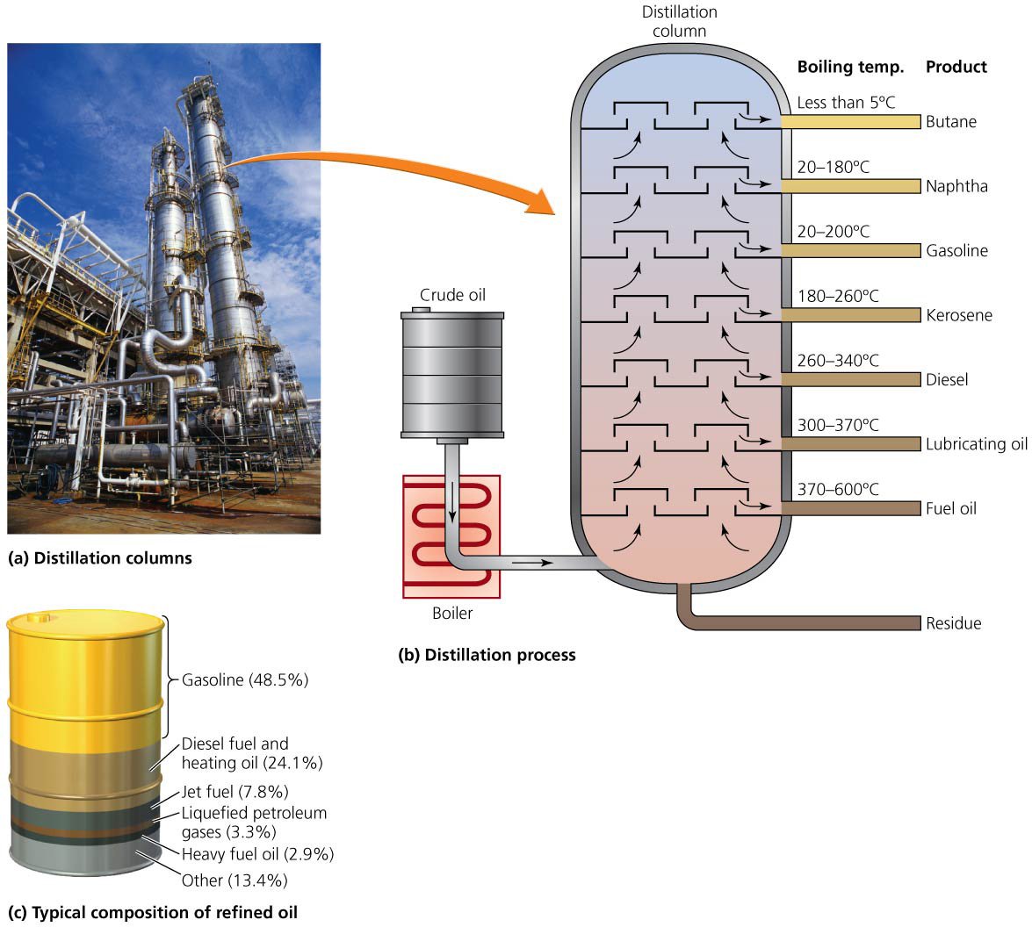

Slide 43
Fossil fuels have many uses
Cultures have used coal for centuries
Ancient China, Roman Empire, the Hopi Nation
Coal helped drive the Industrial Revolution
It fueled furnaces to produce steam
Coal is used to generate electricity
It converts water to steam, which turns a turbine
China is the primary producer and consumer of coal
It provides 40% of the United States’ electrical generating capacity

Slide 44
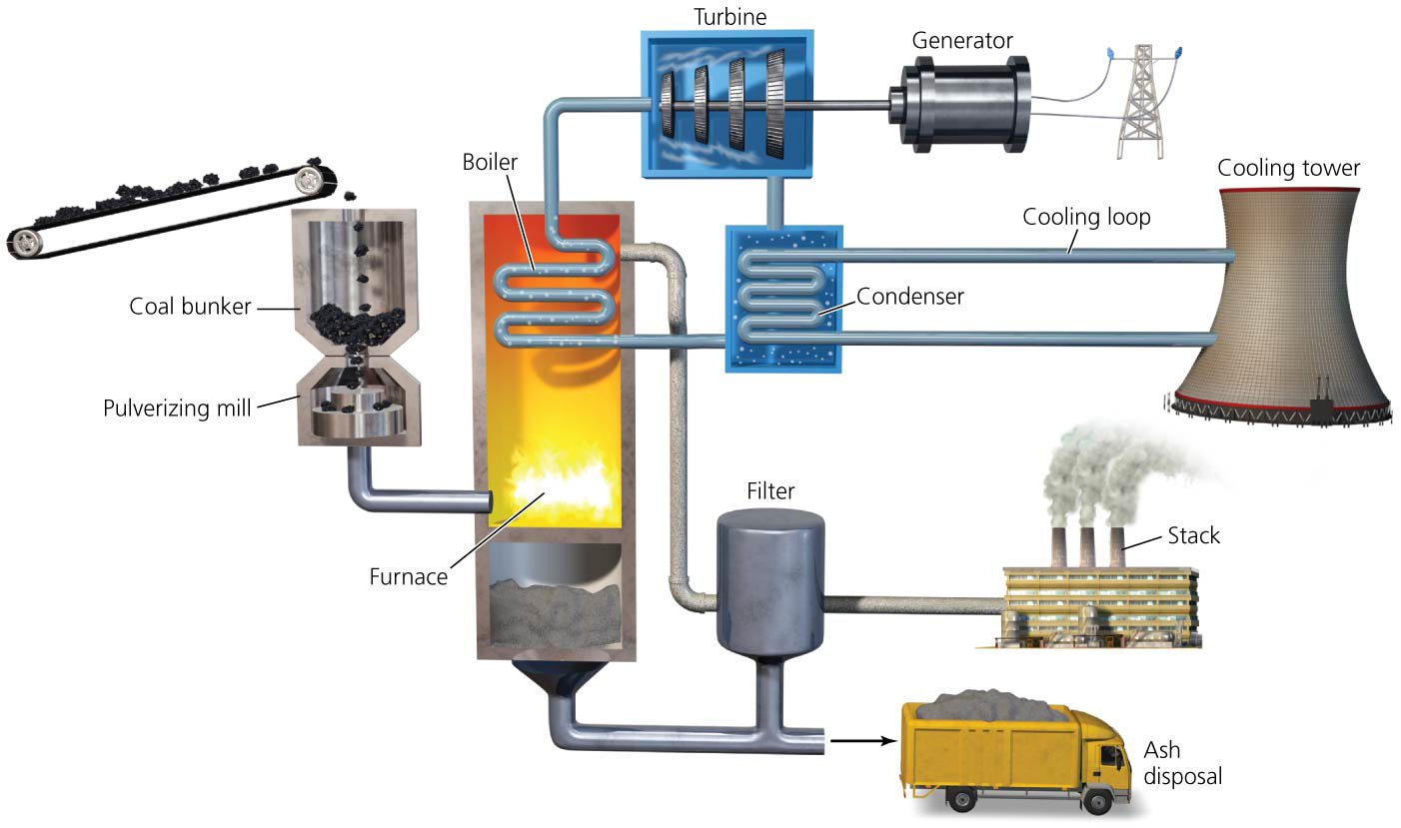

Slide 45
Fossil fuels have many uses
Natural gas is versatile and clean-burning
Emits half as much CO₂ as coal, two-thirds as much as oil per unit energy produced
It is used to generate electricity, heat homes, and cook

Slide 46
Fossil fuels have many uses
Liquefied natural gas (LNG) = gas converted to liquid at low temperatures
Because it produces less carbon emissions than coal, it is viewed as a “bridge fuel”
Will bridge the switch from fossil fuel to renewable energy economy
The United States and Russia lead the world in production and consumption

Slide 47
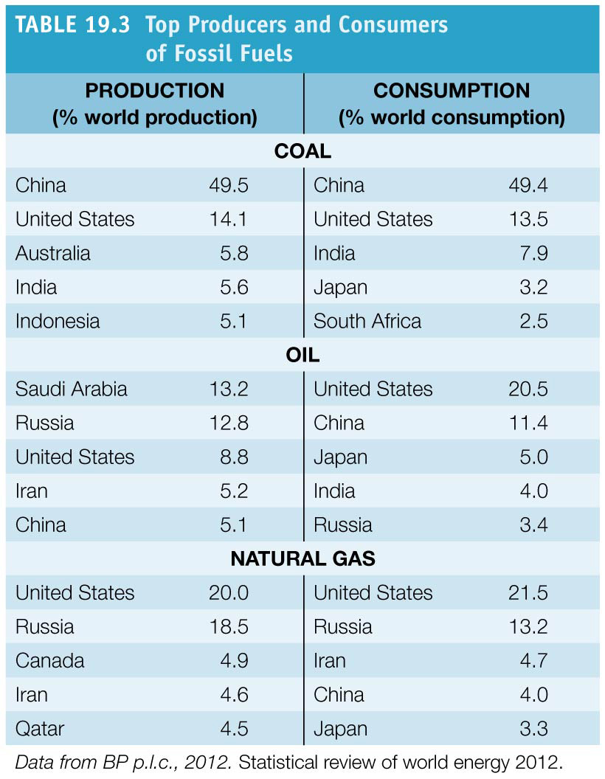

Slide 48
Fossil fuels have many uses
Our modern fossil-fuel-based economy began in Titusville, Pennsylvania, when the world’s first oil well was drilled in 1859
Today the world produces and uses nearly 750 L (200 gal) of oil for each person on the planet
Mostly used for transportation
Used for wide variety of products and applications
The United States consumes one-fifth of the world’s oil
Industrialization in China and India is increasingly driving world demand

Slide 49
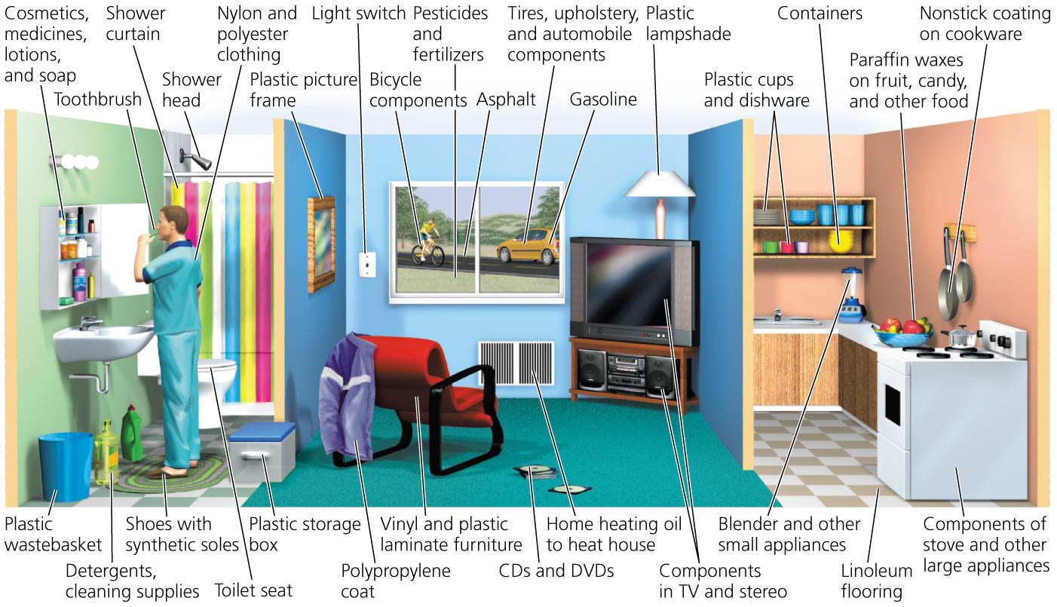

Slide 50
We are gradually depleting fossil fuel reserves
Fossil fuels are nonrenewable
Total amount available declines as we use them
We have used up 1.1 trillion barrels of oil
Almost half our reserves
Reserves-to-production ratio (R/P ratio) = the amount of total remaining reserves divided by the annual rate of production (extraction and processing)
At current levels of production (30 billion barrels/year), we have about 54 years of oil left
Using the R/P ratio, natural gas reserves would last 64 more years, and coal will last 112 more years

Slide 51
We are gradually depleting fossil fuel reserves
The true number of years left for each fuel may be different than predicted by the R/P ratio
May be less since our demand and production have been increasing
May be more as technology and price increase proven reserves (mining of oil sands has increased reserves)
We will face a crisis not when we run out of oil, but when the rate of production begins to decline
Production declines once reserves are depleted halfway
Demand holds constant and a shortage occurs
Peak oil = when rate of production peaks and then declines

Slide 52
Peak oil will pose challenges
In 1956, Geologist M. King Hubbard predicted that oil production would peak around 1970
His prediction was accurate, and U.S. production continues to fall
Hubbard’s peak = the peak in U.S. production
Hubbard analyzed data and predicted peak global oil production in 1995
Still growing, but many scientists predict peak production in the next decade
Discoveries of new oil fields peaked 30 years ago, and we are using more oil than we are discovering

Slide 53
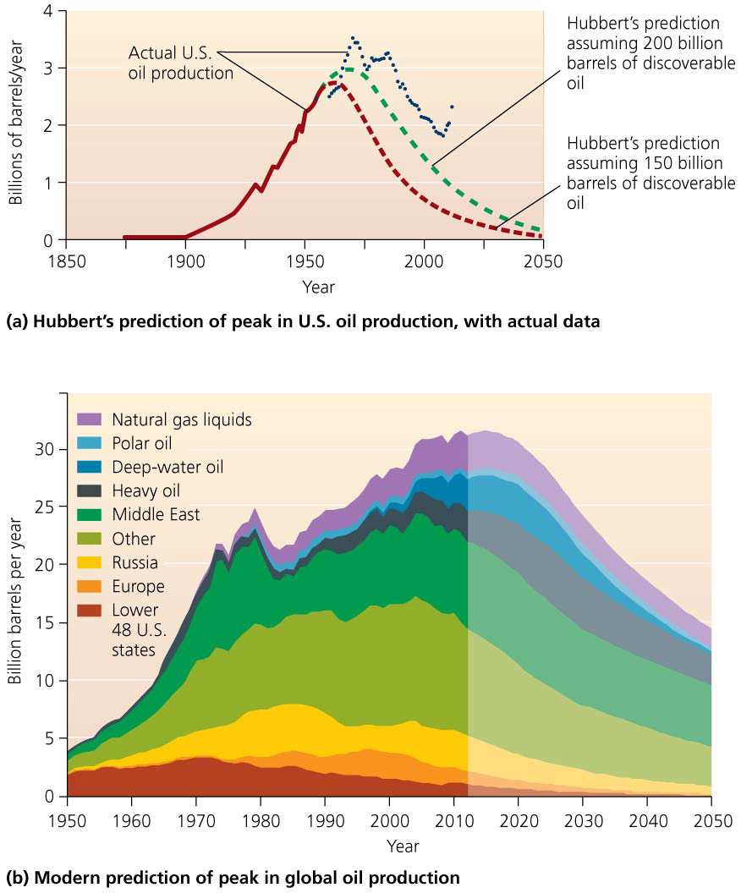

Slide 54
Peak oil will pose challenges
Each discovery of new oil sources delays the peak by increasing proven reserves
Exploiting Canada’s oil sands increased global proven reserves
Some count on continuous new sources
Predicting an exact date for peak oil is hard
Companies and governments do not disclose their amount of oil supply
Disagreement among geologists about reserves
The U.S. Geological Survey estimated twice the proven oil reserves as earlier estimates

Slide 55
Peak oil will pose challenges
Peak production will occur
Our lives will be profoundly affected
“The long emergency”: lacking cheap oil to transport goods, our economies collapse and become localized
Large cities could not be supported without urban agriculture
Fewer petroleum-based fertilizers and pesticides would mean increase in hunger
Suburbs will be hit hard due to reliance on cars

Slide 56
Peak oil will pose challenges
More optimistic observers argue that as supplies dwindle, conservation and alternative energies will kick in
We will be saved from major disruptions

Slide 57
Or we might end up with “too much” fossil fuel energy?
Efforts are being made to develop alternative energy
We are also reaching farther for fossil fuels
A number of approaches are being used to extract more fossil fuels
Secondary extraction from existing wells
Hydraulic fracturing for oil and shale gas
Offshore drilling in increasingly deep waters
Moving into ice-free waters of the Arctic
Exploiting “unconventional” fossil fuel sources
These efforts reduce the EROI of fuels, so drive up costs and intensify pollution and climate change

Slide 58
Secondary extraction produces more fuel
Part of the quest for more fuels has been to revisit old sites
Primary extraction = the initial drilling and pumping of available oil or gas
Secondary extraction = solvents, water, or steam is used to remove additional oil
We lack the technology to remove every bit of oil
Secondary extraction is expensive, so it was not done in many U.S. deposits
As prices rise, it becomes economical to reopen a well

Slide 59
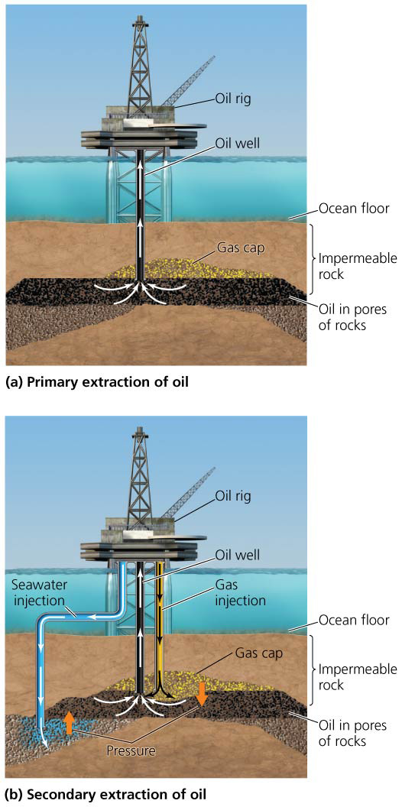

Slide 60
Hydraulic fracturing expands our access to oil and gas
Hydraulic fracturing (hydrofracking or fracking) = breaking rock formations to release oil or gas trapped in impermeable shale
Used for secondary extraction and to tap new deposits
Has allowed access to previously unusable deposits
Has increased proven reserves and boosted U.S. natural gas production
Concern by people living in the area
Choice between financial gain and impacts to health and drinking water

Slide 61
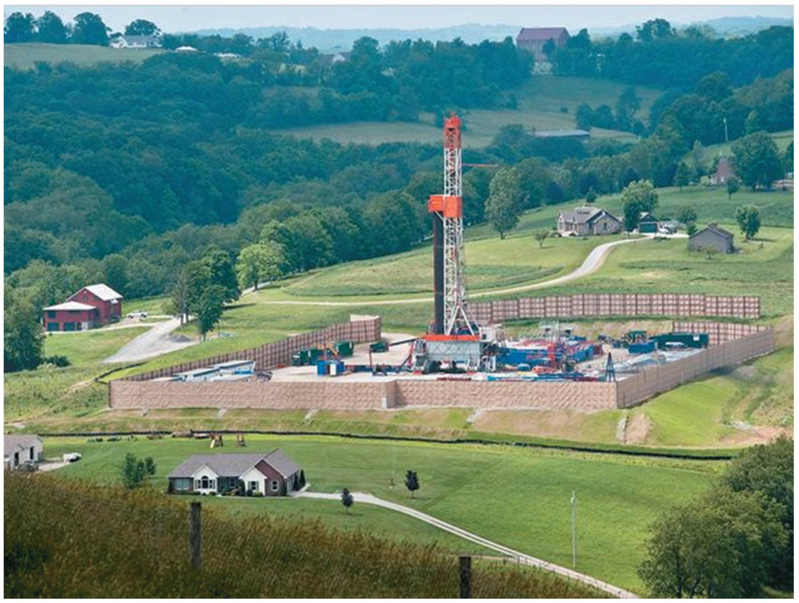

Slide 62
We are drilling farther and farther offshore
Drilling platforms must withstand wind, waves, and currents
Produce 35% of the oil and 10% of the natural gas extracted in the United States

Slide 63
We are drilling farther and farther offshore
Shallow offshore drilling has been going on for decades
Industry is moving into deeper and deeper waters
This poses increased danger
The Deepwater Horizon oil spill of 2010 killed 11 workers and was the largest accidental oil spill in history; it took 86 days to plug
Discoveries of oil far offshore are encouraging more deep water drilling regardless of our ability to deal with accidents there

Slide 64
We are drilling farther and farther offshore
Plans are underway for deepwater drilling in the Arctic
Despite the threat of frigid temperatures, ice flows, winds, waves, and storms
In 2008, Congress lifted a drilling moratorium along U.S. coasts
In 2010, President Obama said vast areas would be opened for drilling
Then British Petroleum’s Deepwater Horizon exploded
Public reaction caused President Obama to backtrack
In 2011, he issued a 5-year plan that opened 75% of technically recoverable reserves to drilling

Slide 65
We are exploiting new fossil fuel sources
Oil sands in Canada and Venezuela are already increasing available oil
Known deposits of oil shale may contain more oil than all conventional crude in the world
Most will not be easy to extract
EROI is very low: 1.1:1 to 4:1

Slide 66
We are exploiting new fossil fuel sources
We are just figuring out how to extract methane hydrates
There may be immense amounts
Do not know if extraction is safe or could cause a massive gas release
Collectively, their net energy values are low because they are expensive to extract and process

Slide 67
Fossil fuel emissions pollute air and drive climate change
Burning fossil fuels takes carbon from long-term storage underground and releases it into the air
Carbon dioxide is a greenhouse gas and drives changes in global climate
CO₂ is the greatest impact of fossil fuel use
Methane itself is a greenhouse gas
Using alternative fossil fuels produces more CO₂ than traditional fossil fuels
Oil sands produce 14%–20% more CO₂ than conventional oil
Shale oil is even more polluting

Slide 68
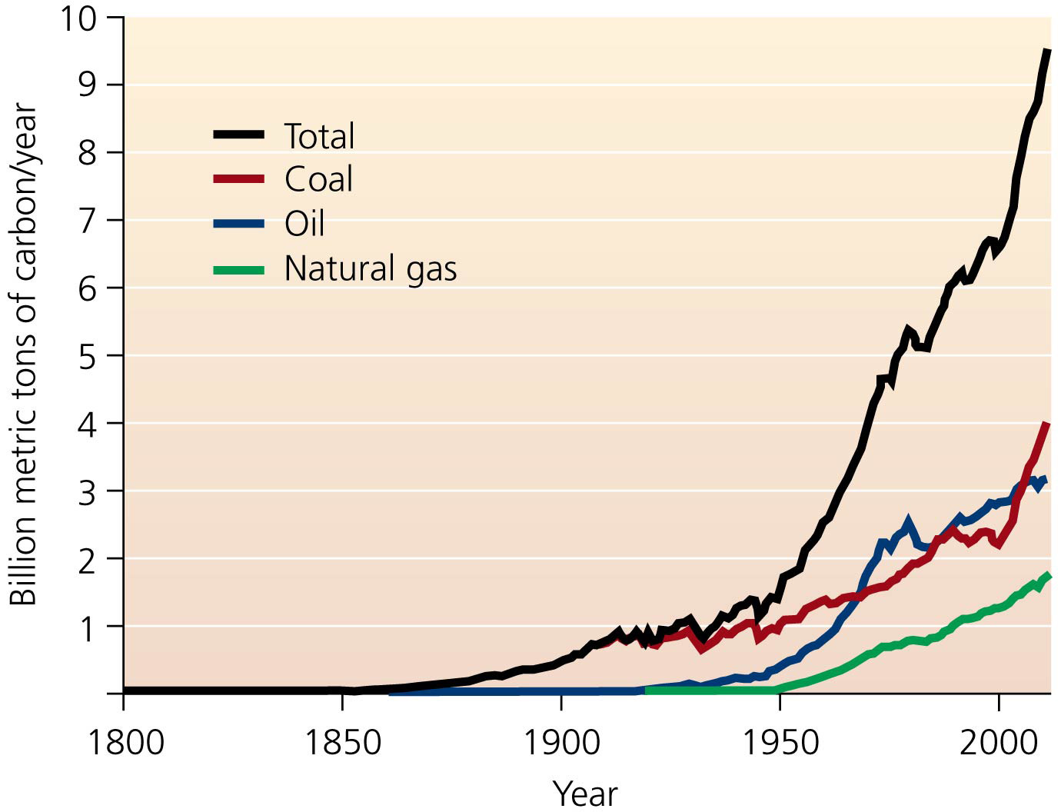

Slide 69
Fossil fuel emissions pollute air and drive climate change
Emissions cause severe health problems
Burning coal high in mercury releases it into the environment
Bioaccumulates, poisoning animals and posing a threat to humans
Pollutants are produced by burning gasoline or evaporate from crude oil
Irritate nose, throat, lungs; can cause cancer
Burning oil and coal produces sulfur dioxide and nitrogen oxides
Contribute to smog formation and acid deposition

Slide 70
Clean coal technologies aim to reduce air pollution from coal
Burning coal emits a variety of pollutants
Sulfur, mercury, arsenic, and other trace metals
Clean coal technologies = technologies, equipment, and approaches to remove chemical contaminants while generating electricity from coal
Scrubbers chemically convert or remove pollutants
Remove sulfur dioxide or nitrogen oxides

Slide 71
Clean coal technologies aim to reduce air pollution from coal
Coal that contains lots of water can be dried
Gasification = coal is converted into cleaner synthesis gas (syngas) by reaction with oxygen and steam
These technologies have reduced pollution
But clean coal is still a dirty way to generate power

Slide 72
Can we capture and store carbon?
Even very clean coal still releases greenhouse gases
Carbon capture and carbon storage (sequestration) = capture CO₂ emissions then convert it to a liquid and store it underground or in the ocean
The $1.3 billion FutureGen project will design, construct, and operate a coal-burning power plant for electricity while capturing and storing carbon underground
This technology is still too unproven to depend on
Possibility of the CO₂ leaking out, contaminating groundwater or acidifying ocean water
It prolongs our dependence on fossil fuels

Slide 73
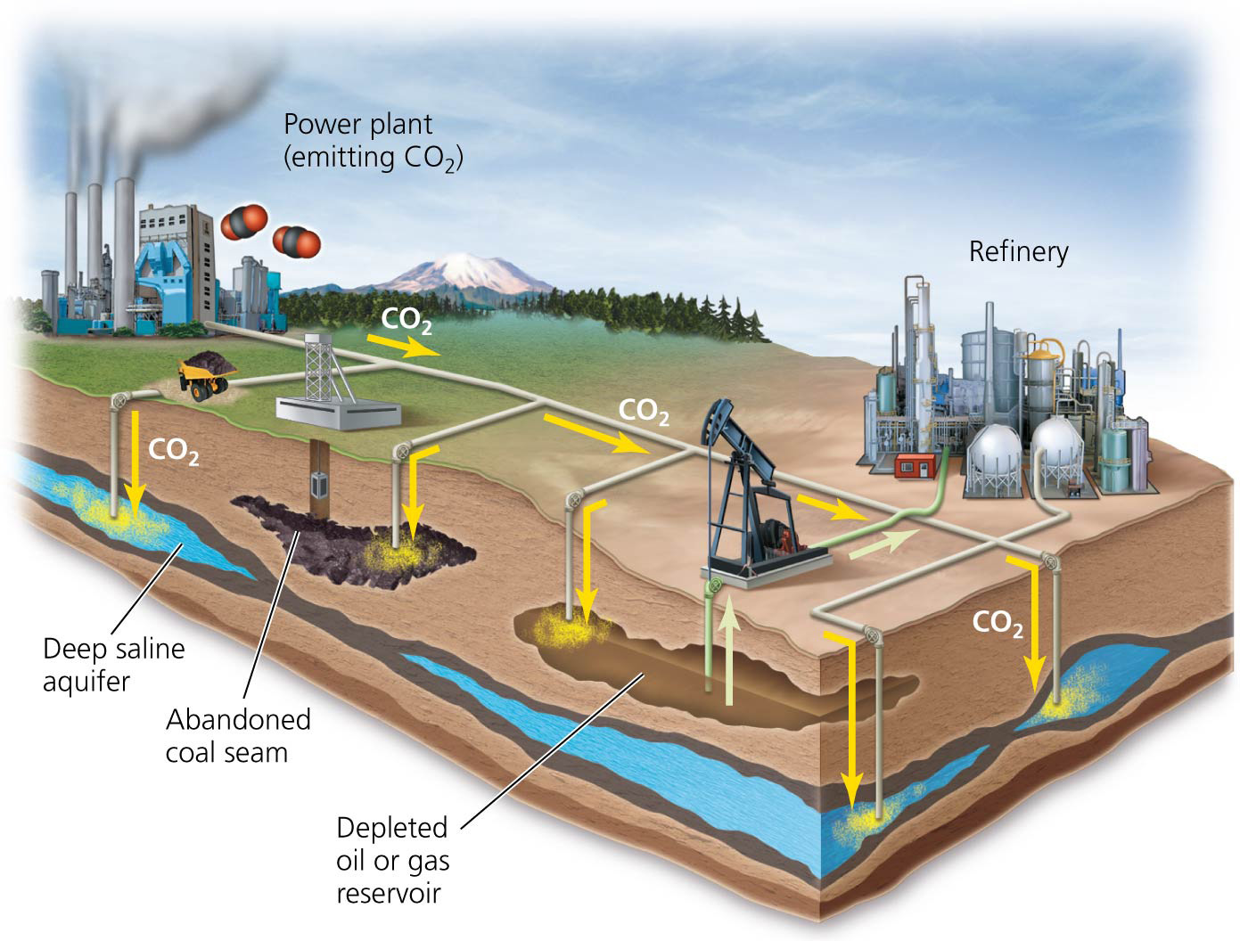

Slide 74
Oil spills pollute oceans and coasts
For 3 months, the Deepwater Horizon’s explosion spilled 4.9 millions of barrels of oil into the Gulf of Mexico
The Gulf of Mexico suffered many impacts
Countless animals (birds, shrimp, fish, etc.) died
Coastal marsh plants died, leading to erosion
Fisheries were devastated and fishermen lost jobs
Proposed oil drilling in the Arctic could pose serious spill threats with difficult cleanup
Most water pollution from oil is from non-point sources
Groundwater can be contaminated when pipelines or underground storage tanks leak

Slide 75
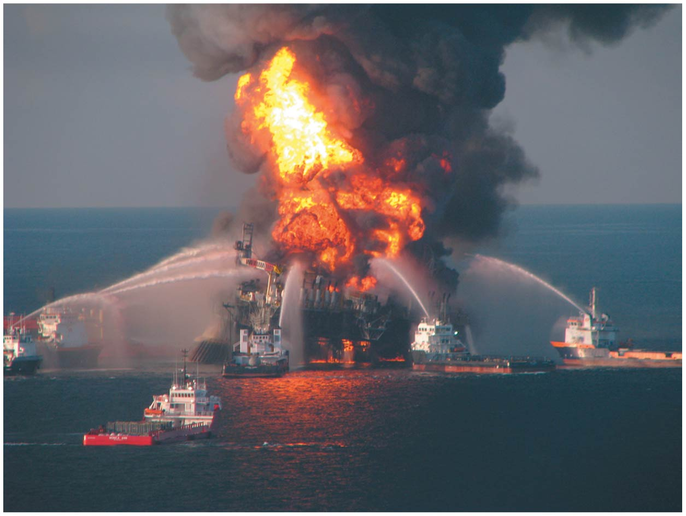
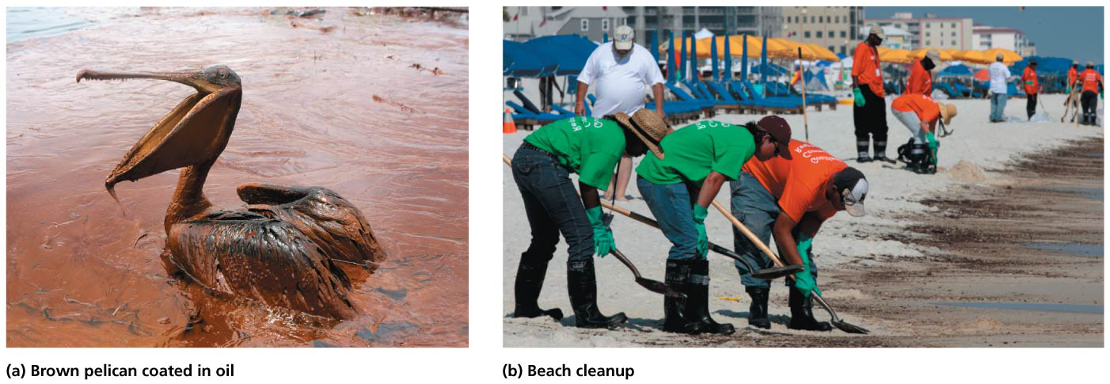

Slide 76
Hydrofracking poses new concerns
Impacts of hydrofracking are not yet understood
Chemicals may leak out of drilling shafts and contaminate aquifers
Methane may travel through the fractures and contaminate drinking water

Slide 77
Hydrofracking poses new concerns
Methane and drilling chemicals escape into the air, causing unhealthy conditions
Immense amounts of wastewater are produced
Water may contain salts, radioactive compounds, and toxic substances
Often sent to sewage treatment plants that are not designed to treat these pollutants

Slide 78
Oil sands development pollutes water
Concerns about pipeline leaks
The Keystone XL pipeline travels over the Ogallala Aquifer, which provides 2 million Americans with water
Oil from oil sands is more corrosive than crude oil
Extraction uses immense amounts of water that becomes polluted and is held in massive reservoirs
Birds landing in the water are killed by the pollutants
Strip mining for oil sands requires deforestation
Alberta’s oil sands, mined 30 years ago, still have not recovered

Slide 79
Coal mining devastates natural systems
Strip mining destroys large swaths of habitat and causes extensive erosion
Acid drainage = process through which chemical runoff from strip mining enters waterways
Sulfuric acid leaches metals from rocks
U.S. regulations require companies to restore strip-mined land, but complete restoration is impossible
Mountaintop removal removes tons of rock and soil, destroying immense amounts of habitat and creeks
Loosening of regulations in 2002 allowed companies to legally dump debris into valleys and rivers, regardless of the consequences

Slide 80
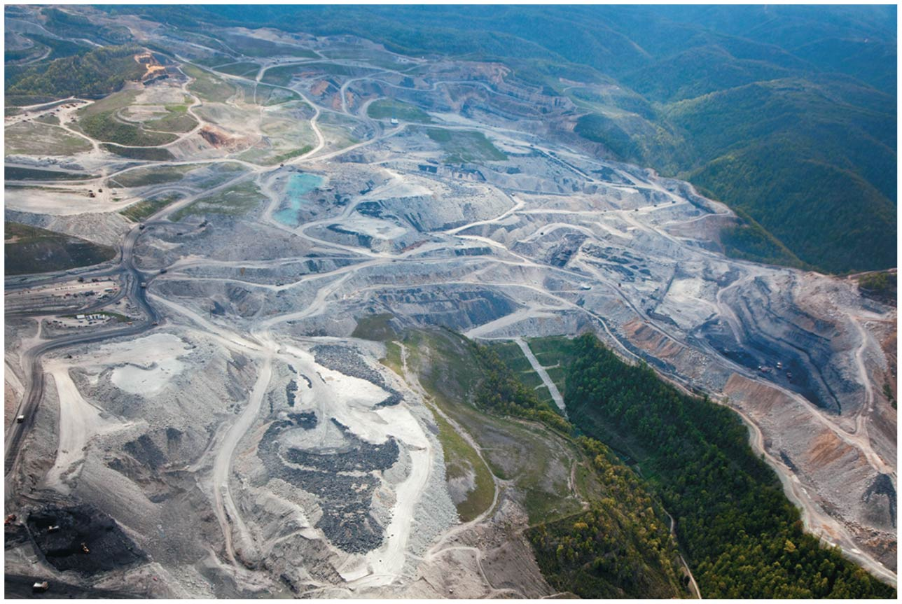

Slide 81
Oil and gas extraction modify the environment
More than drilling is involved in developing oil or gas
Roads, exploration
Infrastructure (housing, roads, pipes, waste piles)
Ponds collect toxic sludge
Pollutes soil, air, water and fragments habitat
Substantial and wide-ranging damage to vegetation, air and water quality, and wildlife has been documented on the tundra of Alaska’s North Slope
Directional drilling = wells are drilled in directions outward from a drilling pad, requiring fewer pads
Surface footprint is smaller

Slide 82
We all pay external costs
Costs of alleviating environmental impacts are high
The public pays for them
Costs are not internalized in the market price of fossil fuels
External costs are paid for in medical expenses, environmental cleanup, and decreased quality of life
Gas prices and utility bills don’t cover production costs
Government subsidies keep fossil fuel prices cheap
Fossil fuel industries get more than renewable ones
Part of our tax dollars pay for our fossil fuel energy use

Slide 83
Fossil fuel extraction has mixed consequences for local people
Fossil fuel extraction generally creates economic activity and jobs in the community where it occurs
But the residents may deal with the legacy of a polluted environment for decades
Alberta’s oil sands have brought tens of thousands of jobs the town of Fort McMurray
Landowners along the route of the Keystone XL pipeline negotiated payment for the rights to use their property
Or they were forced to accept payment by eminent domain = setting aside private property rights for projects that are for the public good

Slide 84
Fossil fuel extraction has mixed consequences for local people
Citizens in Alaska are paid dividends by the government to gain support for oil drilling
Payments to local residents like these are unusual
Money from multinational companies generally does not reach residents
Profits go to the company and governments
Residents are not compensated for pollution, land degradation, and displacement
Many still live in poverty, without water or electricity
People are divided over the short-term benefit vs. the long-term health and environmental impacts

Slide 85
Dependence on foreign energy affects the economies of nations
We are vulnerable to supplies becoming unavailable or costly
Germany, France, South Korea, and Japan consume far more energy than they produce
The U.S. imports nearly half of its crude oil
Other nations control energy prices
OPEC’s (Organization of Petroleum Exporting Countries) oil embargo in 1973 caused panic and skyrocketing prices, spurring inflation
The politically volatile Middle East has the majority of oil reserves, causing a constant concern for the United States

Slide 86
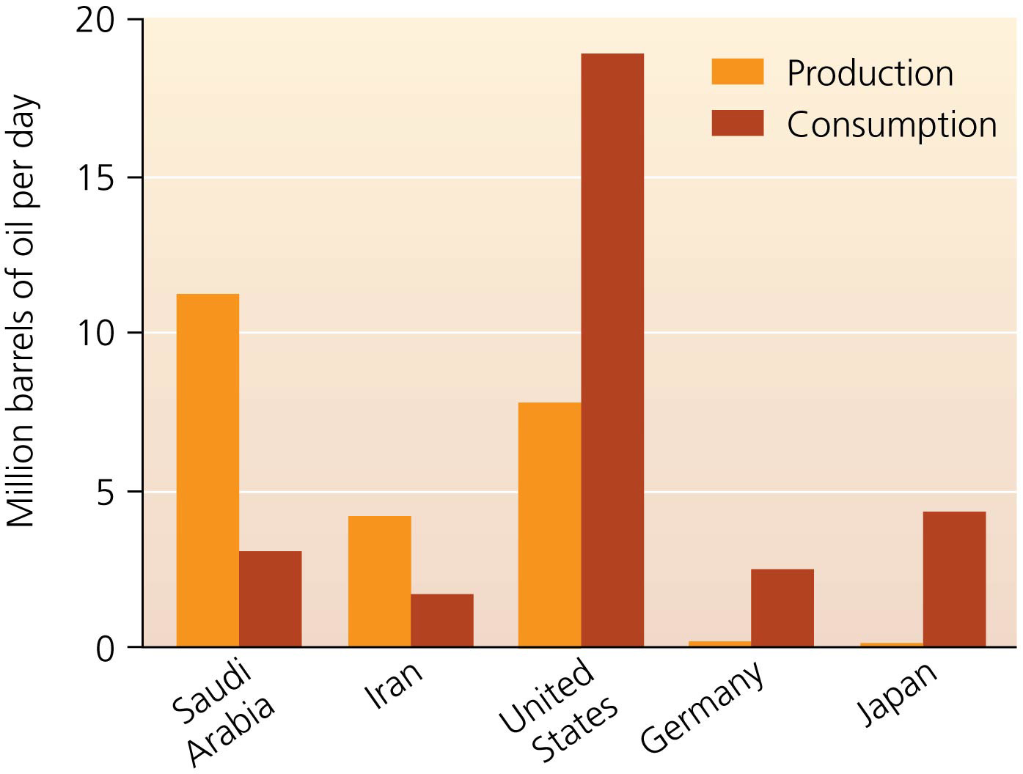

Slide 87
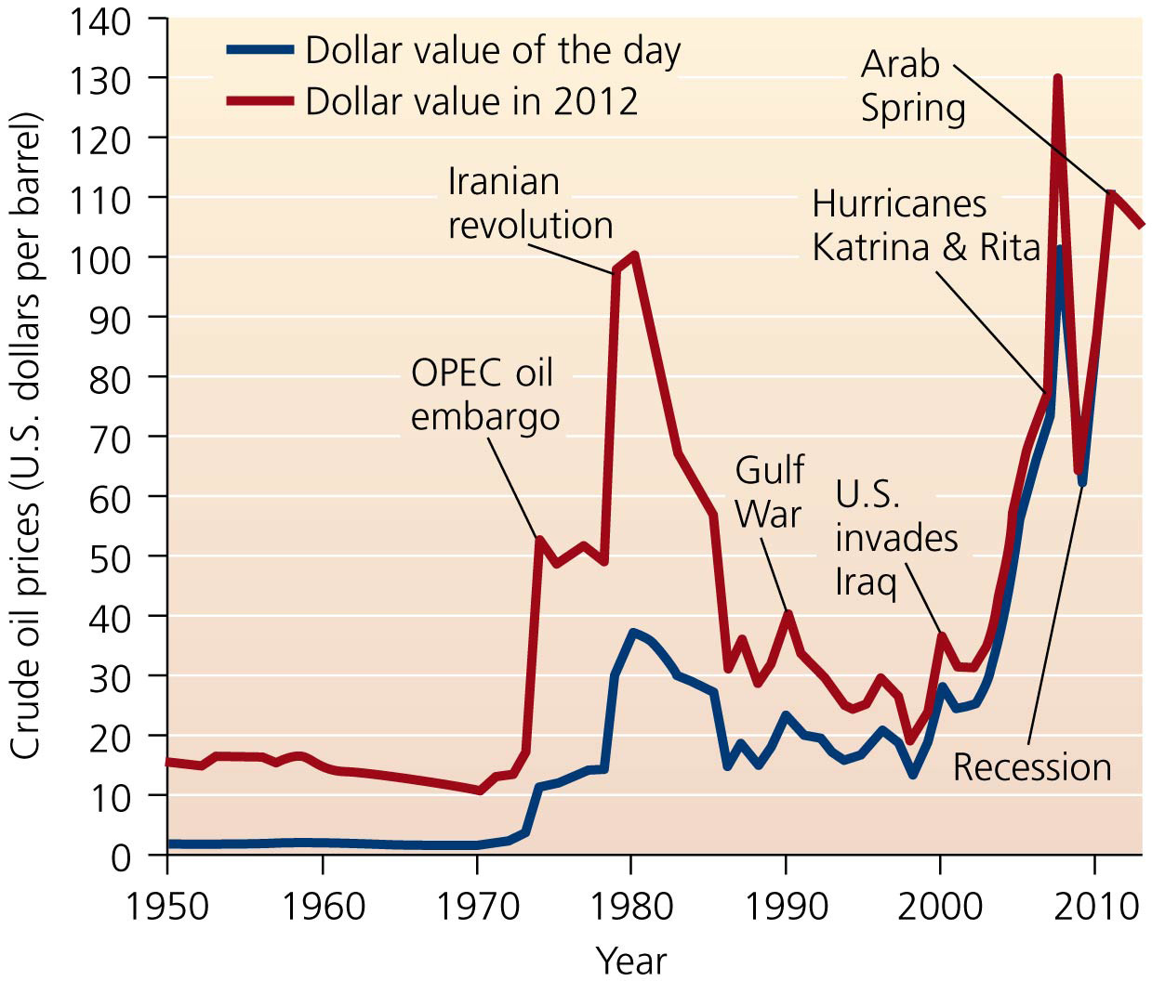

Slide 88
Dependence on foreign energy affects the economies of nations
Using Canada’s oil sands solves many issues associated with U.S. oil supply
Canada is a stable, friendly, democratic neighbor
It is already the United States’ largest trading partner
Would lessen reliance on Middle Eastern oil
The United States is pursuing other means to prevent another embargo like in 1973
The United States has diversified the countries from which it imports oil
Including Canada, Mexico, Venezuela, and Nigeria

Slide 89
Dependence on foreign energy affects the economies of nations
The United States is also working to provide its own energy
The government has enacted conservation measures and funded research into renewable energy sources
Companies are doing secondary extraction at wells

Slide 90
Dependence on foreign energy affects the economies of nations
The Strategic Petroleum Reserve stockpiles oil in caverns under Louisiana as a buffer against shortages
But this reserve equals just one month’s worth of oil
Finding new domestic sources including offshore oil
Many want to drill in the Arctic National Wildlife Refuge despite charges that drilling will destroy America’s last true wilderness and add little to U.S. oil production

Slide 91
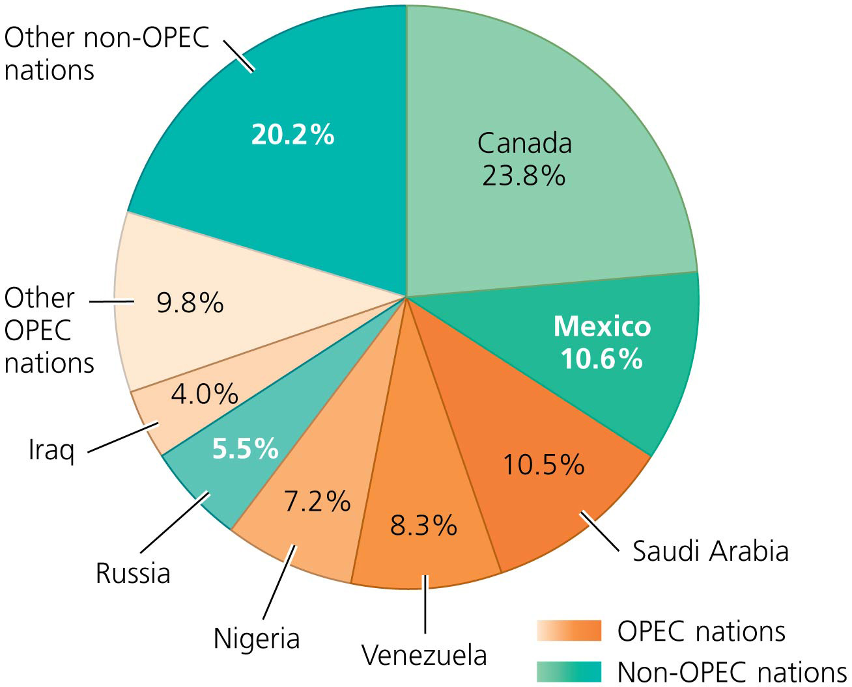

Slide 92
How will we convert to renewable energy?
Fossil fuel supplies are limited, and their use has consequences
Many scientists, environmental advocates, business people, and policy makers have concluded that fossil fuels are not a sustainable energy solution
We need to shift to clean and renewable energy sources

Slide 93
How will we convert to renewable energy?
Many nations are moving faster than the United States
France relies on nuclear power; Germany is investing in solar power; China is developing multiple sources
As we make the transition, we need to prolong fossil fuels through conservation

Slide 94
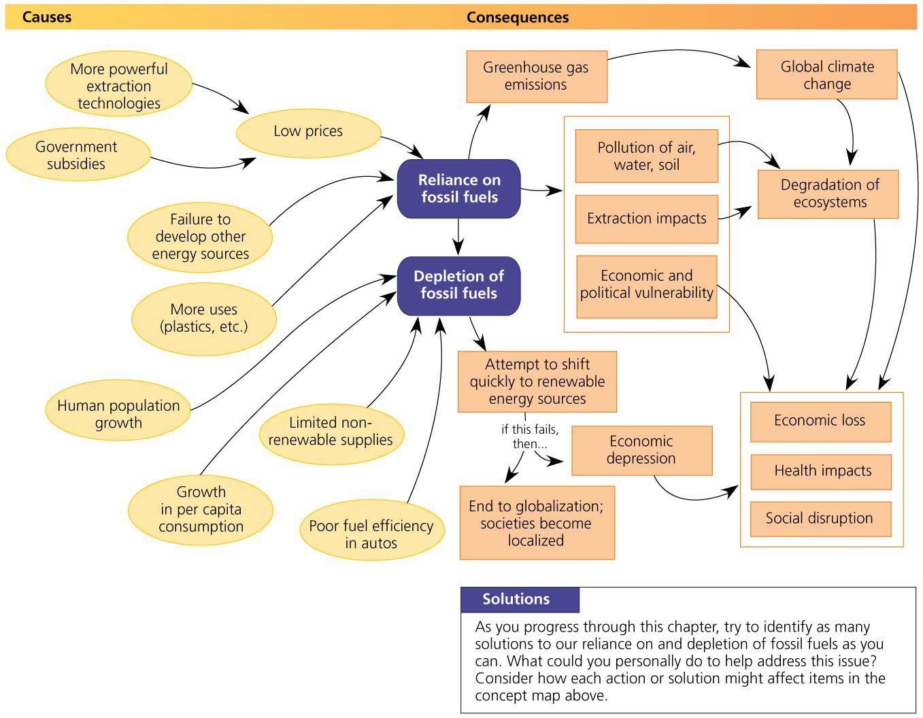

Slide 95
Energy Efficiency and Conservation
We need to minimize and extend the use of dwindling fossil fuel supplies
Energy efficiency = obtaining a given amount of output while using less energy input
Results from technological improvements
Energy conservation = reducing energy use
Results from behavioral choices

Slide 96
Energy Efficiency and Conservation
By being less wasteful and prolonging the fossil fuel supply, we can avoid some difficult energy decisions
The United States uses twice as much energy per dollar of Gross Domestic Product as most other industrial nations
We have cut energy use, and there is room for gains in efficiency in the future

Slide 97
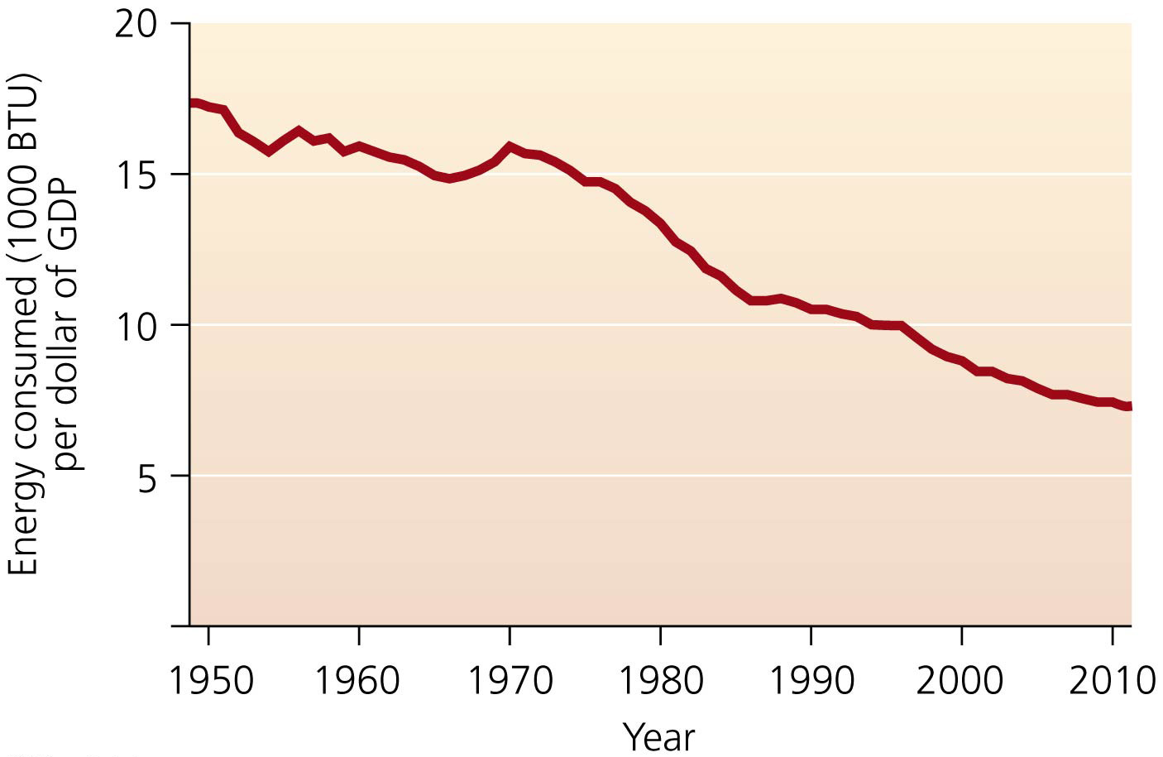

Slide 98
Personal choice and efficient technologies are two routes to conservation
Energy conservation can be accomplished in two ways
Individuals can make conscious choices to reduce energy consumption and increase conservation
Drive less, turn off lights, buy efficient machines
Europeans use less energy per capita than the United States

Slide 99
Personal choice and efficient technologies are two routes to conservation
Energy-consuming devices can be made more efficient
Cars and power plants lose two-thirds of energy as waste heat
This waste can be reduced with cogeneration = using excess heat from electricity generation to heat nearby buildings and produce other kinds of power
Improvements can reduce energy to heat and cool homes
Better insulation, passive solar, vegetation around it

Slide 101
Personal choice and efficient technologies are two routes to conservation
Many consumer products are now more efficient
Energy-efficient lighting can reduce energy use by 80%
Many governments are phasing out incandescent light bulbs

Slide 102
Personal choice and efficient technologies are two routes to conservation
Federal standards and the Energy Star program have reduced electricity used by appliances
If all Americans bought energy-efficient appliances, energy expenditures would be reduced by $200 billion
Automobiles provide the greatest fossil fuel conservation opportunity
Alternative technologies such as electric cars, hybrids, and hydrogen fuel cell vehicles are options

Slide 103
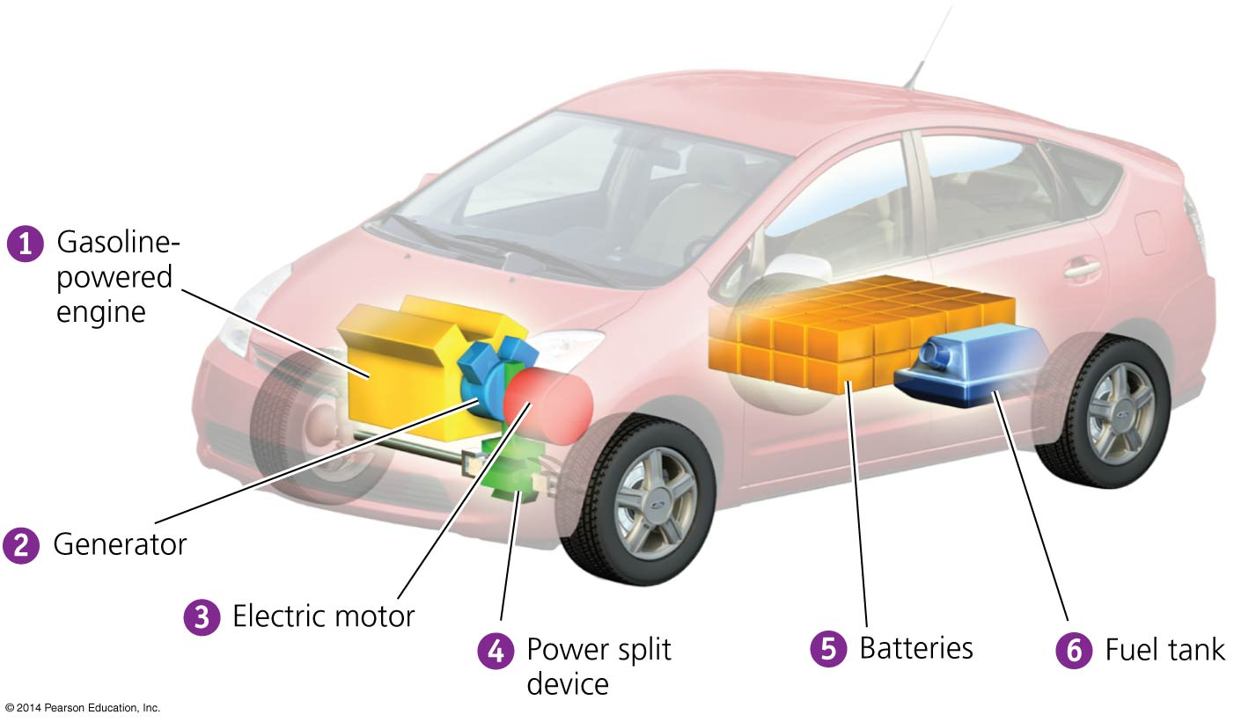

Slide 104
Automobile fuel efficiency is a key to conservation
In response to the OPEC embargo of 1973, the U.S. government tried to reduce gasoline use by mandating an increase in fuel efficiency and decreasing speed limits to 55 mph
While these measures worked, they were abandoned over the next three decades

Slide 105
Automobile fuel efficiency is a key to conservation
Policy makers failed to raise the corporate average fuel efficiency (CAFE) standards, which set mpg standards
New vehicle average efficiency fell from 22.0 mpg in 1987 to 19.3 mpg in 2004
It climbed to 22.8 mpg in 2011 after Congress mandated average fuel economy of 35 mpg by 2020

Slide 106
Automobile fuel efficiency is a key to conservation
In 2009, the Obama administration tried to improve fuel efficiency, stimulate economic activity, and save jobs
Automakers agreed to boost average fuel economies to 54.5 mpg by 2025

Slide 107
Automobile fuel efficiency is a key to conservation
The “Cash for Clunkers” program paid Americans $3,500–$4,500 to turn in old cars and buy new, efficient ones
The $3 billion program subsidized the sale or lease of 678,000 substantially more efficient vehicles
824 million gallons of gasoline will be saved, preventing 9 million tons of greenhouse gases, and creating social benefits worth $278 million

Slide 108
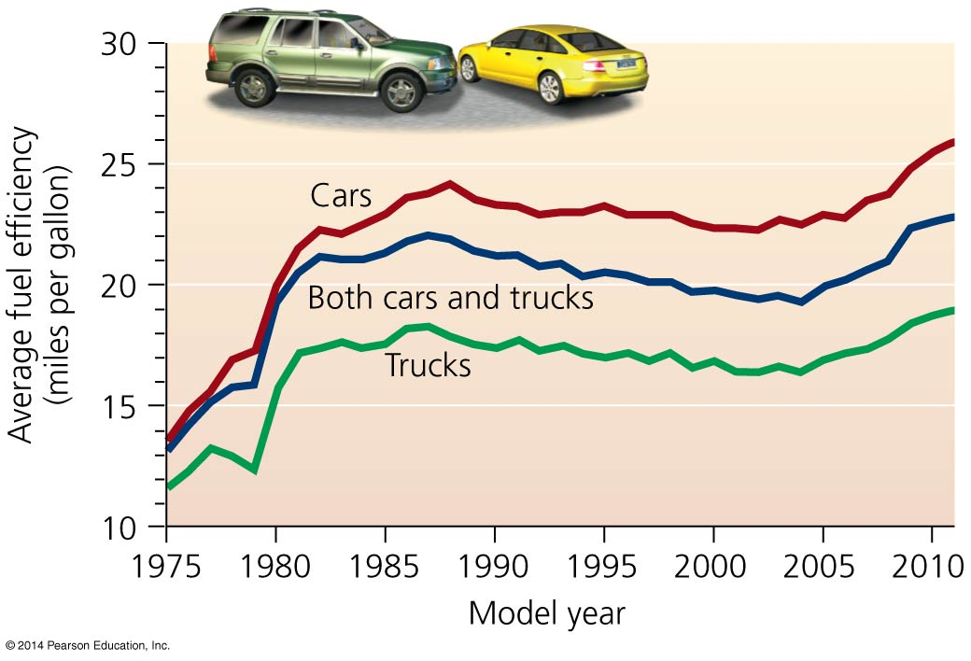

Slide 109
Automobile fuel efficiency is a key to conservation
Low U.S. gas prices do not encourage conservation
U.S. taxes are extremely low compared to other nations
Americans pay 2–3 times less than many Europeans
Prices do not account for external costs
If all external costs were included, estimates are that gasoline would cost more than $13 per gallon

Slide 110
Automobile fuel efficiency is a key to conservation
Efficiency may not save as much energy as we expect
Rebound effect = gains in efficiency from better technology are offset by changes in behavior
People who own more efficient cars may drive more because they get better gas mileage so think it is okay

Slide 111
We need both conservation and renewable energy
Conservation could save 6 million barrels of oil a day
Conserving energy is better than finding a new reserve
It decreases environmental impacts while extending our access to fossil fuels
Conservation does not add to our supply of fuel
We still need energy from somewhere
The only sustainable guarantee of a long-term supply of energy is from renewable energy sources

Slide 112
Conclusion
Fossil fuels have helped build our industrialized societies
We are now approaching a turning point in history
Fossil fuel production will begin to decline
We can search for new sources of fossil fuels
But deal with the health and environmental impacts
Or we can encourage conservation, efficiency, and alternative energy sources
Renewable energy sources are becoming feasible and economical
We can envision giving up our reliance on fossil fuels

Slide 113
QUESTION: Review
_____ contains the most oil in the world, while _____ consumes the most.
Mexico; Japan
Kuwait; France
Saudi Arabia; the United States
The United States; the United States
Notes:
Answer: c

Slide 114
QUESTION: Review
Which energy source is versatile and emits the least CO₂?
Coal
Natural gas
Petroleum
None of the above
Notes:
Answer: b

Slide 115
QUESTION: Review
Which of the following describes the process of heavy machinery removing huge amounts of earth to expose coal?
Strip mining
Subsurface mining
Mountaintop removal
Illegal mining
Notes:
Answer: a

Slide 116
QUESTION: Review
Which of the following does NOT describe natural gas that was formed biogenically?
It was created in shallow water.
It was created by bacteria.
It is also called swamp gas.
It was created deep underground.
Notes:
Answer: d

Slide 117
QUESTION: Review
It is estimated that we have already depleted ___ of our global oil reserves.
25%
50%
75%
100%
Notes:
Answer: b

Slide 118
QUESTION: Review
Which statement about peak oil is NOT correct?
The United States has reached peak oil.
Production declines once reserves are 75% depleted.
Discoveries of new fields peaked 30 years ago.
We are using more oil than we are discovering.
Notes:
Answer: b

Slide 119
QUESTION: Review
While all are serious problems, the greatest environmental impact from emissions from fossil fuels is
greenhouse gases.
hydrogen sulfide.
benzene and toluene.
mercury.
Notes:
Answer: a

Slide 120
QUESTION: Review
What is a major problem of oil shale and tar sands?
Mining for them destroys the land.
They release greenhouse gases.
Mining and using them release pollution.
All of these are major problems of these sources of energy.
Notes:
Answer: d

Slide 121
QUESTION: Weighing the Issues
How is your life affected as oil becomes more expensive? What will you do?
I will start conserving gasoline by walking more or carpooling.
I need my car, so I will just have to earn more money.
It won’t affect me, because I already minimize my driving.
It won’t affect me, because I have enough money to afford gasoline.
Notes:
Answer: any

Slide 122
QUESTION: Weighing the Issues
Should the government raise taxes on gasoline to reflect its true cost?
Yes; that would make people conserve gasoline.
Yes, but poor people would need subsidies to help them buy gasoline.
No; I don’t want to pay more for gasoline.
I don’t care; I have enough money to pay for expensive gasoline.
Notes:
Answer: any

Slide 123
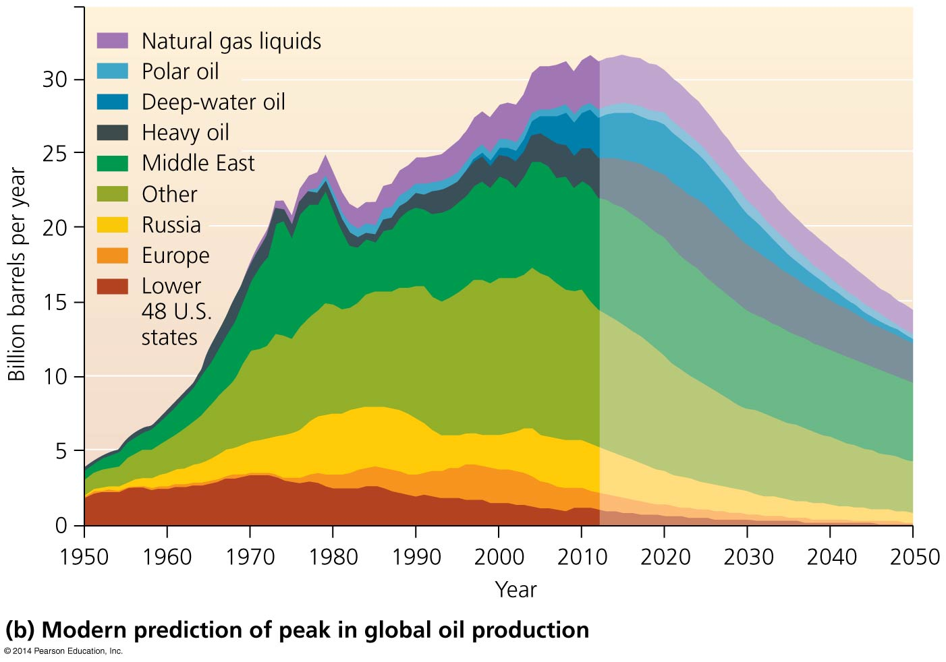
QUESTION: Interpreting Graphs and Data
Which conclusion is supported by this figure?
Polar and deep-water oil are not expected to extend oil production.
U.S. oil production has been expanding.
We are expecting increased European oil production.
Without new discoveries, oil production will peak in 2020.
Notes:
Answer: a

Slide 124
QUESTION: Interpreting Graphs and Data
According to this graph, what happened to average fuel efficiency from 1990 to 2005?
Cars increased.
Trucks increased.
Both sets of vehicles decreased.
No consistent pattern is evident.
Notes:
Answer: c

