Slide 2
This lecture will help you understand:
The Earth’s climate system
Human influences on the atmosphere and climate
Methods of climate research
Trends and impacts of global climate change
Ways we can respond to climate change

Slide 3
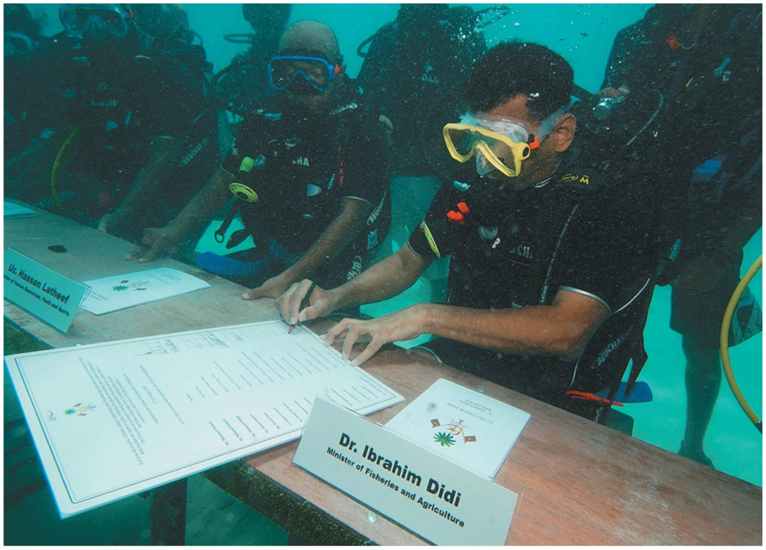

Slide 4
Central Case Study: Rising Seas May Flood the Maldives
Tourists think the Maldives Islands are a paradise
Rising seas due to global climate change could submerge them
Erode beaches, cause flooding
Damage coral reefs
Residents have evacuated the lowest-lying islands
Small nations are not the cause of climate change, yet they suffer
Coastal areas everywhere are threatened by sea level rise

Slide 6
What is climate change?
Climate change is the fastest-developing area of environmental science
Climate = an area’s long-term atmospheric conditions
Temperature, moisture, wind, precipitation, etc.
Weather = short-term conditions at localized sites
Global climate change = describes trends and variations in Earth’s climate
Temperature, precipitation, storm frequency
Global warming and climate change are not the same

Slide 7
What is climate change?
Global warming = an increase in Earth’s average temperature
Only one aspect of climate change
Climate change and global warming refer to current trends
Earth’s climate has varied naturally through time
The current rapid climatic changes are due to humans
Fossil fuel combustion and deforestation
Understanding climate change requires understanding how our planet’s climate works

Slide 8
Three factors influence climate
Without the sun, Earth would be dark and frozen
Without the atmosphere, Earth’s temperature would be much colder (as much as 33°C [59°F] colder)
The oceans store and transport heat and moisture
Together, they influence climate
The sun supplies most of the planet’s energy
The atmosphere and water absorb abut 70% of the incoming solar radiation (and reflect 30% into space)
The absorbed energy powers wind, waves, evaporation, and photosynthesis

Slide 9
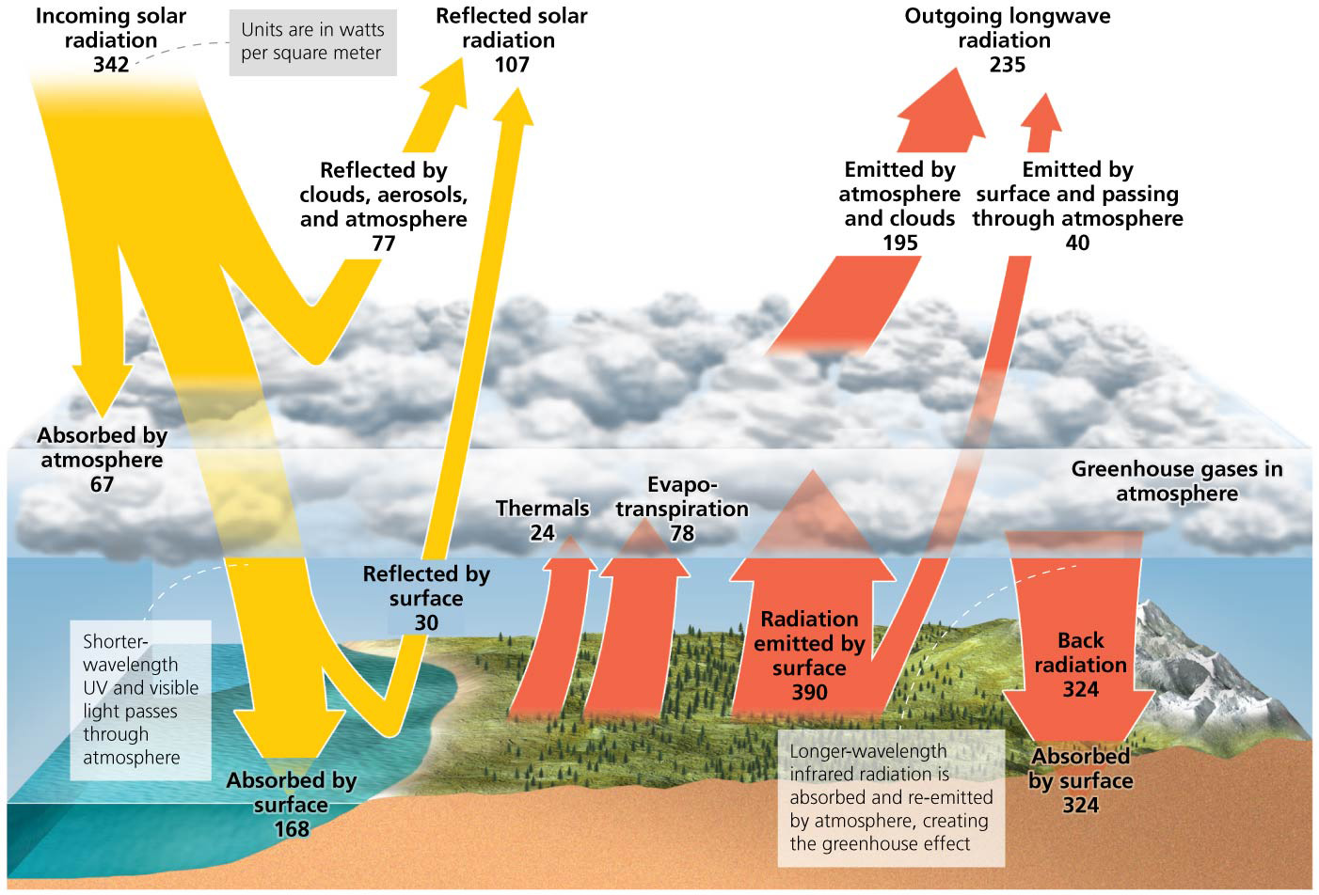

Slide 10
Greenhouse gases warm the lower atmosphere
As Earth’s surface absorbs solar radiation, the surface increases in temperature and emits infrared radiation
Greenhouse gases = atmospheric gases that absorb infrared radiation
Water vapor, ozone, carbon dioxide, nitrous oxide, methane, halocarbons (chlorofluorocarbons [CFCs])

Slide 11
Greenhouse gases warm the lower atmosphere
After absorbing radiation, greenhouse gases re-emit infrared energy, losing some energy to space
Greenhouse effect = phenomenon in which energy travels downward, warming the atmosphere and the planet’s surface

Slide 12
Greenhouse gases warm the lower atmosphere
Greenhouse gases differ in their ability to cause warming
Global warming potential = the relative ability of one molecule of a greenhouse gas to contribute to warming
Expressed in relation to carbon dioxide (potential = 1)
Methane is 25 times more potent than carbon dioxide
Nitrous oxide is 298 times more potent than carbon dioxide

Slide 13
Greenhouse gases warm the lower atmosphere
Carbon dioxide is not the most potent greenhouse gas
It is present in the largest concentrations
It exerts six times more impact than methane, nitrous oxide, and halocarbons combined

Slide 14
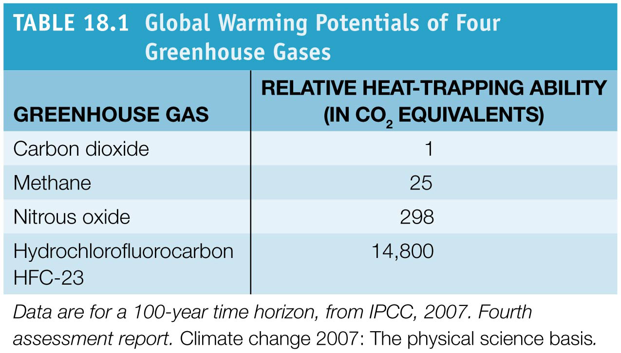

Slide 15
Greenhouse gas concentrations are rising fast
The greenhouse effect is a natural phenomenon
Greenhouse gases have always been in the atmosphere
We are not worried about the natural greenhouse effect
Anthropogenic intensification is of concern
We have added new gasses (CFCs) and increased concentrations of others
Human activities increased atmospheric CO₂ from 280 parts per million (ppm) to 396 ppm in 2013
The highest levels in more than 800,000 years
Likely the highest in 20 million years

Slide 16
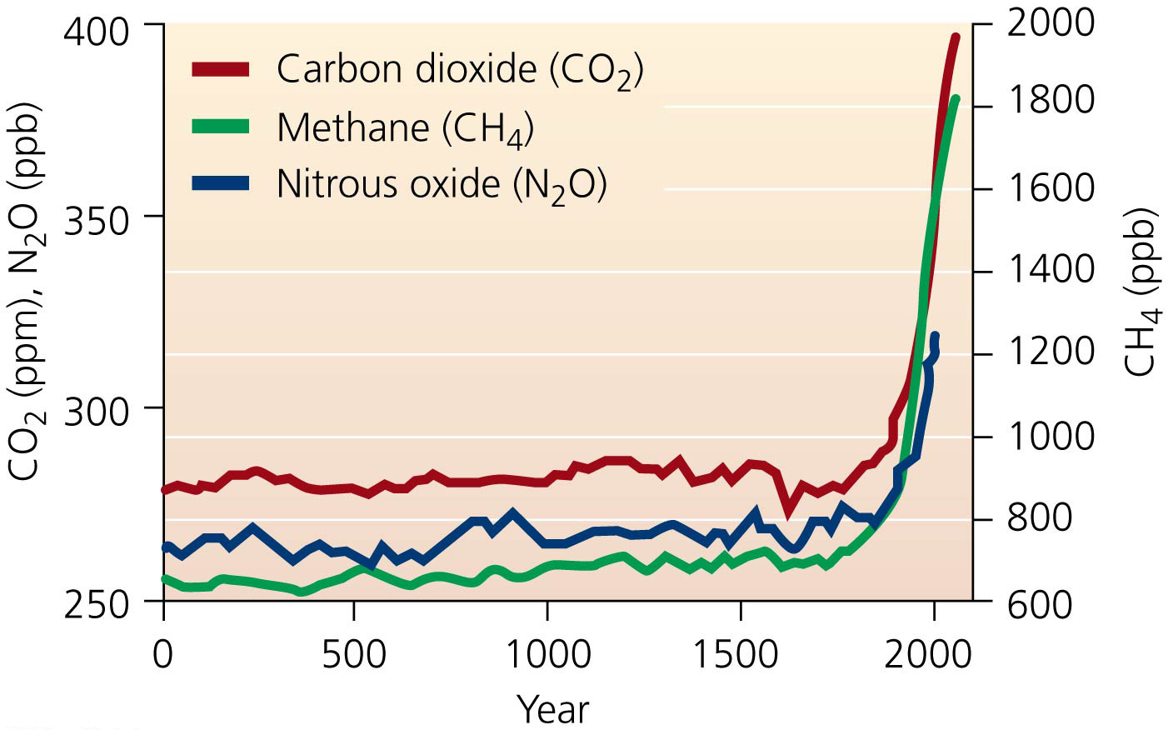

Slide 17
Greenhouse gas concentrations are rising fast
Most carbon is stored in the upper lithosphere
Deposition, partial decay, and compression of organic matter led to formation of coal, oil, and natural gas
These deposits remained buried for millions of years
Burning fossil fuels transfers CO₂ from lithospheric reservoirs into the atmosphere
The main reason atmospheric carbon dioxide concentrations have increased so dramatically

Slide 18
Greenhouse gas concentrations are rising fast
Deforestation contributes to rising atmospheric CO₂
Forests serve as reservoirs for carbon
Removing trees reduces the carbon dioxide absorbed from the atmosphere

Slide 19
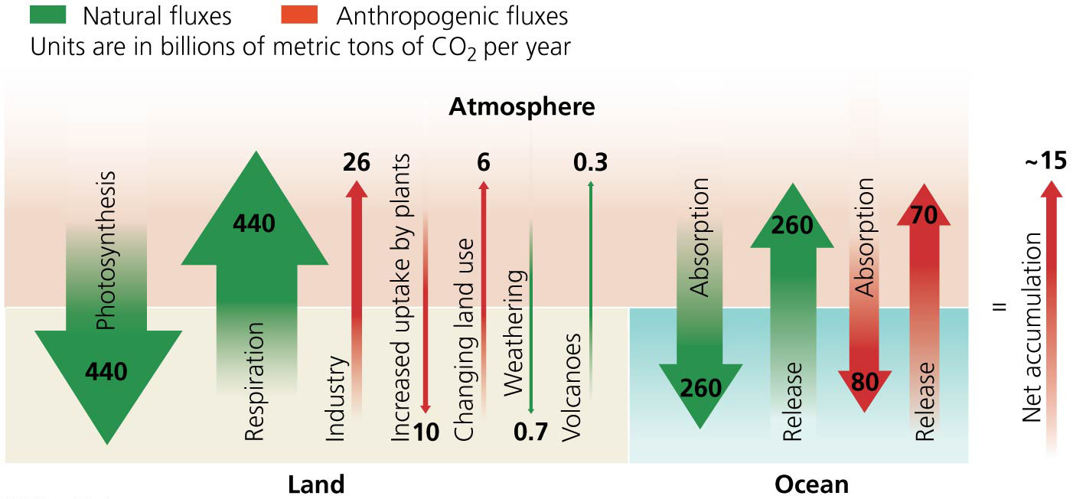

Slide 20
Greenhouse gas concentrations are rising fast
Methane levels have increased 2.5-fold since 1750
Highest level in over 800,000 years
Released by tapping into fossil fuel deposits and from livestock, landfills, and crops such as rice
Nitrous oxide has increased nearly 20% since 1750
Produced by feedlots, chemical manufacturing plants, auto emissions, and synthetic nitrogen fertilizers

Slide 21
Greenhouse gas concentrations are rising fast
Tropospheric ozone levels have risen 36%
Halocarbon gases (CFCs) are declining
Water vapor is the most abundant greenhouse gas
Contributes most to the natural greenhouse effect
Concentrations have not changed

Slide 22
Most aerosols exert a cooling effect
Aerosols = microscopic droplets and particles
They have either a warming or a cooling effect
Soot (black carbon aerosols) causes warming by absorbing solar energy
But most tropospheric aerosols cool the atmosphere by reflecting the sun’s rays
Sulfate aerosols produced by fossil fuel combustion may slow global warming, at least in the short term
Volcanic eruptions reduce sunlight reaching Earth’s surface and cool the Earth

Slide 23
Radiative forcing expresses change in energy input
Radiative forcing = the amount of change in thermal energy that a given factor causes
Positive forcing warms the surface
Negative forcing cools it
Pre-industrial Earth in 1750 was in balance—it had the same amount of energy entering as leaving
Earth is experiencing radiative forcing of 1.6 watts/m² more than it is emitting to space
Enough to alter the climate

Slide 24
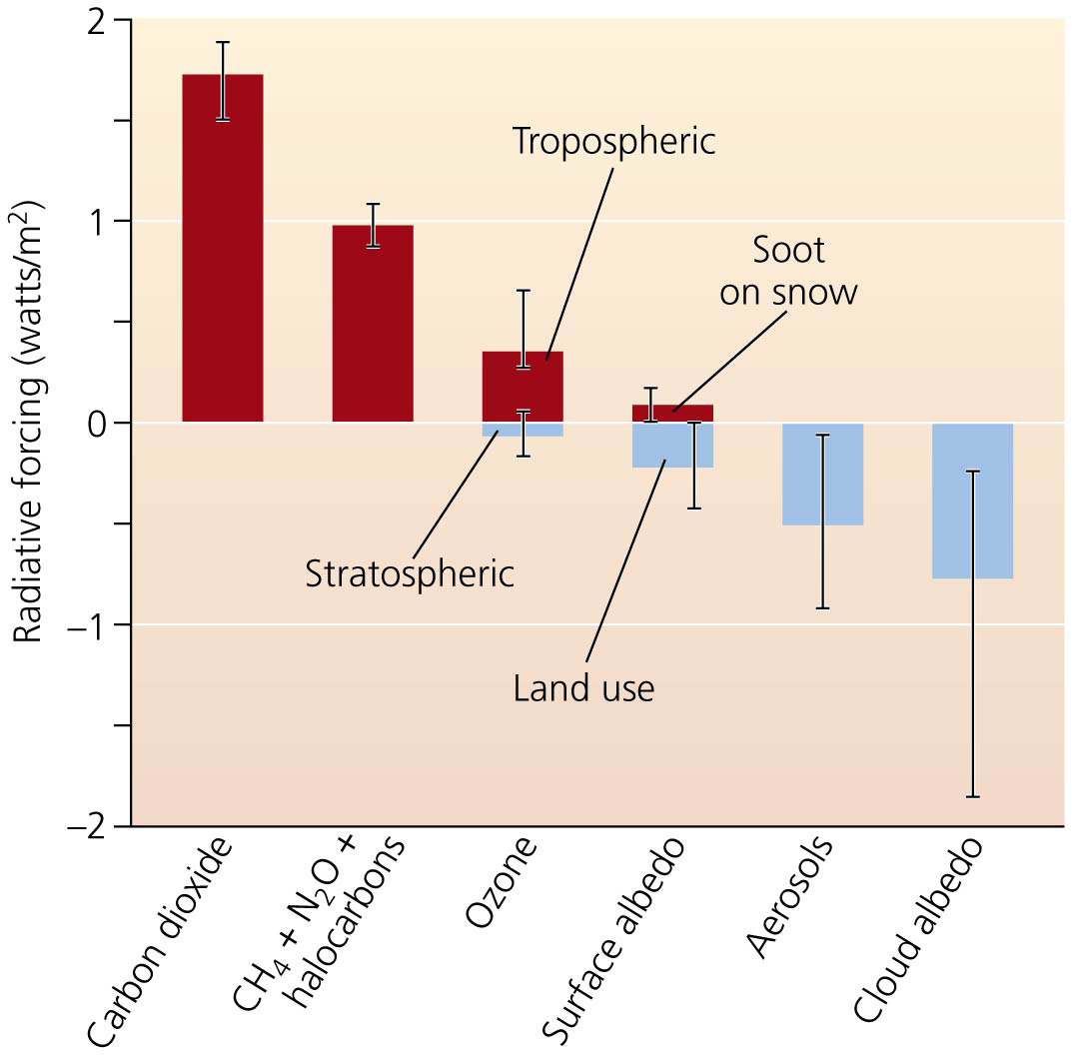

Slide 25
Feedback complicates our predictions
Tropospheric warming will transfer more water to the air
The effects of increased water vapor are uncertain. Two possible feedback loops could result
A positive feedback loop: more water vapor … more warming … more evaporation … more water vapor …
A negative feedback loop: more water vapor … more clouds … shade and cool Earth …less evaporation
Because of the feedback loops, minor modifications of the atmosphere can lead to major effects on climate

Slide 26
Climate varies naturally for several reasons
Milankovitch cycles = periodic changes in Earth’s rotation and orbit around the sun
Alter the way solar radiation is distributed over Earth
Modify patterns of atmospheric heating, triggering climate variation: periods of cold and ice (glaciation) and warm interglacial times
Solar output: the sun varies in the radiation it emits
Variation in solar energy has not been great enough to change Earth’s temperature
Radiative forcing is 0.12 watts/m²—much less than human causes
Solar radiation has been decreasing since 1970

Slide 27
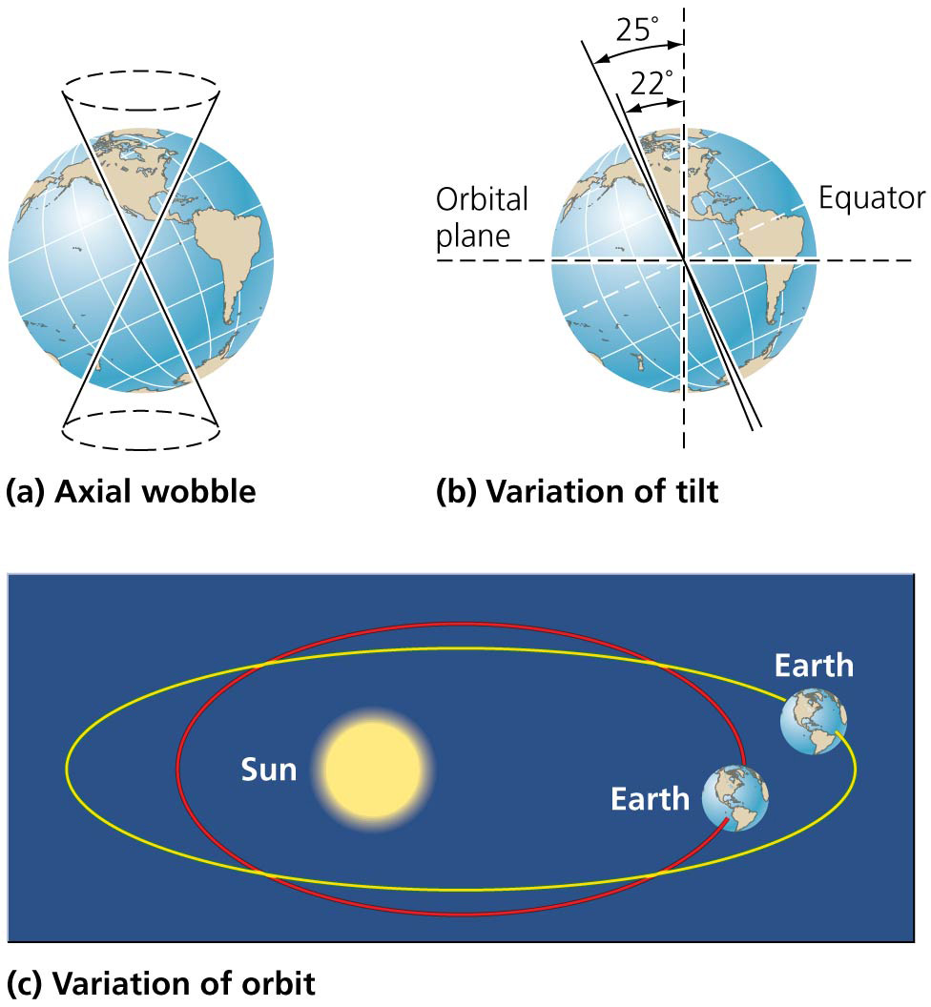

Slide 28
Climate varies naturally for several reasons
Ocean absorption: the ocean holds 50 times more carbon than the atmosphere
Gas dissolves directly in ocean water
Not absorbing as much CO₂ as we are emitting
Slowing, but not preventing, global warming
Warmer oceans absorb less CO₂
Rate of CO₂ absorption is slowing down
A positive feedback effect that accelerates warming

Slide 29
Ocean circulation
Ocean circulation: ocean water exchanges heat with the atmosphere
Currents move energy from place to place
The ocean’s thermohaline circulation system affects regional climates
Moves warm tropical water north, etc.
Greenland’s melting ice sheet will affect this flow
El Niño–Southern Oscillation (ENSO) shifts atmospheric pressure, sea surface temperature, ocean circulation in the tropical Pacific

Slide 30
Proxy indicators tell us about the past
Paleoclimate = climate of the geological past
Gives a baseline to compare to today’s climate
Proxy indicators = indirect evidence that serve as substitutes for direct measurements
Shed light on past climate

Slide 31
Proxy indicators tell us about the past
Ice caps, ice sheets, and glaciers hold clues to Earth’s climate history
Trapped bubbles in ice cores provide a timescale of atmospheric composition, greenhouse gas concentrations, temperature trends, snowfall, solar activity, and frequency of fires
Ice cores let us go back in time 800,000 years

Slide 32
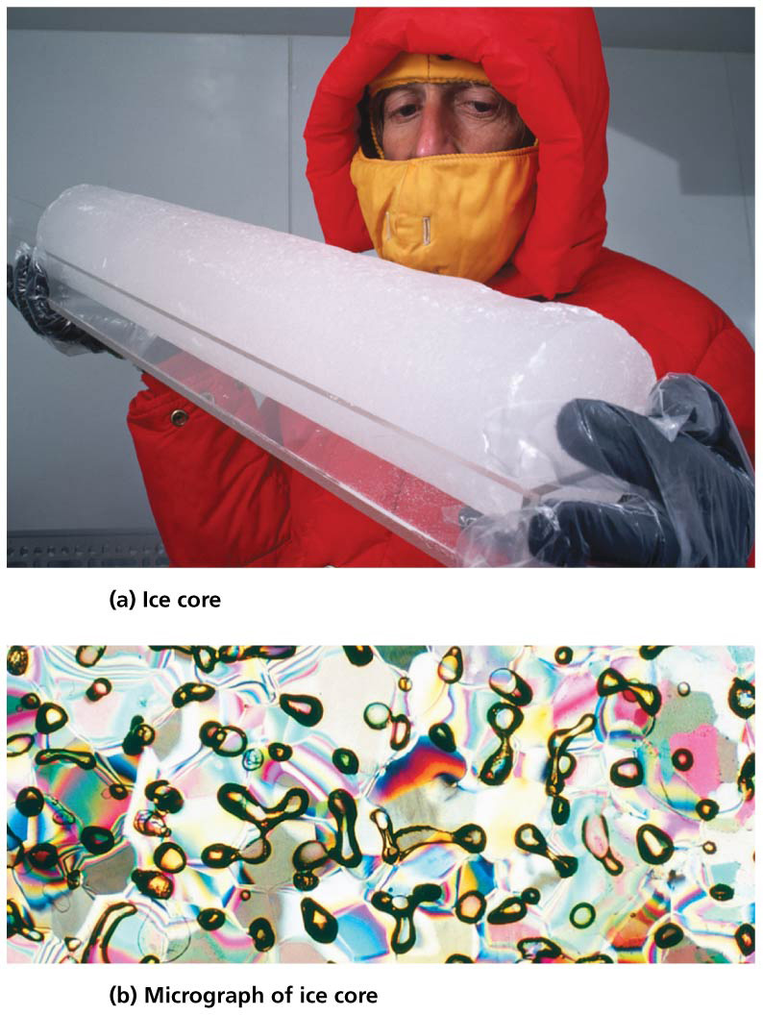

Slide 33
Proxy indicators tell us about the past
Cores in sediment beds preserve pollen grains and other plant remnants
Plants species are specific to certain climates
Tree rings indicate age, precipitation, droughts, and fire history
In arid regions, packrats carry seeds and plants to their middens (dens)
Plant parts can be preserved for centuries
Researchers gather data on past ocean conditions from coral reefs
Scientists combine multiple records to get a global perspective

Slide 34
Direct measurements tell us about the present
We document daily fluctuations in weather
Direct recording of atmospheric CO₂ began in 1958
Samples from Hawaii’s Mauna Loa observatory provide unpolluted, well-mixed air
Atmospheric CO₂ concentrations have increased from 315 ppm in 1958 to 396 ppm in 2013
Thermometer measurements cover over 100 years

Slide 35
Direct measurements tell us about the present
Precise records from economic activities can be used to infer conditions going back a few hundred years
Fishers have recorded the timing of sea ice formations
Winemakers recorded precipitation and length of growing seasons

Slide 36
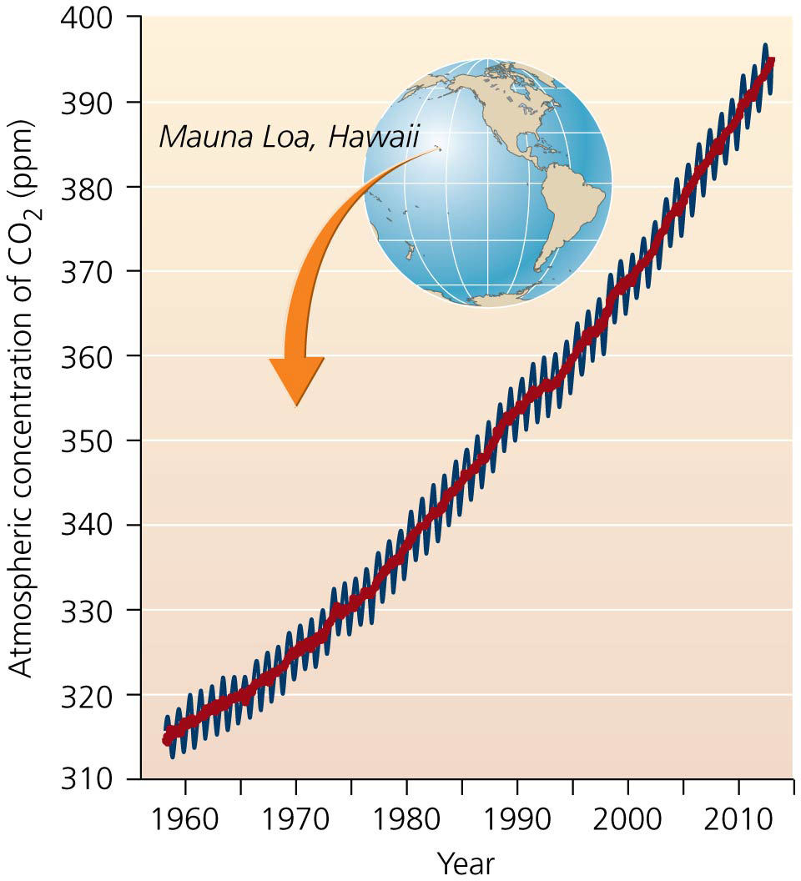

Slide 37
Models help us predict the future
To understand climate functioning and predict the future, scientists simulate climate processes using computer programs
Climate models = programs that simulate climate processes by combining what is known about:
Atmospheric and ocean circulation
Atmosphere-ocean interactions
Feedback mechanisms

Slide 38
Models help us predict the future
Modelers provide starting condition and rules
Test the model by starting it in the past and seeing if it accurately predicts current climate conditions
Challenges remain—climate systems are complex and uncertainty remains in feedback loops

Slide 39
Current and Future Trends and Impacts
Evidence that climate conditions have changed since industrialization is everywhere
Fishermen in the Maldives, ranchers in Texas, homeowners in Florida, etc.
Extreme weather events are part of a pattern supported by a tremendous volume of scientific evidence

Slide 40
Current and Future Trends and Impacts
Climate change has had numerous impacts on organisms, ecosystems, and human well-being
Scientists have studied the many aspects of climate change
Climate variables have been monitored, building a long-term database for researchers to study
Scientific literature is replete with published studies

Slide 41
Scientific evidence for climate change is extensive
The vast research knowledge has been summarized for policymakers and the public by various groups
Intergovernmental Panel on Climate Change (IPCC) = established in 1988 by the U.N. and the World Meteorological Organization
Composed of hundreds of international scientists and government representatives
Publishes periodic assessments of climate change’s impacts on the world as a whole
The IPCC released its Fourth Assessment Report in 2007
Summarized thousands of scientific studies

Slide 42
Scientific evidence for climate change is extensive
Documented observed trends in surface temperature, precipitation patterns, snow and ice cover, sea levels, storm intensity, etc.
Predicted impacts of current and future climate change on wildlife, ecosystems, and human societies
Discussed strategies to pursue in response to climate change
IPCC’s reports deal in uncertainties (as does all science)
Statistical probabilities are assigned to conclusions and predictions
Fifth Assessment Report will be issued from 2013 to 2014

Slide 43
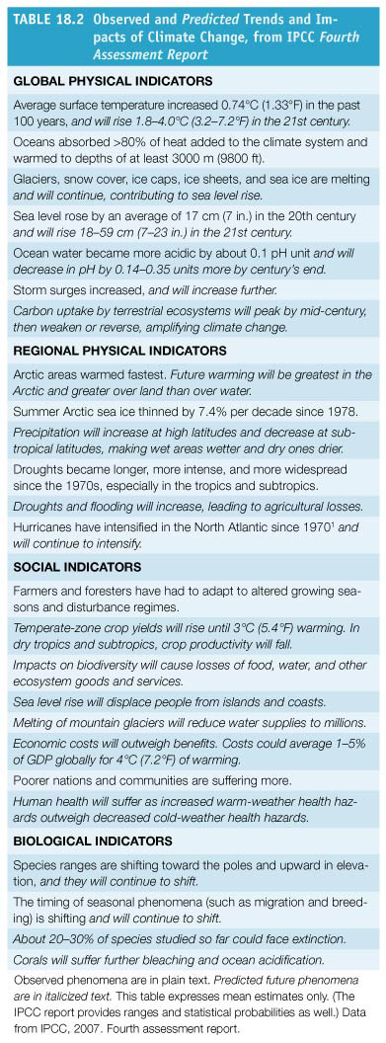

Slide 44
Temperatures continue to increase
Average surface temperatures on Earth have increased 0.9°C (1.6°F) in the past 100 years
Most of the increase occurred in the last few decades
The number of extremely hot days has increased
The 18 warmest years on record have been since 1990
From 1991 to 2001, most areas of the United States experienced a temperature increase of more than 1°F

Slide 45
Temperatures continue to increase
Average global temperatures are expected to rise 0.4°C (0.7°F) in the next 20 years
The IPCC predicts global temperatures will rise 1.8–4.0°C (3.2–7.2°F) by 2100
Amount of change will vary from region to region

Slide 46
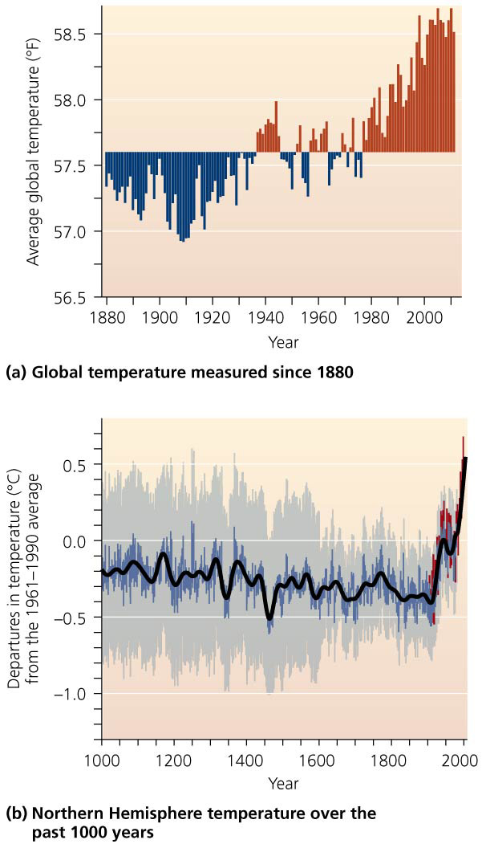

Slide 47
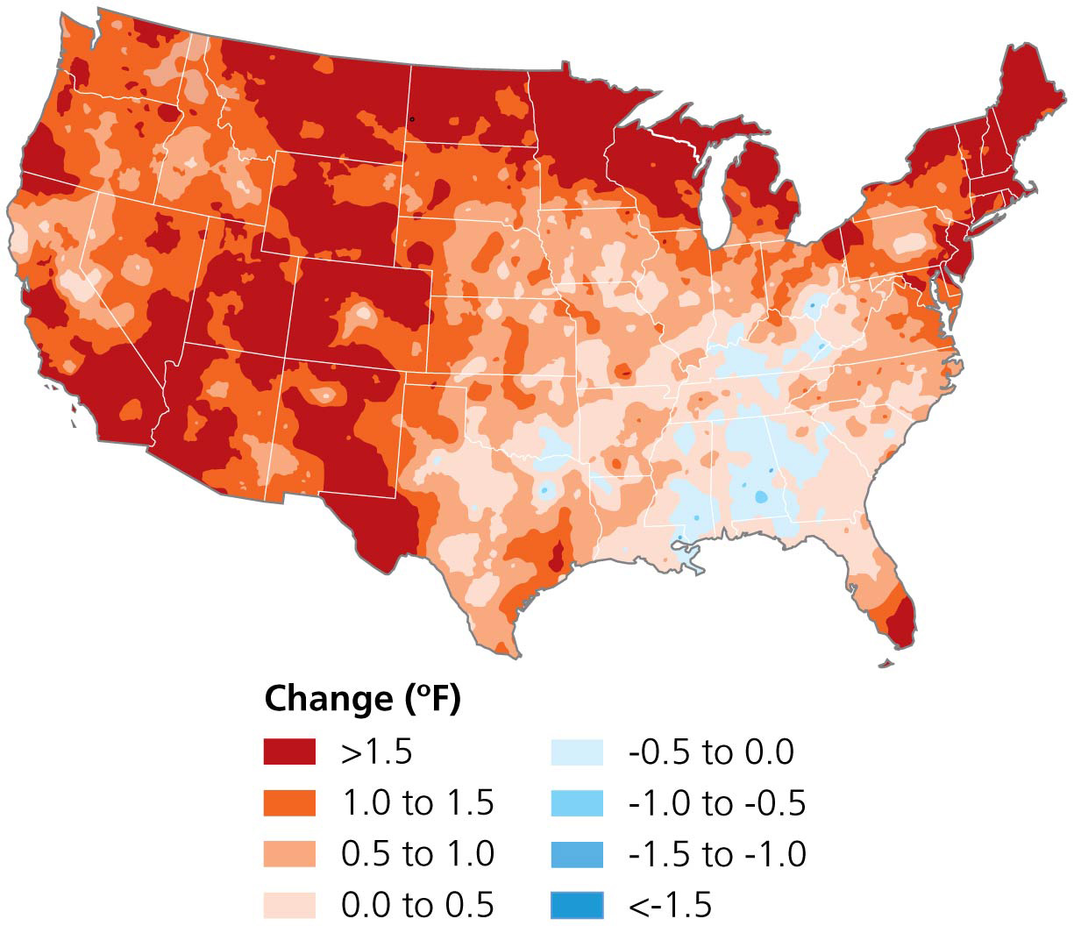

Slide 48
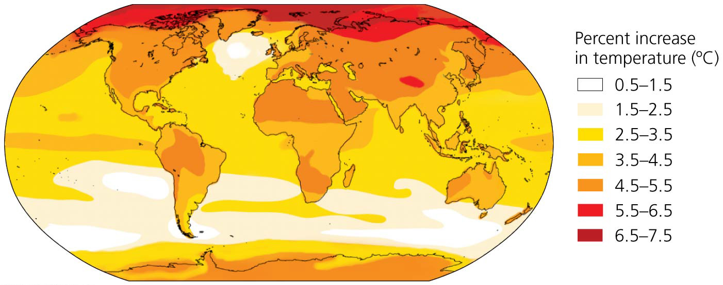

Slide 49
Precipitation is changing, too
The warmer atmosphere speeds evaporation and the air holds more water
Precipitation has increased worldwide by 2% over the last century
Some regions are receiving more precipitation than usual, and others are receiving less

Slide 50
Precipitation is changing, too
Droughts have become more frequent and severe
Harming agriculture, promoting soil erosion, reducing water supplies, and triggering fires
Heavy rains contribute to flooding
Killing people, destroying homes, and inflicting billions of dollars in damage
Wet areas will get wetter; dry areas will get drier

Slide 51
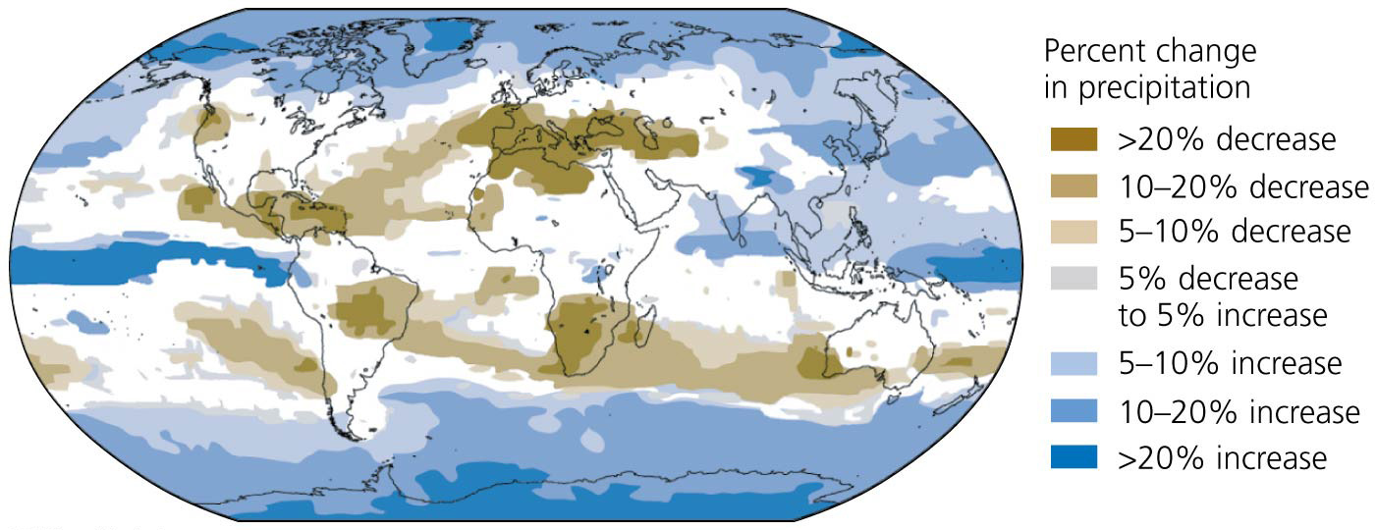

Slide 52
Extreme weather is becoming “the new normal”
There is widespread awareness of the large number of recent extreme weather events (droughts, tornadoes, snowstorms, hurricanes, heat waves
In 2012, there were 34,000 daily high temperature records set across the United States
The U.S. Climate Extremes Index shows that these type of events have been increasing since 1970
Summer temperatures have become more variable (so both unusually warm and cold summers)
The insurance industry has taken note of this
From 1980 to 2011, extreme weather events that caused losses increased 5-fold in North America

Slide 53
Extreme weather is becoming “the new normal”
Researchers have identified a possible mechanism to link climate change to extreme weather events
Warming has led to a weakening of the jet stream = a high-altitude air current that influences weather
The slower jet stream forms longer loops than usual
They may get stuck in a north-south orientation causing an atmospheric blocking pattern that prevents weather systems from moving west to east
If weather systems stay in the same place for long time periods, their effects get magnified
Rain staying in place causes flooding, hot dry conditions staying in place cause drought, etc

Slide 54
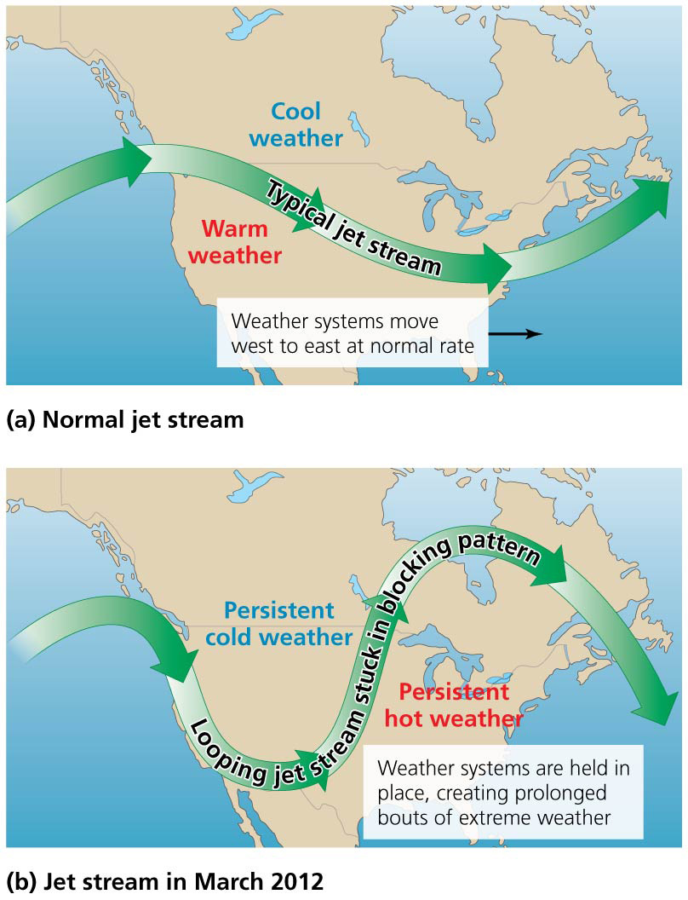

Slide 55
Melting ice has far-reaching effects
Mountaintop glaciers are disappearing
Glaciers on tropical mountaintops have disappeared
Only 25 of 150 glaciers present when Glacier National Park opened are still there, and they will be gone by 2020 or 2030
Reducing summertime water supplies to the millions of people that rely on mountain melt water
Melting of Greenland’s Arctic ice sheet is accelerating
Warmer water is melting Antarctic coastal ice shelves
Interior snow is increasing due to more precipitation

Slide 56
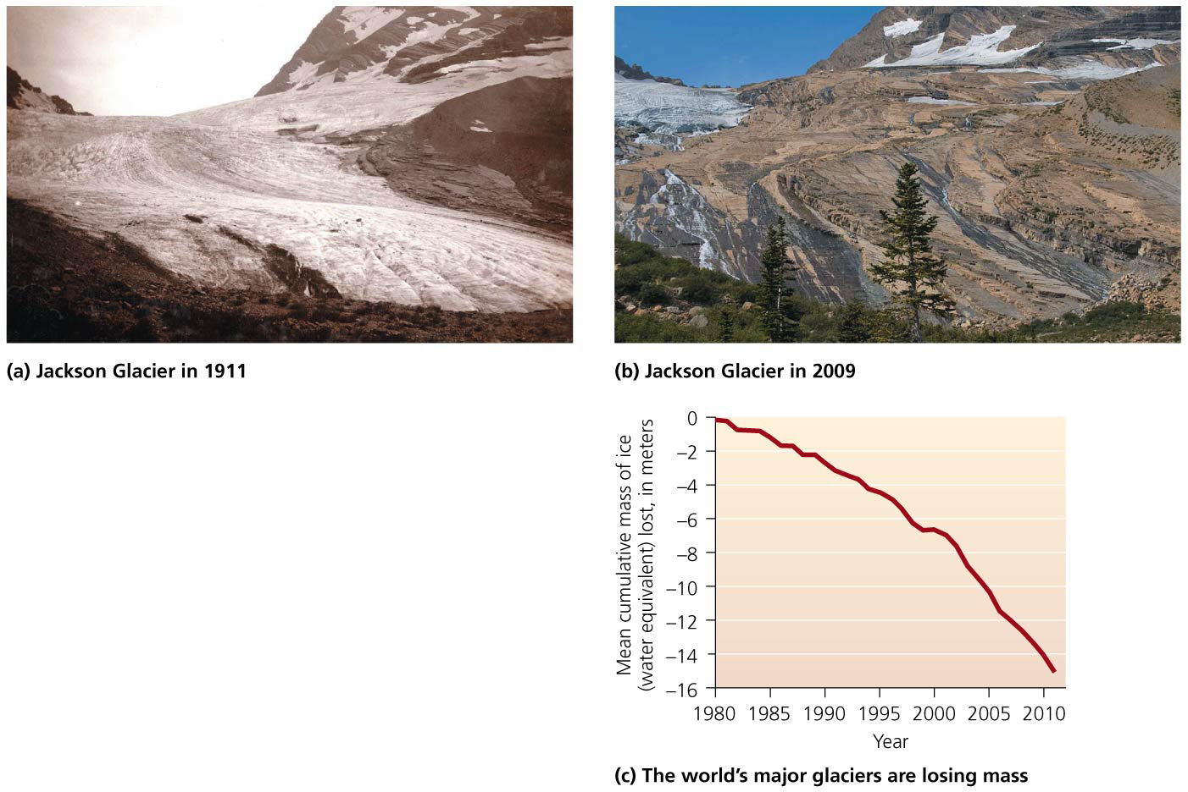

Slide 57
Melting ice has far-reaching effects
Melting ice exposes darker, less-reflective surfaces decreasing albedo = the capacity to reflect light
Lower albedo means more absorbed sunlight, causing heating and more melting
Positive feedback

Slide 58
Melting ice has far-reaching effects
As Arctic sea ice is disappearing, nations are rushing to exploit underwater oil and mineral resources made available by newly opened shipping lanes
Permafrost (permanently frozen ground) is thawing
Destabilizes soil, buildings, etc.
Releases methane trapped for thousands of years, creating positive feedback

Slide 59
Rising sea levels may affect hundreds of millions of people
Runoff from melting glaciers and ice will cause sea levels to rise
As ocean water warms, it expands in volume
Thermal expansion is the primary cause of current sea level rise
Sea levels rose 1.8 mm/year from 1961 to 2003, and 2.9–3.4 mm/year from 1993 to 2010
Even small rises in sea level lead to beach erosion, coastal floods, and intrusion of salt water into aquifers and greater impacts from storm surges
Storm surge = the temporary and localized rise in sea level from high tides and winds from storms

Slide 60
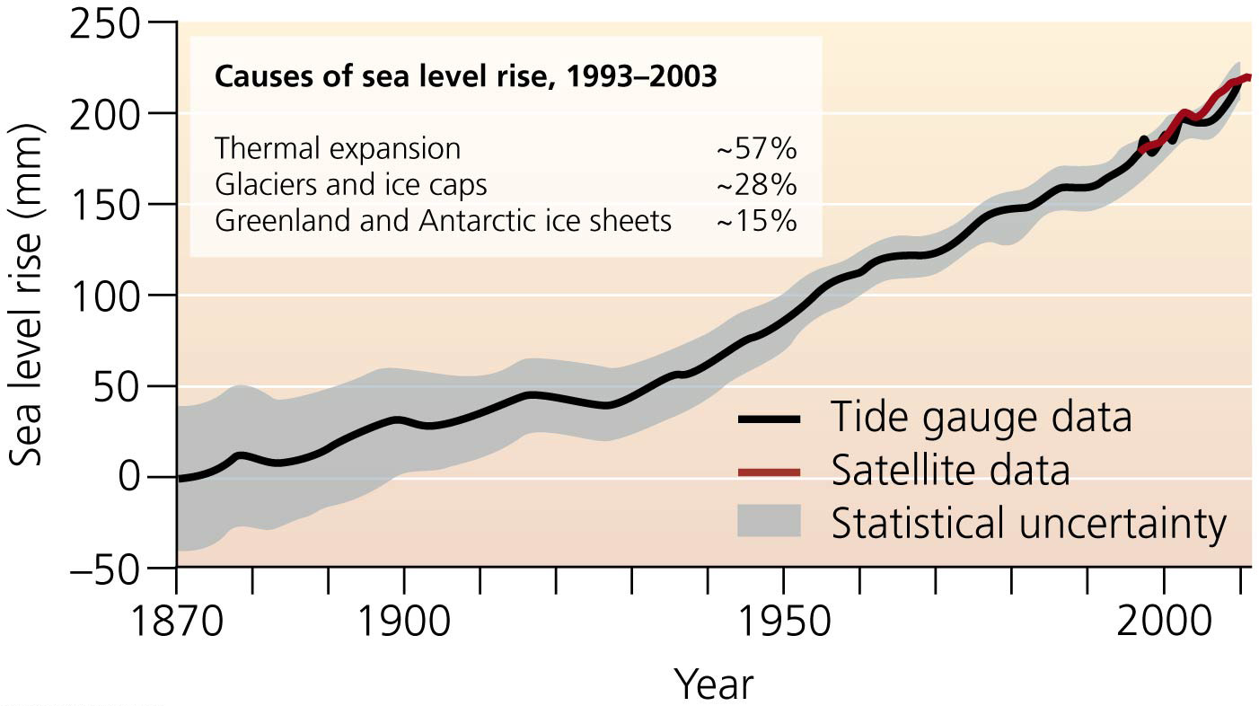

Slide 61
Rising sea levels may affect hundreds of millions of people
Higher sea level allows storm surges to push farther inland and be more damaging
An earthquake caused the 2004 tsunami (tidal wave) that killed 100 Maldives residents and caused $470 million in damages
In 2012, Hurricane Sandy caused $60 billion in damage, killed 130 people, and left thousands homeless across the U.S. east coast
Hurricane Katrina hit the Gulf Coast in 2005, killing over 1800 people and doing $80 billion in damage. Higher sea levels, warmer oceans, and the loss of coastal wetlands made the damage worse

Slide 62
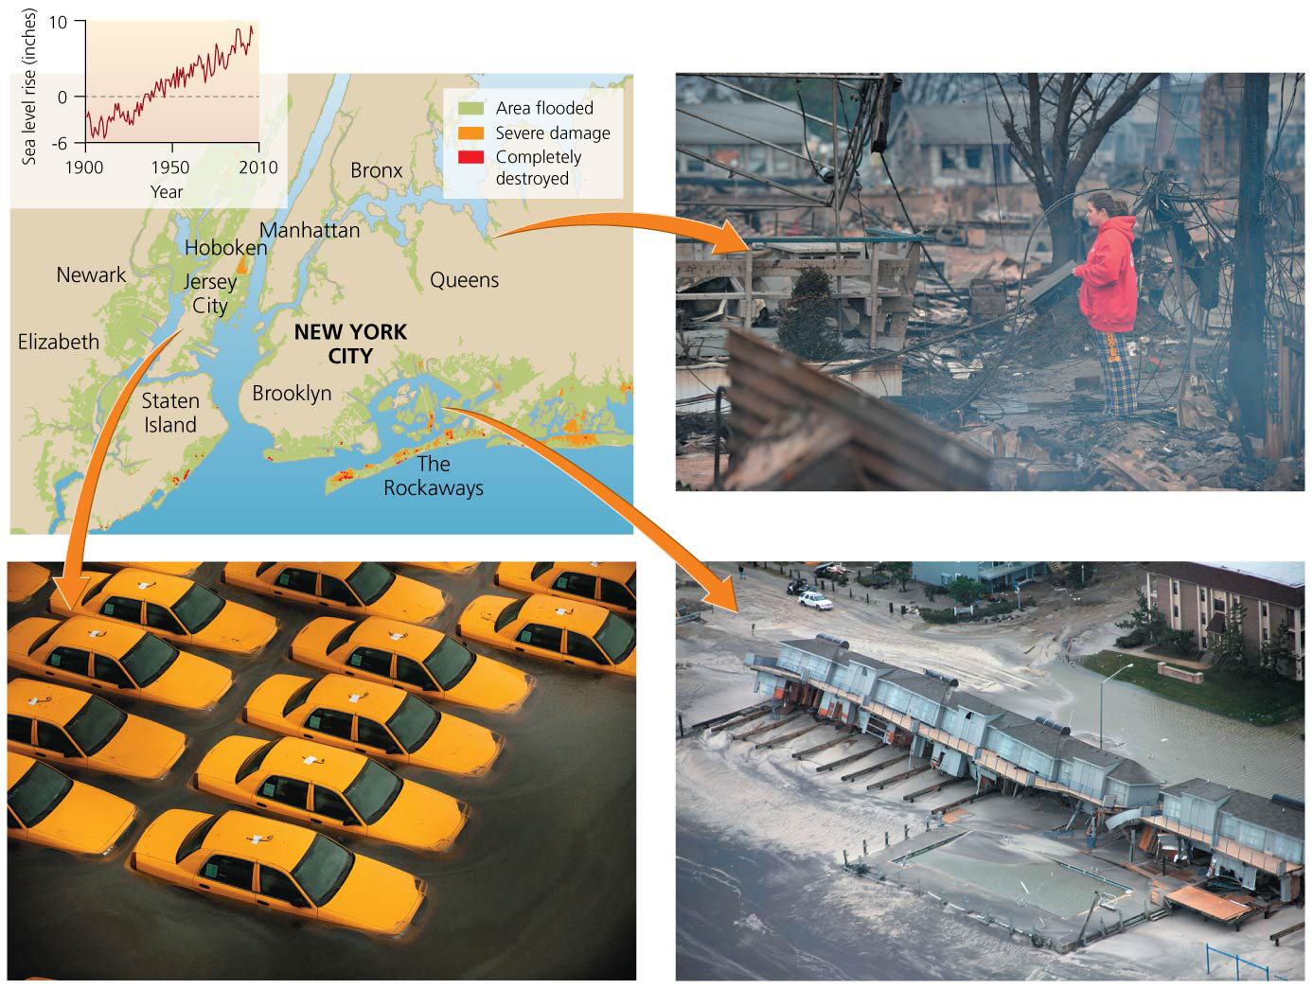

Slide 63
Rising sea levels may affect hundreds of millions of people
53% of people in the United States live in coastal areas
They are at risk from storms and rising water
Different coastal areas are experiencing different amounts of sea level rise

Slide 64
Rising sea levels may affect hundreds of millions of people
Millions of people will be displaced from coastal areas
Sea levels are predicted to rise between 18 cm and 1.3 m (7 in–4.3 ft) by 2100
A 1-m rise will impact 180 U.S. cities
Densely populated regions in low-lying river deltas (Bangladesh), storm-prone regions (Florida), and areas where land is subsiding are most at risk
Pacific islands would need to be evacuated (Tuvalu)

Slide 65
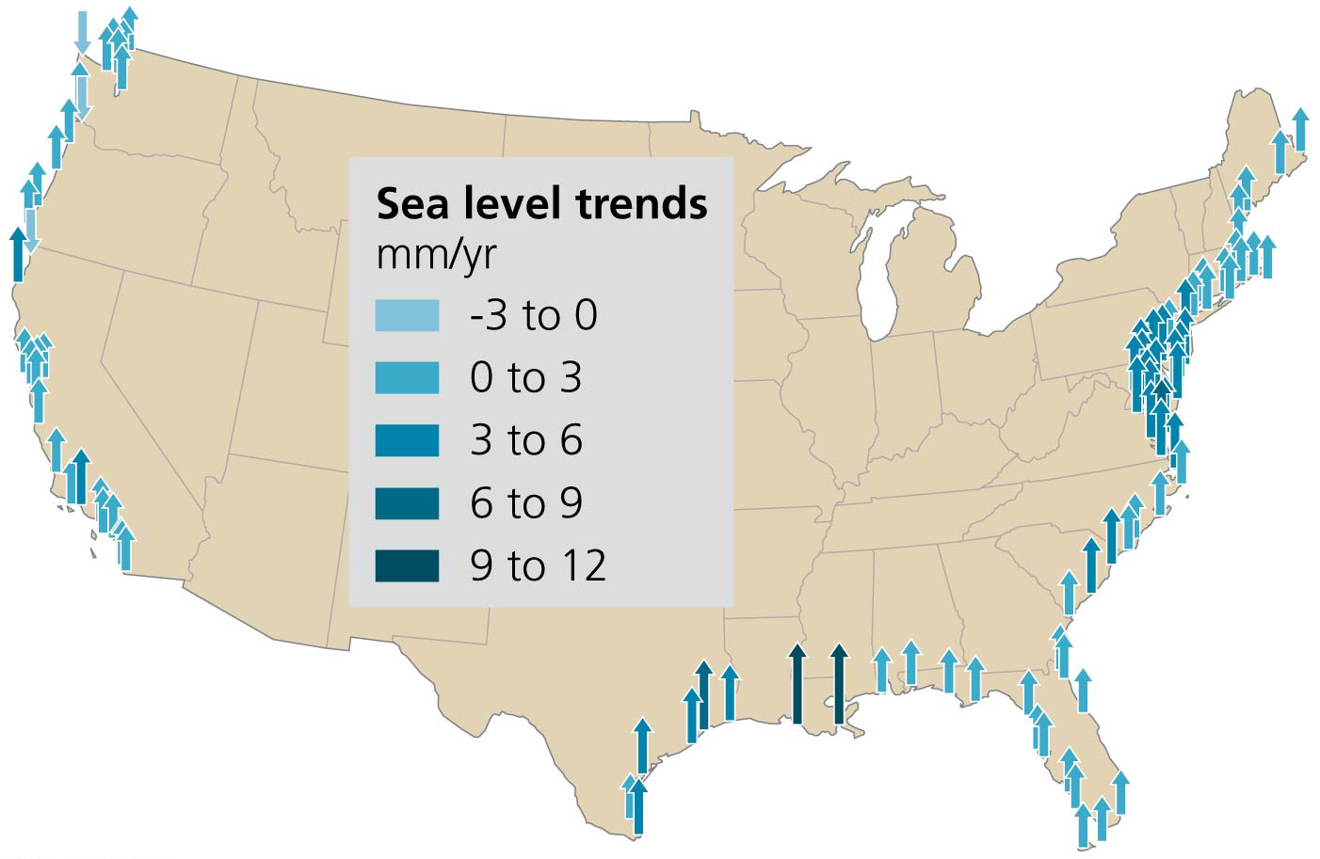

Slide 66
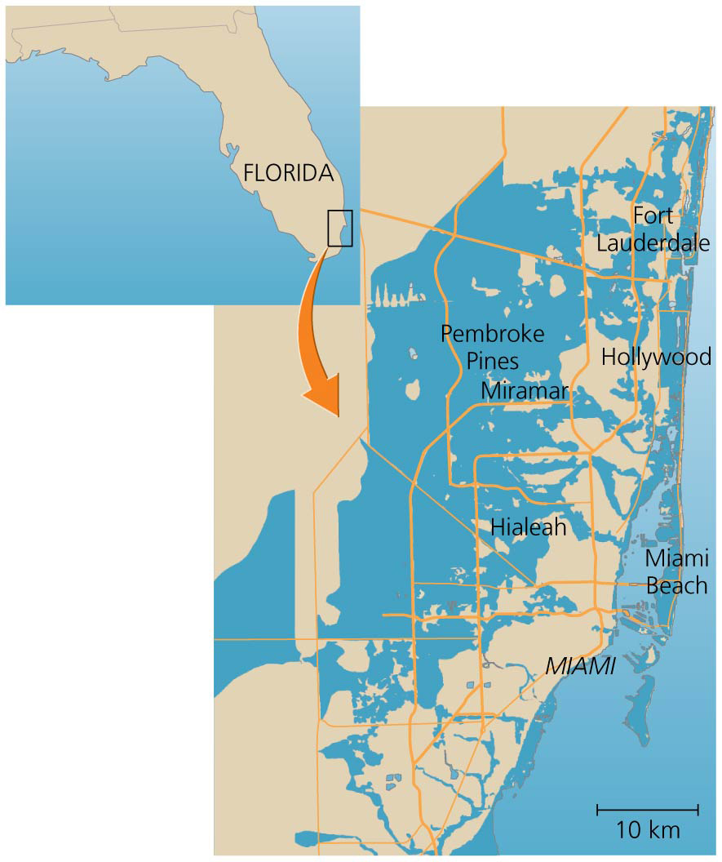

Slide 67
Climate change threatens coral reefs
Coral reefs are important for many coastal and island communities
Provide habitat for food fish, snorkeling and scuba diving sites for tourism, protection against waves and erosion
Warmer waters contribute to coral bleaching, which kills corals

Slide 68
Climate change threatens coral reefs
Increased CO₂ leads to ocean acidification = dissolved CO₂ makes ocean water more acidic
Organisms can’t build their exoskeletons
Oceans have already decreased by 0.1 pH unit
Future changes could kill most coral reefs

Slide 69
Climate change affects organisms and ecosystems
Organisms are adapted to their environments
They are affected when those environments change
Global warming modifies temperature-dependent phenomena
Plants leaf out earlier in the spring
Insects emerge earlier
Birds are migrating and animals are breeding earlier
Changes cause mismatches for organisms (lack of food for young birds since insects emerge earlier)
Animals and plants will move toward the poles or upward in elevation toward cooler areas

Slide 70
Climate change affects organisms and ecosystems
20–30% of species will be threatened with extinction
Trees may not be able to shift their distributions fast enough to match the climate
Rare species will be pushed out of preserves
Animals and plants adapted to mountainous environments will be forced uphill until there is no place to go

Slide 71
Climate change affects organisms and ecosystems
Droughts, fire, and disease will decrease plant growth
Fewer plants means more CO₂ in the atmosphere
Increased precipitation can lead to increased flooding and erosion polluting aquatic habitats, while droughts may cause rivers and ponds to shrink

Slide 72
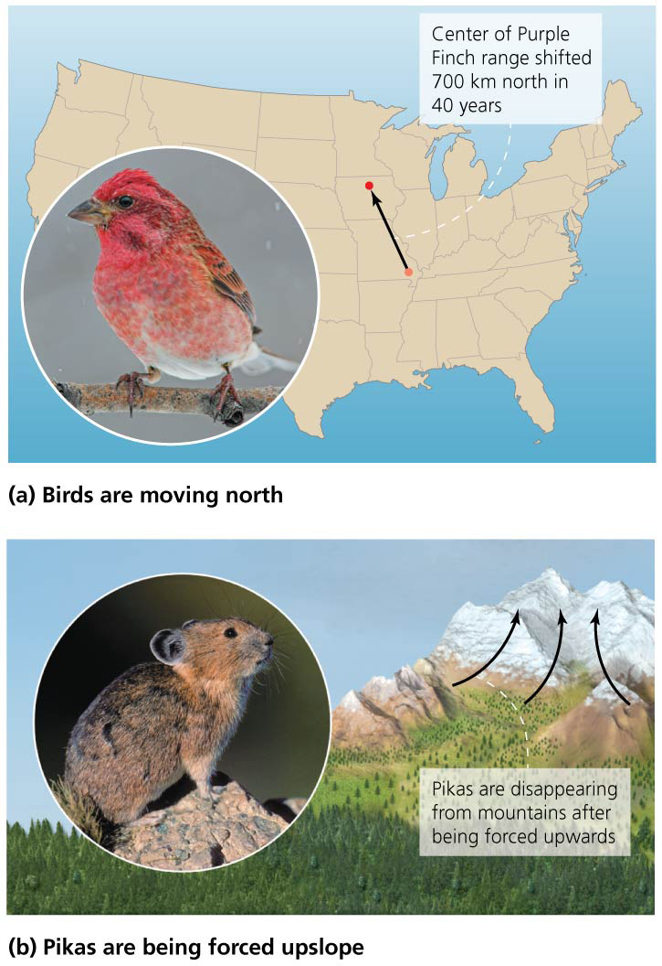

Slide 73
Climate change affects society
Agriculture: warmer temperatures and more CO₂ may initially boost crop yields
But more warming will lead to shortened growing seasons, decreased production, crops being more susceptible to droughts, and increased hunger, particularly in developing nations
Forestry: increased fires, invasive species
Insect and disease outbreaks

Slide 74
Climate change affects society
Health: heat waves and stress can cause death
Respiratory ailments, expansion of tropical diseases
Disease and sanitation problems from flooding
Drowning from storms

Slide 75
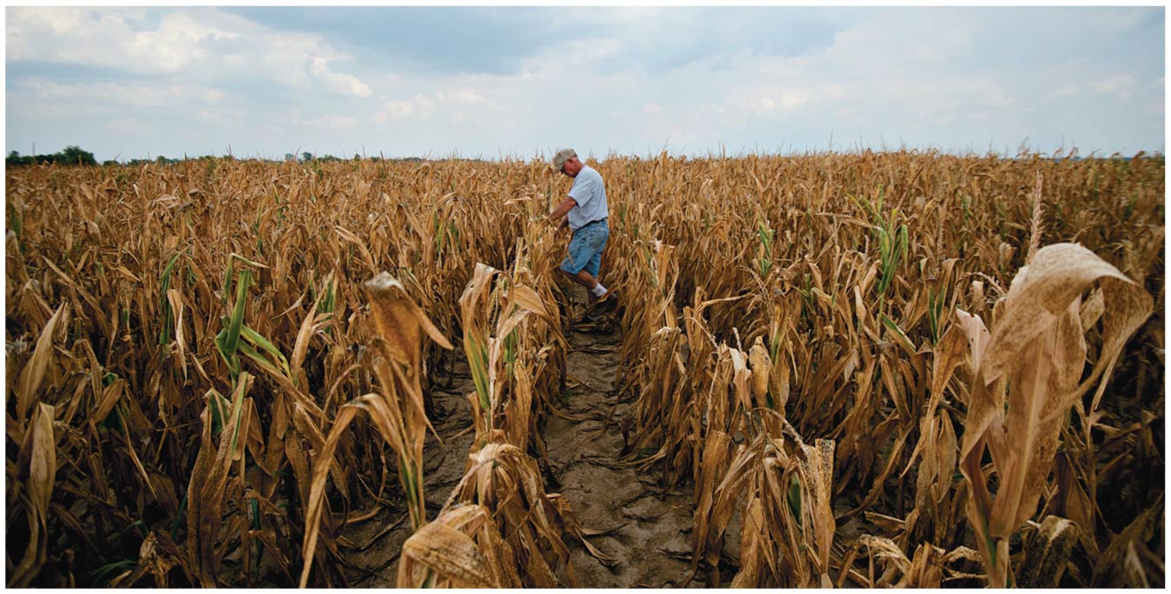

Slide 76
Climate change affects society
Economics: costs will outweigh benefits of climate change
It will widen the gap between rich and poor
Those with less wealth and technology will suffer most
External costs of damages will be $10–350/ton of carbon
It will cost 1–5% GDP on average globally
Poor nations will lose more than rich ones
The Stern Review predicts it will cost 5–20% of GDP by 2200
Investing 1% of GDP now could avoid these costs

Slide 77
Impacts vary by region
Where we live will determine how we experience the impacts of climate change
Temperature changes have been greatest in the Arctic
Melting ice sheets, thinning ice, increasing storms, etc.
Harder for people and polar bears to hunt
Permafrost is melting destabilizing buildings

Slide 78
Impacts vary by region
Impacts on the United States have been analyzed by the U.S. Global Change Research Program
Produced the National Climate Assessment, which will be finalized in 2014
Summarizes current research, present trends, and future impacts of climate change

Slide 79
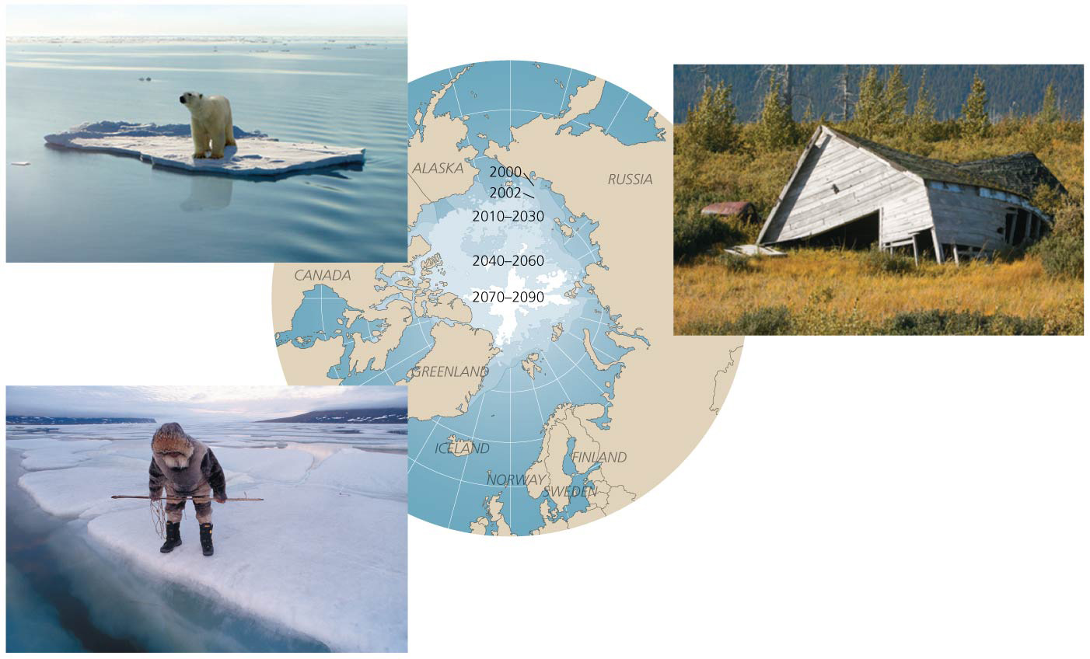

Slide 80
Impacts vary by region
The National Climate Assessment states that U.S. temperatures have risen and will continue rising
Already increased by 0.8°C (1.5°F) since 1895
Predicted to rise 2.1–6.2°C (4–11°F) by 2100
Extreme weather events have become more frequent and will continue to worsen

Slide 81
Impacts vary by region
Most impacts will vary by region
The southern United States will get drier, the northern wetter
Some regions will experience flooding while others are in drought conditions
Sea levels will rise more on the East and Gulf Coasts
This is all the result of increases in greenhouse gases

Slide 82
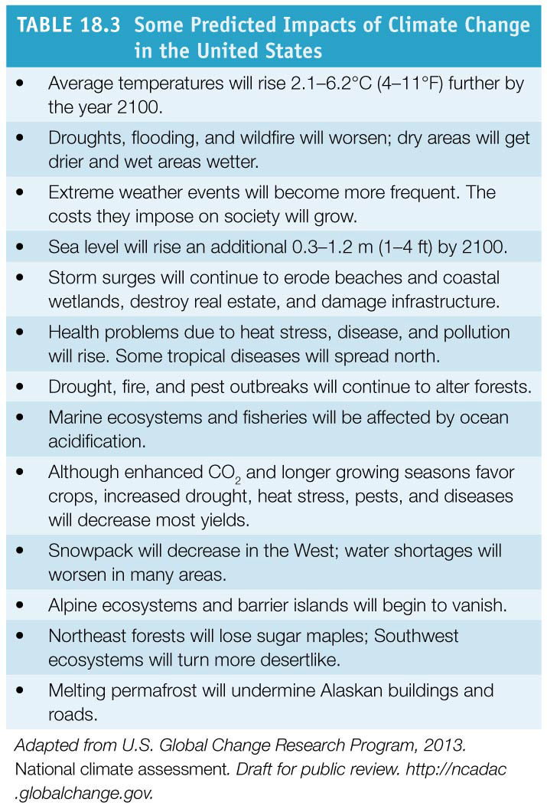
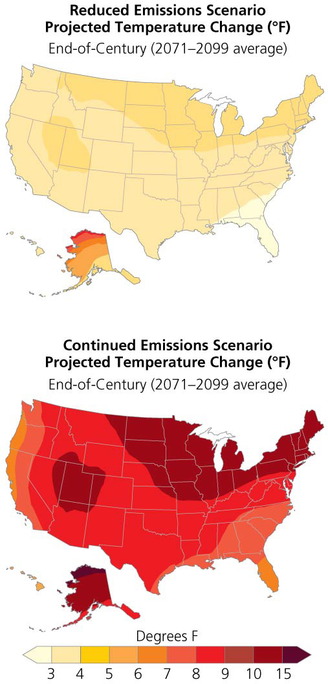

Slide 83
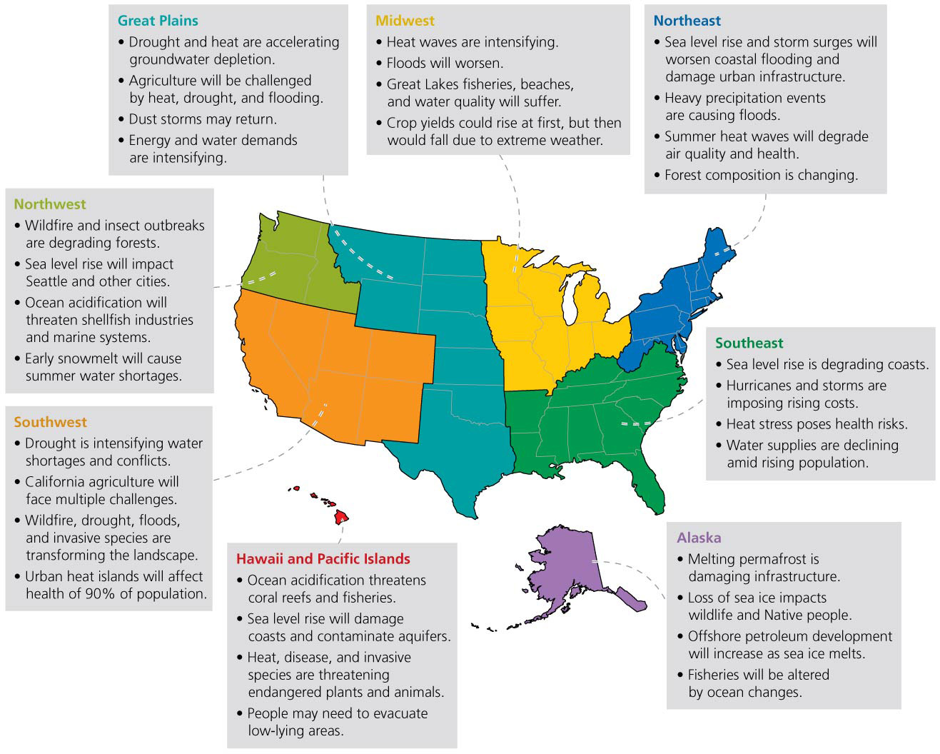

Slide 84
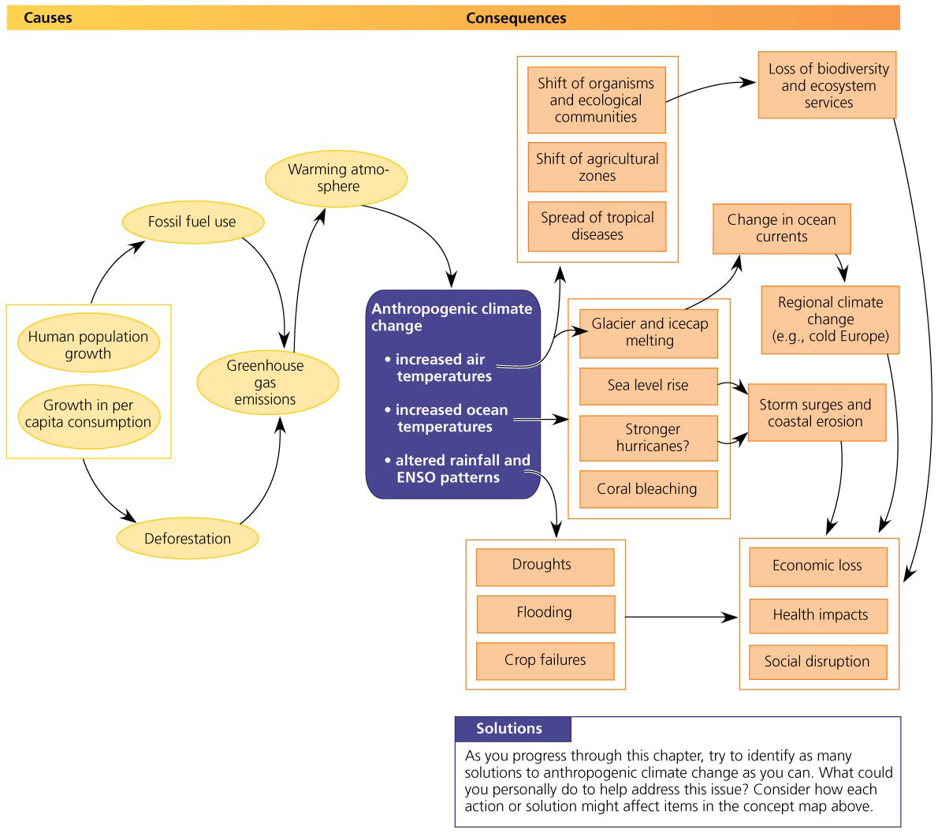

Slide 85
Are we responsible for climate change?
Scientists agree that increased greenhouse gases are causing global warming
Burning fossil fuels is increasing greenhouse gases
In 2005, the national academies of science from 11 nations issued a joint statement urging political leaders to take action
There is a broad and clear scientific consensus that climate change is a pressing issue
But many people deny what is happening
Some people will admit the climate is changing but doubt we are the cause

Slide 86
Are we responsible for climate change?
Conservative think tanks and industry-sponsored scientists aimed to cast doubt on the scientific consensus
The news media tries to present two sides to an issue
But the sides’ arguments are not equally supported by evidence

Slide 87
Are we responsible for climate change?
Most Americans accept that fossil fuel consumption is changing the planet
Al Gore’s An Inconvenient Truth and the release of the 2007 IPCC report on the Internet raised public awareness
Both were widely covered in the media
They were jointly awarded the Nobel Peace Prize

Slide 88
Are we responsible for climate change?
In 2009, a hacker illegally broke into a university’s computer in the U.K.
Private emails seemed to show questionable behavior by a few scientists in using data
Climate deniers accused the entire scientific establishment of wrongdoing and conspiracy
The story was widely told in the news
Investigations showed no evidence of wrongdoing
Media accounts misrepresented the email contents
Despite no wrongdoings, scientists strengthened procedures to ensure the IPCC’s reputation

Slide 89
Responding to Climate Change
Most people accept that our fossil fuel consumption is altering the planet
Mitigation = strategy of pursuing actions that reduce greenhouse gas emissions to lessen severity of future climate change
Energy efficiency, renewable energy, protecting soil, preventing deforestation

Slide 90
Responding to Climate Change
Adaptation = strategy of cushioning ourselves from the impacts of climate change
Seawalls, leaving the area, restricting coastal development, adjusting farming practices, etc.
Both are necessary, as warming will continue even if we were to stop all greenhouse gas emissions today

Slide 91
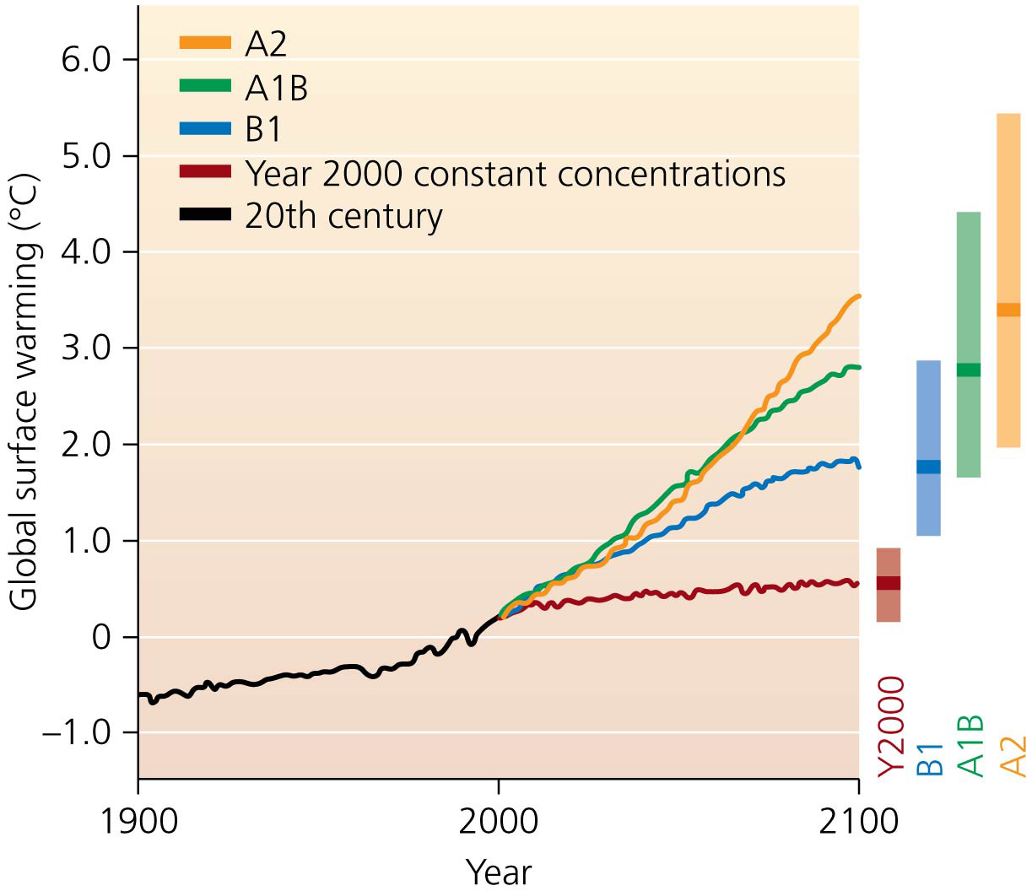

Slide 92
We are developing solutions in electricity generation
Electricity is the largest source of U.S. CO₂ emissions (40%)
70% of electricity comes from fossil fuels
Coal causes most of these emissions
To reduce fossil fuel use:
Encourage conservation and efficiency
Switch to cleaner and renewable energy sources

Slide 93
Conservation and efficiency
We can make lifestyle choices to reduce electricity use
The EPA’s Energy Star Program rates appliances, lights, windows, etc. by their energy efficiency
Replace old appliances with efficient ones
Using compact fluorescent lights reduces energy for lighting by 40%
Using efficient windows, ducts, insulation, heating and cooling systems can reduce energy usage and emissions by 30%
Manufacturers can make the same types of energy-saving decisions
Can manufacture energy efficient products

Slide 94
Sources of electricity
We need to switch to clean energy sources
Switching from coal to natural gas cuts emissions 50%
Alternatives to fossil fuels produce no net emissions during use (some emitted during construction)
Nuclear power, bioenergy, hydroelectric, solar, wind, and ocean sources

Slide 95
Sources of electricity
Carbon capture = technologies that remove CO₂ from emissions
Carbon sequestration (storage) = storing carbon underground where it will not seep out
Use depleted oil and gas deposits, salt mines, etc.
We may not be able to store enough CO₂ to make a difference

Slide 96
Transportation solutions are at hand
Transportation is the second largest source of U.S. greenhouse gas emissions
The Average U.S. family makes 10 car trips each day
Typical cars are inefficient—85% of fuel is wasted
More efficient gas-powered cars can be built
Hybrid, electric, alternative fuel, and hydrogen fuel cell cars are more efficient and produce fewer emissions

Slide 97
Transportation solutions are at hand
Alternatives to relying on cars exist
Living near a workplace allows biking or walking
U.S. public transportation saves 4.2 billion gallons of gasoline and 37 million metric tons of CO₂ emissions

Slide 98
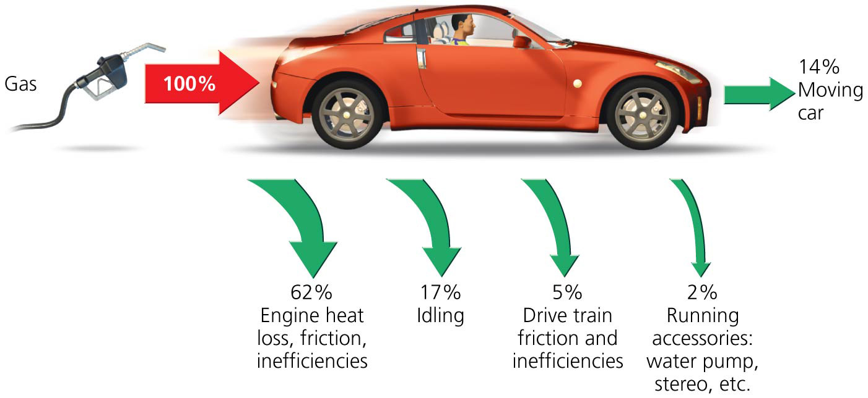
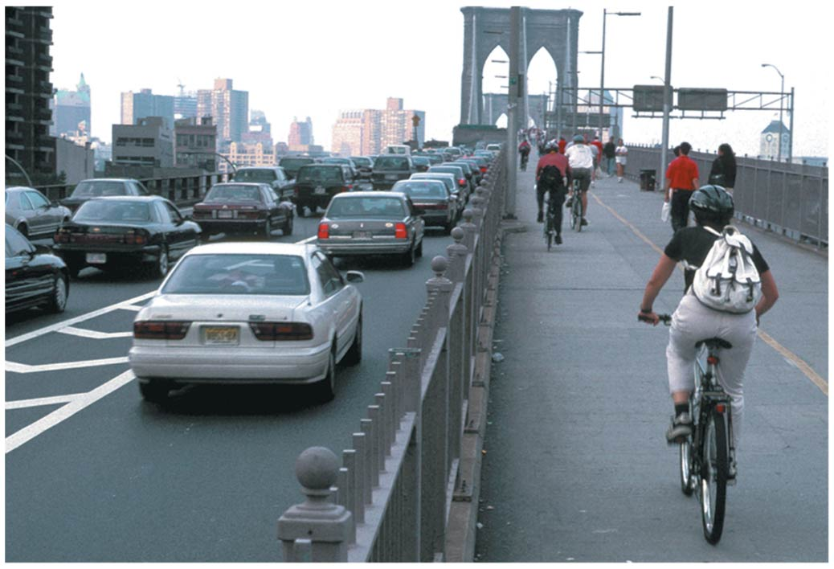

Slide 99
We will need to follow multiple strategies
Agriculture: sustainable land management lets soil store more carbon
Reduce methane emissions from rice and cattle
Grow renewable biofuels
Forestry: reforest cleared land, preserve existing forests
Sustainable forestry practices
Waste management: treating wastewater
Generating electricity by incinerating waste
Recovering methane from landfills
Individuals can recycle, compost, reduce, or reuse goods

Slide 100
We will need to follow multiple strategies
There is no magic bullet for mitigating climate change
Most reductions can be achieved using current technology that we can use right away
Adopt a portfolio of strategies, each one feasible in itself, that could stabilize CO₂ emissions
15 strategies identified for reducing 1 billion tons of carbon each per year by 2050
Achieving 7 would stabilize emissions
Achieving more than 7 would reduce emissions

Slide 101
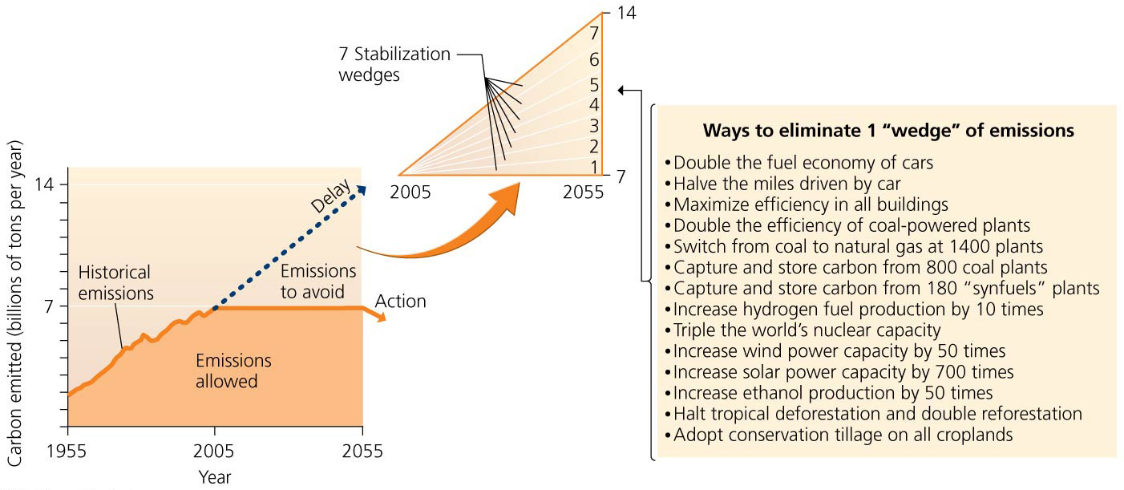

Slide 102
What role should government play?
Governments could take different approaches to address climate change
Mandate change through laws and regulations
Do nothing and let the market solve the problem
Use financial incentives to have private entities reduce emissions

Slide 103
What role should government play?
In 2009, the House of Representatives passed legislation creating an emissions cap-and-trade system = industries and utilities compete to reduce emissions for financial gain (it did not pass the Senate)
EPA has begun a slowly phased-in program of emissions reductions from industry and utilities

Slide 104
The Kyoto Protocol sought to limit emissions
Global cooperation is needed to forge effective solutions to global climate change
U.N. Framework Convention on Climate Change = a 1992 plan to reduce greenhouse gas emissions to 1990 levels by 2000 by a voluntary, nation-by-nation approach
By the late 1990s, it was clear that the voluntary approach would not succeed (emissions kept rising)
Developing nations created a binding international treaty requiring emission reductions
Kyoto Protocol = between 2008 and 2012, signatory nations must reduce emissions of six greenhouse gases to levels below those of 1990

Slide 105
The Kyoto Protocol sought to limit emissions
This treaty took effect in 2005
The United States was the only industrialized nation not to ratify the Kyoto Protocol
It requires industrialized nations to reduce emissions
But it does not require industrializing nations (China and India) to reduce theirs

Slide 106
The Kyoto Protocol sought to limit emissions
Other countries resented the United States because it emits 20% of the world’s greenhouse gases but won’t take action
Signatory countries reduced emissions by 8.9% from 1990
Largely due to economic contraction in the countries of the former Soviet Union
With those nations removed, others showed a 4.9% rise

Slide 107
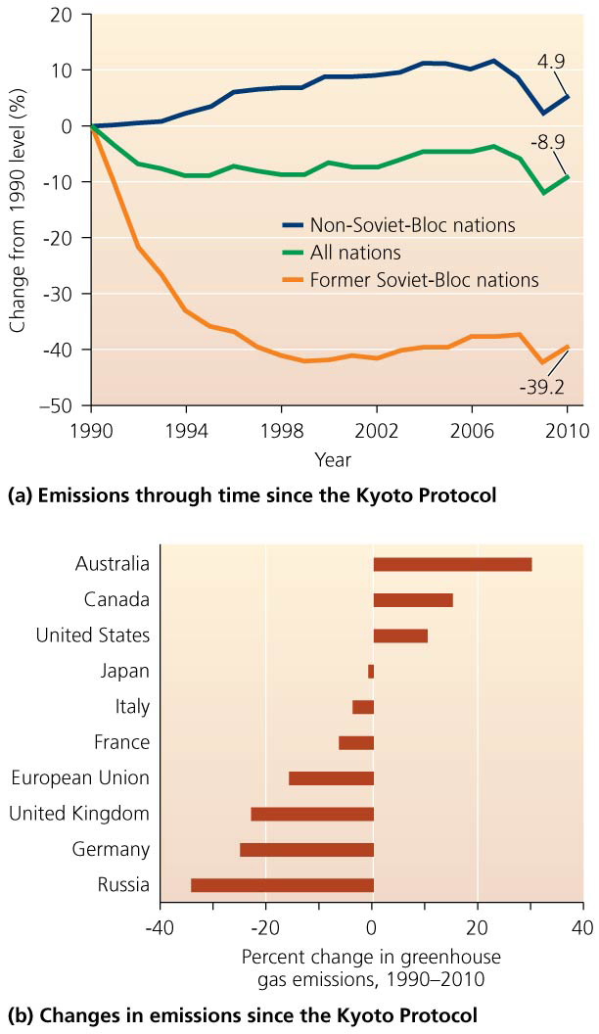

Slide 108
International climate negotiations seek a way forward
International conferences have been held to design a successor treaty to the Kyoto Protocol
The conference in 2009 was held in Copenhagen
China promised steep emissions cuts but without international monitoring
Obama favored emissions cuts but would not promise more than Congress had agreed to
Could not achieve a unanimous vote, so no specific targets or commitments were set
Several nations denounced the accord so that it could not even be adopted by concensus

Slide 109
International climate negotiations seek a way forward
The conference in 2010 was held in Cancun, Mexico
Developed nations pledged to financially support developing nations in mitigation and adaptation efforts and to reduce tropical forest loss
China and India agreed in principle to emissions targets and monitoring
The conference in 2011 was held in Durban, S. Africa
All nations agreed to a “road map” toward a legally binding deal in 2015 to start after 2020
Scientists were disappointed that nothing would happen until 2020, creating a “lost decade”

Slide 110
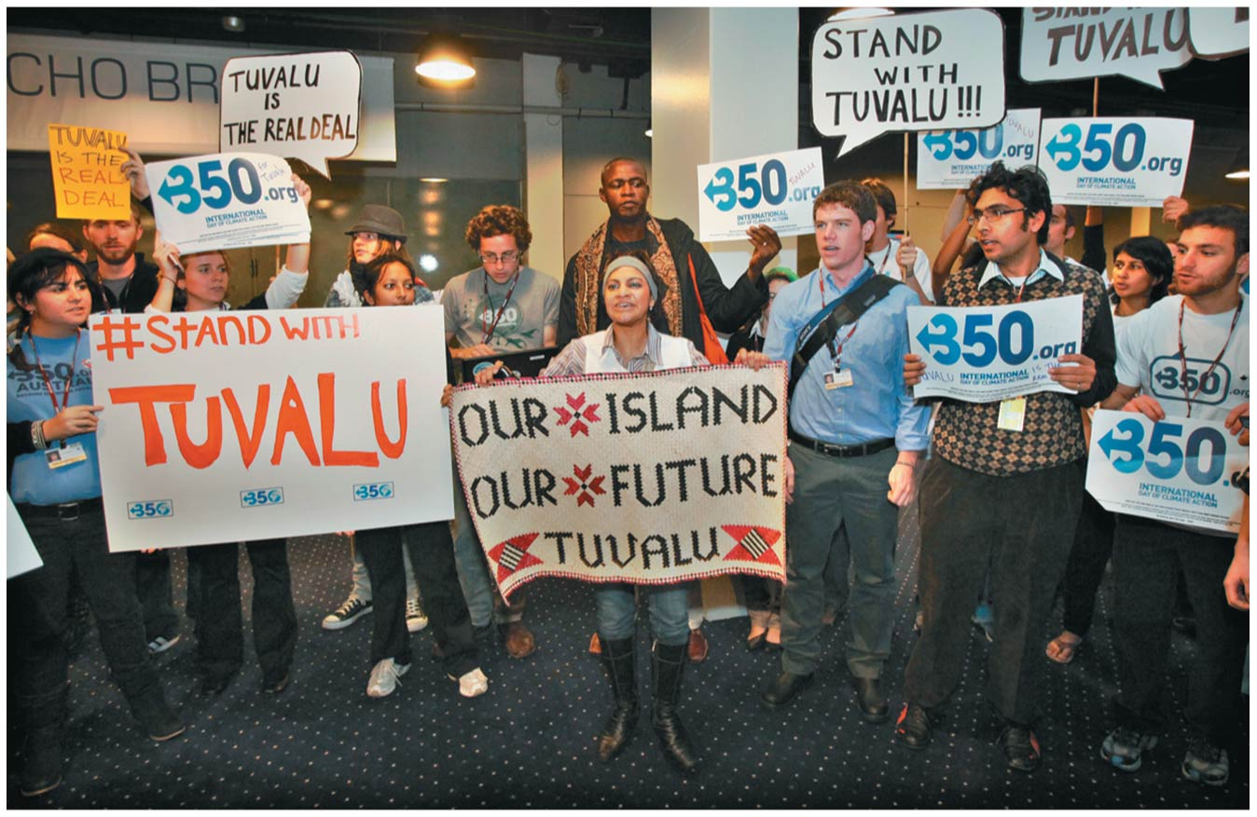

Slide 111
Will emissions cuts hurt the economy?
U.S. policymakers fear emissions reductions will hurt the economy
China and India also resist emissions cuts
Economic vitality does not need higher emissions
Germany has the third most technologically advanced economy in the world
They cut emissions by 25% between 1990 and 2010

Slide 112
Will emissions cuts hurt the economy?
On a person-per-person basis, other wealthy nations have standards of living comparable to the United States
Emit greenhouse gases at less than half the U.S. rate
The future will belong to nations willing to develop new technologies and energy sources

Slide 113
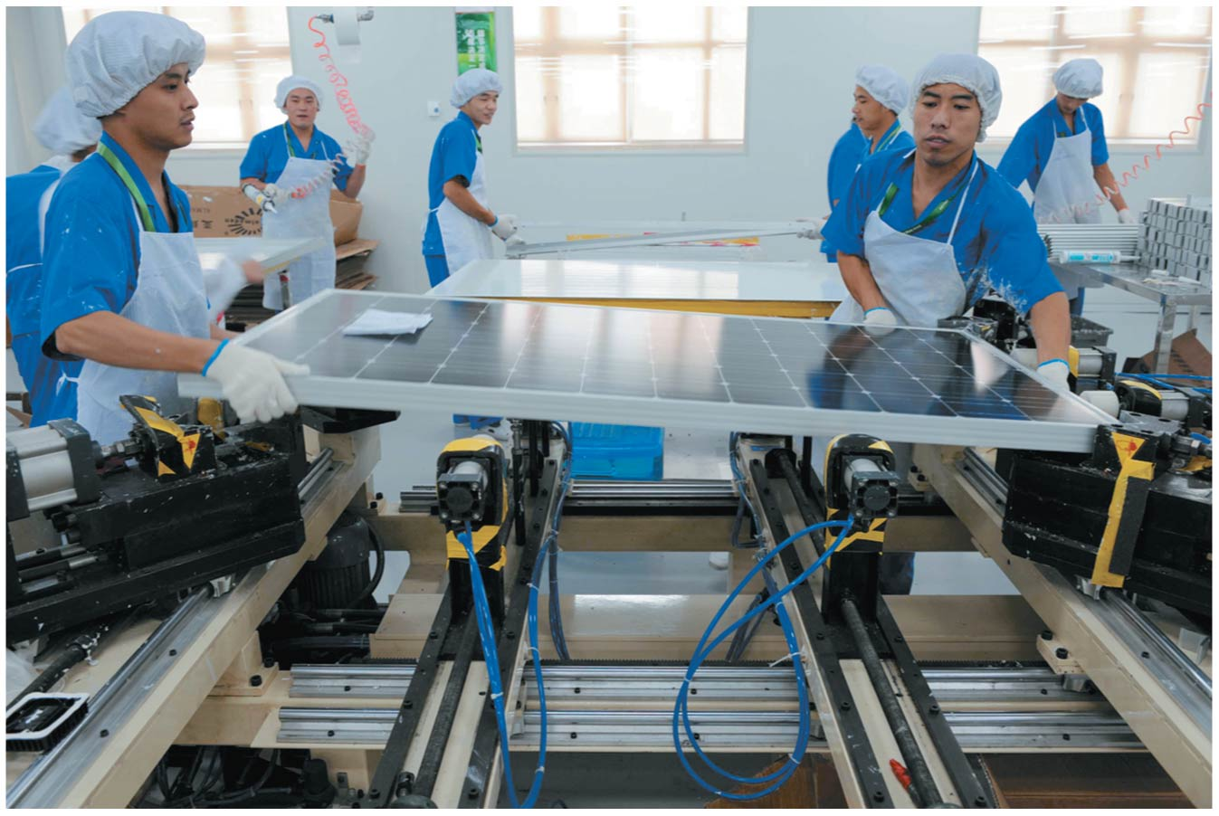

Slide 114
States and cities are advancing climate change policies
The U.S. federal government is not taking action
State and local governments are
Over 1000 mayors from all 50 states have signed the U.S. Mayors Climate Protection Agreement
To “meet or beat” Kyoto Protocol guidelines
States have set targets or mandates for alternative energy
California passed the Global Warming Solutions Act
To cut emissions 25% by 2020
Regional Greenhouse Gas Initiative (RGGI) in 2007
10 northeastern states set up a cap-and-trade program

Slide 115
Market mechanisms are being used to address climate change
Permit trading programs try to harness the economic efficiency of the free market to achieve policy goals
Businesses have flexibility in how they meet the goals
Polluters choose how to cut their emissions
They are given financial incentives to reduce them below the legally required level

Slide 116
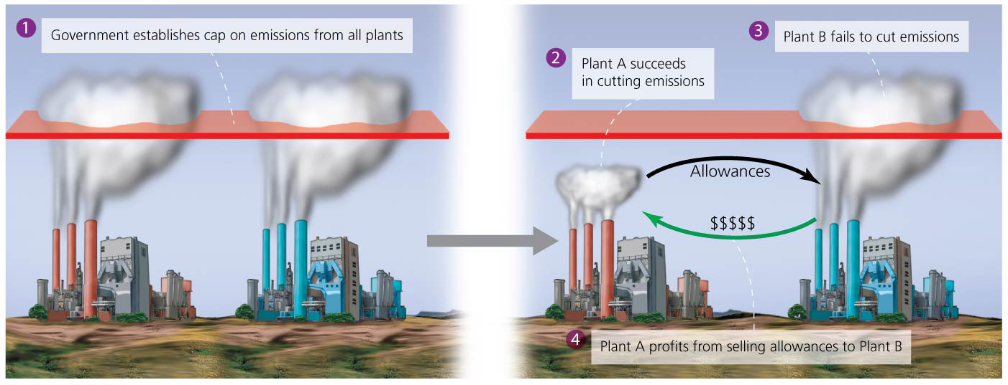

Slide 117
Market mechanisms are being used to address climate change
The approach of the Regional Greenhouse Gas Initiative:
Each state decides which polluting sources participate
Each state sets a cap on total CO₂ emissions it allows (2009 levels) and issues permits for those emissions
Each state lowers its cap (and permits) over time
Sources with too few permits must reduce emissions, buy permits from others, or pay for carbon offsets
Sources with too many permits may sell them
Any source emitting more than permitted will be penalized

Slide 118
Market mechanisms are being used to address climate change
The European Union Emission Trading Scheme
The world’s largest cap-and-trade program
Governments had allocated too many permits and their value plummeted
Little incentive for businesses to reduce emissions
The Chicago Climate Exchange was the world’s first emissions trading program for greenhouse gas reduction
Low cost of permits caused the Exchange to close in 2010
Permits will only be valuable and exchanges will only work if government policies limit emissions

Slide 119
Carbon taxes are another option
Critics say cap-and-trade systems are not effective
Carbon tax = governments charge polluters a fee for each unit of greenhouse gases they emit
Polluters have a financial incentive to reduce emissions
Roughly 20 nations have a carbon tax of some sort
Boulder, Colorado has a tax on electricity consumption
Montgomery County, Maryland taxes polluting power plants

Slide 120
Carbon taxes are another option
Polluters pass costs on to consumers
Fee-and-dividend = approach in which funds from the carbon tax (fee) are passed to taxpayers as refunds (dividends)

Slide 121
Carbon offsets are popular
Carbon offset = a voluntary payment intended to enable another entity to reduce the greenhouse emissions that one is unable to reduce oneself
The payments offset one’s own emissions
Popular among utilities, businesses, universities, governments, and individuals trying to achieve carbon-neutrality, where no net carbon is emitted
Carbon offsets fall short
Need rigorous oversight to make sure that the offset money accomplishes what it is intended for

Slide 122
Corporations are going carbon-neutral
Carbon offsets can help businesses become carbon neutral
Can also find ways to reduce carbon footprint
Pearson (the publisher of this textbook) became carbon neutral in 2009
Directly reduced energy consumption and emissions by 12% by upgrading buildings and computers for energy efficiency and reducing employee travel and using more video conferencing
Eliminated 47% of emissions by installing solar panels and a wind turbine
Remaining 41% of emissions were offset by funding preservation and replanting of forests

Slide 123
Should we engineer the climate?
We may not be able to stop severe climate change
Geoengineering = cooling the climate by removing CO₂ from the air or reflecting sunlight away from earth
Carbon dioxide can be removed from the air by
Planting trees or fertilizing the oceans
Designing “artificial trees” that chemically filter out CO₂

Slide 124
Should we engineer the climate?
Block sunlight before it reaches the Earth by
Injecting sulfate aerosols into the stratosphere
Seeding clouds with seawater
Deploying fleets of reflecting mirrors
Solutions are technically challenging, and some do not reduce greenhouse gases

Slide 125
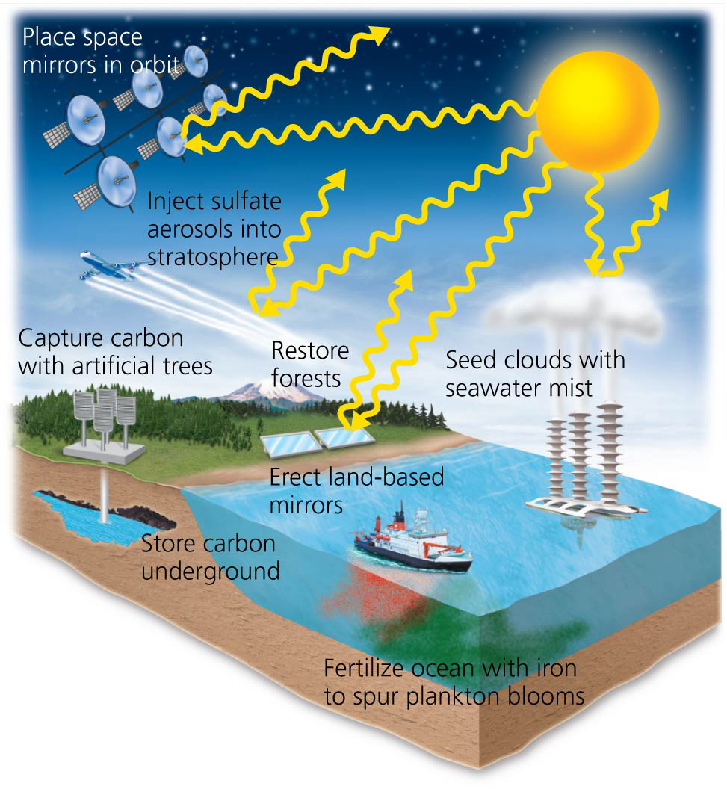

Slide 126
You can address climate change
Carbon footprint = expresses the amount of carbon we are responsible for emitting
Many strategies can be used to decrease the footprint
College students must help drive personal and societal changes needed to mitigate climate change
On October 24, 2009, the International Day of Climate Action had 5200 events held in 181 nations
“The most widespread day of political action in the planet’s history”
Global climate change may be the biggest challenge facing us and our children
Halting it would be our biggest victory

Slide 127
Conclusion
Many factors influence Earth’s climate
Human activities play a major role
Climate change is well underway
Further greenhouse gas emissions will cause severe impacts
More and more scientists are urging immediate action
Reducing emissions and mitigating and adapting to a changing climate are the foremost challenges for our society

Slide 128
QUESTION: Review
“Global warming” is defined as
long-term atmospheric conditions.
trends and variations in Earth’s climate.
an increase in Earth’s average temperature.
atmospheric gases that absorb infrared radiation.
Notes:
Answer: c

Slide 129
QUESTION: Review
Which of the following greenhouse gases is of most concern?
Carbon dioxide
CFCs
Methane
Water vapor
Notes:
Answer: a

Slide 130
QUESTION: Review
Which of the following is a type of proxy indicator?
Ice cores
Tree rings
Sediment cores containing pollen grains
All of these are proxy indicators.
Notes:
Answer: d

Slide 131
QUESTION: Review
Which of the following combinations are both major contributors of global warming?
Burning fossil fuels and recycling
Burning fossil fuels and deforestation
Deforestation and nuclear energy
Fossil fuels and nuclear energy
Notes:
Answer: b

Slide 132
QUESTION: Review
Which statement regarding climate change is true?
Climate is changing, but the evidence is lacking that humans are the cause of this change.
There is a broad and clear scientific consensus that climate change is a pressing issue.
The evidence is not yet strong enough to definitely say that climate is changing.
Scientists are driven by greed to modify data about climate change.
Notes:
Answer: b

Slide 133
QUESTION: Review
Climate change causes which of these?
More damage from storm surges
Increases in extreme weather events
Movement of species to higher latitudes and elevations
All of the above
Notes:
Answer: d

Slide 134
QUESTION: Review
Since 1997 (when the Kyoto Protocol was written) greenhouse gas emissions in the United States have
decreased.
stabilized.
increased.
stopped completely.
Notes:
Answer: c

Slide 135
QUESTION: Review
What happens in a cap-and-trade program?
People pay higher taxes to drive larger cars.
Industries pay the government higher taxes, which they pass on to consumers in higher prices.
Industries must buy permits for their emissions.
Industries can voluntarily decrease emissions.
Notes:
Answer: c

Slide 136
QUESTION: Viewpoints
Do you think cap and trade should be enacted in the United States for carbon dioxide emissions?
Yes, because industries will have incentives to decrease emissions.
Yes, but only large corporations should be forced to participate.
No; we are in an economic crisis and don’t need any new taxes.
No; people will adapt to new conditions.
Notes:
Answer: any

Slide 137
QUESTION: Interpreting Graphs and Data
According to this model, which area will have increased droughts?
The United States
The tip of South America
North Africa
Greenland
Notes:
Answer: c

Slide 138
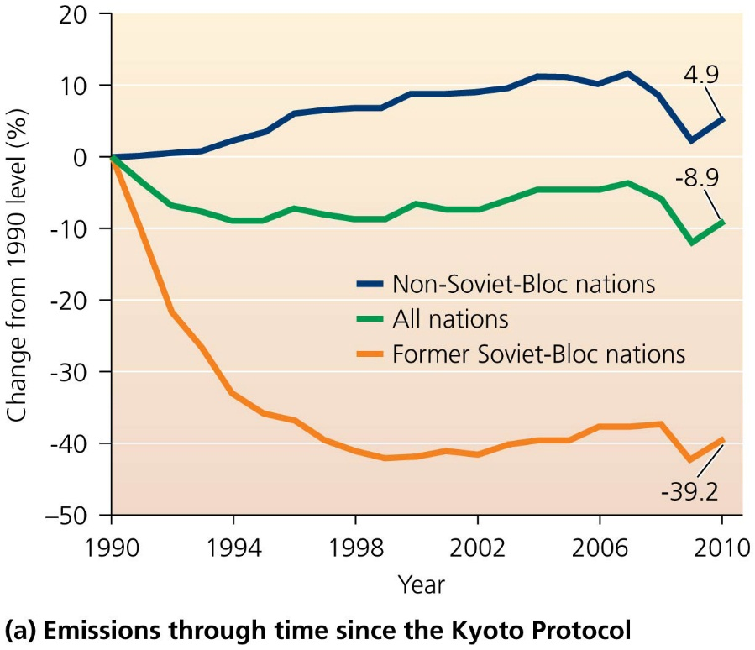
QUESTION: Interpreting Graphs and Data
Which statement is supported by this figure?
The former Soviet Bloc nations have increased their emissions.
All nations combined dropped their emissions by 39.2%.
Non-Soviet Bloc nations have reduced emissions since 2006.
Non-Soviet Bloc nations have reduced emissions since 1990.
Notes:
Answer: c

