Slide 2
This lecture will help you understand:
The composition, structure, and function of Earth’s atmosphere
Weather, climate, and atmospheric conditions
Outdoor pollution and solutions
Stratospheric ozone depletion
Acidic deposition and consequences
Indoor air pollution and solutions

Slide 3
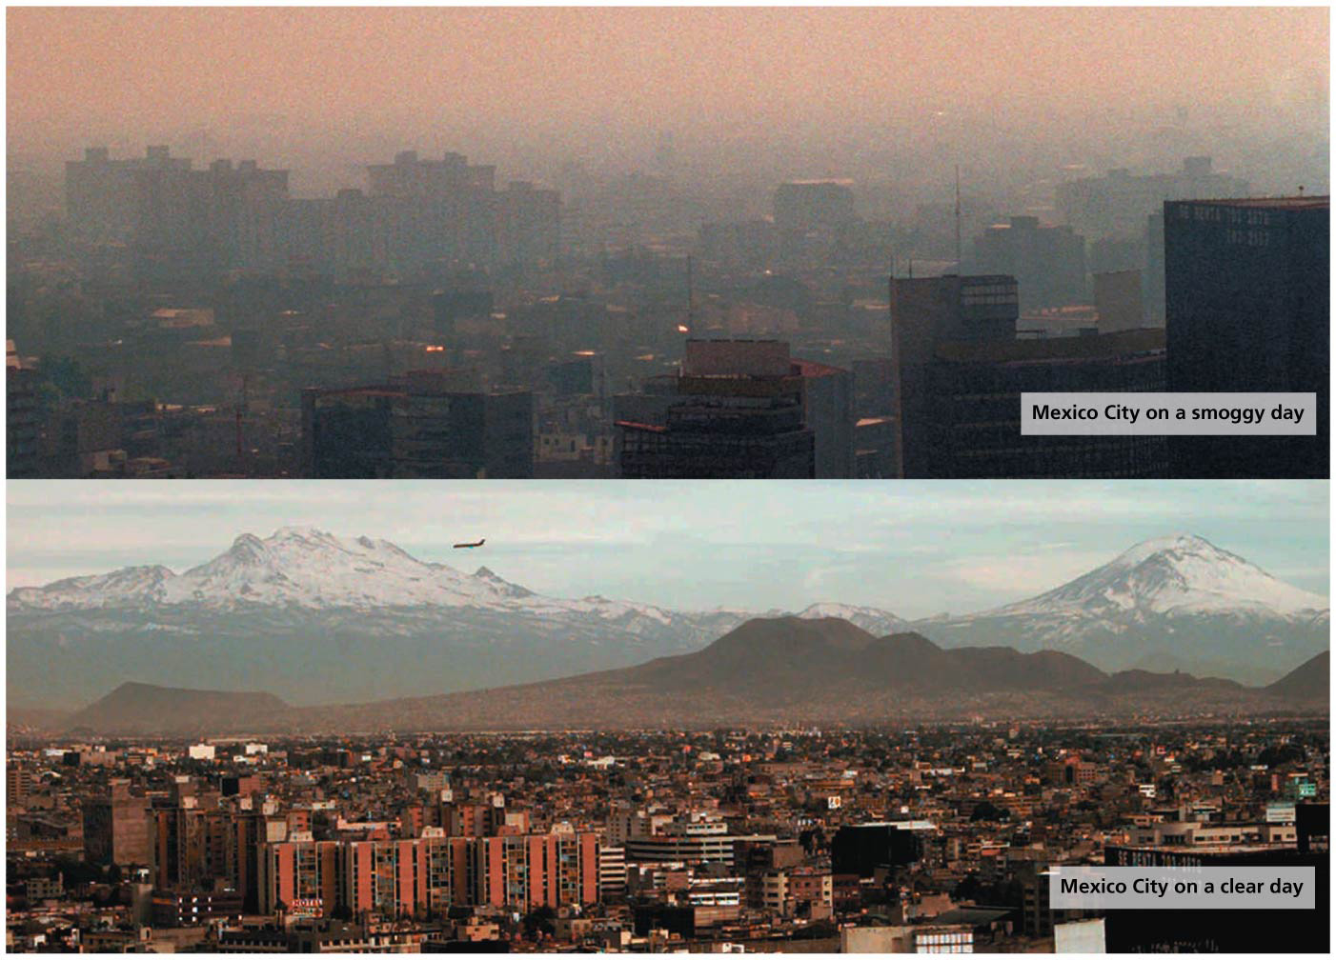

Slide 4
Central Case Study: Cleaning the Air in L.A. and Mexico City
Vehicles caused smog in Los Angeles from 1970s to 1990s
Policies and technologies improved its air quality
But its “sister cities” are not as clean
Mexico City suffered the most polluted air in the world
Vehicles generated most of the pollution
The city is also surrounded by mountains and is at a high elevation, increasing solar radiation

Slide 5
Central Case Study: Cleaning the Air in L.A. and Mexico City
Government policies sought to stop the pollution
Shifted industries to cleaner burning fuels
Vehicle emissions were regulated and monitored
New subway lines were added and more efficient busses replaced older ones
Bike rental and car sharing programs were started
Most pollutants have been cut by over 75%
Air meets health standards 1 out of every 2 days (compared to 8 days in all of 1991)
But there is still work to be done; air pollution contributes to an estimated 4000 deaths per year

Slide 6
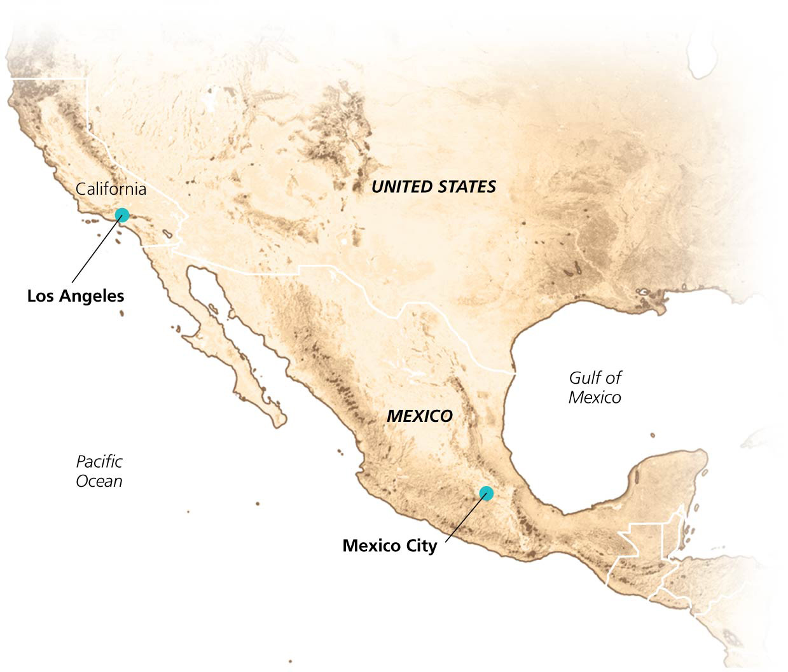

Slide 7
The Atmosphere
Atmosphere = the thin layer of gases around Earth
Provides oxygen
Absorbs radiation and moderates climate
Transports and recycles water and nutrients
78% N₂, 21% O₂

Slide 8
The Atmosphere
Rest is minute concentrations of either
Permanent gases = gases that remain at stable concentrations
Variable gases = gases with varying concentrations across time and place
Human activity is changing the amount of some gases
CO₂, methane (CH₄), ozone (O₃)

Slide 9
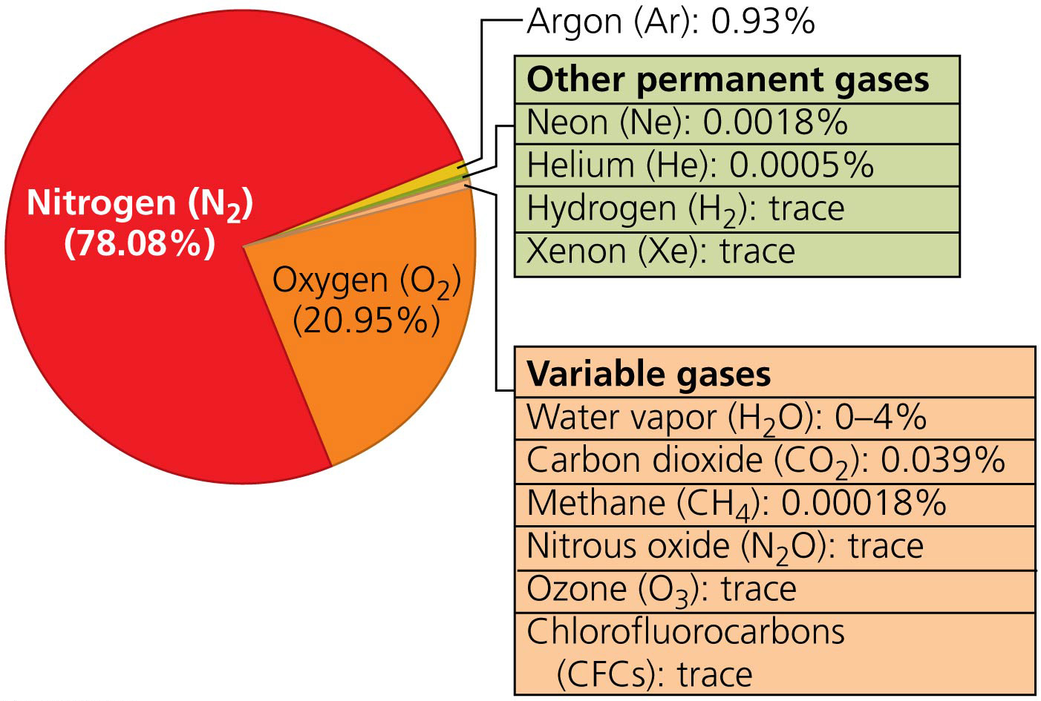

Slide 10
The atmosphere is layered
The atmosphere is a thin coating only 1/100 the diameter of the Earth
Consists of four layers that differ in temperature, density, and composition
Troposphere = bottommost layer (from ground up to 11 km [7 mi])
Contains ¾ of the atmosphere’s mass
Air for breathing, weather
The air gets colder with altitude
Tropopause = boundary that limits mixing between troposphere and the layer above it

Slide 11
The atmosphere is layered
Stratosphere = 11–50 km (7–31 mi) above sea level
Drier and less dense, with little vertical mixing
Becomes warmer with altitude
Contains UV radiation-blocking ozone, 17–30 km (10–19 mi) above sea level
Mesosphere = 50–80 km (31–56 mi) above sea level
Extremely low air pressure
Temperatures decrease with altitude
Thermosphere = atmosphere’s top layer
Extends upward to 500 m (300 mi)

Slide 12
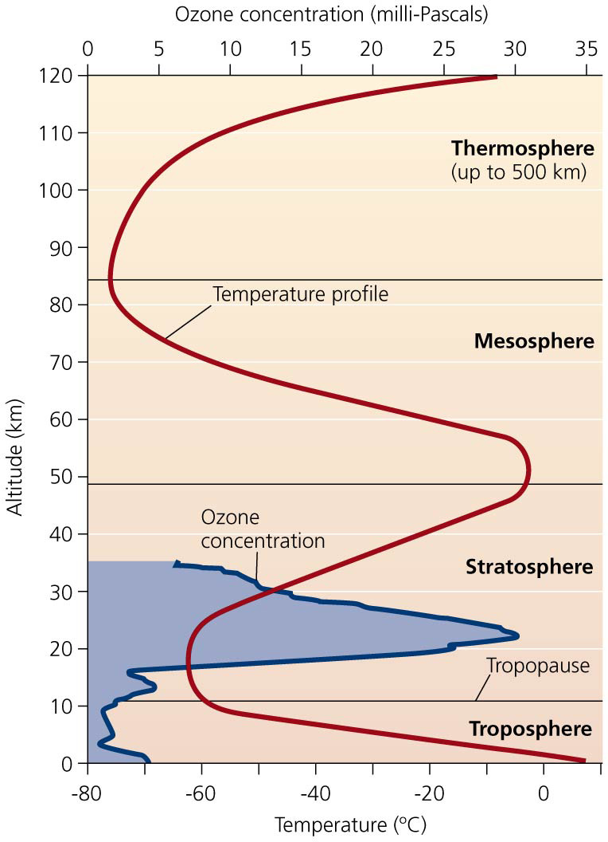

Slide 13
Temperature, pressure, and humidity vary within the atmosphere
Atmospheric pressure = the force per unit area produced by a column of air
Decreases with elevation (less air above)
Mount Everest’s peak is above 2/3 of the air molecules
Relative humidity = the ratio of water vapor air contains to the amount it could contain at a given temperature
High humidity makes it feel hotter than it really is because it prevents evaporative cooling
Temperature varies with location and time
Microclimate = localized pattern of weather condition

Slide 14
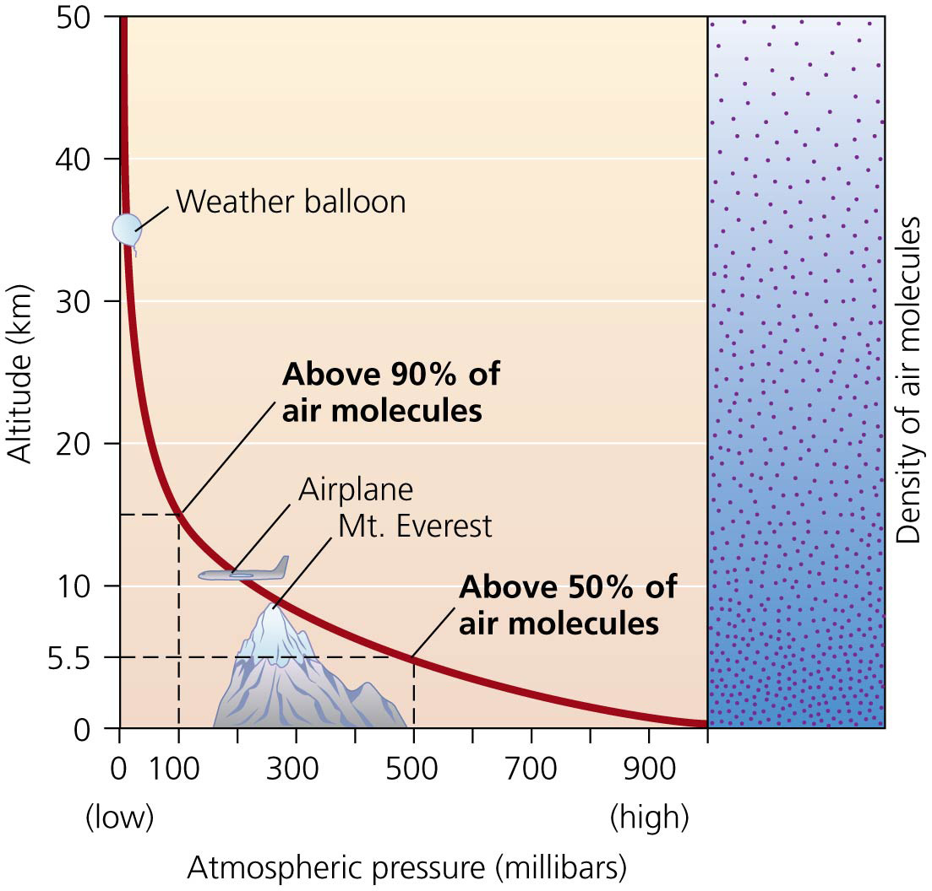

Slide 15
Solar energy heats the atmosphere, helps create seasons, and causes air to circulate
Vast amounts of energy hit the atmosphere from the sun
Sunlight is most intense when it meets the planet’s surface at a perpendicular angle
Solar radiation is highest near the equator
At an oblique angle, light loses its intensity
Solar radiation is weakest near the poles
Because the Earth is tilted, each hemisphere tilts toward the sun for half the year
Results in a change of seasons
Equatorial regions are unaffected by this tilt, so days average 12 hours throughout the year

Slide 16
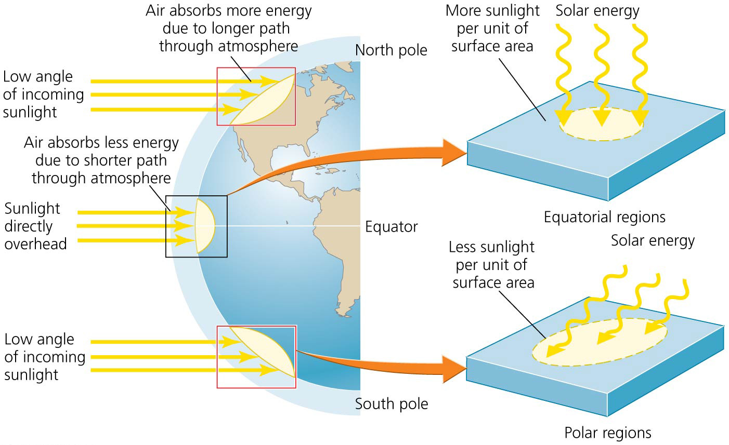

Slide 17
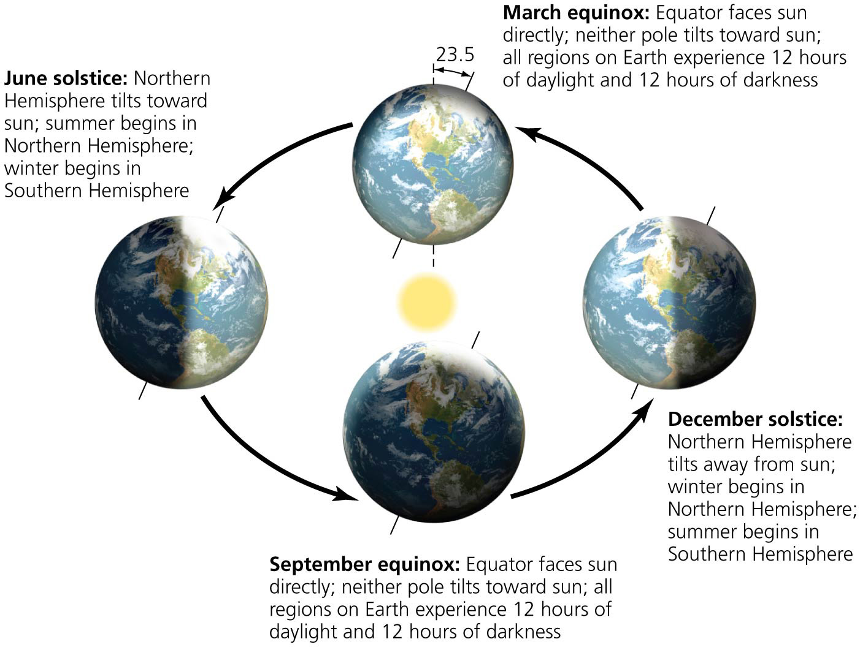

Slide 18
Solar energy heats the atmosphere, helps create seasons, and causes air to circulate
Land and water absorb solar energy then radiate heat, evaporating water
Air near Earth’s surface tend to be warm and moist
Convective circulation = less dense, warmer air rises, creating vertical currents
Rising air expands and cools
Cool air descends and becomes denser, replacing rising warm air
It then warms and rises again, continuing the process
Convective circulation also occurs in oceans and magma

Slide 19
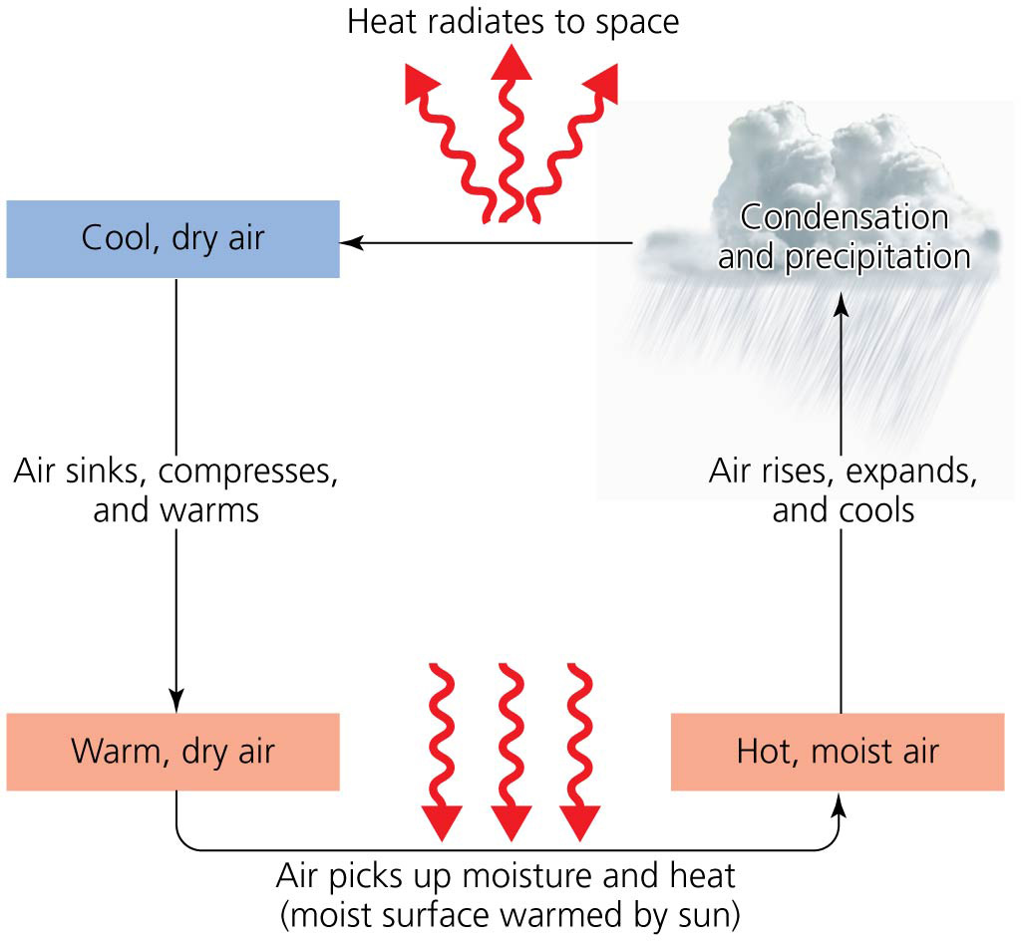

Slide 20
The atmosphere drives weather and climate
Weather and climate involve the physical properties of the troposphere
Temperature, pressure, humidity, cloudiness, wind
Weather = specifies atmospheric conditions over short time periods and within small geographic areas
Climate = patterns of atmospheric conditions across large geographic regions over long periods of time
As Mark Twain said, “Climate is what we expect; weather is what we get”

Slide 21
Air masses interact, producing weather
Weather can change rapidly when air masses with different properties meet
Front = the boundary between air masses that differ in temperature, moisture, and density
Warm front = boundary where warm, moist air replaces colder, drier air
Clouds and light rain
Cold front = boundary where colder, drier air displaces warmer, moister air
Clouds and thunderstorms

Slide 22
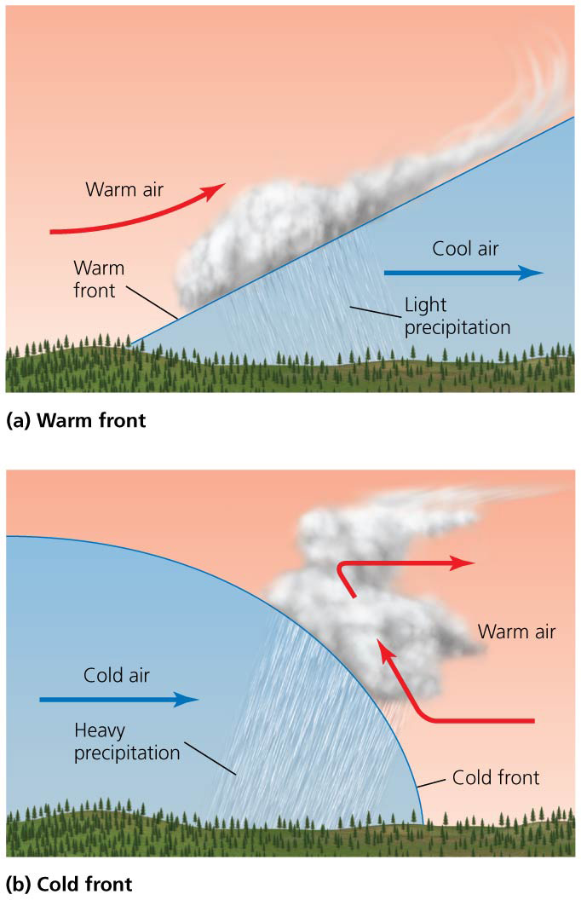

Slide 23
Air masses interact, producing weather
High-pressure system = contains air that descends because it is cool
It spreads outward as it nears the ground
It brings fair weather
Low-pressure system = warm air rises and draws air inward toward the center of low pressure
Rising air expands and cools
It brings clouds and precipitation

Slide 24
Air masses interact, producing weather
Air temperature normally decreases as altitude increases
Warm air rises from close to the ground, causing vertical mixing
Temperature inversion or thermal inversion = a layer of cool air occurs beneath warm air
Inversion layer = the band of air where temperature rises with altitude
Denser, cooler air at the bottom of the layer resists mixing
Inversions often trap pollutants in cities surrounded by mountains

Slide 25
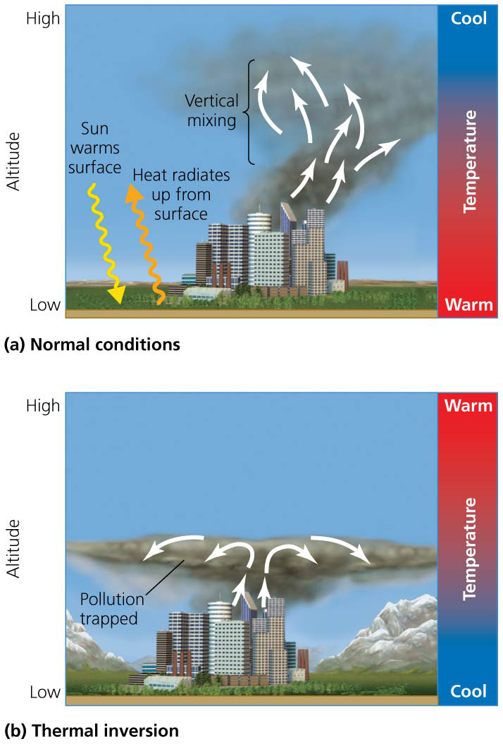

Slide 26
Large-scale circulation systems produce global climate patterns
Convective currents contribute to climatic patterns at large geographic scales
Hadley cells = convective cells near the equator
Surface air warms, rises, and expands, causing heavy rainfall near the equator
Gives rise to tropical rainforests
Currents heading north and south are dry
Gives rise to deserts at 30 degrees
Ferrel cells and polar cells = lift air and create precipitation at 60 degrees latitude north and south
Conditions at the poles are dry

Slide 27
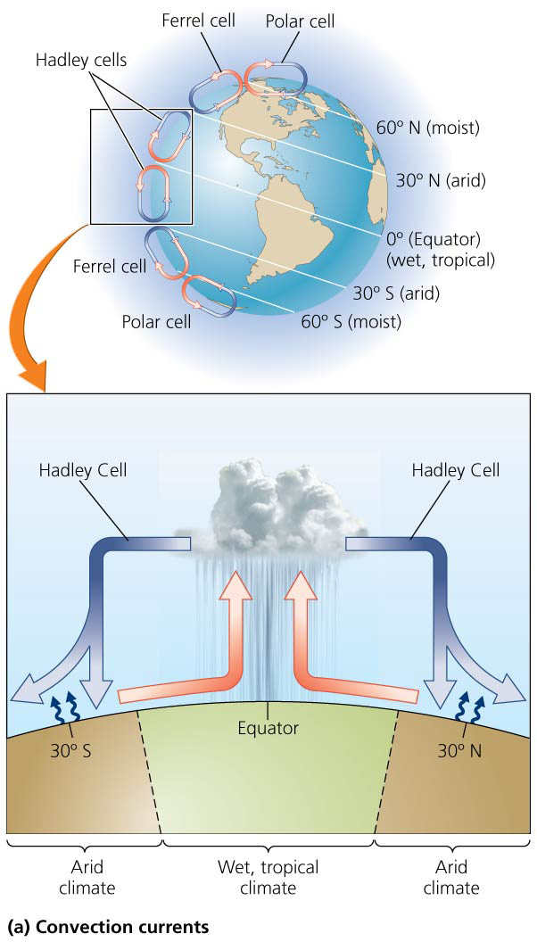

Slide 28
Large-scale circulation systems produce global climate patterns
Atmospheric cells interact with Earth’s rotation to produce global wind patterns
As Earth rotates, equatorial regions spin faster
Coriolis effect = the apparent east-west deflection of air currents of the convective cells
At the equator where there is little wind is a region know as the doldrums
Curving global wind patterns from the Coriolis effect cause the trade winds between the equator and 30° latitude, and the westerlies between 30° and 60°
For centuries, these wind patterns facilitated ocean travel by wind-powered sailing ships

Slide 29
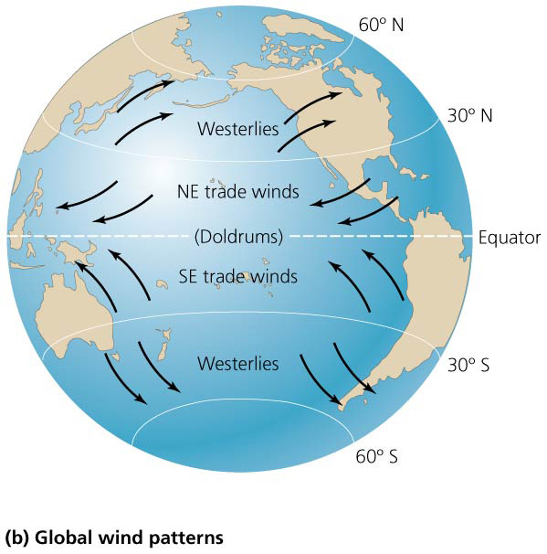

Slide 30
Storms pose hazards
Atmospheric conditions can produce dangerous storms
Hurricanes = form when winds rush into areas of low pressure (also known as typhoons or cyclones)
Warm, moist air over the tropical oceans rises, drawing up huge amounts of water vapor, which falls as heavy rains

Slide 31
Storms pose hazards
Tornadoes = form when warm air meets cold air
Quickly rising warm air forms a powerful convective current (spinning funnel)
Winds can reach 500 km per hour (310 mph)
Understanding how the atmosphere works helps us to predict violent storms and protect people

Slide 32
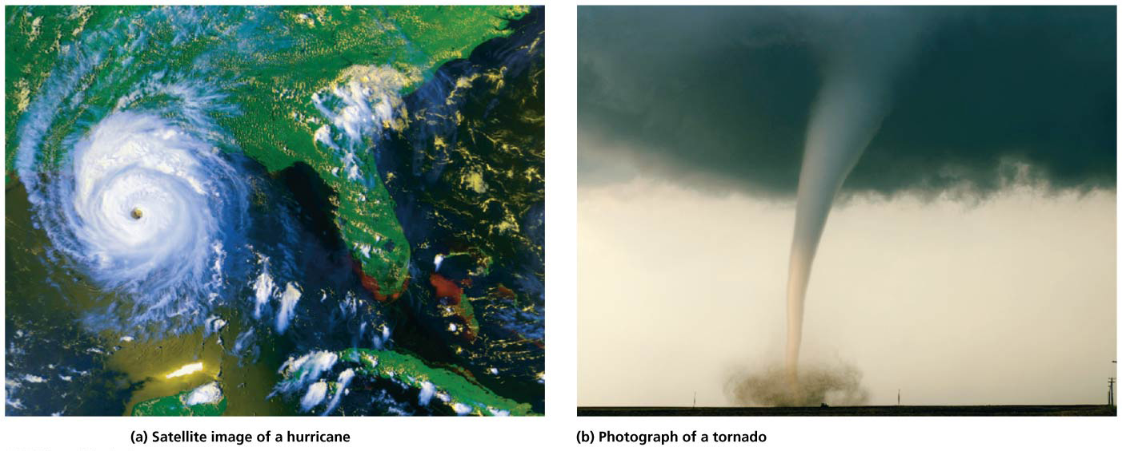

Slide 33
Outdoor Air Quality
Air pollutants = gases and particulate material added to the atmosphere
Can affect climate or harm people or other organisms
Air pollution = the release of air pollutants
Outdoor (ambient) air pollution = pollution outside
Has recently decreased due to government policy and improved technologies in developed countries
Developing countries and urban areas still have significant problems
Greatest air pollution problem may be our emission of greenhouse gasses

Slide 34
Natural sources can pollute
Fires pollute the atmosphere with soot and gases
Over 60 million ha (150 million acres) of forests and grasslands burn per year
Human influence makes fires more severe
Fuel buildup from fire suppression
Development in fire-prone areas (such as chaparral)
“Slash-and-burn” agriculture causes fire where they might not naturally occur

Slide 35
Natural sources can pollute
A severe El Niño in 1997 caused unprecedented forest fires that sickened 20 million and caused a plane to crash
Climate change will increase drought and fires
Volcanoes release particulate matter, sulfur dioxide, and other gases that can remain in the air for months or years
Aerosols = fine droplets of sulfur dioxide, water, oxygen
Reflect sunlight back to space
Cool the atmosphere and surface

Slide 36
Natural sources can pollute
Dust storms occur when wind sweeping over arid land sends huge amounts of dust aloft
Unsustainable farming and grazing contribute by promoting erosion and desertification
Trade winds blow dust from Africa across oceans, providing nutrients to the Amazon and infecting coral reefs in the Caribbean with fungal spores

Slide 37
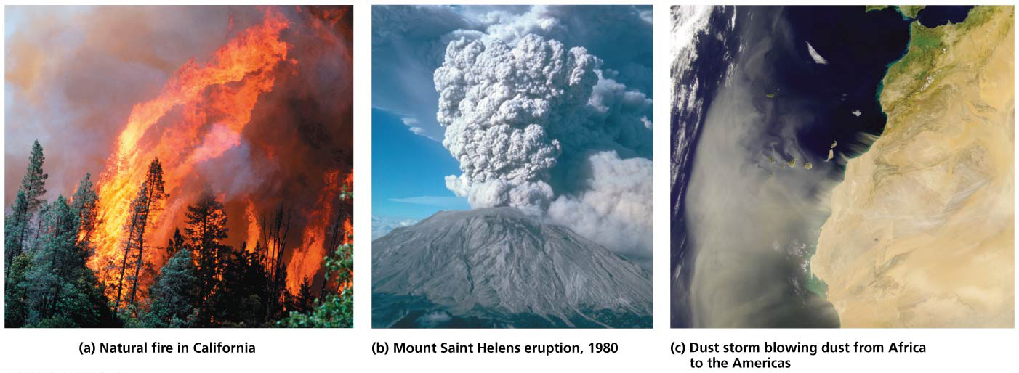

Slide 38
We create outdoor air pollution
Point sources = specific spots where large quantities of pollutants are discharged (power plants and factories)
Non-point sources = more diffuse sources, consisting of many small sources (automobiles)
Primary pollutants = pollutants that are directly harmful and can react to form harmful substances (soot and carbon monoxide)
Secondary pollutants = pollutants that form when primary pollutants interact or react with components of the atmosphere
Tropospheric ozone and sulfuric acid

Slide 39
We create outdoor air pollution
Residence time = the time a pollutant stays in the atmosphere
Pollutants with brief residence times exert localized impacts over short time periods
Particulate matter, automobile exhaust
Pollutants with long residence times exert regional or global impacts
Pollutants causing climate change or ozone depletion

Slide 40
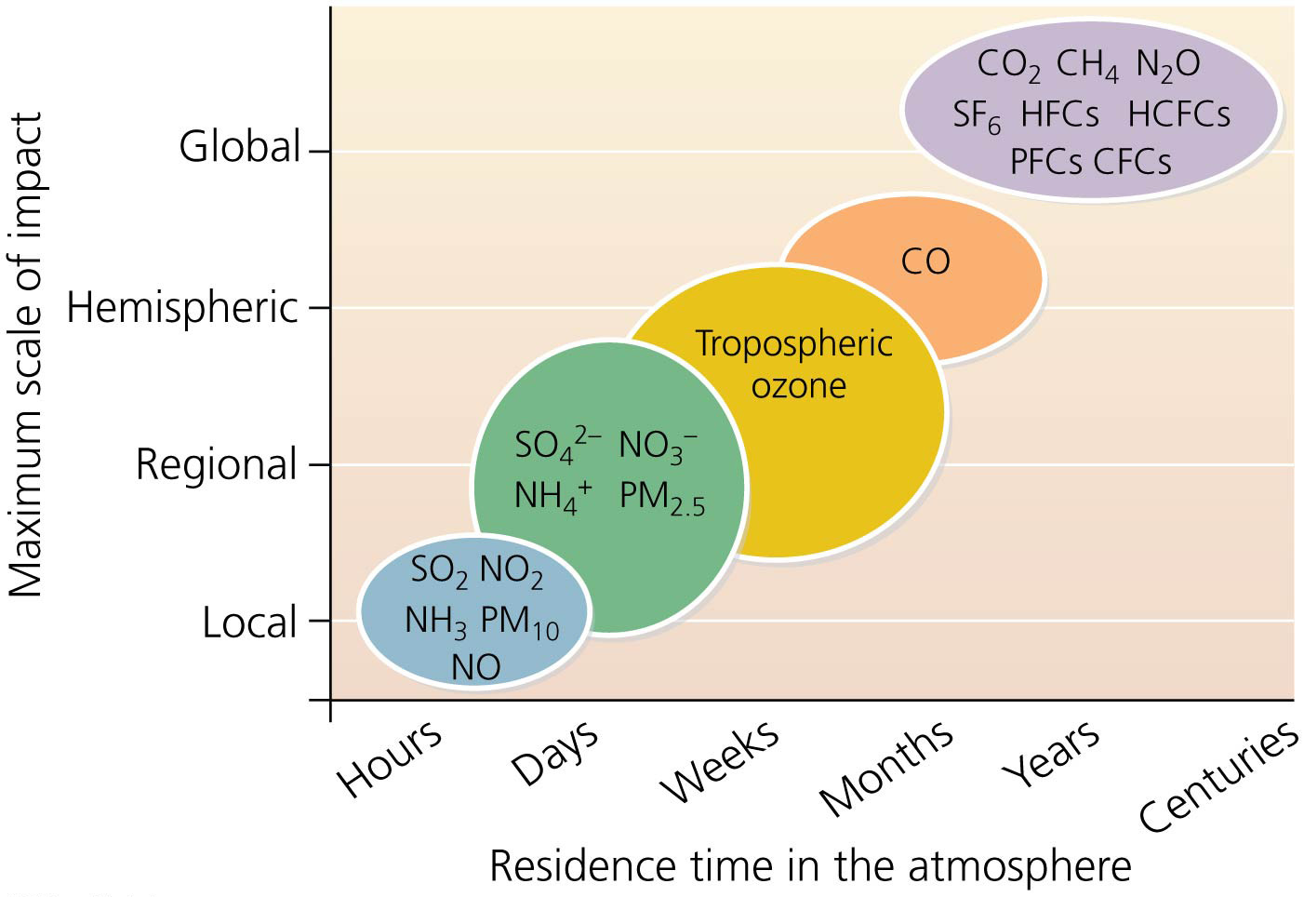

Slide 41
Clean Air Act legislation addresses pollution in the United States
Clean Air Act of 1963 funded research and encouraged emissions standards
The Clean Air Act of 1970
Set standards for air quality and limits on emissions
Provided funds for pollution-control research
Allowed citizens to sue parties violating the standards
The Clean Air Act of 1990 strengthened regulations for auto emissions, toxic air pollutants, acidic deposition, stratospheric ozone depletion
Introduced emissions trading for sulfur dioxide

Slide 42
Clean Air Act legislation addresses pollution in the United States
The Environmental Protection Agency (EPA) sets nationwide standards for emissions and concentrations of toxic pollutants
States monitor air quality
They develop, implement, and enforce regulations
They submit plans to the EPA for approval
The EPA takes over enforcement if plans are inadequate
The EPA can prevent regions from receiving money for transportation projects if they fail to clean up their air

Slide 43
Agencies monitor emissions
State and local agencies monitor and report on six major pollutants: carbon monoxide (CO), sulfur dioxide (SO₂), nitrogen oxides (NO_{X}), volatile organic compounds (VOCs), particulate matter, and lead (Pb)
Carbon monoxide (CO) = colorless, odorless gas
Produced primarily by incomplete combustion of fuel
From vehicles and engines, industry, waste combustion, residential wood burning
Poses risk to humans and animals, even in small concentrations
Binds irreversibly to hemoglobin, preventing oxygen transport in the blood

Slide 44
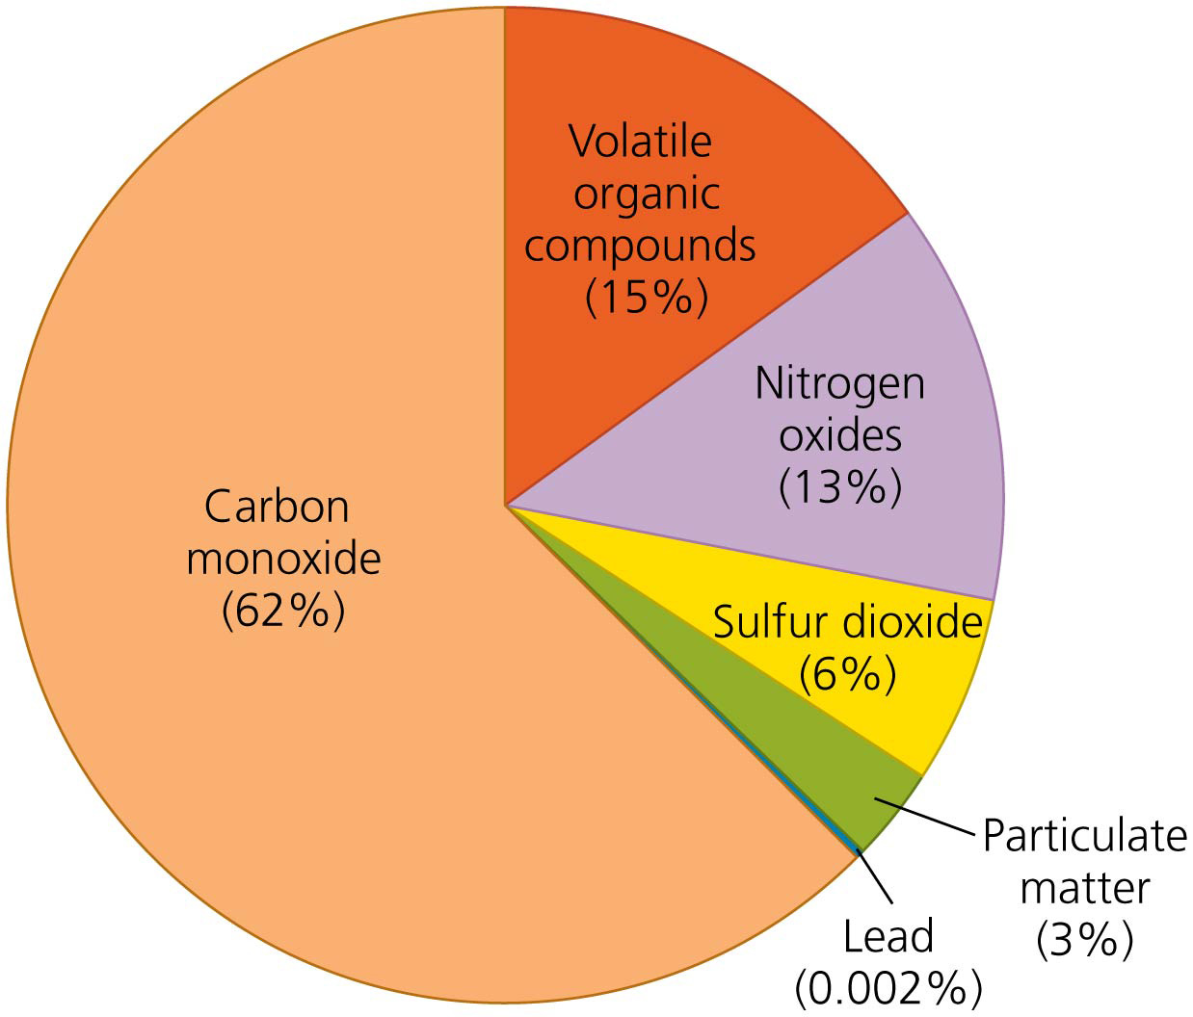

Slide 45
Agencies monitor emissions
Sulfur dioxide (SO₂) = colorless gas with a strong odor
From coal emissions from electricity generation, industry
Can form acid precipitation
Nitrogen oxides (NO_{x}) = formed when nitrogen and oxygen react at high temperatures; includes NO and NO₂
From vehicles, industrial combustion, electrical utilities
Contribute to smog and acid precipitation

Slide 46
Agencies monitor emissions
Volatile organic compounds (VOCs) = carbon-containing chemicals
Used and emitted by engines, solvents, household chemicals, and industrial processes
Can react to produce secondary pollutants

Slide 47
Agencies monitor emissions
Particulate matter = suspended solid or liquid particles
Primary pollutants: dust and soot
Secondary pollutants: sulfates and nitrates
Damages respiratory tissue when inhaled
Two size classes for particles
PM₁₀ = less than 10 microns in diameter (dust)
PM_{2.5} = less than 2.5 microns (combustion products)

Slide 48
Agencies monitor emissions
Lead = heavy metal used in gasoline and industrial metal smelting
Bioaccumulates and damages the nervous system
Banned in gasoline in developed countries
Being banned in most developing countries

Slide 49
We have reduced pollutant emissions
Total emissions of the six monitored pollutants have declined substantially since the Clean Air Act of 1970
Despite increased population, energy consumption, miles traveled, and gross domestic product
Most other industrialized nations have also reduced their emissions
Reductions have been achieved by a combination of policy and technology driven by grassroots demand
Cleaner-burning engines and catalytic converters
Scrubbers = chemically convert or physically remove pollutants before they leave smokestacks

Slide 50
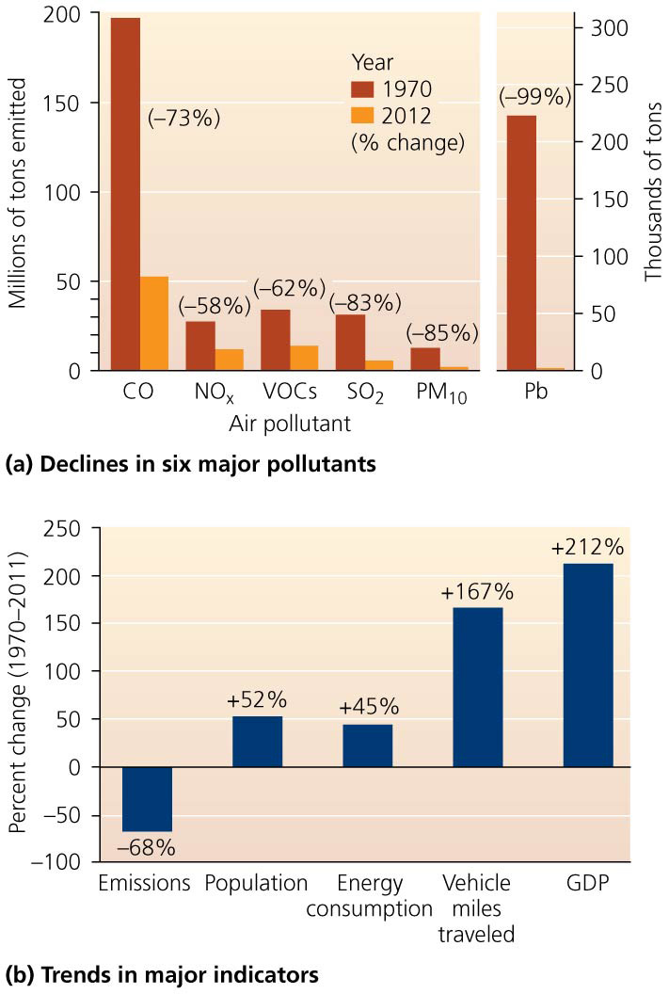

Slide 51
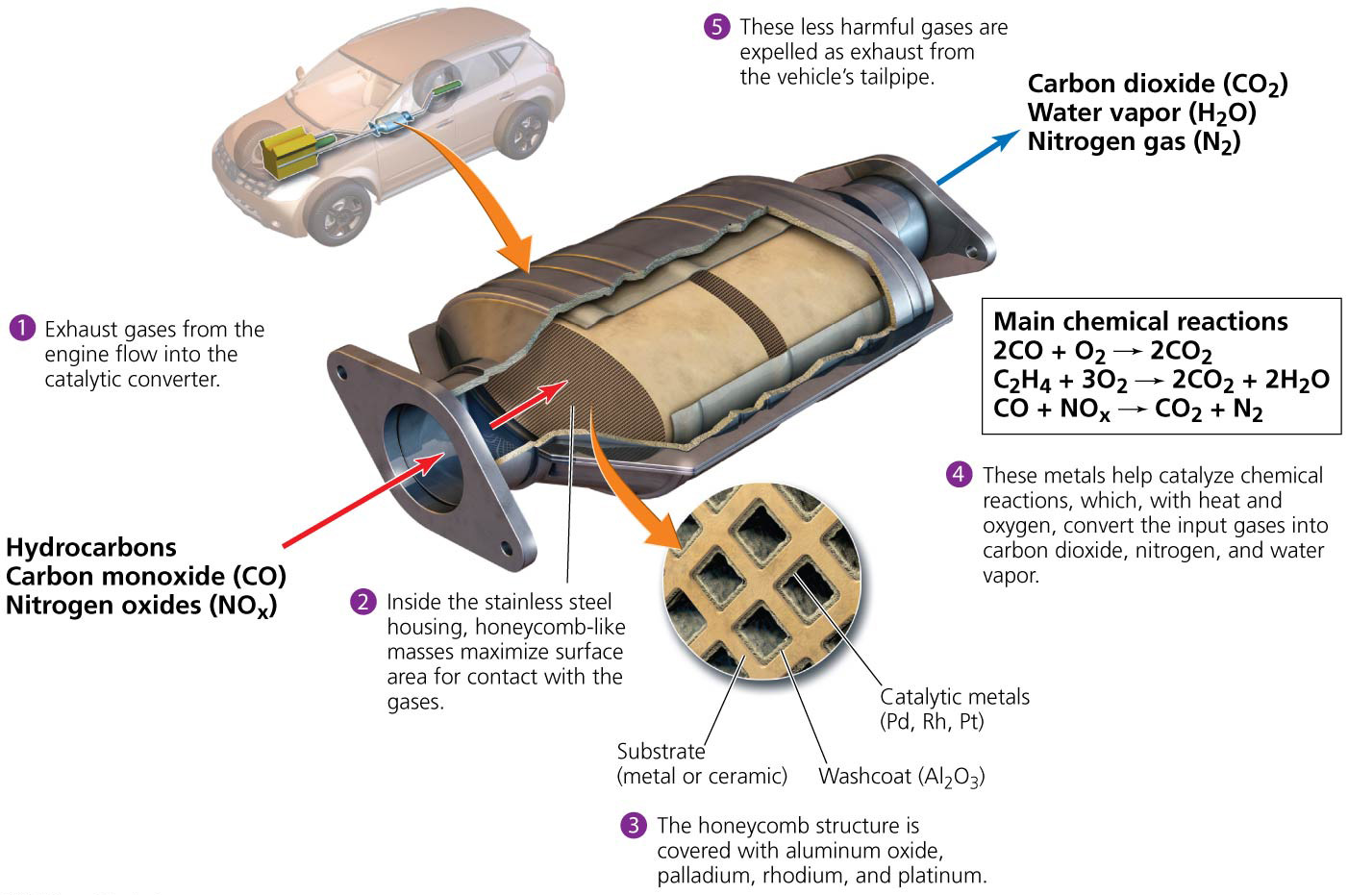

Slide 52
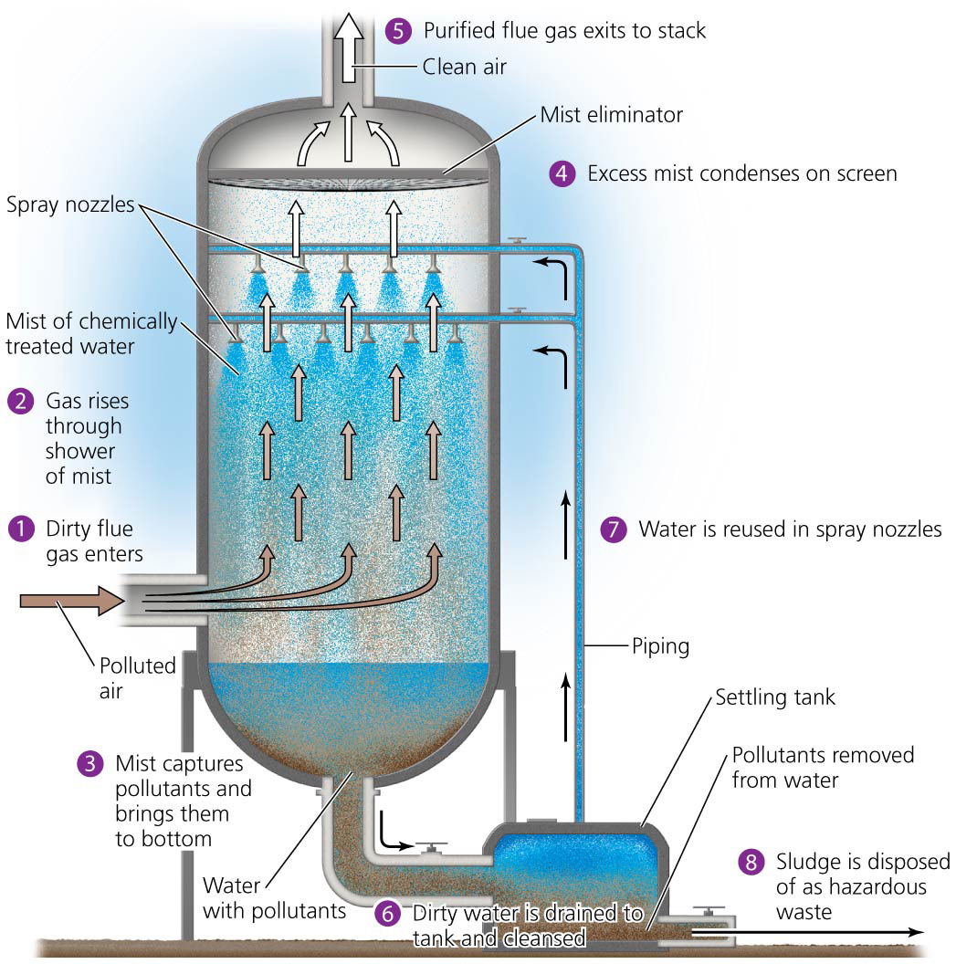

Slide 53
We have reduced pollutant emissions
Permit-trading programs and clean coal technologies reduce SO₂ emissions
Phaseouts of leaded gasoline caused emissions of lead to drop 93% in the 1980s
Reduction of emission is regarded as one of the greatest accomplishments of the United States in protecting health and the environment
Shows what can be accomplished when government and industry use scientific information and listen to public demands
EPA estimates that 200,000 lives were saved between 1970 and 1990 because of cleaner air

Slide 54
Air quality has improved
EPA and states monitor outdoor air quality
Criteria pollutants = pollutants that pose especially great threats to human health
Carbon monoxide, sulfur dioxide, particulate matter, lead, nitrogen dioxide, tropospheric ozone

Slide 55
Air quality has improved
National ambient air quality standards (NAAQS) = maximum concentrations allowed in outdoor air
Nitrogen dioxide (NO₂) = a highly reactive, foul-smelling reddish brown gas
Contributes to smog and acid precipitation
Along with nitric oxide (NO) is part of the chemical group called nitrogen oxides (NO_{X})

Slide 56
Air quality has improved
Tropospheric ozone (O₃) or ground-level ozone = a colorless gas that poses health risks due to the instability of the O₃ molecule
Results from interactions of sunlight, heat, nitrogen oxides, and volatile carbon-containing chemicals
Is a secondary pollutant
Is a major component of smog
Participates in reactions that harm tissues and cause respiratory problems
Is the pollutant that most frequently exceeds EPA standards

Slide 57
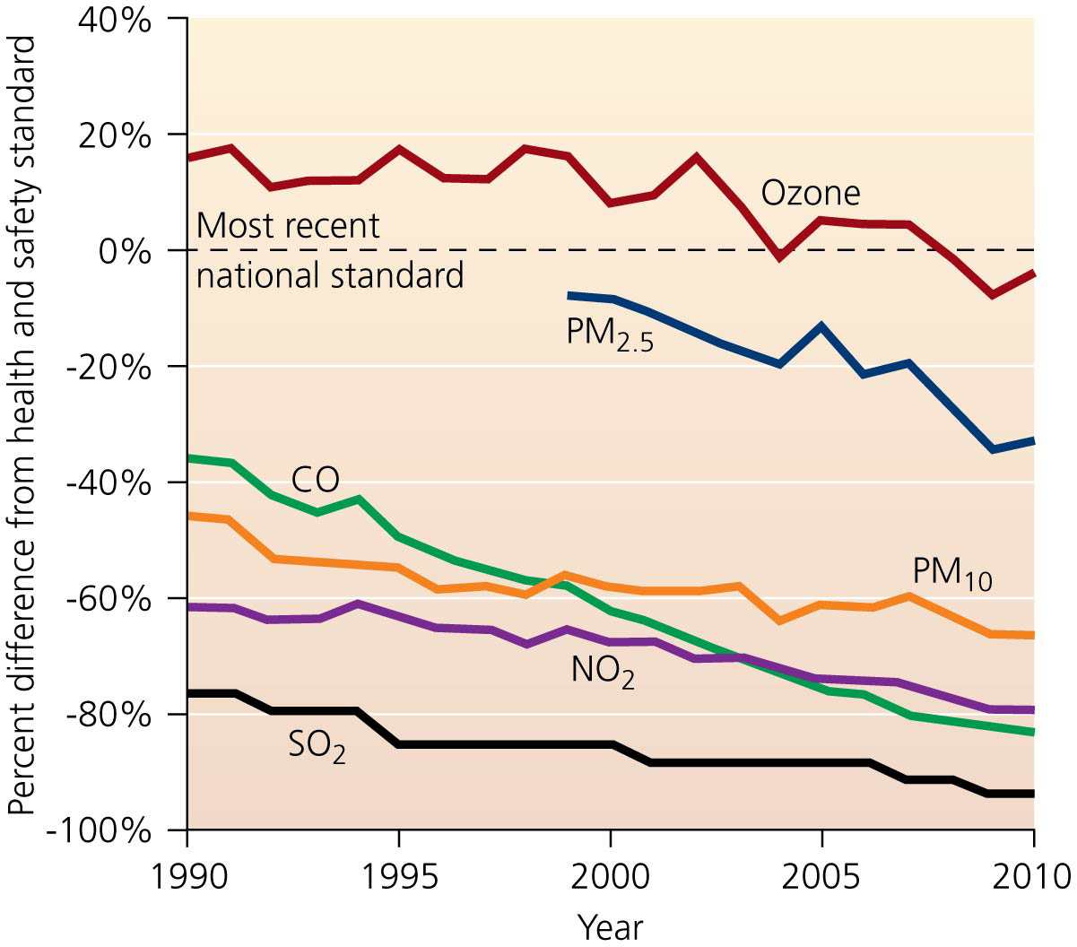

Slide 58
Air quality has improved
Air quality today is better than it has been for at least a generation
However, new pollutants are emerging as new problems, particularly greenhouse gas emissions
Many Americans live in areas where criteria pollutants still reach unhealthy levels
The air in Los Angeles county violates NAAQS for five of the six criteria pollutants

Slide 59
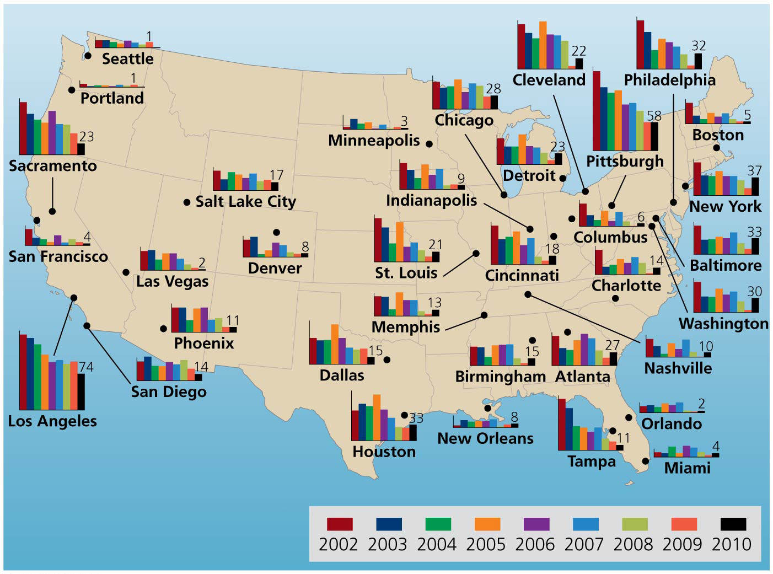

Slide 60
Air quality has improved
Much of the focus of controlling emissions is on cities, but rural residents can suffer from poor air quality
Airborne pesticides from farms
Industrial pollutants that drift from cities, factories, and power plants
Feedlots, where cattle, hogs, or chickens are raised in dense concentrations
Produce dust, methane, hydrogen sulfide, and ammonia
Create objectionable odors
People living or working nearby have high rates of respiratory illness

Slide 61
Toxic substances pose health risks
Toxic air pollutants = substances that cause cancer, reproductive defects, or neurological, developmental, immune system, or respiratory problems
The EPA regulates 187 toxic air pollutants from metal smelting, sewage treatment, industry, etc.
Includes heavy metals, VOCs, methylene chloride
Toxic air pollutants cause cancer in 1 out of 20,000 Americans
Clean Air Act regulations helped reduce emissions by more than 42% since 1990

Slide 62
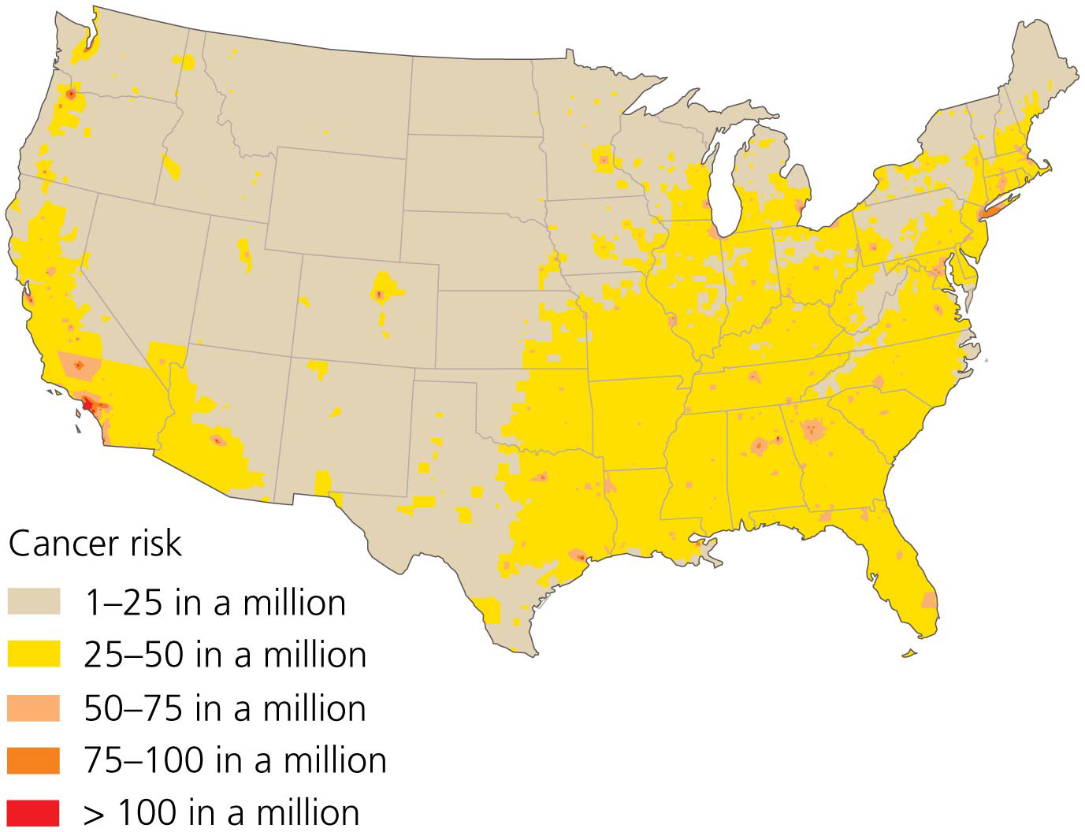

Slide 63
Should we regulate greenhouse gasses as air pollutants?
Industrialized countries have reduced most sources of air pollution but are continuing to release vast amounts of greenhouse gasses
Warming of the lower atmosphere by greenhouse gas emission may be the largest air pollution threat we face today
Industry and utilities generate much of the emissions
All of us contribute to greenhouse gas emissions
The average U.S. vehicle driver releases close to 6 metric tons of carbon dioxide and large amounts of methane and nitrous oxide per year

Slide 64
Should we regulate greenhouse gasses as air pollutants?
In 2007, the U.S. Supreme Court ruled that the EPA could regulate greenhouse gasses under the Clean Air Act
Congress failed to pass legislation to regulate greenhouse gas emission
In 2011 the EPA introduced standards for cars and trucks and in 2012 for new coal-fired power plants

Slide 65
Should we regulate greenhouse gasses as air pollutants?
Coal and petrochemical industries sued to stop the EPA
The courts upheld the EPA’s regulations
U.S. CO₂ emissions decreased by 12% from 2007 to 2012 (partly because of the economic recession, partly from cleaner burning fuels and more efficient cars)

Slide 66
Industrializing nations are suffering increasing pollution
Outdoor pollution is getting worse in developing nations
Growing numbers of factories and power plants pollute
Governments emphasize economic growth, not pollution control
People burn traditional fuels (wood and charcoal)
Residents of Mexico City and other Mexican cities suffer a variety of health impacts from the heavily polluted air
China has the world’s worst air pollution
Coal burning, more cars, power plants, factories
Causes over 300,000 premature deaths/year

Slide 67
Industrializing nations are suffering increasing pollution
In Beijing in January–February 2013, smog became so thick that residents wore face masks to breath and airplane flights were canceled
The U.S. embassy’s air pollution monitor recorded a measurement of 755 on a scale from 0–500
The health impacts of air pollution across China are huge
A 2013 report blamed 1.2 million premature deaths per year on air pollution
Winds carry the pollution to neighboring countries and even across the Pacific Ocean to the U.S. west coast

Slide 68
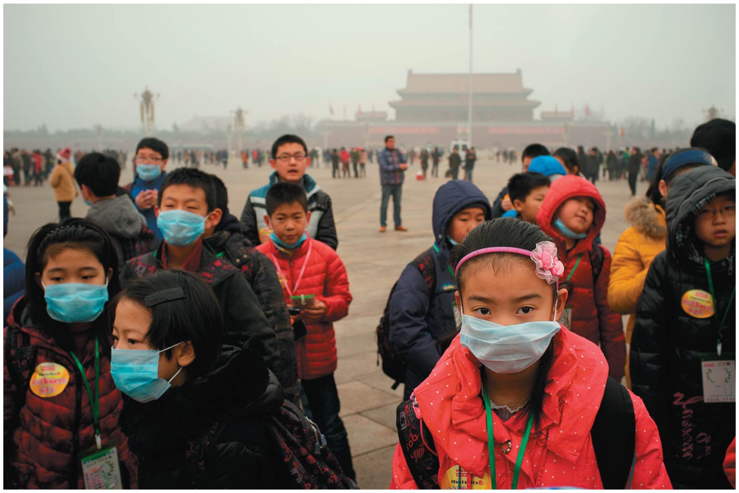

Slide 69
Industrializing nations are suffering increasing pollution
The government is trying to decrease pollution
Shutting down heavily polluting factories and mines
Phasing out some subsidies for polluting industries
Installing pollution controls in factories
Encouraging renewable and nuclear energy
Mandating cleaner burning fuels
Asian (Atmospheric) Brown Cloud = a 2-mile-thick layer of pollution over southern Asia
Reduces sunlight reaching the ground by 10–20%
Decreased crop productivity, increased flooding, etc.

Slide 70
Smog poses health risks
Smog = an unhealthy mixture of air pollutants over urban areas
Industrial smog = smog created when industries burn coal or oil
Carbon monoxide and soot are produced
Sulfur reacts with water to form sulfuric acid, and nitrogen compounds also contribute

Slide 71
Smog poses health risks
Smog combined with a thermal inversion killed 21 and sickened 6000 people in Donora, PA in 1948
Industrial smog is now rare in industrialized nations
Coal-burning industrializing countries face smog risks because of coal burning and lax pollution control

Slide 72
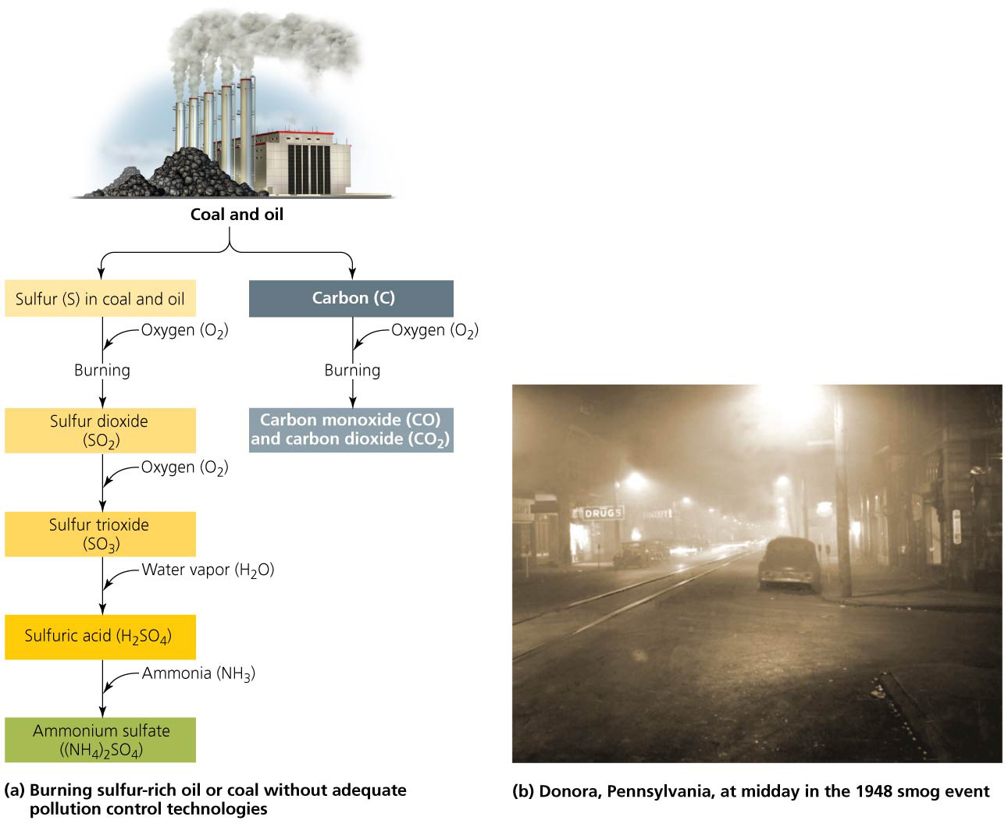

Slide 73
Smog poses health risks
In urban areas, pollution results mainly from automobile exhaust
Photochemical smog = smog produced when sunlight drives a series of reactions involving primary pollutants
Produces over 100 different chemicals
Tropospheric ozone is often the most abundant
NO₂ causes photochemical smog to form a brown haze
Exhaust from morning traffic releases nitric oxide (NO) and VOCs into the air
Photochemical smog typically peaks in the afternoon
Can cause eye, nose, and throat irritation

Slide 74
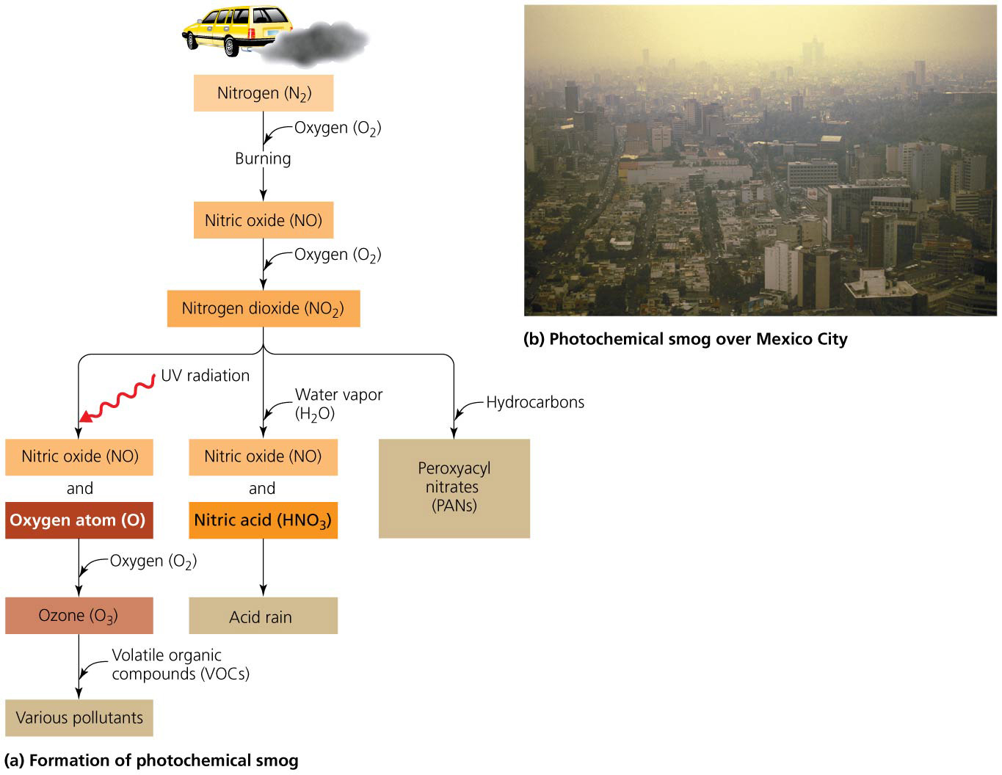

Slide 75
We can take steps to reduce smog
California has lead the way in adopting pollution control technology and emissions standards for vehicles
New cars generate just 1% of the smog-forming emissions of a 1960s car
California and 33 other states require vehicle exhaust inspections, cutting emissions by 30% in many states

Slide 76
We can take steps to reduce smog
Other countries are trying to reduce their emissions, requiring cleaner industrial facilities or closing those that can’t improve or providing financial incentives to replace aging vehicles
Increased public transit and bike use
Mexico City has reduced its smog by over 50% since 1990

Slide 77
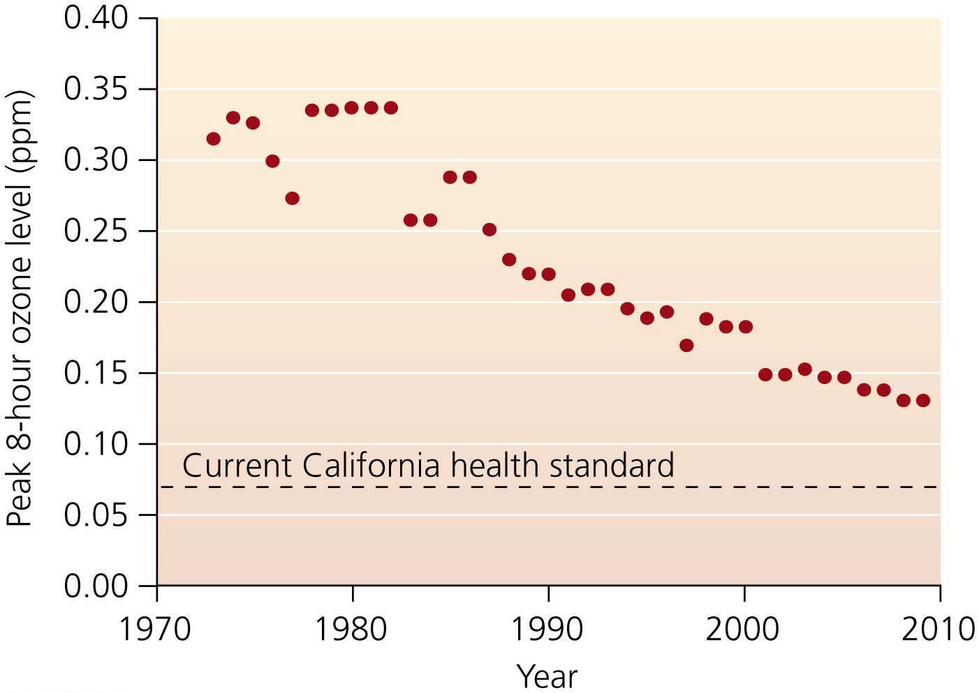

Slide 78
Ozone Depletion and Recovery
Ozone is a pollutant in the troposphere, but it is helpful when in the stratosphere
Ozone layer = ozone in the lower stratosphere
Blocks incoming ultraviolet (UV) radiation
Protects life from radiation’s damaging effects

Slide 79
Ozone Depletion and Recovery
The stratospheric ozone was being depleted
Ozone-depleting substances = human-made chemicals that destroy ozone by splitting its molecules apart
The campaign to halt the degradation of the ozone layer is one of society’s most successful efforts to address a major environmental problem

Slide 80
Synthetic chemicals deplete stratospheric ozone
Halocarbons = human-made compounds made from hydrocarbons with added chlorine, bromine, or fluorine
Chlorofluorocarbons (CFCs) = halocarbons used as refrigerants, in fire extinguishers, in aerosol cans, etc.

Slide 81
Synthetic chemicals deplete stratospheric ozone
CFCs are nonreactive so can reach the stratosphere and remain there for a century
UV radiation breaks CFCs into chlorine and carbon atoms
The chlorine atom splits ozone, destroying it
One chlorine can destroy 100,000 ozone molecules

Slide 82
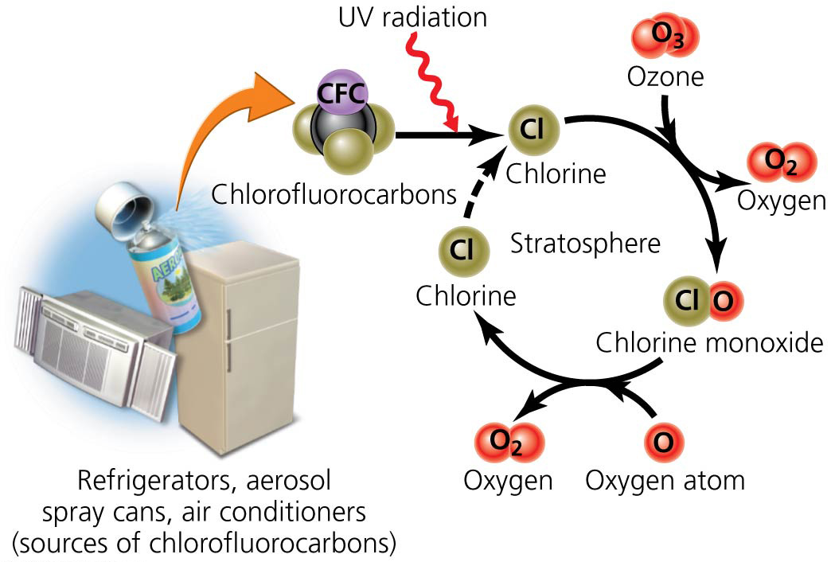

Slide 83
The Antarctic ozone hole appears each spring
Ozone over Antarctica declined by nearly half in 10 years
Ozone hole = thinned ozone concentration over Antarctica
High-altitude polar stratospheric clouds form during the dark, frigid winter

Slide 84
The Antarctic ozone hole appears each spring
Nitric acid in clouds splits chlorine off of CFCs
A polar vortex (swirling winds) traps chlorine
UV radiation in September (spring) sunshine dissipates the clouds and releases the chlorine
The chlorine destroys the ozone
December’s warmer air shuts down the polar vortex
Ozone-poor air diffuses, while ozone-rich air enters

Slide 85
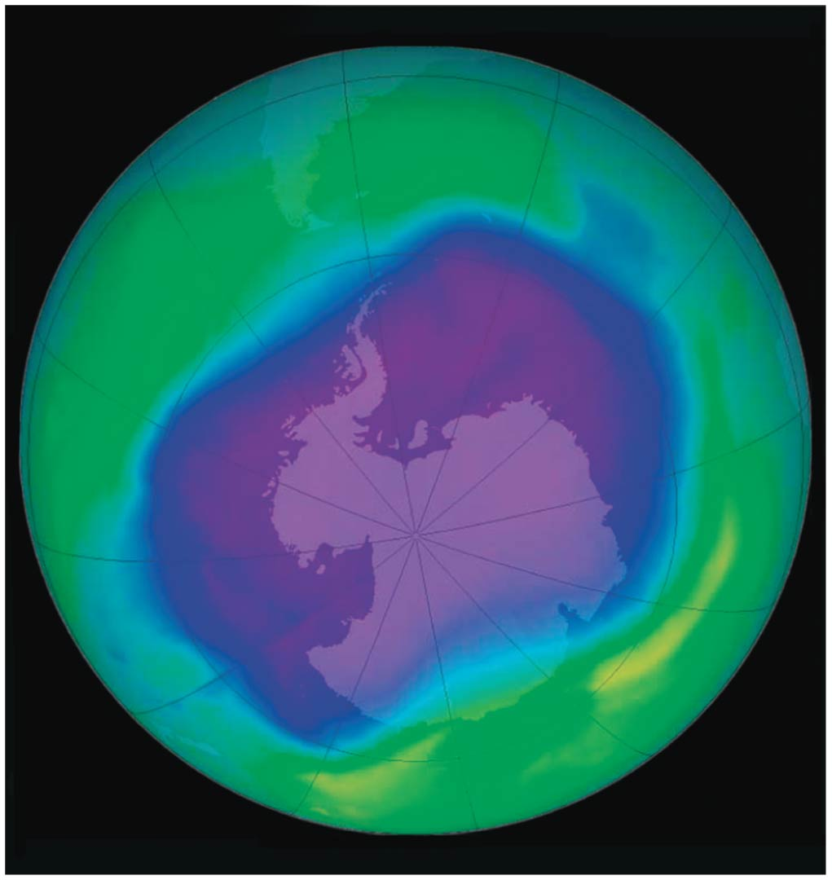

Slide 86
We addressed ozone depletion with the Montreal Protocol
Montreal Protocol = treaty in which 196 nations agreed to cut CFC production in half by 1998
Follow-up agreements deepened cuts, advanced timetables, and addressed other ozone-depleting chemicals
Industry shifted to safer, inexpensive, and efficient alternatives
Challenges still face us
CFCs will remain in the stratosphere for a long time
Nations can ask for exemptions to the ban

Slide 87
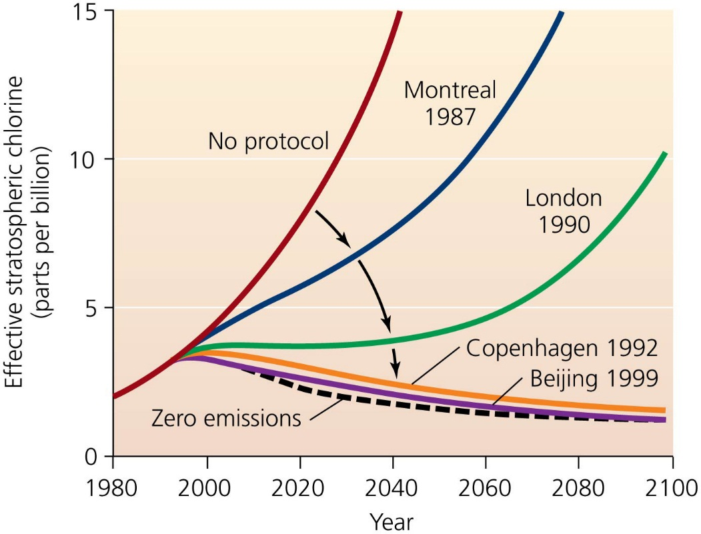
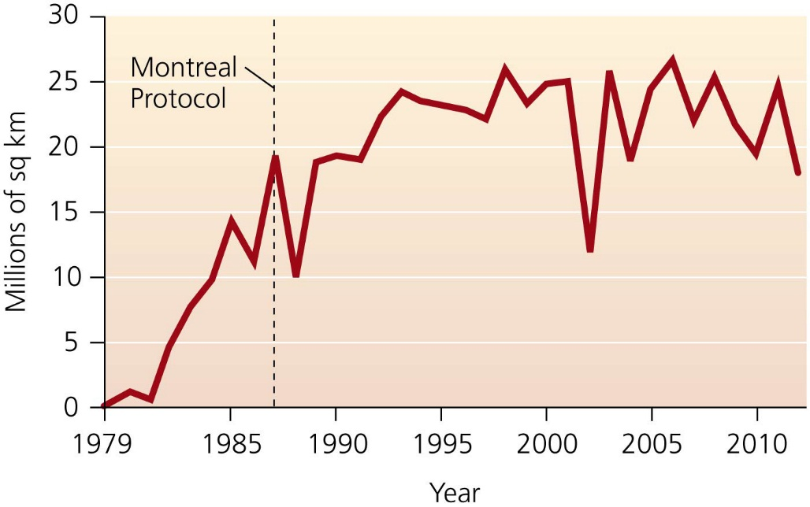

Slide 88
We addressed ozone depletion with the Montreal Protocol
It is considered our biggest environmental success story
Research developed rapidly, along with technology
Policymakers included industry in helping solve the problem
Implementation of the plan allowed an adaptive management strategy
Strategies responded to new scientific data, technological advances, and economic figures
The Montreal Protocol can serve as a model for international environmental cooperation

Slide 89
Addressing Acid Deposition
Acid deposition is another transboundary issue
Acidic deposition = the deposition of acid or acid-forming pollutants from the atmosphere onto Earth’s surface
Acid rain = precipitation (rain, snow, sleet, hail) containing acid

Slide 90
Addressing Acid Deposition
Atmospheric deposition = the wet or dry deposition on land of pollutants (mercury, nitrates, organochlorines)
Acid deposition originates from sulfur dioxide and nitrogen oxides mostly from automobiles, electric utilities, industrial facilities
These compounds react with water, oxygen, and oxidants to form sulfuric and nitric acids

Slide 91
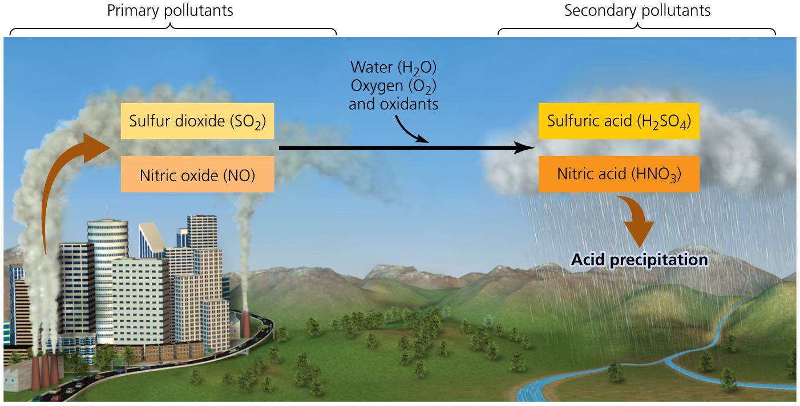

Slide 92
Acid deposition has many impacts
Wide-ranging effects on ecosystems and infrastructure
Nutrients (calcium, magnesium) are leached from topsoil, harming plants and soil organisms
Metal ions (aluminum, zinc, etc.) are converted into soluble forms that pollute water, weakening plants by damaging root tissues
Affects surface water and kills fish

Slide 93
Acid deposition has many impacts
The acid-neutralizing capacity of soil, rock, or water impacts the severity of acid rain’s effects
Damages agricultural crops
Erodes stone buildings, corrodes cars, erases writing on tombstones

Slide 94
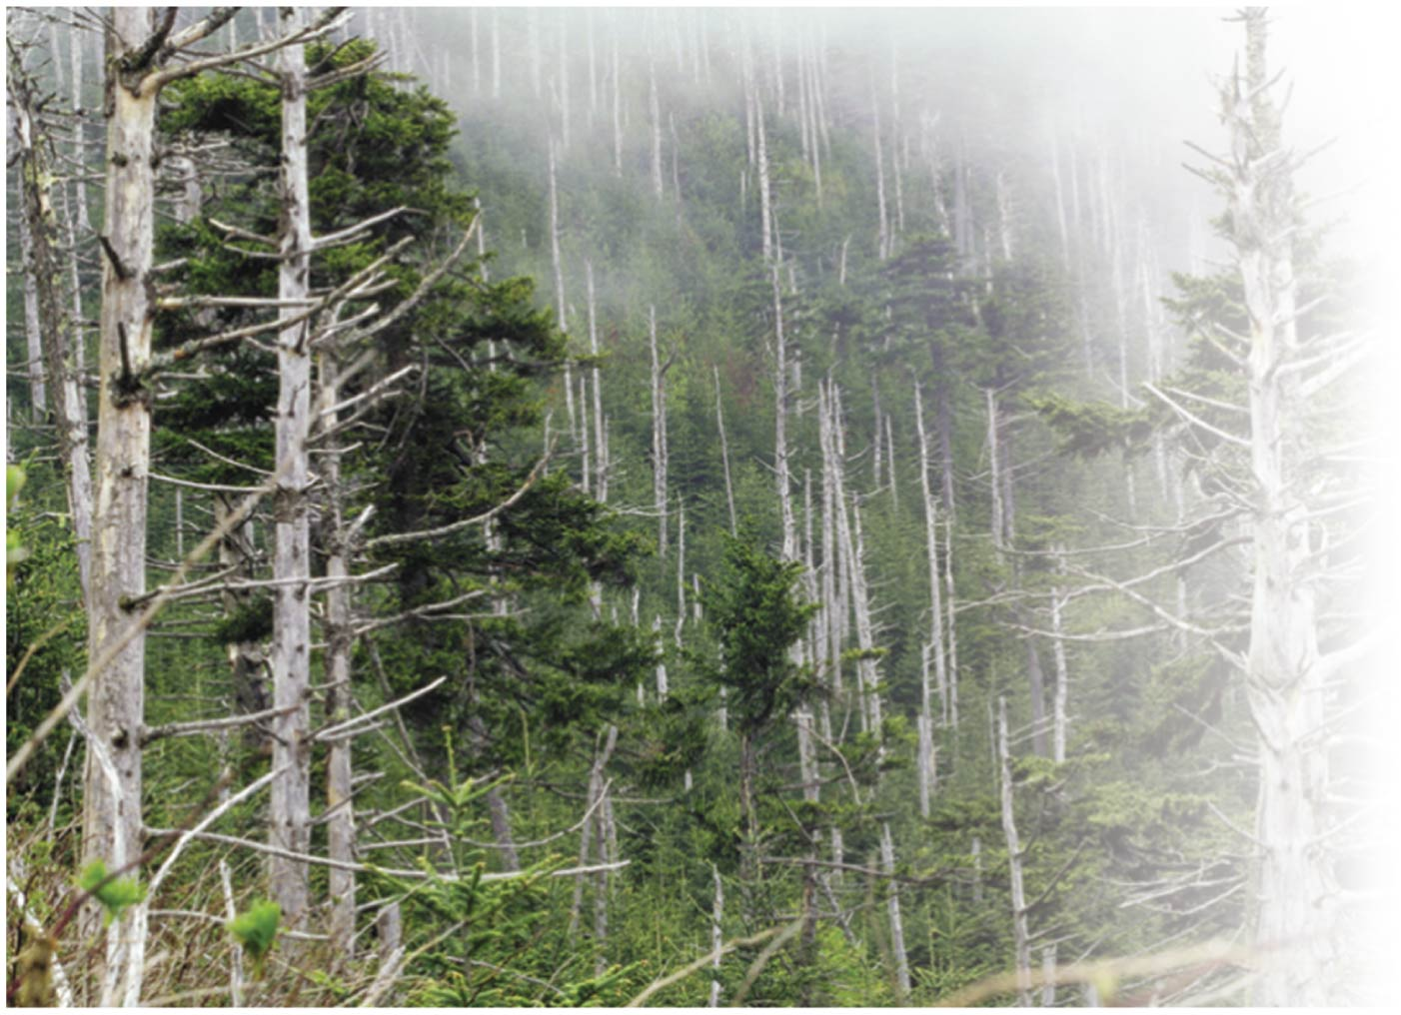
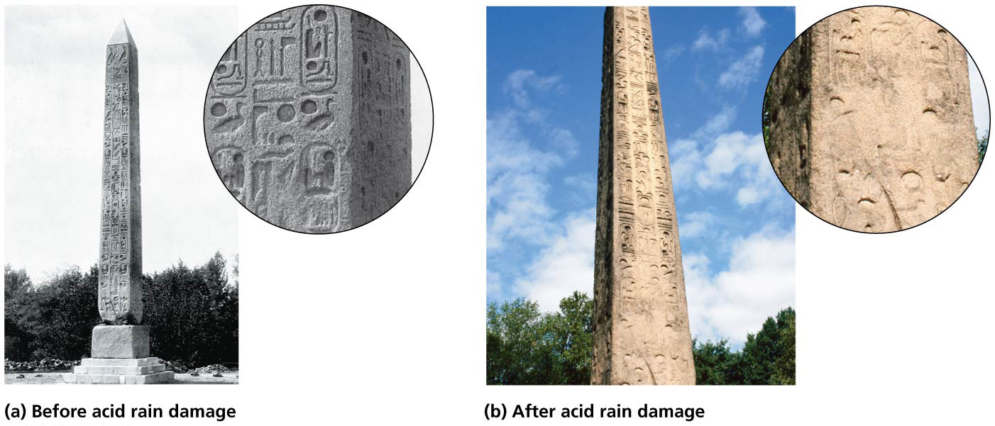

Slide 95
We are addressing acid deposition
The Clear Air Act of 1990 established an emissions trading program for sulfur dioxide
Economic incentives encourage polluters to invest in new technology or use other means to be cleaner
SO₂ emissions across the U.S. have fallen 67%
Benefits outweighed costs 40:1
Sulfate loads in rainfall in the eastern United States were 51% lower in 2008–2010 than 1989–1991
Wet nitrogen deposition has also declined
Air and water quality in the eastern United States has improved

Slide 96
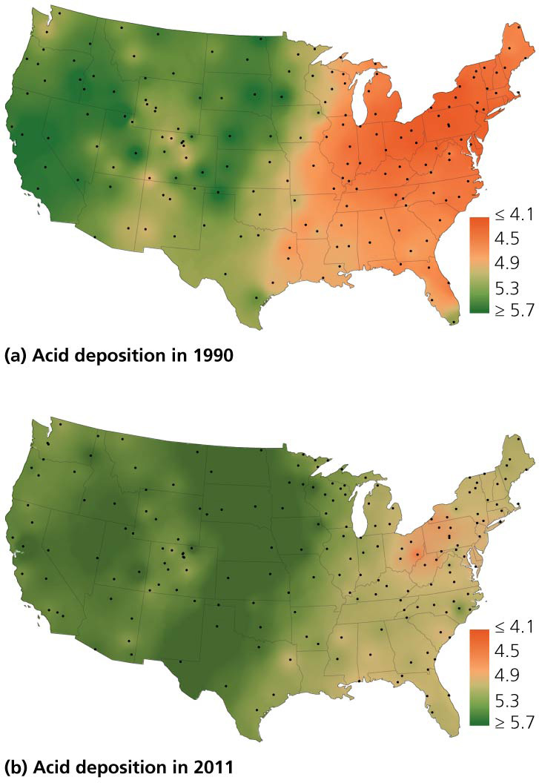

Slide 97
We are addressing acid deposition
The impacts of acid deposition have long been studied at the Hubbard Brook Experimental Forest
Scientists added an acid-neutralizing mineral to a forest to simulate lowered acid deposition
Soil pH rose
Sugar maple trees were healthier
There will be a time lag between reduced emissions and its positive consequences
Acid deposition is worse in the developing world
Especially in China, which burns coal in factories lacking pollution control equipment

Slide 98
Indoor Air Quality
Indoor air pollution = pollution in workplaces, schools, and homes
Health effects are greater than from outdoor pollution
The average U.S. citizen spends 90% of the time indoors
Exposure to synthetic materials that have not been comprehensively tested
Being environmentally prudent can make it worse
To reduce heat loss and improve efficiency, ventilation systems were sealed off
New buildings were constructed with windows that do not open, trapping pollutants inside

Slide 99
Burning fuelwood causes indoor air pollution in the developing world
Indoor air pollution has the greatest impact on the developing world
Poverty forces millions to burn wood, charcoal, dung, crop wastes inside homes for heating and cooking with little to no ventilation
Produces soot, carbon monoxide, and other pollutants increasing risk of pneumonia, bronchitis, lung cancer, allergies, cataracts, asthma, heart disease, etc.
Fuel-burning pollution causes 3.5 million deaths/year (nearly 7% of all deaths)

Slide 100
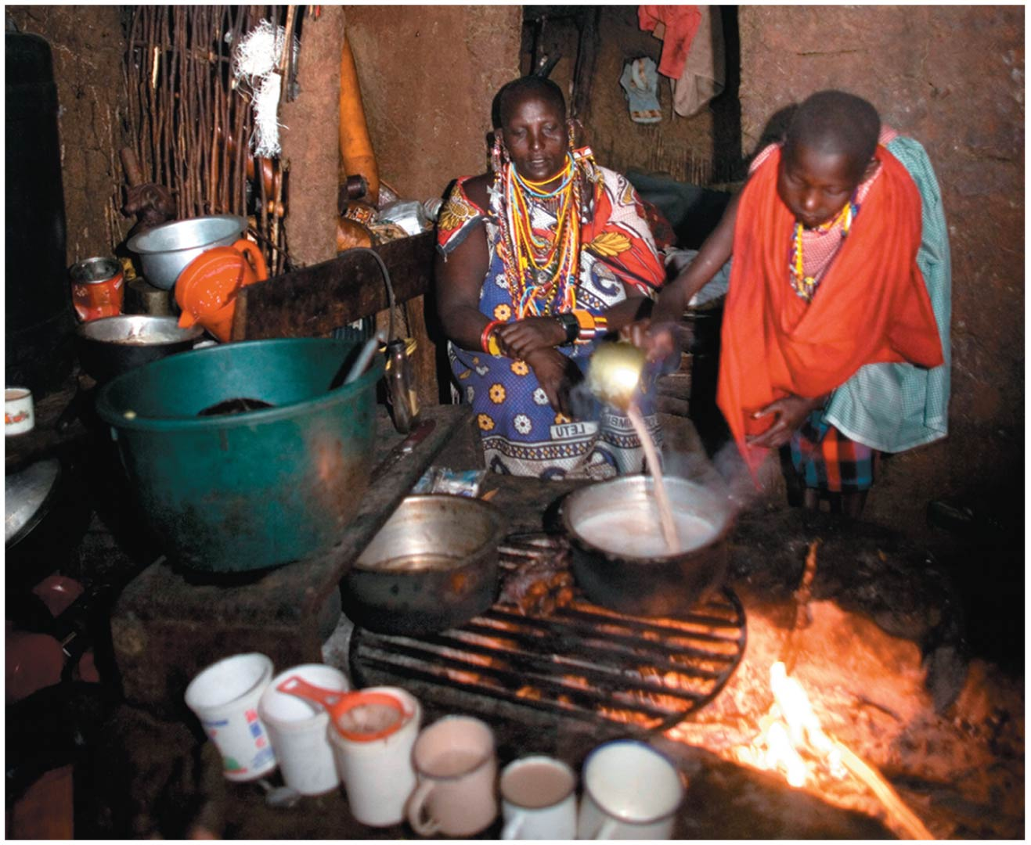

Slide 101
Tobacco smoke and radon are the primary indoor pollutants in industrialized nations
Cigarettes
Cause eye, nose, and throat irritation
Greatly increase risk of lung cancer
Contain over 4000 chemical compounds
Secondhand smoke causes similar problems to smoking
While smoking has declined in developed nations, it still causes 160,000 cases of lung cancer per year in the United States

Slide 102
Tobacco smoke and radon are the primary indoor pollutants in industrialized nations
Radon causes 21,000 deaths/year in the United States
A radioactive gas resulting from natural decay of rock, soil, or water that can seep into buildings
New homes are being built that are radon resistant

Slide 103
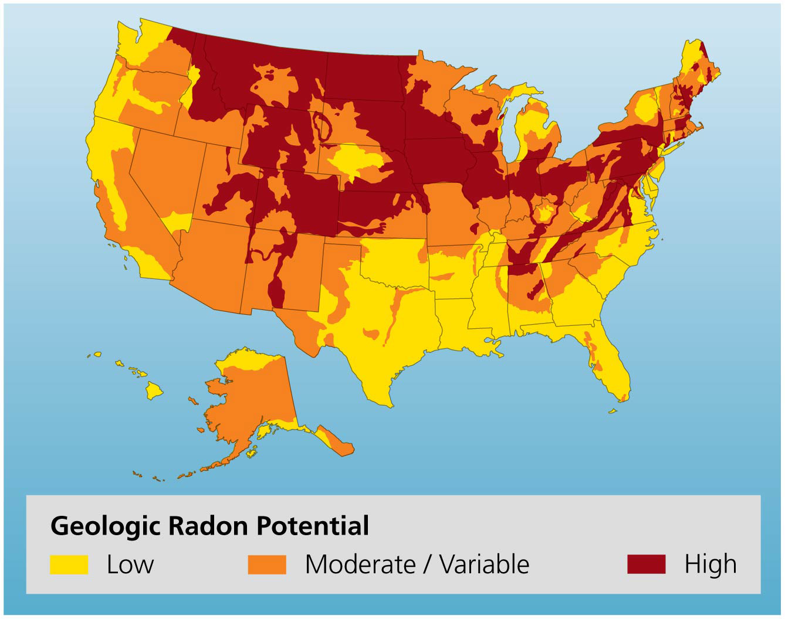

Slide 104
Many VOCs pollute indoor air
VOCs are the most diverse group of indoor air pollutants
Released by everything from plastics and oils to perfumes and paints
Most are released in very small amounts
Health implications are unclear because exposure is to low concentrations and people are exposed to mixtures of pollutants
Formaldehyde leaks from pressed wood and insulation
Irritates mucous membranes and induces skin allergies

Slide 105
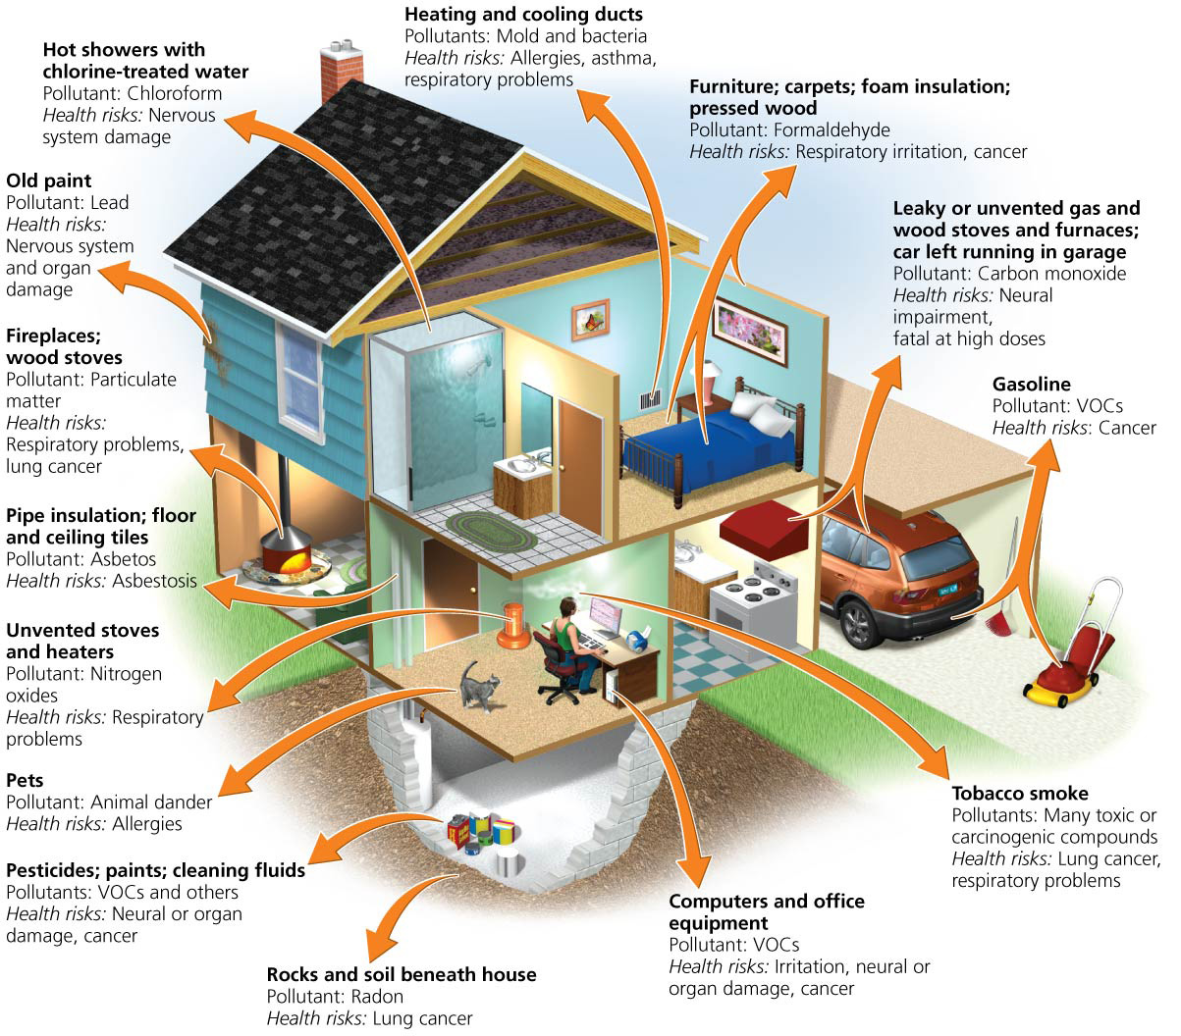

Slide 106
Living organisms can pollute
Tiny living organisms may be the most widespread source of indoor air pollution in the developed world
Dust mites and animal dander worsen asthma
Fungi, mold, mildew, airborne bacteria cause allergies, asthma, other respiratory ailments, and diseases
Building-related illness = a sickness produced by indoor pollution
Sick building syndrome = a sickness produced by indoor pollution with general and nonspecific symptoms
Reduced by using low-toxicity building materials and good ventilation

Slide 107
We can enhance indoor air quality
Using low-toxicity materials, monitoring air quality, keeping rooms clean and providing adequate ventilation alleviate indoor air pollution
In developing countries:
Dry wood before burning and cooking outside
Use more efficient stoves and less-polluting fuels
In developed countries:
Limit exposure to known toxicants
Test homes and offices for radon and use CO detectors
Premature deaths from indoor air pollution worldwide dropped 40% from 1990 to 2010

Slide 108
Conclusion
Indoor air pollution is a potentially serious health threat
We can significantly minimize risks
Outdoor air pollution has been addressed by government legislation and regulation in developed countries
The global deletion of ozone has been halted
Reduction in outdoor air pollution represents some of the greatest strides in environmental protection
There is still room for improvement in reducing acid deposition in developing countries

Slide 109
QUESTION: Review
The major component of Earth’s atmosphere is
nitrogen gas.
oxygen gas.
argon gas.
water vapor.
Notes:
Answer: a

Slide 110
QUESTION: Review
Ozone in the _________ is a pollutant but in the ______ is vital for life.
stratosphere; troposphere
troposphere; stratosphere
troposphere; tropopause
stratosphere; thermosphere
Notes:
Answer: b

Slide 111
QUESTION: Review
With convective circulation,
less dense, cooler air rises.
denser, warmer air rises.
less dense, warmer air rises.
denser, cooler air rises.
Notes:
Answer: c

Slide 112
QUESTION: Review
If you were on a sailing ship going from the United States to Europe, you would want to be in the area of the _____.
doldrums
trade winds
westerlies
polar cell
Notes:
Answer: c

Slide 113
QUESTION: Review
The Clean Air Act does all of the following EXCEPT
forbid emissions trading.
provide funds for pollution-control research.
allow citizens to sue violators.
set standards for air quality.
Notes:
Answer: a

Slide 114
QUESTION: Review
Which criteria pollutant is highly reactive, foul smelling, and has a reddish brown color?
Sulfur dioxide
Nitrogen dioxide
Tropospheric ozone
Carbon monoxide
Notes:
Answer: b

Slide 115
QUESTION: Review
Why is the Montreal Protocol considered our greatest environmental success story?
It has stopped global warming.
It decreased criteria pollutants.
It successfully stopped ozone depletion.
It slowed acid deposition.
Notes:
Answer: c

Slide 116
QUESTION: Viewpoints
Think of a major city near you. Do you think drivers should have to pay to drive downtown?
Yes, if mass transit is available.
Yes, but only charge people who do not live in the downtown area.
No; it’s my right to drive wherever I want to.
I don’t care, because I don’t own a car.
Notes:
Answer: any

Slide 117
QUESTION: Viewpoints
Should the government be able to force industries to put pollution-control devices on their factories?
Yes; I don’t want to be exposed to pollution.
Yes, but only if the people in the area agree.
No; let the factory owner decide.
No; in these tough economic times, we need to leave businesses alone.
Notes:
Answer: any

Slide 118
QUESTION: Interpreting Graphs and Data
What does this graph show about the stratosphere?
It contains the most ozone.
It is a very thin layer.
Temperature decreases with increasing altitude.
Temperature is not affected with increasing altitude.
Notes:
Answer: a

Slide 119
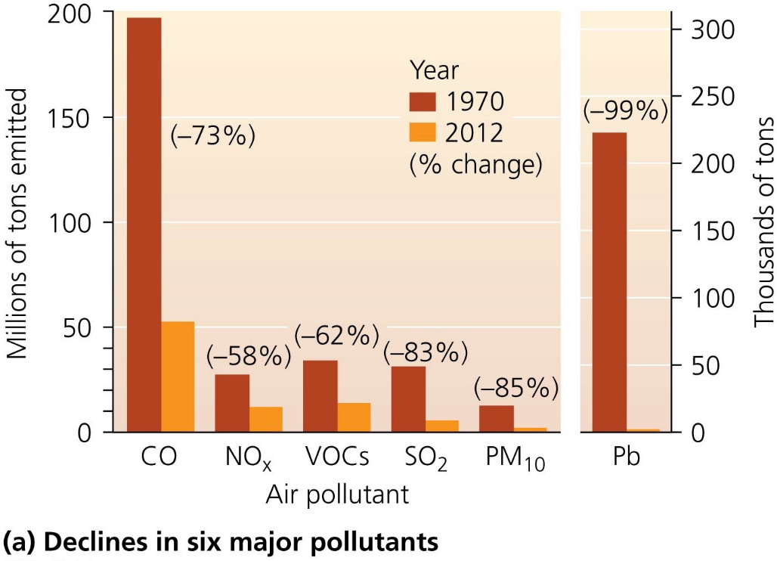
QUESTION: Interpreting Graphs and Data
Which conclusion can you draw from this graph?
The largest reduction has been for carbon monoxide (CO).
We have done the least to reduce NO_{X} emissions.
People have increased emissions, but only slightly.
The United States no longer needs the Clean Air Act.
Notes:
Answer: a

