Slide 2
This lecture will help you understand:
The scale of urbanization
Urban and suburban sprawl
City and regional planning and land use strategies
Transportation options
The role of urban parks
The potential of green buildings
Impacts and advantages of urban centers
Urban ecology and the pursuit of sustainable cities

Slide 3
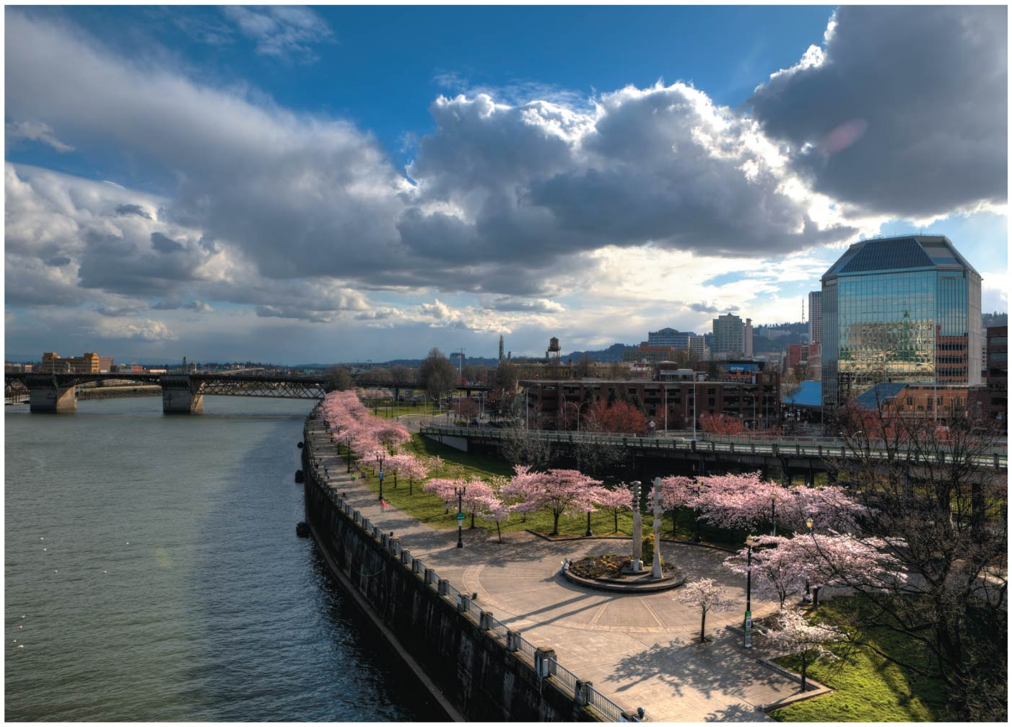

Slide 4
Central Case Study: Managing Growth in Portland, Oregon
Sprawling development can ruin communities
Portland area created a regional planning entity
Established an Urban Growth Boundary (UGB) separating urban from rural areas
UGBs are key to quality of life, but critics say they’re elitist
Urban reserves will allow development
Rural reserves will preserve farms and forests

Slide 5
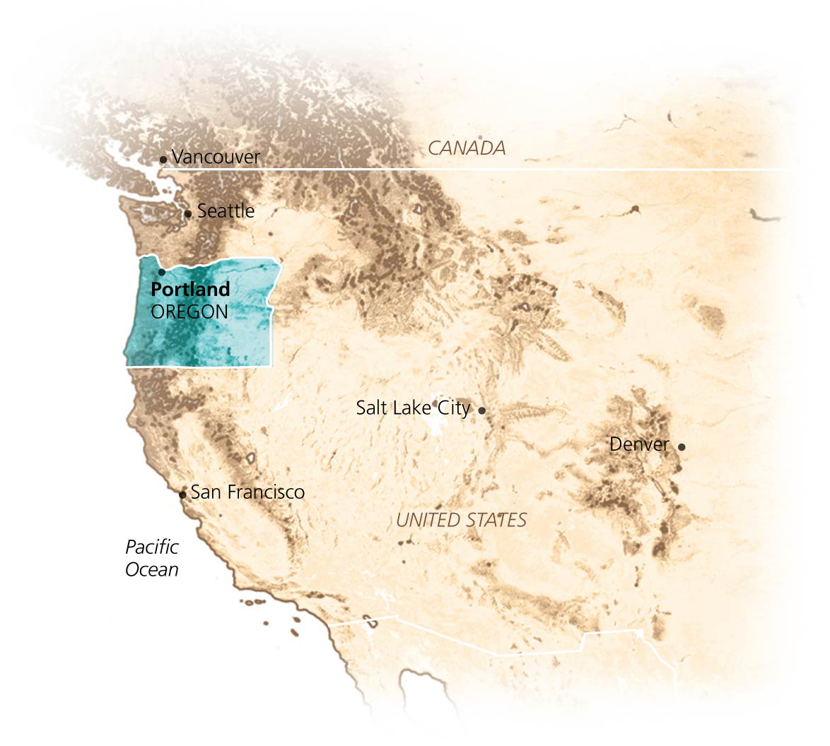

Slide 6
Our Urbanizing World
Since 2009, more people have been living in urban areas than rural ones
Urbanization = the movement of people from rural to urban (cities and suburbs) areas
Society’s greatest change since it became sedentary
People need a safe, clean, urban environment
High quality of life
Urban systems must be sustainable
Must minimize the ecological footprint

Slide 7
Industrialization has driven urbanization
Urban populations are growing
The human population overall is growing
People are moving from farms to cities
Urbanization began when agricultural surpluses allowed people to leave their farms
Created specialized manufacturing professions, class structure, political hierarchies, and urban centers
The industrial revolution spawned technology
Created jobs and opportunities in cities
Increased production efficiencies

Slide 8
Industrialization has driven urbanization
The United Nations projects that
Urban populations will increase 72% by 2050
Rural populations will decline by 9%
In developed nations, urbanization has slowed
In the United States, 80% of people live in urban areas
Half of the U.S. population lives in suburbs = smaller communities that ring cities

Slide 9
Industrialization has driven urbanization
Developing nations are urbanizing rapidly
Searching for jobs; fleeing wars, ecological damage
Population growth often exceeds economic growth, resulting in overcrowding, pollution, and poverty
There are 23 “megacities” of over 10 million people

Slide 10
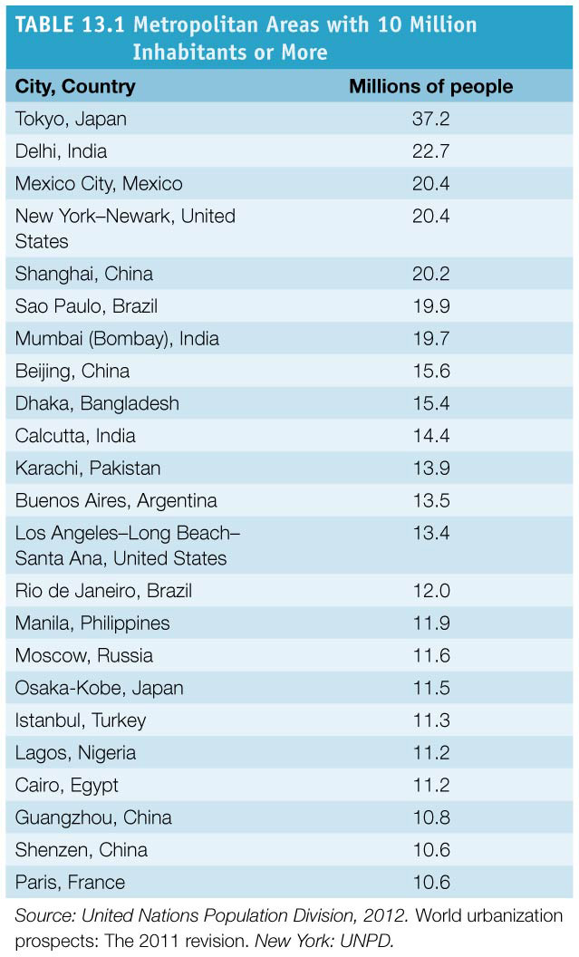
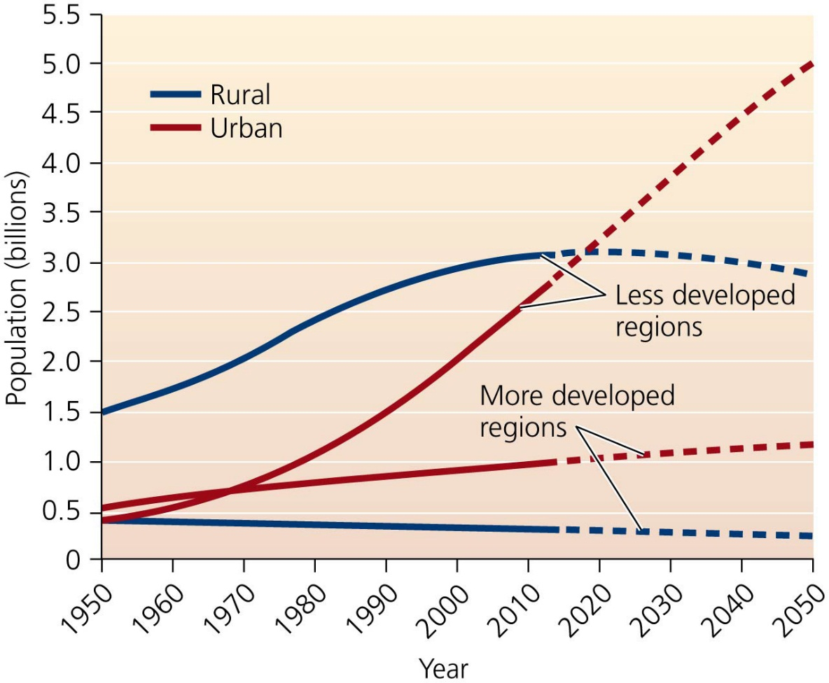

Slide 11
Environmental factors influence the location of cities
Climate, topography, and waterways determine whether a small settlement becomes a large city
Corridors for trade drive economic growth
Many well-located cities are linchpins in trading networks
Today, cities thrive in resource-poor areas due to cheap fossil fuels and powerful technologies
Water is brought in from distant areas

Slide 12
Environmental factors influence the location of cities
Cities in the southern and western United States have grown
Warmer weather, more space
Phoenix grew 93% between 1990 and 2012, Las Vegas by 135%

Slide 13
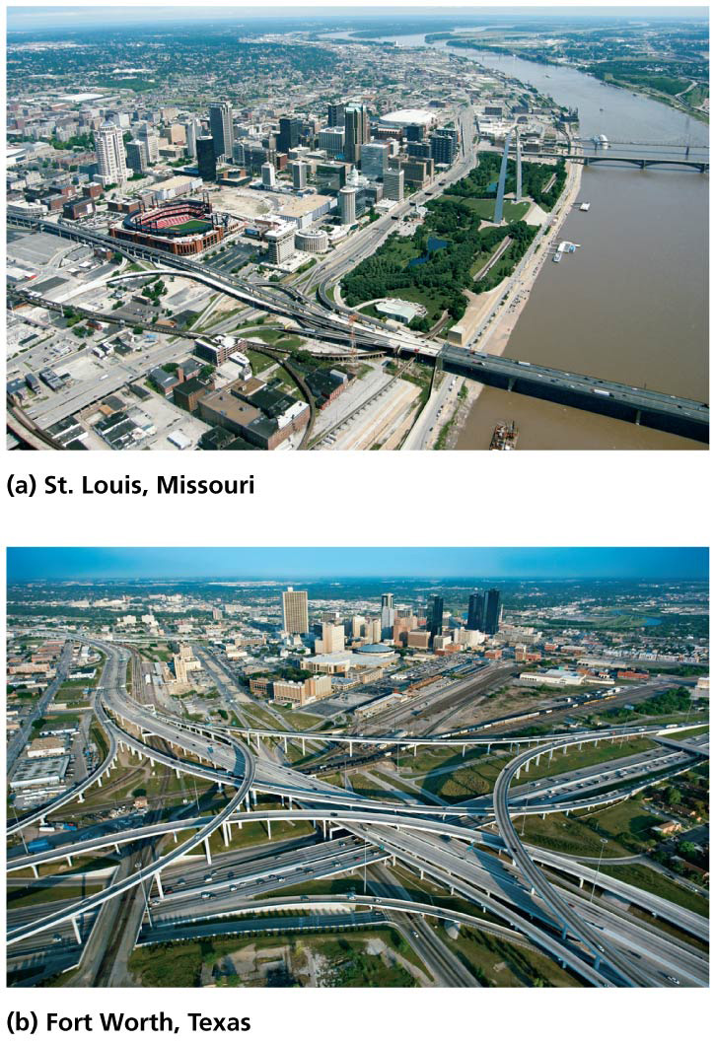

Slide 14
People have moved to suburbs
By the mid-1900s, immigration and trade had increased urbanization
Increased crowding, poverty, and crime
Affluent people moved to suburbs
Suburbs had more space
Economic opportunities and cheaper real estate
Less crime and better schools

Slide 15
People have moved to suburbs
Inner cities declined
Chicago’s population dropped to 80% of its peak, Philadelphia to 76%, Detroit to 55%
Portland’s growth stalled but was restarted due to new policies to revitalize the city center

Slide 16
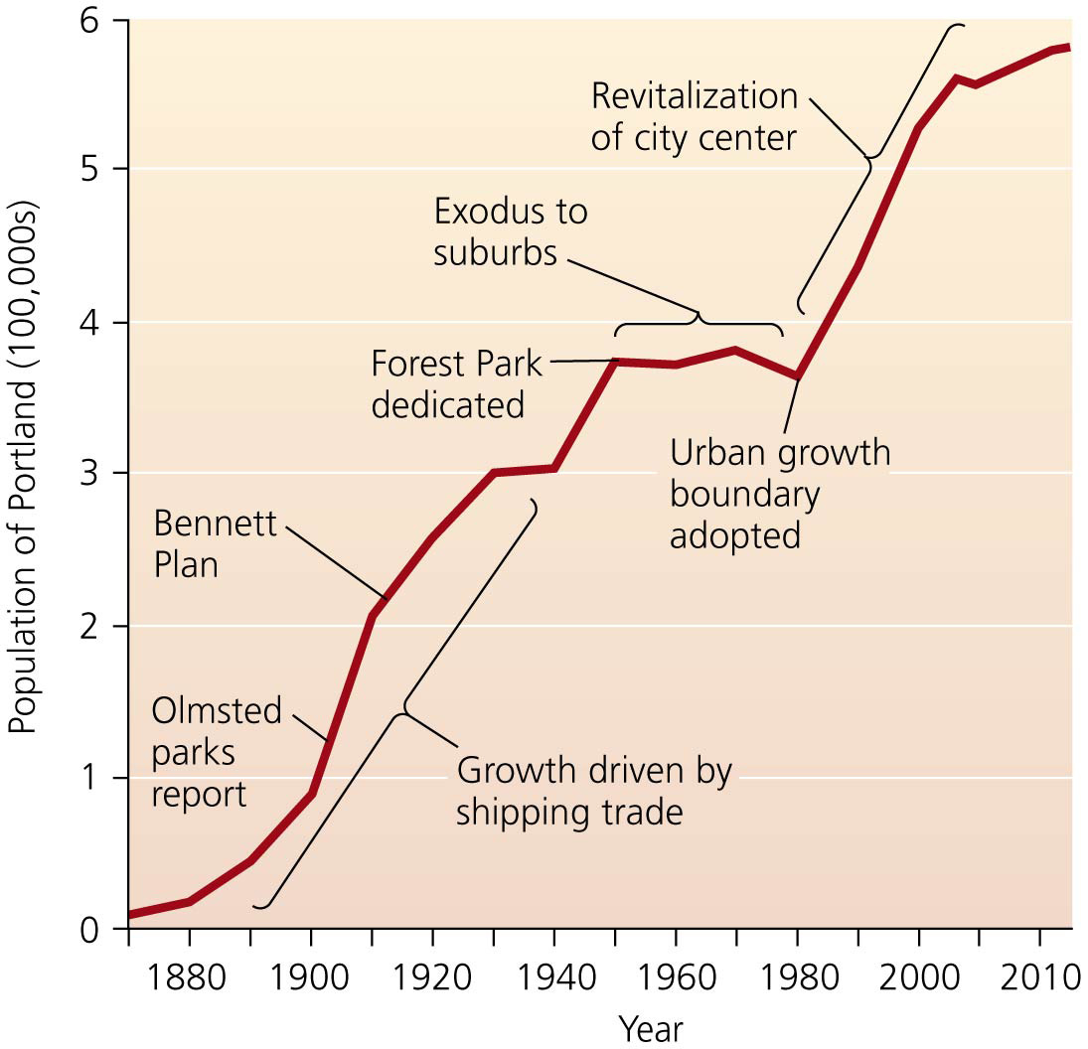

Slide 17
People have moved to suburbs
Millions commute to downtown jobs from suburban “bedroom communities”
Automobiles and an expanding road network
Abundant, cheap oil
Business could import and export resources, goods, and waste using roads and fossil fuels
Helped by the U.S. government’s development of the interstate highway system
Jet travel, cell phones, the Internet, and video conferencing allow easier communication from any area
No longer vital to be on a river or seacoast

Slide 18
Sprawl
Sprawl = the spread of low-density urban or suburban development outward from an urban center
Some see it as ugly, environmentally harmful, and inefficient
Others see it as the outgrowth of desires and decisions in a world of increasing humans
Urban and suburban areas grow in population size and spatially
Houses and roads replace 2700 ha (6700 acres)/day!

Slide 19
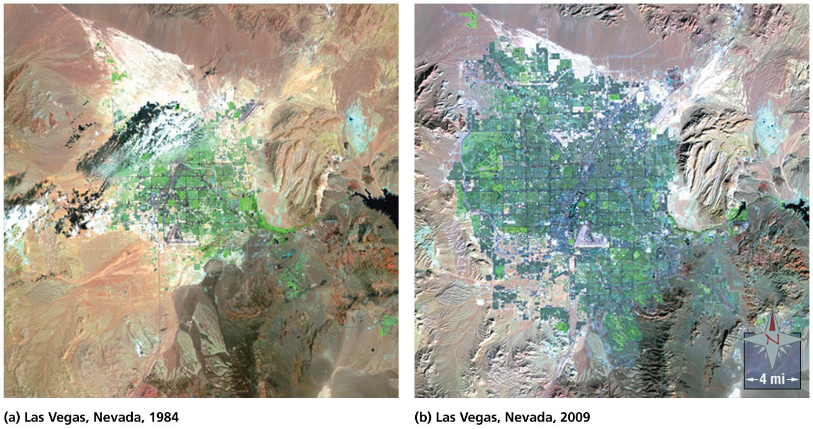

Slide 20
Urban areas spread outward
Several development approaches can lead to sprawl
Allot each person more space than in cities
A resident of Chicago’s suburbs takes up 11 times more space than a city resident
Sprawl may be defined as the physical spread of development faster than population growth
From 1950 to 2000, the population of Phoenix grew 12 times larger, but its land area grew 27 times larger
Even in metropolitan areas where populations declined between 1970 and 1990, the amount of land area increased

Slide 21
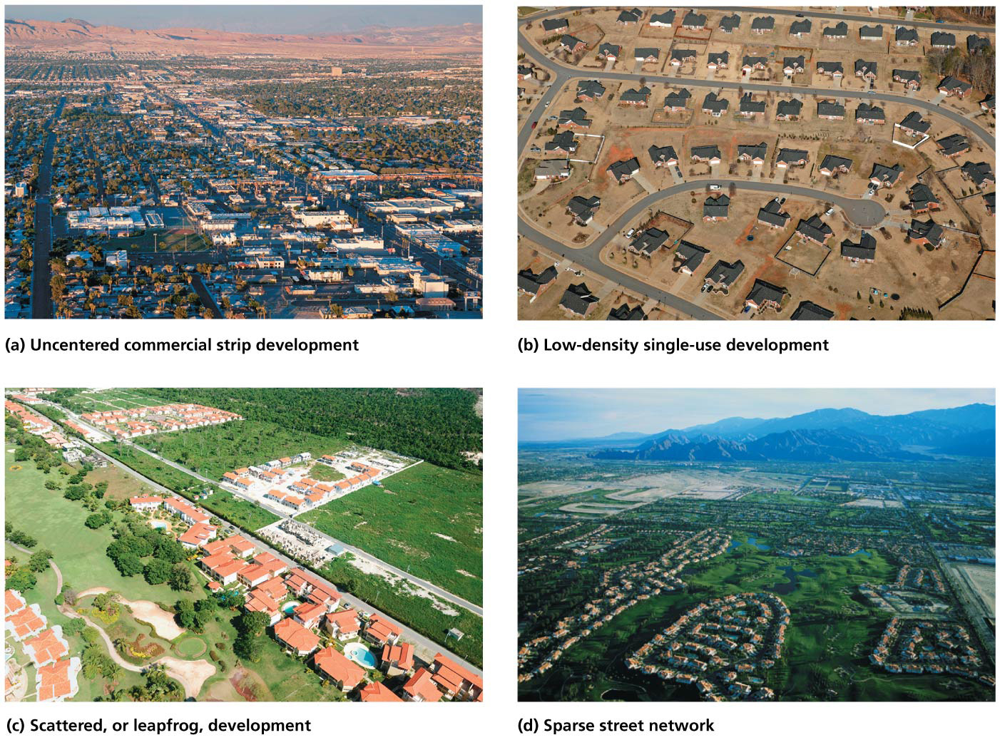

Slide 22
Sprawl has several causes
Two major factors contribute to sprawl: population growth and per capita land consumption
The amount of sprawl equals population size times the amount of land the average person occupies
Cities vary in which is more important
More people in Los Angeles vs. increased land consumption in Detroit
Per land consumption increases due to better highways, cheap gas, telecommunication, etc.
People desire space and privacy

Slide 23
What is wrong with sprawl?
Some see sprawl promoting traffic jams, loss of habitat, and loss of open space
Others see it as the result of people wanting to live
What are the impacts of sprawl?

Slide 24
What is wrong with sprawl?
Transportation: people are forced to drive cars
Pressure to own cars and drive greater distances
Lack of mass transit options
More traffic accidents
Increased dependence on nonrenewable petroleum
Pollution: carbon dioxide, air pollutants, ozone, smog, acid precipitation
Motor oil and road salt from roads and parking lots

Slide 25
What is wrong with sprawl?
Health: sprawl promotes physical inactivity because driving cars replaces walking
Increases obesity and high blood pressure
Land use: less forests, fields, farmland, or ranchland
Loss of resources, recreation, beauty, wildlife habitat, air and water purification, services
Children lose access to experiences with nature

Slide 26
What is wrong with sprawl?
Economics: sprawl drains tax dollars from communities
For roads, water and sewer systems, electricity, police and fire services, schools, etc. in new areas
Taxpayers, not developers, subsidize improvements

Slide 27
City and regional planning help to create livable urban areas
City (urban) planning = designing cities to maximize their efficiency, functionality, and beauty
Planners advise policymakers on development options, transportation needs, public parks, etc.
Washington, D.C., is the nation’s earliest example of city planning
Daniel Burnham’s 1909 Plan of Chicago included parks and playgrounds, improved neighborhoods, etc.
The 1912 Greater Portland Plan recommended rebuilding the harbor, new construction, wide roads
Notes:
27

Slide 28
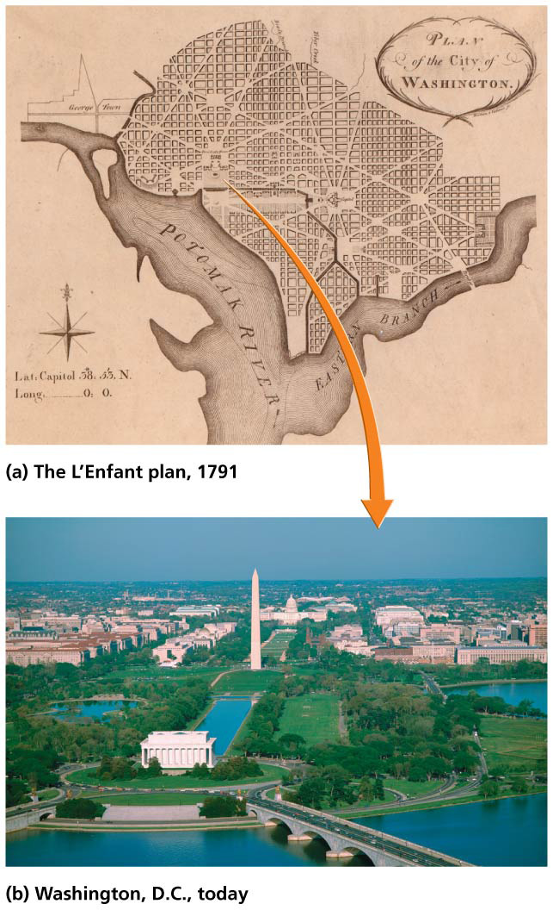

Slide 29
City and regional planning help to create livable urban areas
With today’s sprawling metropolitan areas, planning can not always be successful on only the city level
Regional planning = deals with same issues as city planning, but with broader geographic scales that must coordinate with multiple municipal governments
Some areas have institutionalized planning in formal government bodies
Urban and rural reserves in Portland
Homeowners, farmers, developers, and governments will know what future land uses will be
Notes:
29

Slide 30
Zoning is a key tool for planning
Zoning = practice that classifies areas for different types of development and land use
A powerful means to guide what gets built where
Involves government restriction on the use of private lands
Opponents say that its restrictions violate individual freedoms
Proponents say government can set limits for the good of the community
People have generally supported the use of zoning
Notes:
30

Slide 31
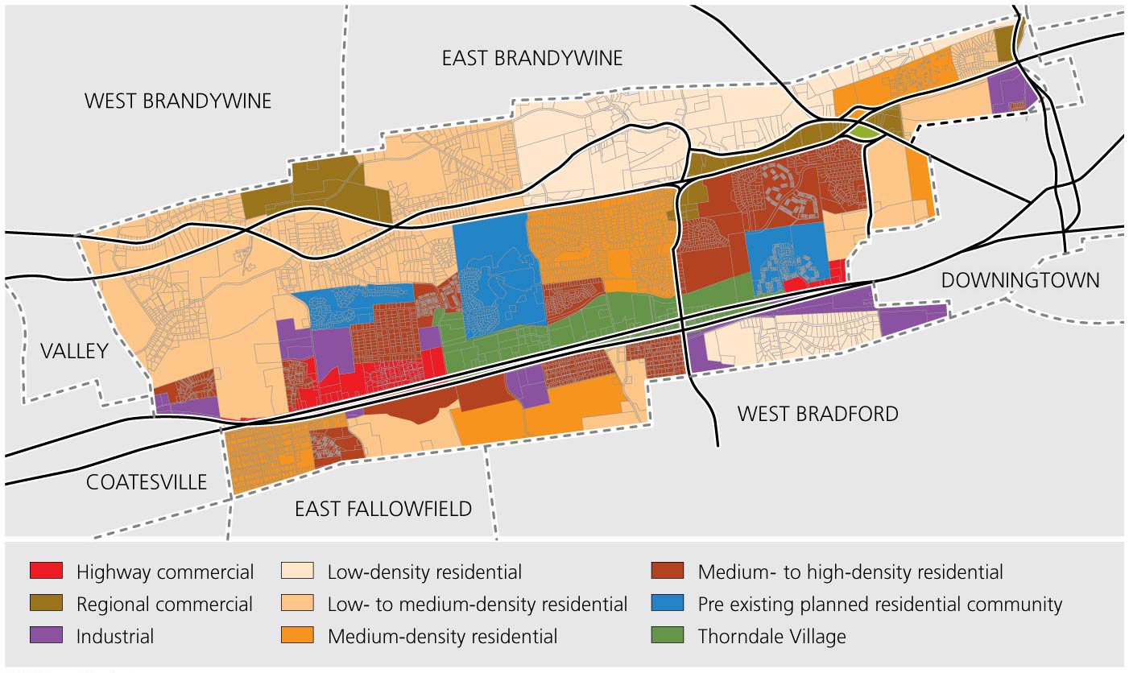

Slide 32
Urban growth boundaries are now widely used
Urban growth boundary (UGB) = a line on a map intended to separate areas desired to be urban from areas desired to remain rural.
Oregon’s UGB was one of the first large-scale attempts to limit sprawl this way
Other states, regions, and cities have adopted UGBs
Boulder, Colorado; many California areas
Try to concentrate development, prevent sprawl, and preserve farmland and habitat

Slide 33
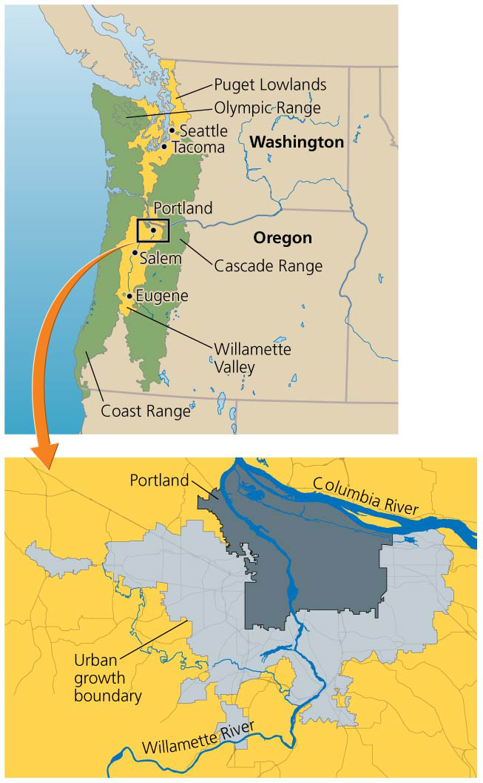

Slide 34
Urban growth boundaries are now widely used
Limit sprawl: keep growth in existing urbanized areas
Revitalize downtowns, increased employment
Protect farms, forests, and industries
Reduce infrastructure costs by roughly 20%
Increase the density of new housing inside the UGB
Restrict development outside the UGB
Disadvantages:
Increased housing prices within their boundaries
As population expands, the UGB must expand with it
The Portland-area UGB has been expanded 36 times
Notes:
34

Slide 35
“Smart growth” aims to counter sprawl
Smart growth = concept of using urban growth boundaries and other land use policies to control sprawl
Proponents of smart growth promote:
Healthy neighborhoods and communities
Jobs and economic development
Transportation options
Environmental quality
Building “up, not out”
Focusing development in existing areas
Favoring multistory shop-houses and high-rises
Notes:
35

Slide 36
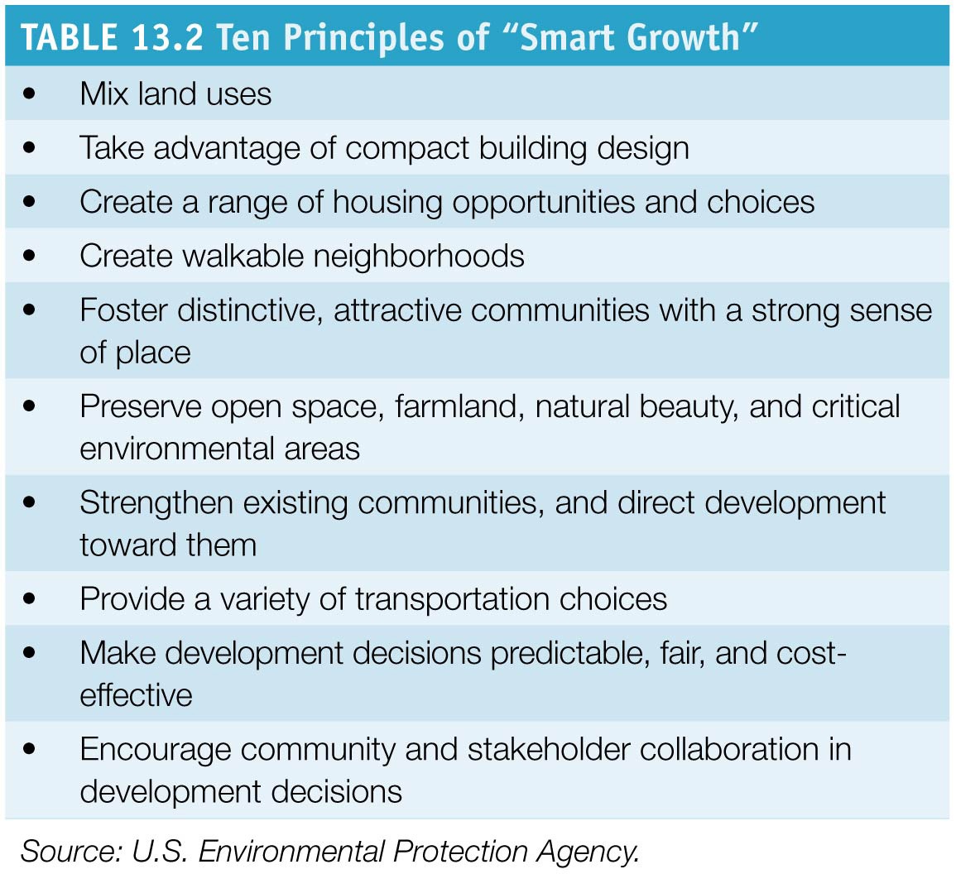

Slide 37
“New urbanism” aims to create walkable neighborhoods
New urbanism = approach in which neighborhoods are designed on a walkable scale
Homes, businesses, and schools are close together
Functional neighborhoods in which most of a family’s needs can be met without using a car
New urbanist developments have green spaces, mixed architecture, creative street layouts
Transit-oriented development = development in which compact communities in the new urbanist style are arrayed around stops on a major rail transit line
People can travel by train and foot
Notes:
37

Slide 38
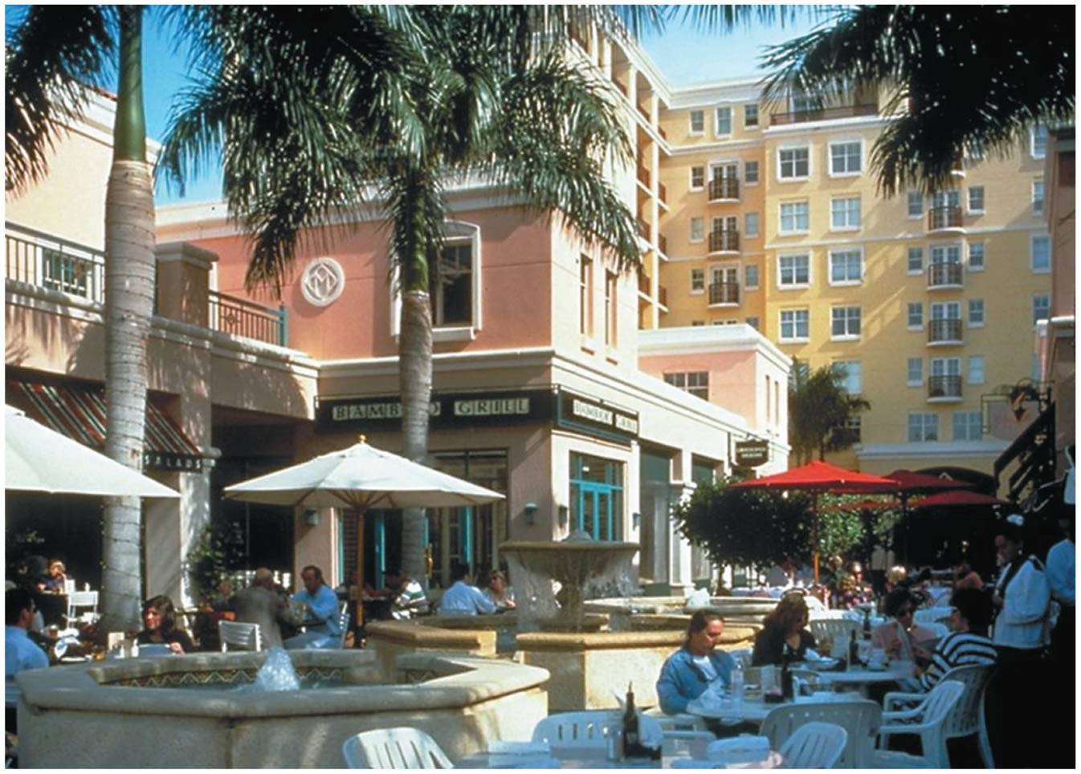

Slide 39
Transit options help cities
Traffic jams cause air pollution, stress, and lost time
Cost the U.S. economy $74 billion/year
Key in improving quality of urban life: alternative transportation options
Bicycle transportation is one key option
Portland’s 400 miles of bike paths and 5000 bike racks cost less than one mile of urban freeway
Mass transit systems = public systems that move large numbers of passengers at once
Buses, trains, subways
Light rail = smaller rail systems powered by electricity
Notes:
39

Slide 40
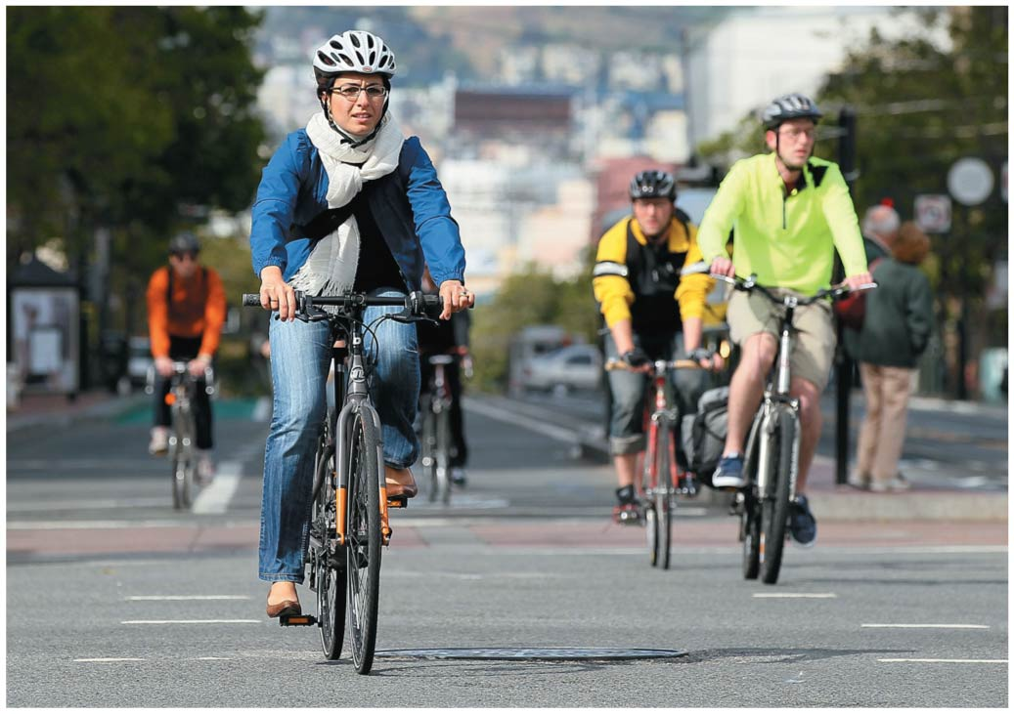

Slide 41
Transit options help cities
Mass transit options solve many problems
Cheaper, more energy efficient, and cleaner than moving the same number of people in cars
Traffic congestion is eased
The most-used U.S. train systems are heavy rail systems in large cities
Carry 25% of each city’s daily commuters
New York’s subways, the T in Boston
Portland’s buses carry 60 million riders/year
Each bus keeps 250 cars off the road every day

Slide 42
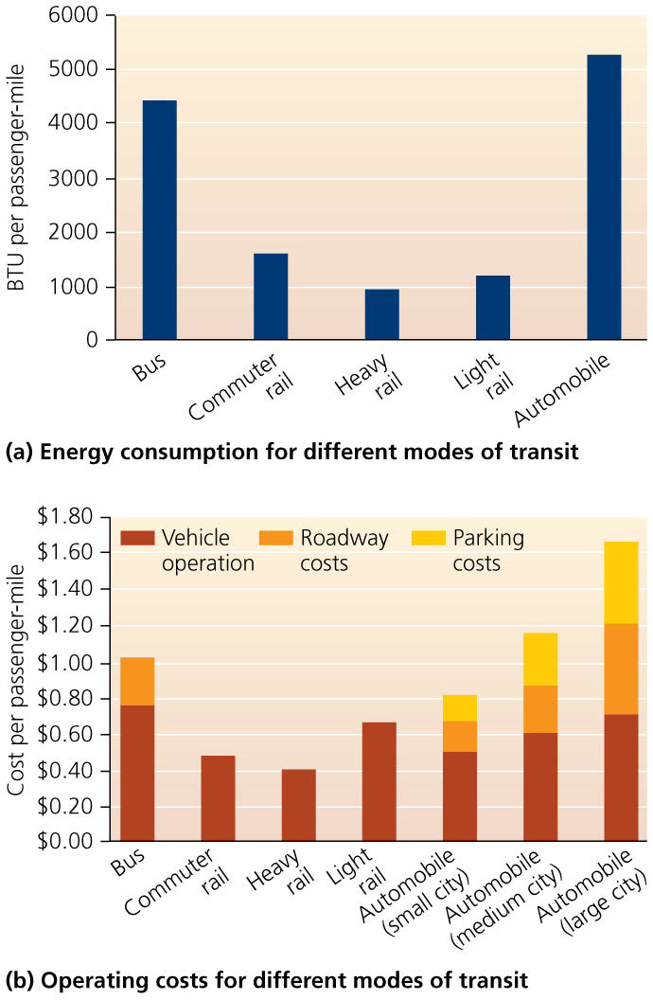

Slide 43
Transit options help cities
Most nations have extensive, accessible bus systems
The United States lags behind in mass transit systems
Japan and many European nations have developed systems of high-speed “bullet” trains
The United States has only one

Slide 44
Transit options help cities
Why is U.S. mass transit behind?
Low population density and cheap fuel led the United States to support road networks for cars
In 2009, Congress set aside $8 billion for high-speed rail in 10 potential rail corridors
Three Republican governors rejected the offer of federal funding for their states

Slide 45
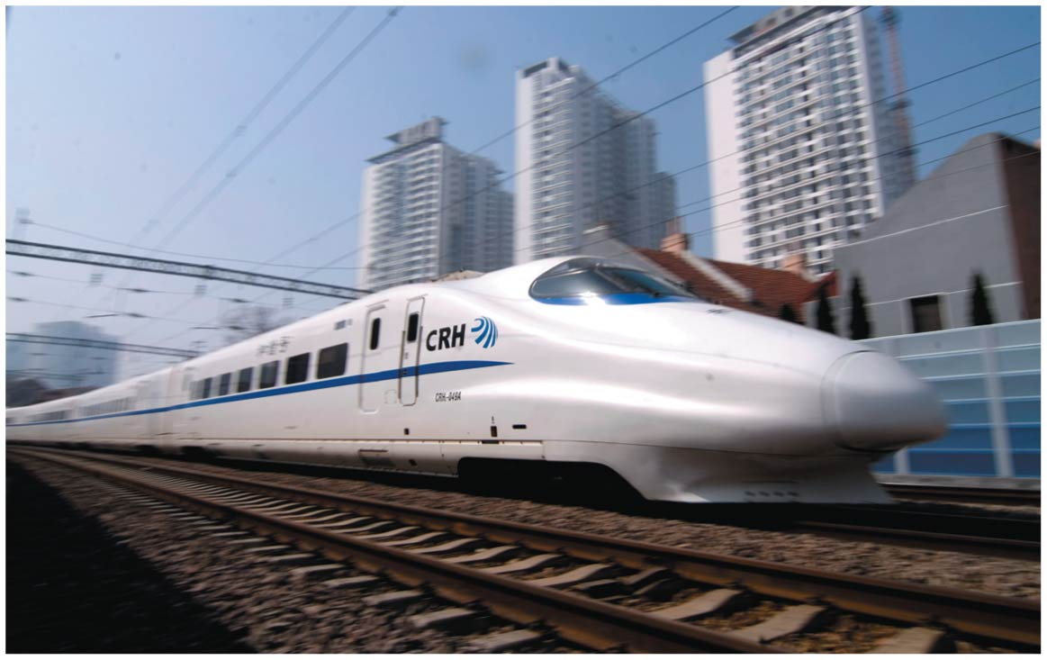

Slide 46
Transit options help cities
It is expensive to replace existing road networks
Strong, visionary political leadership is needed
Growth is directed, instead of being overwhelming
Curitiba, Brazil invested in an extensive bus system that is now used by three-quarters of its 2.5 million residents

Slide 47
Transit options help cities
Governments can encourage mass transit
Raise fuel taxes
Tax inefficient modes of transport
Reward carpoolers
Encourage bicycle use and bus ridership
Charge trucks for road damage

Slide 48
Urban residents need parklands
City dwellers want to escape noise, commotion, and stress of urban life
Natural lands, public parks, and open space provide greenery, scenic beauty, freedom, and recreation
They also keep ecological process functioning by
Helping to regulate climate
Purifying air and water
Providing wildlife habitat
Urbanization makes protecting natural lands important
Urban dwellers become disconnected from nature

Slide 49
Urban residents need parklands
City parks arose in the United States at the end of the 19th century
People wanted to make dirty, crowded cities more livable
Lawns, groves, and curved pathways originated with European ideals
New York’s Central Park was among the first city parks in the United States
Portland’s Forest Park is the largest U.S. city park at 11 km (7 miles) long

Slide 50
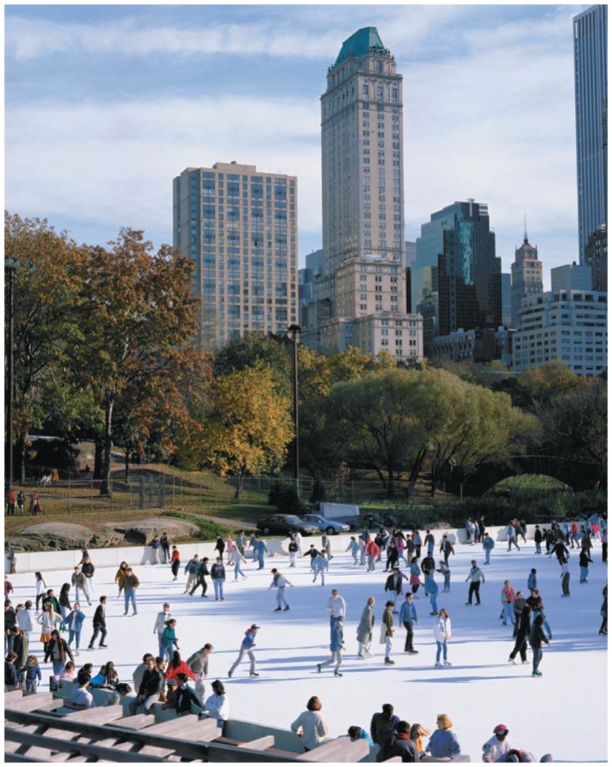

Slide 51
Parklands come in various types
Even small spaces can be important
Playgrounds or community gardens
Greenways = strips of land connecting parks or neighborhoods
Protect water quality, boost property values, provide corridors for wildlife
Greenbelts = long, wide corridors of parklands
May surround an entire urban area
Many cities are trying ecological restoration to restore the area’s naturalness
Volunteers help remove exotic plants, restore prairies

Slide 52
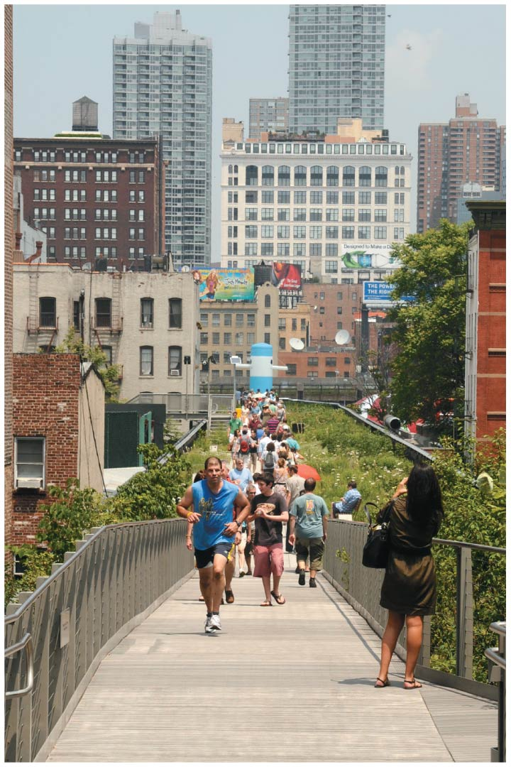
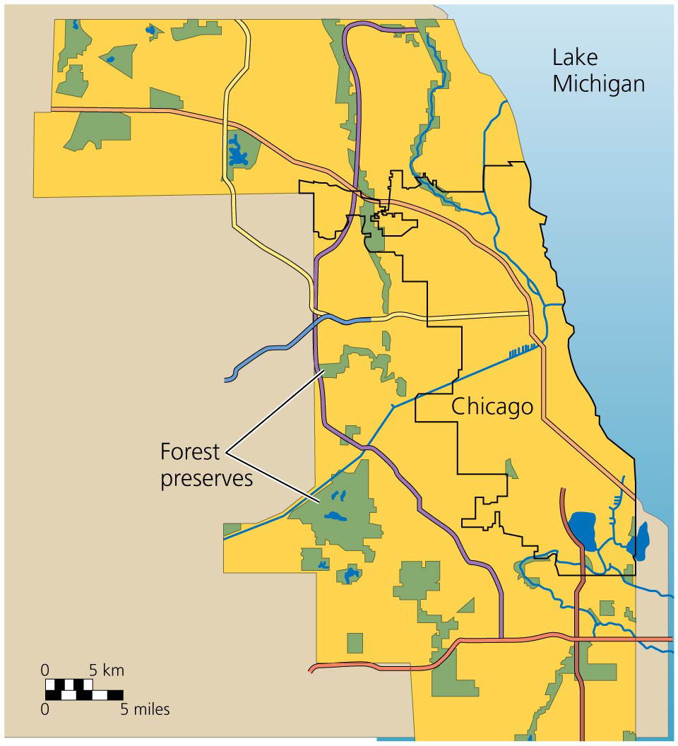

Slide 53
Green buildings bring benefits
Constructing or renovating buildings using efficient technologies is probably the best way to reduce energy use and greenhouse gas emissions
Buildings consume 40% of energy and 70% of electricity

Slide 54
Green buildings bring benefits
Green buildings = structures that use technologies and approaches to minimize the ecological footprints of construction and operation
Built from sustainable materials
Minimize energy and water use
Control pollution
Recycle wastes

Slide 55
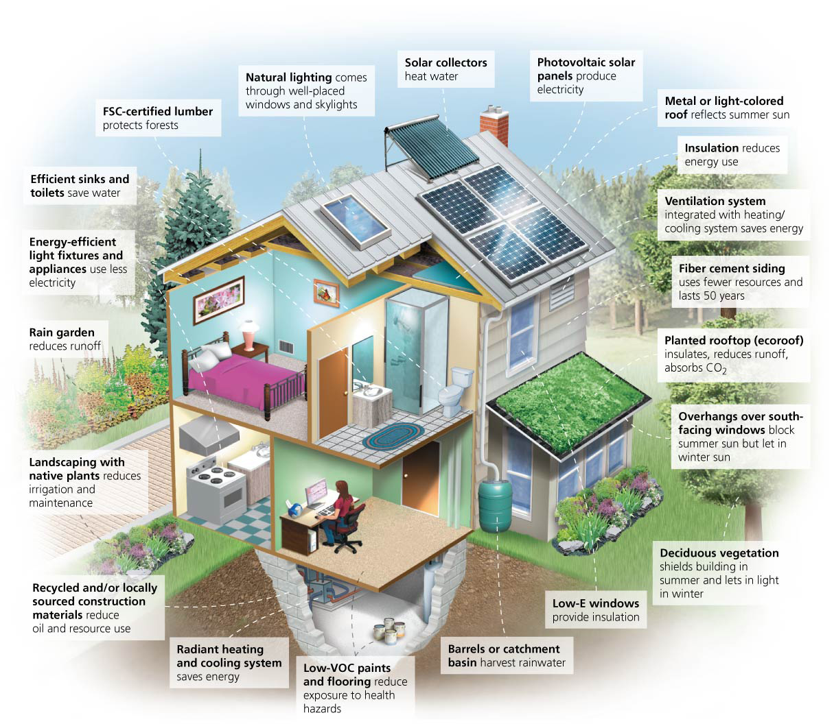

Slide 56
Green buildings bring benefits
Leadership in Energy and Environmental Design (LEED) = a certification program run by the U.S. Green Building Council
New or renovated buildings apply for certification
They can be granted silver, gold, or platinum status

Slide 57
Green buildings bring benefits
Green building techniques are more expensive
LEED certified buildings cost 3%–10% more
The Portland sports arena’s savings on energy, water, and waste paid for its upgrade to LEED certification after just one year of operation
Schools, colleges, and universities are leaders in sustainable building

Slide 58
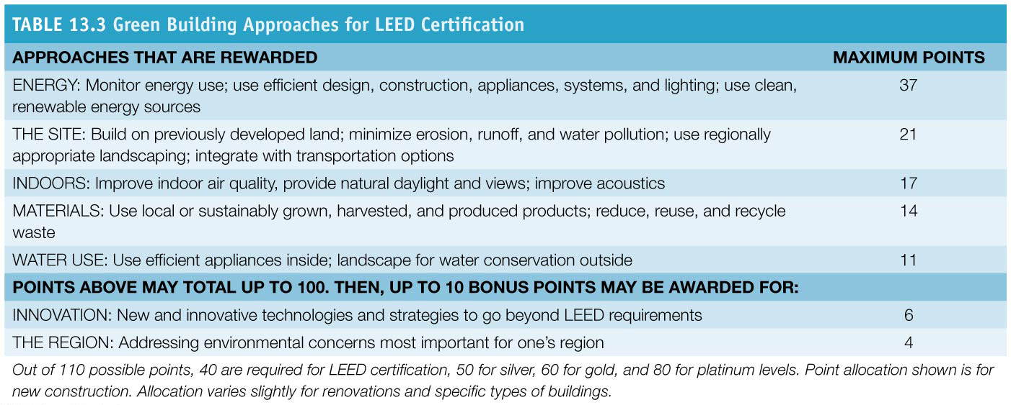

Slide 59
Urban Sustainability
Things that make cities safe, clean, healthy, and pleasant also make them more sustainable
A sustainable city functions effectively and prosperously over the long term
Generations will have a good quality of life
Impacts on natural systems and resources are minimized
A city’s impacts depend on how we use resources, produce goods, transport materials, and deal with waste

Slide 60
Urban resource consumption brings a mix of environmental effects
Resource sinks: cities must import resources, relying on large expanses of land elsewhere to supply resources
We need natural land for
Food, shelter, ores, water
Ecosystem services (air and water purification, nutrient cycling, waste treatment)
Moving resources to cities requires fossil fuel use
But would it be greater if populations were widely spread?

Slide 61
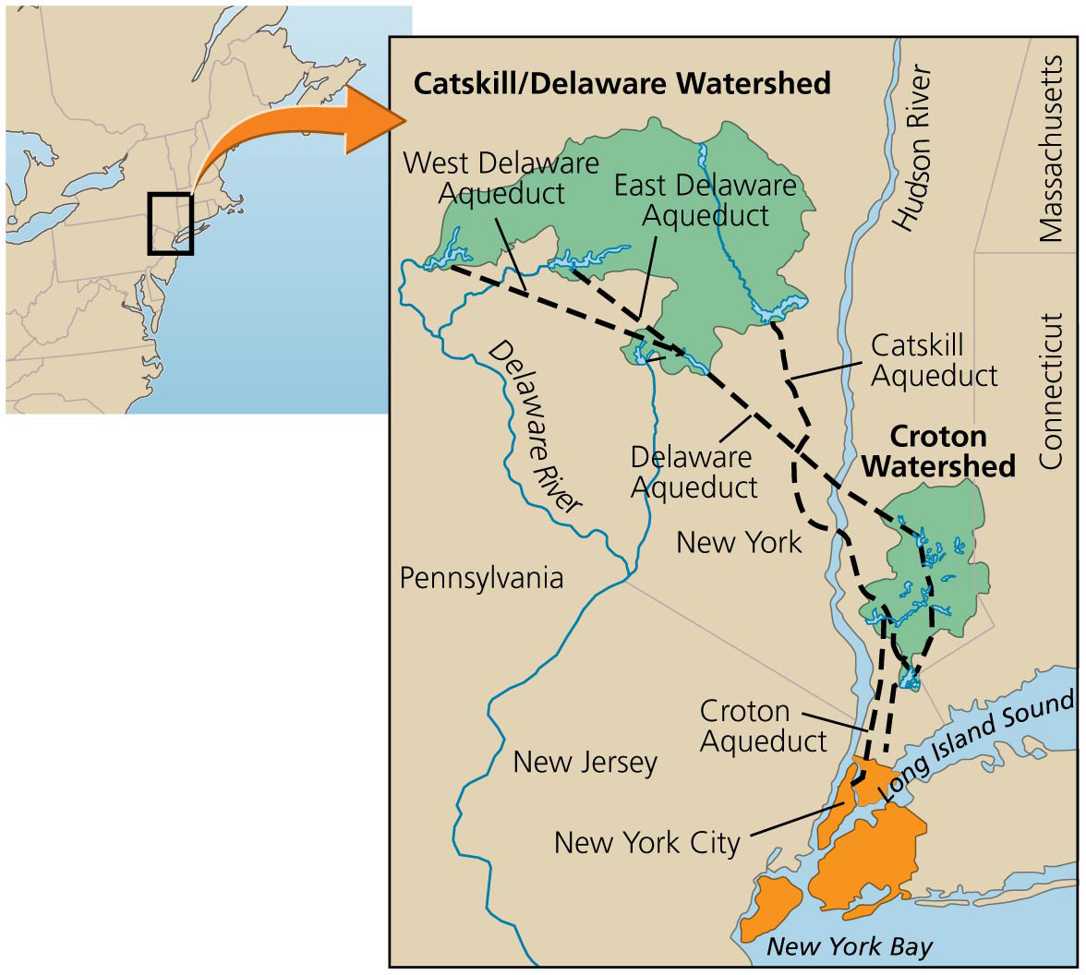

Slide 62
Urban resource consumption brings a mix of environmental effects
Efficiency: dense concentrations of people in cities allow efficient delivery of goods and services
Delivery of electricity is more efficient
High city density facilitates social services that improve the quality of life
Medical services, education, water and sewer systems, waste disposal, transportation

Slide 63
Urban resource consumption brings a mix of environmental effects
Consumption: heavy use of outside resources increases the ecological footprints of cities
The footprints are far greater than their land area
Cities take up 2% of the land surface, but consume over 75% of the world’s resources
London’s ecological footprint is 125 times larger than the actual city
Urban dwellers have far larger ecological footprints than rural dwellers
Urban residents tend to be wealthier, and wealth correlates with consumption

Slide 64
Urbanization preserves land, but urban centers suffer and export pollution
Because people are packed densely in cities, more land outside cities is left undeveloped
Without cities, we would have much less room for agriculture, wilderness, biodiversity, or privacy
Cities export wastes through pollution and trade
They transfer the costs of activities to other regions
Acid precipitation and garbage impact distant areas
Not all pollution leaves the urban centers
Citizens are exposed to heavy metals, chemicals, smog, acid precipitation, etc.

Slide 65
Urban centers suffer and export pollution
Noise pollution = undesired ambient sound
Degrades surroundings, stressful, hurts hearing
Light pollution = light that obscures the night sky, impairing the visibility of stars

Slide 66
Urban centers suffer and export pollution
Urban heat island effect = cities are hotter than surrounding areas
Buildings, vehicles, factories, and people generate heat
Dark buildings and pavement absorb heat
Those who bear the brunt of pollution by living downstream or downwind of polluting facilities are disproportionately poor or racial and ethnic minorities

Slide 67
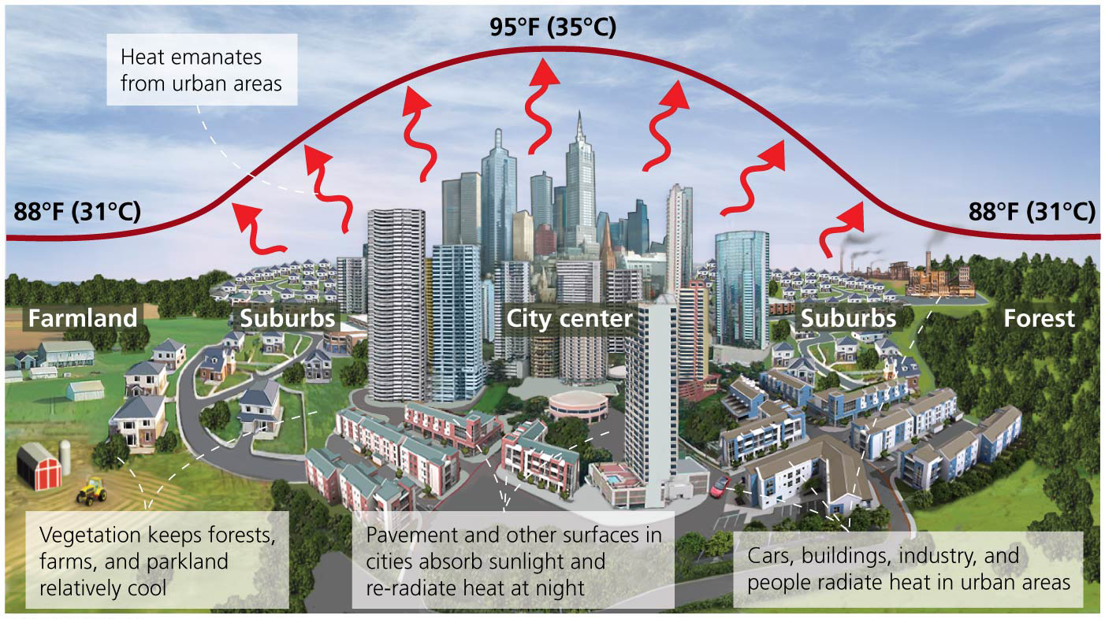

Slide 68
Urban centers foster innovation
Cities promote a flourishing cultural life and mix a diverse group of people and influences
They spark innovation and creativity, promoting education and scientific research
They are engines of technological and artistic inventiveness that can solve societal problems
The wealth accumulated by urban residents allows them to serve as markets for organic produce, recycling, and environmental education

Slide 69
Urban ecology helps cities toward sustainability
Cities must replace the one-way linear metabolism of importing resources and exporting wastes
This destabilizes environmental systems and is not sustainable
Urban ecology = field that holds that cities can be viewed explicitly as ecosystems
Fundamentals of ecology and systems apply to cities

Slide 70
Urban ecology helps cities toward sustainability
Cities should follow an ecosystem-centered model by striving to
Use resources efficiently
Recycle
Develop environmentally friendly technologies
Account fully for external costs
Offer tax incentives for sustainable practices
Use locally produced resources
Use organic waste and wastewater to restore soil fertility
Encourage urban agriculture

Slide 71
Urban ecology helps cities toward sustainability
Future “eco-cities,” built from scratch, have been planned but not yet been built
Urban sustainability is happening step by step across the world
Urban agriculture is thriving

Slide 72
Urban ecology helps cities toward sustainability
Curitiba, Brazil has invested in mass transit, recycling, environmental education, job training, and free health care
Its citizens are happier and economically better off than residents of other Brazilian cities
PlaNYC is a program through which New York City is trying to become the first environmentally sustainable 21st-century city

Slide 73
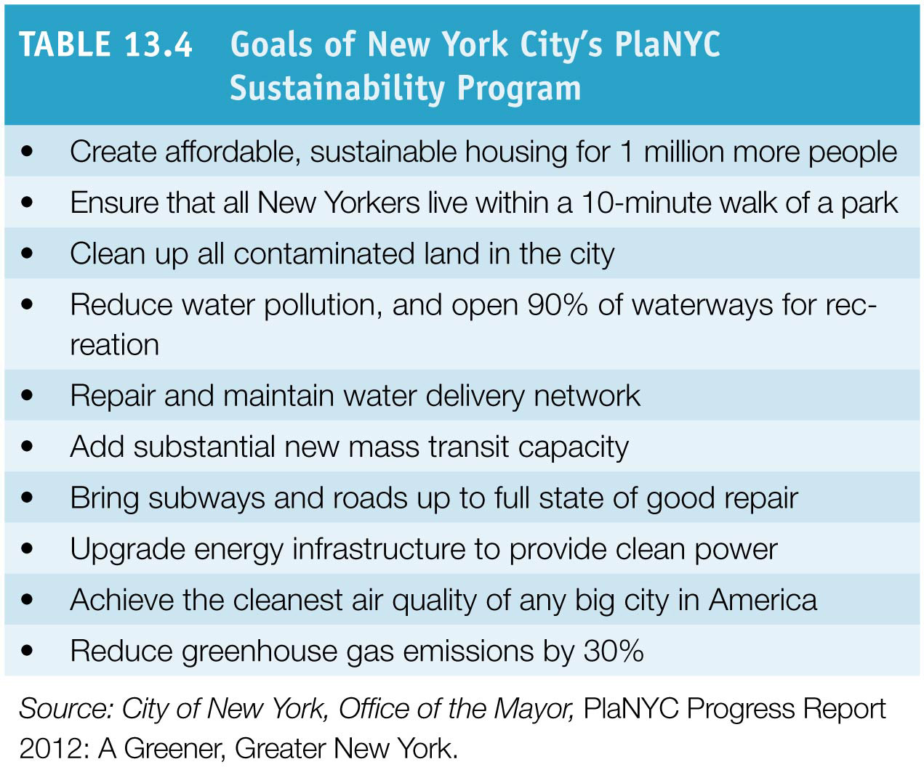

Slide 74
Steps toward livability enhance sustainability
Making cities more livable (pleasant, safe, clean, healthy) helps make them more sustainable
Planning and zoning are long-term, powerful sources for sustaining urban communities
They project farther into the future than most political leaders
Smart growth and new urbanism reduce energy use
Mass transit reduces gasoline use, carbon emissions
Because urban centers affect the environment in many positive ways, they are a key element toward global sustainability

Slide 75
Conclusion
As half the human population has moved to urban lifestyles, our environmental impact has changed
Resources must be delivered over long distances
Innovation fostered by urban centers can help mitigate environmental impact
Urban sustainability makes urban areas better places to live
For example, expanding transportation options to relieve congestion
Park lands and green spaces prevent us from becoming isolated from nature
American cities are becoming more livable

Slide 76
QUESTION: Review
As cities grew through immigration and trade, people responded by
moving to suburbs.
moving to rural areas.
developing inner cities.
decentralizing city management.
Notes:
Answer: a

Slide 77
QUESTION: Review
What happens during urban sprawl?
Increased resources are extracted from rural areas.
Inner cities become more “livable.”
People move outward, away from an urban center.
High-density development occurs in rural areas.
Notes:
Answer: c

Slide 78
QUESTION: Review
Which of the following is NOT something that is wrong with sprawl?
People are forced to use mass transit.
Pollution increases in the area.
People become inactive and less healthy.
There are fewer forests, farmlands, and ranchlands.
Notes:
Answer: a

Slide 79
QUESTION: Review
In new urbanism,
architects try to envision what a city could look like.
families still use their cars for going to jobs, but not shopping.
neighborhoods are designed on a walkable scale.
jobs are created through expanding suburbs.
Notes:
Answer: c

Slide 80
QUESTION: Review
Increased use of mass transportation
is not a viable option for U.S. cities.
can be implemented only in wealthier cities.
reduces traffic jams and pollution.
is more expensive and dirtier, but makes people feel good.
Notes:
Answer: c

Slide 81
QUESTION: Review
Why does urbanization make protection of natural lands important?
People in cities lose their connection with nature.
Natural processes must be protected.
People want to escape the stress and noise of city life.
All of the above.
Notes:
Answer: d

Slide 82
QUESTION: Review
A sustainable city is one that
must import resources from far away.
functions effectively and prosperously over the long term.
relies on large expanses of land for ecosystem services.
is less safe, but cleaner.
Notes:
Answer: b

Slide 83
QUESTION: Viewpoints
Imagine you live next to a 10-acre parcel of forested land that the owner wants to develop into a shopping mall. How would you feel?
Fine; it’s the person’s right to develop the land as he or she wants.
I would not like it, but it’s the person’s right to develop the land.
The city should buy the property to put in a park.
I would try to buy the property and post large “Keep Out” signs.
Notes:
Answer: any

Slide 84
QUESTION: Viewpoints
Do you want your university to become more sustainable (e.g., increased recycling, LEEDS certification, etc.)?
Absolutely, even if it slightly increased my costs.
Yes, but only if it didn’t affect my costs.
No; this is a temporary phase and not worth the cost.
I’m not sure; it really does not affect me.
Notes:
Answer: any

Slide 85
QUESTION: Interpreting Graphs and Data
What are the projections for the future of less developed nations?
Only urban areas will increase.
Only rural areas will increase.
Urban and rural areas will increase.
Urban and rural areas will decrease.
Notes:
Answer: a

Slide 86
QUESTION: Interpreting Graphs and Data
What can you say about transportation patterns in Portland based on this graph?
Automobile use has increased faster than rail use.
No one is taking the train.
Bus use has remained relatively stable over the last 10 years.
Light rail did not exist prior to 1998.
Notes:
Answer: c

