Slide 2
This lecture will help you understand:
Ecological and economic contributions of forests
History and scale of deforestation
Forest management and harvest methods
Major federal land management agencies
Types and design of protected areas

Slide 4
Central Case: Certified Sustainable Paper in Your Textbook
The paper in this book is made from trees sustainably grown, managed, harvested, and processed in Michigan
This does not deplete mature trees or degrade ecological functions
The mill recycles chemicals and paper and burns discarded lignin to help provide power
This paper is Forest Stewardship Council (FSC)-certified from sources that use sustainable practices
Every step in the manufacturing process must meet certain standards to receive certification

Slide 5
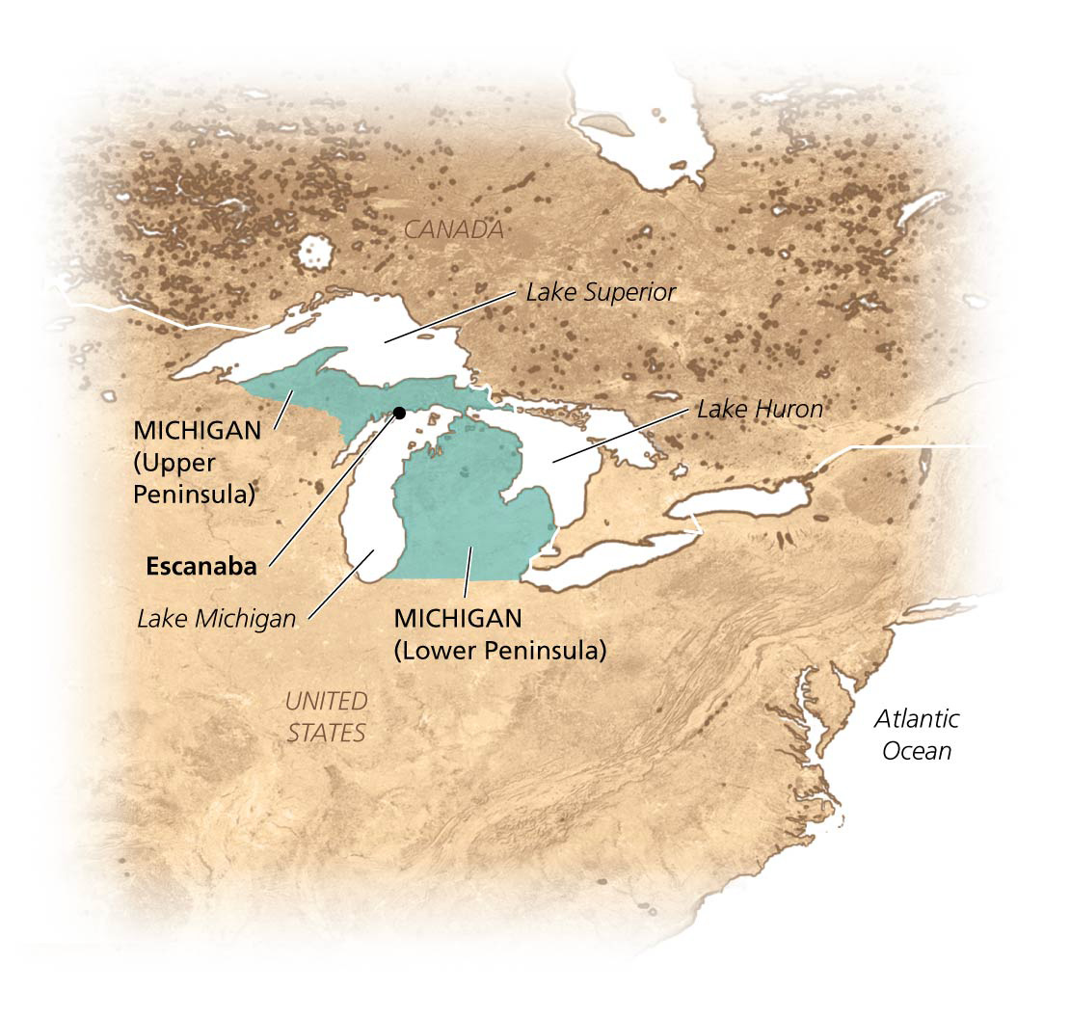

Slide 6
Forest Ecosystems and Forest Resources
Forest = any ecosystem with a high density of trees
Provide habitat for organisms and help maintain the quality of soil, air, and water
Provide wood for fuel, construction, paper
Different biomes have different kinds of forest
Boreal forest in Canada, Scandinavia, and Russia
Tropical rainforest in South and Central America, Africa, Indonesia, and southeast Asia
Temperate deciduous forests, temperate rainforests, and tropical dry forests also exist

Slide 7
Many kinds of forests exist
Plant communities differ due to soil and climate
Forest types are defined by predominant tree species
The Eastern United States has 10 forest types
Spruce-fir, oak-hickory, longleaf-slash pine
The Western United States holds 13 forest types
Douglas fir, ponderosa pine, pinyon-juniper woodlands
Forests currently cover 31% of the Earth’s land surface

Slide 8
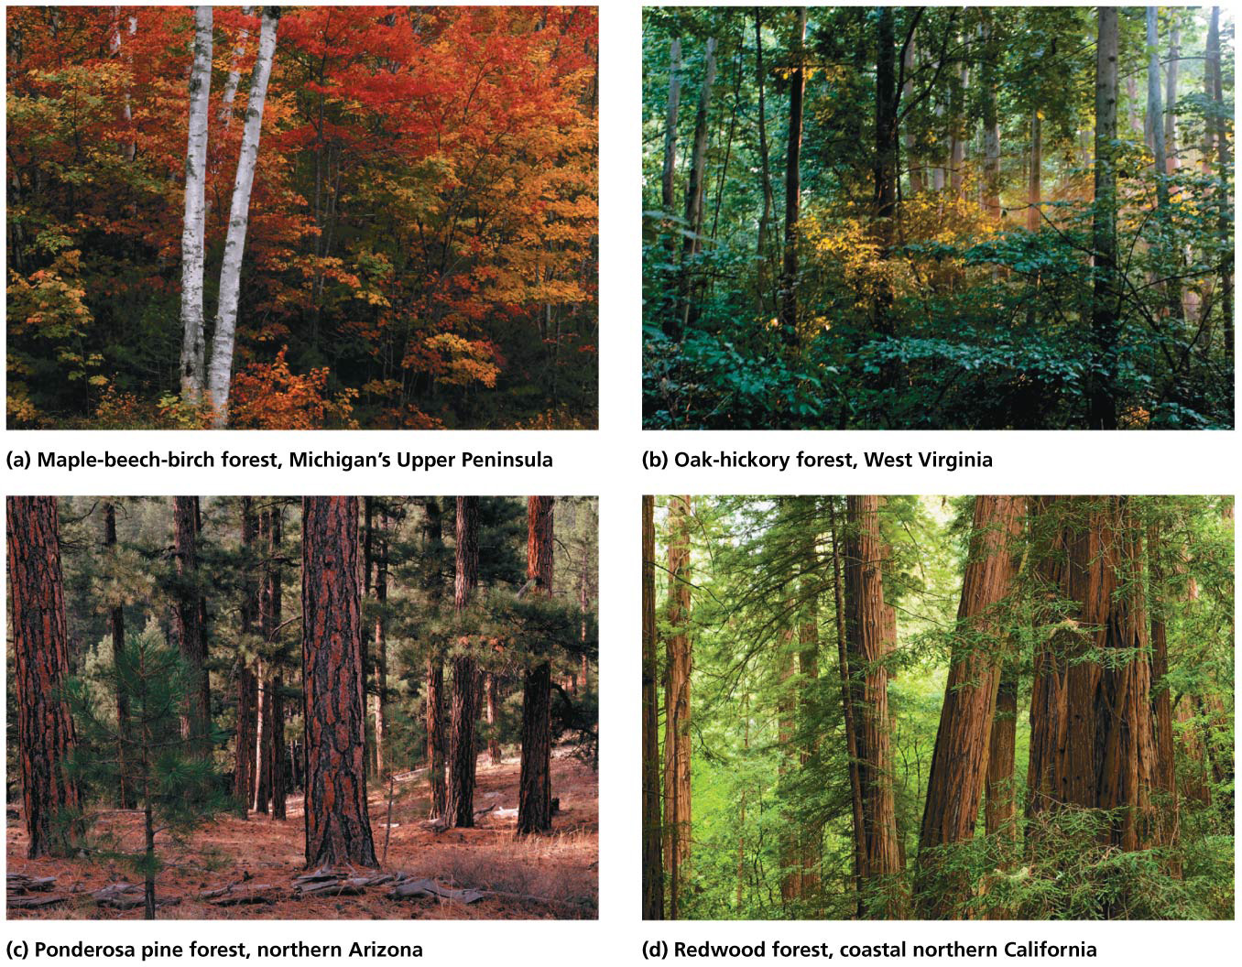

Slide 9
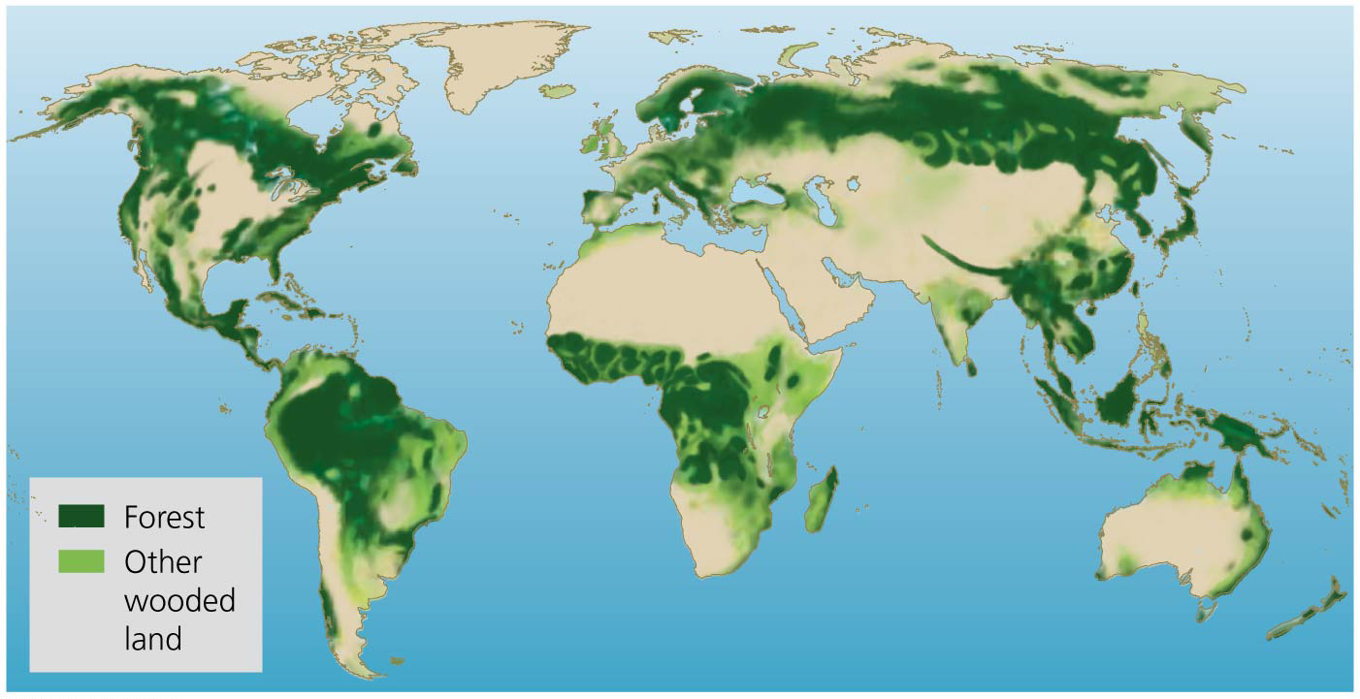

Slide 10
Forests are ecologically complex
Forests are some of the richest ecosystems for biodiversity
They are structurally complex, with many niches
They provide food and shelter for multitudes of species
Fungi and microbes have parasitic and mutualistic relationships with plants

Slide 11
Forests are ecologically complex
Canopy = upper level of trees and branches in the treetop
Subcanopy = the middle and lower portions of trees
Understory = shrubs, small trees, and plants on the forest floor
Plant diversity leads to greater overall organism diversity
Succession changes species composition
Old-growth forest diversity exceeds that of young forests

Slide 12
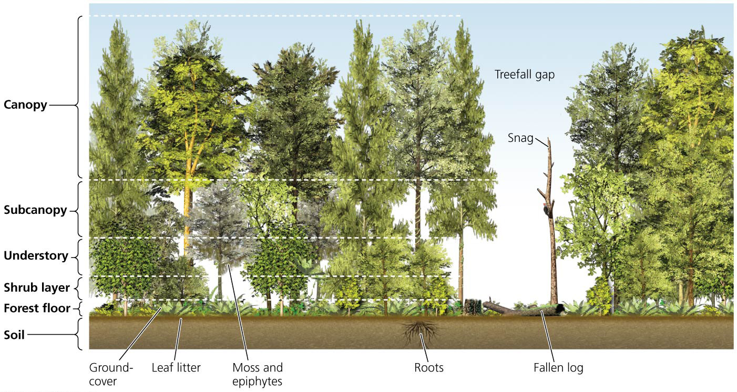

Slide 13
Forests provide ecosystem services
Forests provide vital ecosystem services
Stabilize soil and prevent erosion
Slow runoff, prevent flooding, purify water
Store carbon, release oxygen, influence weather patterns, and moderate climate
Roots draw minerals to surface soil layers where other plants can use them
Plants return organic material to the topsoil as litter
Forests provide cultural, aesthetic, health, and recreation values

Slide 14
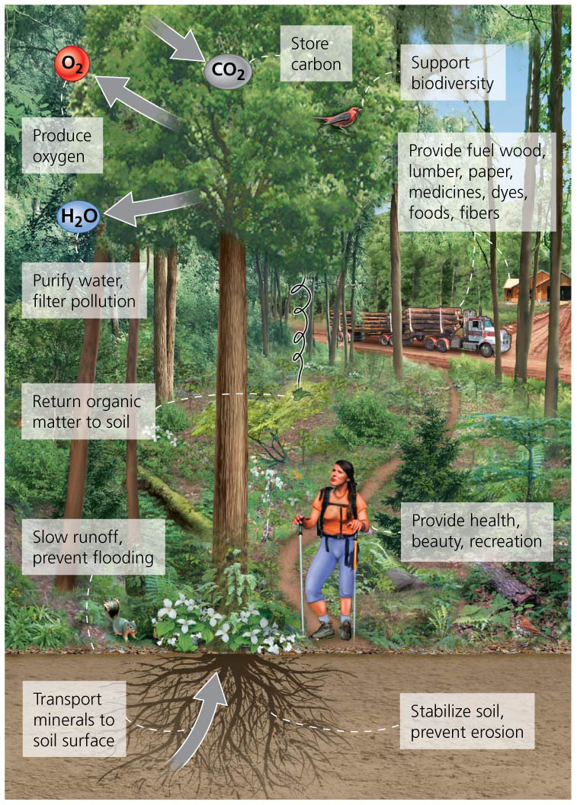

Slide 15
Carbon storage limits climate change
Carbon storage by forests is of great international interest
Nations debate how to control climate change
Trees absorb carbon dioxide and store carbon
The world’s forests store 280 billion metric tons of carbon
Cutting forests worsens climate change
Dead plants decompose and release carbon dioxide
Fewer trees soak up less carbon dioxide
Preserving forests keeps carbon out of the atmosphere

Slide 16
Forests provide us valuable resources
Forests provide many economically valuable resources
Plants for medicines, dyes, and fibers
Animals, plants, and mushrooms for food
Wood from trees: fuel, shelter, and paper
In 2010, 30% of all forests were designated primarily for timber production
Most commercial timber is extracted from
Boreal forests of Canada and Russia
Rainforests in countries such as Brazil and Indonesia
Pine plantations and conifer forests in the United States

Slide 17
Forest Loss
Deforestation = the clearing and loss of forests
When trees are removed faster than they can regrow
Our need for food and fibers has led to loss of forests
Forests are cleared for agricultural land
Trees are also cut for their wood and to make paper
Clearing forests has had negative consequences
Reduces biodiversity and increases soil degradation
Worsens climate change
Although the rate of deforestation is slowing, we still lose 13 million hectares (32 million acres) per year

Slide 18
We deforested much of North America
Deforestation propelled the expansion and growth of the United States and Canada
Eastern deciduous forests were the first to be logged
Timber companies moved south to the Ozarks, west to the Rockies
Primary forest = natural forest uncut by people
Little remained by the 20th century
Second-growth trees = trees grown to partial maturity after old-growth timber has been cut
Secondary forest = contains second-growth trees
Smaller trees, very different species and structure

Slide 20
Forests are being cleared most rapidly in developing nations
Uncut tropical forests still remain in many developing countries (Brazil, Indonesia, and West Africa)
Technology allows for even faster exploitation
Brazil had the highest rate of deforestation of any country
Government subsidized clearing of forests for cattle and soybean farming for export
Established the Forest Code, which substantially slowed the rate of deforestation
Developing countries are often so desperate for economic development that they have few logging restrictions

Slide 21
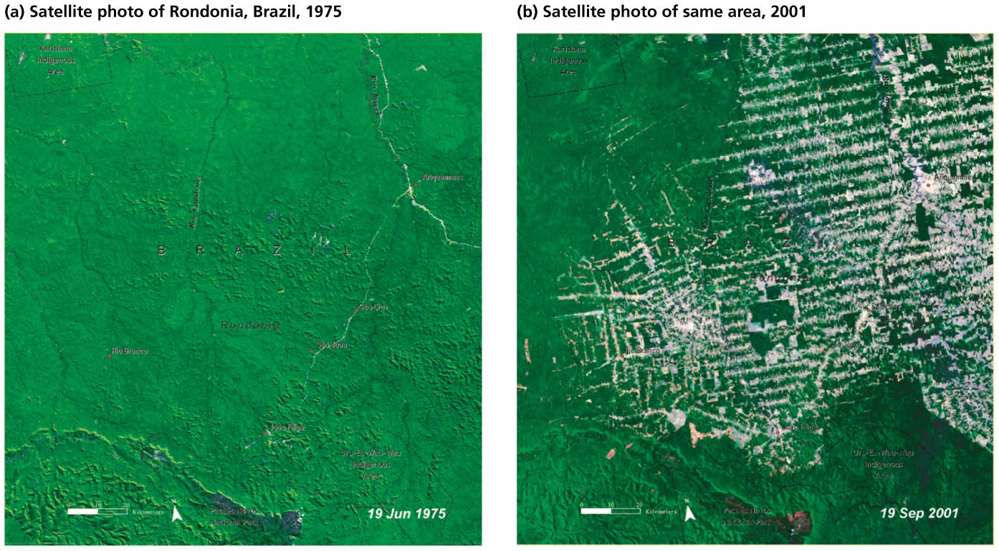

Slide 22
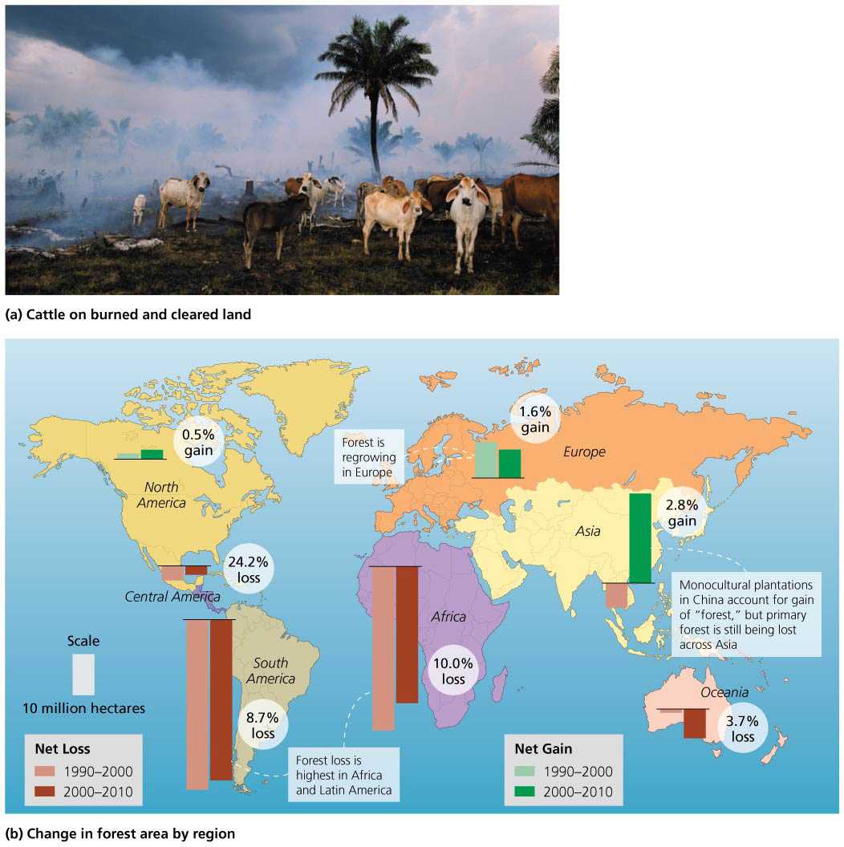

Slide 23
Forests are being cleared most rapidly in developing nations
Concession = corporations pay the government for the right to extract resources
Corporations have no incentive to manage the forest sustainably
Temporary jobs and forest resources are soon lost
Wood is exported to North America and Europe
In Indonesia, forest is cut for palm oil plantations
Palm oil is used in snack foods, soaps, cosmetics, biofuel
Clearing encourages further development and illegal logging

Slide 24
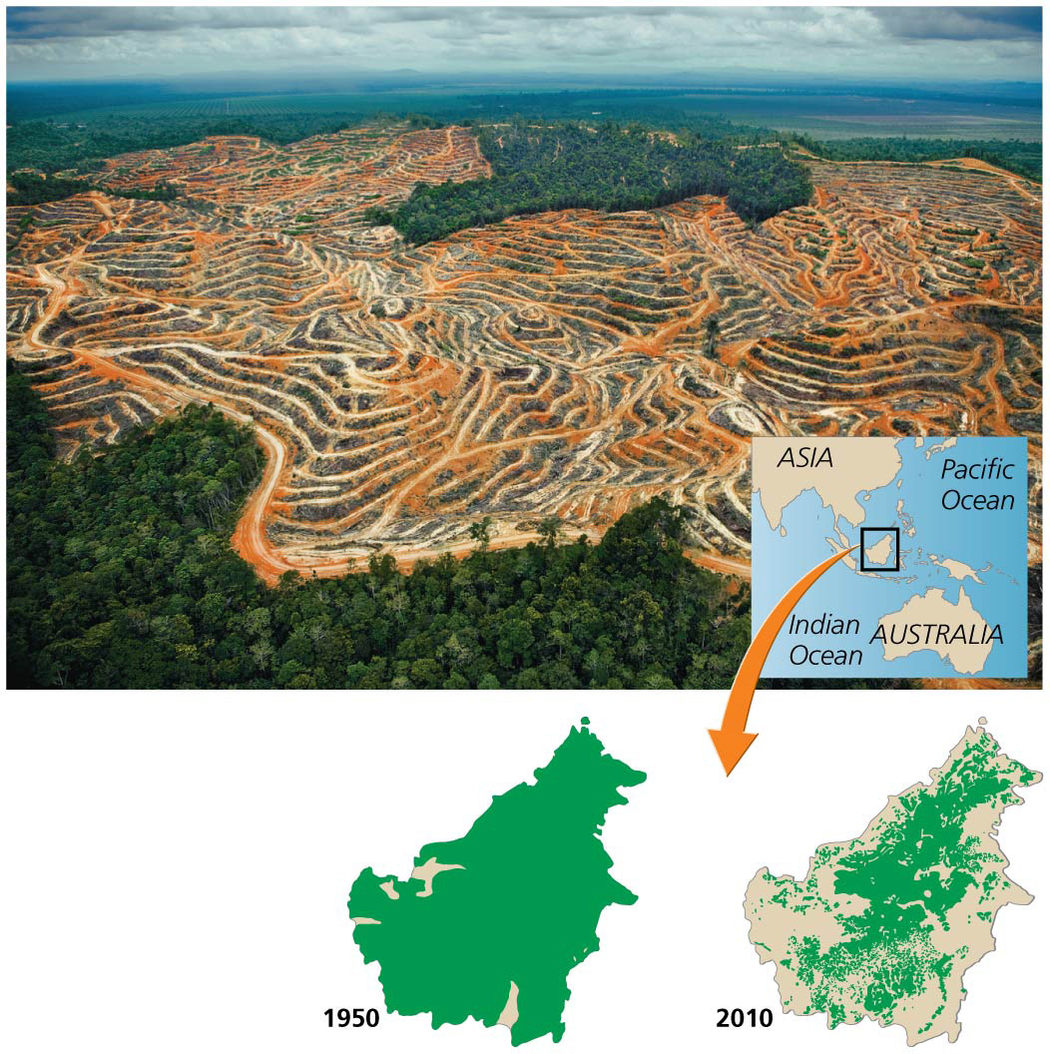

Slide 25
Solutions are emerging
Conservation concessions = organizations buy rights to forests to keep them intact rather than deforest them
Conservation International paid Surinam $15 million and almost all deforestation in the country has stopped
Carbon offsets curb deforestation and climate change
Forest loss causes at least 12% of the world’s greenhouse gas emissions
The Kyoto Protocol does not address this

Slide 26
Solutions are emerging
REDD = Reducing Emissions from Deforestation and Forest Degradation
Wealthy nations would pay poor nations to conserve forests to prevent/store greenhouse gas emission to offset their own carbon emissions

Slide 27
Solutions are emerging
The REDD plan has not been formally agreed to
But the industrialized nations have pledged $100 billion/year going to poor nations, some of which may go toward REDD
Guyana is taking a leading role in REDD
It is poor financially but rich in forests
Cutting forests would provide $580 million/year
Norway will pay and up to $250 million by 2015 if Guyana reduces forest loss

Slide 28
Forest Management
Forestry = forest management
Sustainable forest management is spreading
Foresters = professional managers who must balance demand for forest products (short-term benefits) vs. the importance of forests as ecosystems (long term)
Resource management = strategies to manage and regulate potentially renewable resources
Sustainable management does not deplete resources
Managers are influenced by social, political, and economic factors

Slide 29
Resource managers follow several strategies
Maximum sustainable yield = aims to achieve the maximum amount of resource extraction without depleting the resource from one harvest to the next
Populations grow fastest at an intermediate size
Population size is kept at half its carrying capacity
This approach will have ecological side effects
Reduced population size will impact predators on the species or prey of the species
Harvesting timber when trees have completed their fastest growth means forests without large trees

Slide 30
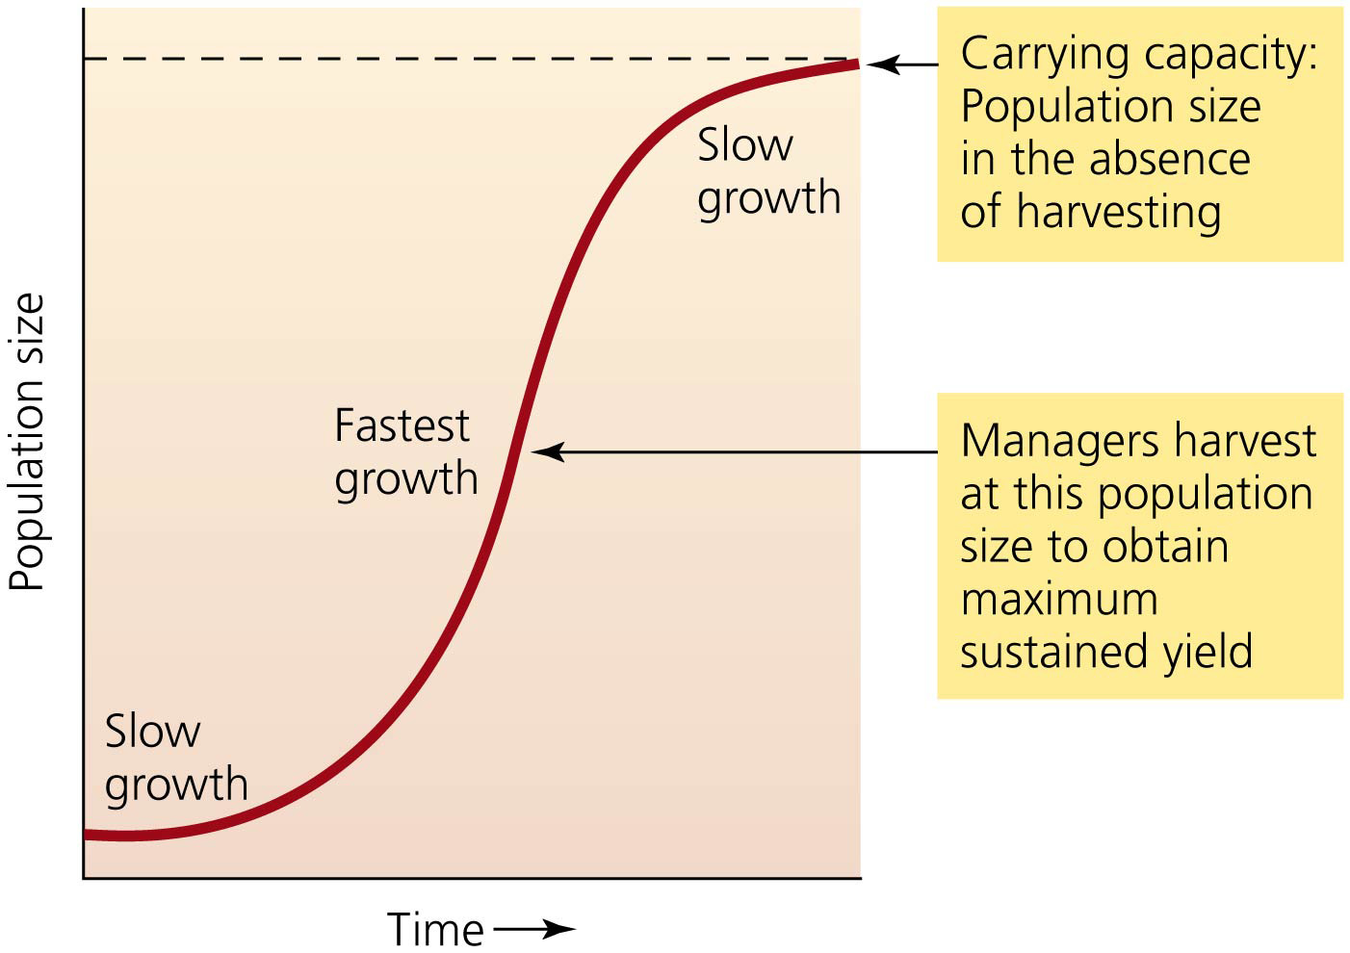

Slide 31
Ecosystem-based management
Ecosystem-based management = managing resource harvesting to minimize impacts on ecosystems and ecological processes
Sustainably certified forestry plans protect areas
Restore ecologically important habitats
Consider patterns at the landscape level
Preserve the forest’s functional integrity
It is challenging to implement this type of management
Ecosystems are complex
Different managers may have different ideas

Slide 32
Adaptive management
Adaptive management = testing different approaches and aiming to improve methods through time
Monitoring results and adjusting methods as needed
Time-consuming and complicated, but effective
The 1994 Northwest Forest Plan resolved disputes between loggers and preservationists over the last U.S. old-growth temperate rainforests
The plan let science guide management
It allowed limited logging while protecting species and ecosystems

Slide 33
Fear of a “timber famine” spurred forest protection
Depletion of eastern U.S. forests caused alarm
National forest system = public lands set aside to grow trees, produce timber, protect watersheds, and ensure future timber supplies
77 million ha (191 million acres)—8% of U.S. land area
The U.S. Forest Service was established in 1905
Manages forests for the greatest good of the greatest number in the long run
Management includes logging and replanting trees

Slide 34
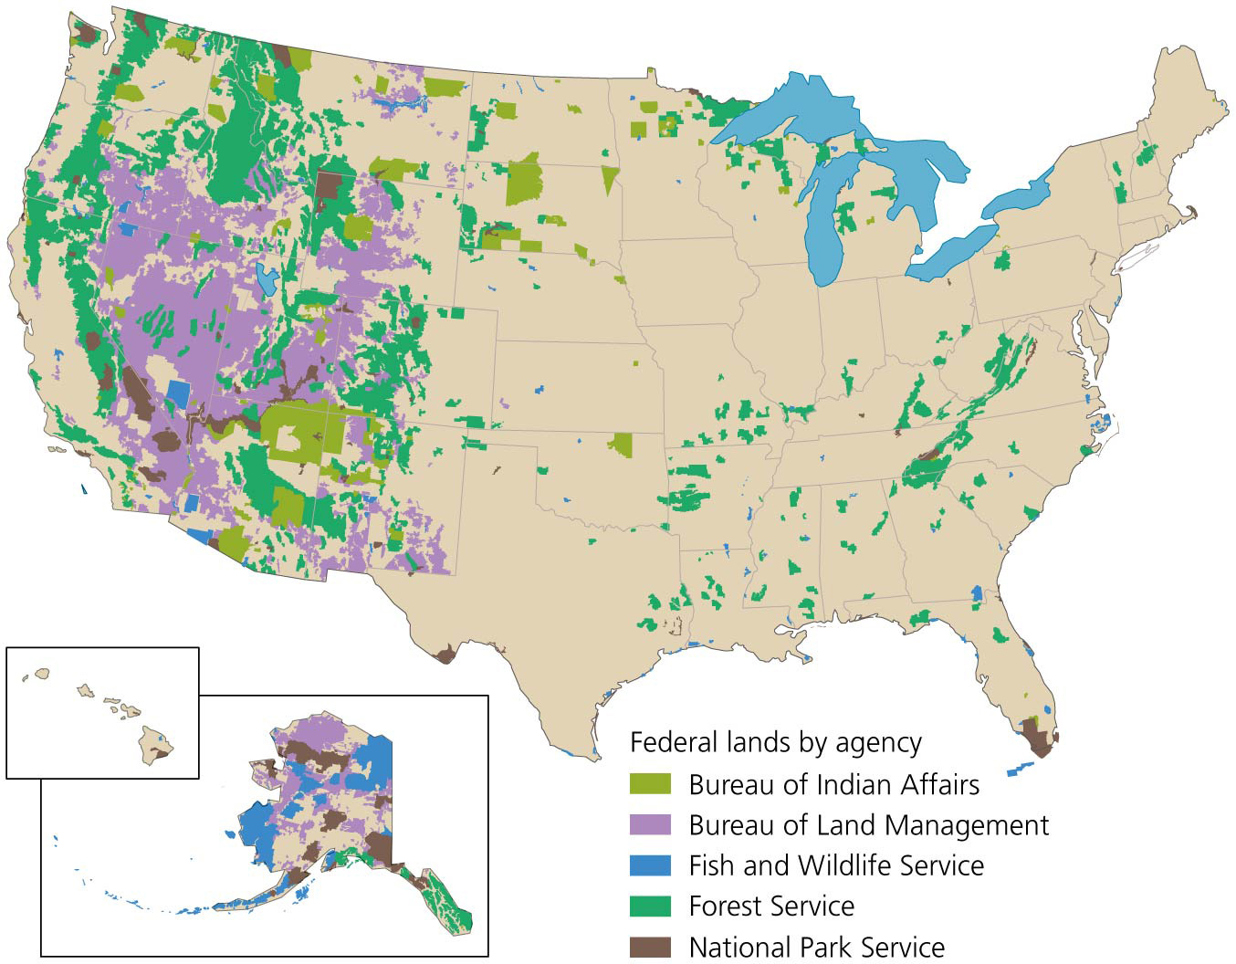

Slide 35
We extract timber from private and public lands
Most U.S. logging occurs on private land owned by timber companies or small landowners
Private companies also extract timber from public land
The Forest Service plans and manages timber sales and builds roads
They sell the timber for less than their costs
Private companies log and sell the timber for profit
Taxpayers subsidize private timber harvesting on public land

Slide 36
We extract timber from public and private lands
Timber harvesting in the United States and other developed nations has remained stable for the last 45 years
Companies logging on private land use the maximum sustainable yield approach

Slide 37
We extract timber from public and private lands
Management on public lands reflects social and political factors that change over time
Public concern, changing management philosophies, and economics caused harvests to decrease starting in the 1980s
By 2006, regrowth outpaced removal 11:1
But the secondary forests that replace primary forests are less ecologically valuable

Slide 38
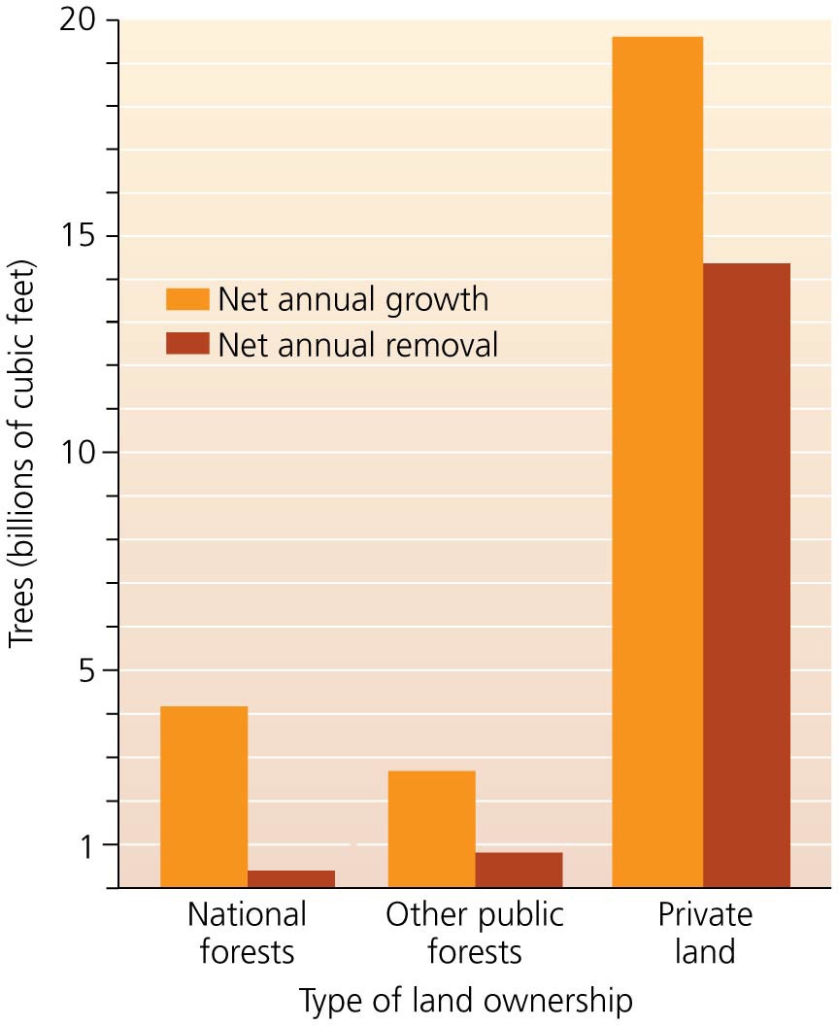

Slide 39
Plantation forestry has grown
The timber industry focuses on timber plantations
Fast-growing, single-species monocultures
Even-aged stands = all trees are the same age
Rotation time = trees are cut after a certain time
The land is replanted
7% of the worlds forests are plantations
Plantations are more like crops than forests
They lack diversity of species and structure
They do not offer habitat to many forest organisms
Uneven-aged stands = mixed ages of trees and in some cases species

Slide 40
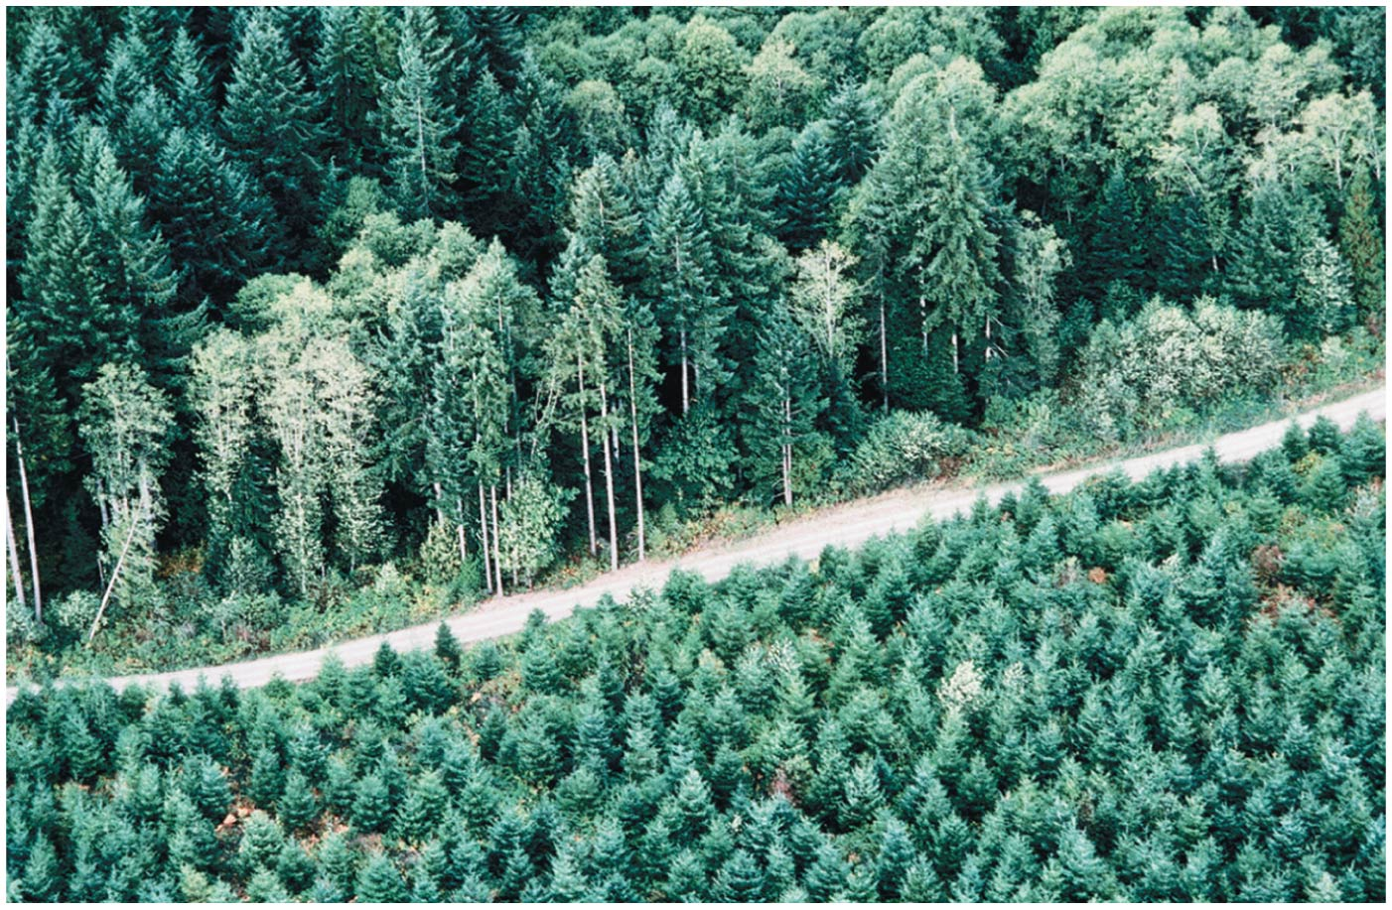

Slide 41
We harvest timber by several methods
Clear-cutting = all trees in the area are cut
Most cost-efficient
Greatest ecological impact
May mimic some natural disturbance (e.g., storms)
Leads to soil erosion
Resulting climax community may be different
Most widely used harvesting method
But concerns have caused companies to use other harvesting methods

Slide 42
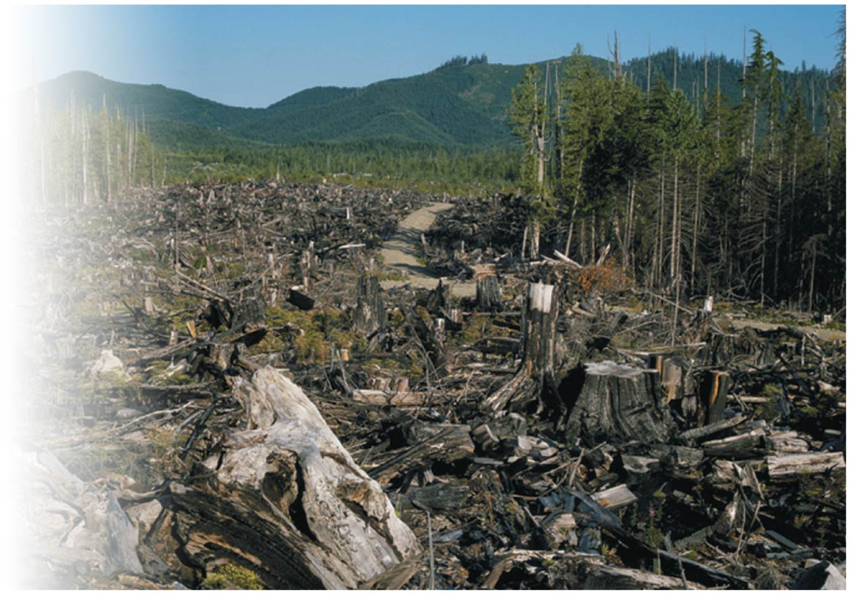

Slide 43
We harvest timber by several methods
Seed-tree approach = a few seed-producing trees are left standing to reseed the logged area
Shelterwood approach = some trees are left to provide shelter for the seedlings as they grow
Selection systems = only select trees are cut
Single-tree selection = widely spaced trees are cut
Group tree selection = small patches of trees are cut
Results in uneven aged stands

Slide 44
We harvest timber by several methods
All methods disturb habitat and affect species
Change forest structure and composition
Increased runoff, flooding, erosion, siltation, landslides

Slide 45
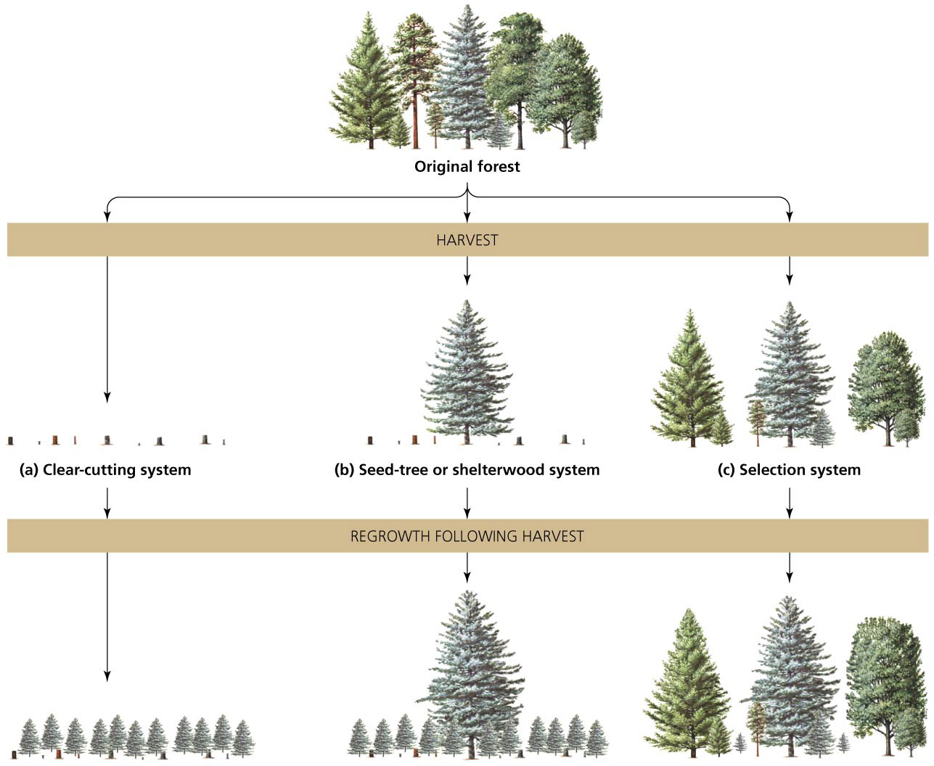

Slide 46
Forest management has evolved over time
Multiple use = policy that national forests are to be managed for recreation, habitat, minerals, and other uses
In reality, timber production was the primary use
Increased public awareness caused people to urge that forests be managed for recreation, wildlife, and ecosystem integrity, instead of only for logging

Slide 47
Forest management has evolved over time
National Forest Management Act, passed by Congress in 1976, mandated that every national forest formulate plans for renewable resource management based on:
Multiple use
Maximum sustainable yield
Public input

Slide 48
Forest management has evolved over time
Plans written under the National Forest Management Act must:
Consider both economic and environmental factors
Provide for and protect regional diversity
Ensure research and monitoring of management
Permit only sustainable harvest levels
Ensure that profit alone does not guide harvest method
Protect soils and wetlands
Assess all impacts before logging to protect resources

Slide 49
Forest management has evolved over time
U.S. Forest Service programs:
Manage wildlife, non-game animals, endangered species
Push for ecosystem-based management
Run programs for ecological restoration

Slide 50
Forest management has evolved over time
New forestry = approaches calling for timber cuts that mimic natural events
Sloppy clear-cuts mimic windstorms
President Clinton issued an executive order in 2001 known as the roadless rule, which protected 31% of national forests from logging
Had strong public support

Slide 51
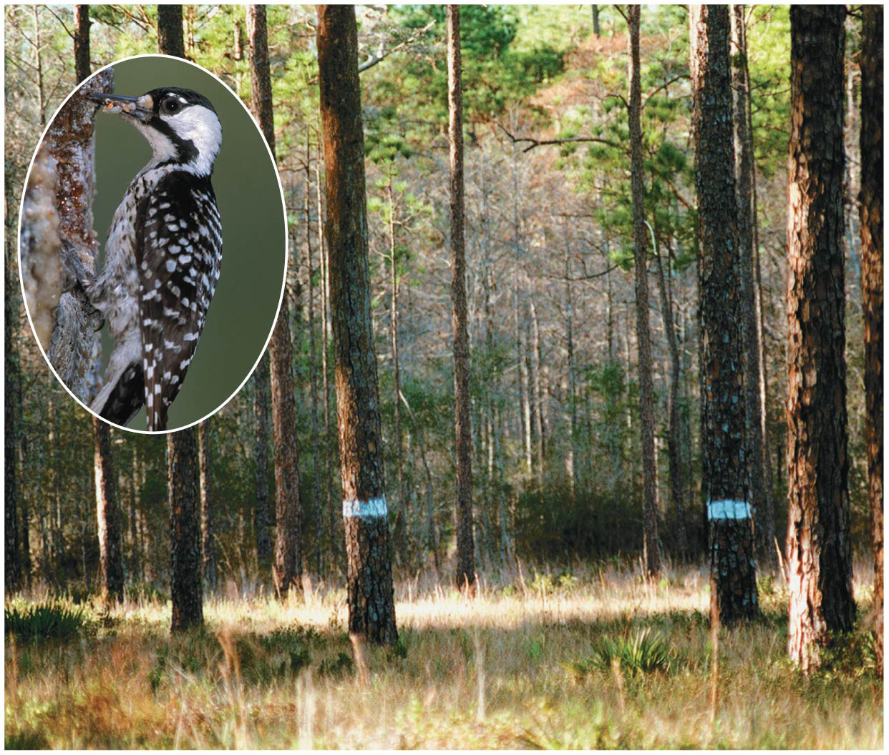

Slide 52
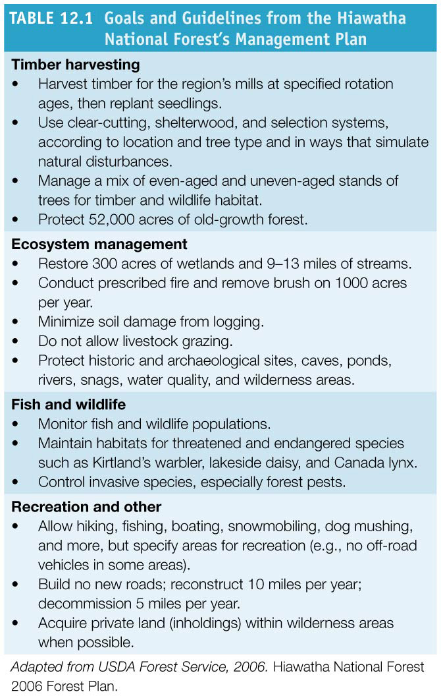

Slide 53
Forest management has evolved over time
The Bush administration rolled back regulations in 2004
Freed managers from requirements of the National Forest Management Act
Loosened environmental protections and public oversite
Repealed President Clinton’s roadless rule
States were to decide how their national forests would be managed
The Obama administration reinstated most of the roadless rule policies

Slide 54
Fire can hurt or help forests
For over 100 years, the Forest Service suppressed all fires
Research shows that many ecosystems depend on fires
Grasslands and pine woodlands burned frequently
Lack of fire decreases animal diversity and abundance

Slide 55
Fire can hurt or help forests
Fire suppression leads to occasional catastrophic fires
Excess vegetation produces kindling for future fires
Severe fires have become more numerous
In the wildland-urban interface, housing developments that are near forests are vulnerable to forest fires
Increased residential development has placed more homes in danger

Slide 56
Fire can hurt or help forests
Prescribed (controlled) burns = burning areas of forests under carefully controlled conditions to clear away fuel loads, nourish soil, encourage growth of new vegetation
Are time-intensive and impeded by public misunderstanding and political interference

Slide 57
Fire can hurt or help forests
Healthy Forests Restoration Act (2003) promotes salvage logging = removal of small trees, underbrush, and dead trees by timber companies after a disturbance. However:
Snags (standing dead trees) provide nesting and roosting cavities for countless animals
Removing timber from recently burned areas increases erosion and soil damage

Slide 58
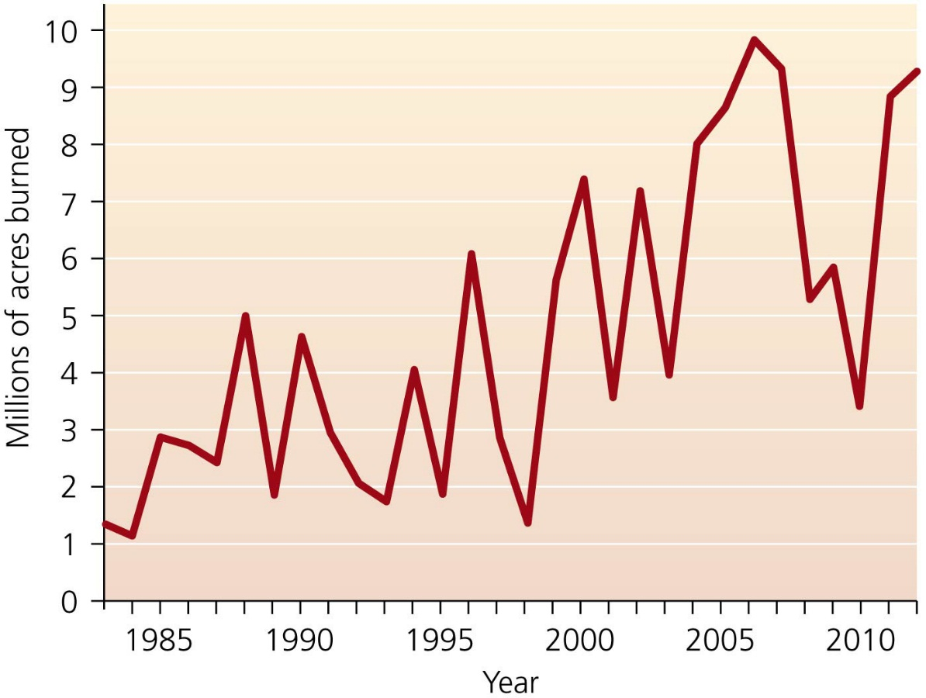
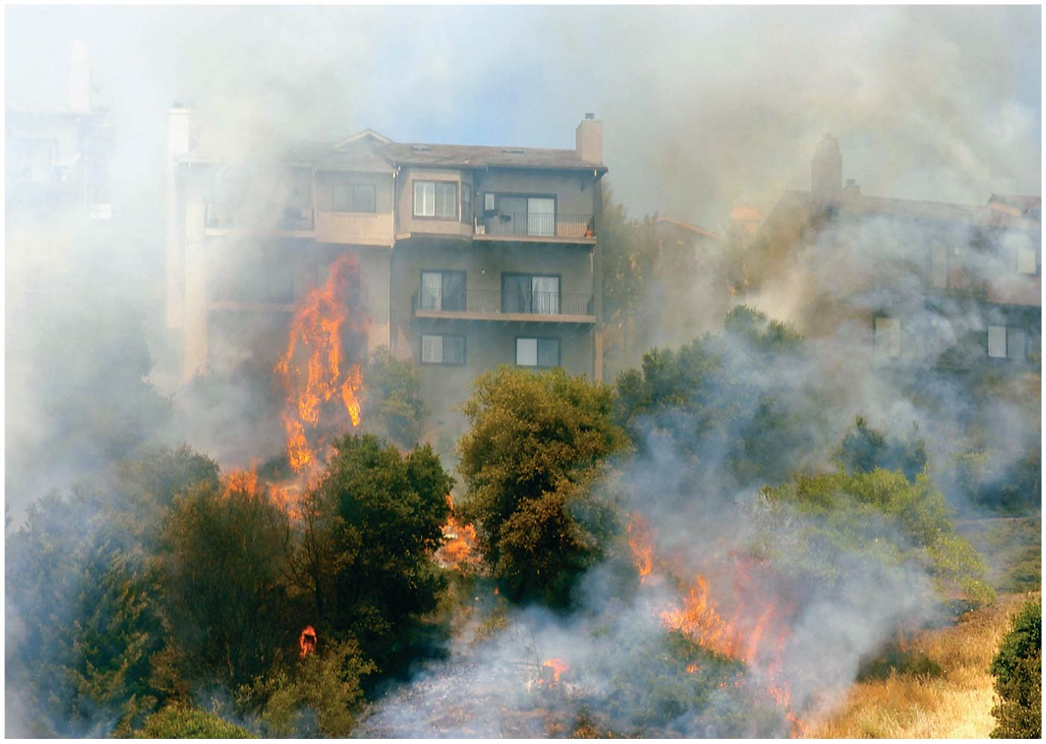

Slide 59
Climate change and pest outbreaks are altering forests
North America is warming and the American West is getting drier
Climate models predict this to continue
Changed climate is resulting in more fires
Climate change is promoting pest outbreaks (particularly bark beetles) that kill huge areas of trees
Milder winters allow more successful overwintering
Even-aged forests of single species are prime targets
Dead trees do not remove carbon dioxide, intensifying climate change
Woodlands, shrublands, or grasslands may replace forests

Slide 60
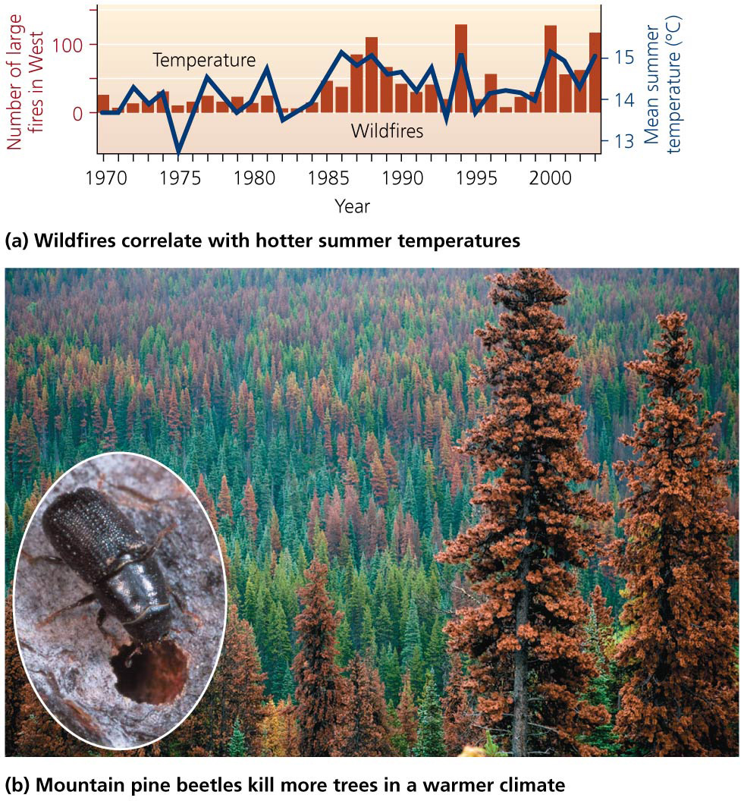

Slide 61
Sustainable forestry is gaining ground
The world is still losing forested land, but advances are being made toward sustainable forestry
Sustainable forest certification = products produced sustainably can be certified by organizations
The Forest Stewardship Council (FSC) has the strictest standards
Companies such as Home Depot sell sustainable wood, encouraging better logging practices
Construction of green buildings and consumers looking for logos to buy sustainably produced timber are influencing timber harvesting practices
Certification standards need to be kept strong

Slide 62
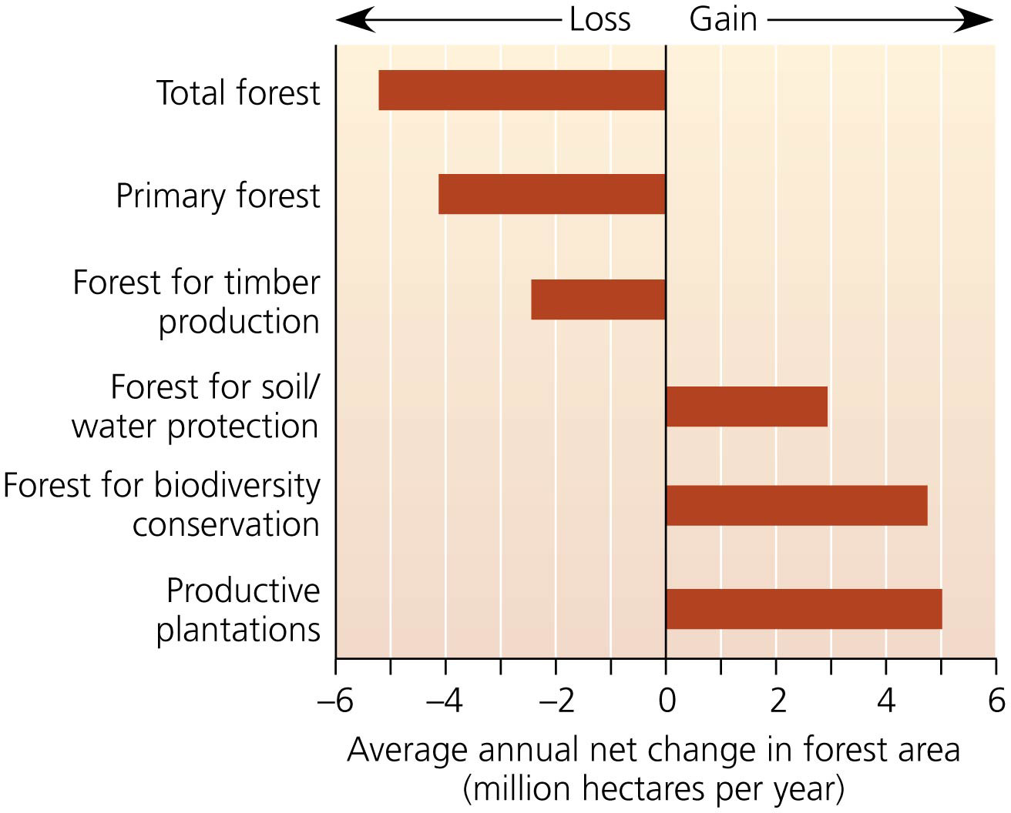

Slide 63
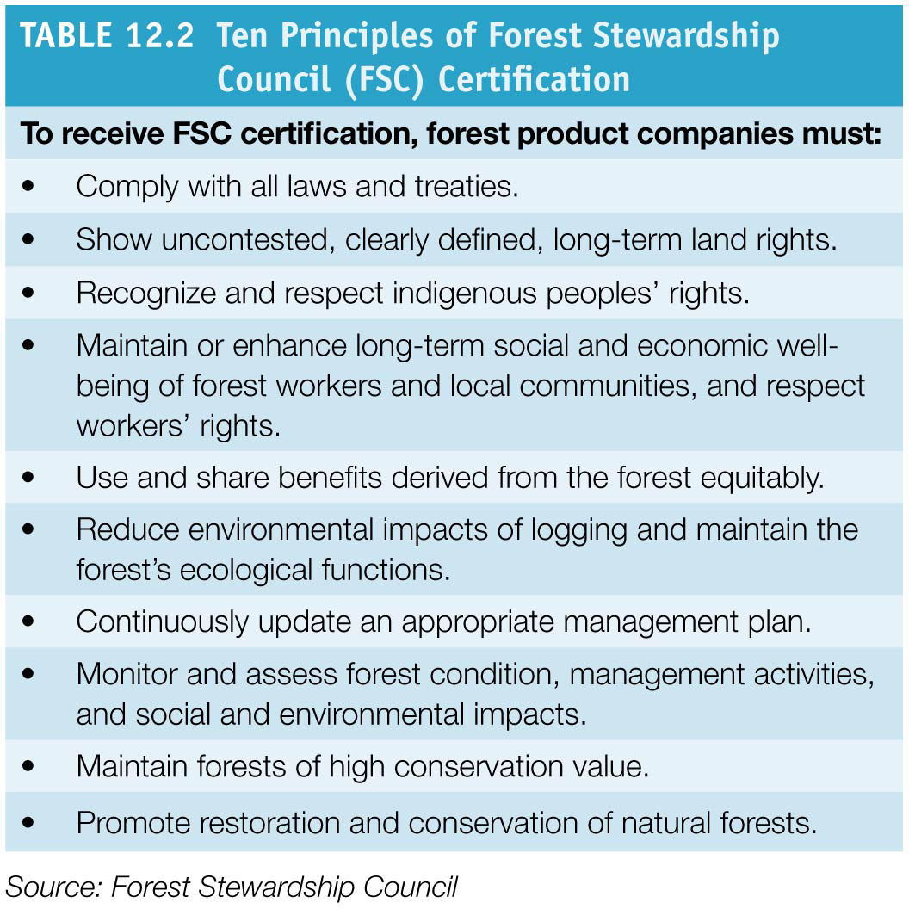

Slide 64
Parks and Protected Areas
12.7% of the world’s land area is designated for preservation
People establish parks and reserves to:
Preserve areas with enormous or unusual scenic features, such as the Grand Canyon
Offer recreational value: hiking, fishing, hunting, etc.
Generate revenue from ecotourism
Offer peace of mind, health, exploration, wonder, etc.
Protect areas that provide ecosystem services
Preserve biodiversity

Slide 65
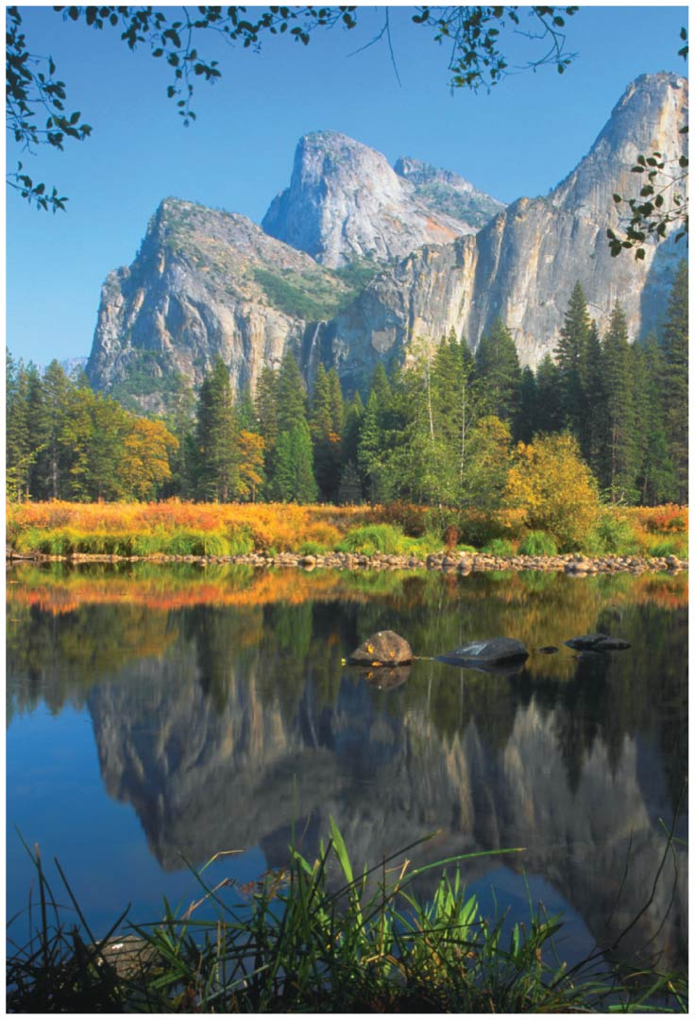

Slide 66
Federal parks and reserves began in the United States
National parks = public lands protected from resource extraction and development
Open to nature appreciation and recreation
Yellowstone National Park was established in 1872
The Antiquities Act (1906) lets the president declare public lands as national monuments, which may later become national parks

Slide 67
Federal parks and reserves began in the United States
The National Park Service was created in 1916 to administer parks and monuments
401 sites totaling 34 million ha (84 million acres)
280 million recreation visits per year
These parks are “the best idea we ever had”

Slide 68
Federal parks and reserves began in the United States
The national wildlife refuge system was begun in 1903 by President Theodore Roosevelt
39 million ha (96 million acres) in 560 sites
The Pacific Remote Islands Marine National Monument added 22 million ha (55 million acres)
U.S. Fish and Wildlife Service (USFWS)
Administers wildlife refuges, serving as havens, but allows hunting, fishing, wildlife observation, photography, education
Managed for waterfowl and non-game species
Restores marshes and grasslands

Slide 69
Wilderness areas are established on federal lands
U.S. Congress passed the Wilderness Act in 1964 creating wilderness areas = areas off-limits to development to assure that some areas were protected in their natural condition
Open only to hiking, nature study, and other low- impact activities
Grazing and mining were allowed if already happening as a political compromise
Established in federal lands
Overseen by the agencies that administer those areas
Over 750 areas, 44 million ha (110 million acres)

Slide 70
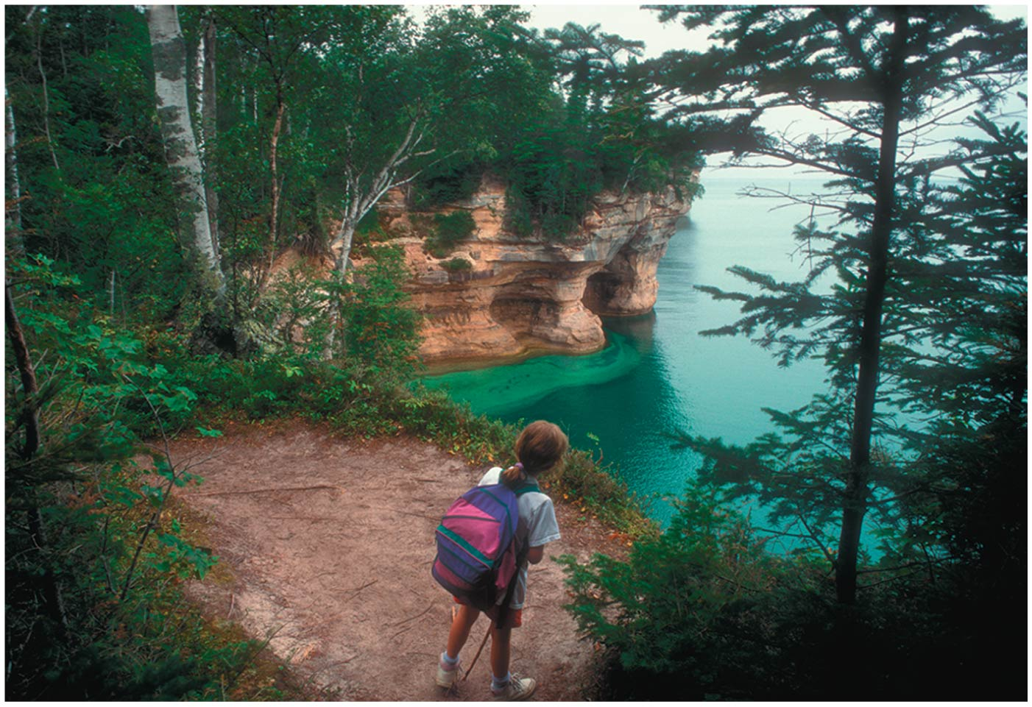

Slide 71
Not everyone supports land set-asides
Some western states want resource extraction and development on protected lands
Supported by industries that extract timber, minerals, fossil fuels, as well as farmers and ranchers
Privatization advocates and those making a living from the land have been driving policy debates, encouraging that:
Federal lands be transferred to state or private hands
Government regulation on extraction be weakened
Motorized recreation be allowed on public lands

Slide 72
Not everyone supports land set-asides
Indigenous people are often opposed to set-asides
Were forced off of the land
Receive no benefit from having the land protected

Slide 73
Many agencies and groups protect land
Each U.S. state has agencies that manage resources on public lands
There are nearly 7000 state parks in the U.S.
Also parks managed by counties and municipalities
Land trusts = local or regional organizations that purchase land to protect it
The Nature Conservancy is the world’s largest land trust
Trusts own 870,000 ha (2.1 million acres) and protect an additional 5.6 million ha (13.9 million acres)
Thousands of local volunteer groups care for protected land

Slide 74
Parks and reserves are increasing internationally
Many nations have established systems of protected areas
Benefit from ecotourism
Protected areas cover 12.7% of the world’s land area
Parks do not always receive necessary funding
Paper parks = areas protected on paper but not in reality

Slide 75
Parks and reserves are increasing internationally
Biosphere reserves = land with exceptional biodiversity
Couple preservation with sustainable development
Benefit local people who can make use of part of the reserve for agriculture and extractive use

Slide 76
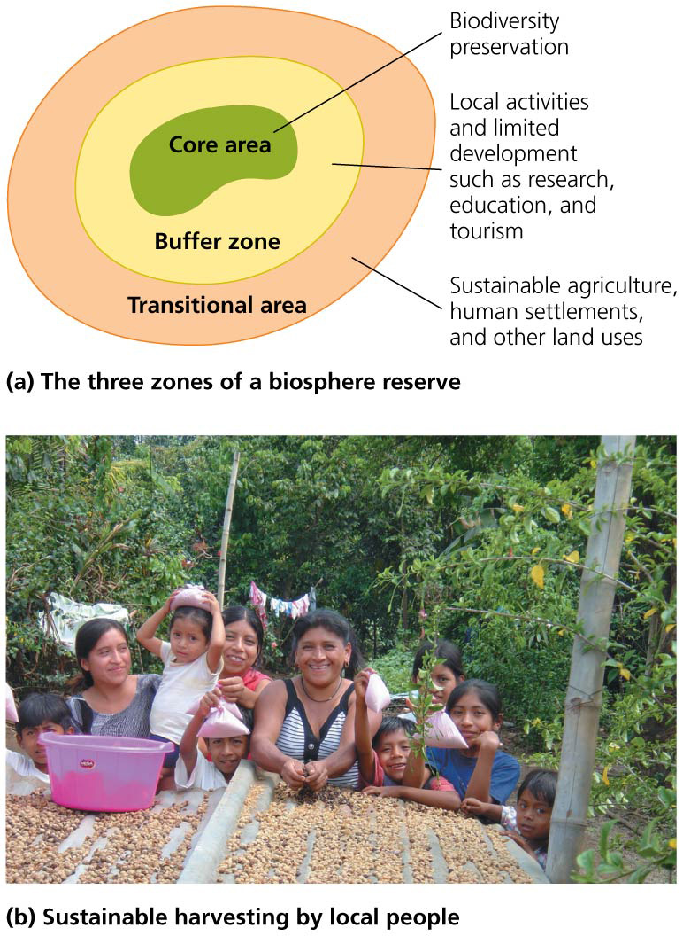

Slide 77
Parks and reserves are increasing internationally
World heritage sites = another type of international protected area valued for their natural or cultural value
Nearly 1000 sites in 150 countries are listed
Transboundary parks = overlap national borders
Over 100 nations, 10% of protected land

Slide 78
Parks and reserves are increasing internationally
Peace parks = transboundary parks that ease tensions by acting as buffers between quarreling nations
Peru and Equador, Costa Rica and Panama
It may work for Israel and its neighbors
Reserves in marine waters now protect 7.2% of coastal waters and 1.6% of the world’s ocean area

Slide 79
Economic incentives can help preserve land
Debt-for-nature swap = a conservation organization pays off a portion of a developing country’s international debt
In exchange, the country promises to:
Set aside reserves
Fund environmental education
Better manage protected areas
The Tropical Forest Conservation Act
As of 2011, deals for $400 million in debt payments went to 17 developing countries in exchange for conservation efforts

Slide 80
Habitat fragmentation makes preserves more vital
Logging, agriculture, and residential development chop up large habitats into small, disconnected ones
Fragments may not contain enough area to support some species
Edge effects = impacts that result because conditions along a fragment’s edge are different than conditions in the interior
Interior bird species can’t reproduce when forced near the edge of a fragment
Parasites and predators attack nests
Fragmentation is the main reason populations of North American songbirds are declining

Slide 81
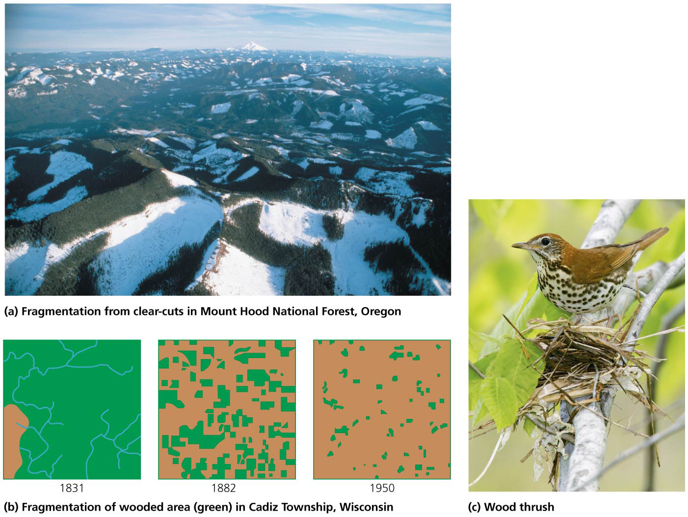

Slide 82
Insights from islands warn us of habitat fragmentation
Island biogeography theory = explains how species come to be distributed among oceanic islands
It also applies to “habitat islands” = patches of one habitat within “seas” of others

Slide 83
Insights from islands warn us of habitat fragmentation
The number of island species results from a balance between species added (immigration) versus species lost (extirpation)
Predicted by the island’s size and distance from the mainland
Distance effect = the farther an island is from the continent, the fewer species find and colonize it

Slide 84
Insights from islands warn us of habitat fragmentation
Area effect = large islands have more species than small island. There are multiple reasons:
Larger islands have higher immigration rates—they are fatter targets
Larger islands have lower extinction rates—more space allows for larger populations
They have more habitats, environments, and variety

Slide 85
Insights from islands warn us of habitat fragmentation
Species-area curves = show the relationship between the size of an island and the number of species it holds
Number of species doubles as island size increases 10x
Pattern holds in loss of mammals in U.S. national parks

Slide 86
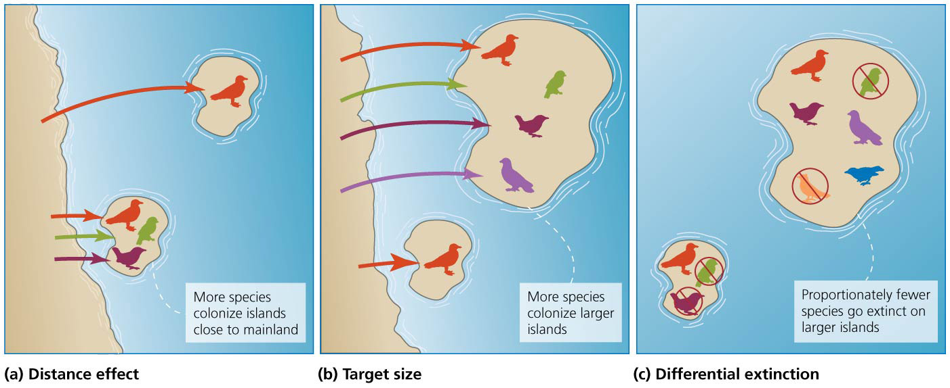

Slide 87
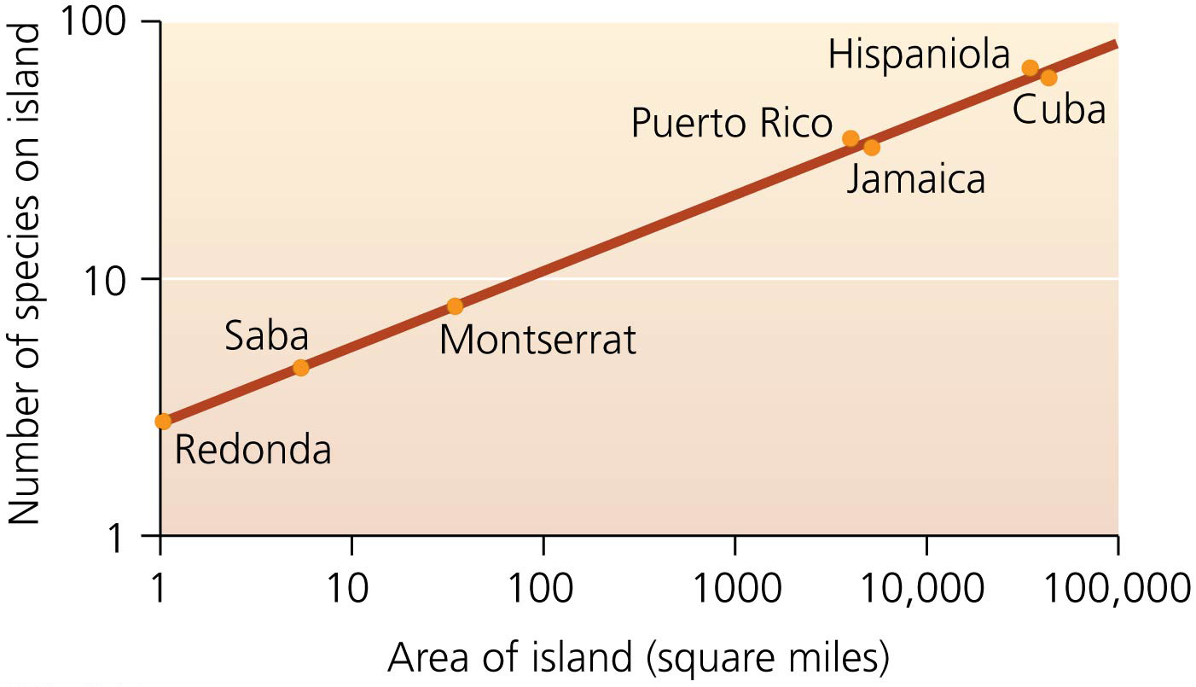

Slide 88
Reserve design has consequences for biodiversity
With habitat fragmentation, the size and placement of protected areas are key to protecting biodiversity
Limited amount of land can be set aside
The SLOSS dilemma = which is better to protect species: a single large or several small reserves?
Depends on the species: wildebeest vs. insects
Corridors = protected land that allows animals to travel between islands of habitat
Animals get more habitat
Enables gene flow between populations

Slide 89
Climate change threatens protected areas
Global climate change threatens to undo our efforts to design, establish, and guard protected areas
Species shift northward with warmer temperatures
Species can’t move in a fragmented habitat
High-elevation species are most at risk
To stay cool, they need to move higher
There is no place for them to go
Corridors to allow movement become very important
Preserving biodiversity must go beyond parks and protected areas

Slide 90
Conclusion
We are losing ecologically and environmentally valuable forests
Resource management policies first emphasized extraction and then shifted to sustained yield and multiple use
Sustainable forest certification provides economic incentives for responsible conservation of forests
Public support for land preservation resulted in parks and protected areas in the U.S. and abroad
Development fragments habitats and subdivides populations

Slide 91
QUESTION: Review
Erosion prevention, decreased flooding, and storing carbon are all _________ services that forests provide.
economic
hypothetical
ecosystem
minimal
Notes:
Answer: c

Slide 92
QUESTION: Review
Which of the following is NOT a result of deforestation?
Changes in landscape structure
Reduced biodiversity
Worsened climate change
All of these are results of deforestation.
Notes:
Answer: d

Slide 93
QUESTION: Review
If an area with 100 organisms is at its carrying capacity and is managed for maximum sustainable yield, how many organisms will be harvested from the area?
100
75
50
25
Notes:
Answer: c

Slide 94
QUESTION: Review
Tree harvesting by shelterwood cutting
cuts all trees in an area, leaving only stumps.
cuts most trees but leaves some to produce seeds.
cuts most trees but leaves some to shelter seedlings.
produces uneven-aged tree stands.
Notes:
Answer: c

Slide 95
QUESTION: Review
People create parks and reserves for many reasons. Which of the following is NOT a reason to protect land?
Preserve an area with scenic features
Protect areas that provide ecosystem services
Offer recreational opportunities
Maximize profit for the federal government
Notes:
Answer: d

Slide 96
QUESTION: Review
Which agency manages federally protected areas?
U.S. Fish and Wildlife Service
U.S. Forest Service
Bureau of Land Management
Any of these, depending on the federal land the wilderness is located within
Notes:
Answer: d

Slide 97
QUESTION: Review
Which areas are off-limits to all development?
National forests
National parks
Wilderness areas
Bureau of Land Management lands
Notes:
Answer: c

Slide 98
QUESTION: Review
Biosphere reserves are
picked and enforced by the U.N. without local approval.
areas with exceptional biodiversity.
heavily developed.
completely protected from all development.
Notes:
Answer: b

Slide 99
QUESTION: Review
According to the island biogeography theory, a large island close to the mainland will
have low rates of extinction.
have high rates of extinction.
have few species colonize it.
be without species, since most can’t make it to islands.
Notes:
Answer: a

Slide 100
QUESTION: Viewpoints
Some states manage their natural resources (e.g., forests) based strictly on profit maximization. Is this the best way to manage natural resources?
Yes. Anytime profit can be made, that should be the type of management used.
Yes, but only if more jobs are created than lost.
No. Natural resources are far more important than their economic value suggests.
I don’t care; I just want to be able to buy what I want.
Notes:
Answer: any

Slide 101
QUESTION: Viewpoints
Should a wilderness area be drilled for petroleum or natural gas, or mined for minerals?
Absolutely yes; we are in a crisis and need every resource we can get.
Maybe, if the resource results in jobs and income.
No. We need to preserve some nature—we can find alternatives ways of satisfying our needs.
No, but only if I can benefit from going there.
Notes:
Answer: any

Slide 102
QUESTION: Interpreting Graphs and Data
Which type of land ownership has the largest ratio of growth to removal?
National forests
Other public forests
Forest industry land
Private land
Notes:
Answer: a

Slide 103
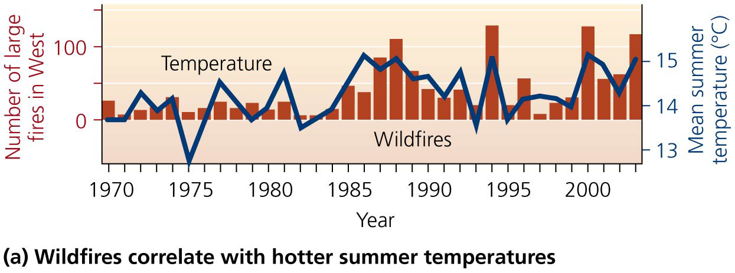
QUESTION: Interpreting Graphs and Data
What does this graph say about the incidence of large fires?
They have decreased.
They have increased recently.
They have nothing to do with temperature.
Cooler temperatures cause more fires.
Notes:
Answer: b

