Slide 2
This lecture will help you understand:
The scope of Earth’s biodiversity
Background extinction rates and mass extinctions
Causes of biodiversity loss
The benefits of biodiversity
Conservation biology
Conservation of species
Conservation above the species level

Slide 3
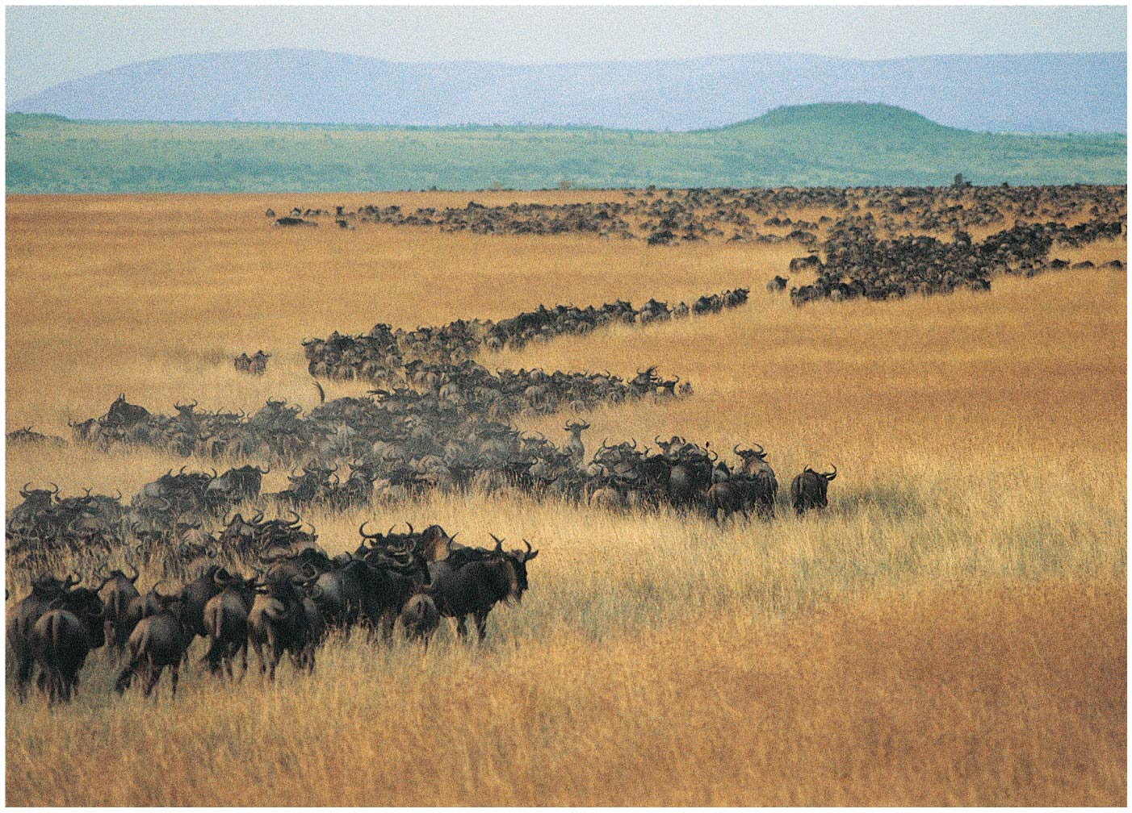

Slide 4
Central Case Study: Will We Slice Through the Serengeti?
The Serengeti is home to a yearly migration of over 2 million wildebeest, zebras, and antelope
The Serengeti park complex is 30,000 km² and has 800,000 visitors a year, bringing in almost $3 billion
Tanzania intends to build a highway across the Serengeti
Conservations fear that the highway will block the yearly migration and encourage poaching = illegal killing of wildlife for meat or body parts
International pressure has kept the road from being built—so far

Slide 5
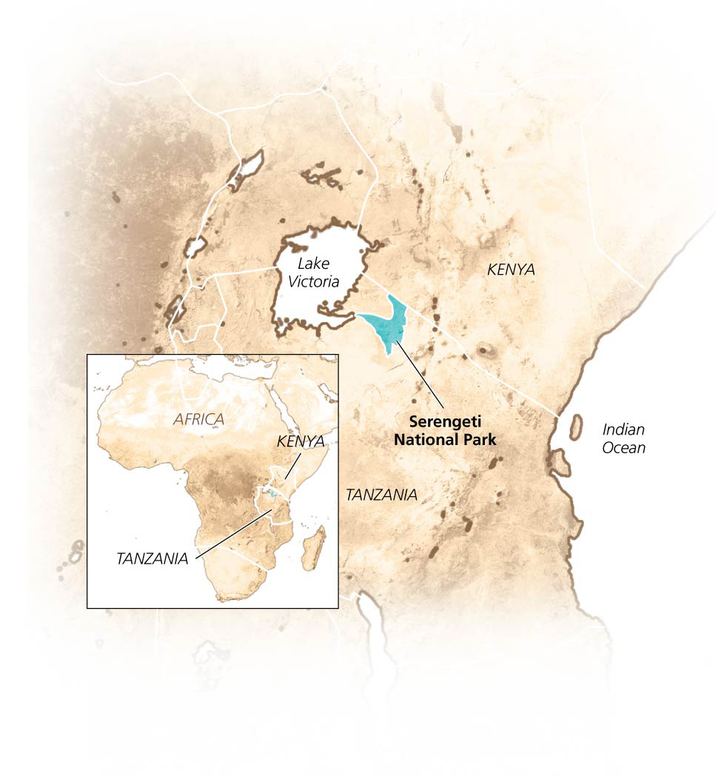
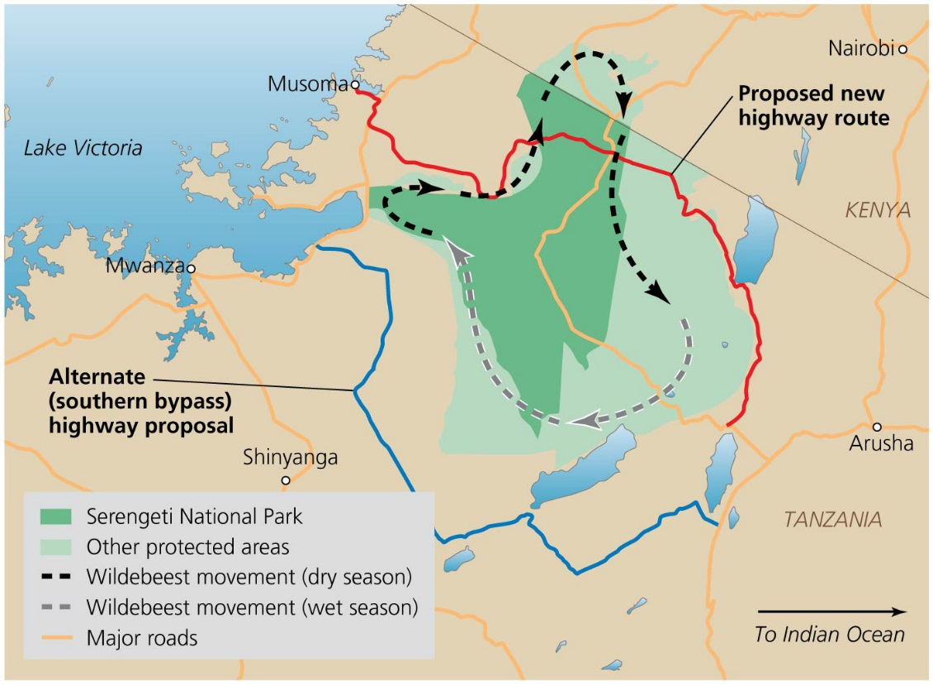

Slide 6
Our Planet of Life
Humans are reducing Earth’s diversity of life
Biological diversity or biodiversity = variety of life at all levels of organization
Species diversity
Genetic diversity
Population and community diversity
Biologists employ different working definitions and look at different levels according to their aims and philosophies
Basic concept applies across all levels

Slide 7
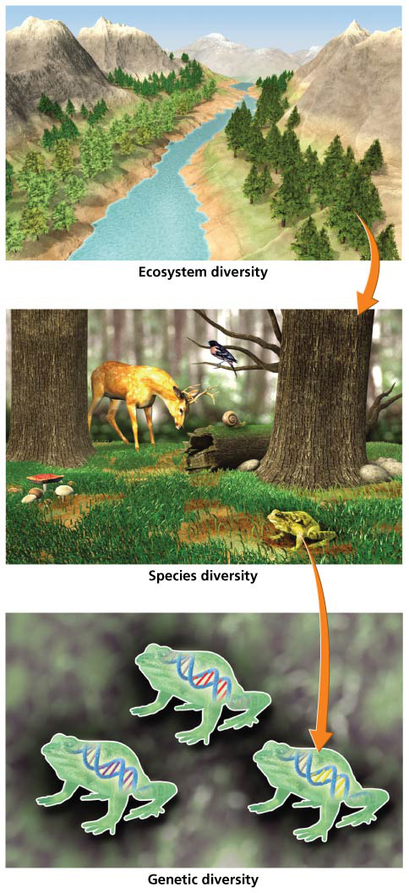

Slide 8
Species diversity
Species = a set of individuals that share certain characteristics and can interbreed, producing fertile offspring
Species diversity = the number or variety of species in a particular region
Richness = the number of species
Evenness (relative abundance) = the similarity in numbers between species

Slide 9
Species diversity
Speciation adds to species richness; extinction reduces species richness
Subspecies = populations of species that occur in different areas and differ slightly from each other
Divergence stops short of separating the species

Slide 10
Genetic diversity
Encompasses the differences in DNA composition among individuals
The raw material for adaptation to local conditions
Populations with higher genetic diversity can survive
They can cope with environmental change
Populations with low genetic diversity are vulnerable to environmental change or disease
Inbreeding depression = genetically similar parents mate and produce inferior offspring
Cheetahs, bison, elephant seals

Slide 11
Ecosystem diversity
Ecosystem diversity = the number and variety of ecosystems
May include different biotic communities or habitats within an area
The open plains of the Serengeti hold a diversity of habitats, including savanna, grassland, wetland
May include habitats, communities, or ecosystems at the landscape level
Sizes, shapes, and connections among patches
An area with a variety of vegetation holds more biodiversity than the same size area with one plant type

Slide 12
Some groups hold more species than others
Species are not evenly distributed among taxonomic groups
Insects predominate over all other life-forms
40% of insects are beetles
Beetles outnumber all other non-insect animals combined
Groups accumulate species by:
Adapting to local conditions
Populations becoming divided geographically
Low rates of extinction

Slide 13
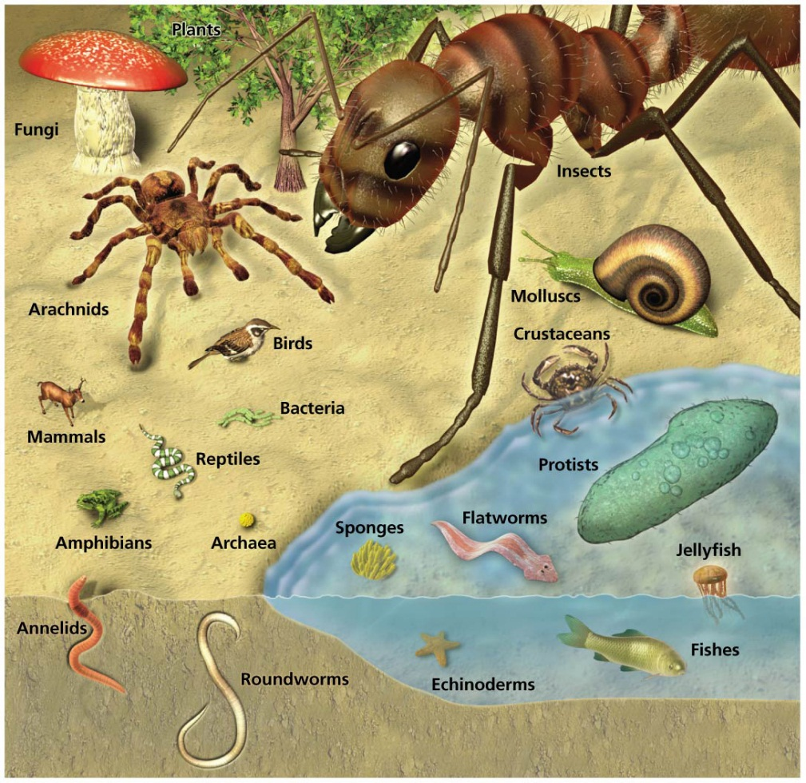
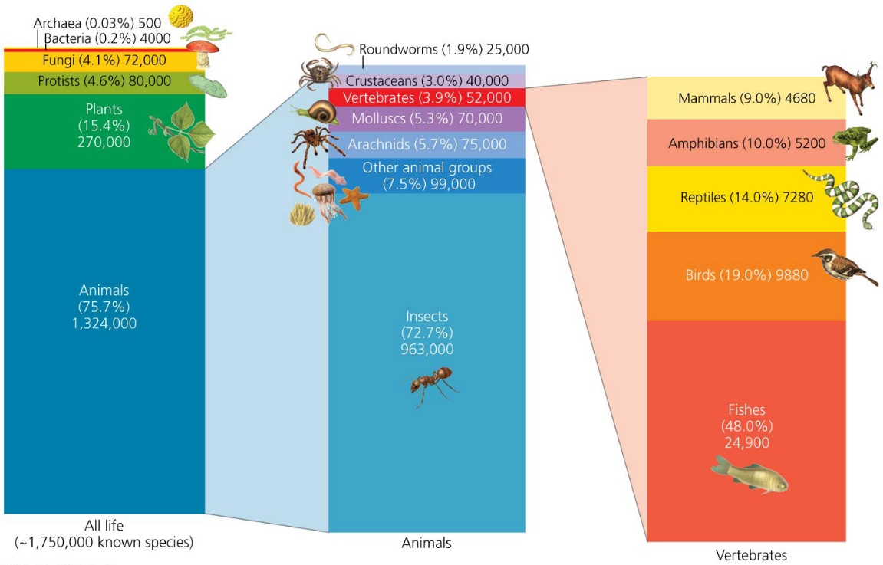

Slide 14
Many species await discovery
1.8 million species have been identified and described
Estimates of the total number of species on the planet range from 3 million to 100 million
Most widely accepted estimate of the number of species?
Around 14 million
It is very difficult to know how many species exist
Small organisms are easily overlooked
Many species look identical until thoroughly examined
Many remote spots on Earth remain unexplored

Slide 15
Biodiversity is unevenly distributed
Living things are not distributed evenly on Earth
Latitudinal gradient = species richness increases toward the equator
Factors that contribute to higher diversity at the equator:
High plant productivity supports more animals
Climate stability allows specialization, niches, and species coexistence
No glaciation means species never have to leave

Slide 16
Biodiversity is unevenly distributed
Diversity of habitats increases species diversity
Human disturbance can increase habitat diversity locally

Slide 17
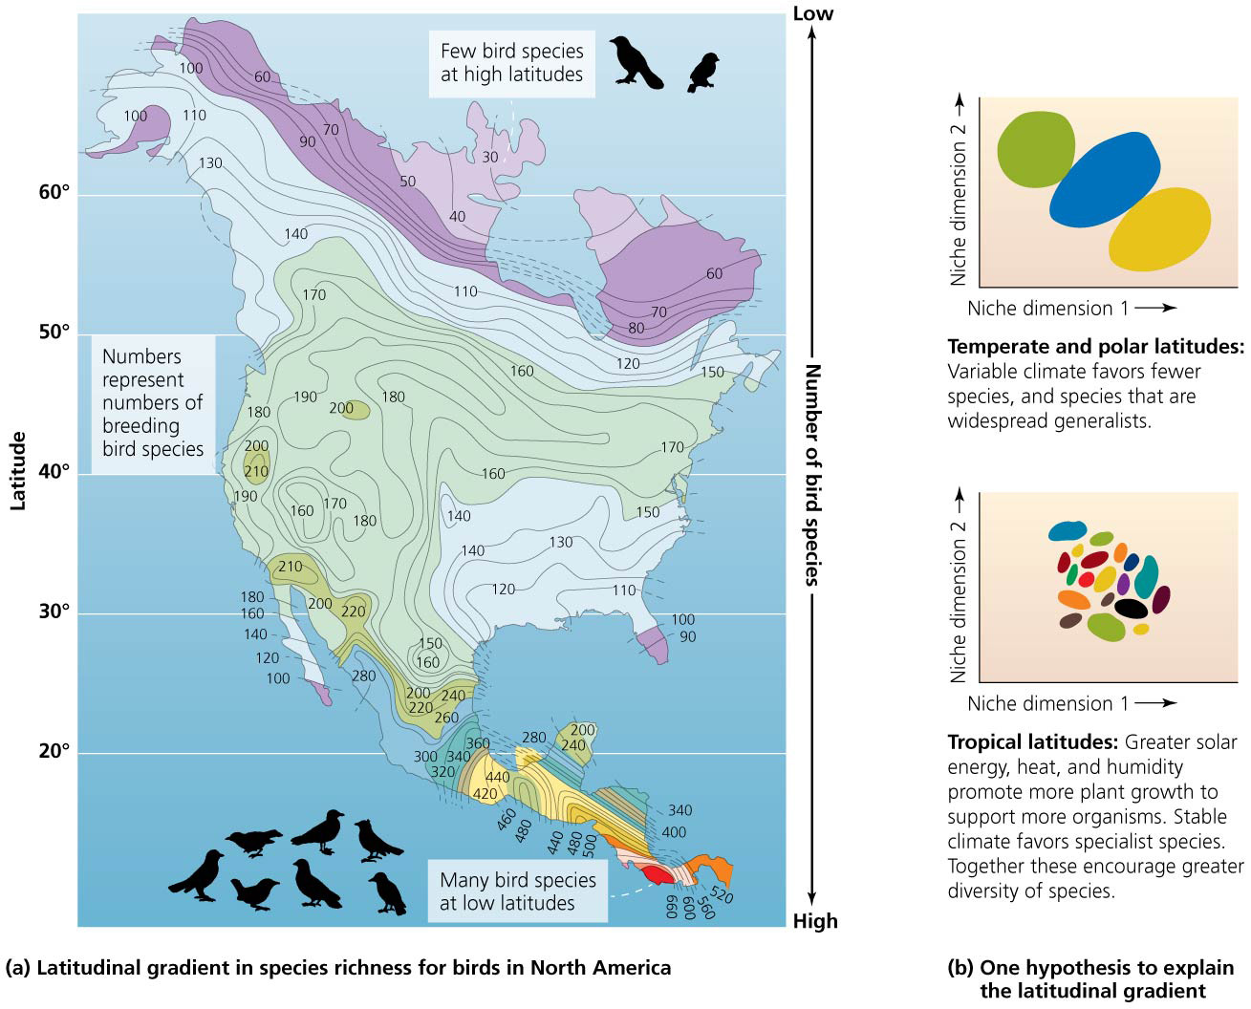

Slide 18
Extinction and Biodiversity Loss
Extinction = the loss of all members of a species so it ceases to exist
Extirpation = loss of a particular population, but not the entire species
Can lead to extinction
Extinction occurs naturally
99% of all species that ever lived have gone extinct
Although most extinction today is because of human action
Background rate of extinction = the pace of independent, one-by-one species loss

Slide 19
Earth has experienced five mass extinction events
Earth has had five mass extinctions in the past 440 million years
Each event eliminated at least 50% of all species
Permo-Triassic: 250 million years ago
80–95% of all species on Earth went extinct
Cretaceous-Tertiary: 65 million years ago
Dinosaurs went extinct
Humans are causing this sixth extinction event
We will suffer as a result

Slide 20
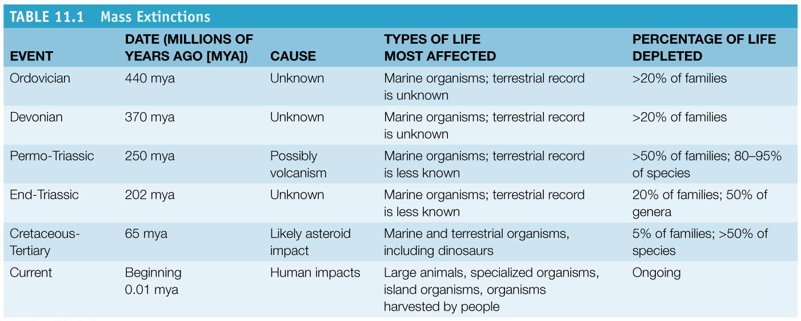

Slide 21
We are setting the sixth mass extinction in motion
Humans have driven hundreds of species to extinction
Dodo bird, Carolina parakeet, passenger pigeon
Multitudes of others teeter on the brink of extinction
Whooping crane, Kirtland’s warbler, California condor
Humans have been causing extinction for thousands of years
Bird extinctions followed Polynesians arriving in Hawaii and New Zealand
Many large mammals went extinct in Australia after human arrival 50,000 years ago

Slide 22
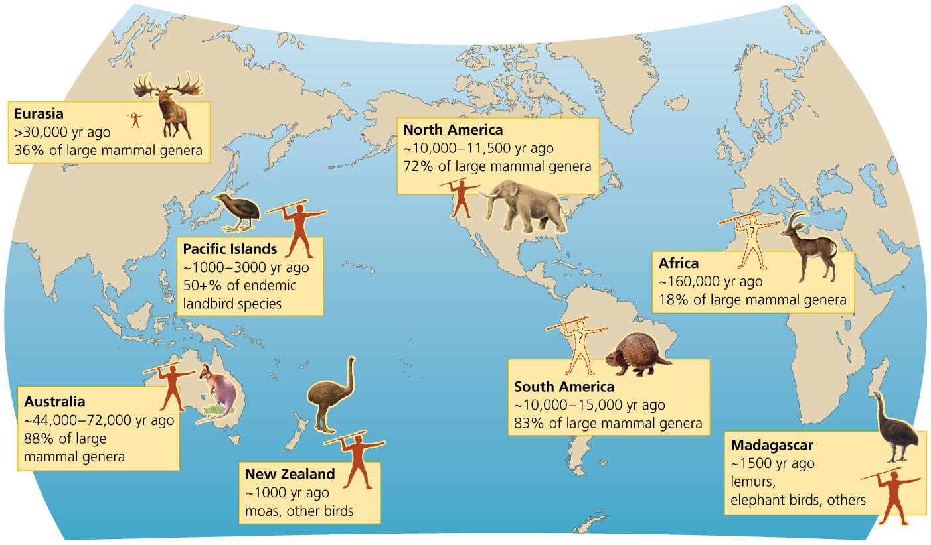

Slide 23
Current extinction rates are much higher than normal
The current extinction rate is 100–1000 times greater than the background rate
This rate is projected to increase tenfold in future decades
Human population growth strains ecosystems
Red List = list of species facing high risks of extinction
21% of mammal species, 13% of bird species, 30% of amphibian species, 20% of fish species threatened

Slide 24
Current extinction rates are much higher than normal
In the United States, in the last 500 years, 236 animal and 30 plant species have been confirmed extinct
Actual numbers are undoubtedly higher

Slide 25
Biodiversity loss involves more than extinction
Smaller populations have smaller geographic ranges and are more likely to go extinct
Extirpation has shrunk many species
The Living Planet Index summarizes population trends
Measures change in size of populations
Between 1970 and 2008, the index fell by 28%, meaning the average population is 28% smaller now
Changes to the index are not the same everywhere
In temperate zones, the index rose by 31%
In tropical zones, it decreased by 61%

Slide 26
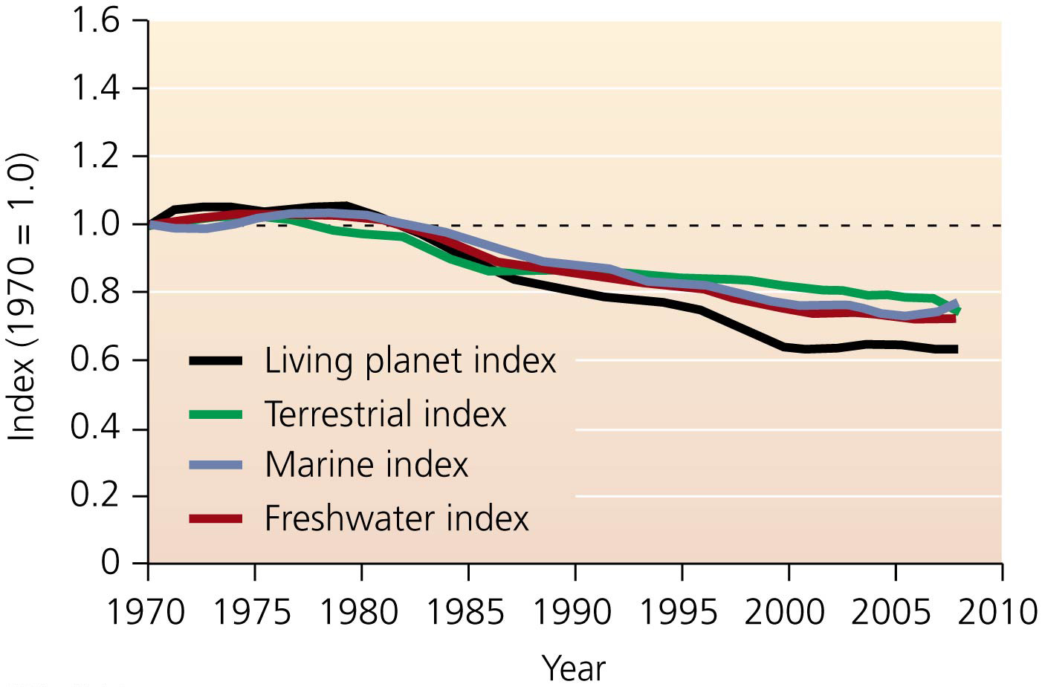

Slide 27
Habitat loss
The greatest cause of biodiversity loss
Habitats are destroyed, fragmented, and degraded
Housing developments replace natural communities
Farming simplifies communities
Grazing modifies grassland structure and composition
Clearing forests removes resources organisms need
Hydroelectric dams turn rivers into reservoirs

Slide 28
Habitat loss
Habitat fragmentation = occurs when continuous habitats are broken into small patches (by farming, roads, logging, etc.)
Species needing larger areas of that habitat disappear from the small fragments
Can also prevent animals from moving to other places

Slide 29
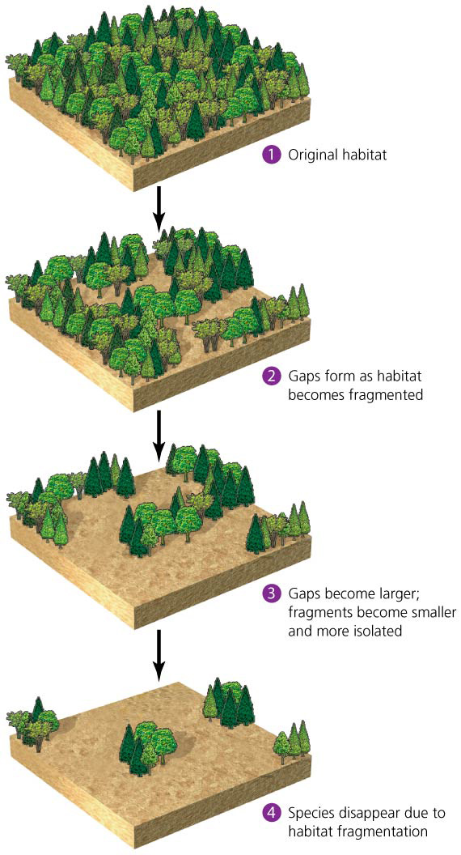
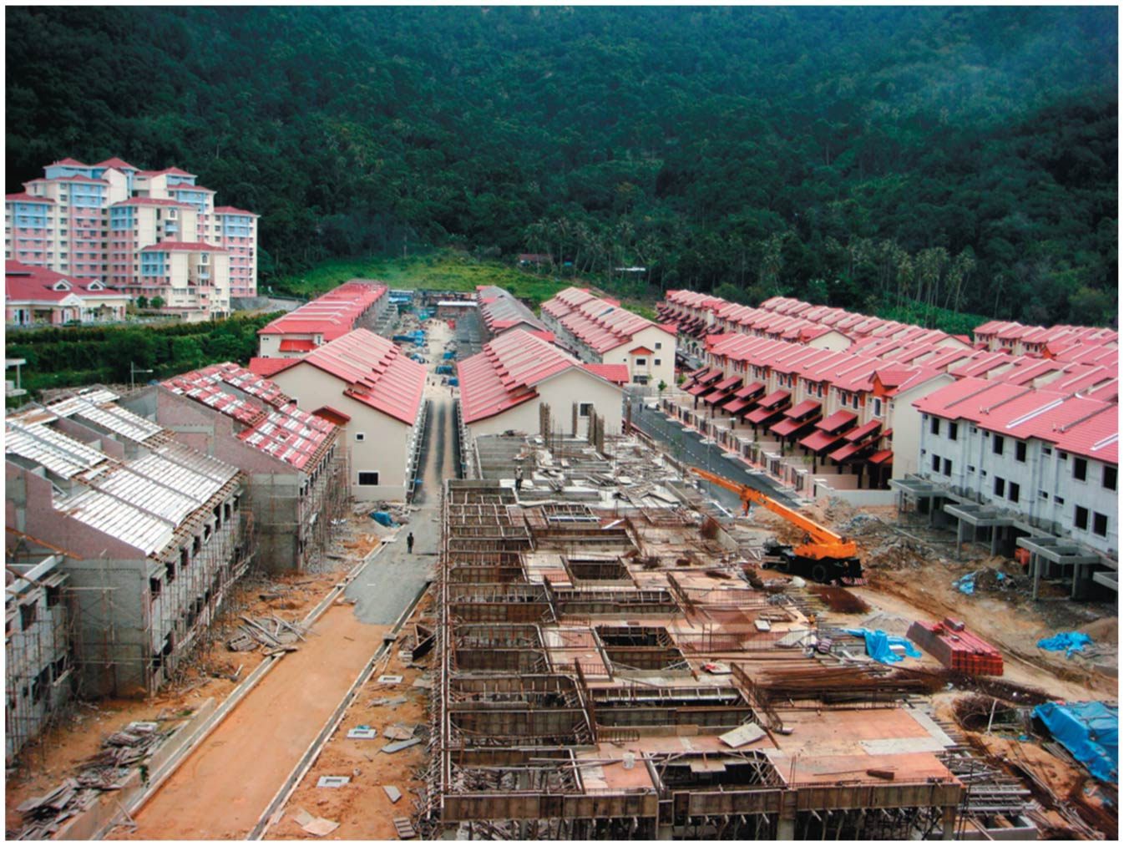

Slide 30
Habitat loss
Habitat loss occurs in nearly every biome
Habitat loss is responsible for declines in 83% of mammals and 85% of birds
Over 99% of U.S. prairies have been converted to agriculture
Grassland bird populations have declined 82–99%
A few species (e.g., pigeons, rats, cockroaches) benefit from human-changed habitats

Slide 31
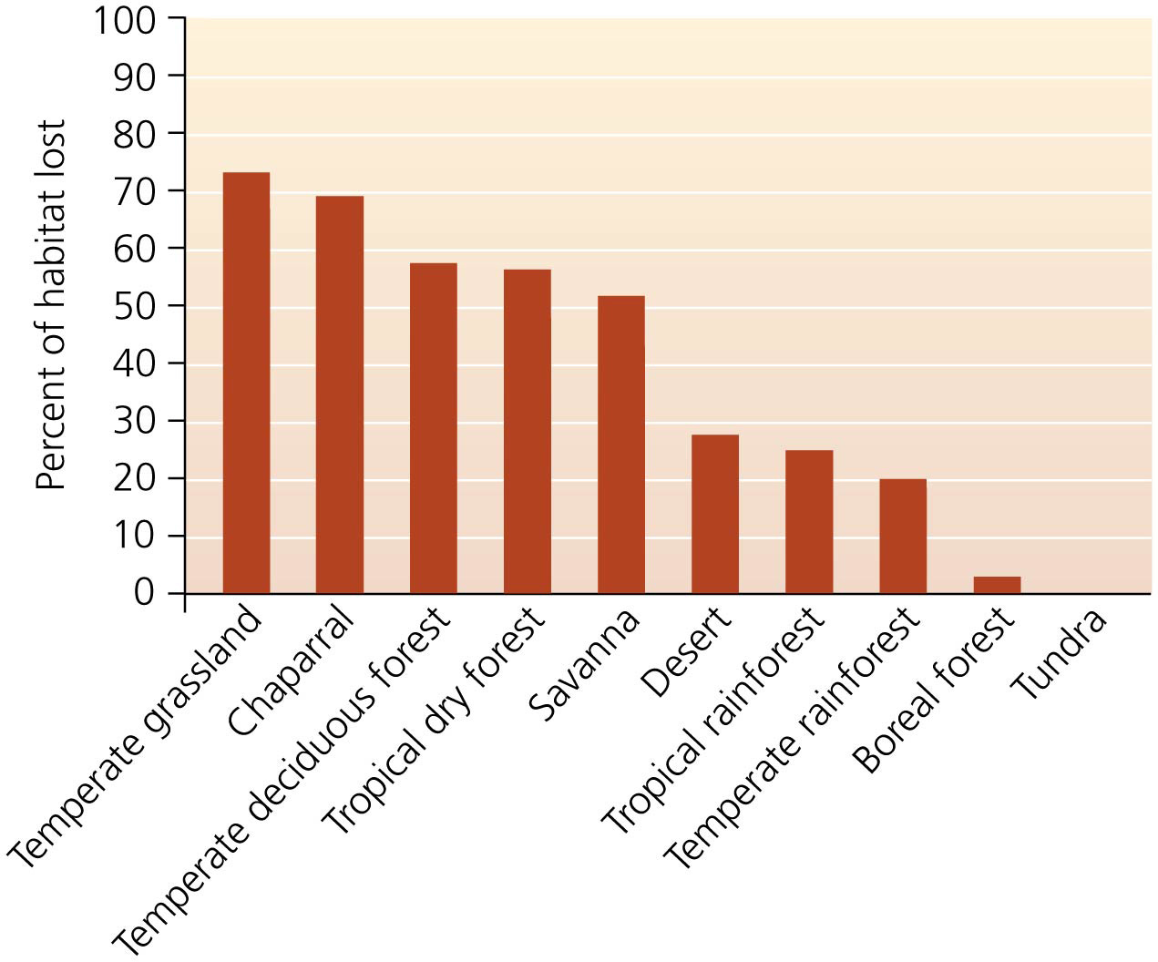

Slide 32
Pollution and Overharvesting
Pollution harms organisms in many ways
Air pollution degrades forest ecosystems
Water pollution impairs fish and amphibians
Toxins, garbage, oil, and chemicals impact organisms
Although pollution is a substantial threat, it is less significant than the public thinks
Hunting or harvesting threatens K-selected species
Large, long-lived organisms that have few young can be hunted to extinction
Elephants, gorillas, tigers, whales are at risk
Governments have passed laws and signed treaties banning the hunting of many species

Slide 33
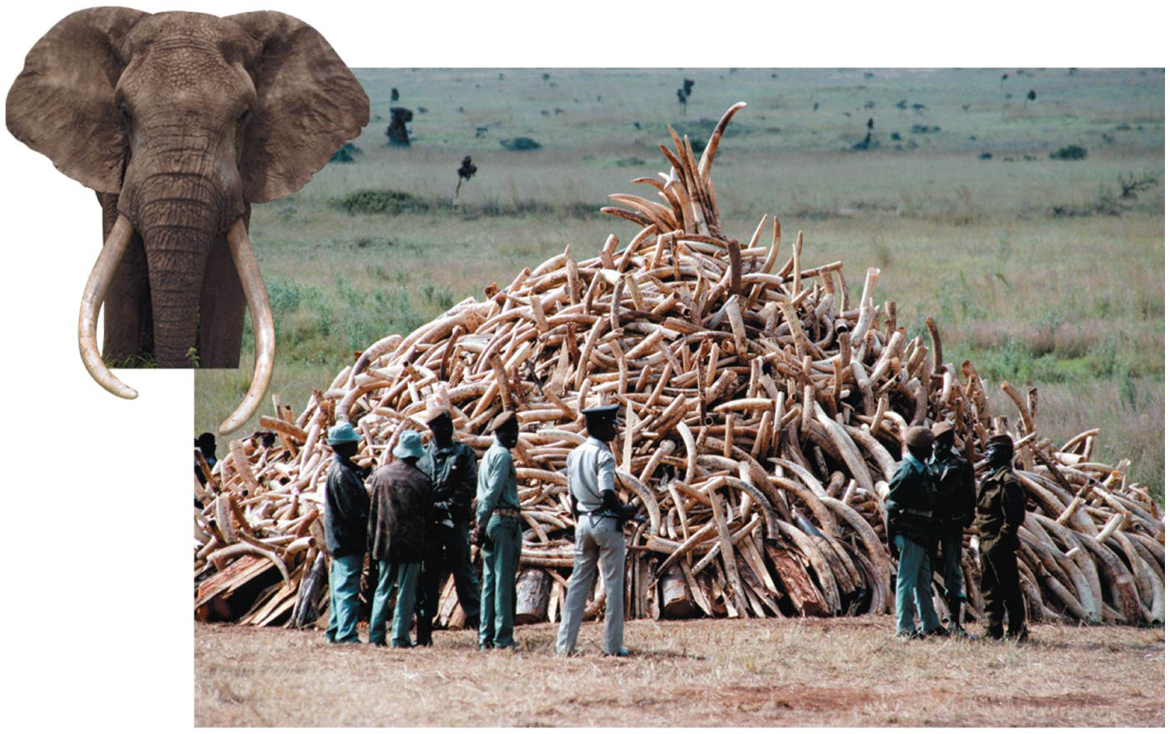

Slide 34
Invasive species and Climate change
Introduction of non-native species to new areas
Can be accidental or intentional
Outcompete or kill native species
Island species are especially vulnerable
Invaders lack natural predators, competitors, or parasites

Slide 35
Invasive species and Climate change
Impacts on the Earth’s climate system are global
Extreme weather events (storms) increase stress
Melting sea ice in the Arctic threatens polar bears
Mountaintop species are losing their habitat
A 1.5–2.5°C temperature rise could put 20%–30% of plants and animals at increased risk of extinction

Slide 36
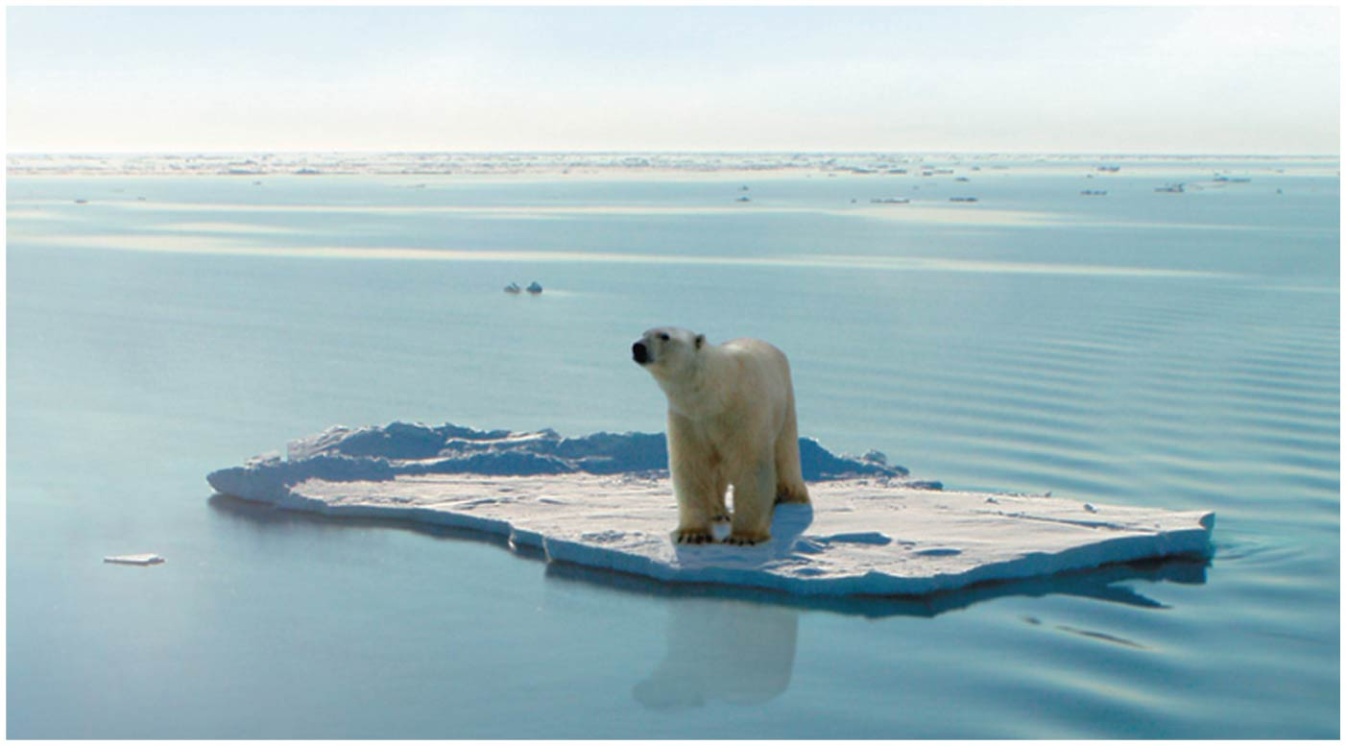

Slide 37
Amphibians are vanishing
Reasons for the decline of a species can be complex
Amphibian populations are collapsing worldwide
2600 of the 6400 known species are in decline
1900 are threatened; 170 have gone extinct

Slide 38
Amphibians are vanishing
Wide variety of potential causes and contributors
Habitat destruction, pollution, invasive species, climate change
Populations in pristine environments were vanishing due to a fungal disease
Scientists are beginning to understand the causes of biodiversity loss
We are also grappling with its consequences

Slide 39
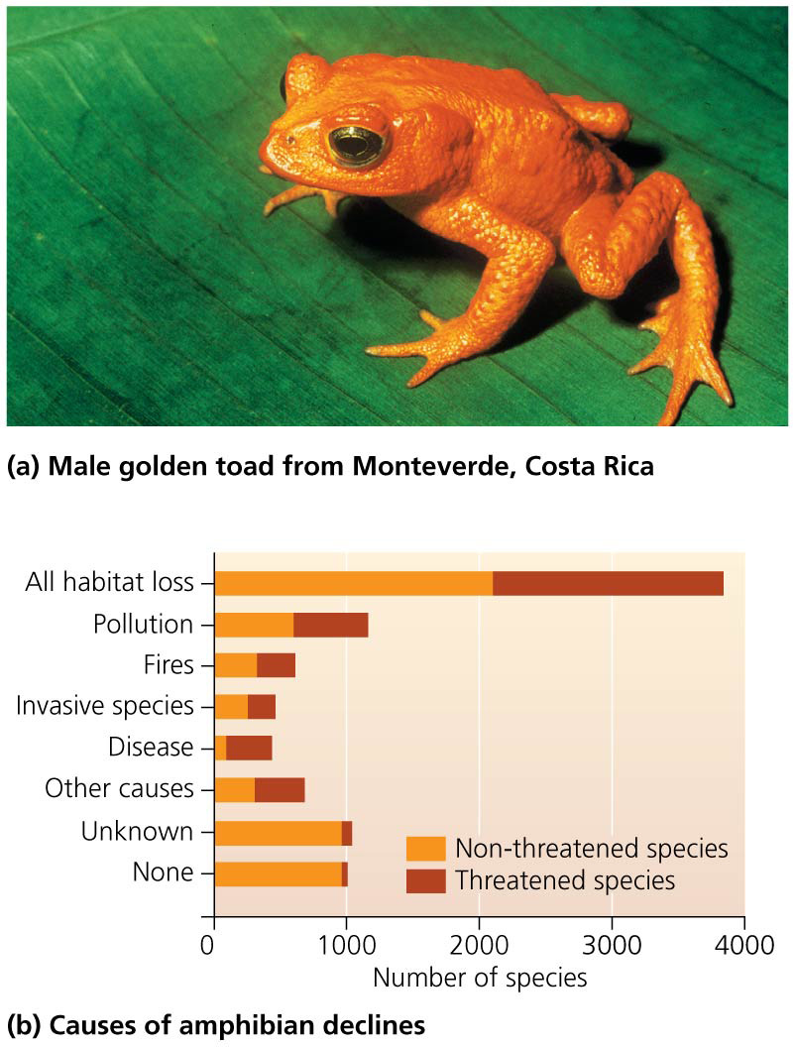

Slide 40
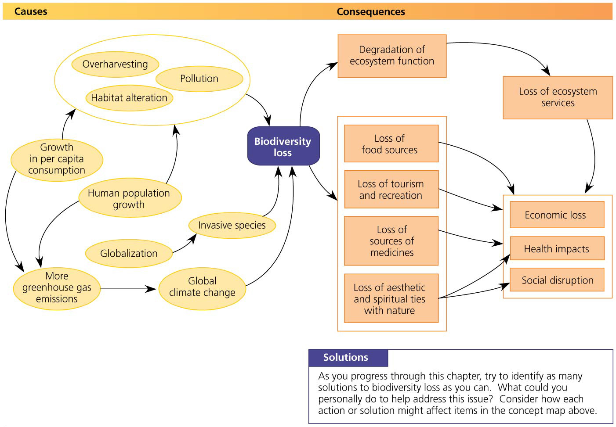

Slide 41
Biodiversity provides ecosystem services
Healthy ecosystems provide us with free services
Provides food, fuel, fiber, and shelter
Purifies air and water and detoxifies wastes
Stabilizes climate; moderates floods, droughts, wind, temperature
Cycles nutrients; renews soil fertility
Pollinates plants and controls pests and disease
Maintains genetic resources
Provides cultural and aesthetic benefits
Allows us to adapt to change
The value of 17 ecosystem services = $48 trillion per year

Slide 42
Biodiversity helps maintain ecosystem function
It increases stability and resilience of natural systems
Decreased biodiversity reduces a system’s ability to function and provide services to our society
The loss of a species affects ecosystems differently
If the species can be functionally replaced by others, it may make little difference
Loss of keystone species, ecosystem engineers, or top predators causes other species to decline or disappear
“To keep every cog and wheel is the first precaution of intelligent tinkering” (Aldo Leopold)

Slide 43
Biodiversity enhances food security
Industrial agriculture has narrowed our diet
90% of our food comes from 15 crops and 8 animal species
New potential food crops are waiting to be used
Serendipity berry is 3000 times sweeter than sugar

Slide 44
Biodiversity enhances food security
Genetic diversity within crops is enormously valuable
Turkey’s wheat crops received $50 billion worth of disease resistance from wild wheat
Wild and rare species can improve food security
Some are disease resistant; others can be watered with sea water or grow year after year without being replanted

Slide 45
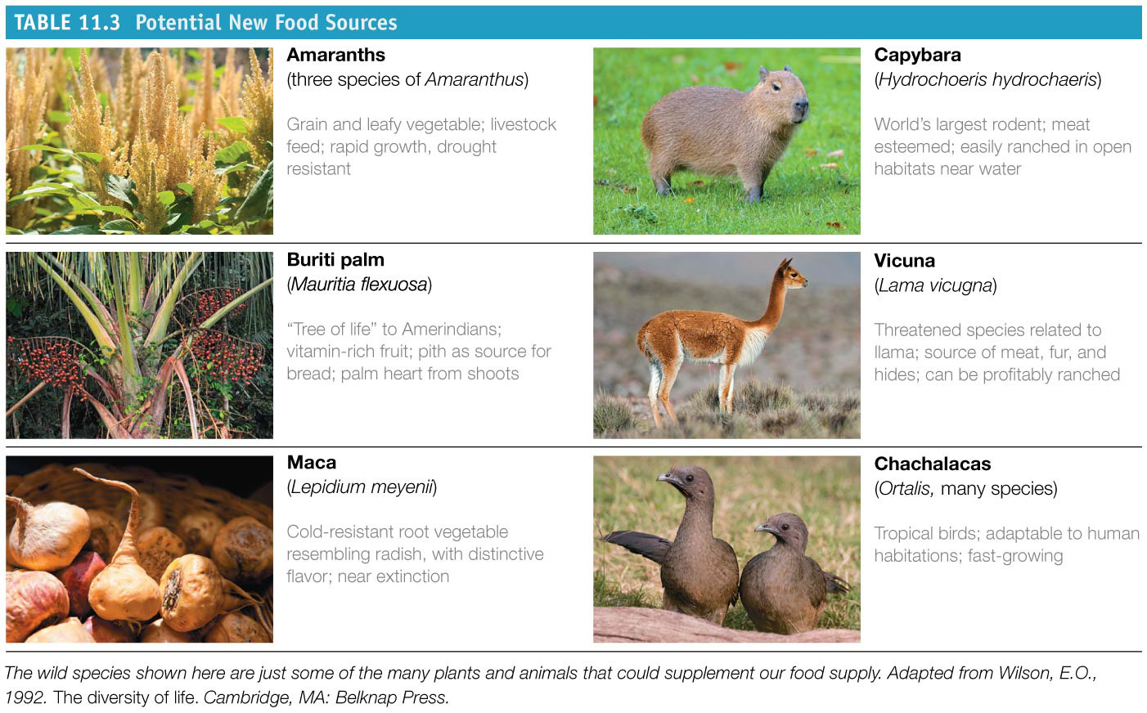

Slide 46
Organisms provide drugs and medicines
People have used plants for medicine for centuries
Many modern medicines are derived from plants
Wild species produce $150 billion/year of drugs
Taxol comes from the Pacific yew tree
Treats cancer
Every species that goes extinct is a lost opportunity to cure disease
Some organisms that show medical promise are threatened with extinction

Slide 47
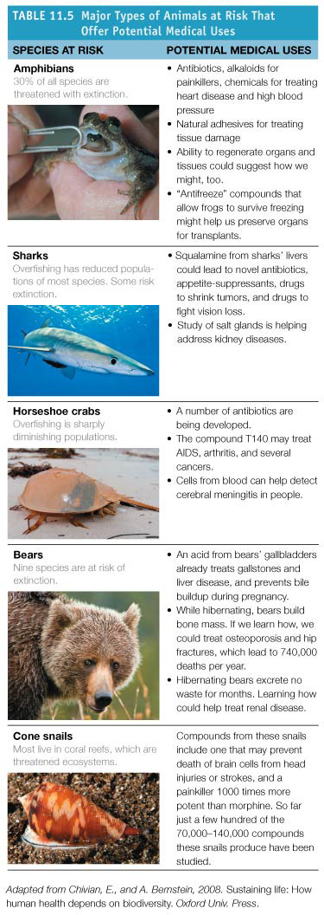
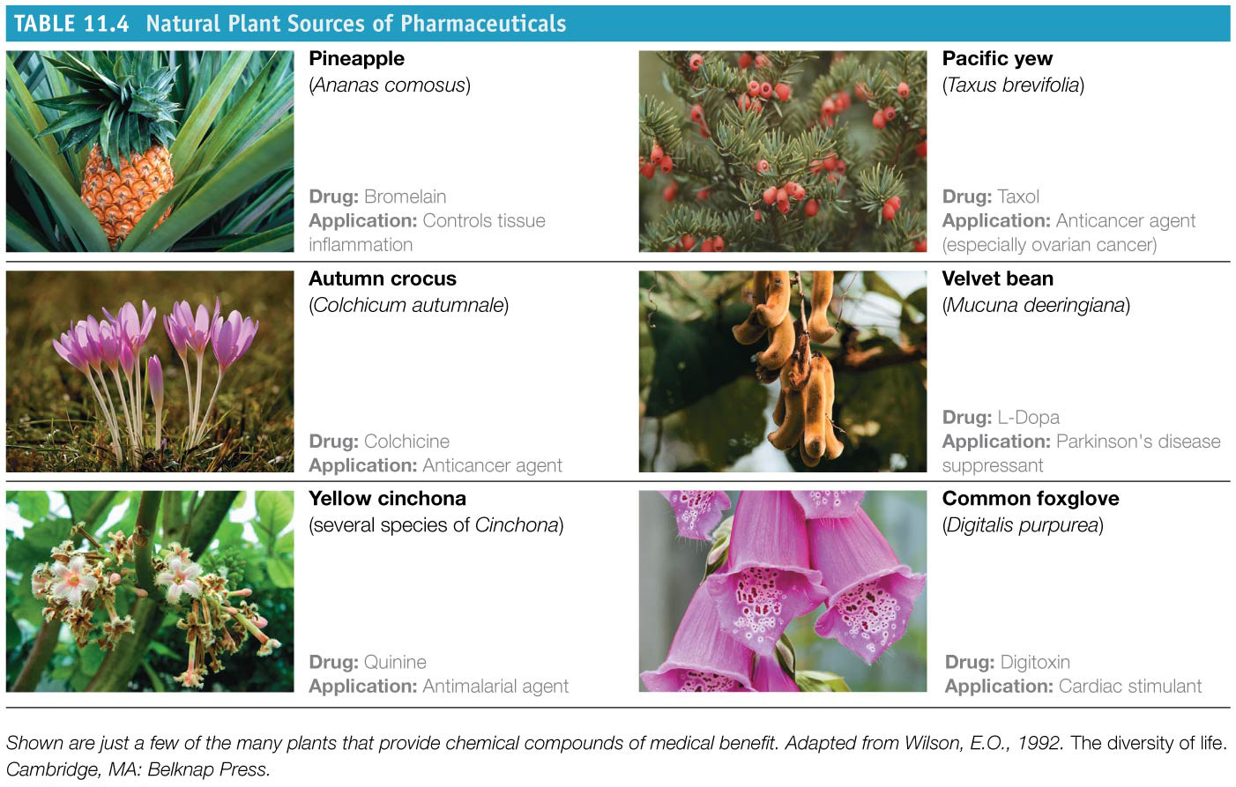

Slide 48
Biodiversity boosts economies through tourism and recreation
Biodiversity generates income through ecotourism
Especially in developing countries
Tanzania: savanna wildlife
Ecotourism brings in one-quarter of all foreign money
Costa Rica: rainforests
Australia: Great Barrier Reef
Belize: reefs, caves, and rainforests

Slide 49
Biodiversity boosts economies through tourism and recreation
A powerful incentive to preserve natural areas
Reduce impacts on the landscape and species
But too many visitors to natural areas can degrade the outdoor experience and disturb wildlife

Slide 50
People value connections with nature
Biophilia = notion that humans love nature and have an emotional bond with other living things
We have an affinity for parks and wildlife
We love our pets
We value real estate with views of natural lands
Our interest in hiking, bird watching, fishing, etc.
“Nature deficit disorder” = alienation from biodiversity and nature
Suggested to be behind the emotional and physical problems of the young

Slide 51
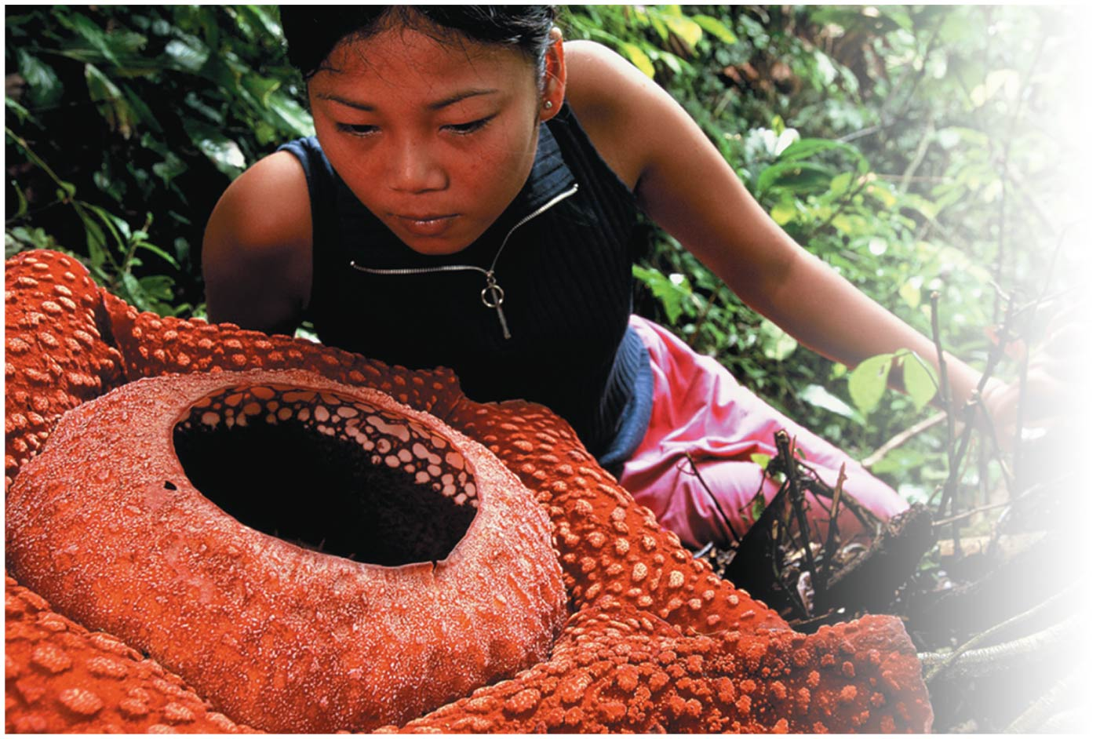

Slide 52
Do we have ethical obligations toward other species?
Many people feel that other organisms have an inherent right to exist
Biodiversity conservation is justified on ethical grounds alone
Humans are part of nature and need resources to survive
But we can control our actions and make choices
Despite our expanding ethical considerations, the future of biodiversity remains unsecure

Slide 53
Conservation biology responds to biodiversity loss
Conservation biology = study of the factors behind the loss, protection, and restoration of biodiversity
Scientists became alarmed at the degradation of natural systems
An applied and goal-oriented science
Conservation biologists integrate evolution, extinction, ecology, and environmental systems
Aim of developing solutions to habitat degradation and species loss

Slide 54
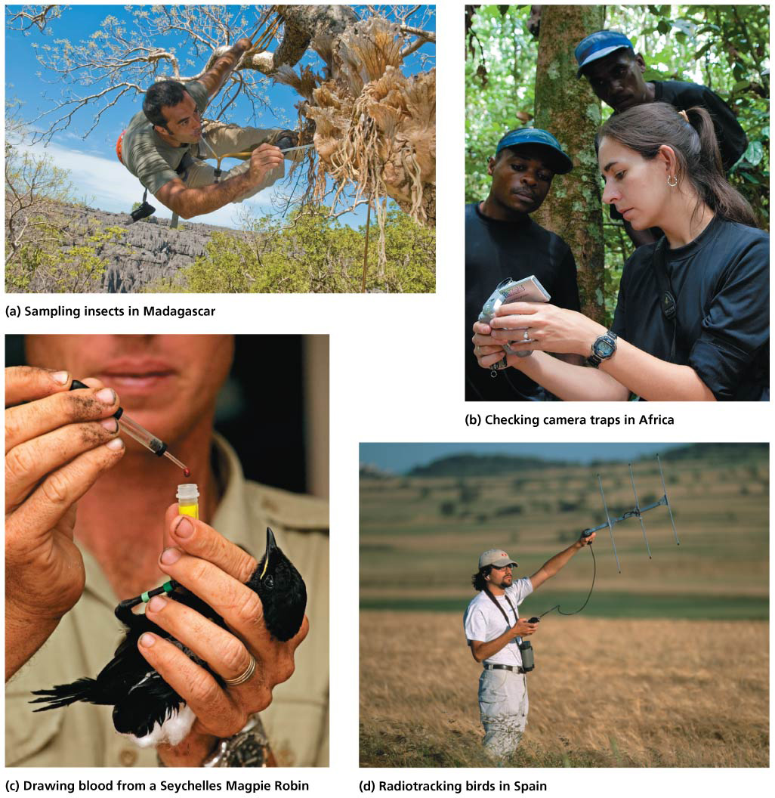

Slide 55
Conservation biologists work at multiple levels
Use field data, lab data, theory, and experiments to study our impacts on other organisms
Conservation geneticists study genetic attributes of organisms to infer the status of their populations
Minimum viable population size is how small a population can become before it runs into problems
Small populations may suffer inbreeding depression
Metapopulations = a network of subpopulations
Small populations are most vulnerable to extinction and need special attention

Slide 56
Endangered species are a focus of conservation efforts
Endangered Species Act (ESA) (1973) = the primary U.S. legislation for protecting biodiversity
It forbids the government and citizens from taking actions that destroy endangered species or their habitats or trading in products made from endangered species
The ESA’s goal is to prevent extinction
Stabilize declining populations
Enable populations to recover
In 2013, the United States had 1118 species listed as endangered and 322 listed as threatened

Slide 57
Endangered species are a focus of conservation efforts
Intensive management has saved or stabilized species
40% of declining populations have been stabilized
These successes occur despite problems
Underfunding of the U.S. Fish and Wildlife Service and the National Marine Fisheries Service
Recent political forces have tried to weaken the ESA

Slide 58
Endangered species are a focus of conservation efforts
“Warranted but precluded” = the science says the species should be listed, but lack of resources prevents the listing (e.g., greater sage grouse)
Some environmental advocacy groups have sued the federal government for failing to enforce the law

Slide 59
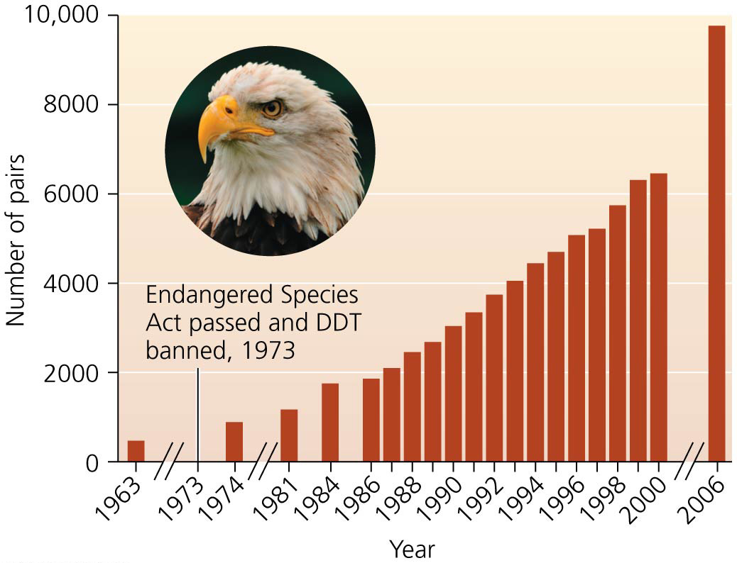
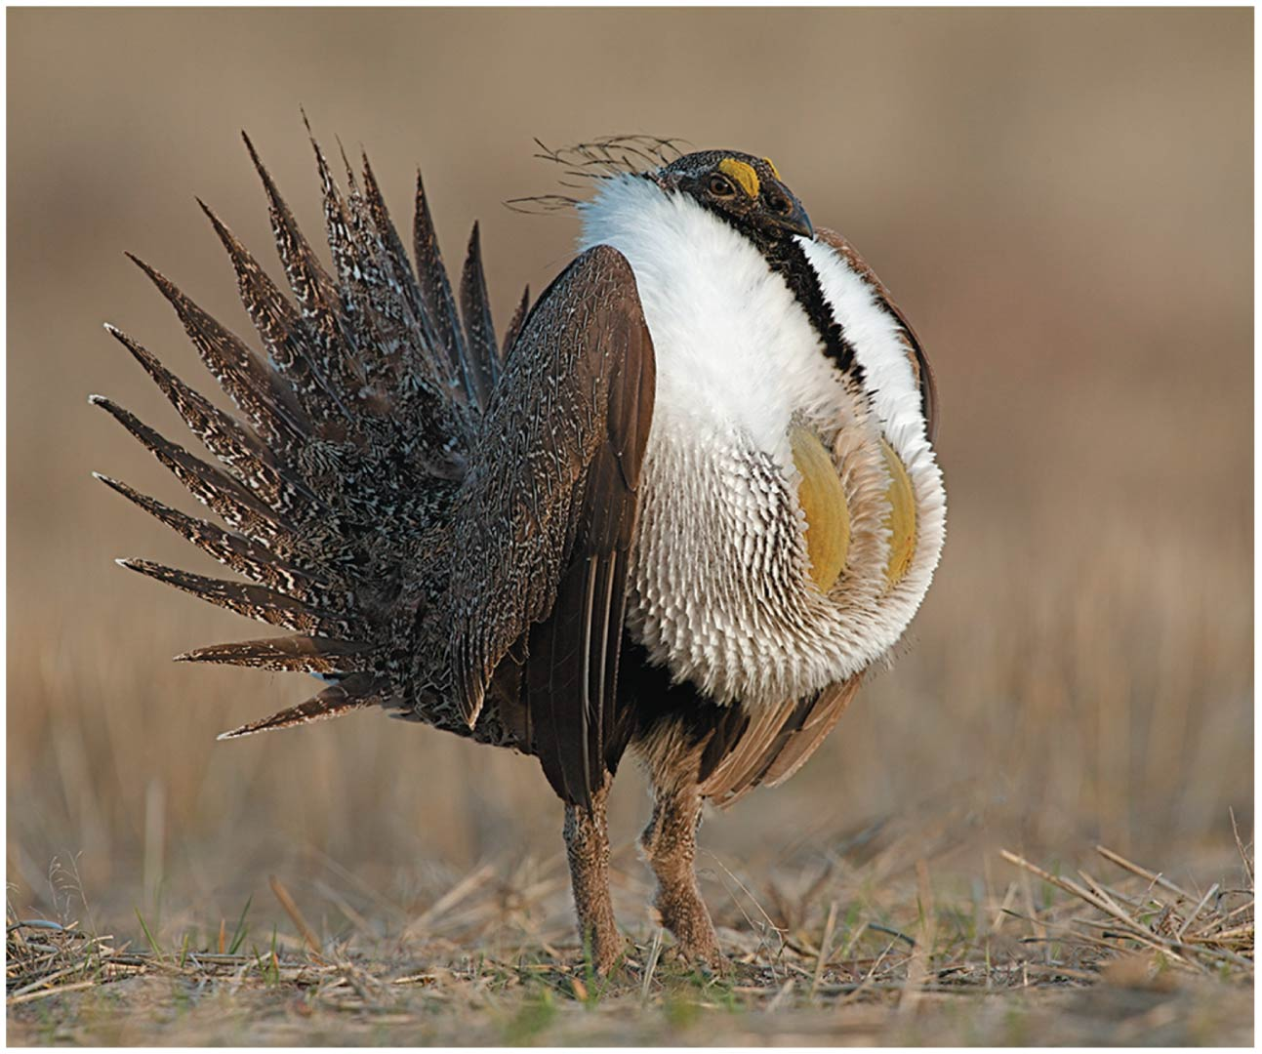

Slide 60
Endangered species are a focus of conservation efforts
Many Americans support protecting endangered species
Opponents feel that the ESA values endangered organisms more than the livelihood of people
Protection will restrict land use and cost jobs
“Shoot, shovel, and shut up” = landowners conceal the presence of endangered species on their land
But the ESA has stopped few development projects
Habitat conservation plans and safe harbor agreements = arrangements whereby landowners can harm species if they improve habitat for the species in other places
Notes:
60

Slide 61
Endangered species are a focus of conservation efforts
Many countries have laws protecting endangered species
They are not always effective
Species at Risk Act (SARA) (2002) = Canada’s endangered species law
Stresses cooperation between federal government and landowners or provincial governments
Criticized as being weak and failing to protect habitat

Slide 62
International treaties promote conservation
UN Convention on International Trade in Endangered Species of Wild Fauna and Flora (1973) (CITES) = protects endangered species by banning international transport of their body parts
Goals of the Convention on Biological Diversity (1992):
Conserve biodiversity
Use biodiversity in a sustainable manner
Ensure the fair distribution of biodiversity’s benefits
Helped African nations gain economic benefit from ecotourism with their wildlife preserves
Enhanced global market for sustainable crops
Notes:
62

Slide 63
International treaties promote conservation
The Convention on Biological Diversity aims to:
Provide incentives to conserve biodiversity
Manage access to and use of genetic resources
Transfer technology (including biotechnology)
Promote scientific cooperation
Assess human effects on biodiversity
Promote biodiversity education and awareness
Provide funding for critical activities
Encourage nations to report on conservation efforts
Despite some successes, biodiversity is still being lost

Slide 64
Captive breeding, reintroduction, and cloning are being used to save species
Captive breeding = individuals are bred and raised so they can be reintroduced into the wild
65 plant and animal species exist only in captivity
Reintroductions can be successful
Black rhinos were reintroduced into Serengeti National Park to reestablish that population
California condors have been reintroduced and went from 22 to over 230 birds in the wild
Reintroductions can be controversial
Ranchers opposed reintroducing wolves to Yellowstone National Park
Notes:
64

Slide 65
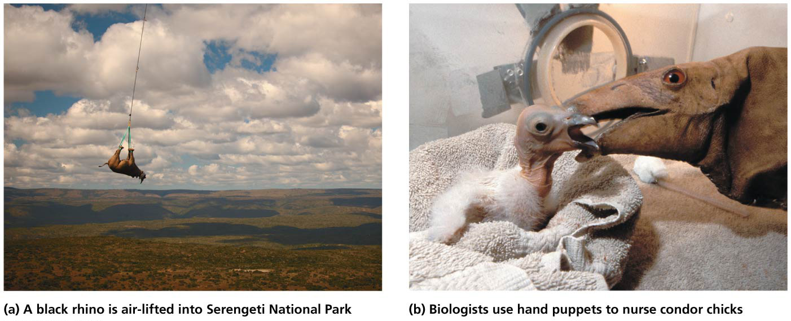

Slide 66
Captive breeding, reintroduction, and cloning are being used to save species
Cloning creates more individuals and saves species from extinction
DNA from an endangered species is inserted into an egg without a nucleus
The egg is inserted into a closely related species
Several mammal species have been cloned
But these efforts are not enough to recreate lost biodiversity and do not always succeed
Without ample habitat and protection in the wild, having cloned animals in a zoo does little good

Slide 67
Forensics can help to protect species
Forensic science (forensics) = the analysis of evidence to identify or answer questions relating to a crime
Conservation scientists use forensics to protect species
Researchers use DNA to identify a species or subspecies and its geographic origin

Slide 68
Forensics can help to protect species
Detecting illegal activity helps enforce laws protecting wildlife
For example, whale meat is analyzed in Asian markets
DNA from killed elephants shows many more were killed than the Zambian government realized

Slide 69
Some species act as “umbrellas” that protect habitat and communities
Conservation biologists use particular species as tools to conserve communities and ecosystems
Umbrella species = species that, when protected, also help protect other, less charismatic species
Often large species that need large amounts of habitat
Protecting their habitat automatically protects others
Notes:
69

Slide 70
Some species act as “umbrellas” that protect habitat and communities
Flagship species = large and charismatic species used as spearheads for biodiversity conservation
The World Wildlife Fund’s panda
Some organizations are moving beyond the single-species approach to focus on whole landscapes
Notes:
70

Slide 71
Parks and protected areas help conserve biodiversity at the ecosystem level
Setting aside land in parks and preserves conserves habitats, communities, ecosystems, and landscapes
13% of the world’s area is set aside in parks, wilderness, reserves, etc.
But these areas are not all managed for biodiversity
They are used for recreation, water protection, etc.
They are also illegally logged, etc.
Some are large enough to preserve whole ecosystems
Parks can not protect animals that leave the park boundaries
Climate change is altering the habitat in some preserves

Slide 72
Biodiversity hotspots pinpoint regions of high diversity
Biodiversity hotspots = regions most important globally for biodiversity
Support a great number of endemic species = species found nowhere else in the world
The area must have at least 1500 endemic plant species (0.5% of the world total)
It must have lost 70% of its habitat due to humans
2.3% of the planet’s land surface contains 50% of the world’s plant species and 42% of all terrestrial vertebrate species
Focusing on hotspots protects the greatest number of species per unit effort
Notes:
72

Slide 73
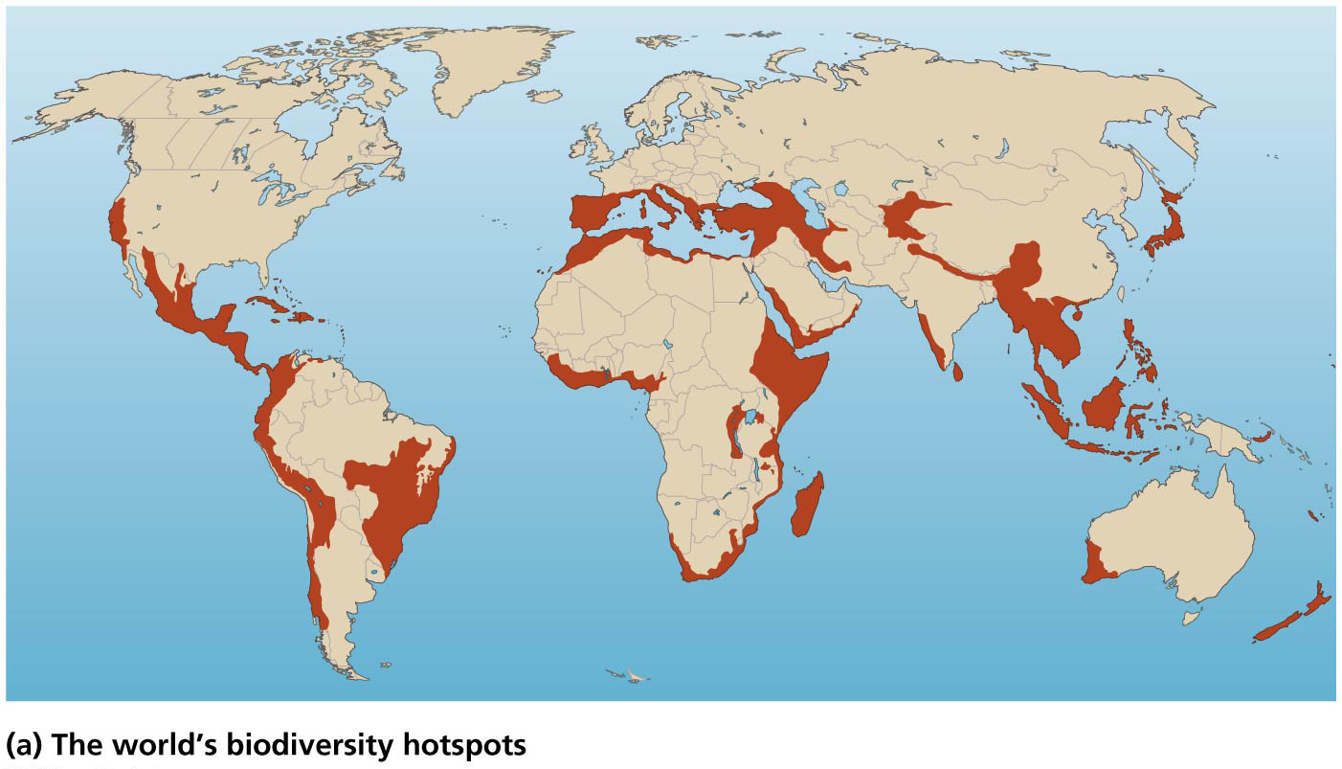

Slide 74
We can restore degraded ecosystems
The best way to safeguard biodiversity and natural systems?
Protect natural areas before they become degraded
Ecological restoration = process of restoring degraded areas to some semblance of their former condition
Also reestablishes the processes that make ecosystems function
Restoration ecology = restoring damaged systems to bring back species and reestablish ecological processes
Filter pollutants, clean water and air, build soil, etc.

Slide 75
Community-based conservation
Community-based conservation = approach in which conservation biologists engage local people to protect land and wildlife
Makes protecting the land valuable to the local people
23% of the world’s protected areas were being managed using community-based conservation
Notes:
75

Slide 76
Community-based conservation
In East Africa, protecting land was not seen to be benefiting the local people. To encourage local stewardship:
Tourism dollars were reallocated to local villages
Some local control over management decisions was given
Scientists helped protect crops from wild animals
It ensures that local resources can be sustainably used
Notes:
76

Slide 77
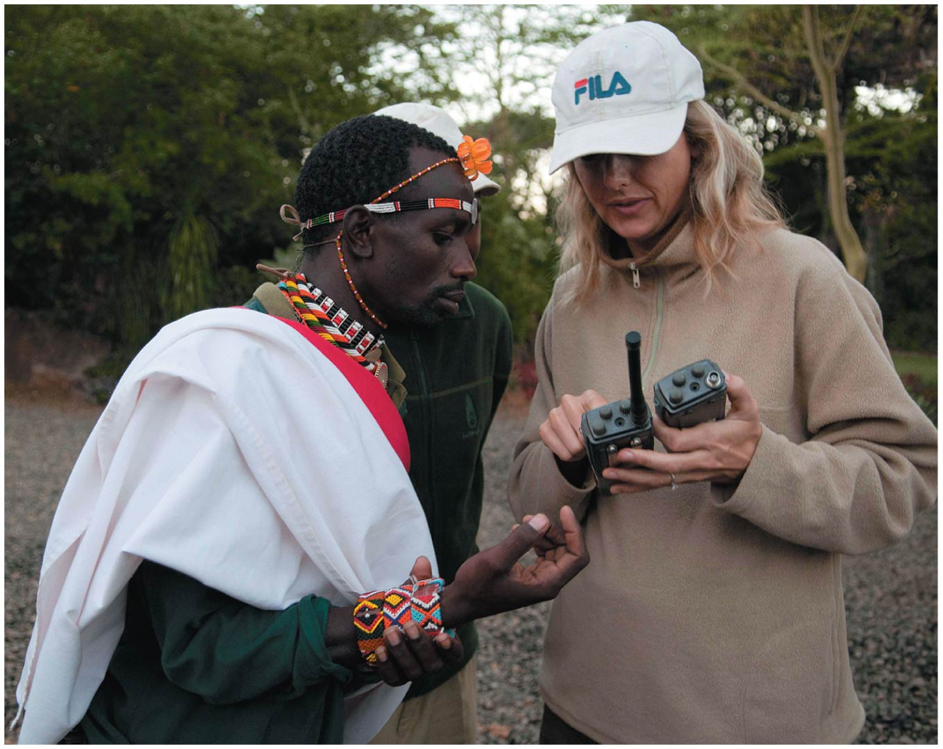

Slide 78
Conclusion
Biodiversity is being lost rapidly and visibly, threatening mass extinction
Primary causes of biodiversity loss are habitat alteration, invasive species, pollution, overharvesting, and climate change
Human society cannot function without biodiversity’s benefits
Science can help save species, preserve habitats, restore populations, and keep natural ecosystems intact
Notes:
78

Slide 79
QUESTION: Review
Which concept describes the number of species in an area?
Species evenness
Species richness
Relative abundance
All of the above describe the number of species in an area.
Notes:
Answer: b

Slide 80
QUESTION: Review
What does “inbreeding depression” result in?
The species becoming too large for the resource base
Inferior offspring when genetically similar parents mate
Superior offspring when genetically similar parents mate
Increased number and variety of species
Notes:
Answer: b

Slide 81
QUESTION: Review
Why does Costa Rica have more bird species than Canada?
Costa Rica has a more stable climate.
Canada has a more stable climate.
Prehistoric glaciers carved out more niches in Costa Rica.
Canada has higher plant productivity but lower bird species.
Notes:
Answer: a

Slide 82
QUESTION: Review
Which of the following is the major cause of extinction?
Invasive species
Pollution
Habitat loss
Overharvesting
Notes:
Answer: c

Slide 83
QUESTION: Review
Biodiversity does all of the following EXCEPT
provide ecosystem services.
increase food security.
decrease ecosystem function.
provide aesthetic benefits.
Notes:
Answer: c

Slide 84
QUESTION: Review
Which branch of science studies factors behind the loss, protection, and restoration of biodiversity?
Conservation biology
Ecosystem ecology
Population genetics
Demography
Notes:
Answer: a

Slide 85
QUESTION: Review
Which statement about biodiversity hotspots is NOT correct?
They must have lost a large percent of habitat due to humans.
They protect a very high number of species per unit effort.
They must be extremely large, taking up a large portion of the Earth’s surface.
They contain a large number of endemic species.
Notes:
Answer: c

Slide 86
QUESTION: Weighing the Issues
Many conservation strategies involve protecting a single species. Do you think this is a good approach?
Yes. Every species is important and should be protected.
Yes. By protecting one species, you protect those around it.
Yes, but only if that species draws attention to the plight of all biodiversity.
No. We need to think about and work on protecting entire ecosystems.
Notes:
Answer: any

Slide 87
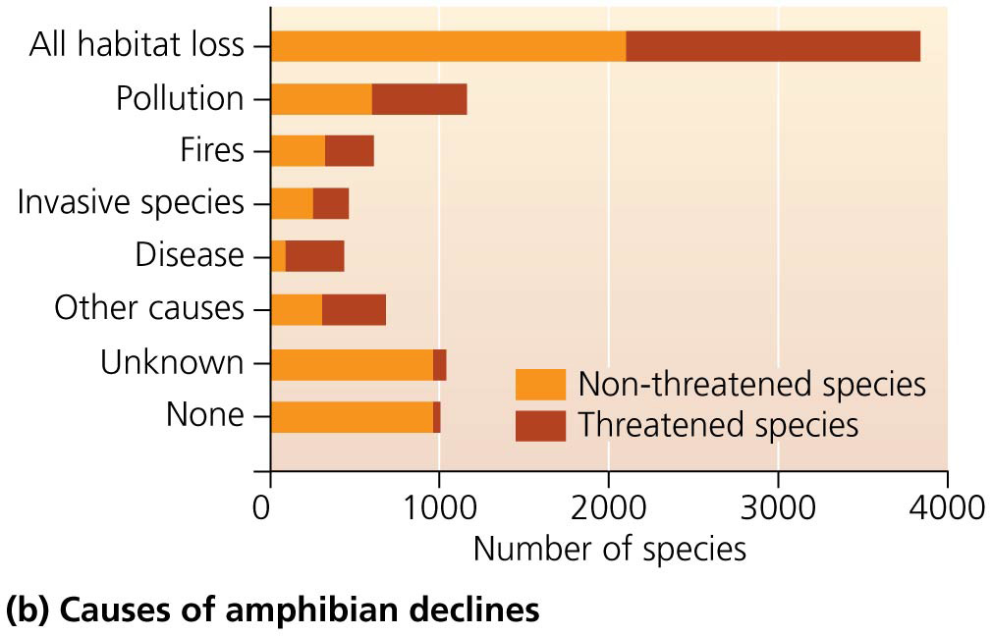
QUESTION: Interpreting Graphs and Data
After habitat loss, what has the most impact on amphibian species (which affects the second-most species overall)?
Disease
Fires
Invasive species
Pollution
Notes:
Answer: b

Slide 88
QUESTION: Interpreting Graphs and Data
Which biome has lost the most area?
Tropical dry forest
Desert
Savanna
Temperate rainforest
Notes:
Answer: a

