Slide 2
This lecture will help you understand:
Challenges of feeding a growing human population
The Green Revolution
How we raise animals for food
Preserving crop diversity
Pollination
Strategies of pest management
Organic agriculture
Genetically modified food
Sustainable agriculture

Slide 3
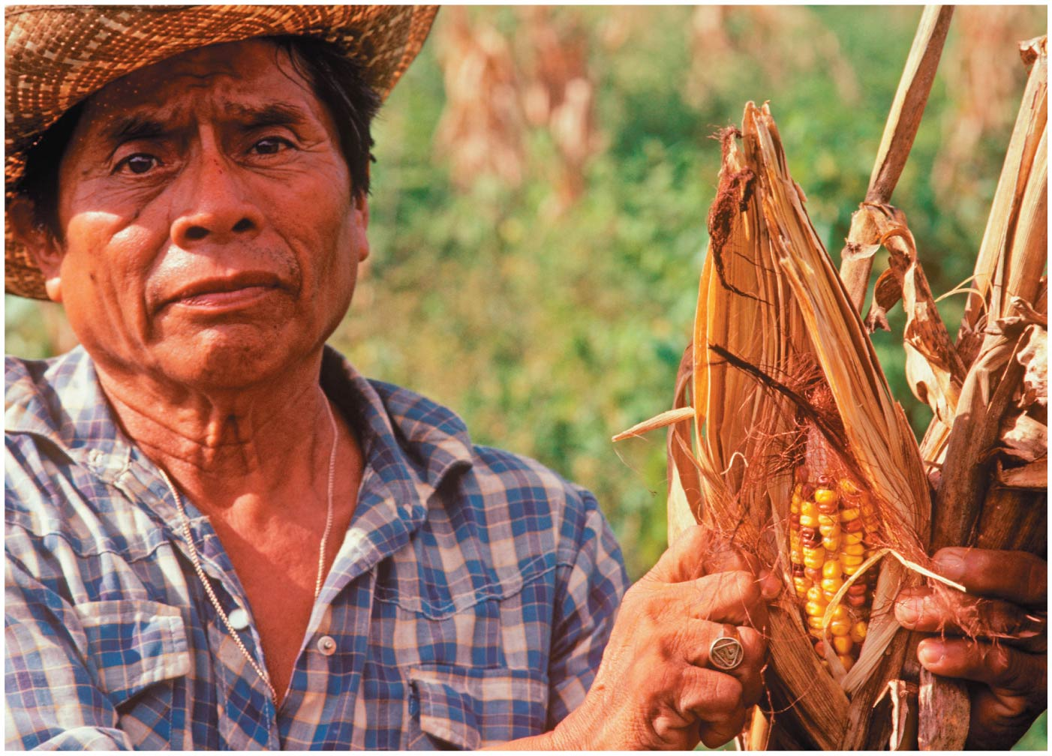

Slide 4
Central Case Study: Transgenic Maize in Southern Mexico?
Corn (maize) originated in Mexico 9000 years ago
Mexico is home to many corn landraces = locally adapted domestic varieties
In 2001, genes from genetically modified corn appeared in traditional maize

Slide 5
Central Case Study: Transgenic Maize in Southern Mexico?
These transgenes (genes from another species) came from U.S. corn
Genetically modified organisms (GMOs) = organisms whose genes have been directly manipulated
Could contaminate native crops
Impact of GM corn is difficult to assess

Slide 6
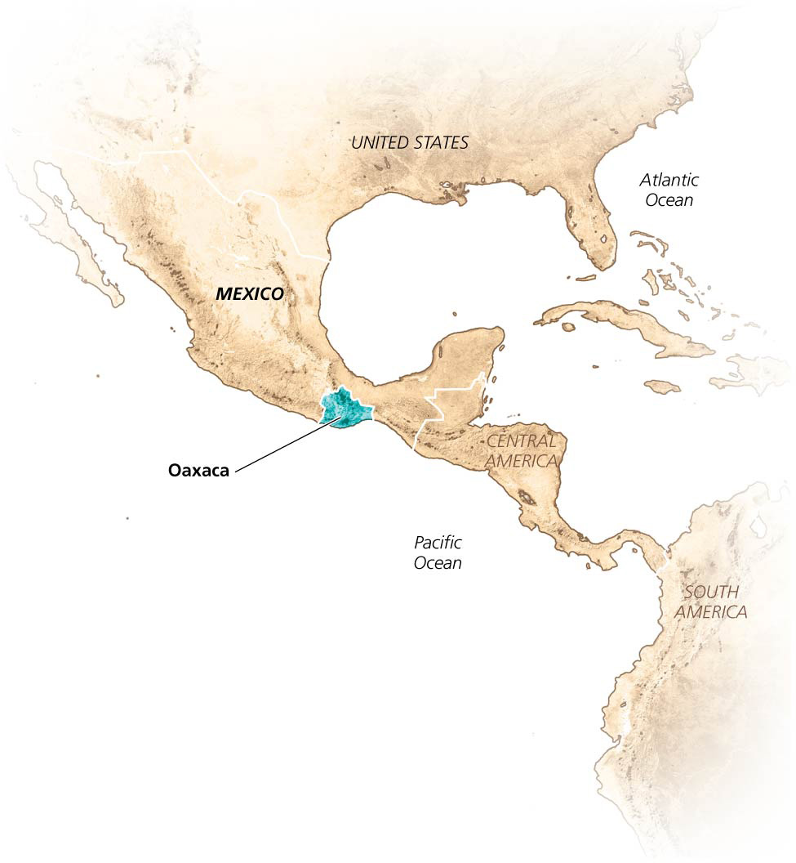

Slide 7
We are producing more food per person
The human population is expected to reach 9 billion by 2050
This will mean 2 billion more people to feed
Food production has exceeded population growth over the last 50 years
We produce food through technology
Fossil fuels, irrigation, fertilizer, pesticides, cultivating more land, genetic engineering
Today, soils are in decline and most arable land is already farmed

Slide 8
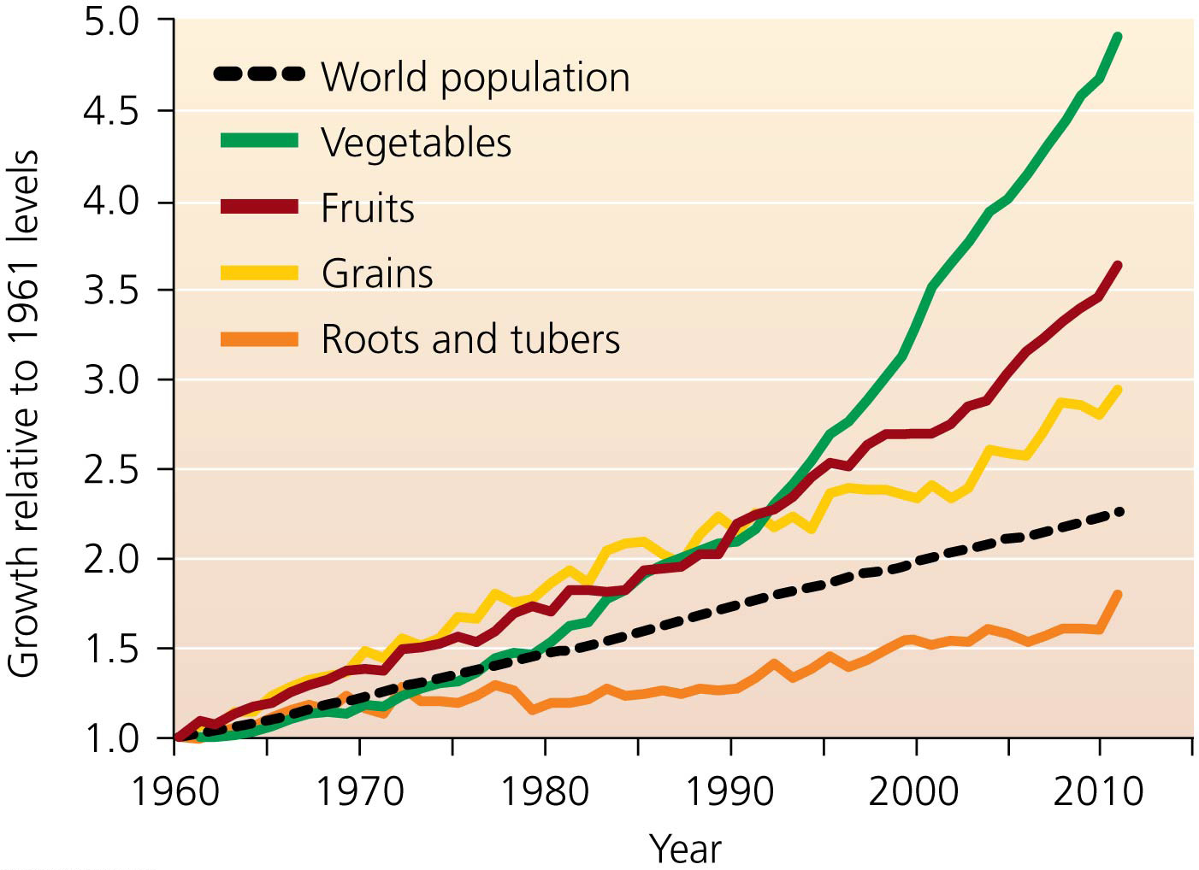

Slide 9
We face undernutrition, overnutrition, and malnutrition
870 million people do not have enough to eat
Undernutrition = people receive fewer calories than their minimum requirements
Due to economics, politics, conflict, and inefficiencies in distribution
Most undernourished live in developing nations
But 50 million Americans are “food insecure”
Food security = guarantee of an adequate, safe, nutritious, and reliable food supply
Undernutrition has decreased since the 1960s

Slide 10
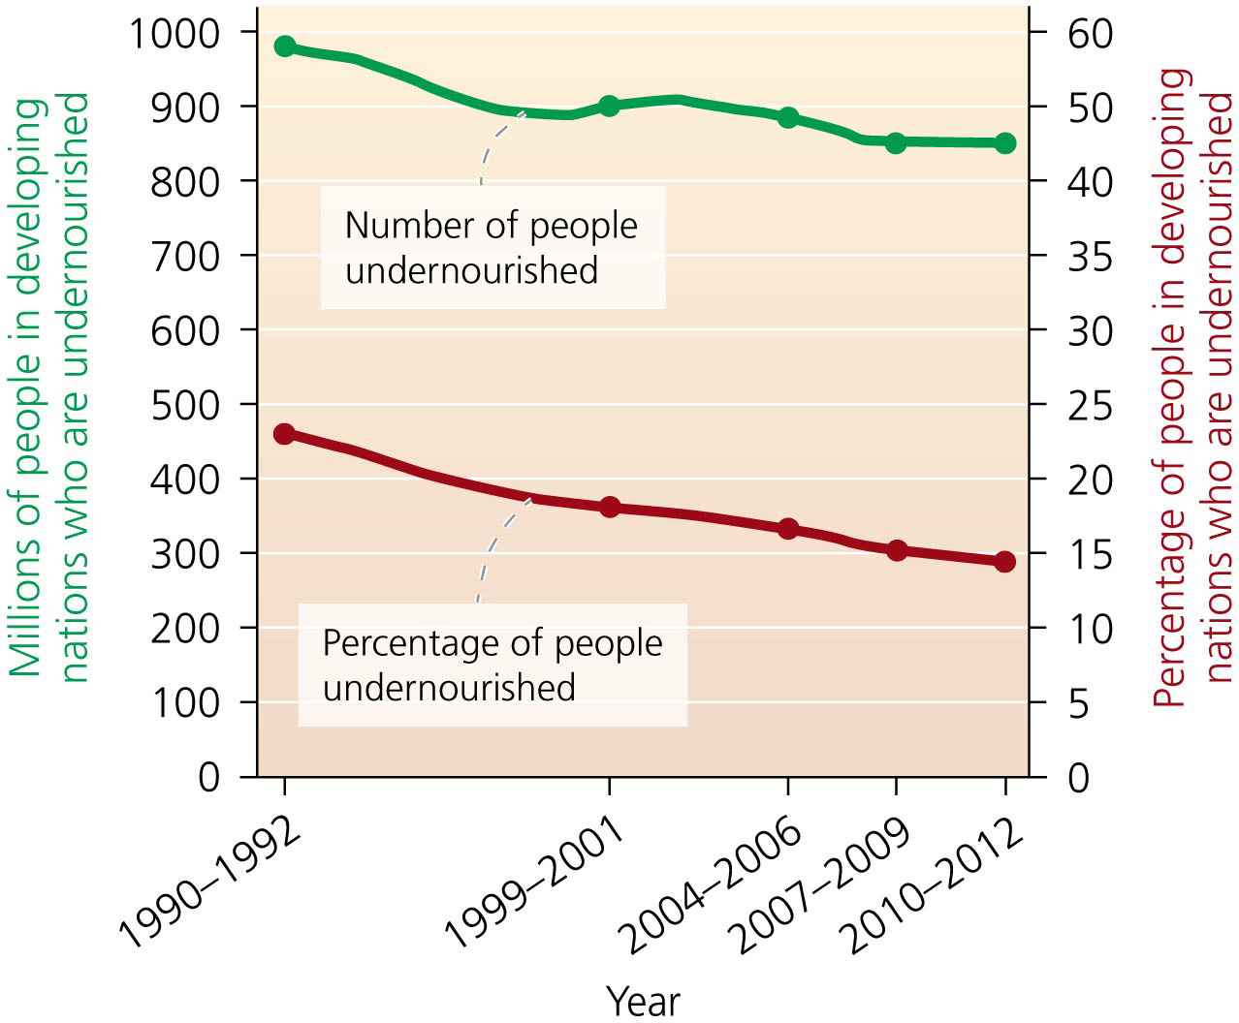

Slide 11
We face undernutrition, overnutrition, and malnutrition
Drop in undernutrition is due to falling cost of food
But food prices have been rising since 2002
Overnutrition = receiving too many calories each day
Developed countries have abundant, cheap junk food, and people lead sedentary lives
In the U.S., 25% of adults are obese
Worldwide, over 400 million people are obese
Malnutrition = a shortage of nutrients the body needs
The diet lacks adequate vitamins, minerals, protein
Can lead to diseases

Slide 12
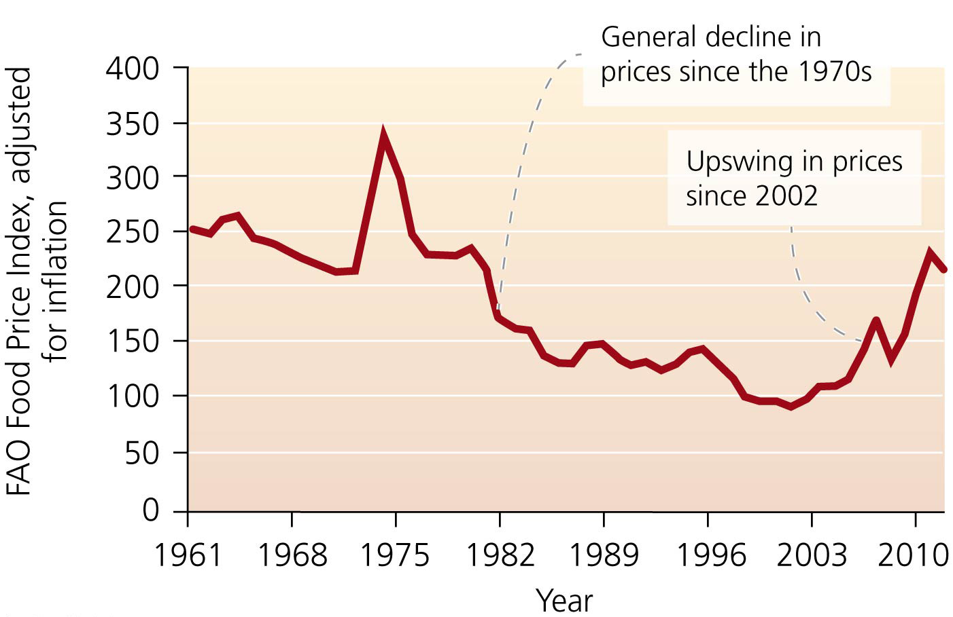

Slide 13
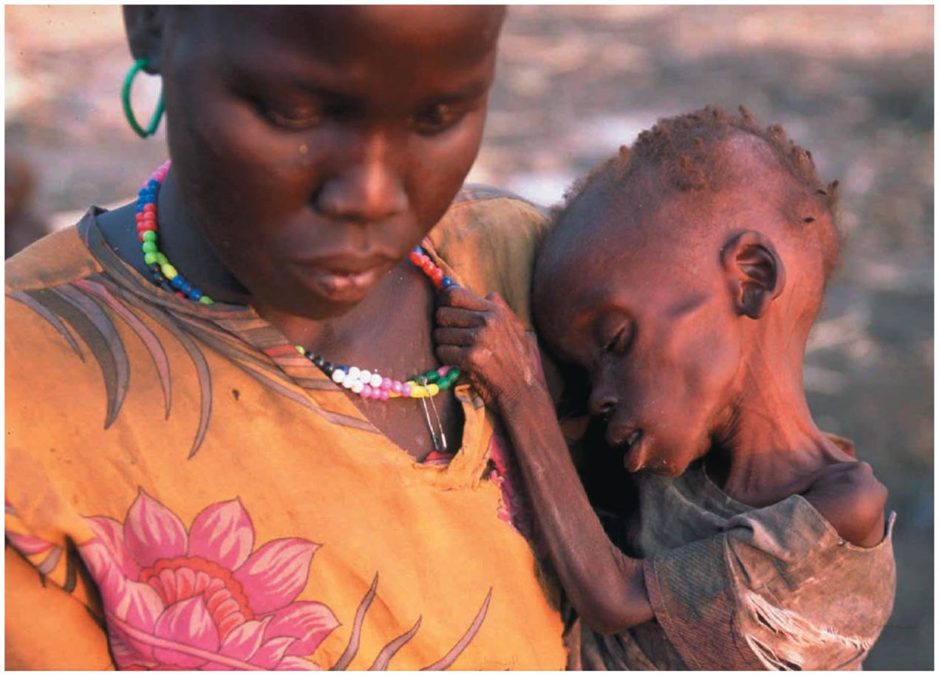

Slide 14
The Green Revolution boosted agricultural production
Spread to the developing world in the 1940s
Wheat, rice, corn
Plants produce more and are disease and wind resistant
Norman Borlaug won the Nobel Peace Prize for his work
Developing countries were able to double, triple, or quadruple yields
India went from importing grain to exporting

Slide 15
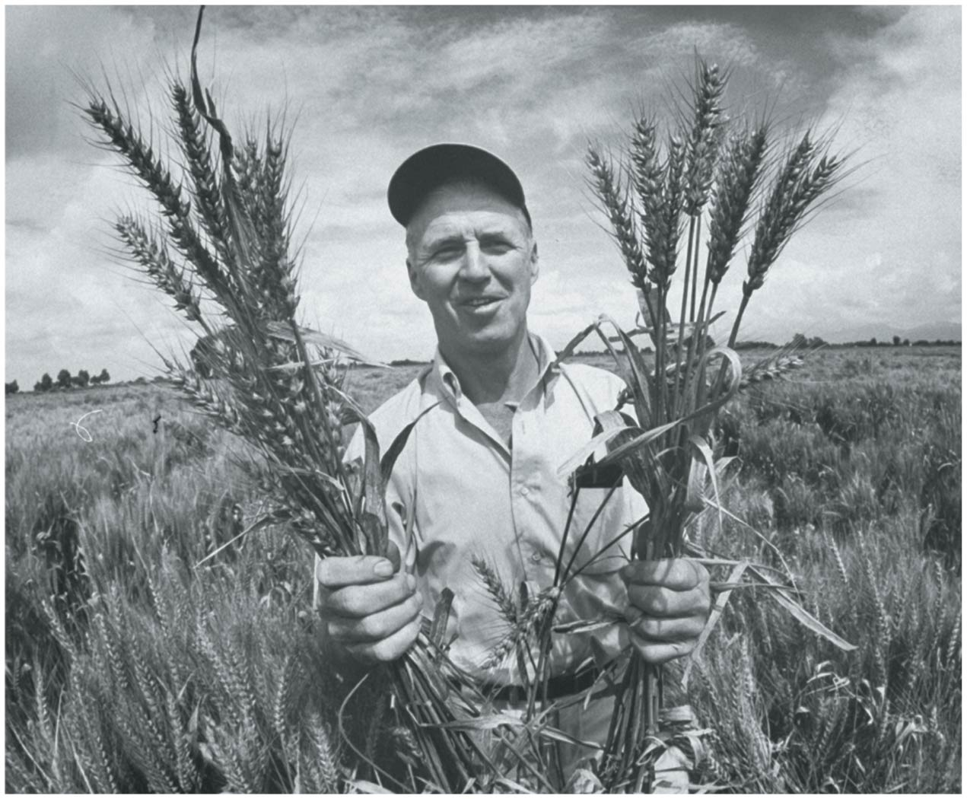

Slide 16
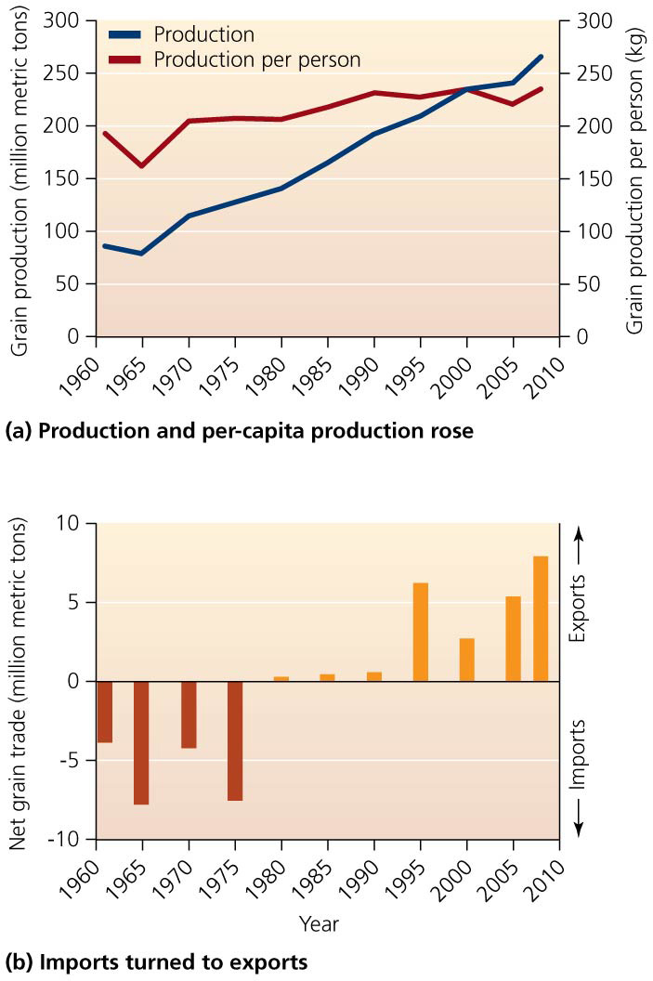

Slide 17
The Green Revolution brought mixed consequences
Depended on heavy use of:
Synthetic fertilizers and chemical pesticides
Irrigation
Fossil fuel-powered machinery
From 1900 to 2000, cultivated area increased 33% while energy inputs increased 80 times
Positive effects on the environment
Prevented some deforestation and land conversion
Preserved biodiversity and ecosystems

Slide 18
The Green Revolution brought mixed consequences
Negative effects on natural resources
Pollution
Loss of topsoil and soil quality
Monoculture = large expanses of a single crop
More efficient, increases output
Devastates biodiversity
Plants are more susceptible to disease and pests
Human diet is narrowed: 90% of our food comes from 15 crop and 8 livestock species
Yields in some Green Revolution regions are now declining

Slide 19
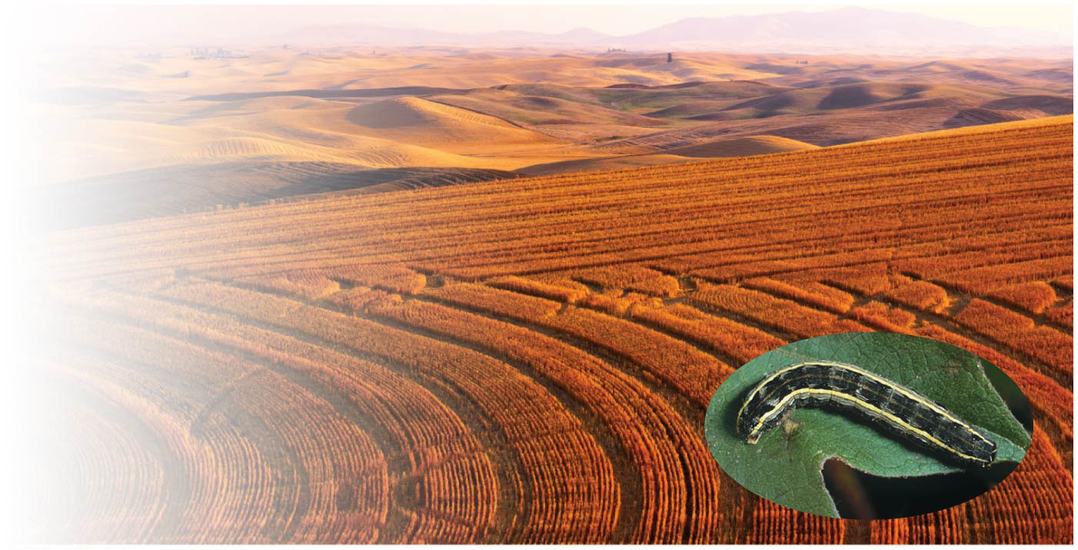

Slide 20
Some biofuels reduce food supplies
Biofuels = fuels derived from organic materials
Replace petroleum in engines
Ethanol = a biofuel derived from corn
2007 subsidies doubled production
Food prices increased
Farmers sold corn for ethanol, not food
Farmers planted biofuels, not food crops
Riots erupted in many nations

Slide 21
We are moving toward sustainable agriculture
Sustainable agriculture = agriculture that does not deplete soils faster than they form. It does not
reduce the amount of healthy soil
pollute water
decrease genetic diversity
No-till farming and other soil conservation methods help make agriculture more sustainable
Reducing fossil-fuel inputs and pollution is a key goal
Many approaches move away from the industrial agriculture model

Slide 22
Raising Animals for Food
Food from cropland agriculture makes up the majority of the human diet
Most people also eat animal products
Consuming animal products has environmental, social, agricultural, and economic impacts

Slide 23
Raising Animals for Food
Since 1950, global meat production has increased fivefold and per capita meat consumption has doubled
As wealth and commerce increase, so does meat, milk, and egg consumption
Domestic animals raised for food increased from 7.2 billion in 1961 to 27.5 billion in 2011
Meat consumption is expected to double by 2050

Slide 24
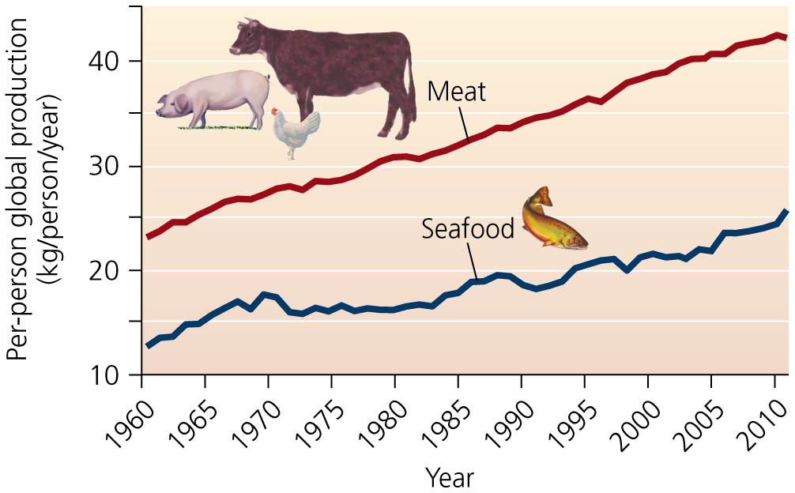

Slide 25
Our food choices are also energy choices
Eating meat is far less energy efficient than eating crops
90% of energy is lost from one trophic level to the next
Eating lower on the food chain feeds more people
Some animals convert grain into meat more efficiently than others

Slide 26
Our food choices are also energy choices
Land and water are needed to raise food for livestock
Producing eggs and chicken meat requires the least space and water
Producing beef requires the most
Foods from different animals have different ecological footprints

Slide 27
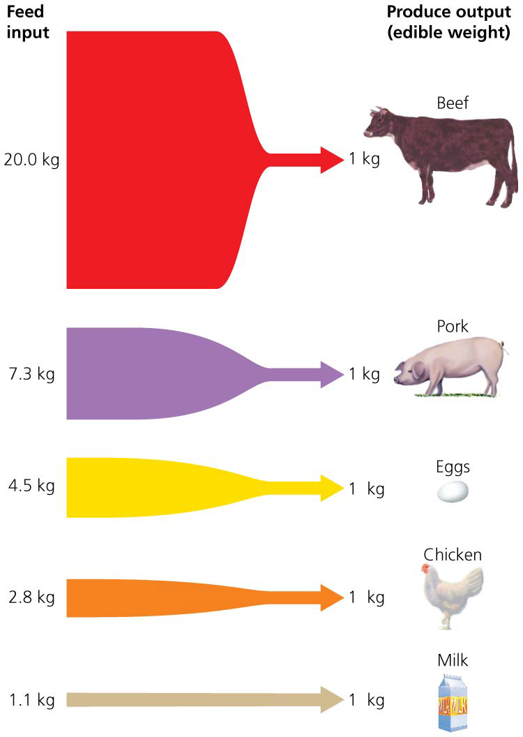
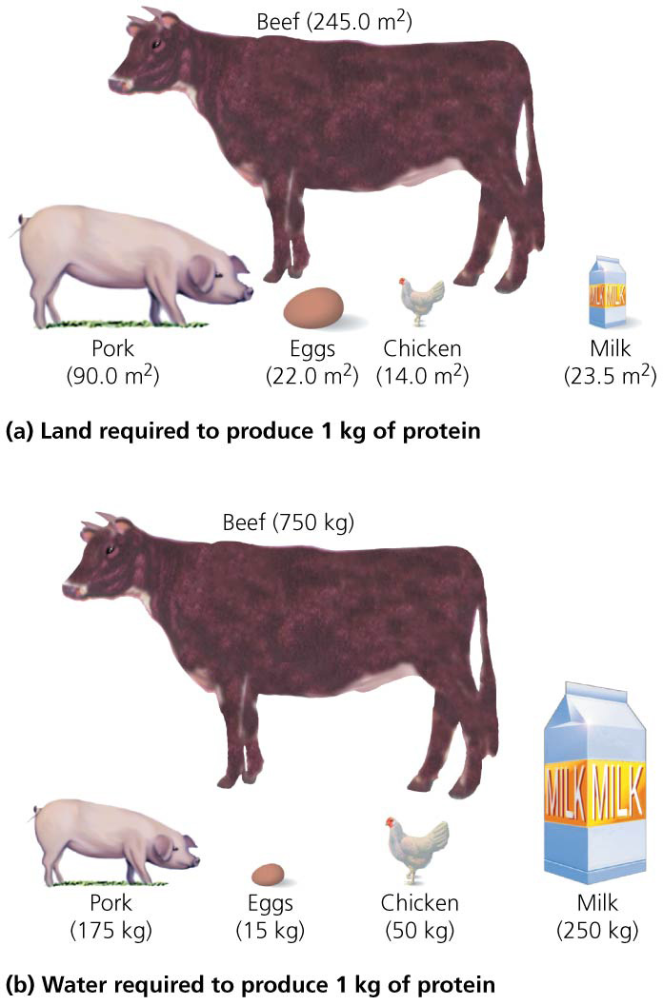

Slide 28
Rising demand led to feedlot agriculture
Feedlots (factory farms, also called concentrated animal feeding operations, or CAFOs) = huge warehouses or pens that deliver food to animals living at extremely high densities
Increases production and lowers costs
Over half of the world’s pork and most of its poultry come from feedlots
45% of global grain production goes to livestock
Environmental benefits:
Reduced grazing impacts on the land
Manure can be applied to fields as fertilizer

Slide 29
Livestock agriculture pollutes water and air
Feedlots produce huge amounts of manure and urine
Pollute surface and groundwater and can lead to eutrophication
Waterborne pathogens can sicken people
Crowded conditions require heavy use of antibiotics to prevent disease outbreaks
Microbes evolve resistance to antibiotics

Slide 30
Livestock agriculture pollutes water and air
To spur growth, animals are fed hormones and heavy metals
Chemicals can be transferred to people
Feedlots produce odor and more greenhouse gases (CO₂, methane, nitrous oxides) than automobiles

Slide 31
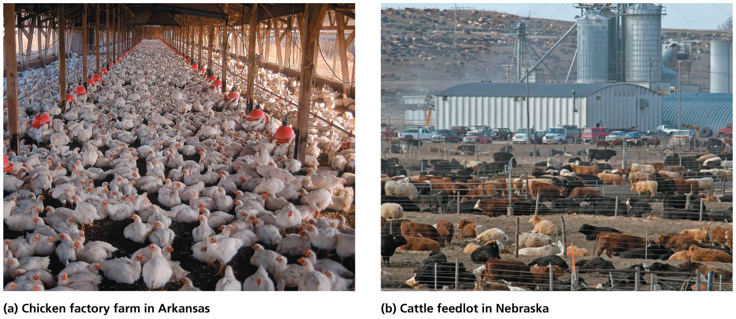

Slide 32
We raise seafood with aquaculture
World fish populations are plummeting
Technology and increased demand led to overharvesting
Aquaculture = raising aquatic organisms in a controlled environment
Species are raised in open-water pens or land-based ponds
Over 220 freshwater and marine species are grown
The fastest-growing type of food production
Production has doubled in the last decade to $125 billion worth of food
Most widespread in Asia

Slide 33
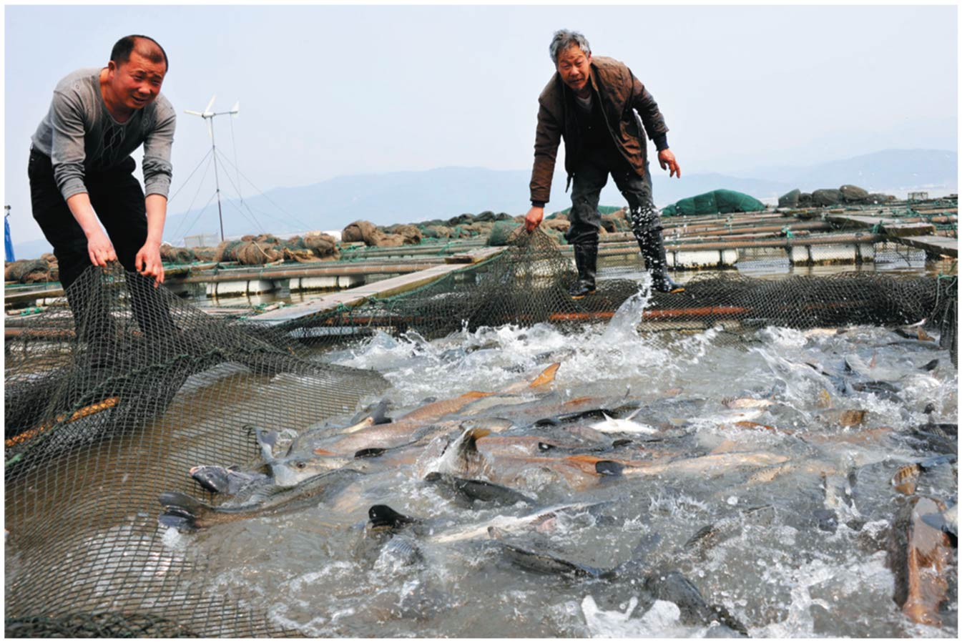

Slide 34
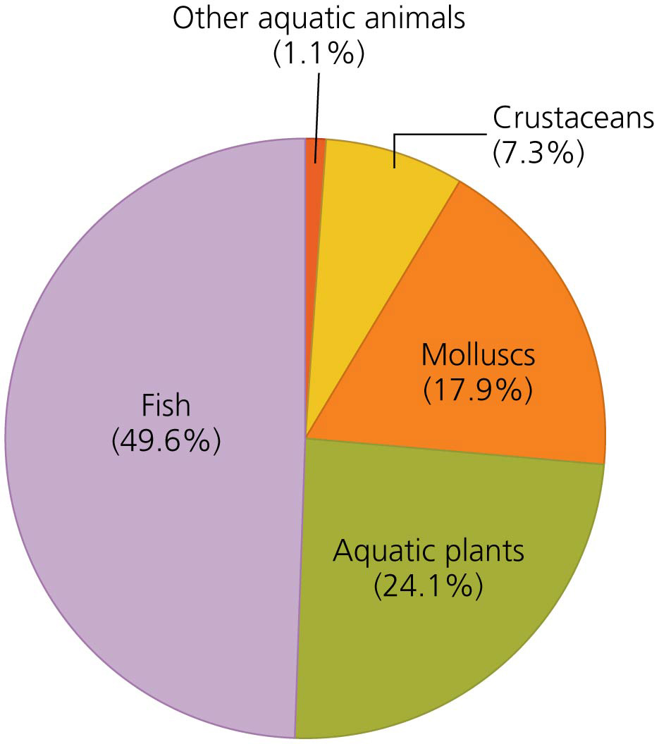

Slide 35
Aquaculture brings benefits and has negative impacts
Benefits:
A reliable protein source
Can be sustainable
Reduces pressure on overharvested wild fish
Reduces bycatch (nontarget organisms)
Energy efficient
Negative impacts:
Diseases require expensive antibiotics
Lots of waste
Sometimes fed wild-caught fish
Uses grain that might otherwise go to people
Escaped fish may introduce disease or outcompete wild fish

Slide 36
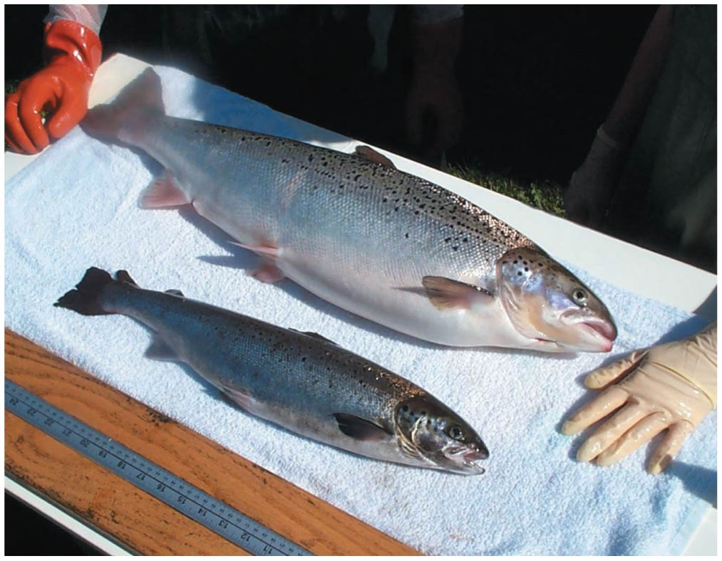

Slide 37
Crop diversity provides insurance against failure
Preserving native variants protects against crop failure
Monocultures are vulnerable
Wild relatives contain genes that can provide resistance to disease and pests
We have lost a great deal of genetic diversity in crops
Only 30% of the corn varieties in Mexico in 1930 still exist today
In the United States, many fruit and vegetable crops have decreased 90% in diversity
Food producers prefer uniform, standardized food

Slide 38
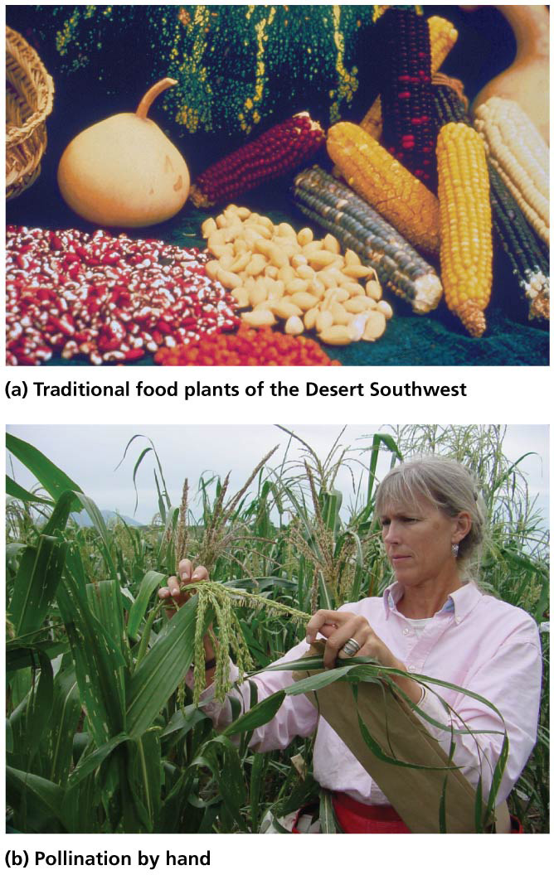

Slide 39
Seed banks are living museums
Seed banks = institutions that preserve seed types as living museums of genetic diversity
Seeds are collected, stored, and periodically planted
1400 seed banks house 1–2 million distinct types of seeds worldwide
Internationally funded Svalbard Global Seed Vault
So-called doomsday seed vault
Stores millions of seeds from seed banks around the world in case of global agricultural calamity

Slide 40
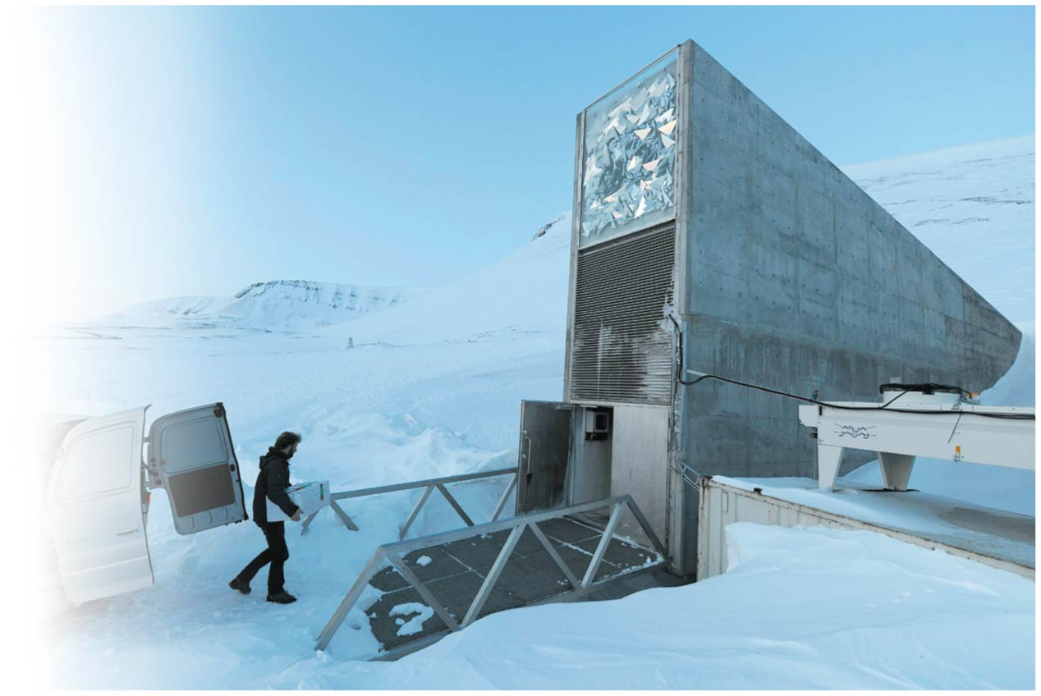

Slide 41
We depend on insects to pollinate crops
Not all insects are pests; some are absolutely vital
800 crop species rely on insect pollinators
Pollination = male plant sex cells fertilize female sex cells
By wind or animals
Pollinators include:
Hummingbirds
Bats
Insects (e.g., bees, wasps)
Native bees provide $3 billion in yearly pollination services in the United States

Slide 42
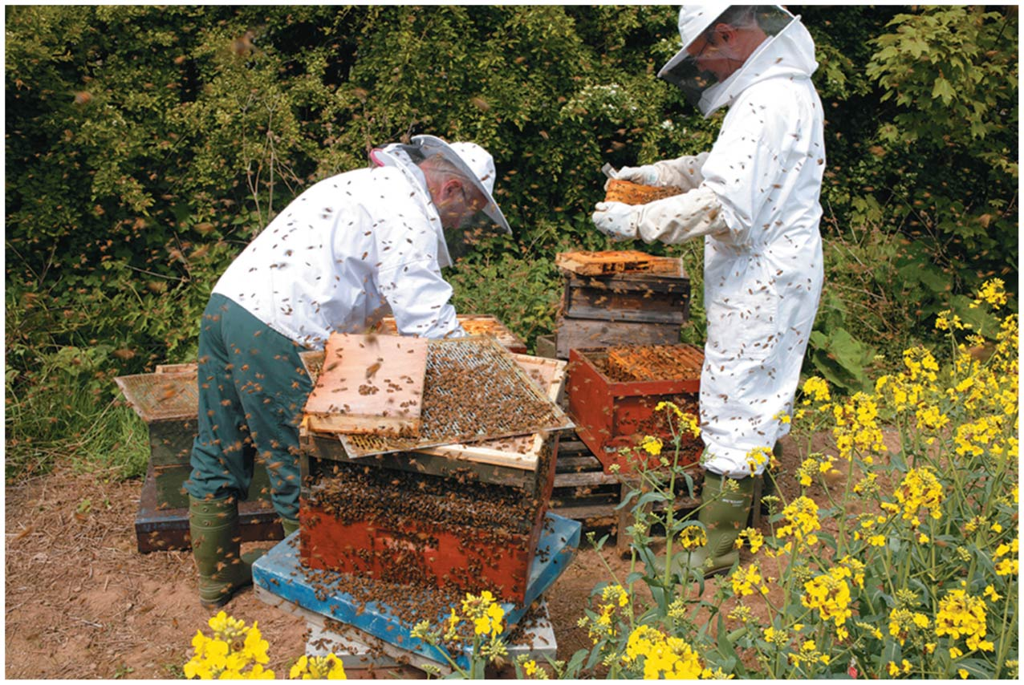

Slide 43
Conservation of pollinators is vital
The honey bee pollinates over 100 crops that make up one-third of the U.S. diet and contributes $15 billion in services per year
Populations of pollinators (e.g., bees) have plummeted
Colony collapse disorder = entire beehives have vanished
Unknown causes—Insecticides? Parasites? Stress?
Reducing or eliminating pesticide use and planting flowering plants will help preserve bees

Slide 44
“Pests” and “weeds” hinder agriculture
Pest = any organism that damages valuable crops
Weed = any plant that competes with crops
Industrial farming limits natural mechanisms to control pest and weed populations
Pesticides = poisons that target pest organisms
Insecticides kill insects, herbicides kill plants, fungicides kill fungi
400 million kg (900 million lb) of pesticides are applied in the United States each year
Fourfold increase in use worldwide since 1960
$32 billion/year is spent on pesticides

Slide 45
Pests evolve resistance to pesticides
Some individuals are genetically immune to a pesticide
They pass these genes to their offspring
Nonresistant pests are killed off
Pesticides stop being effective
“Pesticide treadmill” = chemists change chemicals or increase toxicity to compete with resistant pests
Over 586 insect species are resistant to 330 pesticides
Pesticides also kill nontarget organisms, including predators and parasites of pests
Pest populations become harder to control

Slide 46
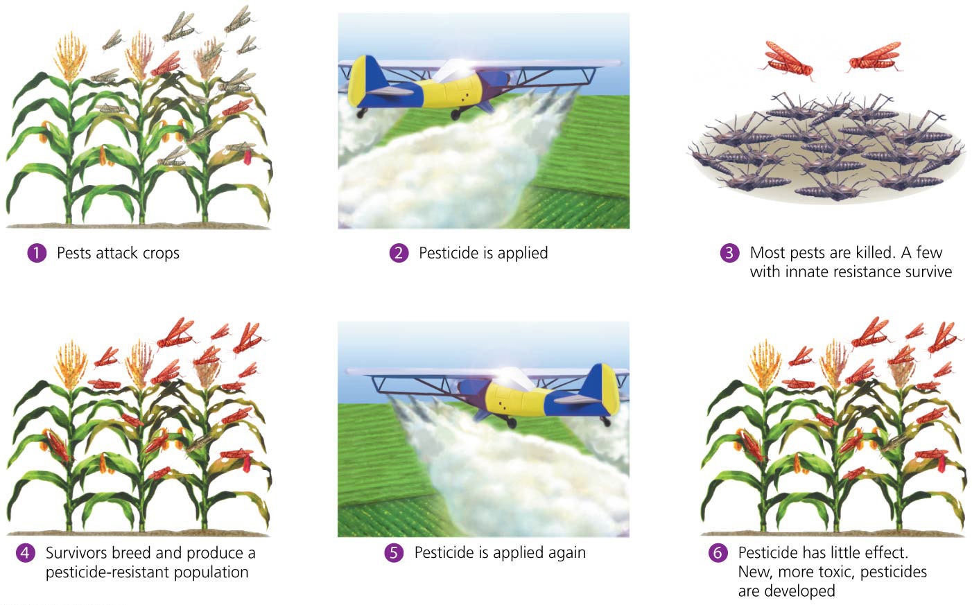

Slide 47
Biological control pits one organism against another
Biological control (biocontrol) = strategy that uses a pest’s predators or parasites to control the pest
Parasitoid wasps are a commonly used group of biocontrol agents
Reduces pest populations without chemicals
Cactus moths control prickly pear
Bacillus thuringiensis (Bt) = soil bacterium that kills many caterpillars and some fly and beetle larvae

Slide 48
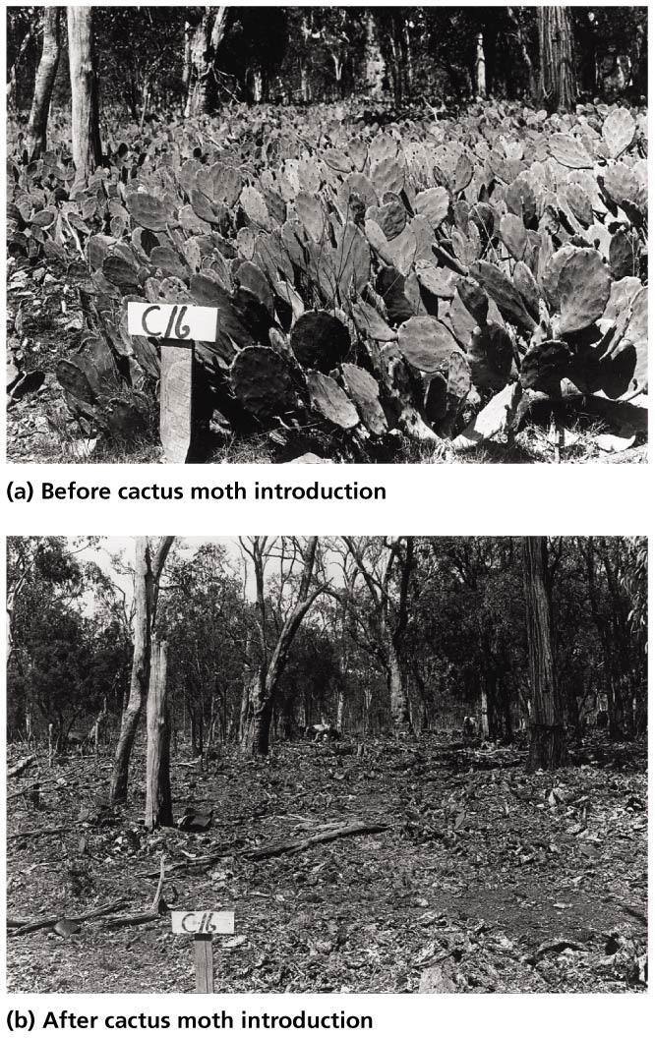

Slide 49
Biocontrol agents themselves can become pests
It is risky to introduce an organism from a foreign ecosystem into a new ecological context
The effects of an introduced species are unpredictable
The agent may have nontarget effects on the environment and surrounding economies
Cactus moths are eating rare Florida cacti
Removing a biocontrol agent is harder than halting pesticide use
Biocontrol use must be carefully planned and regulated

Slide 50
Integrated pest management combines biocontrol and chemical methods
Integrated pest management (IPM) = use of a mix of techniques to suppress pests:
Pest population monitoring
Biocontrol and mechanical pest removal
Chemicals, if necessary
Crop rotation and alternative tillage methods
Use of transgenic crops
IPM in Indonesia increased rice yields 13%, cut pesticide use in half, and saved $179 million/yr in phased-out subsidies

Slide 51
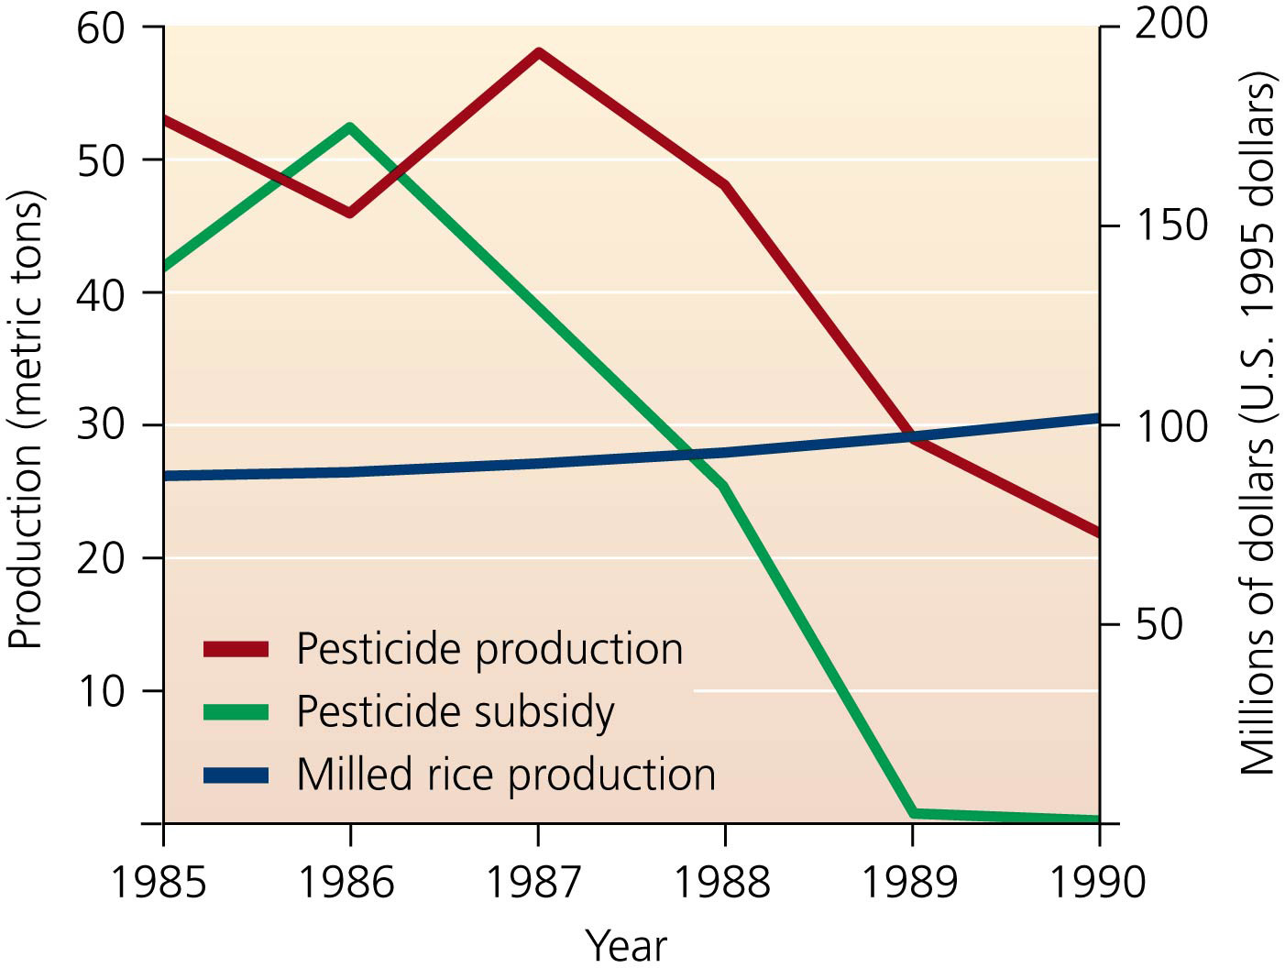

Slide 52
Organic approaches reduce inputs and pollution
Organic agriculture = food-growing practices that use no synthetic fertilizers or pesticides but rely on biological approaches such as composting and biocontrol
Organic Food Production Act (1990) establishes national standards for organic products
The USDA issued criteria in 2000 by which food could be labeled organic
Some states (California, Washington, Texas) and over 80 nations have stricter guidelines

Slide 53
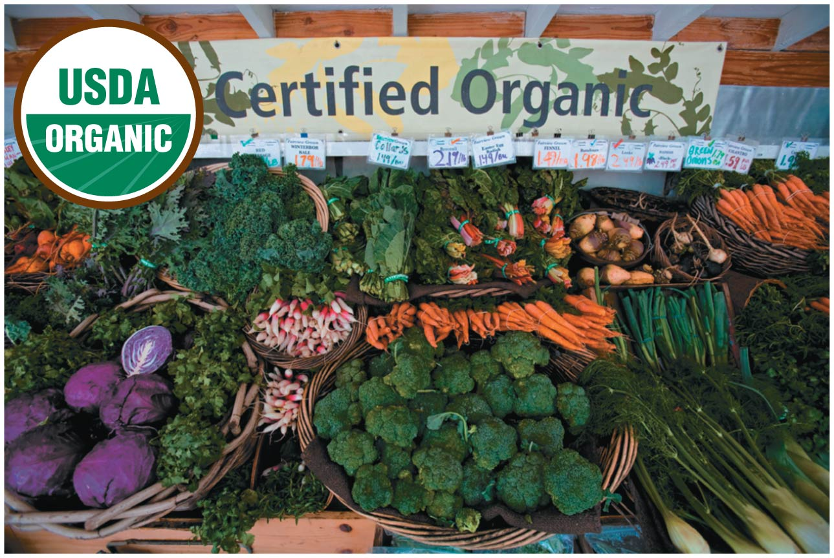

Slide 54
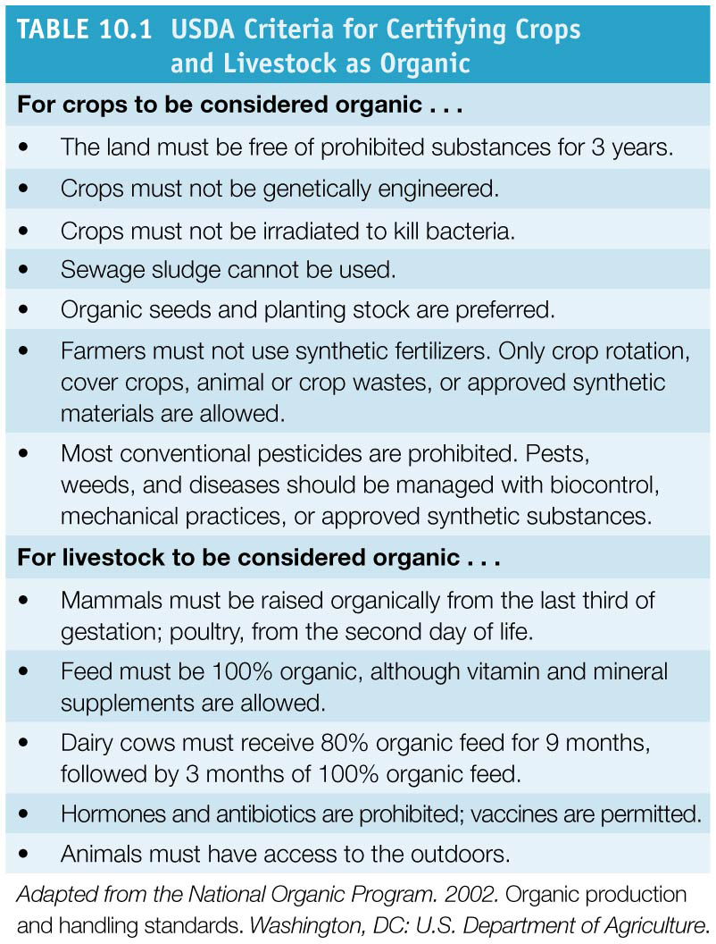

Slide 55
Organic approaches reduce inputs and pollution
Farmers have lower input costs, enhanced income (organic crops fetch a higher price), reduced chemical pollution and soil degradation
They adopt organic practices primarily to practice stewardship toward the land
Obstacles include risks and costs of switching to new methods
Transitioning to certified organic may take years
Consumers are concerned about pesticides’ health risks
They also want to improve environmental quality
Obstacles include the higher price of organics

Slide 56
Organic agriculture is booming
Organic farmers can’t keep up with demand
U.S. consumers pay $29.2 billion in 2011
Worldwide sales tripled from 2000 to 2010
Production is increasing. In 2011:
Nearly 2 million ha (4.8 million acres) in the U.S.
37 million ha (91 million acres) worldwide
But still less than 1% of total agricultural land
Two-thirds of organic agricultural land is in developing nations
30% of Mexico’s coffee production is organic

Slide 57
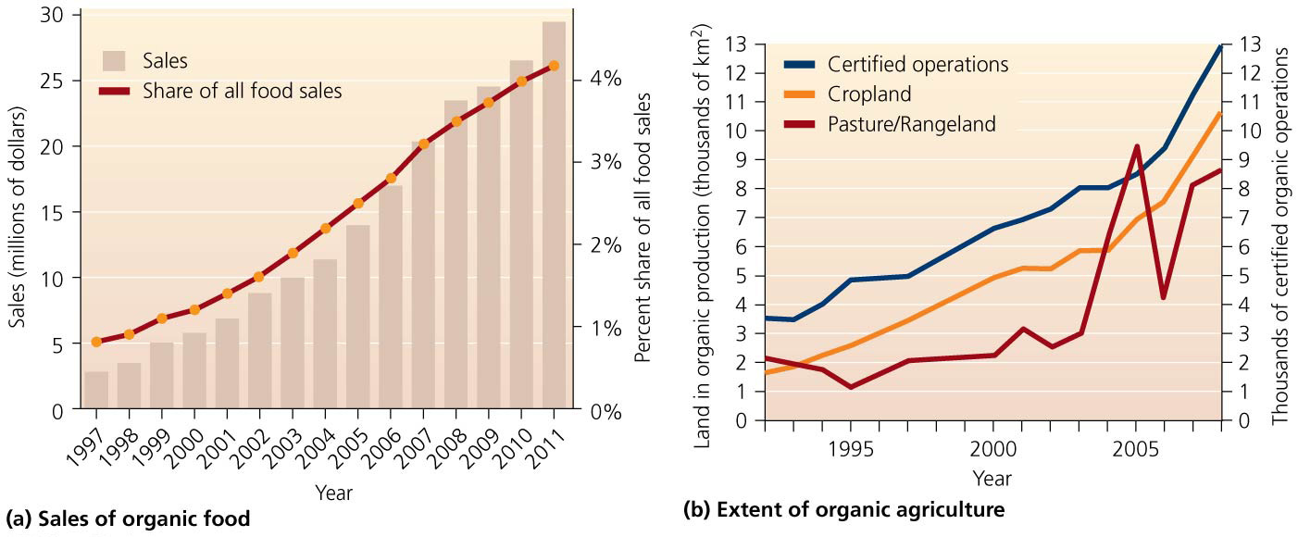
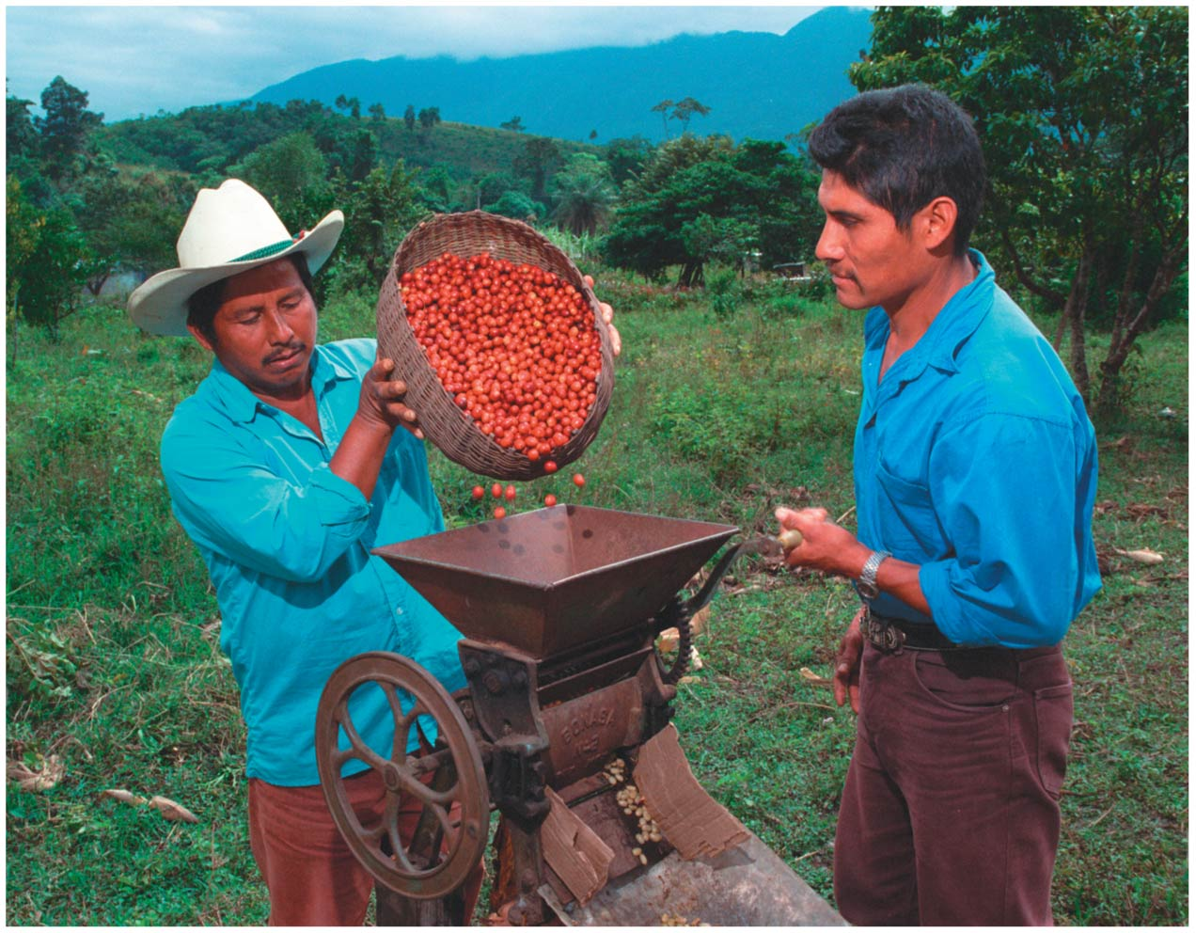

Slide 58
Organic agriculture is booming
The European Union supports farmers financially during conversion to organic farming
Conversion can mean a temporary loss of income
This support is a subsidy to cover external costs
The U.S. offers no such subsidies so organic production lags
The 2008 Farm Bill gives $112 million over 5 years for organic agriculture
In the long run, organic farming is at least as profitable as conventional farming

Slide 59
Genetically Modified Food
Biotechnology = the application of biological science to create products derived from organisms
Seeks to scale up the technological aspects of agriculture
Genetic engineering = direct manipulation of genetic material through adding, deleting, modifying DNA

Slide 60
Genetically Modified Food
Genetically modified organisms (GMOs) = organisms that have been genetically engineered by …
Recombinant DNA = DNA patched together from multiple organisms
Biotechnology has created medicines, cleaned up pollution, and dissolved blood clots

Slide 61
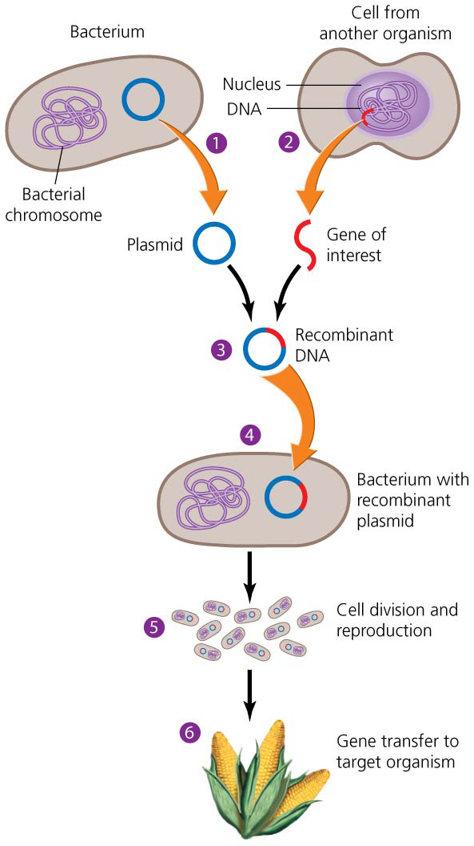

Slide 62
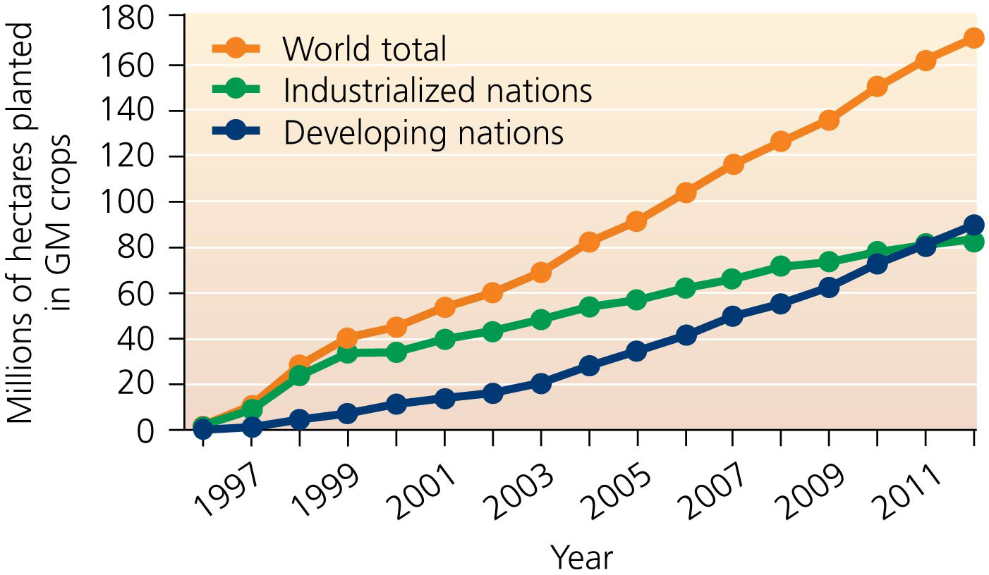

Slide 63
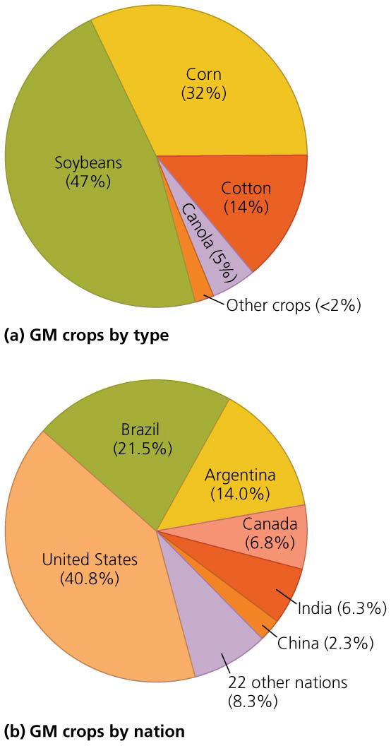

Slide 64
Genetic engineering is like, and unlike, traditional breeding
Traditional breeding changes organisms through selective breeding of the same or similar species
Works with entire organisms in the field
Genes come together on their own
Uses the process of selection
Genetic engineering mixes genes of different species
Works with genetic material in the lab
Directly creates novel combinations of genes
Resembles the process of mutation

Slide 65
Biotechnology is transforming the products around us
GM foods are a big business
Globally in 2012, 17 million farmers grew GM foods on 170 million ha (420 million acres)—11% of all cropland
90% of U.S. corn, soybean, cotton, and canola are GM plants
Most GM crops are herbicide and pesticide resistant
Large-scale farmers grow crops more efficiently

Slide 66
What are the benefits of GM foods?
Increased yield with lower costs
Decreased irrigation, deforestation, land conversion
Reduced production of greenhouse gasses through increased no-till farming
Reduced use of chemical insecticides since plants produce their own insecticides (like Bt)
Bt cotton in India increased yields with less chemicals
Plants are made herbicide resistant so less herbicides used
But studies are showing increased use of herbicides since plants can withstand the high doses

Slide 67
What are the impacts of GM foods?
As GM crops expanded, scientists, citizens, and policymakers became concerned
Impacts on human health, but support of this has been elusive
Ecological concerns over escaping transgenes
They could harm nontarget organisms
Pests could evolve resistance
They could ruin the integrity of native ancestral races and interbreed with closely related wild plants
Precautionary principle = idea that one shouldn’t undertake a new action until the effects of that action are understood

Slide 68
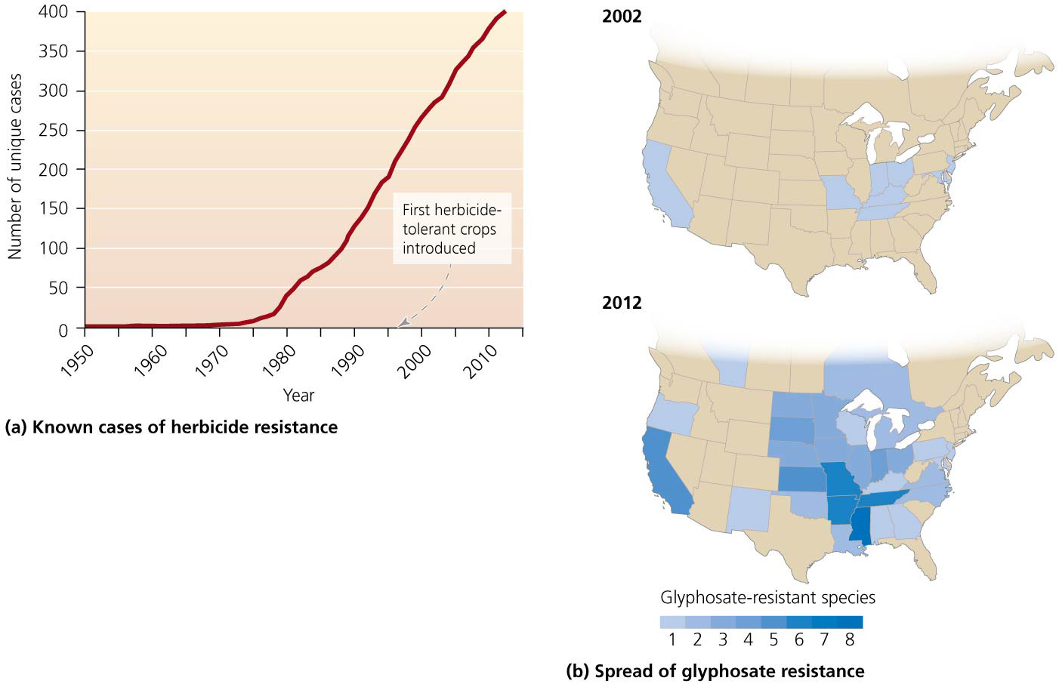

Slide 69
Public debate over GM foods continues
Ethical and economic (rather than scientific) concerns have largely driven the public debate
People don’t like “tinkering” with the food supply
With increasing use, people are forced to use GM products or go to special effort to avoid them
Critics say multinational corporations threaten the small farmer
Research is funded by corporations that profit if GM foods are approved for use
Approval decisions may not match Environmental Impact Statement findings (e.g., GM sugar beets)

Slide 70
Public debate over GM foods continues
GM crops have not eradicated hunger or helped poor farmers in developing nations
GM crops do not focus on increased nutrition, drought tolerance, salinity tolerance, etc.
Unlike the Green Revolution, which was a public venture, the “genetic revolution” has been driven by corporate financial interests

Slide 71
Public debate over GM foods continues
Corporations patent transgenes and protect them
Monsanto has launched 145 lawsuits against several hundred farmers for having transgenes in their fields without buying them from Monsanto
Widespread concern exists that organic foods will be contaminated by GM plants

Slide 72
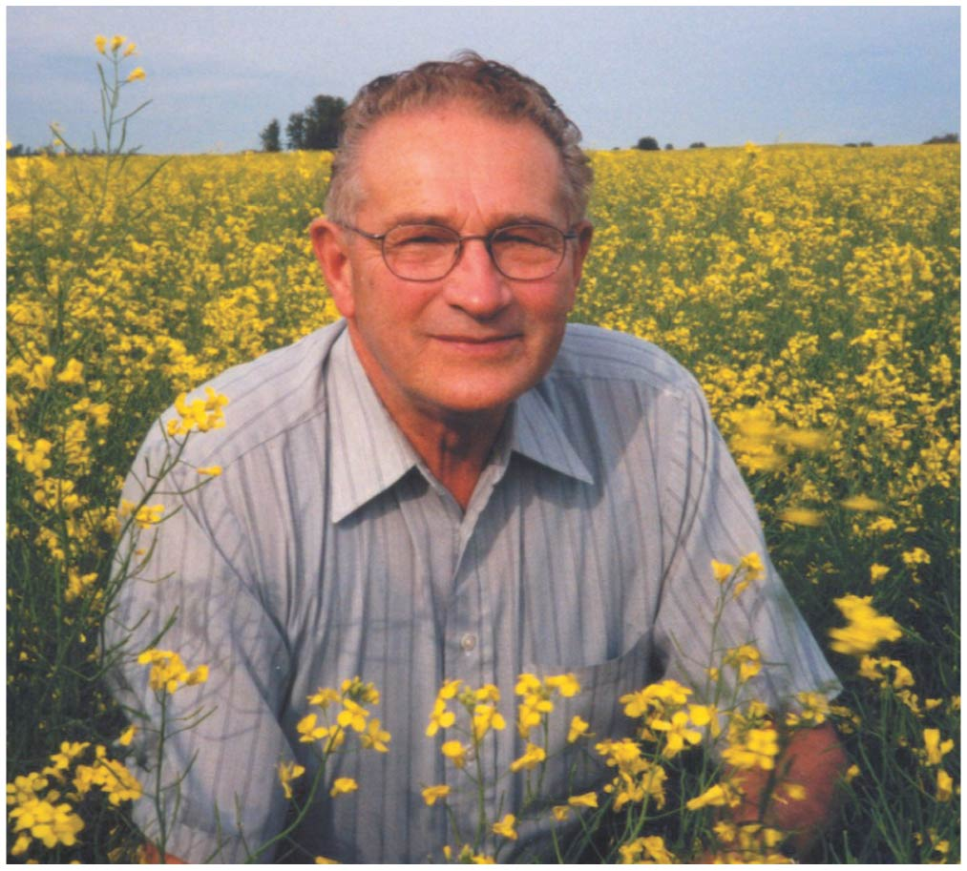

Slide 73
Public debate over GM foods continues
Consumers in Europe have expressed widespread unease about genetic engineering
U.S. consumers have largely accepted GMOs
Europe blocked import of American agricultural products from 1998 to 2003 because of concerns about the products being genetically modified
The United States sued the European Union before the World Trade Organization for hindering free trade
The Cartagena Protocol on Biosafety lays out guidelines for open information about exported crops

Slide 74
Many nations label GM foods
Some nations now demand that GM foods be labeled
United States does not require labeling
Large majority of Americans would like labeling
Petition of over 1 million signatures asked the FDA to start requiring labeling
Labeling proponents: people have a right to know what they are eating
Labeling opponents: labeling implies that the food is dangerous
In countries where food is labeled, some products stopped being stocked due to consumer aversion

Slide 75
Sustainable Food Production
Multiple strategies can be used to sustainably meet the food demands of the growing human population
Biotechnology can increase yields and reduce environmental impacts
Results to date are debatable
Organic agriculture promotes sustainability by eliminating fossil-fuel-based chemical inputs
Questions about how many people can be fed using only organic methods
All approaches must deal with impacts to soil, water, crop diversity, and pollution

Slide 76
Locally supported agriculture is growing
Average food item in a U.S. grocery store traveled 1300 km (1000 mi) to get there from the farm
Food is chemically treated for freshness and color
Farmers’ markets = provide meats and fresh fruits and vegetables from local producers
Community-supported agriculture (CSA)
Consumers pay farmers in advance so farmers get guaranteed income
Consumers get fresh locally grown food
Life-cycle analysis = analysis of all inputs across all stages of production, transportation, sale, and use
Only 4–5% of energy use is from transport

Slide 77
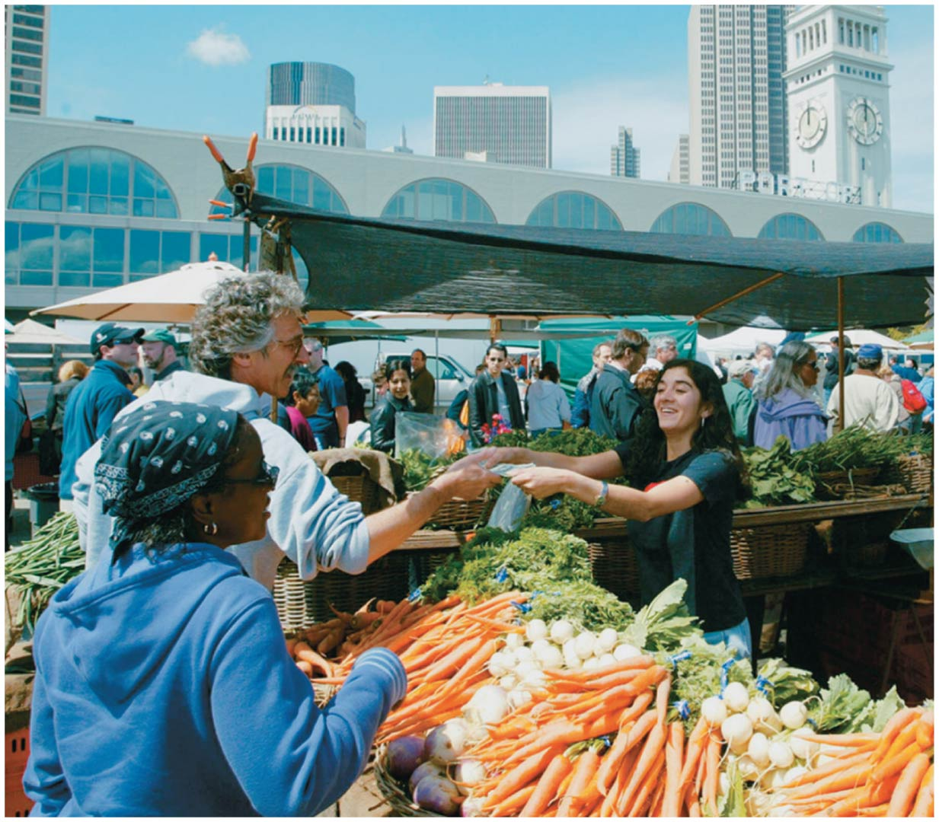

Slide 78
Sustainable agriculture mimics natural ecosystems
Ecosystems are naturally sustainable and operate in cycles stabilized by negative feedback loops
Agriculture can be sustainable if it mimics ecosystems
Small-scale Japanese farmers add ducks to rice fields
Ducks eat weeds, insects, snails
Their waste is fertilizer
Their paddling oxygenates the water
Fish and ferns provide food and habitat
Twice as productive as region’s conventional farms

Slide 79
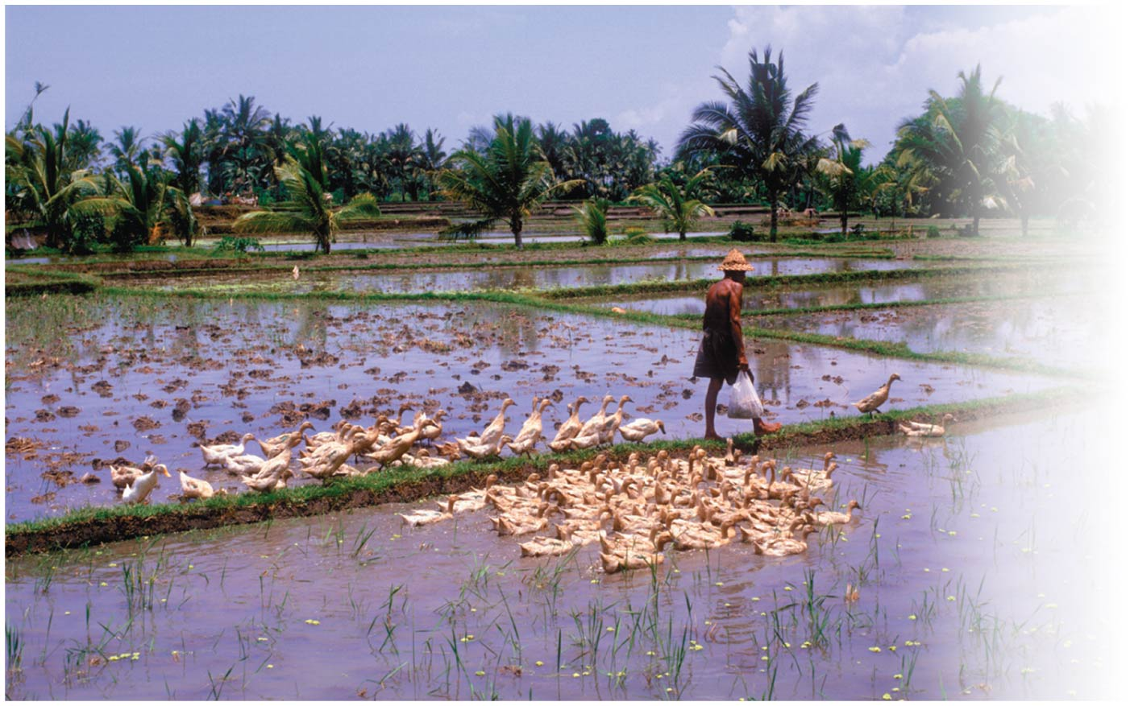

Slide 80
Conclusion
Industrialized agriculture has relieved pressures on the land, but the environmental consequences are severe
To support 9 billion humans, we must shift to sustainable agriculture
Biological pest control, organic agriculture
Pollinator protection, preservation of native crops
Sustainable aquaculture
Careful, responsible genetic modification of food

Slide 81
QUESTION: Review
Which statement is true?
a) We have become more sustainable in food production.
b) We can convert much more land to agricultural production.
c) Technology in the form of fossil fuels, pesticides, and fertilizers has increased production.
d) Population growth has exceeded food production in recent decades.
Notes:
Answer: c

Slide 82
QUESTION: Review
Which term describes the condition in which a person receives fewer calories than he or she needs?
Undernutrition
Overnutrition
Food security
Malnutrition
Notes:
Answer: a

Slide 83
QUESTION: Review
Which of the following is NOT correct about the Green Revolution?
It dramatically increased food production.
It most benefits poor farmers.
It uses large amounts of fertilizers and pesticides.
It prevented starvation of millions of people.
Notes:
Answer: b

Slide 84
QUESTION: Review
Which statement is NOT correct about factory farming?
It is far more energy efficient than eating grains.
Some species convert grain into meat more efficiently than other species.
Much of the world’s grain is fed to livestock.
More livestock can be produced in an area.
Notes:
Answer: a

Slide 85
QUESTION: Review
Which of the following is NOT a problem with using pesticides?
Many species can become resistant to pesticides.
Offspring of resistant species are also resistant.
Pesticides kill many nontarget species.
All are problems involved in using pesticides.
Notes:
Answer: d

Slide 86
QUESTION: Review
Which statement about GM food production is true?
It mixes genes from different organisms.
It mimics natural selection.
It has resulted in less herbicide use.
Producing GM foods has benefited poor farmers in developing countries.
Notes:
Answer: a

Slide 87
QUESTION: Review
Sustainable agriculture
uses concentrated animal feeding operations.
maximizes use of fertilizers and pesticides.
does not deplete soil or pollute water.
is currently not a feasible solution.
Notes:
Answer: c

Slide 88
QUESTION: Weighing the Issues
The Green Revolution has increased crop yields, but only by increasing fertilizers, pesticides, irrigation, and hybrid seed. Do you consider it a success?
Yes, because more people were fed, regardless of the price.
Yes, because industrialized countries can help through education and technology.
No. We will eventually pay the environmental costs of producing food in this way.
It does not matter; I can buy food whenever I want.
Notes:
Answer: any

Slide 89
QUESTION: Weighing the Issues
Factory farming allows us to have lots of meat products. But the animals are often kept in undesirable, stressful the conditions. Should the quality of the animals’ lives be considered when we decide how to raise food?
Yes. The quality of an animal’s life is important, too.
Yes, but only if it does not interfere with access to meat.
No. Animals have no right to a quality of life.
I don’t care; I’m not fond of cows or chickens.
Notes:
Answer: any

Slide 90
QUESTION: Interpreting Graphs and Data
If a person eats 3 kg of meat per week, how many kg of grain are required if the meat came from a pig?
60 kg
22 kg
3 kg
12 kg
Notes:
Answer: b

Slide 91
QUESTION: Interpreting Graphs and Data
What does this graph show about sales of organic food in the United States?
Sales increased slowly.
Sales increased but not the dollar amounts.
Acreage has declined in the past years.
Sales, dollar amounts, and acreage increased.
Notes:
Answer: d

