Slide 2
This lecture will help you understand:
The meaning of the term environment
The field and interdisciplinary nature of environmental science
The consequences of population growth
The importance of natural resources and ecosystem services
The scientific method and the process of science
Some pressures on the global environment
Concepts of sustainability and sustainable development

Slide 3
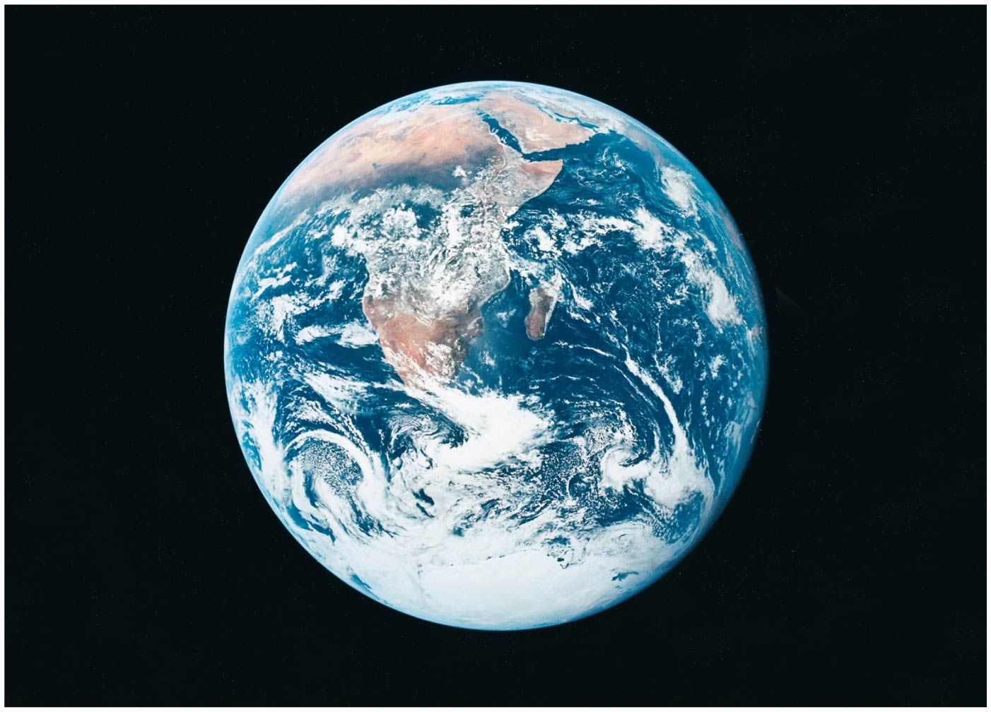

Slide 4
Our Island, Earth
Earth may seem enormous
But it and its systems are finite and limited
We can change the Earth and damage its systems
Environment = all the living and nonliving things around us
Animals, plants, forests, farms, etc.
Continents, oceans, clouds, ice caps
Structures, urban centers, living spaces
Social relationships and institutions

Slide 5
Our environment surrounds us
Humans depend on a healthy, functioning planet
The fundamental insight of environmental science:
We are part of the natural world, but we can also change it
Our interactions with its other parts matter a great deal

Slide 6
Our environment surrounds us
We depend completely on the environment for survival
Increased health, longer lives, wealth, mobility, leisure
But natural systems have been degraded by pollution, soil erosion, species extinction, etc.
Environmental changes threaten long-term health and survival

Slide 7
Environmental science explores our interactions with the world
Environmental science = the study of:
How the natural world works
How the environment affects humans and vice versa
We need to understand our interactions with the environment to creatively solve environmental problems
Global conditions are rapidly changing
We are also rapidly gaining knowledge
The opportunity to solve problems is still available

Slide 8
We rely on natural resources
Natural resources = substances and energy sources needed for survival
Renewable natural resources = that can be replenished
Perpetually renewed: sunlight, wind, wave energy
Renew themselves over short periods: timber, water, soil
These can be destroyed
Nonrenewable natural resources = that are unavailable after depletion
Oil, coal, minerals

Slide 9
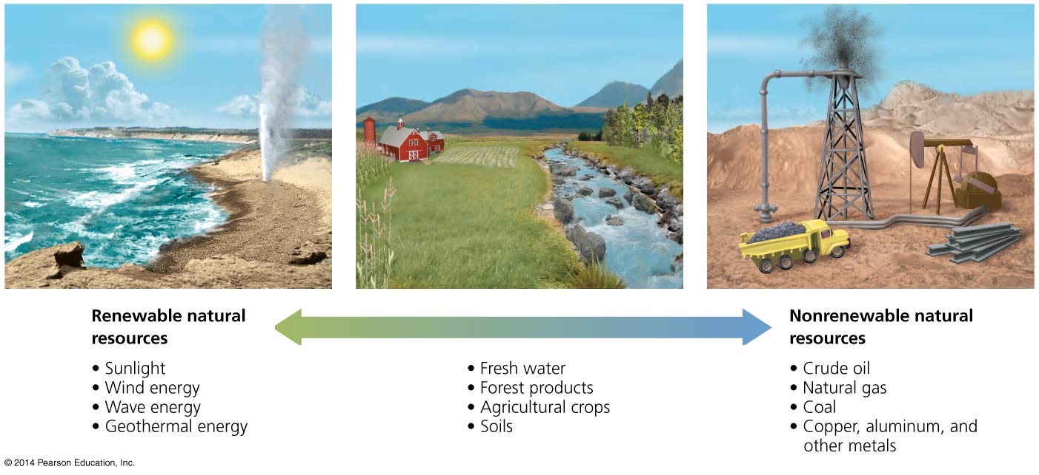

Slide 10
We rely on ecosystem services
Natural resources are “goods” produced by nature
Earth’s natural resources provide “services” to us
Ecosystem services = services that arise from the normal functioning of natural services
Purify air and water, cycle nutrients, regulate climate
Pollinate plants, receive and recycle wastes
We degrade ecosystem services by depleting resources, destroying habitat, generating pollution
Increased human affluence has intensified degradation

Slide 11
Population growth amplifies our impact
There are over 7 billion humans
Agricultural revolution
Crops, livestock
Stable food supplies
Industrial revolution
Urbanized society powered by fossil fuels (oil, gas, coal)
Sanitation and medicines
Pesticides and fertilizers

Slide 12
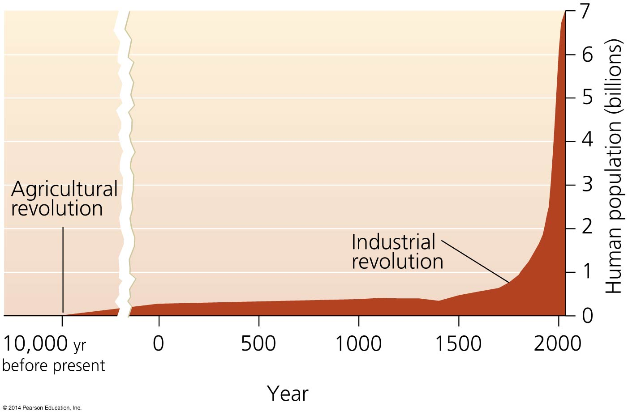

Slide 13
Resource consumption exerts social and environmental pressures
Affluence increases consumption
Ecological footprint = the environmental impact of a person or population
The area of biologically productive land + water required to supply raw resources and dispose/recycle waste
People in rich nations have much larger ecological footprints
Overshoot = humans have surpassed the Earth’s capacity to support us
We are using renewable resources 50% faster than they are being replenished

Slide 14
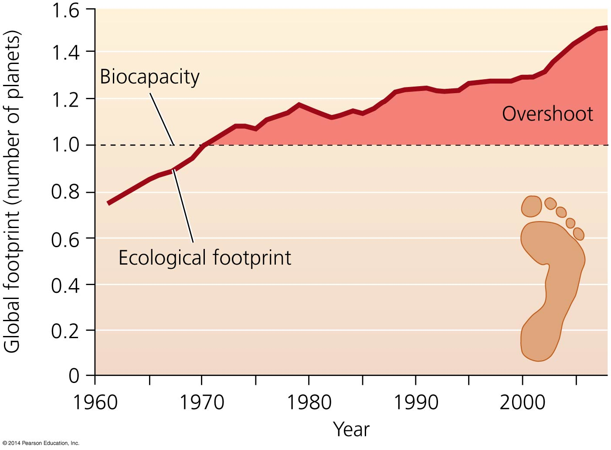
If everyone consumed the amount of resources
the U.S. does, we would need four Earths!

Slide 15
Environmental science can help us avoid past mistakes
How will resource consumption and population growth impact today’s global society?
Civilizations have fallen after degrading the environment
Easter Island, Greek and Roman empires
Once lush regions (e.g., Iraq) are now barren deserts
Civilizations succeed or fail according to how they interact with the environment
Along with how they respond to problems
Environmental science can help build a better world

Slide 16
The Nature of Environmental Science
Environment ← impacts ➔ Humans
Its applied goal: solving environmental problems
Solutions are applications of science
An interdisciplinary field
Natural sciences = disciplines that examine the natural world
Environmental science programs
Social sciences = disciplines that examine values and human behavior
Environmental studies programs

Slide 17
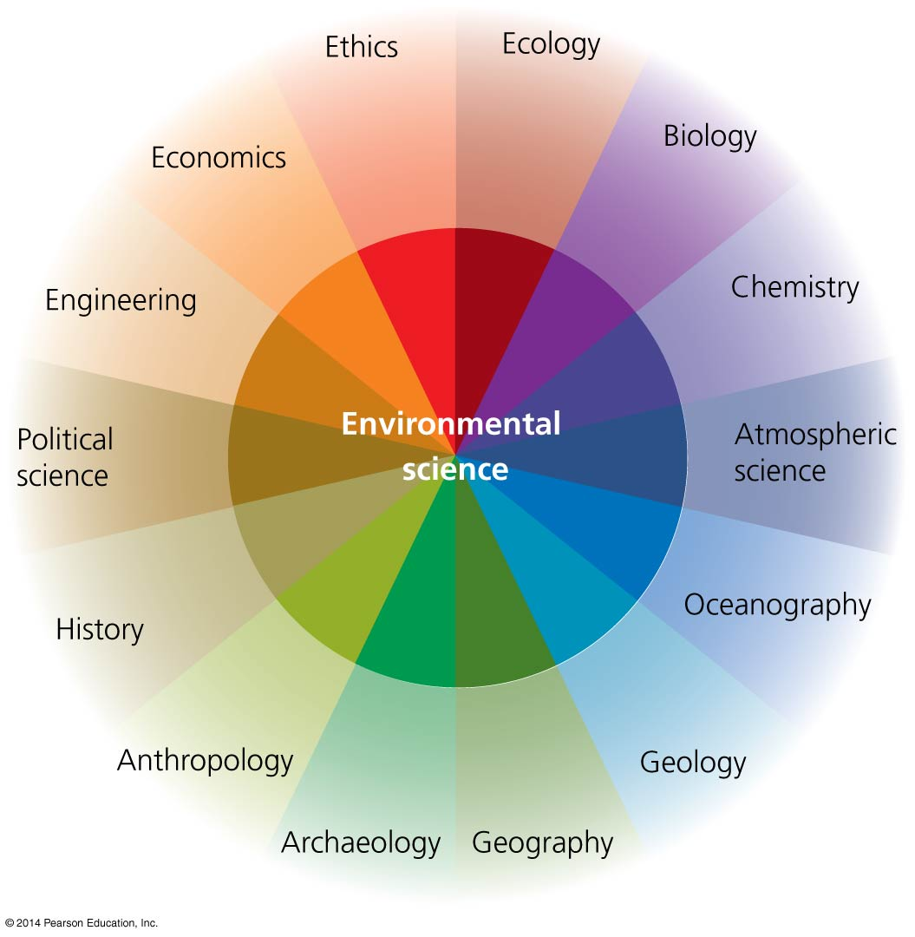

Slide 18
People vary in how they perceive environmental problems
Whether an environmental condition is seen as a problem depends on the individual and situation
For example, the pesticide DDT
In malaria-infested Africa it is welcome because it kills malaria-carrying mosquitoes
In America it is not welcome, due to health risks
People also differ in their awareness of problems, depending on who they are, where they live, what they do

Slide 20
Environmental science is not the same as environmentalism
Environmental science
Pursues knowledge about the environment and our interactions with it
Scientists try to remain objective and free from bias
Environmentalism
A social movement
Tries to protect the natural world from human-caused changes

Slide 21
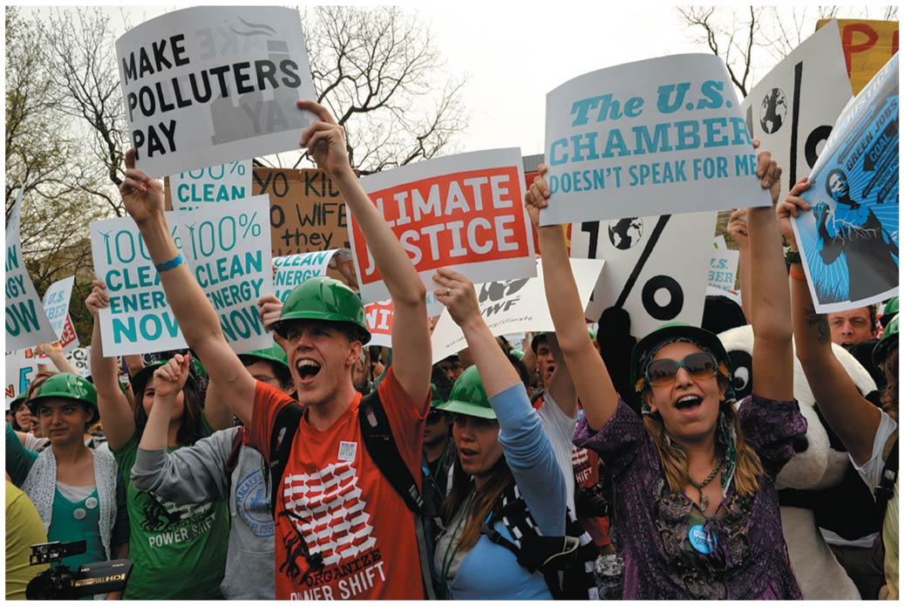

Slide 22
The Nature of Science
Science = a systematic process for learning about the world and testing our understanding of it
The accumulated body of knowledge arising from the dynamic process of observation, testing, and discovery
Civilization depends on science and technology
Science tries to understand the world and steer a safe course
Science is essential to sort fact from fiction and develop solutions to the problems we face
It must be accessible and understandable to the public

Slide 23
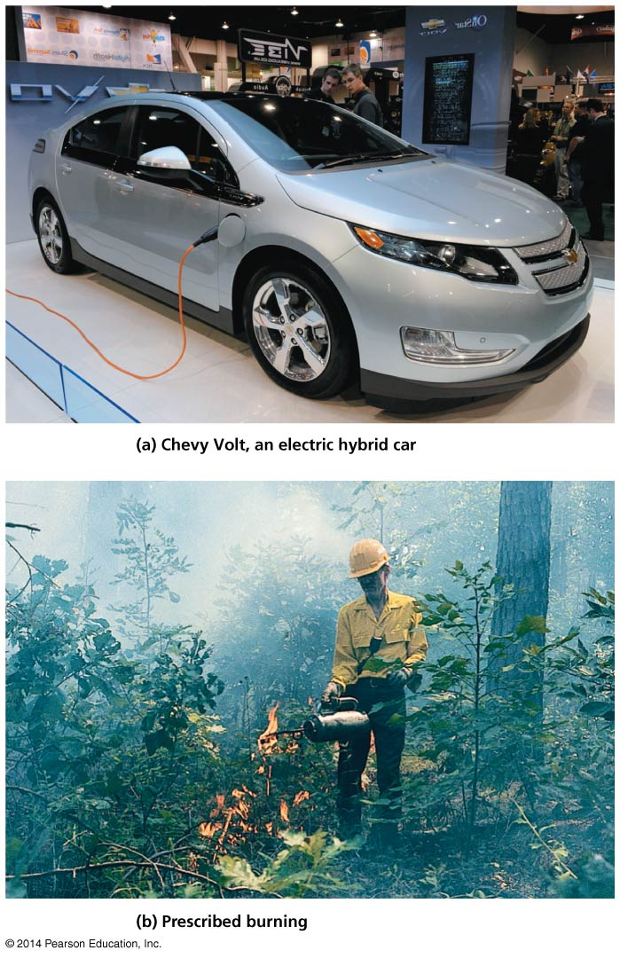

Slide 24
Scientists test ideas by critically examining evidence
Science is an incremental approach to the truth
Scientists do not simply accept conventional wisdom
They judge ideas by the strength of their evidence
Observational (descriptive) science = information is gathered about organisms, systems, processes, etc.
Cannot be manipulated by experiments
Phenomena are observed and measured
Used in astronomy, paleontology, taxonomy, genomics
Hypothesis-driven science = targeted research
Experiments test hypotheses using the scientific method

Slide 25
The scientific method is a traditional approach to research
It tests ideas
Scientists in different fields approach problems differently
A scientist makes an observation and asks questions about some phenomenon

Slide 26
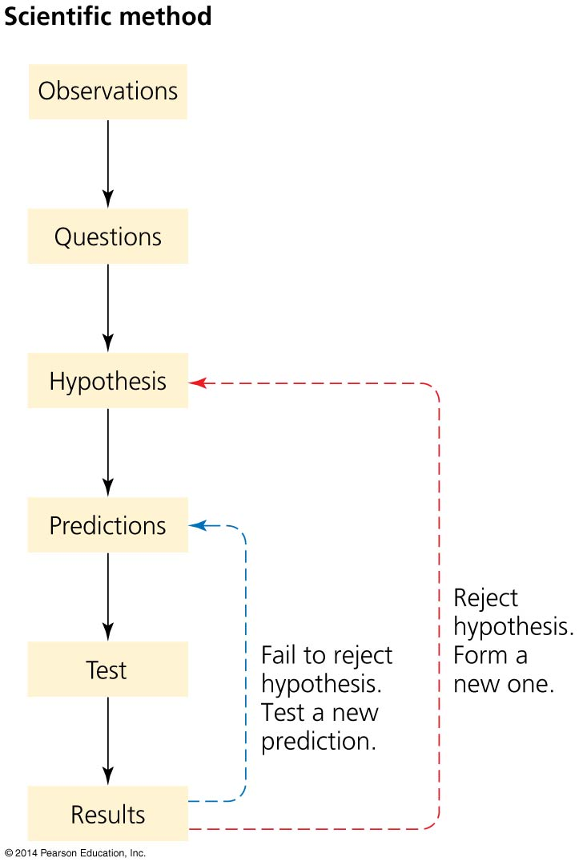

Slide 27
Develop a hypothesis and Make predictions
Hypothesis = a statement that tries to explain the question
The hypothesis generates predictions = specific statements that can be directly tested
The test results either support or reject the hypothesis

Slide 28
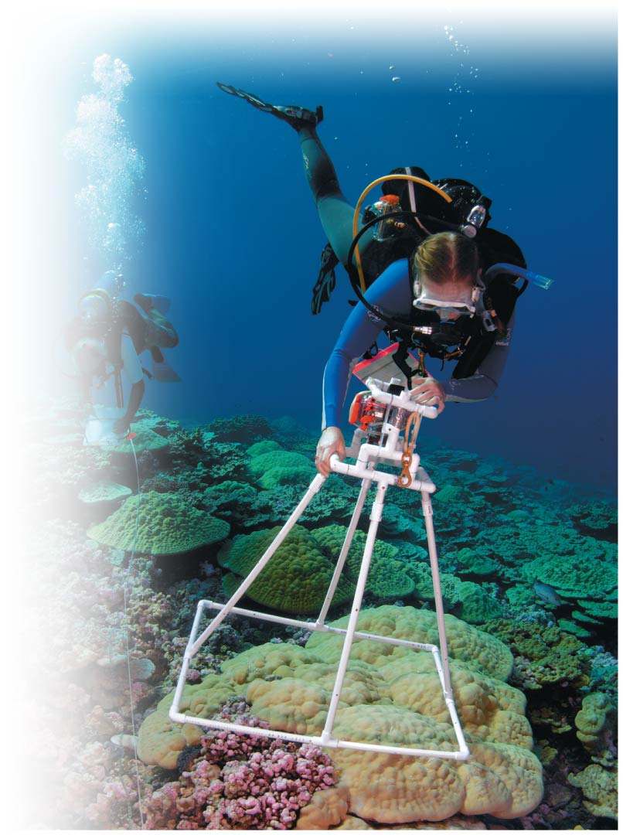

Slide 29
Test the predictions
Variable = a condition that can change
Independent variable = a variable that can be manipulated
Dependent variable = a variable that depends on the independent variable

Slide 30
Test the predictions
Controlled experiment = one in which the effects of all variables are controlled
Except the independent variable whose effect is being tested
Control = an unmanipulated point of comparison
Quantitative data = information that uses numbers
Qualitative data = information that does not use numbers

Slide 31
We test hypotheses in different ways
Manipulative experiments yield the strongest evidence
Researchers control independent variables
Reveal causal relationships
Many things cannot be manipulated
Natural experiments show real-world complexity
Use existing conditions to test predictions—little control over variables
Results are not neat and clean
Answers are not black and white

Slide 32
The scientific process continues beyond the scientific method
The scientific process guards against faulty research. Checks include:
Peer review
Publication in scientific journals
Competition for funding

Slide 33
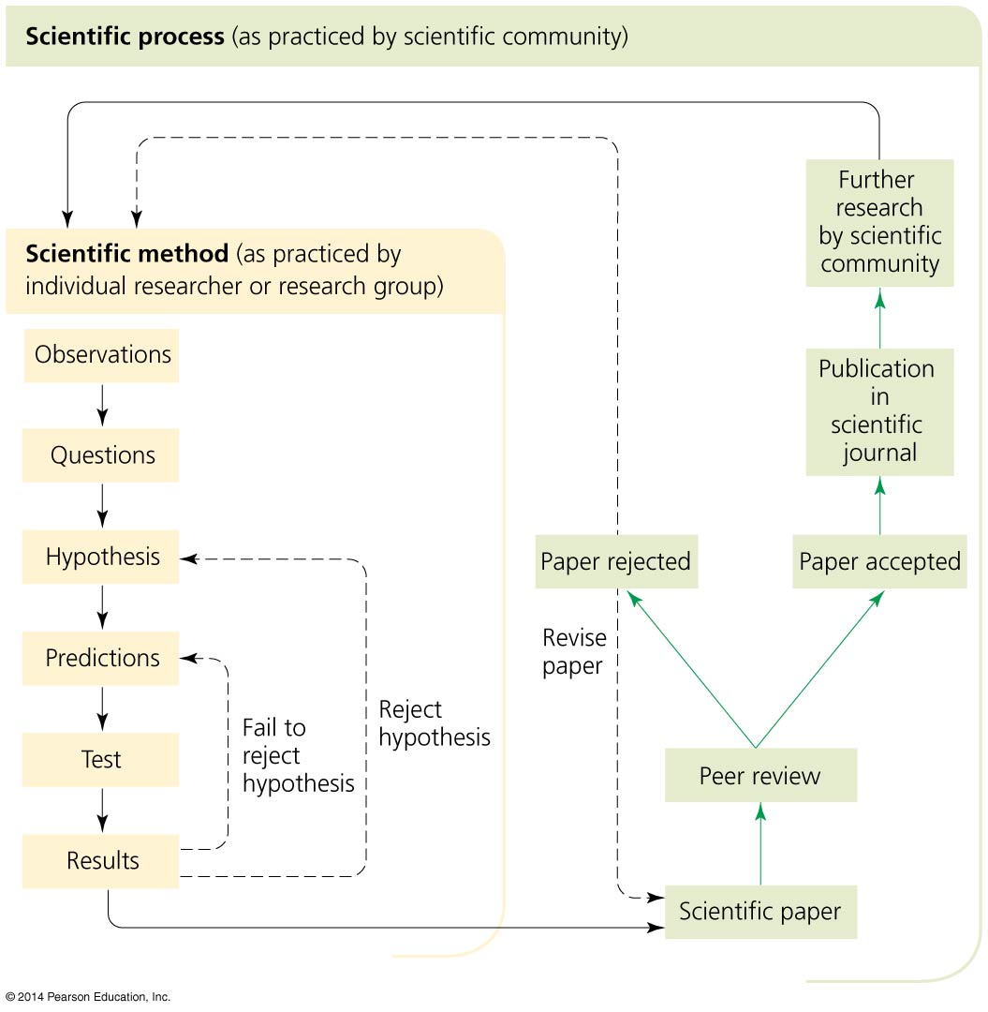

Slide 34
Experimental design
Introductions to Experimental Design—Testing the Hypothesis of Spontaneous Generation 1 Right-click/Select Play

Slide 35
Experimental results, 8-year study
Introductions to Experimental Design—Testing the Hypothesis of Spontaneous Generation 2 Right-click/Select Play

Slide 36
Control group and experimental group
Introductions to Experimental Design—Testing the Hypothesis of Spontaneous Generation 3 Right-click/Select Play

Slide 37
Science goes through “paradigm shifts”
Theory = a well-tested and widely accepted explanation
Consolidates widely supported, related hypotheses
Paradigm shift = a dramatic upheaval in thought
It changes the dominant viewpoint
Wicked problems = problems that are complex, with no simple solution
For example, environmental problems

Slide 38
Sustainability and Our Future
Sustainability = the idea that we must live within our planet’s means so the Earth and its resources can sustain us and all life for the future
Sustainability involves
Conserving resources
Developing long-term solutions
Keeping fully functioning ecosystems

Slide 39
Sustainability and Our Future
Natural capital = Earth’s total wealth of resources
We are withdrawing it faster than it’s being replenished
We must live off Earth’s natural interest (replenishable resources), not its natural capital

Slide 40
Population and consumption drive impact
Population growth amplifies all human impacts
The growth rate has slowed, but we still add more than 200,000 people to the planet each day
Resource consumption has risen faster than population
Life has become more pleasant
Rising consumption also amplifies our demands on the environment
The 20 wealthiest nations have 55 times the income of the 20 poorest nations
This is three times the gap that existed 40 years ago

Slide 41
Population and consumption drive impact
Not everyone benefits equally from rising affluence
The ecological footprints of countries vary greatly; the United States’ footprint is much greater than the world’s average
In the United States, the richest 1% have 25% of all income

Slide 42
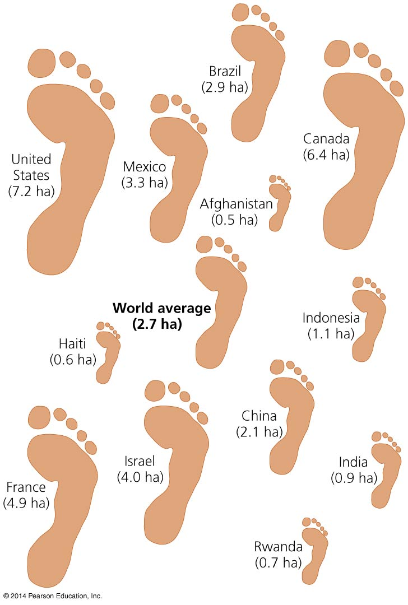

Slide 43
Population and consumption drive impact
Erosion and other impacts from agriculture
Deforestation
Toxic substances
Fresh water depletion
Fisheries declines
Air and water pollution
Waste generation
Mineral extraction and mining impacts
Global climate change
Loss of Earth’s biodiversity
Once a species is extinct, it is gone forever

Slide 44
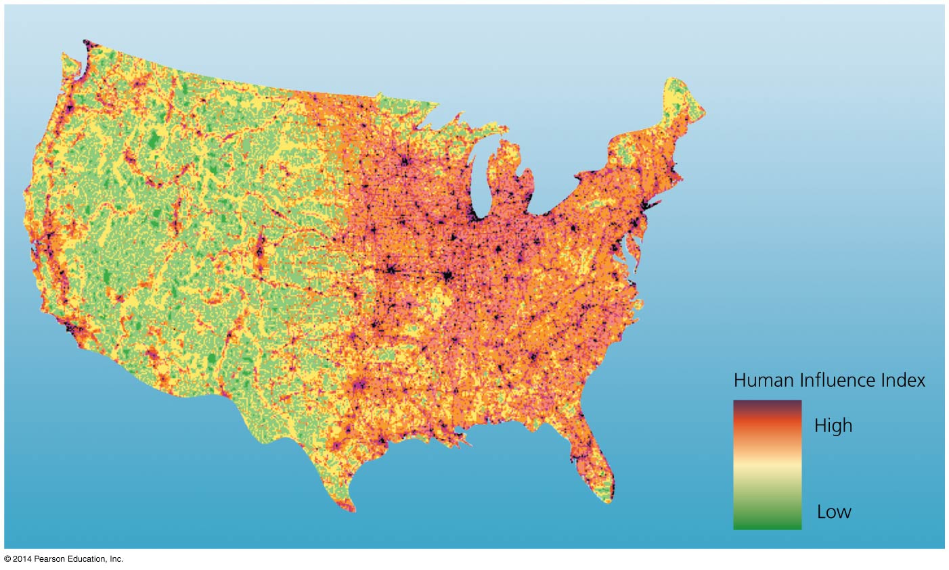
Agriculture, urban sprawl, and other land uses have substantially affected most of the landscape of all nations

Slide 45
Population and consumption drive impact
The Millennium Ecosystem Assessment is to date the most comprehensive scientific assessment of the condition of the world’s ecological systems
In 2005, 2000 of the world’s leading scientists from 100 nations reported:
Humans have drastically altered ecosystems
These changes have contributed to human well-being and economic development, but at a cost
Environmental degradation could get much worse
Degradation can be reversed, but it requires work

Slide 46
Our energy choices will influence our future enormously
The lives we live today are due to fossil fuels
Machines
Chemicals
Transportation
Consumer products
Fossil fuels are a one-time bonanza
Supplies will certainly decline
We have used up half of the world’s oil supplies; how will we handle this imminent fossil fuel shortage?

Slide 47
Sustainable solutions abound
Renewable energy and efficiency
Organic agriculture
Legislation and technology to reduce pollution
Protecting species and their habitat
Recycling, decreasing waste
Decreasing greenhouse gas emissions

Slide 48
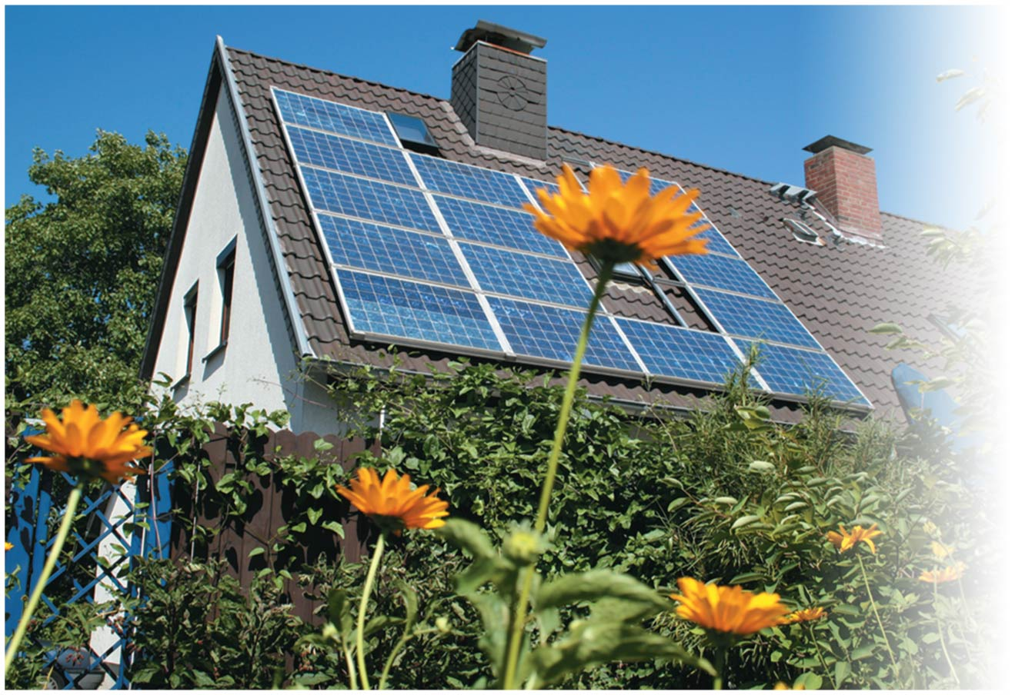
We must develop solutions that protect
both our quality of life and the environment

Slide 49
Students are promoting solutions on campus
Campus sustainability seeks to reduce the campus ecological footprint
Student organizations are often key in initiating recycling programs, finding ways to reduce energy use, and advocating for new courses or majors

Slide 50
Students are promoting solutions on campus
College and university campuses are major users of resources
Most have extensive infrastructure including classrooms, offices, research labs, residential housing, dining establishments, sports arenas, vehicle fleets, and road networks
Taken together, these institutions generate perhaps 2% of U.S. carbon emissions

Slide 51
Campus sustainability efforts are diverse
Students are advancing sustainability efforts on their campuses by promoting efficient transportation options, running recycling programs, planting trees and restoring native plants, and growing organic gardens.
Students who take such initiatives accomplish several things at once:
Make a difference by reducing the ecological footprint of a campus
Serve as models to their peers and raise awareness of the issues
Learn and grow to be better prepared for life in the broader world

Slide 52
Conclusion
Environmental science helps us understand our relationship with the environment
It informs our attempts to solve and prevent problems
The trends we will see in future chapters will be both causes for concern and reasons for optimism
Solving environmental problems can move us toward health, longevity, peace, and prosperity
Environmental science can help us find balanced solutions to environmental challenges

Slide 53
QUESTION: Review
The term “environment” does NOT include
animals and plants.
oceans and rivers.
structures and urban centers.
All of the above are included in this term.
Notes:
Answer: d

Slide 54
QUESTION: Review
Which of the following statements about the term “environmental science” is correct?
It is a social movement to protect the environment.
It studies how the natural world works.
It usually does not include human activities.
It is a declining science.
Notes:
Answer: b

Slide 55
QUESTION: Review
If you add various amounts of fertilizer to plants in a laboratory, the fertilizer would be a/an ______ variable.
correlative
natural
independent
rare
Notes:
Answer: c

Slide 56
QUESTION: Review
The push for sustainable solutions on college and university campuses is important because
colleges and universities are major resource users in food, energy, and transportation.
students who work to promote sustainable practices better prepare themselves for life after higher education.
opportunities for positive change are vast, ranging from adding new academic majors to energy efficiency to organic gardening.
All of the above are true.
Notes:
Answer: d

Slide 57
QUESTION: Weighing the Issues
What do you think of the Millennium Ecosystem Assessment?
It is a well-supported report on the Earth’s ecological systems.
It abuses science to draw special conclusions.
It suggests much more study on environmental problems is needed.
It concludes that humans really aren’t causing many environmental problems.
Notes:
Answer: any

Slide 58
QUESTION: Weighing the Issues
Do you think it is ethical for the United States to have the largest ecological footprint in the world?
Yes, because we find the most new technologies and resources.
Yes, because the footprint of the United States is not really that large.
Definitely not; people in the United States need to reduce their footprint.
It does not matter; it’s not that important.
Notes:
Answer: any

Slide 59
QUESTION: Interpreting Graphs and Data
According to this graph, what was responsible for population growth over the last 500 years?
Fossil fuels
Increased food
The Black Plague
Education
Notes:
Answer: a

Slide 60
QUESTION: Interpreting Graphs and Data
What happens if test results can not reject a hypothesis?
The scientist formulates a new hypothesis.
It shows the test failed.
The hypothesis was supported.
The predictions may not have been correct.
Notes:
Answer: c

