Slide 1
Air
Mixture of gases and particulates that are found in the atmosphere
Two major gases are Nitrogen (70%) and Oxygen (20%)
Most other gases are found in varying amounts
Carbon dioxide is found in increasing amounts because of human activities
CO₂ raises the temperatures in the atmosphere because of a blanketing effect that traps the heat here near the surface of the earth

Slide 2
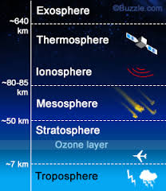
Layers of the Atmosphere
Exosphere→ This is really space and contains very small amounts of gases; temperatures increase
Thermosphere→ Highest level of the atmosphere where many of our satellites and the northern lights are found; temperatures increase
Mesosphere→ Air begins to get thicker and meteorites will begin to burn up with friction; temperatures decrease
Stratosphere→ Layer where the ozone layer is found, along with HALO jump flights and military flights; Temperature increases
Troposphere→ Layer that we live in and the air is thickest because gravity pulls it down, all weather is located in this layer; temperatures decrease as you increase in altitude

Slide 3
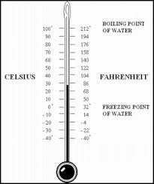
Temperature
a measure of the warmth or coldness of an object or substance with reference to some standard value
Most of the world uses Celsius as a tool for measuring temperature; Americans use Fahrenheit.
Temperatures have a great effect on the biomes and environments of the Earth
Can change them over long term or short term changes
Example long term→ Plate tectonics and Ice Ages
Examples short term→ Volcanic Eruptions and Storm Fronts

Slide 4
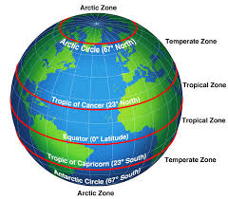
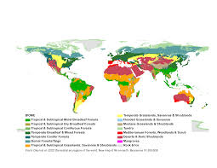
Temperature effects on Biomes
The amount of radiation that the different parts of the Earth receives creates different zones on the Earth that are created by their temperatures
The elevation changes also affect the biomes because the temperatures change as you go further up mountains and plateaus

Slide 5
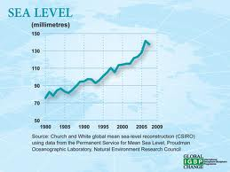
Temperature effects on Sea Levels
Sea level has naturally changed from changes in plate movements and global cooling and warming trends
Since the Industrial Revolution, there has been a general increase in sea level due to the increased amounts of carbon dioxide in the atmosphere that keeps heat near the surface of the Earth and melts the glaciers, adding to the water found in the oceans

Slide 6
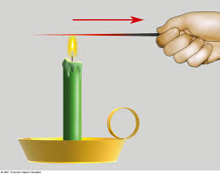
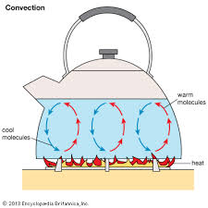
Heat transfer on earth
Heat on Earth is transferred in 3 ways
Conduction
Heat transfer through direct contact of an object
Examples: Hand touching a hot pan, lava touching a forest, hot iron on hair/clothes
Convection
Heat transfer through the
circulation of heat
Examples: Mantle convection,
air and water currents, convection oven

Slide 7
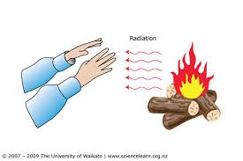
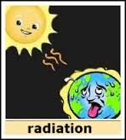
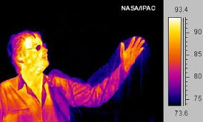
Heat transfer on earth
Radiation
Heat transfer through which heat travels by waves through an empty space
3 types of ways that radiant energy will react when it comes to Earth
1. Absorption→ Heat is taken in by an object
2. Reflection → Heat is bounced off a reflective surface (water, glass)
3. Scattering → Heat hits an object and is thrown in random directions

