Slide 1
Chapter 19
Air Pressure and Wind
Notes:
Who is Stan Hatfield and Ken Pinzke

Slide 2
19.1 Understanding Air Pressure
Air Pressure Defined
◆ Air pressure is the pressure exerted by the weight of air.
◆ Air pressure is exerted in all directions— down, up, and sideways. The air pressure pushing down on an object exactly balances the air pressure pushing up on the object.

Slide 3
19.1 Understanding Air Pressure
Measuring Air Pressure
◆ A barometer is a device used for measuring air pressure.
◆ When air pressure increases, the mercury in the tube rises. When air pressure decreases, so does the height of the mercury column.

Slide 4
19.1 Understanding Air Pressure
Factors Affecting Wind
◆ Wind is the result of horizontal differences in air pressure. Air flows from areas of higher pressure to areas of lower pressure.
◆ The unequal heating of Earth’s surface generates pressure differences. Solar radiation is the ultimate energy source for most wind.
◆ Three factors combine to control wind: pressure differences, the Coriolis effect, and friction.

Slide 5
19.1 Understanding Air Pressure
Factors Affecting Wind
◆ Pressure Differences
• A pressure gradient is the amount of pressure change occurring over a given distance.
• Closely spaced isobars—lines on a map that connect places of equal air pressure—indicate a steep pressure gradient and high winds. Widely spaced isobars indicate a weak pressure gradient and light winds.

Slide 6
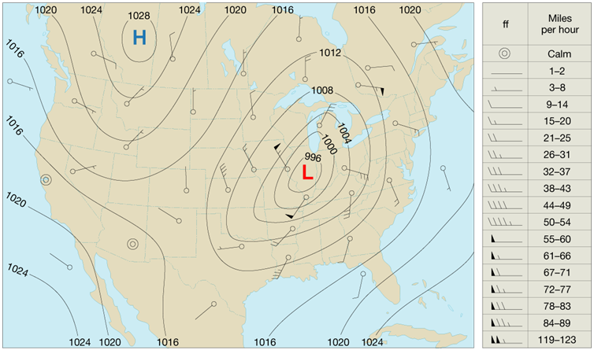
Isobars
Notes:
Makes no sense without caption in book

Slide 7
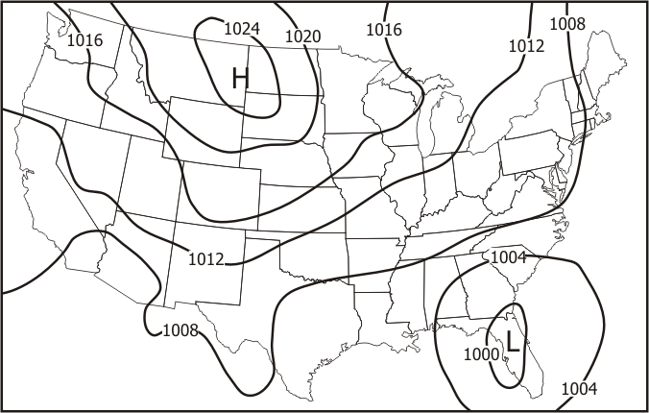

Slide 8
19.1 Understanding Air Pressure
Factors Affecting Wind
• The Coriolis effect describes how Earth’s rotation affects moving objects. In the Northern Hemisphere, all free-moving objects or fluids, including the wind, are deflected to the right of their path of motion. In the Southern Hemisphere, they are deflected to the left.

Slide 9
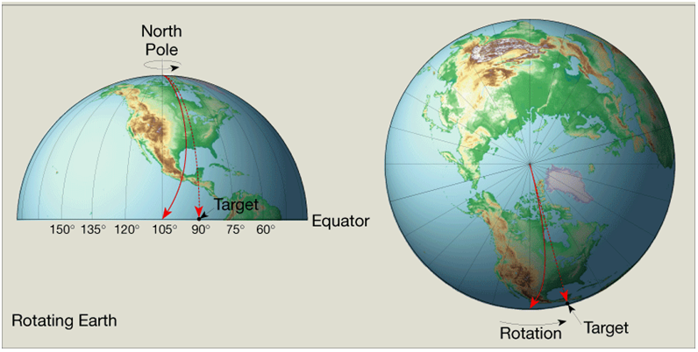
The Coriolis Effect
Notes:
Makes no sense without caption in book

Slide 10
19.2 Pressure Centers and Winds
Highs and Lows
◆ Cyclones are centers of low pressure.
◆ Anticyclones are centers of high pressure.
◆ In cyclones, the pressure decreases from the outer isobars toward the center. In anticyclones, just the opposite is the case—the values of the isobars increase from the outside toward the center.

Slide 11
19.2 Pressure Centers and Winds
Highs and Lows
◆ Cyclonic and Anticyclonic Winds
• When the pressure gradient and the Coriolis effect are applied to pressure centers in the Northern Hemisphere, winds blow counterclockwise around a low. Around a high, they blow clockwise.

Slide 12
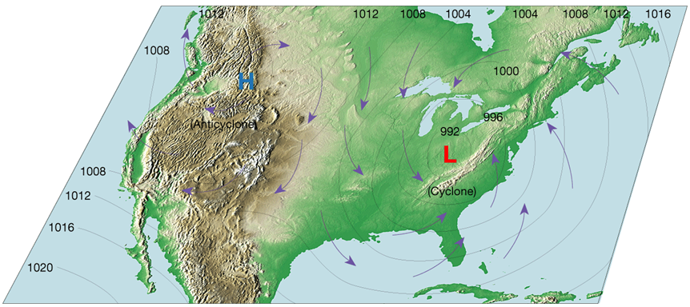
Cyclonic and Anticyclonic Winds
Notes:
Makes no sense without caption in book

Slide 13
19.2 Pressure Centers and Winds
◆ Weather and Air Pressure
• Rising air is associated with cloud formation and precipitation, whereas sinking air produces clear skies.
◆ Weather Forecasting
• Weather reports emphasize the locations and possible paths of cyclones and anticyclones.
• Low-pressure centers can produce bad weather in any season.

Slide 14
19.3 Regional Wind Systems
Local Winds
◆ The local winds are caused either by topographic effects or by variations in surface composition—land and water—in the immediate area.

Slide 15
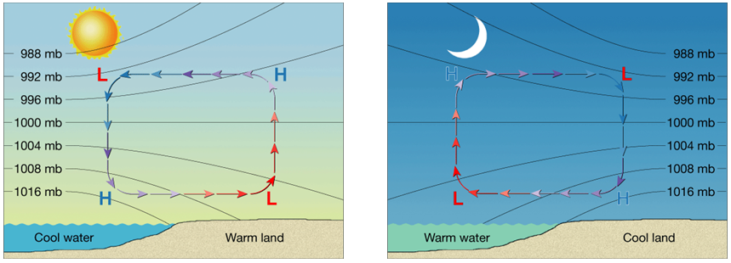
Sea and Land Breezes
• In coastal areas during the warm summer months, the land surface is heated more intensely during the daylight hours. As a result, the air above the land surface heats, expands, and rises, creating an area of lower pressure. At night the reverse takes place.
Notes:
Makes no sense without caption in book

Slide 16
19.3 Regional Wind Systems
◆ Valley and Mountain Breezes
• In mountainous regions during daylight hours, the air along the slopes of the mountains is heated more intensely than the air at the same elevation over the valley floor. Because this warmer air on the mountain slopes is less dense, it glides up along the slope and generates a valley breeze. After sunset the pattern may reverse.

Slide 17
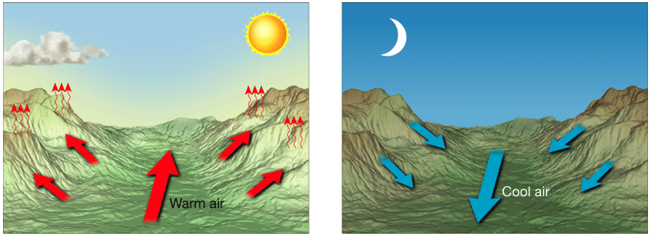
Valley and Mountain Breezes
Notes:
Makes no sense without caption in book

Slide 18
19.3 Regional Wind Systems
How Wind Is Measured
◆ Wind Direction
• The prevailing wind is the wind that blows more often from one direction than from any other.
• In the United States, the westerlies consistently move weather from west to east across the continent.

Slide 19
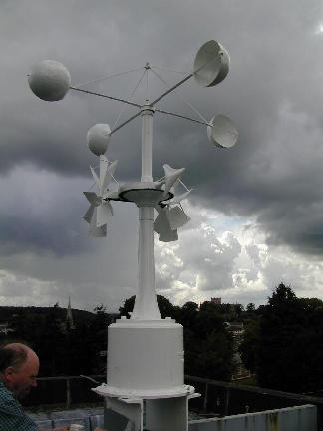
19.3 Regional Wind Systems
How Wind Is Measured
• An anemometer is an instrument that resembles a cup and is commonly used to measure wind speed.

