Slide 1
Chapter 20
Air Masses and Severe Storms
Notes:
Who is Stan Hatfield and Ken Pinzke

Slide 2
20.1 Air Masses
Air Masses and Weather
• An air mass is an immense body of air that is characterized by similar temperatures and amounts of moisture at any given altitude.
◆ Movement of Air Masses
• As it moves, the characteristics of an air mass change and so does the weather in the area over which the air mass moves.

Slide 3
20.1 Air Masses
Classifying Air Masses
◆ In addition to their overall temperature, air masses are classified according to the surface over which they form.

Slide 4
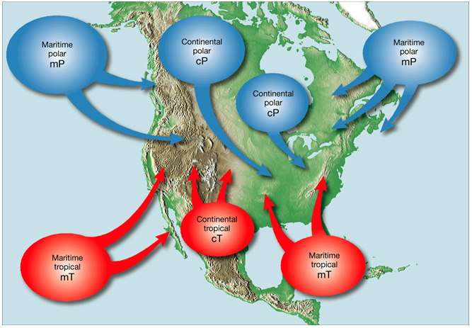
Air Masses Are Classified by Region
Page 560
Notes:
Makes no sense without caption in book

Slide 5
20.1 Air Masses
Weather in North America
◆ Much of the weather in North America is influenced by continental polar (cP) and maritime tropical (mT) air masses.

Slide 6
20.1 Air Masses
Weather in North America
◆ Continental Polar Air Masses: Canada/Northern U.S
• cP air masses are uniformly cold and dry in winter and cool and dry in summer.
◆ Maritime Tropical Air Masses: Gulf of Mexico/South Atlantic and Pacific Ocean
• mT air masses are warm, loaded with moisture, and usually unstable.
• mT air is the source of much of the precipitation received in the eastern two-thirds of the United States.

Slide 7
20.1 Air Masses
Weather in North America
◆ Maritime Polar Air Masses: N. Atlantic Ocean/N. Pacific Ocean
• mP air masses begin as cP air masses in Siberia. The cold, dry continental polar air changes into relatively mild, humid, unstable maritime polar air during its long journey across the North Pacific.
• mP air masses also originate in the North Atlantic off the coast of eastern Canada.

Slide 8
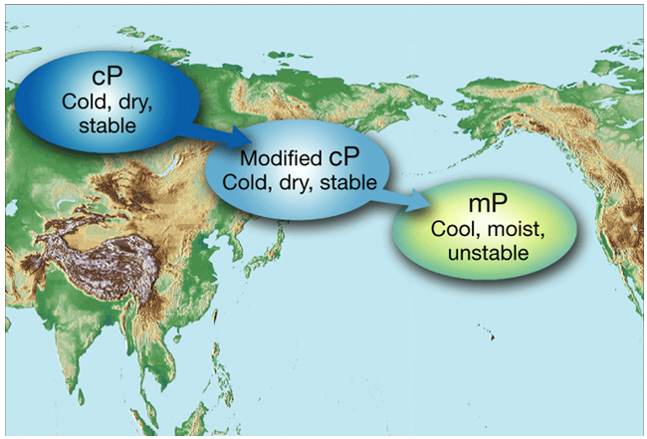
Maritime Polar Air Masses
Notes:
Makes no sense without caption in book

Slide 9
20.1 Air Masses
Weather in North America
◆ Continental Tropical Air Masses: Mexico/Southern U.S.
• Only occasionally do cT air masses affect the weather outside their source regions. However, when a cT air mass moves from its source region in the summer, it can cause extremely hot, droughtlike conditions in the Great Plains.
• Movements of cT air masses in the fall result in mild weather in the Great Lakes region, often called Indian summer.

Slide 10
20.2 Fronts
Formation of Fronts
◆ When two air masses meet, they form a front, which is a boundary that separates two air masses.

Slide 11
20.2 Fronts
Types of Fronts
◆ Warm Fronts
• A warm front forms when warm air moves into an area formerly covered by cooler air.
◆ Cold Fronts
• A cold front forms when cold, dense air moves into a region occupied by warmer air.

Slide 12
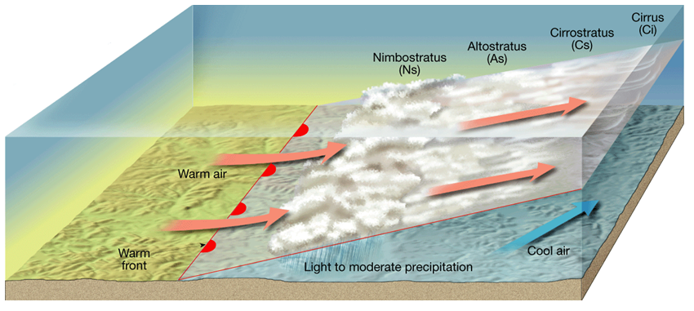
Formation of a Warm Front
Notes:
Makes no sense without caption in book

Slide 13
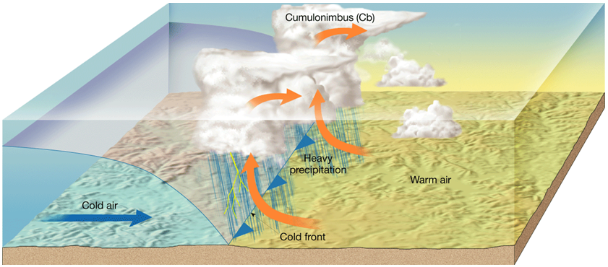
Formation of a Cold Front
Notes:
Makes no sense without caption in book

Slide 14
20.2 Fronts
Types of Fronts
◆ Stationary Fronts
• Occasionally, the flow of air on either side of a front is neither toward the cold air mass nor toward the warm air mass, but almost parallel to the line of the front. In such cases, the surface position of the front does not move, and a stationary front forms.
◆ Occluded Fronts
• When an active cold front overtakes a warm front, an occluded front forms.

Slide 15
20.3 Severe Storms
Thunderstorms
◆ A thunderstorm is a storm that generates lightning and thunder. Thunderstorms frequently produce gusty winds, heavy rain, and hail.

Slide 16
20.3 Severe Storms
◆ Occurrence of Thunderstorms
• At any given time, there are an estimated 2000 thunderstorms in progress on Earth. The greatest number occur in the tropics where warmth, plentiful moisture, and instability are common atmospheric conditions.
◆ Development of Thunderstorms
• Thunderstorms form when warm, humid air rises in an unstable environment.

Slide 17
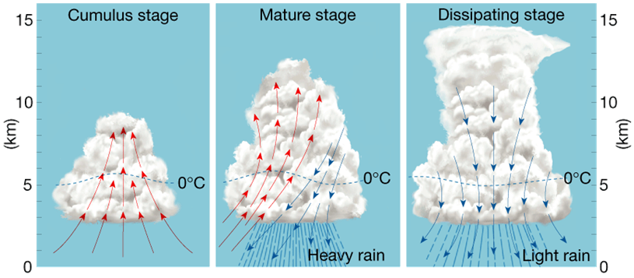
Stages in the Development of a Thunderstorm
Notes:
Makes no sense without caption in book

Slide 18
20.3 Severe Storms
Tornadoes
◆ Tornadoes are violent windstorms that take the form of a rotation column of air called a vortex. The vortex extends downward from a cumulonimbus cloud.
◆ Occurrence and Development of Tornadoes
• Most tornadoes form in association with severe thunderstorms.

Slide 19
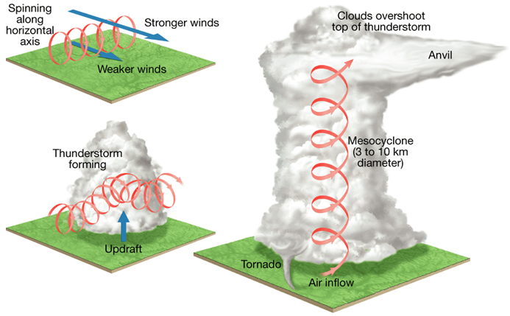
Formation of a Mesocyclone
Notes:
Makes no sense without caption in book

Slide 20
20.3 Severe Storms
◆ Tornado Intensity
• Because tornado winds cannot be measured directly, a rating on the Fujita scale is determined by assessing the worst damage produced by the storm.
◆ Tornado Safety
• Tornado watches alert people to the possibility of tornadoes in a specified area for a particular time.
• A tornado warning is issued when a tornado has actually been sighted in an area or is indicated by weather radar.

Slide 21
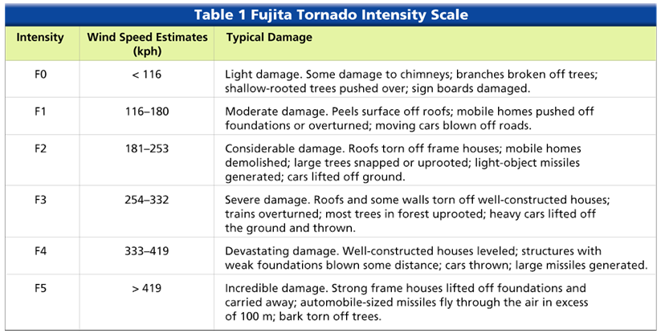
Fujita Tornado Intensity Scale
Notes:
Makes no sense without caption in book

Slide 22
20.3 Severe Storms
Hurricanes
◆ Whirling tropical cyclones that produce winds of at least 74 miles per hour are known as hurricanes.
◆ Occurrence of Hurricanes
• Most hurricanes form between about 5° and 20° north and south latitude. The North Pacific has the greatest number of storms, averaging 20 per year.

Slide 23
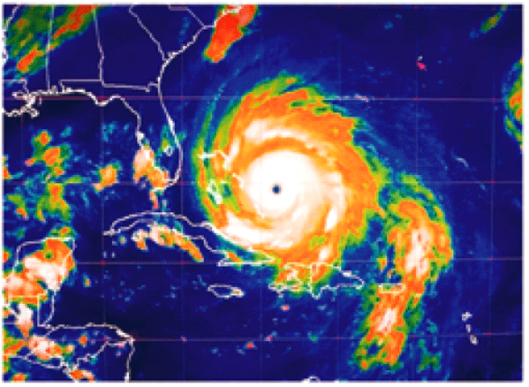
20.3 Severe Storms
Hurricanes
◆ Development of Hurricanes
• Hurricanes develop most often in the late summer when water temperatures are warm enough to provide the necessary heat and moisture to the air.

Slide 24
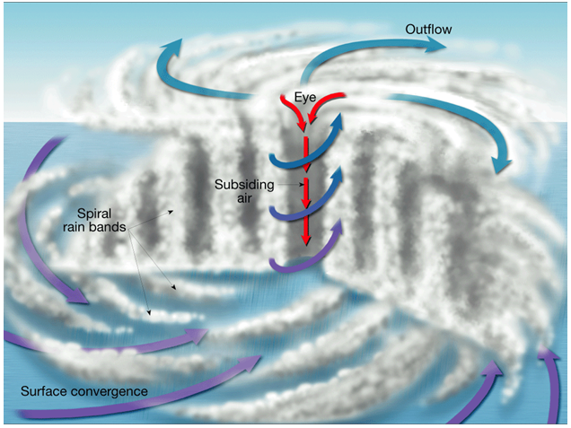
Cross Section of a Hurricane
Notes:
Makes no sense without caption in book

Slide 25
20.3 Severe Storms
Hurricanes
• The intensity of a hurricane is described using the Saffir-Simpson scale.
• A storm surge is the abnormal rise of the sea along a shore as a result of strong winds.

Slide 26
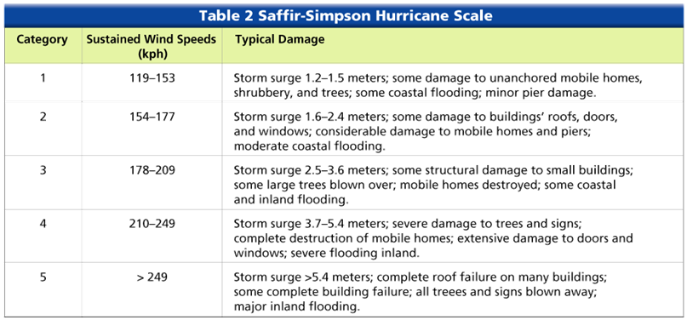
Saffir-Simpson Hurricane Scale
Notes:
Makes no sense without caption in book

